Slide 1
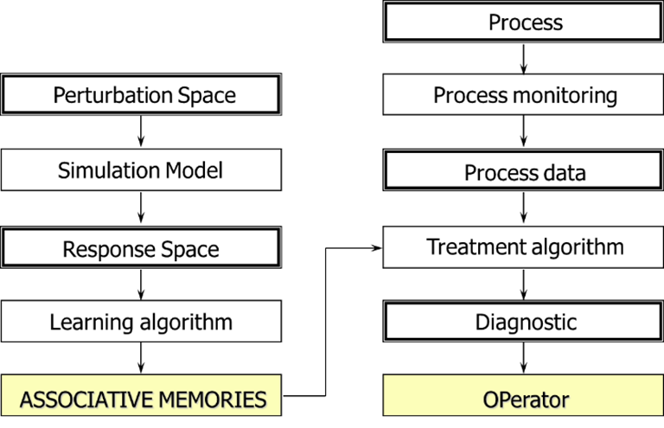
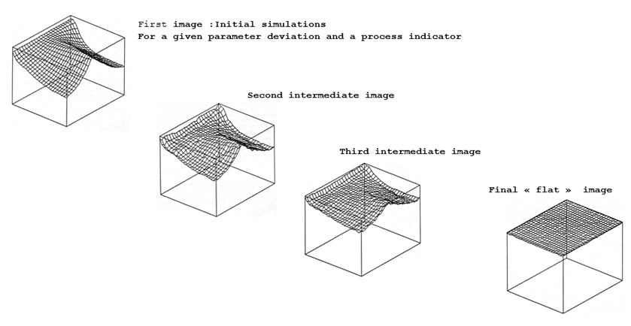
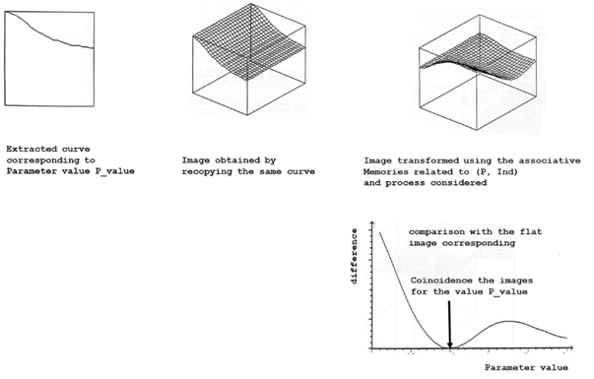
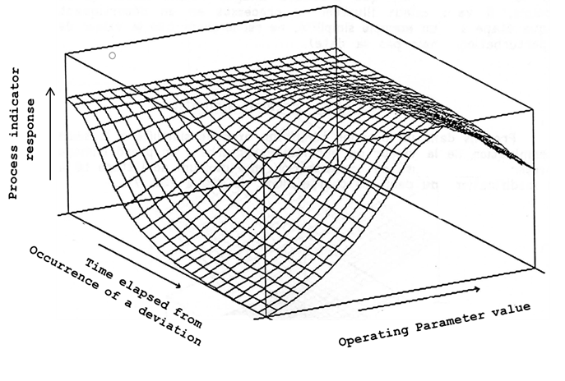
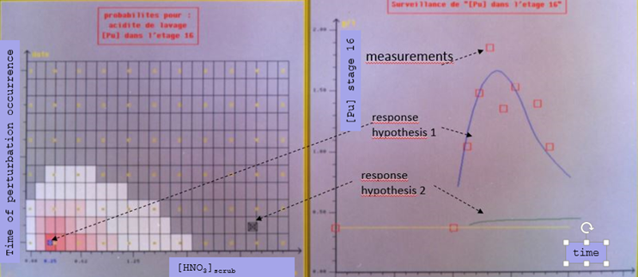
Potentialities of Simulation Tools for NRTA
Binh DINH, Stéphane GRANDJEAN
French Alternative Energies and Atomic Energy Commission
binh.dinh@cea.fr
ID: 299
ABSTRACT
Process simulation code [1] [2] [3] [4]
A diagnostic tool (prototype) able to detect a process malfunction and identify the nature of the perturbation, the magnitude of the deviation, and the instant of its occurence, using monitored process data
It is builded using a qualified process model and a neural network technics to associate process perturbation to process responses
presentation of the diagnostic tool ans the process simulation model
Potential interest of this type of tool for NRTA purpose
based on phenomenological analysis
Qualified by confrontation of the calculation with appropriate experimental data
laboratory data for elementary model
Results of flow sheet experiments both in steady and transient state
(as shown in example)
Great care were taken to obtain an efficient simulation tool (speed of calculations)
BACKGROUND
Simulation and Diagnostic tools were developed for process control purpose
The features of the tool allows the detection and the diagnostic of a process malfunction using the monitored process indicators
Interesting features for NRTA purpose for process mis-use detection
U-Pu extraction flow sheet with TBP 30%
DIAGNOSTIC TOOL [5]
U,Pu HNO₃ concentration aqueous and organic profiles in steady-stage
Symbols represent experimental value, and lines the simulation with the process code
Transient [Pu] evolution in stages after a sharp scrub acidity decrease (3M to 0.2M)
Symbols represent measurements, lines calculation with the process simulation code
Principle of the diagnostic tool
Transient evolution of a process indicator
for different deviation magnitude of a given operating parameter calculated by the process simulation tool
“Learning” step : associative memories parameters are
fitted so as to transform the image generated by the
process simulation tool into a flat image
“Diagnostic” step : use process indicator evolution instead of calculated response, transform it using the appropriate associative memories set and compare the two images
CONCLUSIONS
Using output process data to determine which input process data was responsible for the observed change is a potential interesting feature for NRTA purpose
To adapt this type of tool for NRTA purpose, the definition of the perturbation space as well as output indicators to be considered should be defined to suit the need for NRTA
Using this type of tool allow also to establish the diagnosis considering all the available process output data monitored thus
Consolidate the diagnostic
Allows to detect faulty measurements
An interesting tool worth to be further developed for NRTA purpose.
Application to the “perturbated” flow sheet presented previously: using [Pu] at stage 16 as the process indicator, the decrease of the acidity of the scrub flow was found to be the cause
REFERENCE
[1] C. Sorel, M. Montuir, C. Balaguer, P. Baron, B. Dinh, X. Heres, V. Pacary and H. Roussel, “A powerful tool to model and simulate solvent extraction operations,” in Proceedings of 19th ISEC, Santiago - Chili, 2011.
[2] B. Dinh, M. Montuir and P. Baron, “PAREX, a numeric code for process design and integration,” in Global 2013, Salt-Lake City, 2013
[3] P. Baron, B. Boullis, M. Germain and J. P. Gué, “Extraction Cycles design for La Hague plant,” in Global 2013, Seattle, 1993
[4] B. Dinh, M. Montuir, C. Sorel, J. Bisson, P. Huron and C. Huel, “PAREX, a numerical code for plant operation assistance,” in Global 2015, Paris - France, 2015
[5] A.-L. ALLANIC, “Realisation of a system for process control aid for reprocessing plant of nuclear fuel,” 1993

