Slide 1
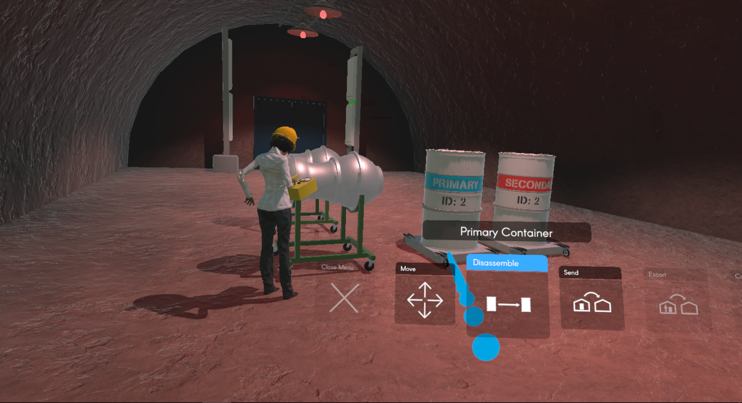
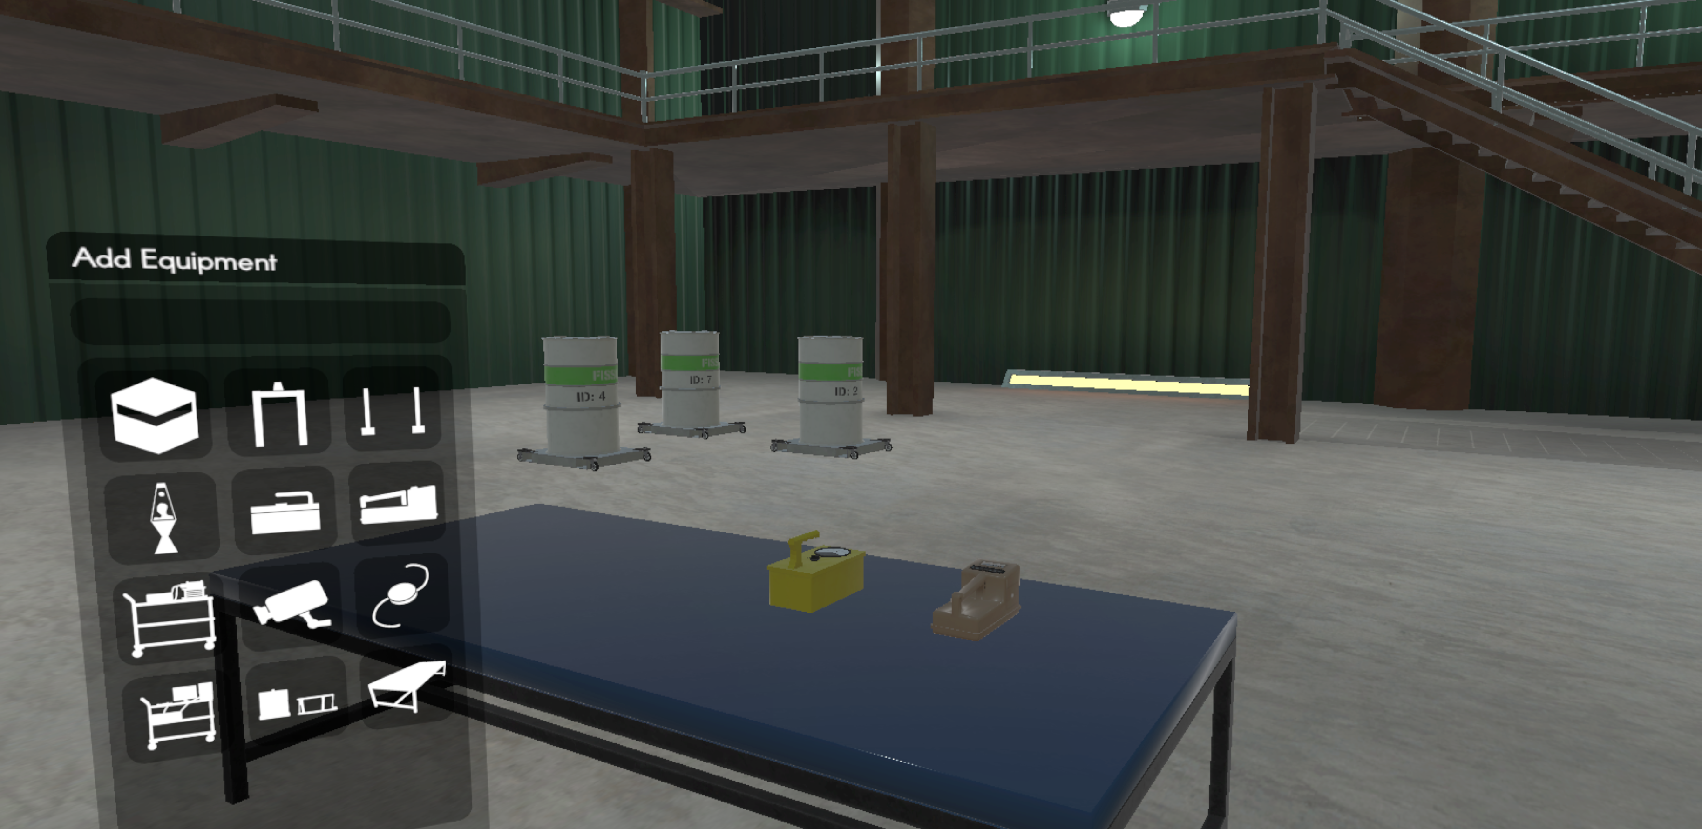
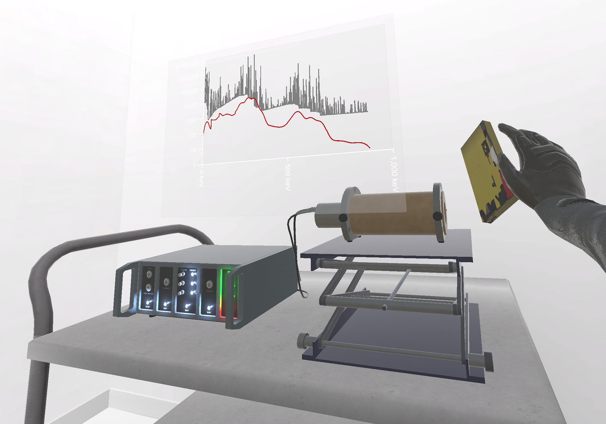
Nuclear Inspections in the Matrix
VIRTUAL REALITY FOR THE DEVELOPMENT OF INSPECTION APPROACHES IN NEW FACILITY TYPES
Moritz Kütt (kuett@princeton.edu), Tamara Patton, Alexander Glaser, Malte Göttsche
Princeton University / RWTH Aachen
ID: 21
ABSTRACT
Virtual reality (VR) offers new pathways to address safeguards challenges and to develop state-of-the-art approaches for verification protocols
Networked VR allows collaboration even under difficult political circumstances, and avoids possible disclosure of sensitive information
A diverse set of inspection equipment, real-time simulation of radiation detection and realistic interactions of inspectors with the equipment make our VR environment immersive and meaningful
BACKGROUND
VR has been used for safeguards application for >15 years, mainly for training; past radiation models were based on static radiation fields
Inspection protocols determine interactions between host/inspector, reflect design of relevant facilities, and describe use of equipment
VR exercises allow for easy environment changes, precisely controlled repetitions and are not restricted by facility access
Princeton has an ongoing partnership with the NGO Games for Change
Scene from a virtual inspection
VIRTUAL REALITY RADIATION MODEL
Safeguards inspections have a unique feature: they involve radioactive materials, instruments used rely on radiation signatures from these materials. The VR environment includes a two-layered radiation simulation:
Simple Layer: Simulate source strength and counter signals.
Complex Layer: Hybrid approach combining pre-computed radiation signatures and detector response functions with deterministic methods to handle shielding and attenuation effects.
Our model captures movement of sources, detectors, and shielding materials during exercises.
IMPLEMENTATION
Multi-user, networked VR environment based on Unity game engine and HTC Vive Pro headsets, world with three sites and multiple buildings
Functional inspection equipment available: Buddy tag, portal monitor, Geiger counter, neutron counter, information barrier, camera, seal, lava lamp, modal testing, zero knowledge experiment
VR environment with equipment menu and radiation counters
Information barrier with gamma spectrum, source term (gray) and
simulated detector spectrum (red)
EXAMPLE INSPECTION SCENARIOS
CONCLUSION
VERIFYING THE ABSENCE OF NUCLEAR MATERIAL
In our VR environment, inspectors can use Geiger or neutron counters and search rooms for radiation sources. Our setup can be used to determine the level of confidence that inspectors report after a time-limited walkthrough.
DENUCLEARIZATION OF THE DPRK
To ensure that warheads are stored separate from delivery systems while awaiting dismantlement, a variety of monitoring tools can be employed. Our VR environment allows to test these in different inspection protocols.
“GET THE GOLDEN WARHEAD”
It is possible to confirm warhead authenticity by comparing radiation signatures. Such comparison requires one item for which inspectors have confidence that it is a nuclear weapon (“golden warhead”) , e.g. because it is a randomly selected warhead from a missile unloaded from a submarine.
VR environment has a sufficient amount of equipment and objects to allow for meaningful inspection exercises
Virtual reality, enhanced by full-motion capabilities and multiplayer networking, provides a flexible and powerful new way to examine larger numbers of options and technology combinations for verification approaches
What safeguards inspection scenarios could most significantly benefit from a VR environment to test new and refine existing practices?
ACKNOWLEDGEMENTS / REFERENCES
The research presented in this article has been funded by a grant by the John D. and Catherine T. MacArthur Foundation, G-1703-151718, which also establishes our ongoing partnership with Games for Change (gamesforchange.org). Additional work has been made possible through DOE/NNSA’s Consortium for Verification Technology, DE-NA 0002534. The authors wish to thank PHL Collective (phlcollective.com), Drew Wallace, and Luke Petruzzi for their development work. Special thanks also go to the class of WWS/MAE 353 for their contributions to the inspection exercise in April 2018 and to UNIDIR for making possible the demonstration in Geneva in May 2018.

