Slide 1
Updated Relevant Thailand Regulatory Framework in the Nuclear Energy for Peace Act (2016) Regarding Nuclear Safeguards and Additional Protocol
Haruetai KASIWATTANAWUT (Ph.D.)
A. RUEANNGOEN, A. WITITTEERANON, B. SRIMOK,
C. SOONTRAPA, S. BIRAMONTRI
Office of Atoms for Peace
Ministry of Science and Technology, Thailand
IAEA Symposium on International Safeguards 5-8 November 2018, Vienna International Centre

Slide 2
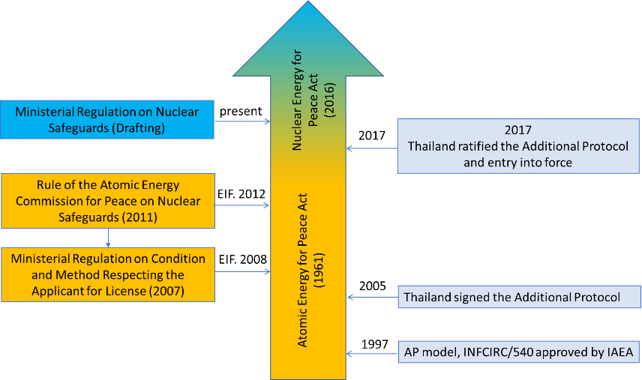
Comprehensive Safeguards Agreement

Slide 3
Nuclear Energy for Peace Act (2016)
The two important AP measures
a) additional information in non-declared activities under the existing CSA
b) Complementary Access
The updated nuclear safeguards regulation was enhanced from placing as of the Thai A.E.C. Rule (2012) to the Ministerial regulation under the NEPA Act (2016).

Slide 4
Nuclear Energy for Peace Act (2016)
The updated nuclear safeguards regulations under the NEPA (2016). These are still considered as draft versions as the followings:
The Ministerial Regulation on Nuclear Safeguards;
The Ministerial Regulation on Specification of a Concentration in Mine or Ore to be a Source Material;
The Ministerial Regulation on Conducting a Nuclear Activity;
The Notification of Office of Atoms for Peace on Conducting a Nuclear Fuel Cycle-Related Research and Development not Involving Nuclear Material.

Slide 5
RELATION BETWEEN NEPA AND ADDITIONAL PROTOCOL ARTICLES
AP Articles | Legal Instrument/Mechanism/NEPA
2.a(i) -government fuel cycle R&D (w/o nuclear material) | Section 89 and Section 90
2.a(ii) - Information identified on operational activities of safeguards relevance at facilities and LOFs where nuclear material is customarily used. | Section 36
2.a(iii) - buildings on sites | Section 36
2.a(iv) - Annex I activities | Section 90
2.a(v) - capacities and locations of mines and concentration plants | Section 36
2.a(vi) - source material holdings | Section 36
2.a(vii) - exempted material | Section 36
2.a(viii) - changes in location of waste | Section 89
2.a(ix) declaration in Annex II | *The draft Act on Trade Control of Weapon of Mass Destruction related items (TCWMD) of Ministry of Commerce, Department of Foreign Trade
2.a(x) - R&D and fuel cycle plans | Section 89 and Section 91
2.b(i) - private fuel cycle R&D (w/o nuclear material) | Section 89 and Section 91
4-9 Complementary Access | Section 107 and Section 113

