Slide 1
3s
Implementation of safety, security and safeguards in the Finnish Encapsulation plant and Geological repository project from the operator's perspective Mari Lahti and Sanna Mustonen, Posiva Oy

Slide 2
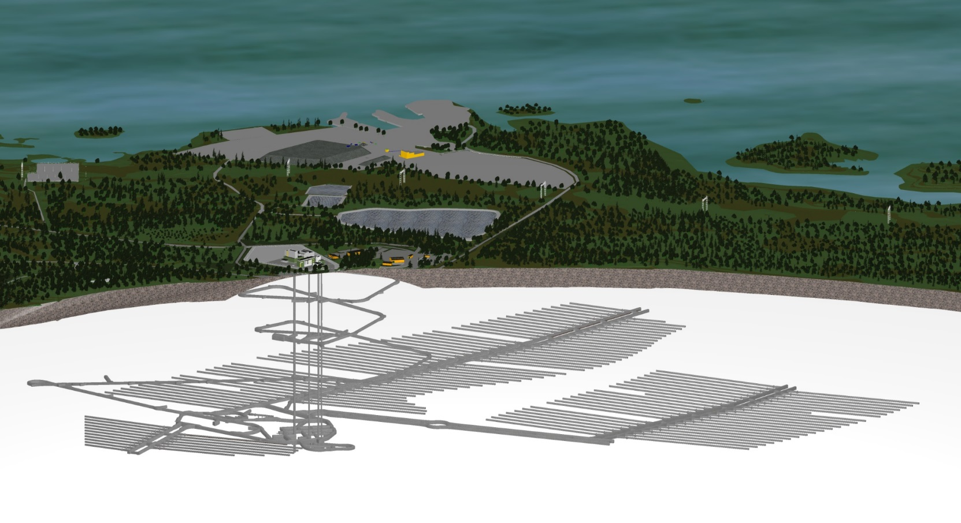
Disposal facility complex
2025
PLANNED START OF OPERATION
Above ground encapsulation plant and underground geological repository
Transfer from Olkiluoto NPP site (2 km)
Transport from Loviisa NPP site (350 km)
2019
CONSTRUCTION OF ENCAPSULATION PLANT
2015
CONSTRUCTION LICENSE
Encapsulation plant and other site buildings
Access routes to underground
Access tunnel
450 m
Shafts for ventilation, personnel entrance and disposal canister transfers
Repository (deposition tunnels)
2004
ONKALO EXCAVATIONS STARTED
Technical rooms, incl. disposal canister receiving station and buffer storage
2001
SITE SELECTION

Slide 3
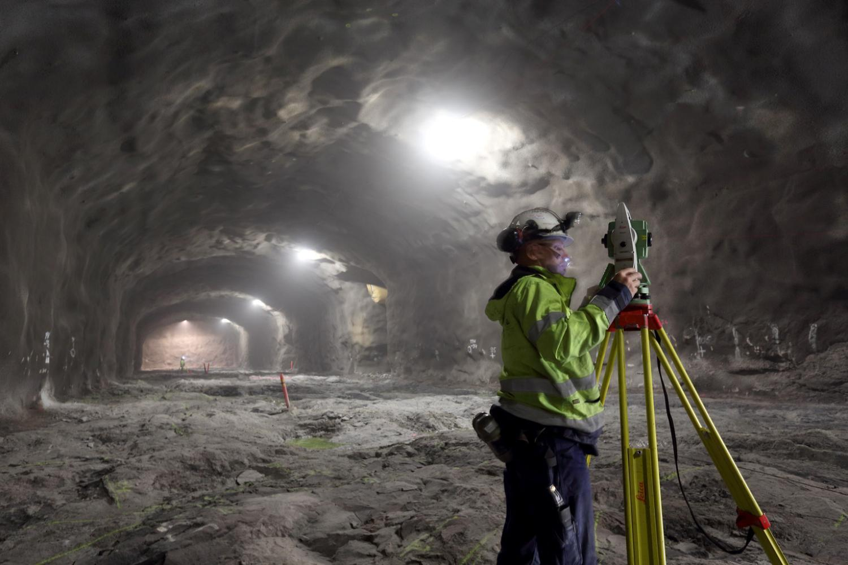
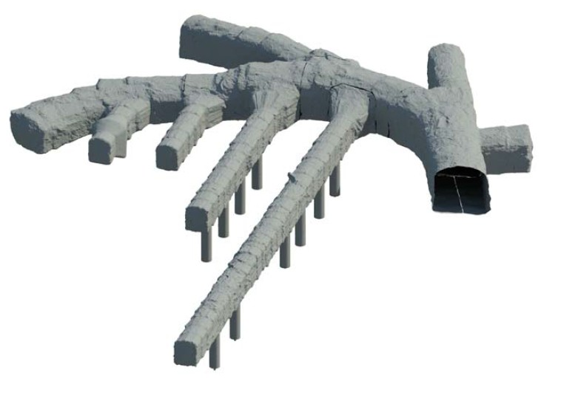
Defining safeguards relevant design information
Safeguards implementation started in parallel with the excavations at the site
documentation and reporting of progress of underground tunnels
demonstrating absence of undeclared activities at the site
What safeguards relevant design information consists of regarding the geological repository
geological features, underground openings, infrastructure?
2025
PLANNED START OF OPERATION
2019
CONSTRUCTION OF ENCAPSULATION PLANT
2015
CONSTRUCTION LICENSE
2004
ONKALO EXCAVATIONS STARTED
2001
SITE SELECTION

Slide 4
Common use of operator data
Responsibility of the safety, physical protection and control of nuclear materials in the facility lies with the operator
Facilities will include systems to control the processes and monitor the repository site
process cameras
radiation monitoring
seismic monitoring
hydrogeological monitoring
These measures can be used to demonstrate that
radioactive materials are transferred and stored only at their intended locations
underground premises are constructed as declared
any other works that could compromise the integrity of the geological containment are excluded
The possibilities to share process data by signal splitting and authentication could be further studied in cases that would benefit both the regulator and the operator
Information security questions to be considered

Slide 5
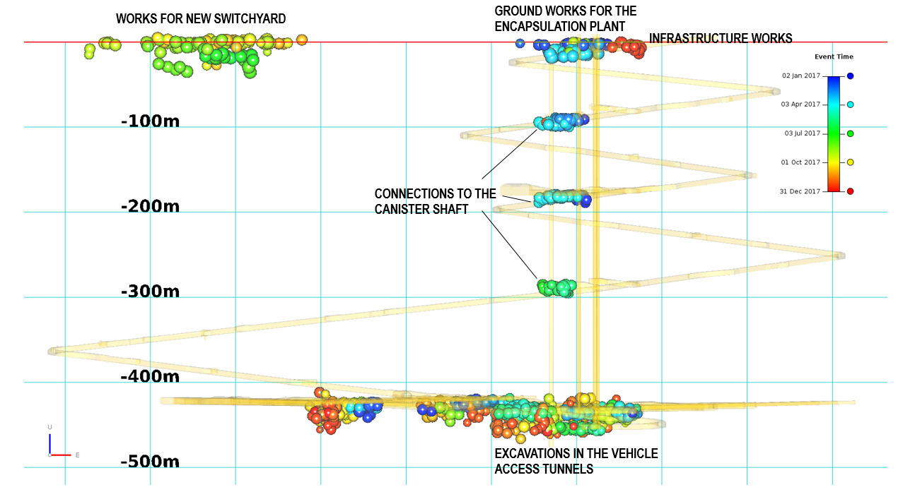
Excavations detected by seismic monitoring

Slide 6
Interaction in safeguards infrastructure planning
2025
PLANNED START OF OPERATION
Development of the safeguards measures for the new type of facilities has benefited from interactive communication
comprehending what is safeguards relevant design information
communicating design changes
understanding intended operation of the facilities
influencing the choice of safeguards measures considering the operational perspective
Integration of the safeguards instrumentation into the facility structures in around 2023, when the commissioning tests are planned to commence
INTEGRATION OF SAFEGUARDS EQUIPMENT
2019
CONSTRUCTION OF ENCAPSULATION PLANT
2015
CONSTRUCTION LICENSE
SAFEGUARDS BY DESIGN
REPORTING OF CONSTRUCTION ACTIVITIES
2004
ONKALO EXCAVATIONS STARTED
2001
SITE SELECTION

Slide 7
Thank you

