Slide 1
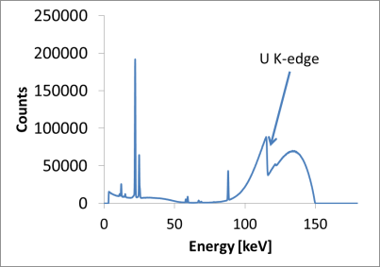
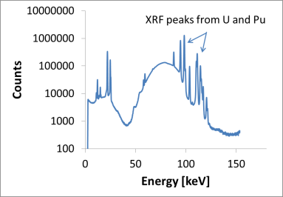
Shaping Together the Future of Hybrid K-edge
J. Zsigrai¹, A. LeTerrier, E. Zuleger, K. Lützenkirchen, M. Toma, S. Morel
European Commission, Joint Research Centre, Karlsruhe, Germany
¹jozsef.zsigrai@ec.europa.eu
A. Bosko, G. Duhamel
International Atomic Energy Agency, Vienna, Austria
ID: 134
ABSTRACT
OUTCOME
The Joint Research Centre (JRC) and the International Atomic Energy Agency (IAEA) organized a workshop on the Hybrid K-Edge/K-XRF (HKED) technique in Karlsruhe, Germany, from 23 - 25 April 2018.
HKED is a key method for nuclear material accountancy.
Particular focus was given to possible future collaboration.
The workshop contributed to addressing current and future challenges of the HKED technique.
The workshop participants agreed to collaborate on advancing the state of the art of the HKED technique and identified a list of actions towards achieving this goal.
Actions identified
Contact details of the participants were shared.
An inter-comparison exercise of spectral evaluation algorithms will be organized.
An inter-laboratory measurement exercise will be organized, sending a real sample to the laboratories.
A platform for further HKED-related collaboration will be established (IAEA SP1, ESARDA sub-workgroup).
Another workshop on HKED will be organized.
BACKGROUND
HKED: X-rays to get Pu and U concentration in liquids.
Uncertainties: 0.2% and 0.7%, for U and Pu, respectively.
Main application: safeguards samples from reprocessing .
Probably, the amount of nuclear material verified by HKED is larger than the amount verified by all other analytical techniques altogether.
Small user's community of HKED, facing similar challenges and working on similar solutions using limited resources.
Sample cell with U/Pu solution
Gray = shielding
X-ray tube
X-ray photons
Transmission
High-resolution gamma spectrometer
Fluorescence
High-resolution gamma spectrometer
The principle of HKED
Geographical distribution of the organizations represented at the HKED workshop in 2018
WORKSHOP ON HKED IN KARLSRUHE, 2018
CONCLUSION
Participants: HKED users from all around the world.
Common challenges identified:
Ageing hardware
Existing HKED systems are not sustainable on a long term: failures and incompatibility with new hardware.
Sustainability of software
Joint efforts to advance HKED spectrum analysis
Common access to source codes and avoiding that a single commercial entity has control over the software.
Improving analytical performance
New algorithms to improve HKED performance: further studies, development and validations are needed.
A workshop on HKED was held in Karlsruhe, Germany, 23 - 25 April 2018, organized by the JRC and IAEA.
Common challenges have been identified and collaboration has been started.
A list of actions for advancing the collaboration has been drafted.
These actions will ensure the continuity of effective safeguards at reprocessing and fuel production facilities worldwide.

