Slide 1
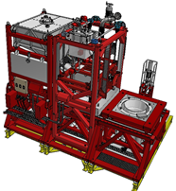
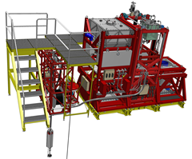
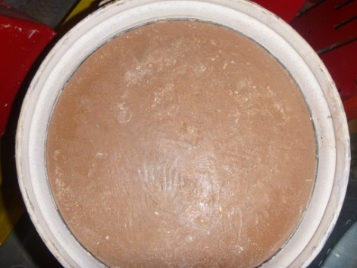
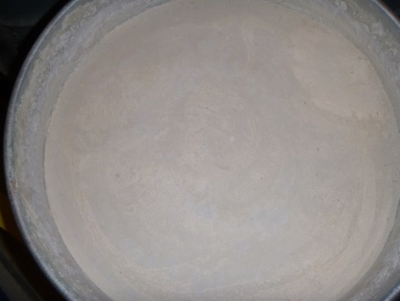
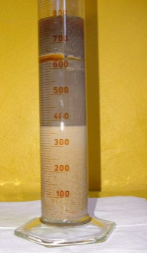
THE NEWLY DESIGNED SUZA II EQUIPMENT FOR SLUDGE IMMOBILISATION
Miroslav Tóth
VÚJE, a. s; 91701 Trnava, Slovakia
E-mail: miroslav.toth@vuje.sk
IAEA-50807CN-242, Vienna 2016
OBJECTIVES
The issue with the processing of radioactive sludge from nuclear installations into solid and safe form requires long-term attention.
SUZA II is a modular semi - automated device that enables the processing of radioactive sludge into cement and geopolymeric matrix in 200 dm³ drums and 60 dm³ kegs
INTRODUCTION
► The Long-Term storage was designed as a pool for cooling and long-term storing of spent fuel elements inserted in carbon steel casings during operation
►The dimensions of the Long-Term storage are as follows: 12 metres length, 7 metres width, 9.75 metres of depth
►Leakage of media from these casings, other manipulation and chemical regimes also caused other accumulation of organic and inorganic sludge on the bottom of the pool
►This storage has gradually become an area where the amount of liquid radioactive waste with high activity has increased
►To prevent possible penetration and leakage media through the bottom and walls of the pool and to create better radiation protection in these premises it was decided to relocate all of the sludge into a new service tank NPN 2.
SUZA II
► A new modular remotely operated semi-automated device
►Enables the sludge to be fixated into a cement and geopolymeric matrices.
► Fixation into 200 dm³ drums and 20 dm³ kegs
►SUZA II consists of the following modules:
Pump module
Stock module
Fixation module
Transport module
►Included in a device is a gantry crane with a capacity of 1 t
►On one side there is a metal shield to protect personnel operating near the equipment
►The technological process of sludge solidification is observed and managed from the adjoining room where the operating panel including touch screen is installed
Pump module
►Installed above the NPN 2 tank outlet
►Contains a cable reel equipped with screw pump with light and a camera
Fixation module
► The main part is a horizontally moving platform
►Equipped with a stirrer, camera sensors and the dose rate probe measuring
►The movable platform seals onto the drum with sludge.
Stock module
►Contains four tanks ,pumps and conveyor for dosing of additives into the process in the Fixation module
Transport module
►The longest part of the device
►Includes the shielded truck with a horizontally moved probe for measuring the dose rate of the sludge in the drum to be solidified
►The second truck contains a rinse tank equipped with a telescopic arm with jets
Stock module
Fixation module
Sampler
Sampler
Geopolymeric in 60 dm³ keg
Plan view of matrices
Shielded
truck
Cement in 200 dm³ drum
Screw pump
Pump module
Transport module
Conclusions
Fig.3,4
SUZA II device for sludge immobilisation
►During the course of non active testing and process optimalisation 16 drums of simulated sludge were immobilised
►The first active tests were performed using 200 dm³ drums and 60 dm³ kegs with cement and geopolymeric matrices with a total β,γ activity :
22,2GBq per 200 dm³ drum
6,32GBq per 60 dm³ drum
►Both waste forms meet the criteria for The National Repository
Fig.1
Sample of sludge suspension taken from The Long-Term Storage

