Slide 1
Progress on the application of ELM control schemes to ITER scenarios from the non-active phase to DT operation
Alberto Loarte
G. Huijsmans, S. Futatani, D.J. Campbell, T. Casper, E. Daly, Y. Gribov, R.A. Pitts, S. Lisgo, A. Sashala Naik
L.R. Baylor, T.E. Evans, D. M. Orlov, A. Wingen
O. Schmitz, H. Frerichs, A. Kischner, R. Laengner, G. Saibene, M.Becoulet, P. Cahyna
A. Kavin
ITER Organization-Plasma Operation Directorate
Acknowledgement : ITPA Pedestal/Edge, Transport and Confinement and Divertor/SOL Groups & ITER Members’ R&D institutes
The views and opinions expressed herein do not necessarily reflect those of the ITER Organization

Slide 2
Outline of the Talk
1. ELM Control in ITER : Requirements and Schemes
2. Improvement of Physics Basis for ELM fluxes to PFCs in ITER → Refining of Requirements
3. Triggering of ELMs by pellets
4. Application of 3-D fields for ELM Control in ITER
5. Other options for ELM control : Vertical Plasma Movements
6. Conclusions
Notes:
2

Slide 3
ELM Control in ITER : Requirements
Large power fluxes to divertor and first wall expected during Type I ELMs in ITER for H-mode high I_{p}/high Q_{DT} operational scenarios (IAEA 2010)
Physics of ELM energy transport from main plasma to PFCs subject of R&D
Operation with a W divertor → additional requirements for ELM control
Minimum f_{ELM} required to expel W influxes produced between ELMs & by ELMs
In addition, e-heating found effective to prevent core W accumulation
ITER requirements for W control by ELMs
ASDEX-Upgrade physics basis (Krieger JNM 2011, Dux NF 2011)
Neo-classical W transport in the pedestal between ELMs
Notes:
3

Slide 4
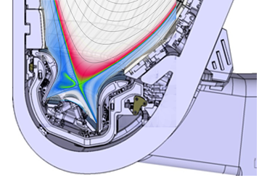
ELM Control in ITER : Schemes
Two systems for ELM control in ITER : ELM Control Coils & Pellet Pacing
ELM Control Coils → Aimed at suppression of Type I ELMs → ΔW_{ELM} ~ 0
Pellet injection → Controlled triggering of Type I ELMs → ΔW_{ELM} < ΔW_{ELM}^{controlled}
VS Coil
ELM Control
Coils (90 kAt)
Maruyama - ITR/P5-24
VS Coil
Pellet parameters :
v_{pellet} = 300 – 500 ms⁻¹
V_{pellet} = 17-34 mm³(pacing)/50-90 mm³(core fuelling)
f_{pellet} (per injector) = 4-16 Hz
Notes:
4

Slide 5
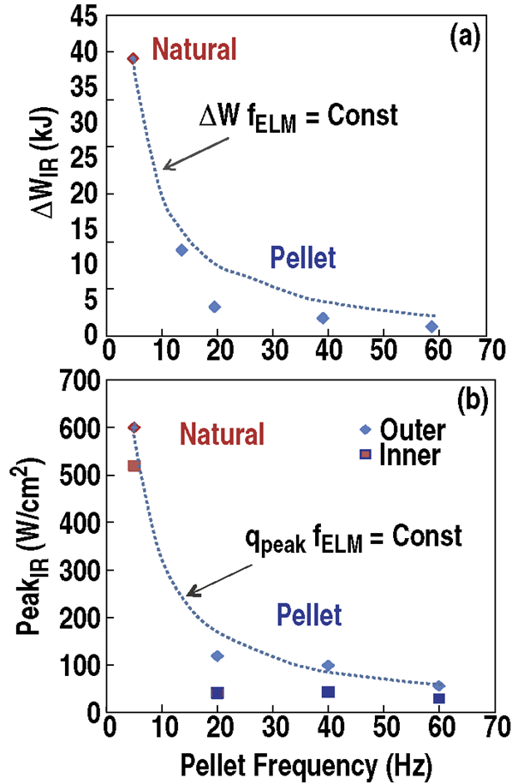
ELM Control in ITER : Summary of Experimental Progress
Major progress on application of both techniques to suppress or control Type I ELMs:
Elimination of Type I ELMs with coils observed in DIII-D, AUG, KSTAR and JET
ELM control by pellets demonstrated in AUG, JET and DIII-D → latest DIII-D experiments have accessed ITER relevant range of ELM control
DIII-D
Baylor
EX/6-02
Notes:
5

Slide 6
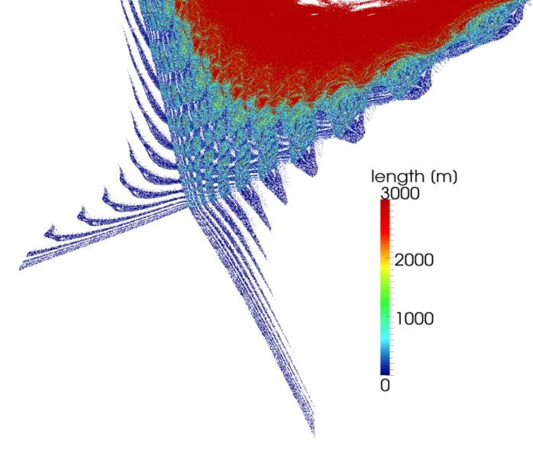
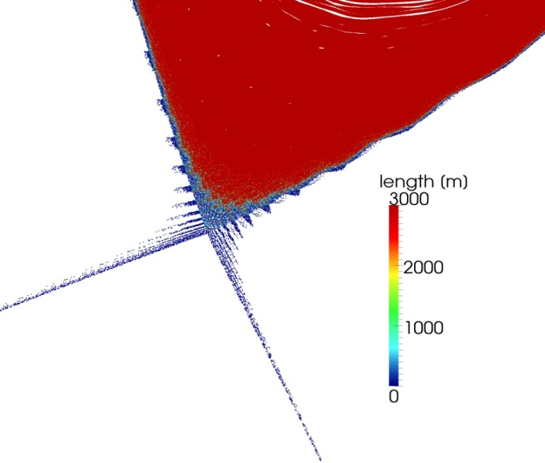
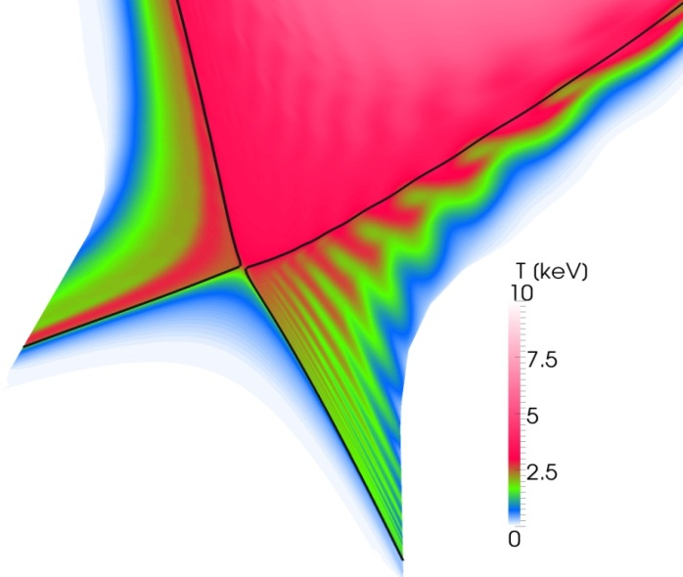
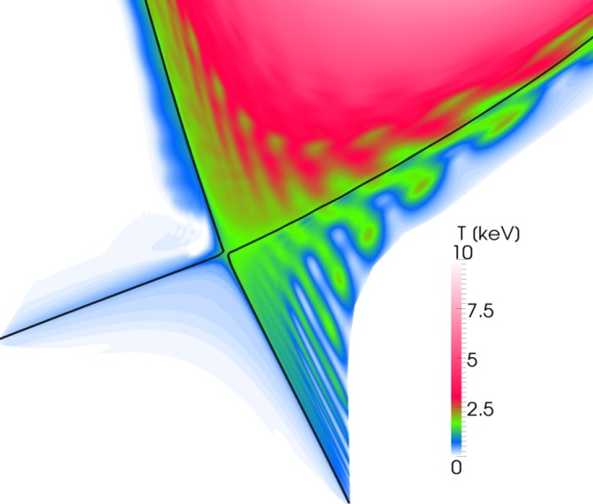
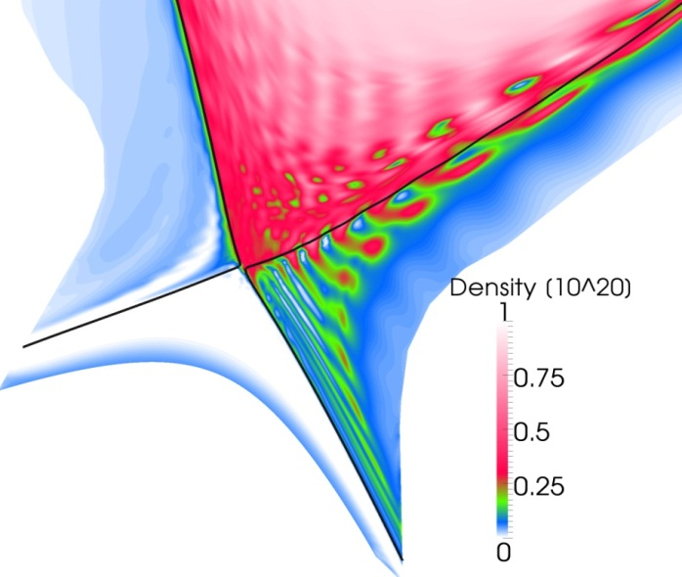
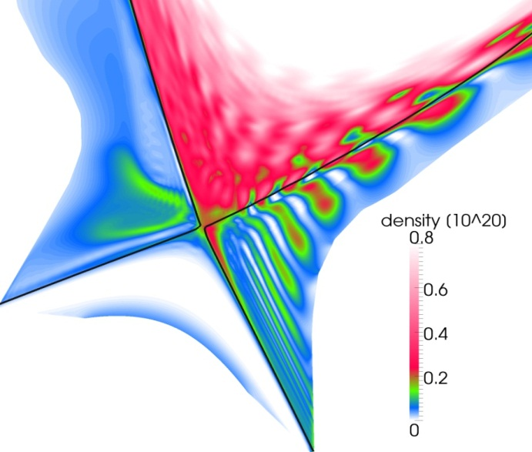
Physics Basis for ELM fluxes to PFCs – I
Transport of ELM energy to PFCs → II conduction in edge ergodised field lines + radial propagation of expelled plasma filaments
Larger/Smaller ELM energy losses are conduction/ convection dominated → II conduction to divertor + convection to divertor and main wall
JOREK - Huijsmans - ITR/P1-23
Smaller ELM (ΔW_{ELM} = 1.6 MJ)
Larger ELM (ΔW_{ELM} = 4 MJ)
Notes:
6

Slide 7
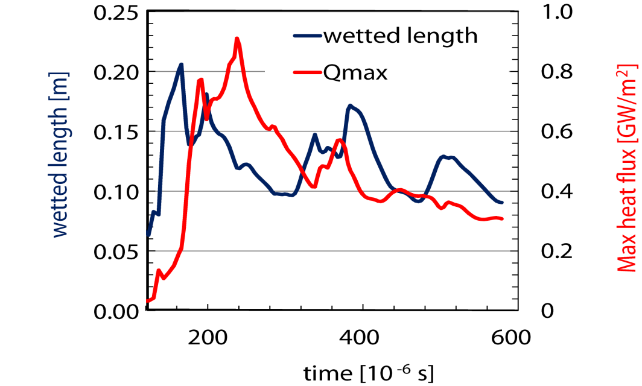
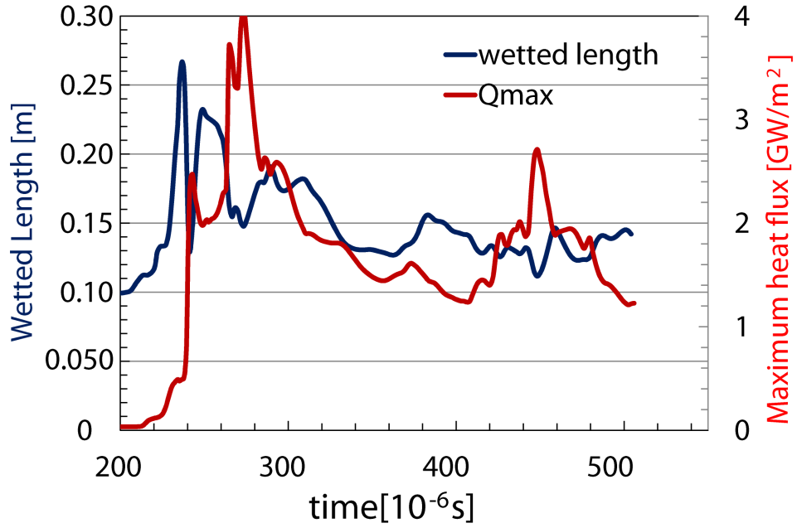
Physics Basis for ELM fluxes to PFCs – II
For Q_{DT} =10 plasmas → ELM divertor footprint width weakly dependent on ΔW_{ELM} (1.5 – 4 MJ) & 2 - 4 times larger than assumed to derive ΔW_{ELM}^{controlled} = 0.7 MJ
JOREK - Huijsmans - ITR/P1-23
ΔW_{ELM} = 4.0 MJ
ΔW_{ELM} = 1.5 MJ
Work in progress to address:
Detailed JOREK/experiment comparison
Larger ΔW_{ELM} losses in ITER
In/out divertor ELM power flux asymmetry:
Magnitude of ELM energy deposition asymmetry
ELM divertor footprint asymmetry
Notes:
7

Slide 8
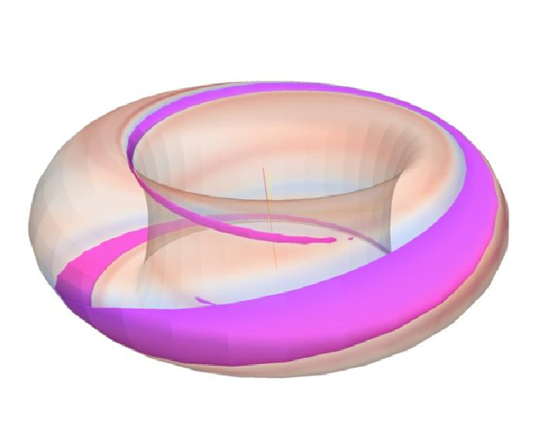
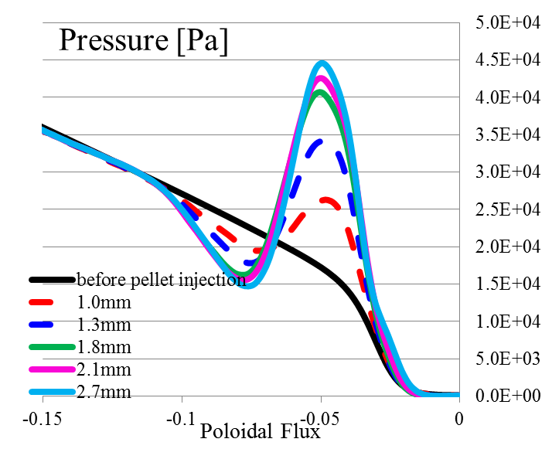
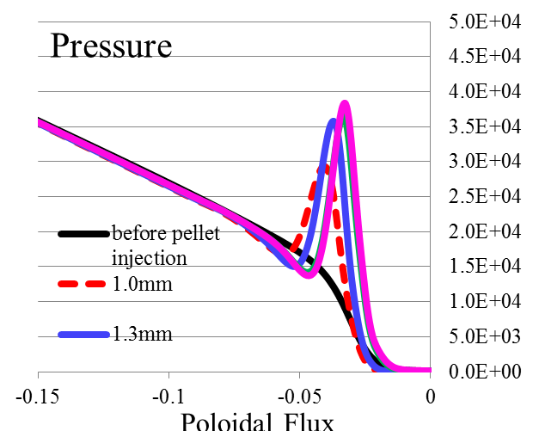
ELM triggering by Pellet Injection in ITER
ELM triggering → growth of ballooning modes by local over-pressure
Triggering physics → Minimum pellet size required to trigger an ELM
Comparison with DIII-D → good qualitative and semi-quantitative agreement (factor of ~ 2-4 more pellet particles in model than experiment to trigger ELM)
Pellet injection in X-point region allows ELM triggering with smaller pellets
ITER modelling requires ~ 34 mm³ pellets to trigger ELMs for 15 MA Q=10 scenario → throughput ~ 6 10²²s⁻¹ required (model/experiment pellets ~ 2-4 more particles)
JOREK – Futatani - ITR/P1-22
DIII-D - midplane
DIII-D - X-point
pellet
pellet cloud
Work in progress to address:
Modelling spatial resolution to approach experimental dimensions
Toroidal (n=1) asymmetries of pellet–triggered ELMs
In/out ELM divertor power deposition asymmetries of pellet–triggered ELMs
Notes:
8

Slide 9
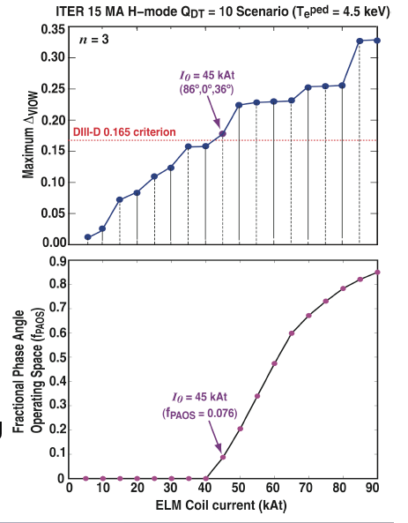
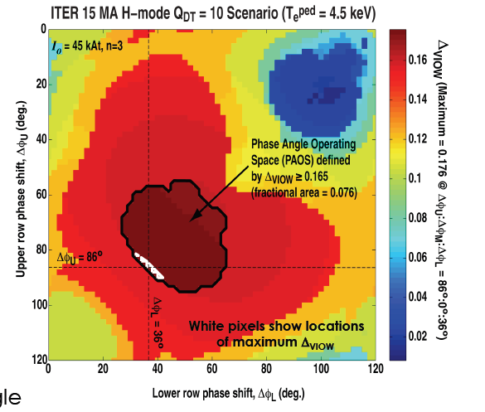
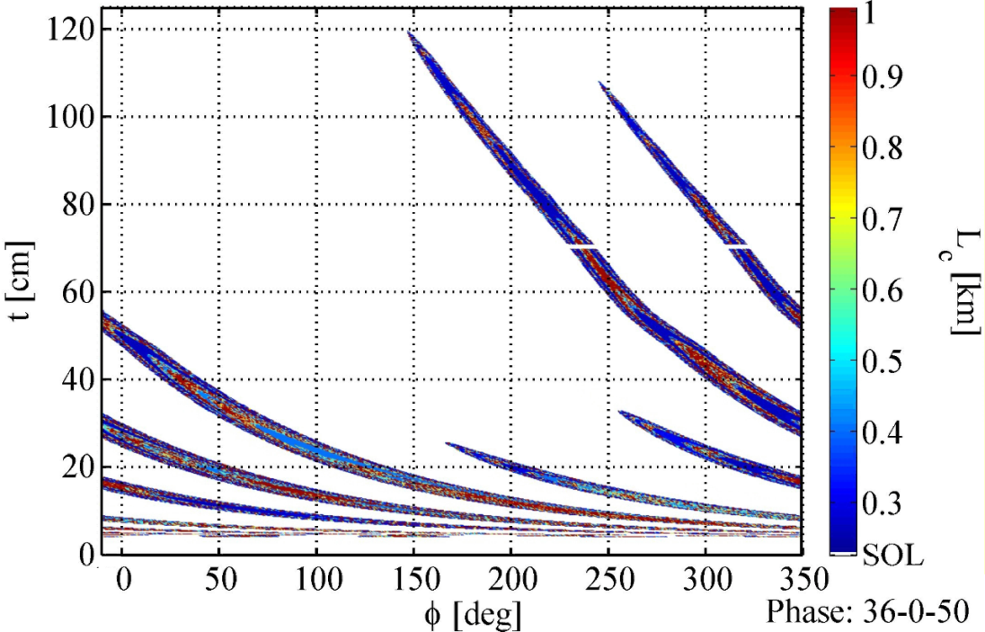
Application of 3-D fields for ELM Control in ITER - I
90 kAt ELM coil current → Meets with margin design criterion (vacuum approximation) with n = 3 & 4 symmetry even if perturbation not perfectly aligned with edge field
Margin in coil current can be used to meet criterion in case of malfunction of some of the coils (up to ~ 5 out of 27 with reasonable good flexibility in alignment)
n = 4 waveform (4 not natural harmonic of 9s) → large asymmetries of divertor strike zones → need to smooth out asymmetries by perturbation rotation
90 kAt n = 4, 36º-0º-50º
Evans - ITR/P1-25
Work in progress to address:
Identification of new empirical criterion for ELM suppression including plasma response
Evaluation of plasma response effect in ITER and optimization of application of ELM control coils for ELM suppression with improved physics basis
Distance along outer target (cm)
Notes:
9

Slide 10
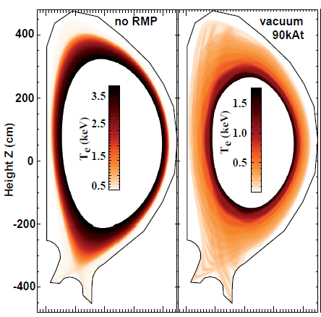
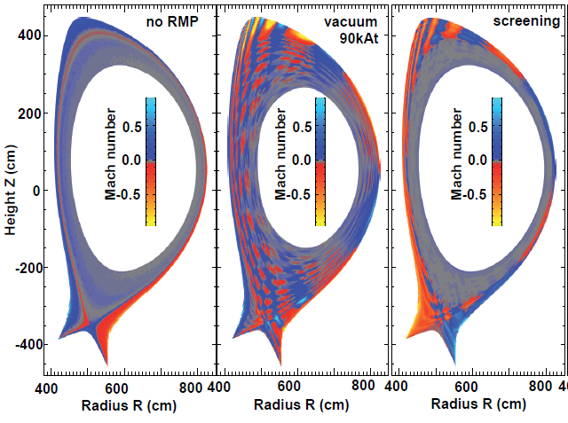
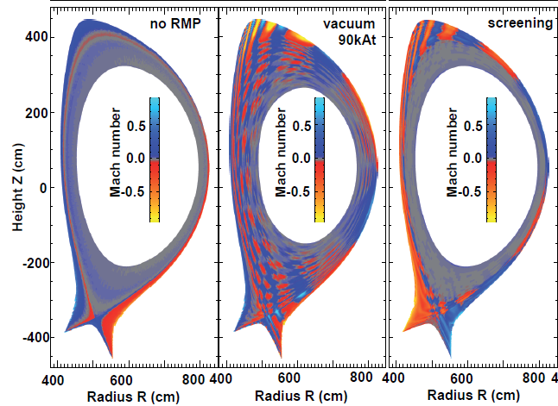
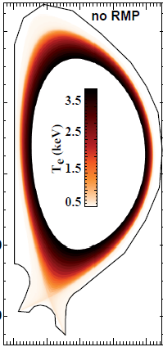
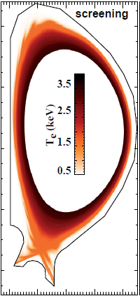
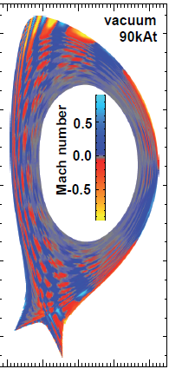
Application of 3-D fields for ELM Control in ITER – II
Large edge plasma thermal and particle losses for maximum current in coils in vacuum approximation unlike in experiment
Inclusion of plasma response shields resonant perturbations deeper in the plasma and reduces drastically thermal and particle losses
Additional pellet fuelling (~ 3 10²² s⁻¹) required to sustain density with screened fields → additional outflux favorable to flush out W in the absence of ELMs (AUG)
Plasma response approximation
Vacuum approximation
EMC3-Eirene
Schmitz- ITR/P1-24
JOREK
Becoulet - TH/1-2
Notes:
10

Slide 11
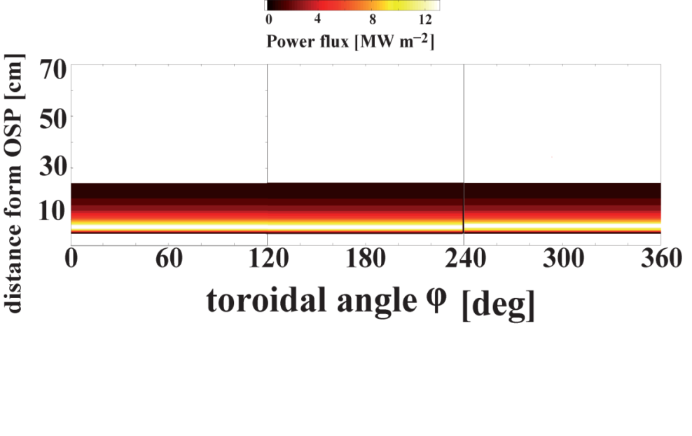
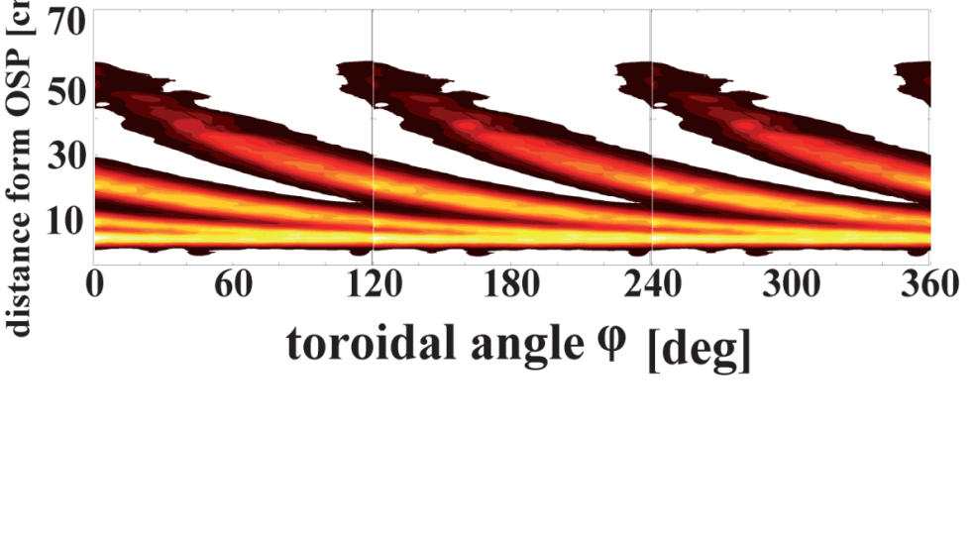
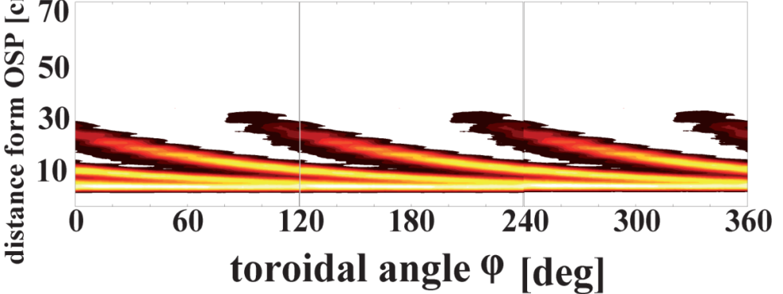
Application of 3-D fields for ELM Control in ITER – III
Power and particle fluxes to PFCs follow closely magnetic field pattern and spread with increasing edge ergodization (even for H-mode like transport giving λ_{q} ~ 3.5mm)
Perturbation rotation frequency may be needed to cope with toroidal asymmetries while avoiding PFC cycling → f_{ELM Control Coils} = 5 Hz
EMC3-Eirene
Schmitz- ITR/P1-24
No coils
Work in progress to address:
Effect of 3-D strike points on high recycling divertor conditions
Effect of 3-D strike points on erosion re-deposition balance at divertor target
90 kAt vacuum
90 kAt plasma response
Notes:
11

Slide 12
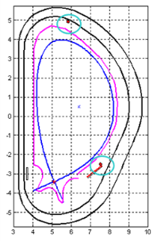
Other options : vertical plasma movements
Vertical plasma oscillations using VS coils unable to meet ELM control requirements for Q = 10 conditions (IAEA 2010) → Potential for initial low I_{p} H-mode scenarios?
VS coil system capability sufficient to meet levels found in experiment to trigger ELMs for H-modes for I_{p} up to 5-10 MA → sufficient for edge W control
Main outstanding issue is physics of ELM triggering (edge currents) and whether v_{Z} in ITER (4 ms⁻¹) is sufficient
Notes:
12

Slide 13
Conclusions
Operation with a W divertor in ITER is expected to impose different requirements on ELM control than divertor damage avoidance even for low I_{p} H-modes → ITER is well equipped with ELM control systems to meet these requirements
Major experimental progress in application of ITER-like ELM control schemes since IAEA 2010
Physics mechanisms for ELM energy transport to PFCs at ITER scale identified → Controlled ELM footprint may be wider than assumed
Detailed physics model for triggering of ELMs by pellets developed → ITER pellet injection system and fuel throughput appropriate for this mission
ELM control coil set has sufficient capability to meet design criterion if small number of coils (~5) malfunction → plasma response effects under study
Effect of ELM coil application on edge plasma and power and particle fluxes to PFCs assessed → need for higher pellet fuelling and perturbation rotation
Use of vertical plasma movements with VS viable for low I_{p} H-modes → tool for W control in initial operation while other systems are commissioned
Other effects of application of ELM coils on plasma (fast particles losses, rotation,…) under study (Oikawa - ITR/P1-35)
Notes:
13

Slide 14
Reserve Slides
Notes:
14

Slide 15
ELM Control in ITER : Requirements - I
Large power fluxes to PFCs expected during Type I ELMs in ITER for H-mode high I_{p}/high Q_{DT} operational scenarios
ELM control requirements in ITER defined to avoid melting of W divertor and Be first wall including edges of castellations
Physics of ELM energy transport from main plasma to PFCs subject of R&D → Relation between A_{ELM} (ΔW_{ELM}) and A_{s.s,} subject of R&D
α ~ few º
Be first-wall ELM Fluxes :
mid-p separatrix-wall distance = 5 cm
n_{filaments} ^{ELM} = 10
α ~ 7º
λ_{ELM}^{wall}|_{mp} = λ_{ELM}^{div}|_{mp}
Notes:
15

Slide 16
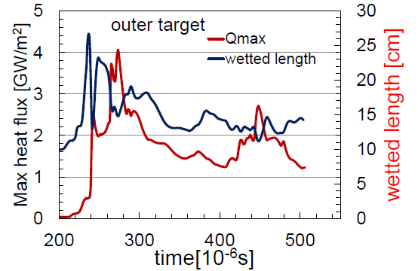
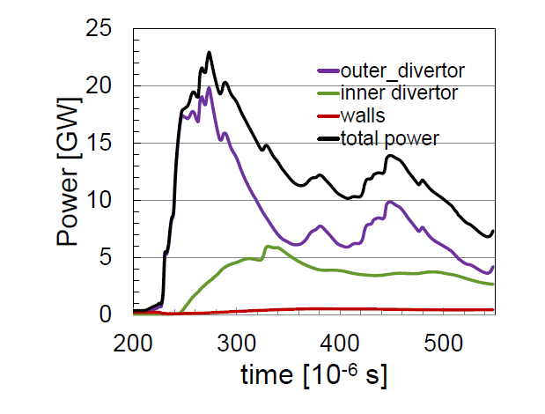
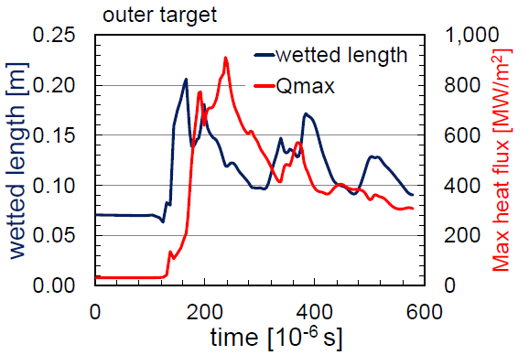
Physics Basis for ELM fluxes to PFCs – I ITR/P1-23
Within range of conditions explored JOREK ITER ELMs
ELM power divertor footprint width weakly dependent on ΔW_{ELM}
ΔW_{ELM}^{wall}/ΔW_{ELM} decreases with ΔW_{ELM}
Work in progress to address:
Detailed JOREK/experiment comparison
Larger ΔW_{ELM} losses in ITER
In/out divertor ELM power flux asymmetry:
Magnitude of ELM energy deposition asymmetry
ELM divertor footprint asymmetry
Notes:
16

Slide 17
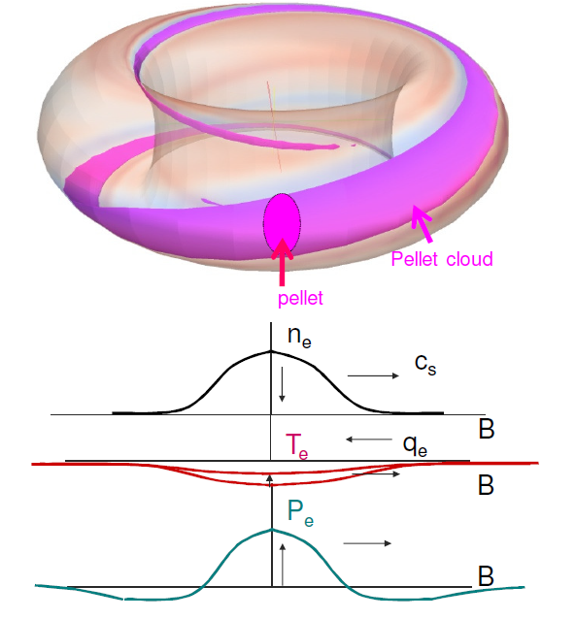
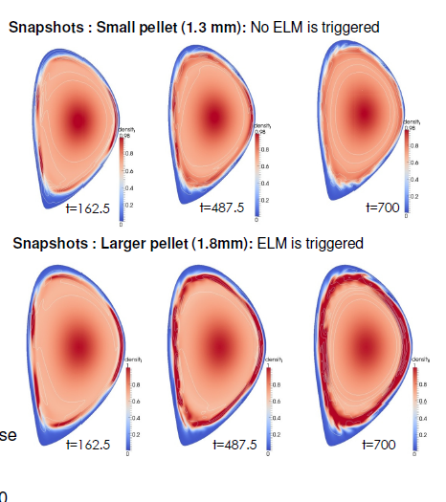
ELM triggering by Pellet Injection in ITER – I
JOREK applied to modelling ELM triggering by pellet injection:
Physics hypothesis for ELM triggering confirmed : destabilization of ballooning modes by local over-pressure following pellet ablation
Physics hypothesis leads to minimum pellet size (for given velocity injection geometry) required to trigger an ELM
Comparison with DIII-D : good qualitative and semi-quantitative agreement (factor of ~ 3-4 more pellet particles in model than experiment to trigger ELM)
JOREK - Huijsmans - ITR/P1-23
DIII-D mid-plane injection
ITER 15 MA
Notes:
17

Slide 18
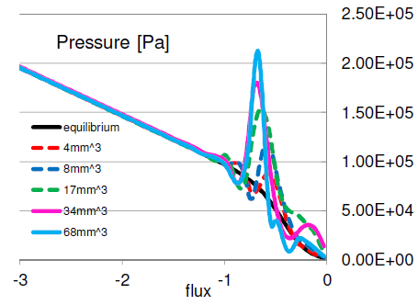
ELM triggering by Pellet Injection in ITER – II ITR/P1-22
Pellet injection in X-point region allows ELM triggering with smaller pellets
ITER modelling requires ~ 34 mm³ pellets to trigger ELMs for 15 MA Q=10 scenario → throughput ~ 6 10²²s⁻¹ required (model/experiment pellets ~ 3-4 more particles)
DIII-D
mid-plane injection
ITER
X-point injection
ITER 15 MA
X-point injection
Work in progress to address:
Modelling spatial resolution to approach experimental dimensions
Toroidal (n=1) asymmetries of pellet–triggered ELMs
In/out ELM divertor power deposition asymmetries of pellet–triggered ELMs
Notes:
18

Slide 19
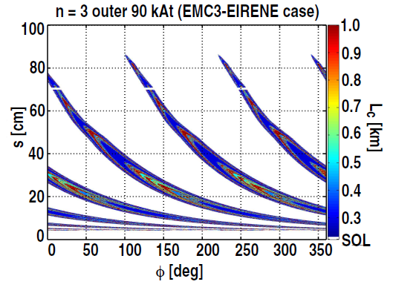
Application of 3-D fields for ELM Control in ITER – II ITR/P1-25
Achieving a given level of edge ergodization requires lower currents in ELM Control Coils for n = 4 because of side harmonics (9 coils)
n = 4 waveform leads to large asymmetries of divertor strike zones → more likely need to rotate perturbation to smooth out asymmetries and higher rotation frequency
90 kAt n = 4, 36º-0º-50º
90 kAt n = 3, 66º-0º-52º
Work in progress to address:
Identification of new empirical criterion for ELM suppression including plasma response which describes experimental results obtained so far
Evaluation of plasma response effect in ITER and optimization of application of ELM control coils for ELM suppression with improved physics basis
Notes:
19

Slide 20
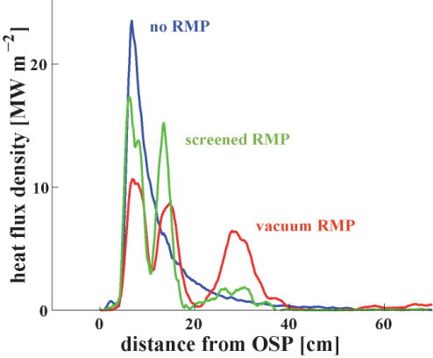
Application of 3-D fields for ELM Control in ITER – III ITR/P1-25
Power and particle fluxes to PFCs follows closely magnetic field pattern and spreads with increasing edge ergodization (even for H-mode like transport giving λ_{q} ~ 3.5mm)
Pertubation rotation frequency to cope with n=4 asymmetry and prevent PFC cycling for worst possible case (20 MWm⁻²) confirmed → f_{ELM Control Coils} = 5 Hz
No coils
90 kAt vacuum
90 kAt plasma response
Work in progress to address:
Effect of 3-d strike points on high recycling divertor conditions
Effect of 3-d strike points on erosion redeposition balance for divertor target
Notes:
20

