Slide 2
Introduction
2/13
Knowledge of the influence of the hydrogen isotope on H-mode confinement is essential for accurately projecting the energy confinement in future burning plasmas.
Energy confinement time increases with isotope mass τ_{th} ∝ M^{ζ} with ζ greater than 0.
This favorable dependence of confinement on isotope mass leads to optimistic visions for a future reactor.
However, the underlying physics behind the role of the hydrogen isotope has not yet clearly been understood.
1.5
deuterium
1
W_{th} [MJ]
0.5
hydrogen
τ_{th} ∝ P_{L}^{-0.69}
1.1MA, 2.4T
0
0
2
4
6
8
10
12
P_{abs} [MW]

Slide 3
Objective
3/13
In the present understanding, H-mode confinement is characterized by separating into pedestal and core components.
Investigate the dependence of the core heat transport on the isotope focusing on T_{i} profiles
Examine how the hydrogen isotope is involved in the physics picture of overall H-mode confinement
Core
Pedestal
Shafranov shift
p(r)
separatrix
Poloidal beta
Pedestal stability
∇p, j
Profile stiffness
Pedestal structure
Δ/a ~ β_{p}^{1/2}
ΔW_{ELM}
Heat source
ELM
hydrogen isotope
The experiments on hydrogen and deuterium H-mode plasmas in JT-60U were used for analysis.

Slide 4
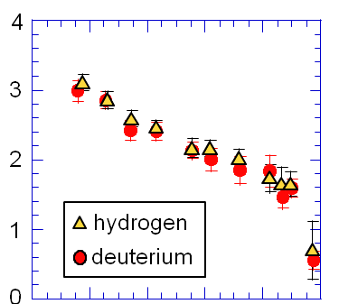
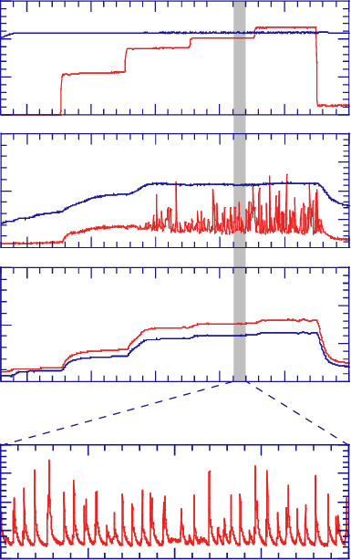
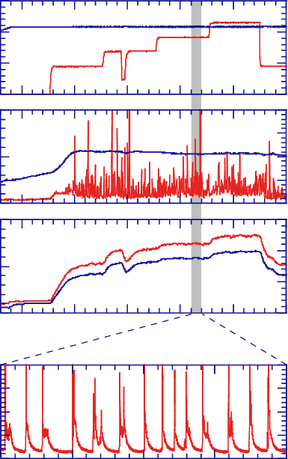
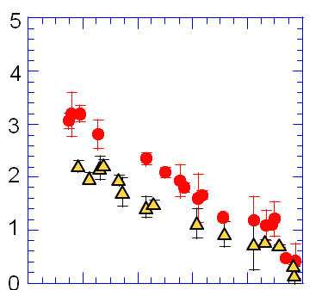
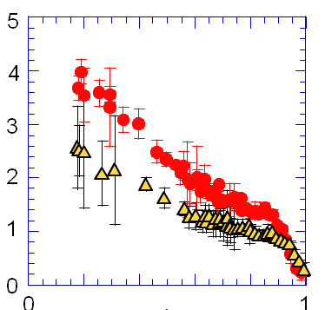
Experiment on hydrogen and deuterium H-mode plasmas
4/13
Power scan has been attempted to examine the characteristics of hydrogen and deuterium H-mode plasmas.
H: W_{th} = 0.7MJ, Z_{eff} = 1.4
D: W_{th} = 0.9MJ, Z_{eff} = 2.4
H
P_{abs} = 7.3 MW
D
15
I_{p}
1.5
15
I_{p}
1.5
n_{e} [10¹⁹m⁻³]
[MW]
P_{NBI}
[MA]
[MW]
P_{NBI}
[MA]
0
0
0
0
2
4
2
4
n_{e}
n_{e}
[a.u.]
[10¹⁹m⁻³]
D_{α}
[10¹⁹m⁻³]
H_{α}
[a.u.]
0
0
0
0
2
1.5
2
1.5
T_{e} [keV]
[MJ]
W_{TOT}
[MJ]
W_{TOT}
β_{p}^{TOT}
β_{p}^{TOT}
0
0
0
10
0
6
7
8
9
10
11
6
7
8
9
11
time [s]
time [s]
2
2
[a.u.]
[a.u.]
0
0
T_{i} [keV]
9.2
9.3
9.4
9.2
9.3
9.4
time [s]
time [s]
f_{ELM} = 170Hz (P_{sep}=6.7MW)
f_{ELM} = 80Hz (P_{sep}=6.6MW)
I_{p} = 1.08 MA, B_{T} = 2.4T
q₉₅ = 3.7, δ = 0.35
n_{e} = 2.2 x 10¹⁹m⁻³
β_{p} = 0.6 (H) and 0.9 (D)
r/a

Slide 5
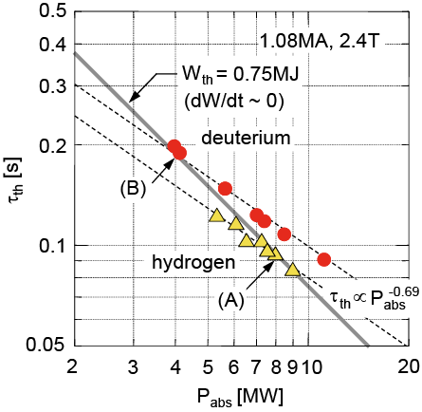
τ_{th} for deuterium is larger by 20-30% than for hydrogen at a given power
5/13
The τ_{th} decreases continuously with P_{abs} for
both cases as expected from IPB98y2 scaling.
However, τ_{th} is larger by 20-30% for deuterium than for hydrogen at a given P_{abs}.
A pair of H and D plasmas with the same W_{th} are chosen for comparison.
The power required to sustain the same W_{th} is greater for H (P_{abs} = 8.0MW) than for D (P_{abs} = 4.0MW) by a factor of two.
Therefore, τ_{th} of 0.1s for H becomes half that for D (τ_{th} = 0.2s).

Slide 6
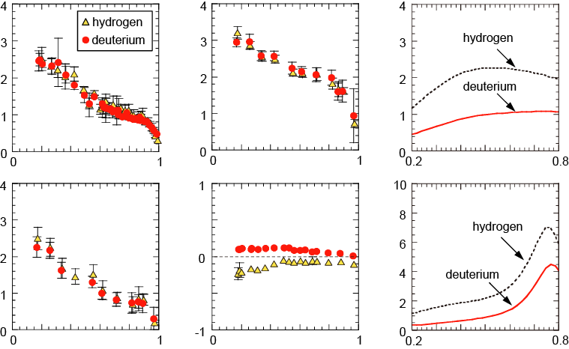
Profiles of n_{e}, T_{e} and T_{i} become identical while χ_{i} is smaller for deuterium throughout the minor radius
6/13
T_{i} [keV]
n_{e} [10¹⁹m⁻³]
Q_{i} [10⁻¹⁵ W m]
r/a
r/a
r/a
T_{e} [keV]
V_{T} [10² krad/s]
χ_{i} [m²/s]
r/a
r/a
r/a
The profiles of T_{i}, T_{e} and n_{e} are obviously identical. The Q_{i} for H is larger than for D. Therefore, the χ_{i} for H also becomes explicitly higher than for D.
A larger number of perp-NBs were injected for H to keep W_{th} the same. This operation leads to a larger ripple loss of fast ions, which enhances the V_{T} toward the counter direction.

Slide 7
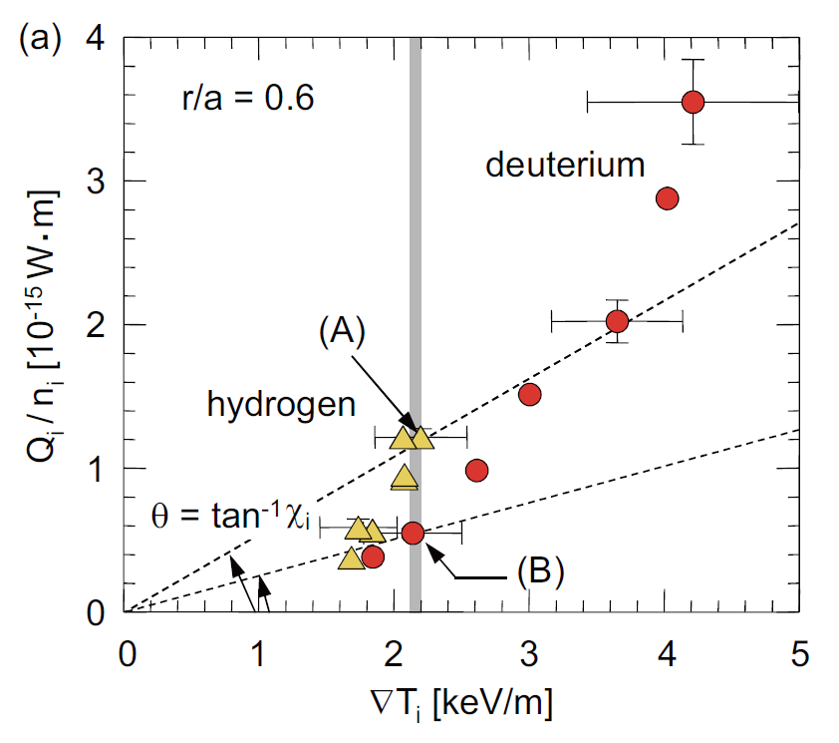
Reduced ion heat diffusivity for deuterium accompanying steeper temperature gradient
7/13
The characteristics of ion heat transport are shown in a diagram of Q_{i}/n_{i} and ∇T_{i}.
For both cases, the increase of ∇T_{i} is less significant than that of Q_{i}/n_{i}, indicating that χ_{i} increases gradually with the heating power.
The increase of χ_{i} with the heating power is more rapid for H than for D.
Increased power
The angle θ formed between the horizontal axis and a straight line that passes through both the data and the origin of the coordinates corresponds to χ_{i} (= tanθ).

Slide 8
Ion-temperature-gradient scale length is smaller with hydrogen isotope mass
8/13
R / L _{Ti}
χ_{i} increases rapidly with ∇T_{i}/T_{i} for both H and D plasmas, indicating the profile stiffness in the variation of the heating power in this exp.
As expected from the same T_{i} profiles for (A) and (B), the χ_{i} for H is nearly two times larger than for D with the same ∇T_{i}/T_{i}.
Considering the characteristics of the rapid increase of χ_{i} with ∇T_{i}/T_{i} for each hydrogen isotope species, this result is indicative of a smaller L_{Ti} for deuterium plasmas.
6
0
2
4
6
8
10
hydrogen
deuterium
4
r/a = 0.6
(A)
χ_{i} [m²/s]
2
linear ITG
threshold
χ_{i}^{neo}
(B)
0
0
1
2
3
∇T_{i} / T_{i} [m⁻¹]

Slide 9
Edge pedestal characteristics
9/13
200
f_{ELM} increases almost linearly with P_{sep} for both cases; a typical feature of type-I ELMs.
At a given P_{sep}, f_{ELM} for H becomes approximately two times larger than that for D.
Over wide range of P_{sep}, ΔW_{ELM} is smaller by a factor of ~2 for H than that for D.
In (f_{ELM}/P_{sep}, ΔW_{ELM}) space, the product of both axis quantities indicates the power fraction assigned to ELM loss from the separatrix power.
ELM loss power P_{ELM} (= f_{ELM} ΔW_{ELM}) for D remains ~20% of P_{sep} while it is ~10% of P_{sep} for H.
The result indicates that the power assigned to the inter-ELM transport for D is smaller than that for H.
hydrogen
165Hz
150
f_{ELM} [Hz]
100
80Hz
50
deuterium
1.1MA, 2.4T
0
0
2
4
6
8
10
P_{sep} [MW]
25
20
deuterium
15
P_{ELM}/P_{sep} = 20%
ΔW_{ELM} [kJ]
10
P_{ELM}/P_{sep} = 10%
5
hydrogen
0
0
10
20
30
f_{ELM} / P_{sep} [Hz / MW]

Slide 10
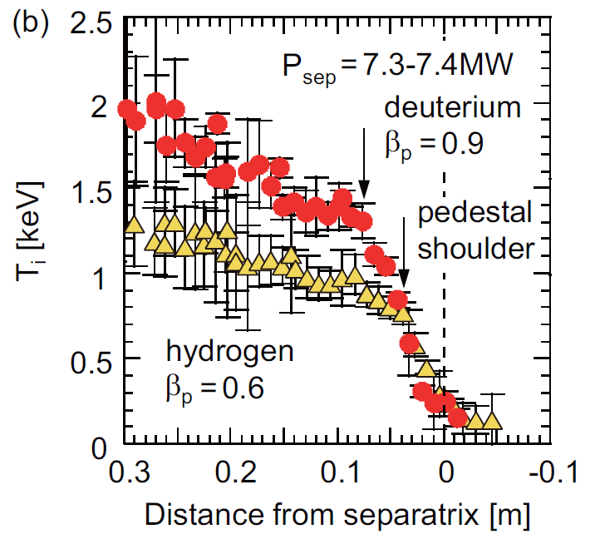
Edge pedestal characteristics
10/13
Despite a given P_{abs}, the pedestal T_{i} value becomes higher for D than for H.
Non-dimensional parameter scan in JT-60U has shown pedestal width Δ_{ped} scales as β_{p}^{ped0.5} while there is nearly no dependence on ρ_{p}^{ped}* [1]. This result indicates that Δ_{ped} is not changed directly by isotope species.
However, the pedestal temperature profiles are clearly different between two cases.
Discuss how this difference in the pedestal temperature appears.
P_{abs}
[1] H. Urano et al, Nucl. Fusion 48 (2008) 045008

Slide 11
Higher pedestal pressure is obtained in deuterium H-mode plasmas
11/13
2
Pedestal pressure evidently differs nearly by a factor of ~1.5 between H and D plasmas.
The difference of p_{ped} is mainly attributed to the difference of T_{ped}.
The edge stability can be improved by the increase in β_{p}^{TOT} [2-4].
The β_{p}^{ped} is increased with increased β_{p}^{TOT} for both cases. Despite different types of isotope species, the relationship between β_{p}^{TOT} and β_{p}^{ped} is almost identical.
Why is larger β_{p}^{TOT} obtained for D?
Better thermal energy confinement for D is one of the contributors.
Fast ion energy is also proportional to m^{0.5}.
deuterium
1
T_{e}^{ped} [keV]
hydrogen
3.0 kPa
1.08MA, 2.4T
P_{abs} = 8-9MW
1.5 kPa
0
0
1
2
n_{e}^{ped} [10¹⁹m⁻³]
0.4
deuterium
0.3
(A)
β_{p}^{ped}
0.2
hydrogen
(B)
0.1
1.08MA, 2.4T
0
0
0.2
0.4
0.6
0.8
1
1.2
β_{p}^{TOT}
[2] Y. Kamada et al, Plasma Phys. Control. Fusion 48 (2006) A419
[3] P. B. Snyder et al, Nucl. Fusion 47 (2007) 961
[4] A. W. Leonard et al, Phys. Plasmas 15 (2008) 056114

Slide 12
Schematic view of H-mode confinement involving hydrogen isotope effect
12/13
Core
Pedestal
Shafranov shift
p(r)
(ii)
separatrix
(i) Pedestal plays a role as a boundary condition determining the core confinement through profile stiffness
(ii) Pedestal stability is improved with increased β_{p}
Poloidal beta
Pedestal stability
∇p, j
Fast ion energy
Profile stiffness
(i)
Pedestal structure
Hydrogen isotope
Δ/a ~ β_{p}^{1/2}
ΔW_{ELM}
Heat source
ELM
f_{ELM}
Reduced heat transport for deuterium improves core confinement.
The β_{p} becomes higher for deuterium.
Increased β_{p} improves the edge stability and raises the pedestal pressure.
Higher pedestal in turn allows higher core confinement due to profile stiffness.

Slide 13
Summary
13/13
The hydrogen isotope effect on H-mode confinement was examined using hydrogen and deuterium H-mode plasmas in JT-60U tokamak.
The τ_{th} was larger by 20-30% for deuterium than for hydrogen over a wide range of power.
When W_{th} was fixed, the profiles of n_{e}, T_{e} and T_{i} became nearly identical for both cases while higher heating power was required for hydrogen. The χ_{i} for hydrogen was higher than that for deuterium.
Ion temperature gradient scale length was smaller for deuterium compared with that for hydrogen.
The relationship between β_{p}^{TOT} and β_{p}^{ped} was nearly the same regardless of the difference of the isotope species.

