Slide 1
Data-acquisition with MDSplus and custom devices Fernando Santoro Thomas Fredian, Stephen Lane-Walsh and Joshua Stillerman PSFC at MIT
id 593
Hardware (the experiment)
Software (MDSplus Device class for data acquisition)
Real-time visualization
Data analysis
Jupyter Lab

Slide 2
id 593
Jupyter Lab
(as the development environment)
Arduino
Lidar, T/H sensors
MDSplus
device class
jScope
Real-time data visualization
Analysis
Scipy, Matplotlib, etc
Custom Device
(as the experiment)
in a subprocess

Slide 3
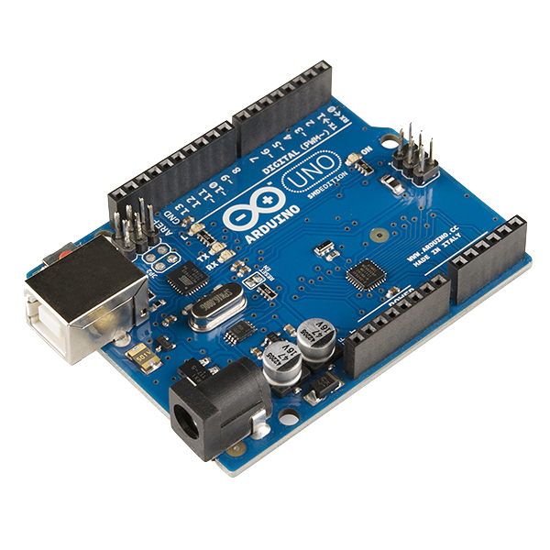
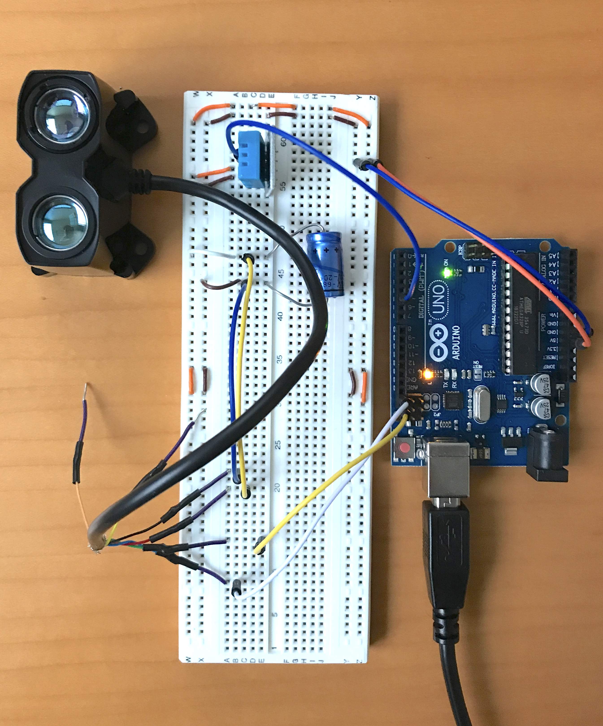
Arduino device and sensors
id 593
Arduino UNO
microcontroller
Garmin Lidar v3HP
Adafruit Temperature
Humidity sensor

Slide 4
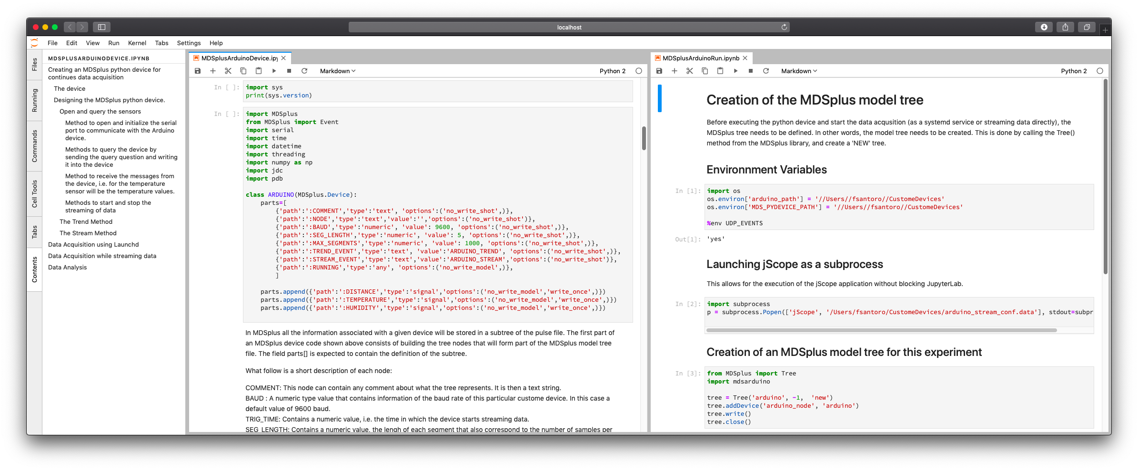
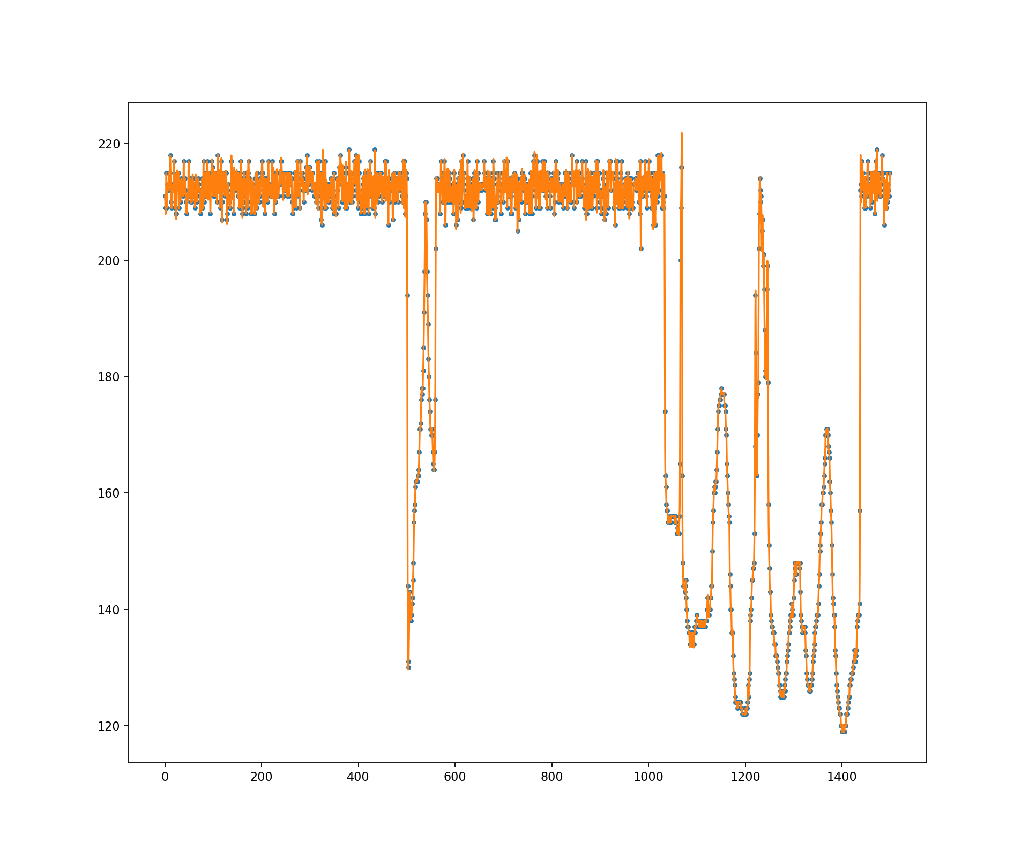
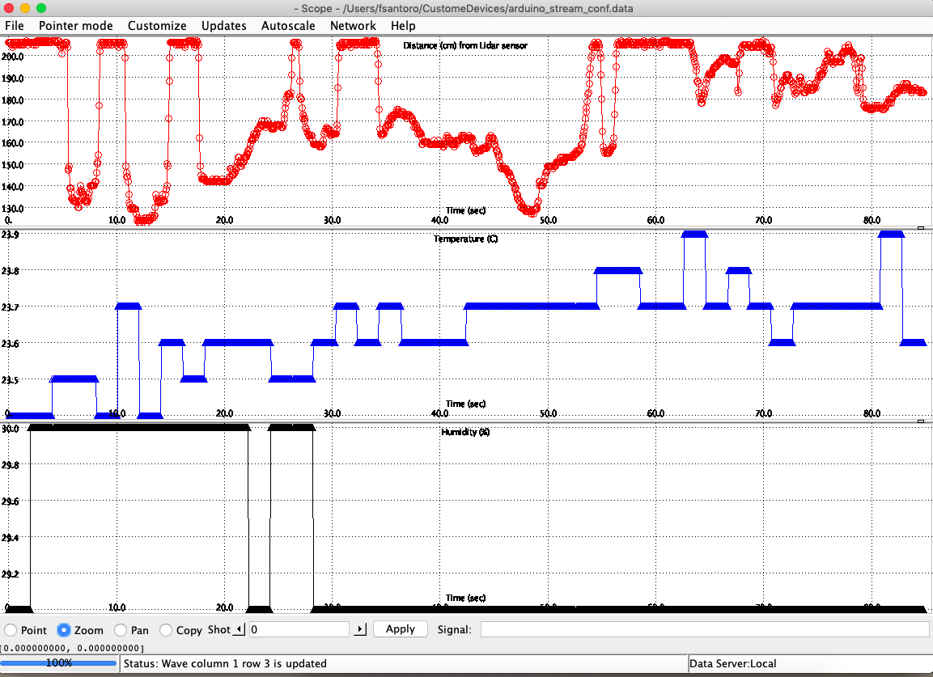
MDSplus and Jupyter Lab
id 593
Data Analysis
Real-time
visualization
matplotlib and scipy
jScope

