Slide 1
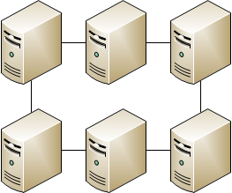
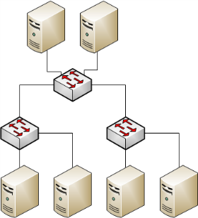
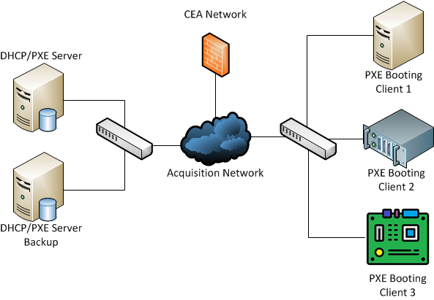
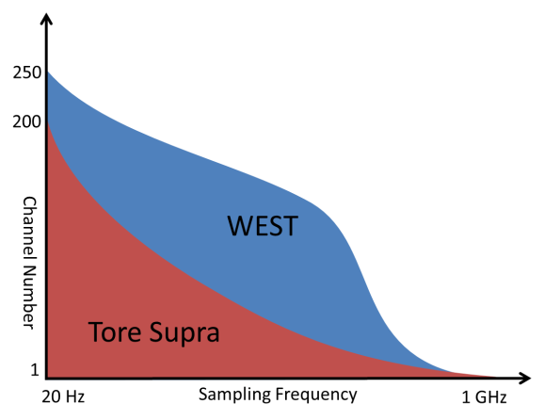
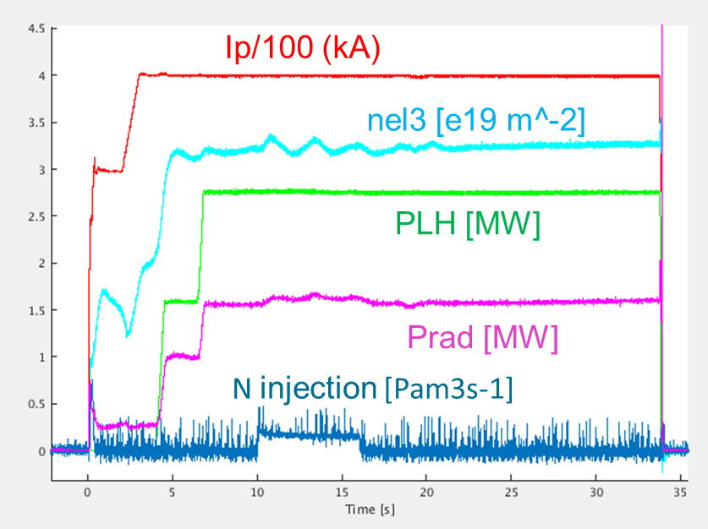
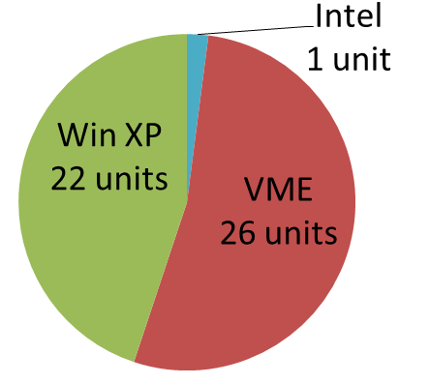
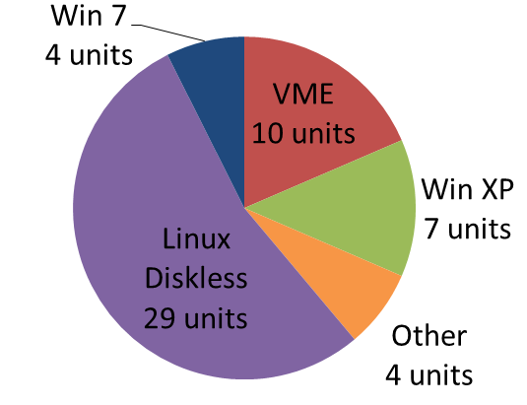
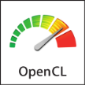
From Tore Supra to WEST
Evolution of the CODAC infrastructure
A. Berne¹, B. Santraine¹, N. Ravenel¹, G. Caulier¹, J. Colnel¹, F. Leroux², A. Barbuti¹, B. Vincent¹,
Y. Moudden¹ and the WEST Team*
¹ CEA, IRFM, F-13108 Saint Paul-lez-Durance, France
² CEA, STIC, F-13108 Saint Paul-lez-Durance, France
*http://west.cea.fr/WESTteam
INTRODUCTION
Real Time Network – Shared Memory
1988 Tore Supra limiter tokamak → 2013 WEST (Tungsten [W] Environment in Steady state Tokamak) X-point divertor device.
Long discharge capability to evaluate technological and operational risks of the actively cooled tungsten divertor for ITER.
CODAC infrastructure upgraded for multiple reasons:
Performance issues
Hardware/software obsolescence
Loss of competencies
Resources reduction
The real time network of Tore Supra could not be maintained anymore: lack of PXIe or PCIe card support.
Moreover, the token topology required all units to be operational and evolution is difficult.
⬅ Tore Supra
vs.
WEST ➔
Acquisition Units
Acquisition units are associated to diagnostics on the tokamak.
Upgrade is mandatory for the following reasons:
Obsolescence of Intel system
Cost and aging of VME systems
Difficult maintainability and end-of-support of Win XP system.
Solution based on PXE technology (Preboot eXecution Environment): PXE server is hosting the Operating System, the client recovers the OS at startup and runs it from internal RAM (diskless).
+ Extended star network, nodes can be simply added or removed.
+ Switches can be monitored via webpage
+ High performance (theoretical): up to 40gbps, 3 TB/s
+ Multi-platform: Linux (32/64 bits), Windows 7
Acquisition boards
Upgrade to match acquisition unit evolution
Increase of performance is required by plasma physics
+ PCI/PXI/PXIe/PCIe, cRIO, VME, Ethernet
20 Hz ➔ 1 GHz
1 channel ➔ 250 channels
+ IR camera, spectrometer
+ FPGA-based reconfigurable acquisition board
+ Real time acquisition using timing system
Plasma Operation and results
+ Easier maintenance with a diskless system (preferred solution)
+ Updates/modifications spread to all units automatically
+ No need to clone disk when replacing acquisition unit
+ Several OS can be hosted on the servers, configuration files are used to associate client / IP address / OS version
+ Multiple hardware supported: desktop / industrial / single board computer, AMD / Intel processor, single / dual processor, …
+ Commercial off-the-shelf components
- Higher network traffic
- Local disk required for high data throughput
- High risk on the PXE server
Operating routinely since 2016 [1]
>4000 experiments performed
First plasma in December 2016
37 s flattop plasma discharge achieved
40+ acquisition units
Remote experiment from the ITER Remote Experimentation Center in Rokkasho, Japan [2].
Plan forward
Remove all Win XP acquisition units
Continue support for VME acquisition units (use of cross-compilation)
Add GPU processing (CUDA, opencl), offer advanced computation performance
Improve network capabilities (speed and routing)
Absolute time synchronization by PTP protocol
⬅ Tore Supra
vs.
WEST ➔
CONCLUSION
Timing System
WEST CODAC infrastructure benefits from Tore Supra experience
Durable and up-to-date components
Easier maintenance for acquisition units
On-going upgrade
Still room for improvement
No modifications were done to the timing system of Tore Supra: distribution of 1 MHz central clock (relative time), distribution of events (shot scheduling, data sampling, trigger event, safety event, …).
Old boards (PCI format) were replaced with new standard (PCIe / PXIe format). FPGA technology is used to offer future improvements.
Reference
[1] “WEST first plasma operation with all tungsten plasma facing components”, 27th IAEA Fusion Energy Conference, J. Bucalossi and the WEST team
[2] IFERC NewsLetter – 2019-01

