Slide 1
EAST MDSplus Log Data Management System
12th IAEA Technical Meeting
on Control, Data Acquisition and Remote Participation for Fusion Research
13-17 May 2019, Daejeon, Korea
P-469
F. Wang*¹, J. Dai^{1,2}, Q.H. Zhang^{1,2}, Y.T. Wang^{1,2}, and F. Yang^{1,3}
¹Institute of Plasma Physics, Chinese Academy of Sciences, Hefei, China
²School of nuclear science and technology, University of Science and Technology of China
³Department of Computer Science , Anhui Medical University, Hefei, China

Slide 2
OUTLINE
1. Introduction
2. System Architecture
3. Test Results
4. Summary

Slide 3
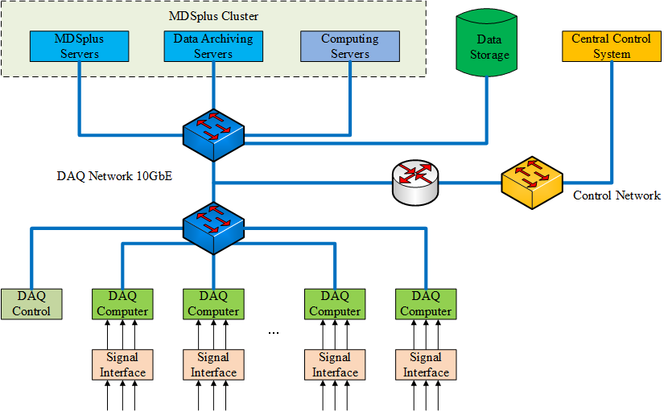
1. Introduction
Tree | Description | Signals | Size
east | Diagnostic DAQ raw data | ~3000 | ~500TB
east_1 | Diagnostic DAQ raw data (1kHz) | ~3000 | ~20TB
analysis | Analyzed data | ~2000 | ~20TB
eng | Engineering DAQ raw data | ~2000 | ~2TB
pcs | Plasma Control System data | ~500 | ~5TB
efit | EFIT calculation data | ~100 | ~2TB
Ccd | Camera DAQ data | ~10 | ~150TB
To develop a Log Data Management System to monitor the operations of all users on MDSplus database.
Log data collection
Off-line log data analysis
Real-time log data analysis
Log data visualization
EAST Distributed and Continuous Data Acquisition：
DAQ Nodes: ~60; Channels: ~3000; Sampling Rate: 1Hz~60MHz; Stream: ~2~5GB/s; Data: ~100~200TB (year) Database: MDSplus

Slide 4
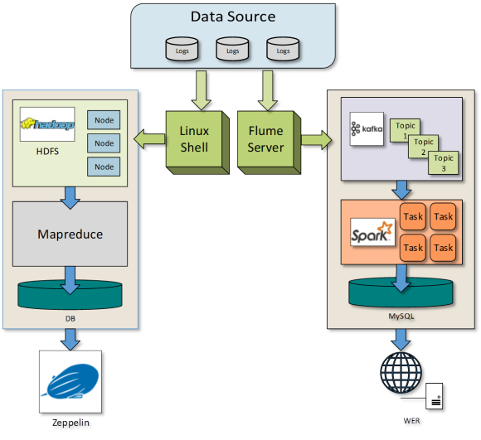
2. System Architecture
The system is developed based on Big Data Technology.
MDSplus logging system can record the detailed log information When users sends requests to the server;
This log information is monitored by the Flume service in real time and Linux shell in offline;
HDFS and Mapreduce use for off-line data analysis;
Kafka and Spark Streaming use for real-time data analysis;
Combining Zeppelin with traditional web can present server status perfectly;
Software environment: CentOS 64bit / Hadoop 2.7.3/ Spark 2.11 / Kafka 0.10.1 / Flume 1.7.0 / PHP / Echart

Slide 5
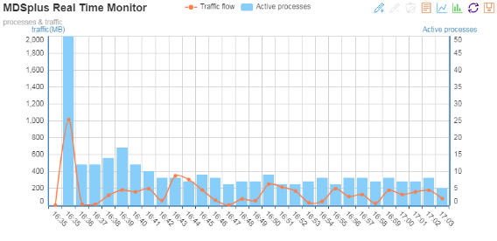
3. Test Results
Data Monitoring：The MySQL table does not directly reflect the value of the data. To solve this problem, building a data browser is quite necessary. Combining Zeppelin with traditional web can present server status perfectly.
Performance Test: To test the log analysis system’s usability, the test method adapts multiply threads access data storage server. The following Table is an offline and real-time comparison of the log information processing.

Slide 6
4. Summary
To monitor the MDSplus data storage server on EAST, a new log data management system has been designed which including log optimization and collection, off-line data analysis, real-time data analysis and data browser.
The log data management system has been implemented and adopted in the campaign of EAST.
Future work:
more data analysis components will be added into the log data management system to mining more useful data ;
more advanced machine learning algorithm will be implemented according to the requirements.

