Slide 1
Development High-Speed Visible Diagnostics for Real-Time Plasma Boundary Reconstruction on EAST
By: Biao Shen
5/6/2019

Slide 2
Outline
Introduction
Optical Plasma boundary reconstruction
Image acquisition & processing system for EAST
Conclusion

Slide 3
Introduction
Large distance to the magnetic pick-up coils result in weak magnetic signals.
Large scale of transients of the flux distribution make magnetic reconstruction problematic.
The camera data do not suffer from drift.
The camera data contains much information: plasma boundary, filament structures, ELMs, and hot spots of PFCs, etc.

Slide 4



Online edge detection algorithm—traditional
(a) Sobel (b) Canny (c) Roberts
Traditional gradient operators such as Sobel、Canny and Roberts extract for plasma edge extraction are not suitable.
There are not only some unextracted edge, but also many false edges.

Slide 5
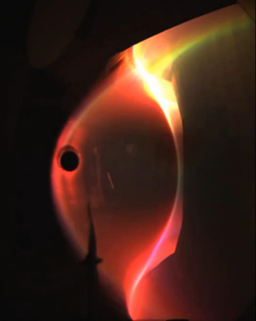

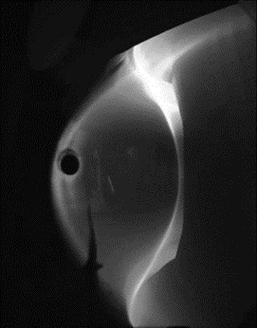
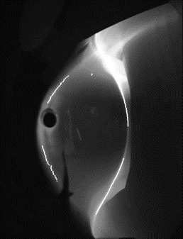
Online edge detection algorithm—ours
Step1: Three-channel color digital images to gray image
Step2: Appoint Regions Of Interest (ROIs)
Step3: Plasma edge extraction (algorithm based on global contrast)
Image of plasma in EAST
With ROIs for the plasma boundary
Gray image of plasma in EAST
Result of edge extraction

Slide 6
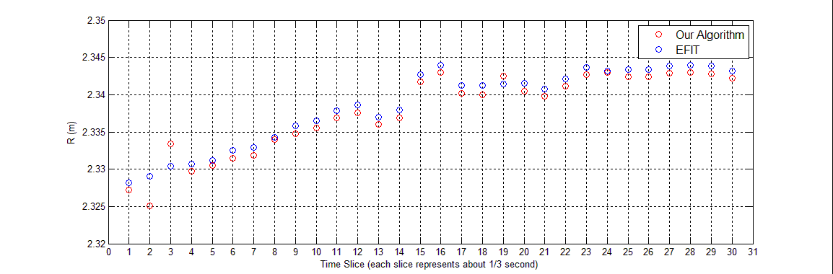
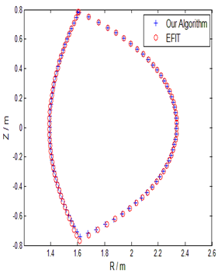
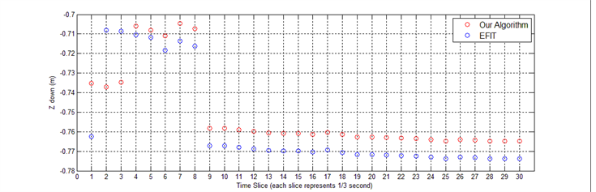
Online boundary reconstruction result
(b) R-observer
(a) Reconstruction result
of one frame image
(c) Z-observer

Slide 7
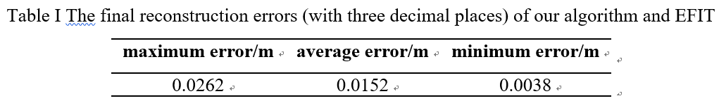
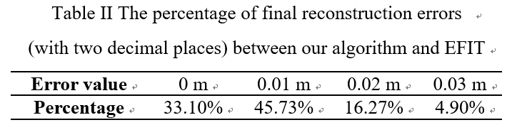
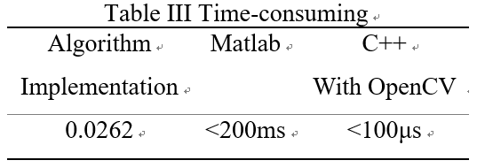
Online boundary reconstruction result

Slide 8
Online boundary reconstruction algorithm
Step1: Three-channel color digital images to gray image
Step2: Appoint Regions Of Interest (ROIs)
Step3: Plasma edge extraction (algorithm based on global contrast)
Image of plasma in EAST
With ROIs for the plasma boundary
Gray image of plasma in EAST
Result of edge extraction

Slide 9

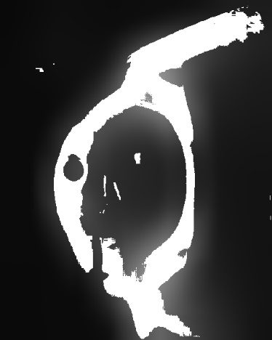
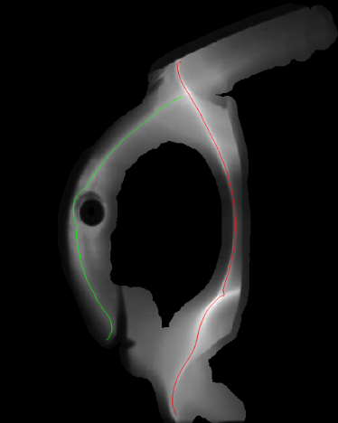
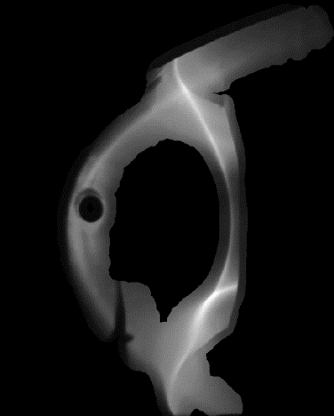

Offline edge detection — algorithm
Original image
Mean filtering
Threshold segmentation
global edge extraction
Morphological filtering
& original image
Morphological filtering

Slide 10
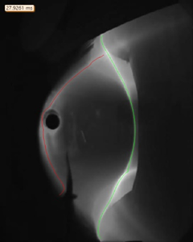
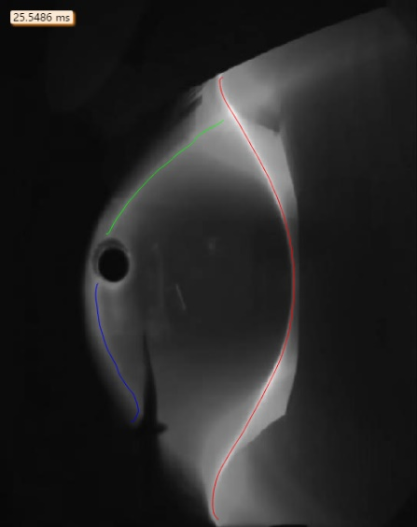
Offline edge detection — some results
Notes:
Tagged Image
File Format

Slide 11


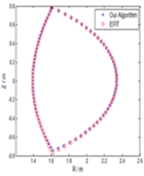
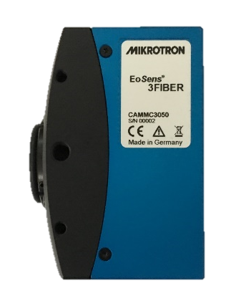
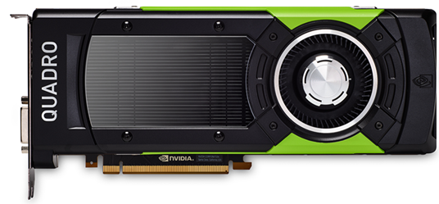
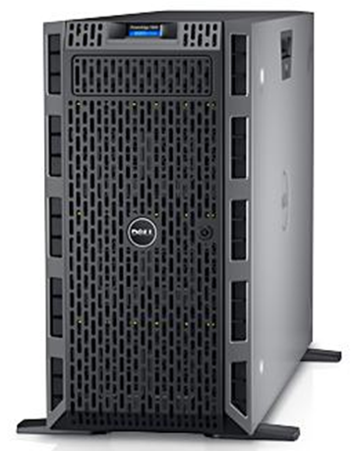
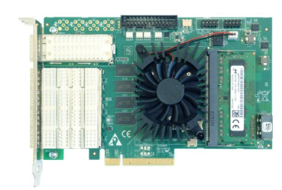
Architectures of IAPS: Hardware and Optics
Back-end transmitting lenses
Optics
Front-end reflecting mirrors
RFM Switch
GPU: Nividia Quadro GP100
Frame Grabber
DAQ Machine
Camera

Slide 12
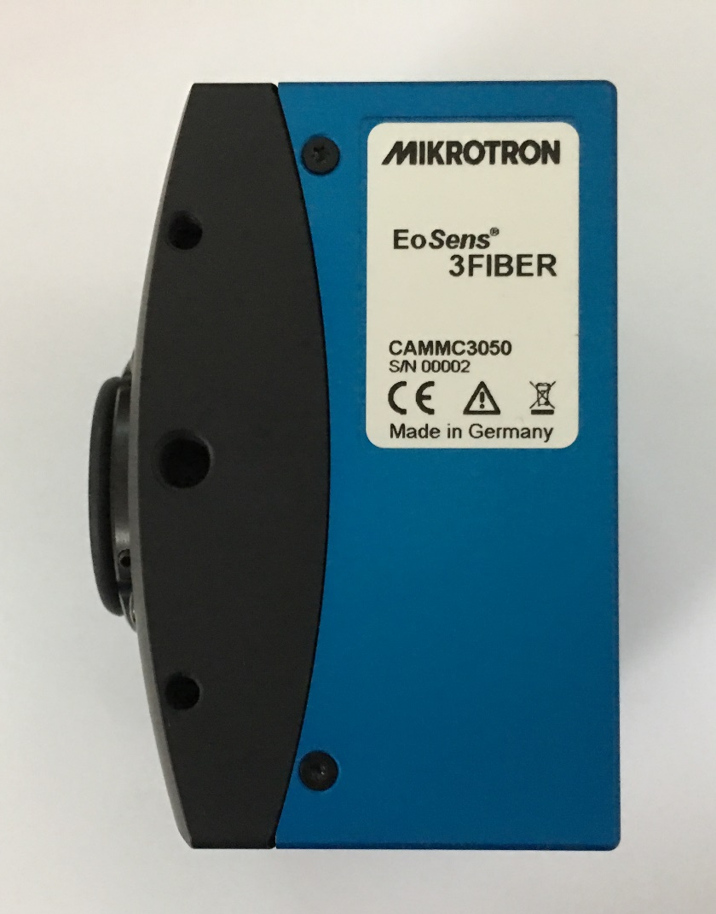
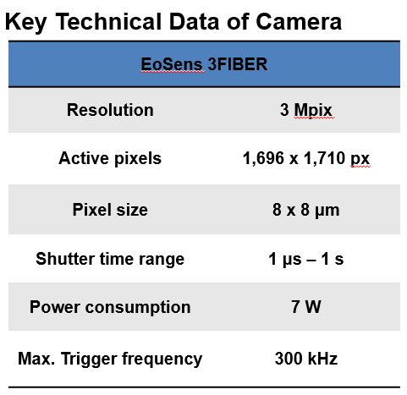
Architectures of IAPS: Hardware and Optics
Camera used in IAPS

Slide 13
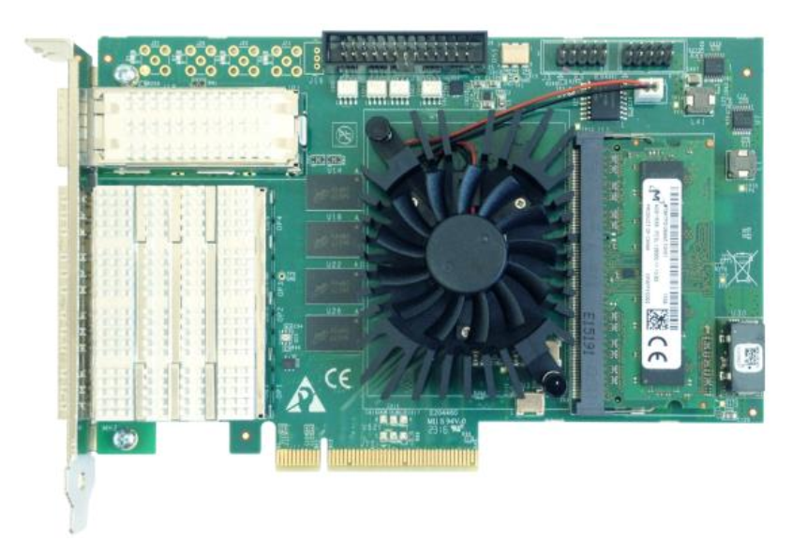
Architectures of IAPS: Hardware and Optics
Frame grabber
1 x QSFP+ channel at 40 Gbps
4 x SFP+ channels at 10 Gbps each
PCIe Gen3 x8 Half-length card
4 TTL configurable I/Os
Transfer Rate of up to 50 Gbps through PCIe

Slide 14
Architectures of IAPS: Software
Every DAQ machine can load 1 or 2 framer grabber cards and the card only connects 1 camera.
More machines can be deployed if need.
Host server provides graphical user interface and manages DAQ machines.
DAQ machine stores image data temporarily.
All data will be stored at database server.

Slide 15
Architectures of IAPS: Software
Architectures of software installed on DAQ machine

Slide 16
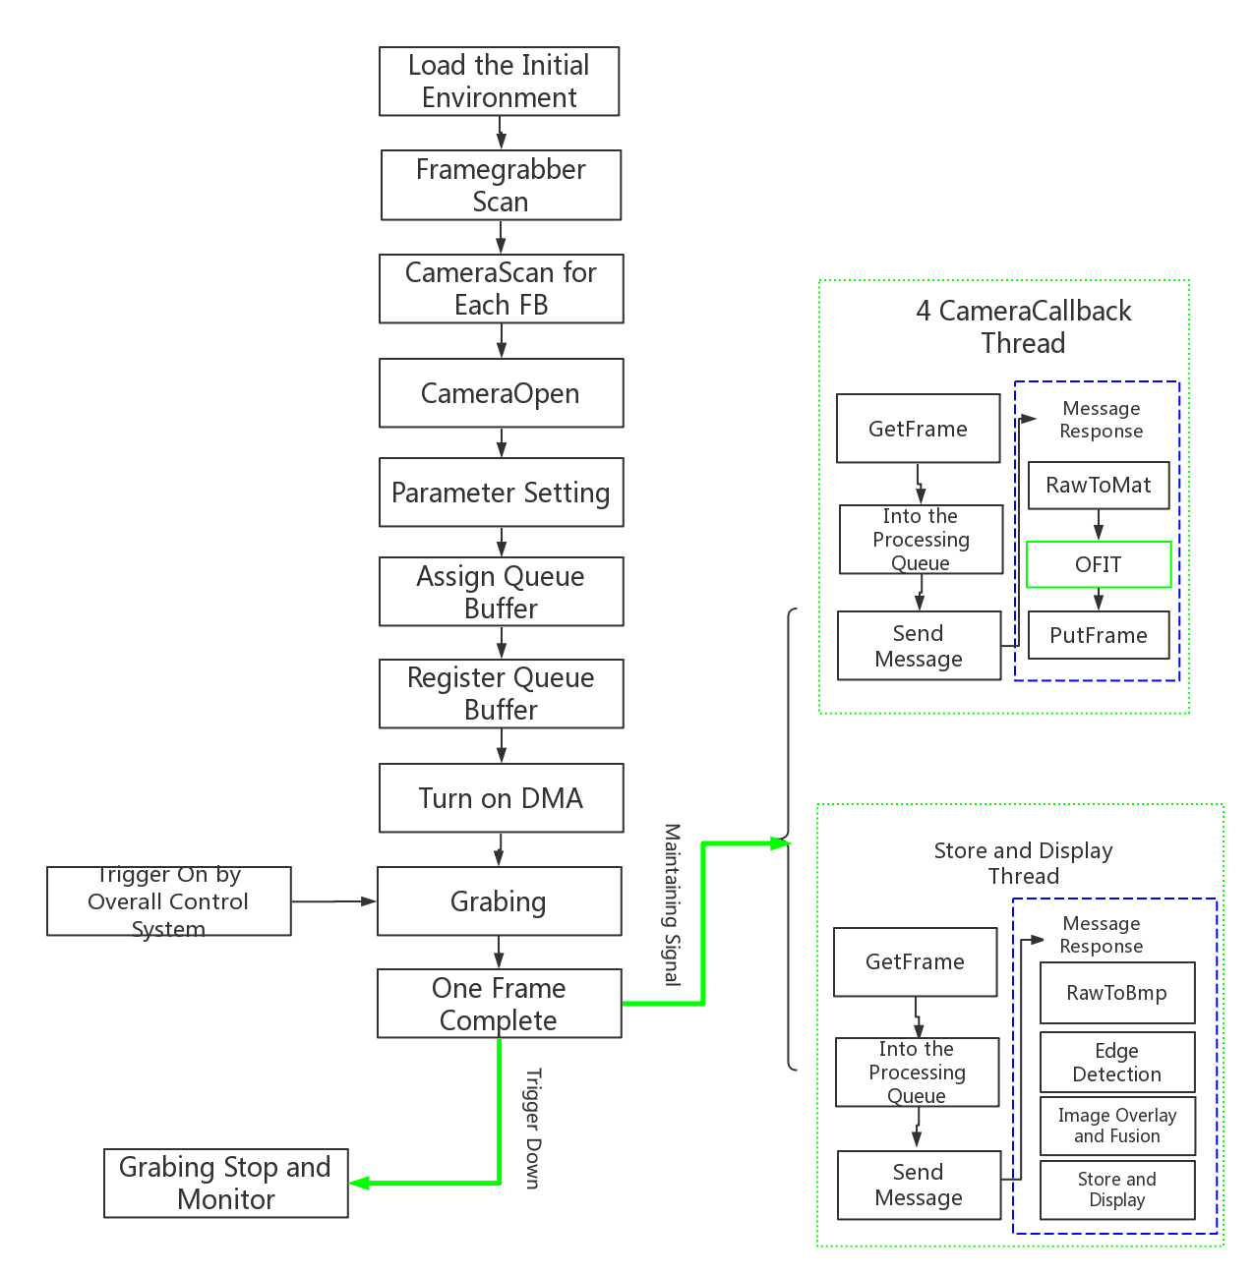
Architectures of IAPS: Software
Acquistion & Processing Module

Slide 17
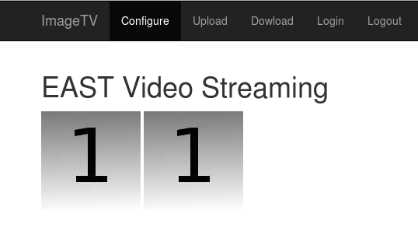
Architectures of IAPS: Software
Graphical User Interface:
Host server connect with DAQ machines through TCP/IP
A web server were built on host server and can receive 16 frames per second from every DAQ machine
A module which named NetCam was used in web server to manage received image data
User can uses the GUI from browser

Slide 18
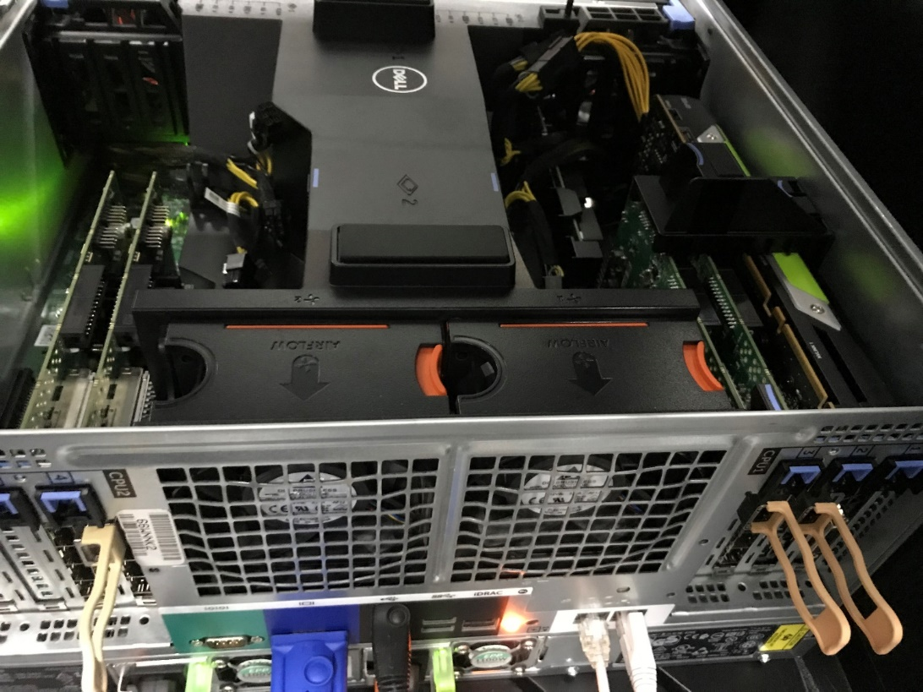
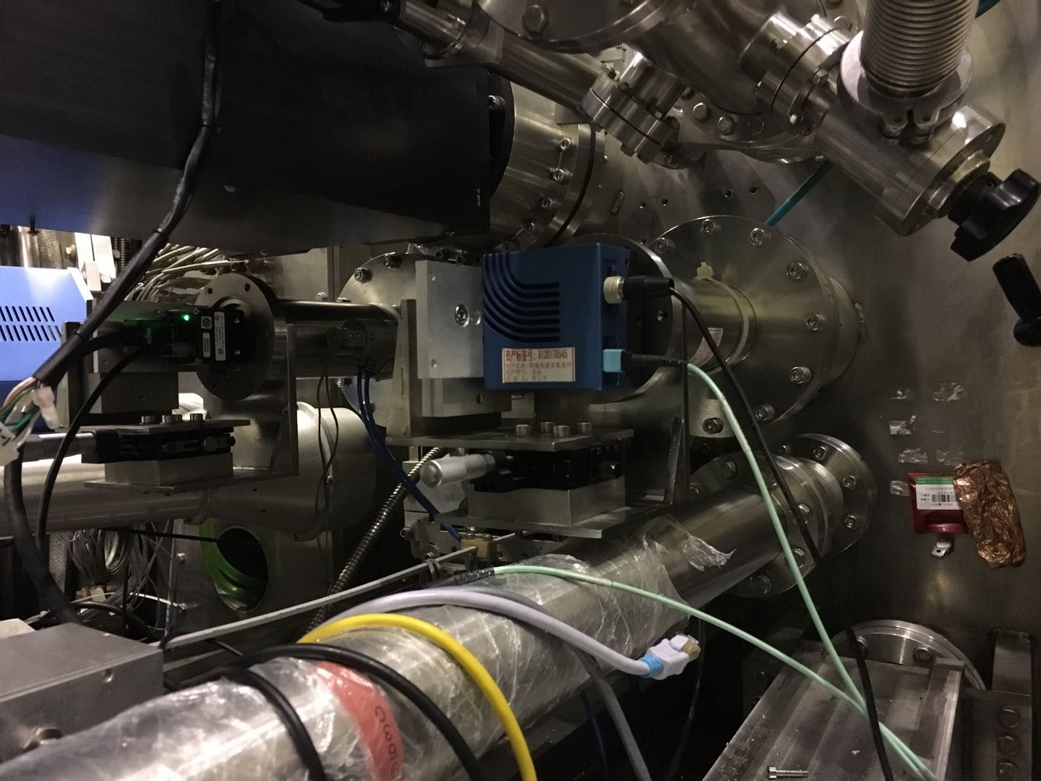
Architectures of IAPS: Hardware and Optics

Slide 19
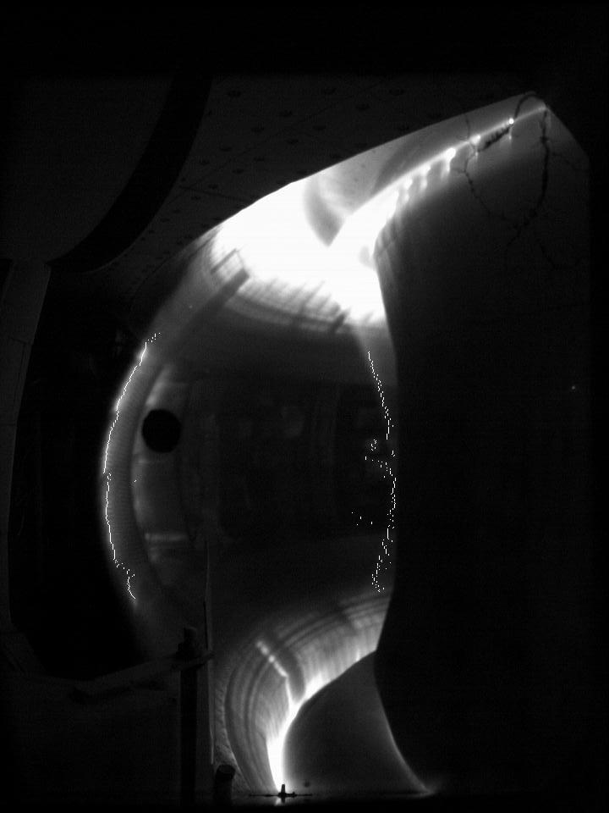
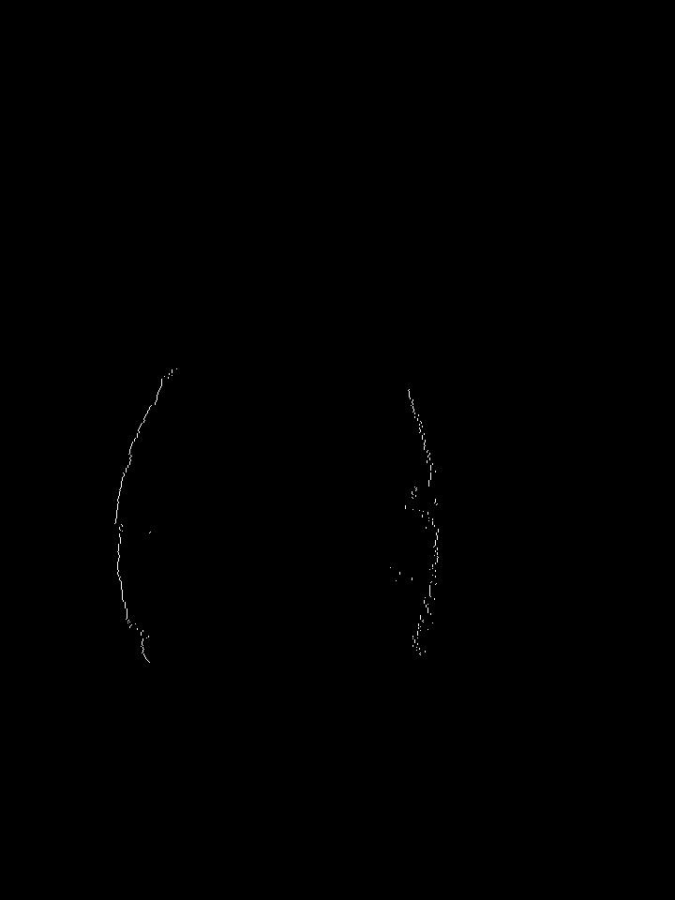
Realtime boundary reconstruction result
Realtime edge detection result EAST # 83807 at 1.40s

Slide 20
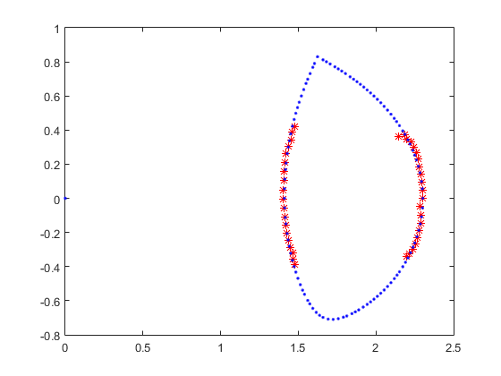
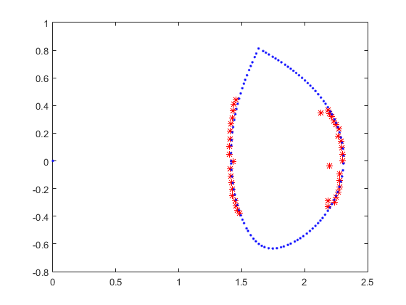
Realtime boundary reconstruction result
Realtime boundary reconstruction result EAST # 83807, result for example at 1.00s and 1.40s. Red is from Realtime Optical reconstruction, blue is from Offline EFIT
Time consuming : including edge detection and boundary reconstruction <100 μs

Slide 21
Conclusion
Through Optics, plasma shape reconstruction can be achieved in real-time
By reducing the number of reconstruction points, the minimum reconstruction time consuming can be less than 60 microseconds
Have potential for faster single point reconstruction, like for VDE
FOV of single optical path is not enough for the whole plasma imaging
The brightness of plasma imaging region varies greatly, and the single optical path can not meet the demand

Slide 22
Thank you for your kind attention!

