Slide 1
Strategy for diagnostics integration into W7-X CoDaC for OP2
Axel Winter, Torsten Bluhm, Hans-Stephan Bosch, Simon Dumke, Heike Laqua, Steffen Pingel, Jörg Schacht, Anett Spring and the W7-X Team

Slide 2
Overview
W7-X – the machine before and after the current upgrade
Challenges for CoDaC
  Upgrades to central systems, interlock and safety
  Integration and upgrades of new diagnostics
    Standardization of Hard- and Software
    Integration of Camera Systems
    Generic Resource Interface (GeRI)
  Upgrades to Central Software Systems
Outlook and Conclusion

Slide 3
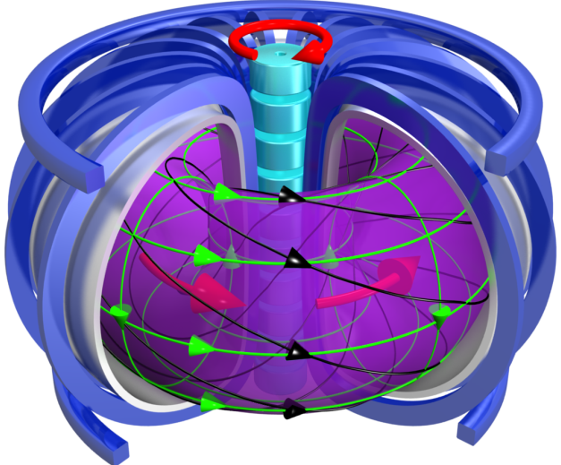
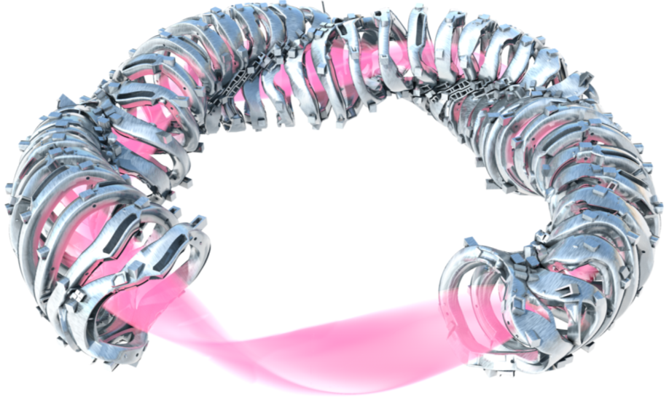
The two magnetic confinement schemes
Tokamak optimized Stellarator
currents in coils and plasma
current in coils only
+ good heat isolation
+ highly symmetric
steady state operation with current drive
active control of instabilities
good heat isolation
quasi-symmetric
+ steady state operation
+ no current-driven instabilities

Slide 4

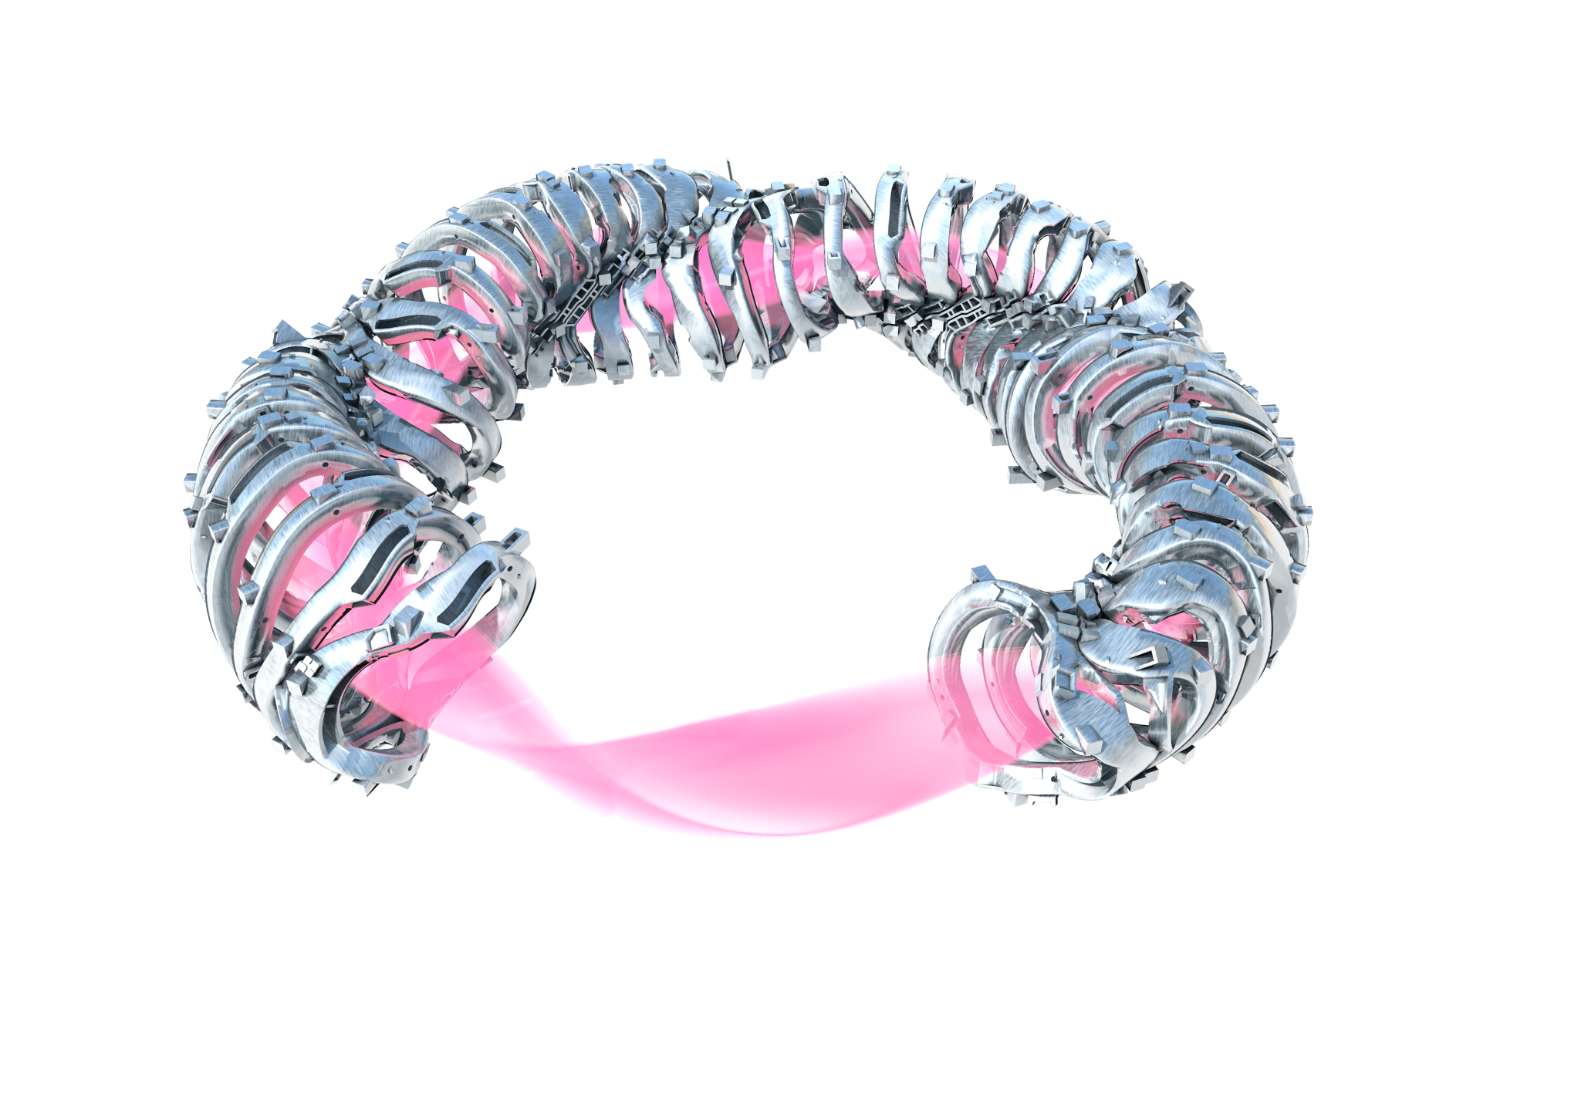
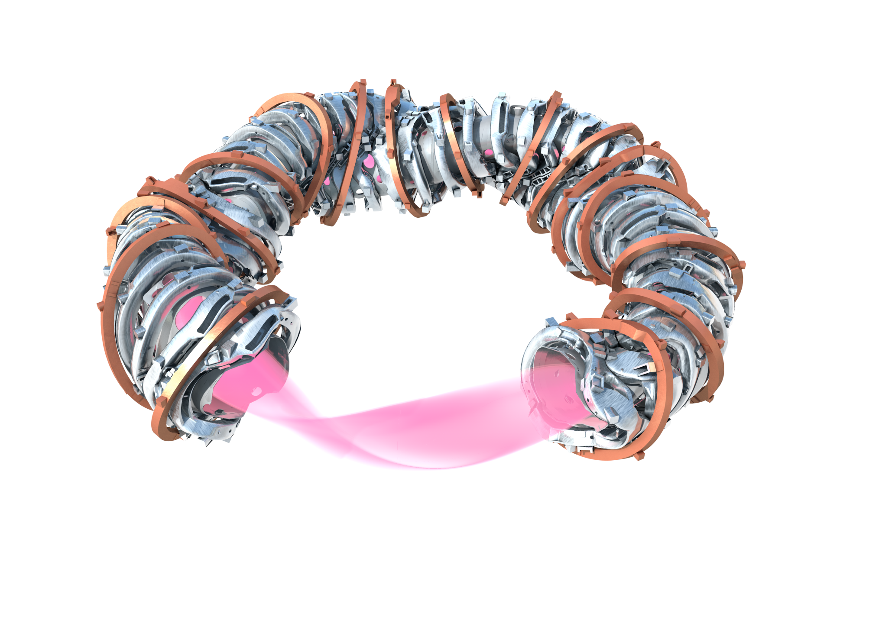
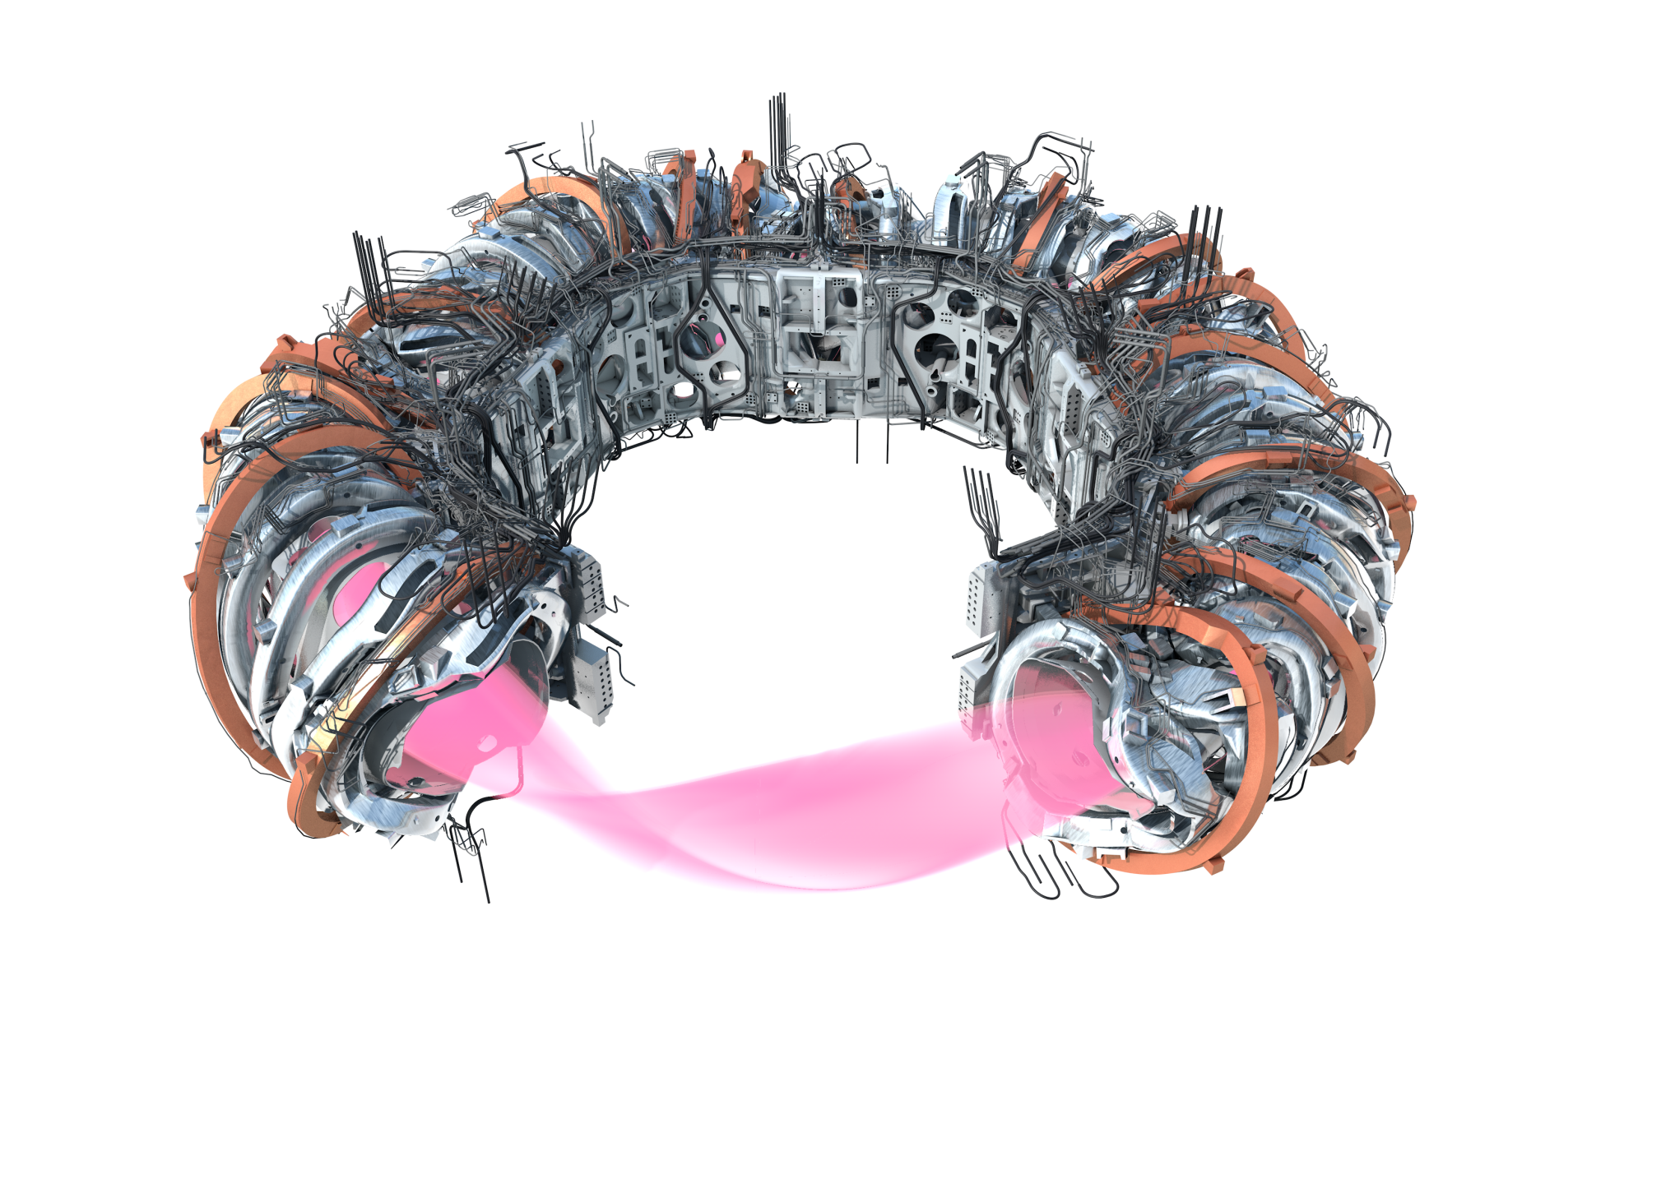
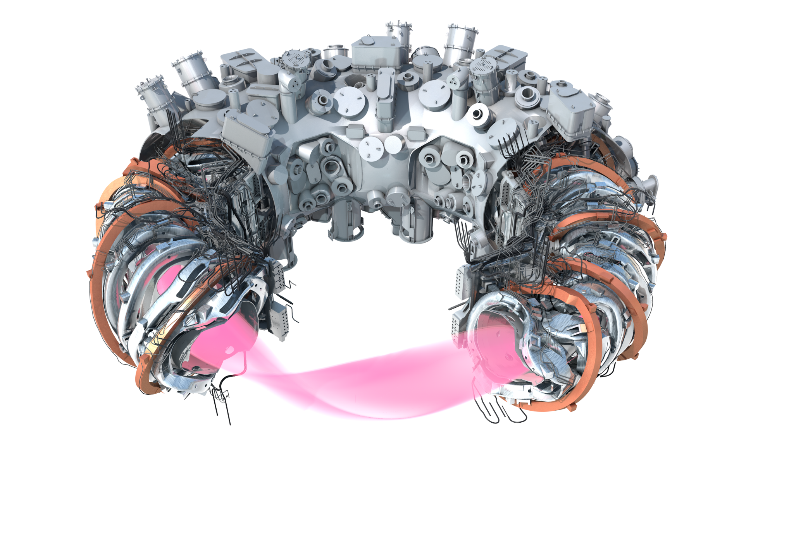
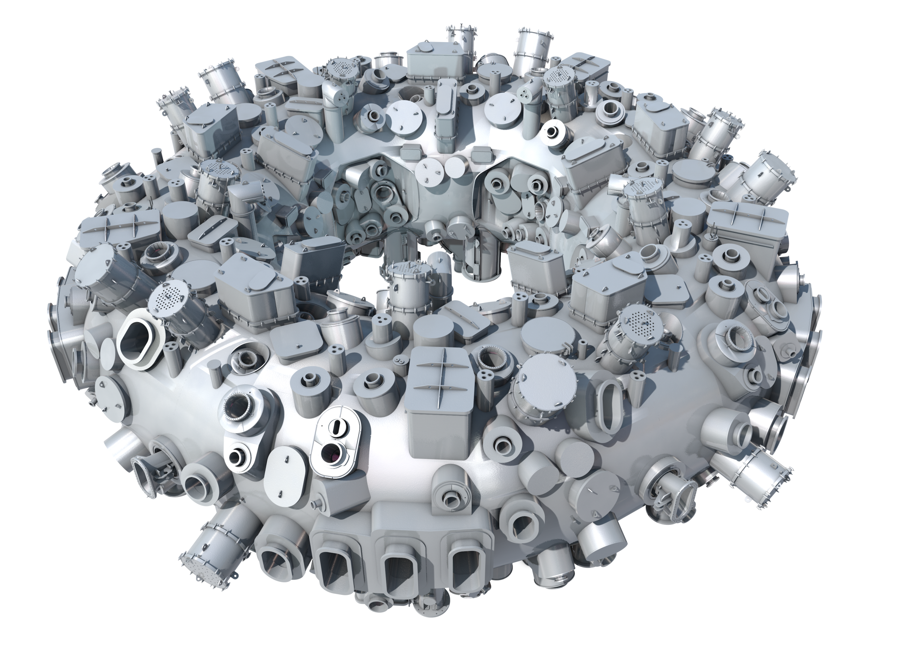
Major elements and parameters of Wendelstein 7-X
50 non-planar NbTi coils
5 types DC <18 kA
plasma 30 m³
20 planar NbTi coils
2 types DC <16 kA
plasma vessel 80 m³
265 m² in-vessel components
254 ports 120 shapes
4.5 m machine height
16 m machine diameter
735 t device mass
435 t cold mass 3.4 K
113 NbTi bus bars
14 HTSC current leads
about 1000 helium pipes
10 central support ring elements
cryostat vessel 420 m³
thermal insulation

Slide 5
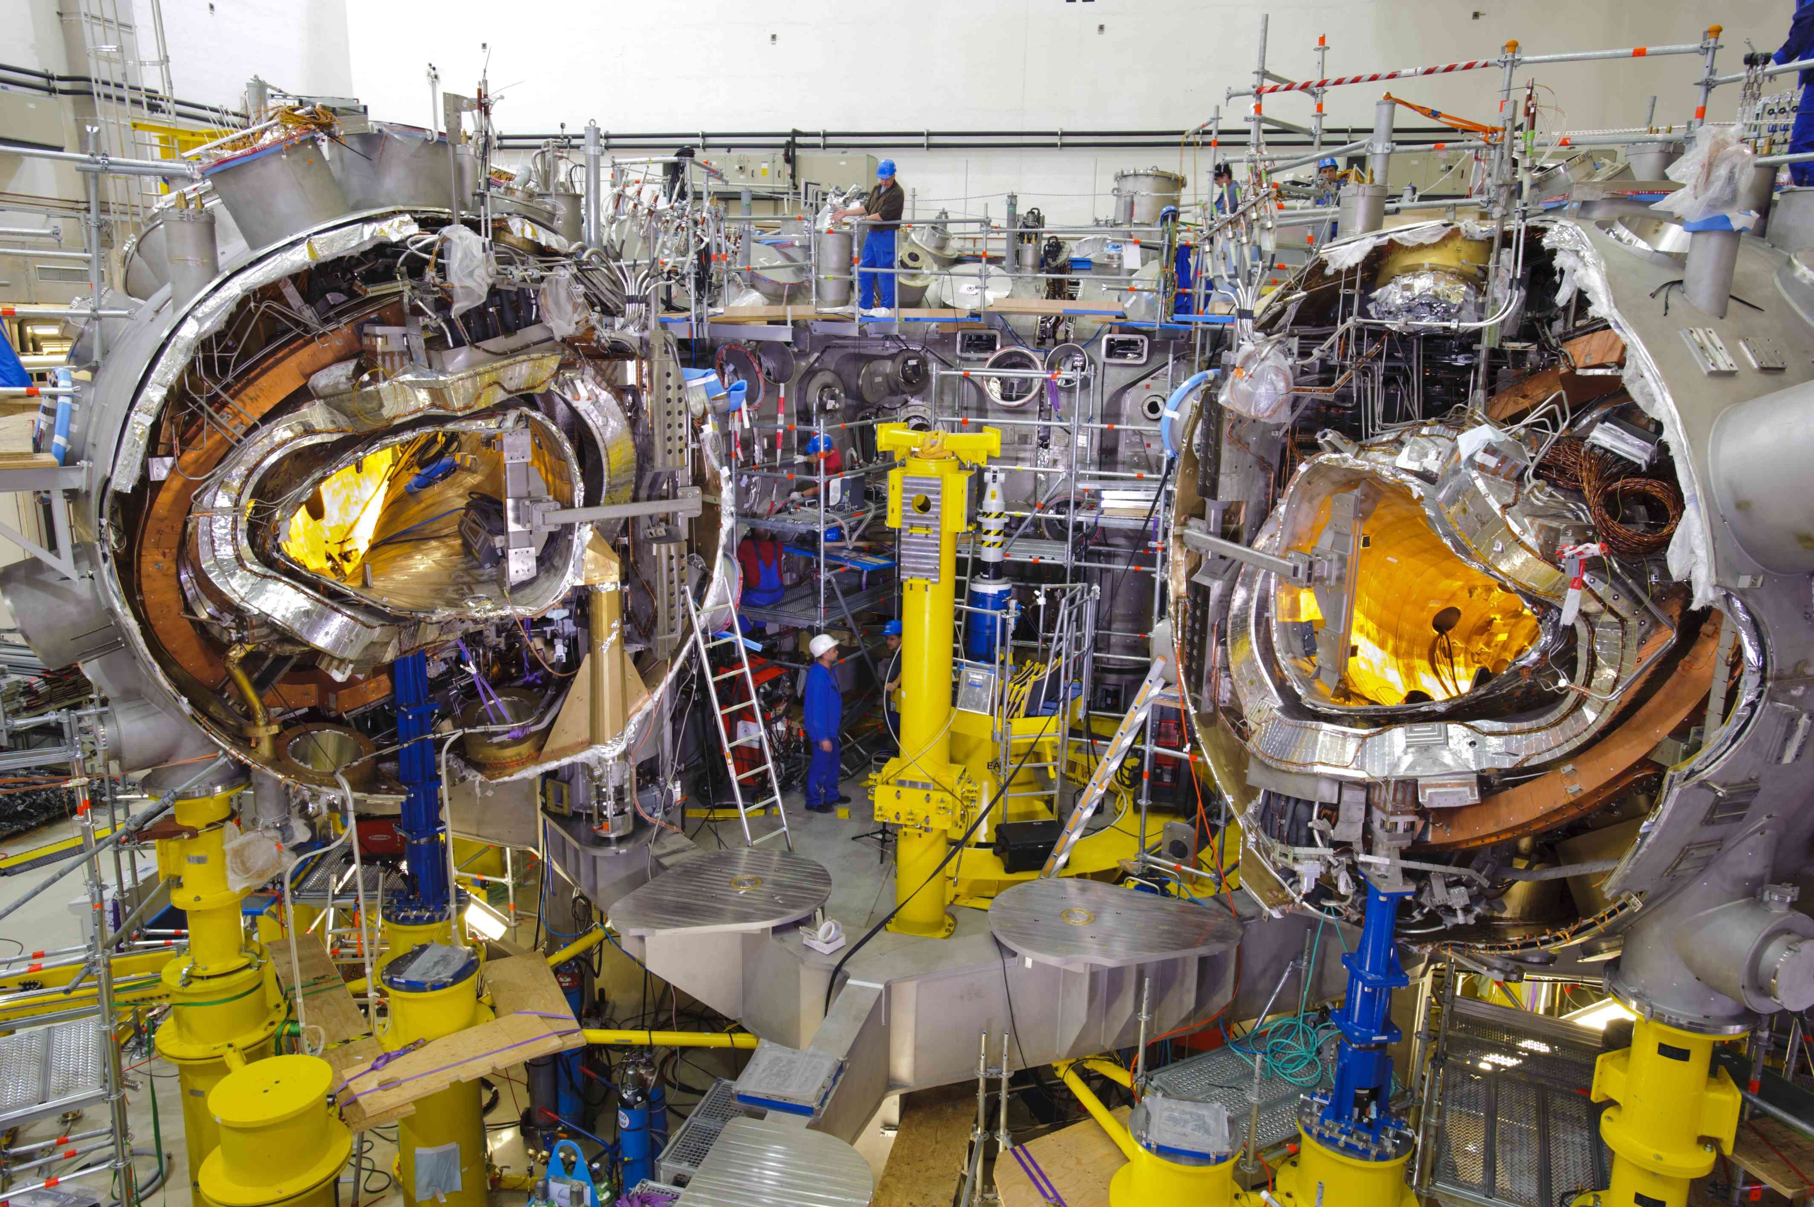
Construction of W7-X, 4/5 modules in the final position

Slide 6
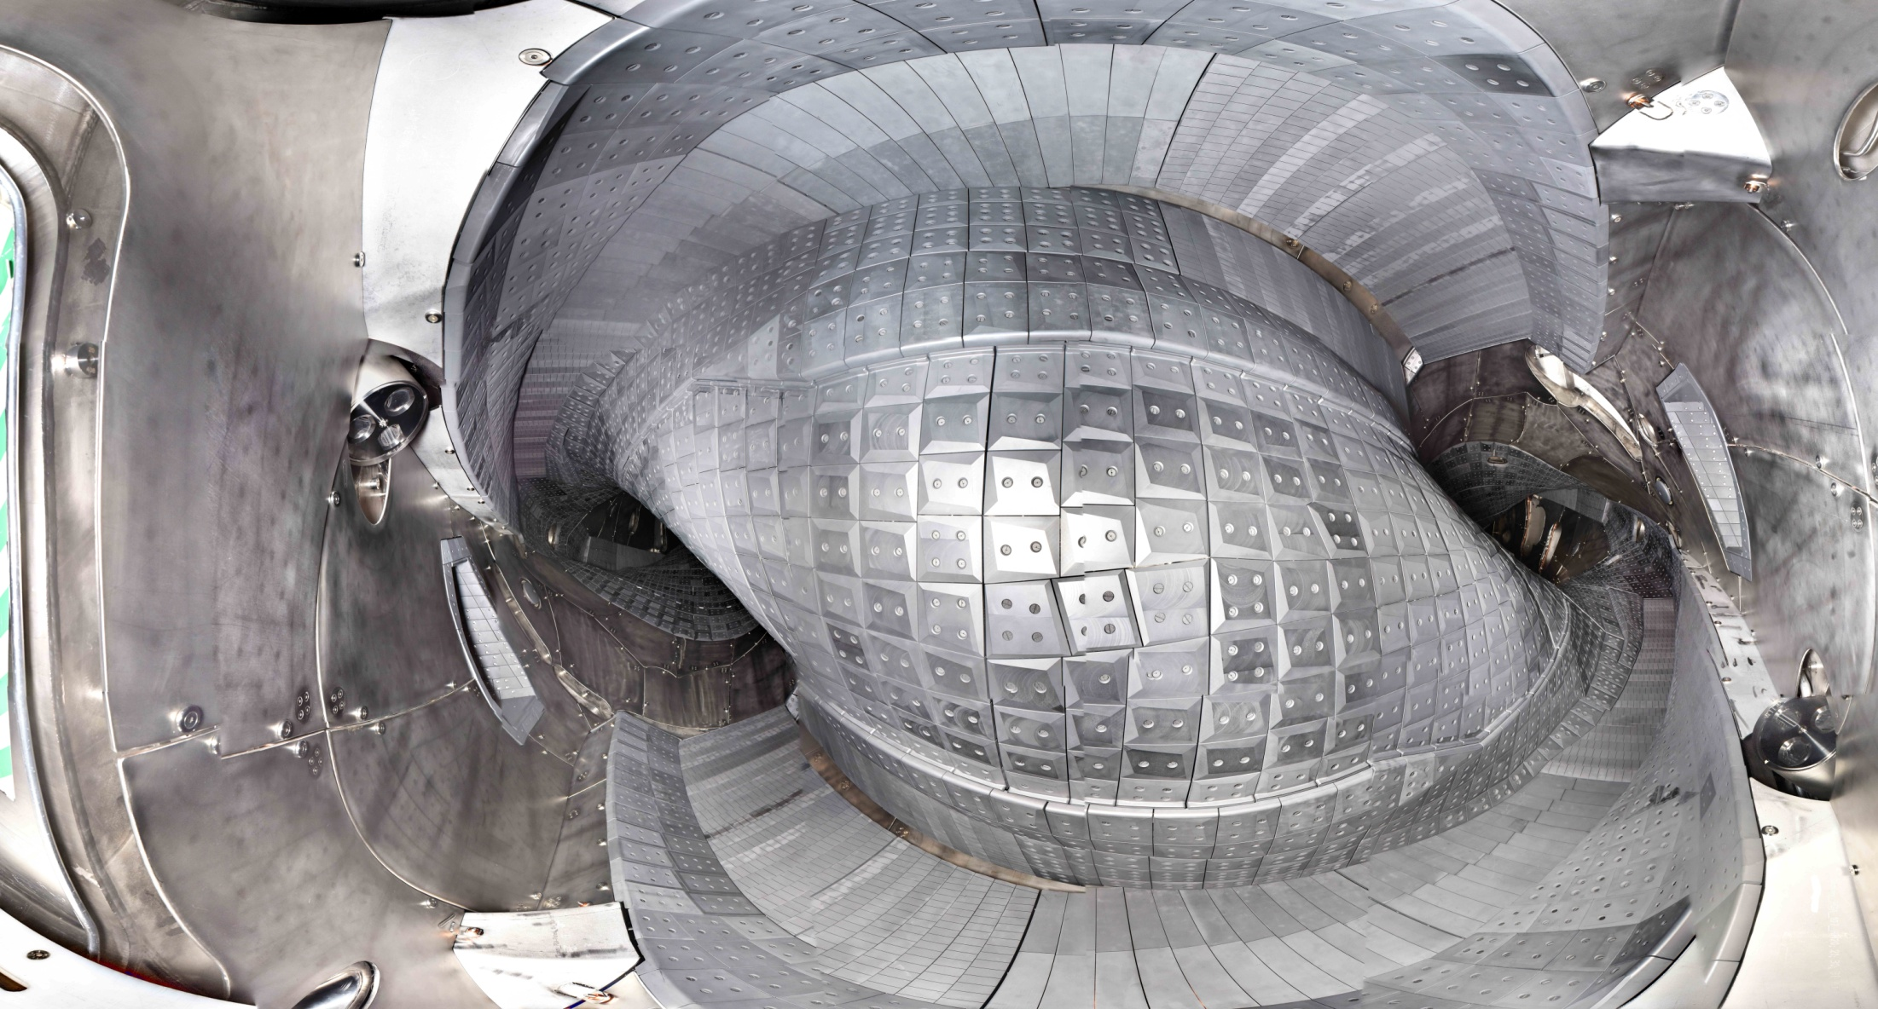
View into the plasma vessel (May 2017, module 2)
© T. Bräuer, IPP

Slide 7
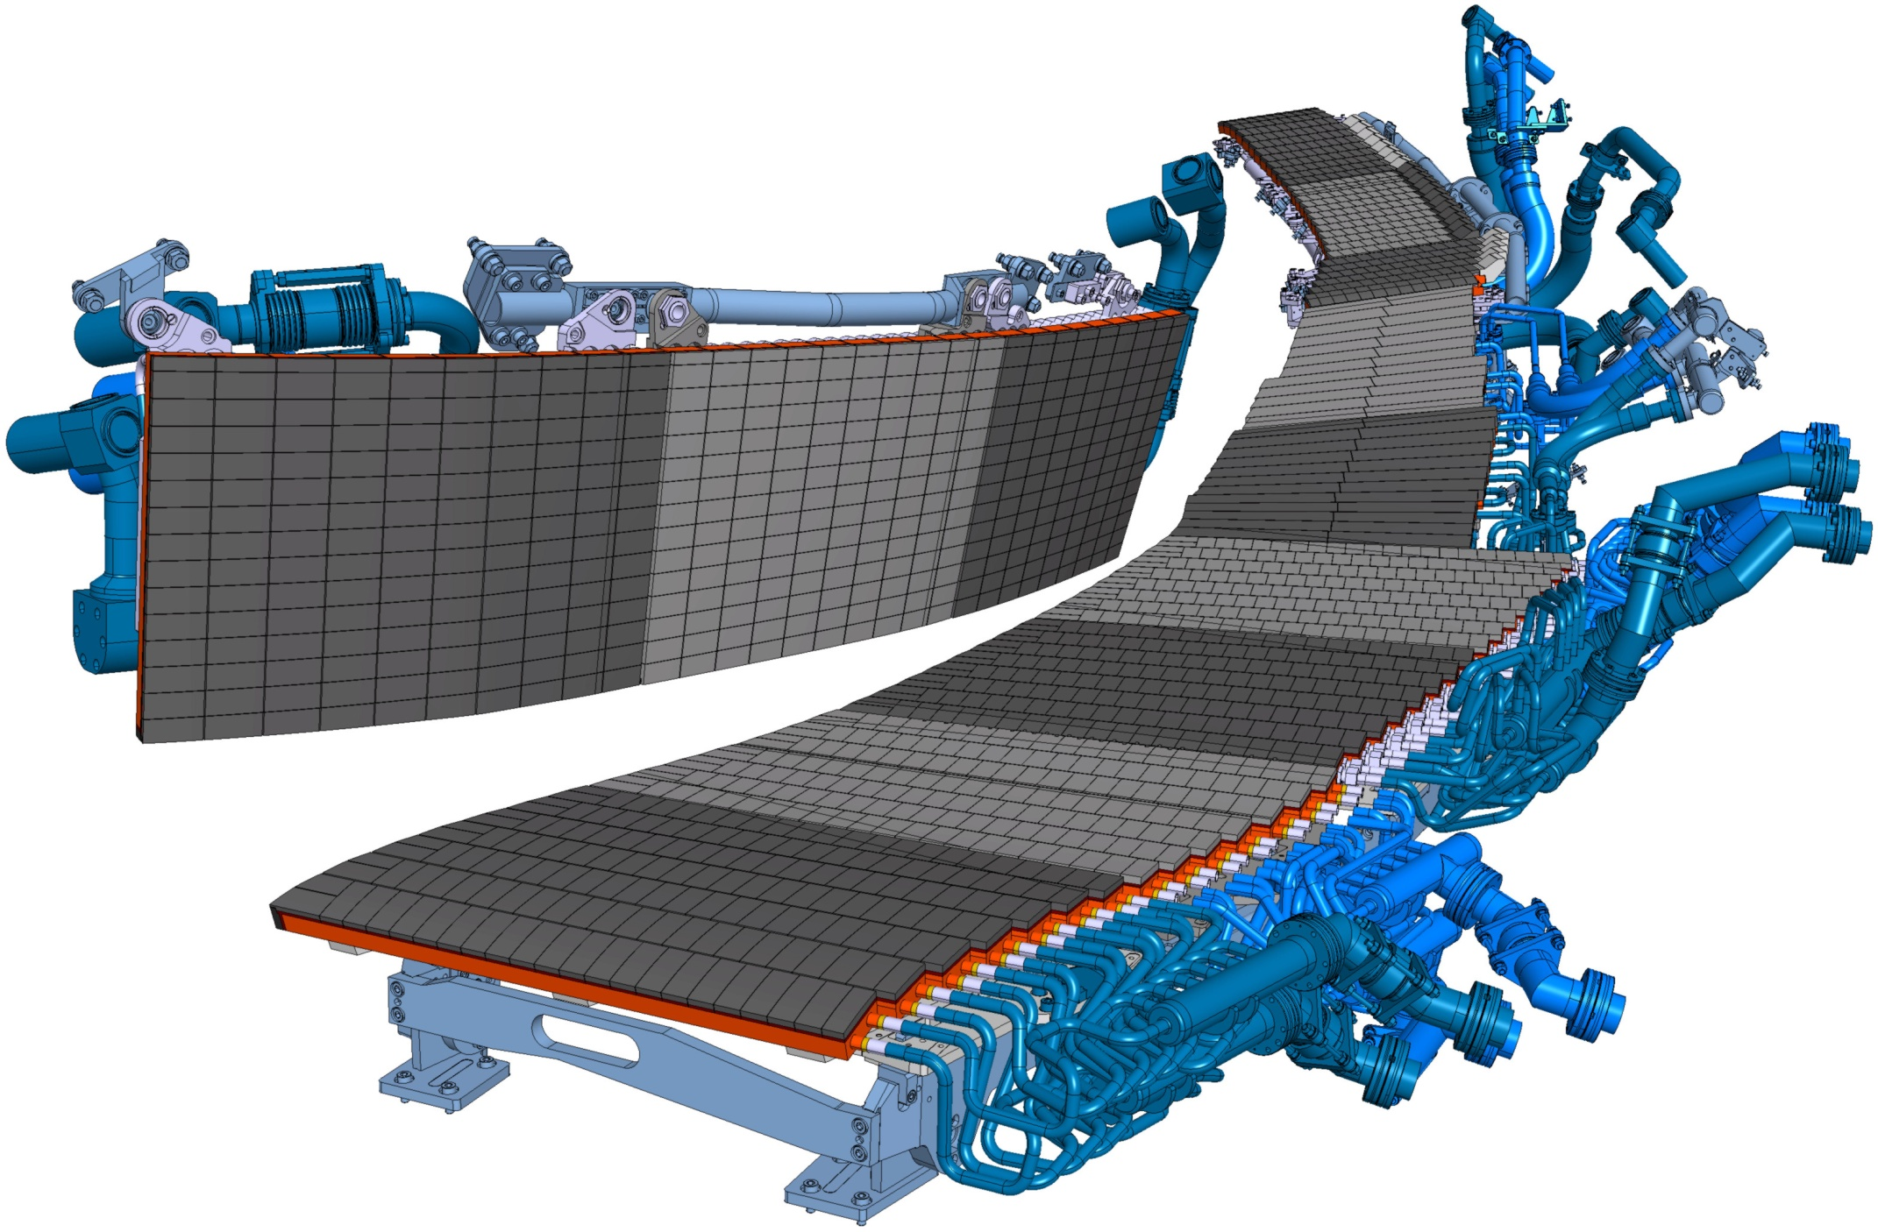
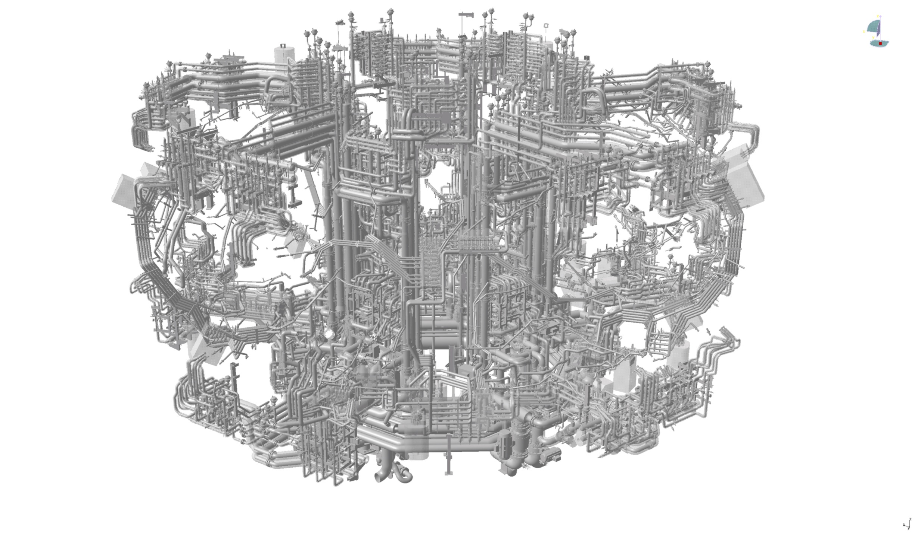
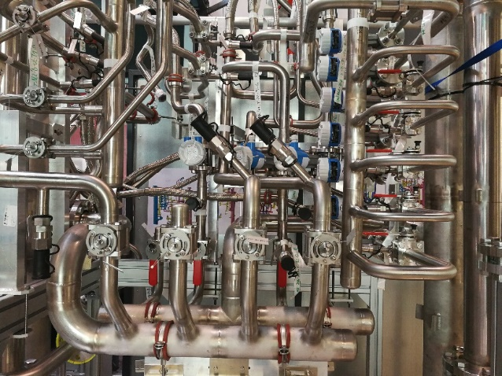
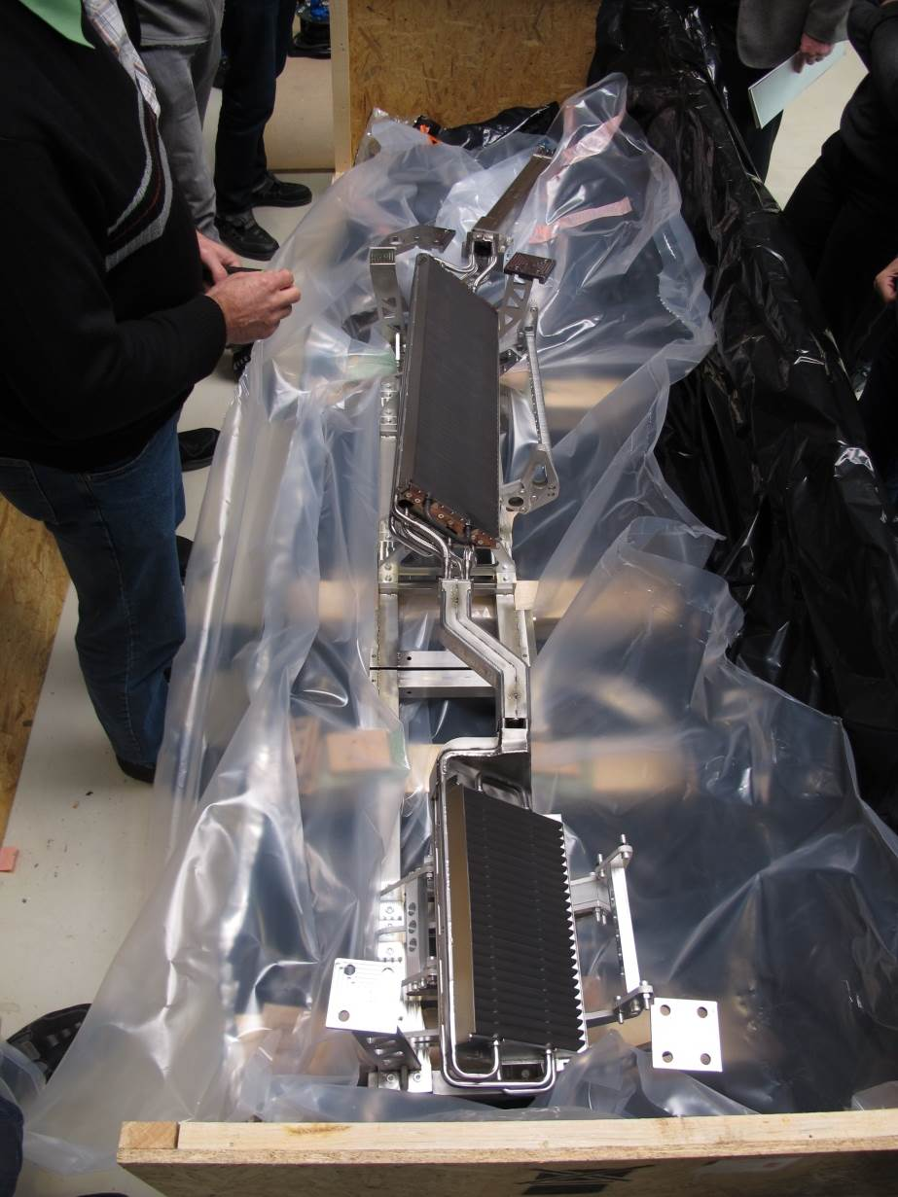
Completion phase 2019-2021
10 HHF Divertors
10 Cryo pumps with LHe
complex cooling water system
pulse length up to 30 min possible
full heating power
10 MW ECRH, steady state
10 MW NBI, for 10 s

Slide 8
Upgrades to Central Systems
Large upgrade of the Central Safety System (→ poster P/3-3)
  W7-X Safety system covers machine and personnel safety/protection
  Implementation of lessons learned from OP 1.2a/b
  Integration of new systems, e.g. ICRH, NBI
  Preparation for D₂-Operation
  Status: New version of Safety Requirements Specification released May 2019, design and implementation starting now
Upgrade of Fast Interlock System (→ poster P/3-4)
  Actively cooled components require additional complex protection schemes (hot spot detection, etc.)
  Functions for new components and diagnostics need to be implemented
  Pontential switch of technology may be necessary to accomodate requirements

Slide 9
W7-X CoDaC Hardware Catalog
Standardization is crucial for efficient integration and maintainability
10 completely new and around 12 upgraded diagnostics need to be integegrated plus full ICRH and cryopumps
PLC-based systems have been standardized for a long time to Siemens PLCs and PCS7 as development environment
CoDaC developed DAQ hardware catalog of supported components to encourage coherent design decisions
  Standard Industry PCs centrally managed and supplied
  ADC cards covering ranges from Hz-GHz available as PLC periphery (low range) or AMC/PXIe form factor for higher frequencies
  General strategy for fully supported diagnostics is µTCA.4 but complementary NI DAQ Hardware is also supported
  AMC Framegrabber for Camera Link and Camera Link HS standards (plus a few legacy cameras) which we intend to deploy for all new/upgraded camera systems at W7-X
  High channel count ATCA DAQ system for magnetics (developed in collaboration with IST)

Slide 10
Camera Integration
Challenges in design of imaging systems for plasma diagnostics
  Plasma diagnostics - monitor plasma temperature, density, radiative properties, divertor/first-wall protection
  Dozens of cameras
  1-8 Mpx @ 50-50k FPS
  Throughput can easily exceed 8 Gb/s per camera
  Scalability and high reliability
  good synchronization accuracy
Call for a highly versatile solution:
  Identical framegrabber hard- and software for all cameras
  Cost-effective, scalable solution
  Good abstraction from camera interface with one software API for all cameras to facilitate integration
  Collaboration with Lodz University, based on their prototype work for ITER

Slide 11
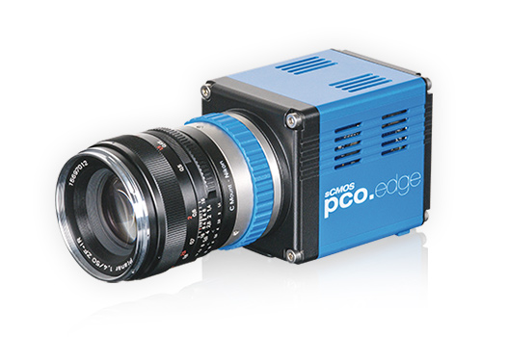
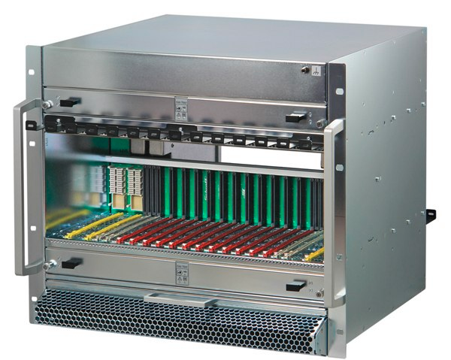
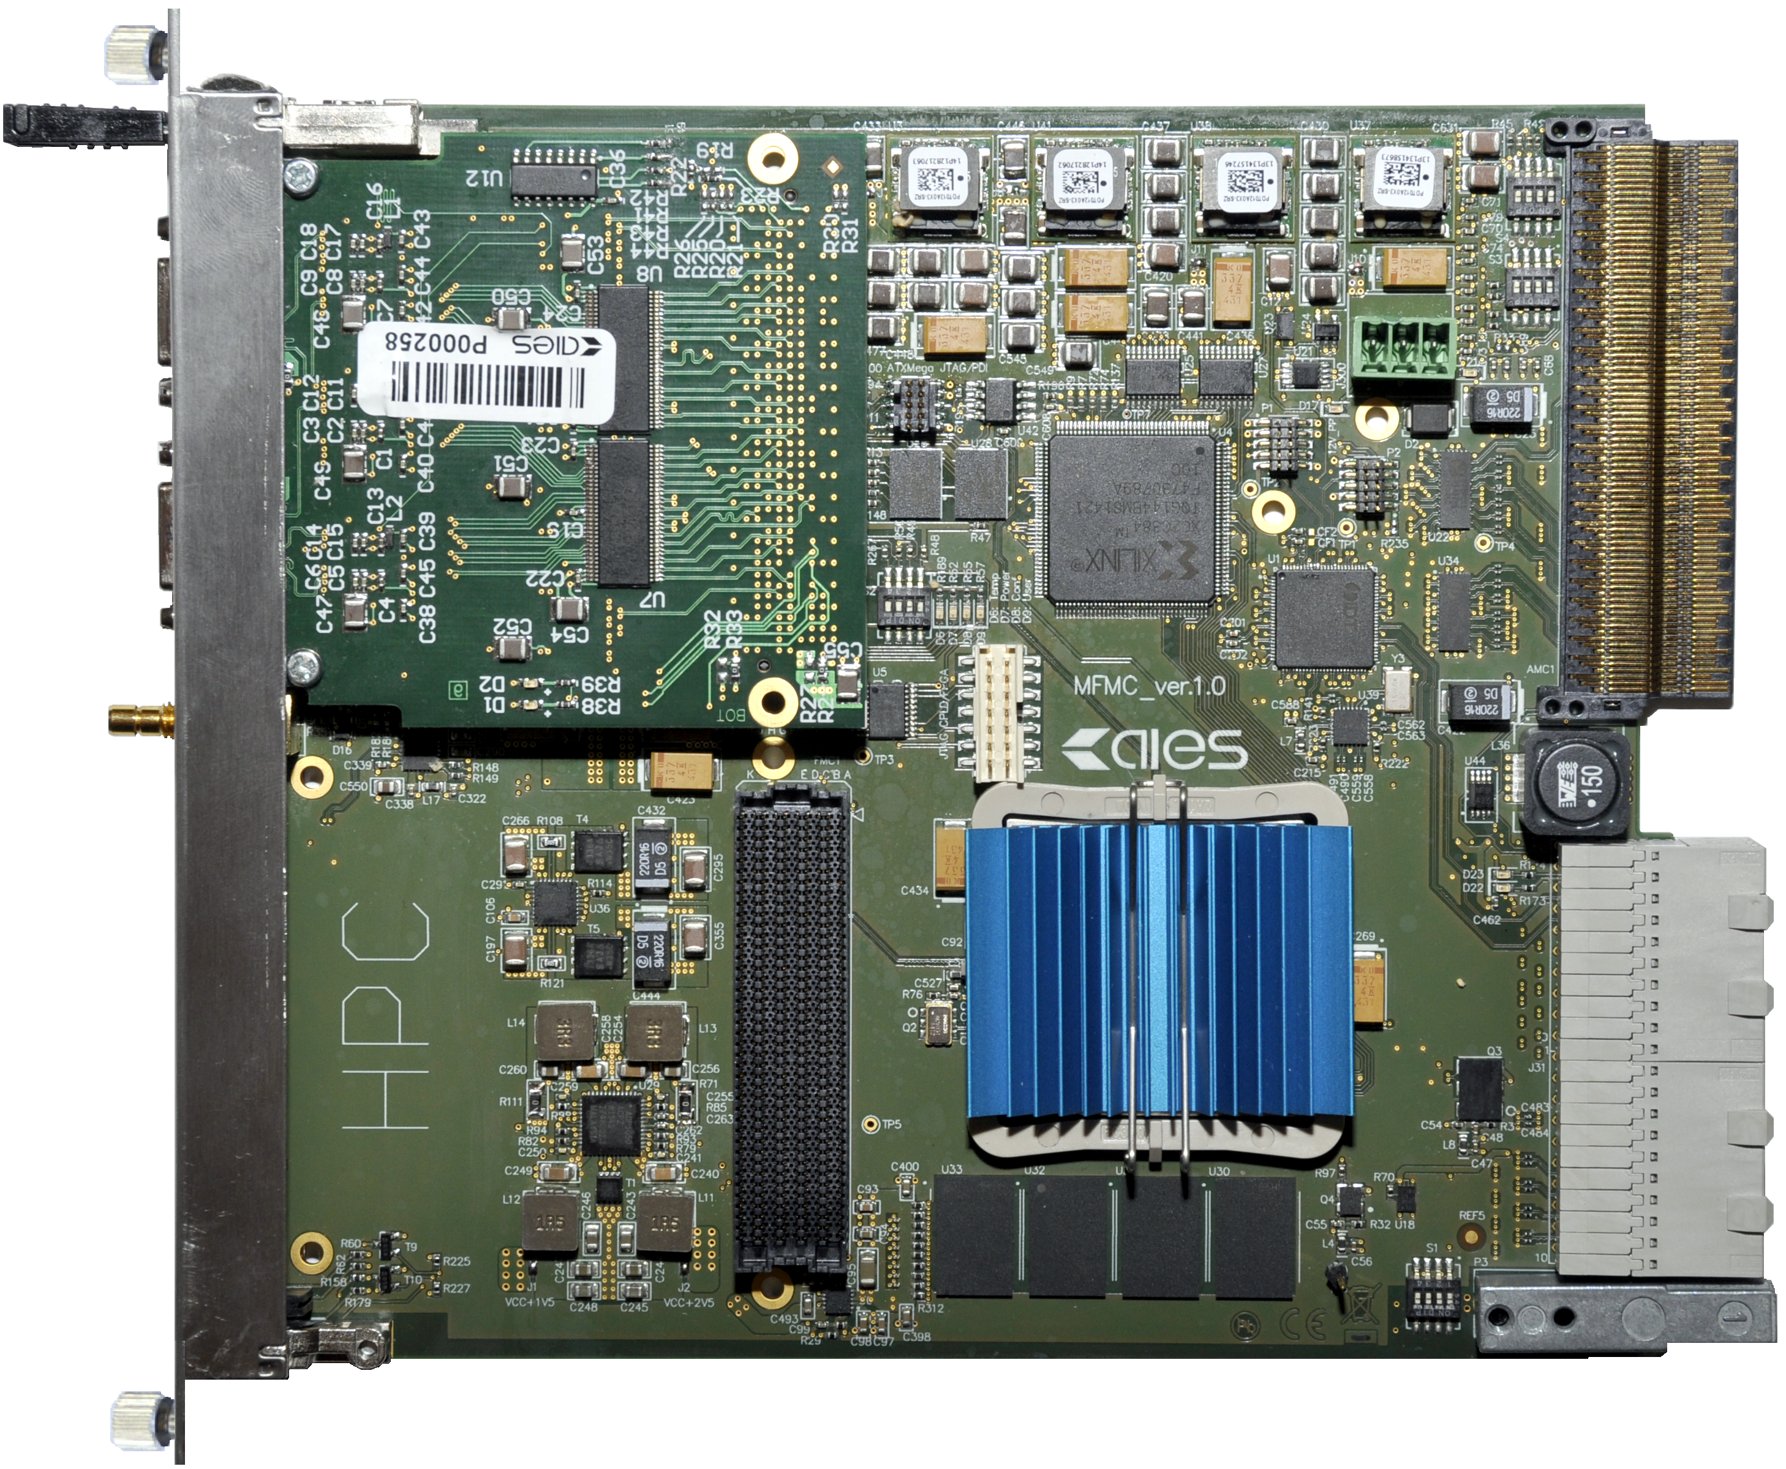
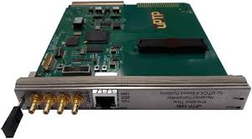
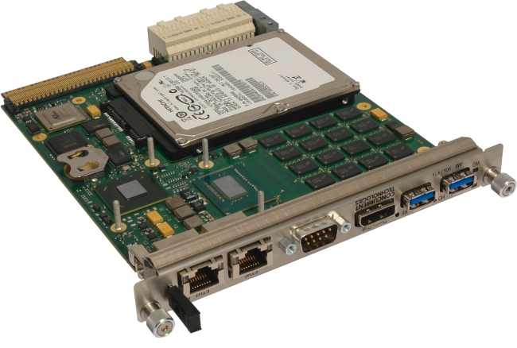
Highly generic interface required
Image Acquisition and Processing with MTCA.4 – Initial Solution
Micro Telecommunication Computing Architecture:
High RAMI (Reliability, Availability, Maintainability and Inspectability)
Extensions for precision timing and synchronization
Intelligent Platform Management
Good price to performance ratio
Additional PCIe extender enables use of standard PC with higher throughput
8-32 Gbps
MTCA.4 12-slot
Chassis
32 Gbps
Frame
Grabber
32 Gbps
32 Gbps
Courtesy D. Mankowski, DMCS Univ. Lodz
Timing module
CPU

Slide 12
MFG4 - Frame Grabber Card for MTCA.4
Cost-effective solution for high-performance image acquisition systems
Designed as FMC carrier module (HPC and LPC) with FMC extension modules:
  Camera Link (Base, Full, Ext-Full), CoaXPress
  (Camera Link HS, IEEE1394, GigEVision)
  Universal IO module
  Firmware support for selected protocols
Provides all resources for data acquisition and control systems (FPGA processing power, SDRAM, clocks distribution, trigger and interlock signals)
Based on Xilinx Artix 7 (XC7A200T) FPGA
RTM Zone 3 connector (D1.2 Digital Class)
Courtesy D. Mankowski, DMCS Univ. Lodz

Slide 13
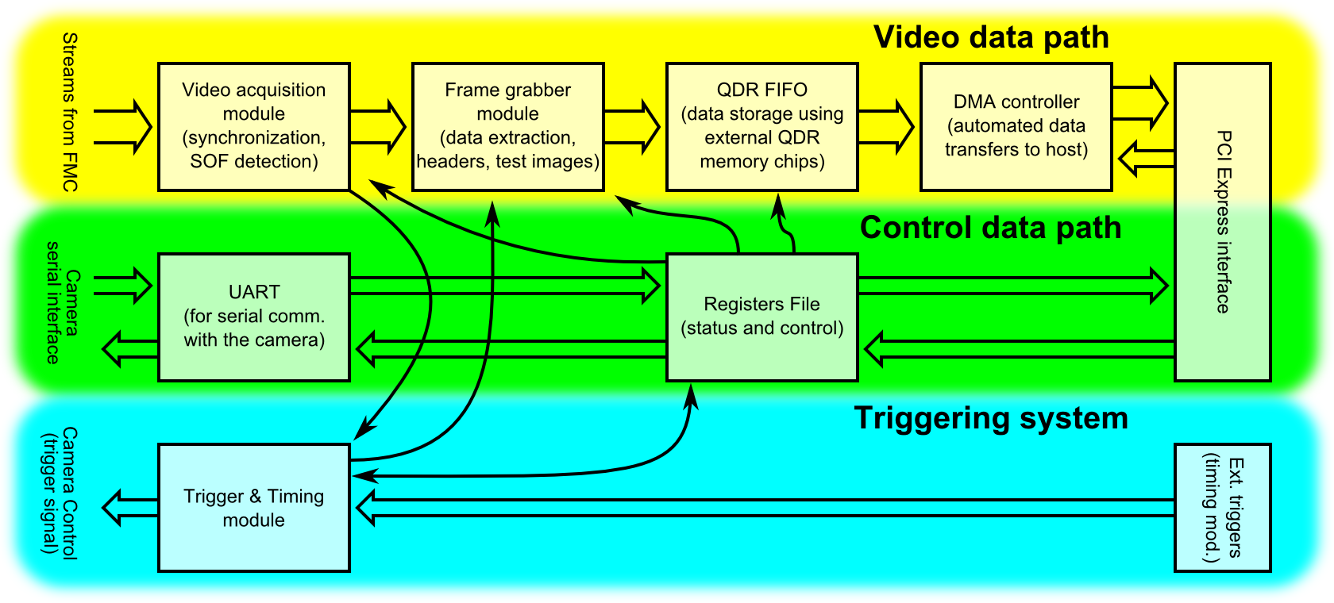
Image Acquisition System - Firmware
Three paths for image, camera control and triggering
Allows acquiring image from CL camera
Powerful DMA over PCIe
AXI Stream interface to CL receiver
Image Acquisition and Processing Firmware
Courtesy D. Mankowski, DMCS Univ. Lodz

Slide 14
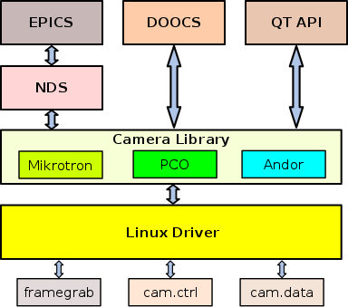
Image Acquisition System - Software
API for EPICS, DOOCS and QT and W7-X CoDaC
Library for a number of cameras, e.g.:
  Microtron
  PCO
  Andor
will be extended to all standard W7-X cameras
Available nodes:
  Frame Grabber, Camera control, Camera image
Linux driver with planned support for GPUDirect
HMI panels in QT
Result: identical API for all supported cameras with little additional effort for new camera (small camera library to translate control commands)
Courtesy D. Mankowski, DMCS Univ. Lodz

Slide 15
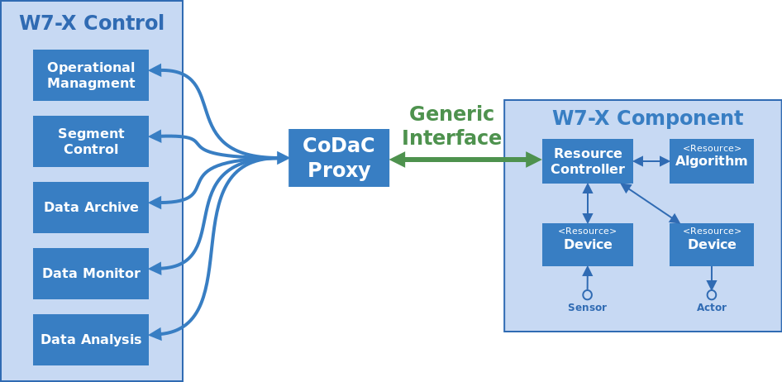
Generic Resource Interface: Concept
Generic software interface for simple integration of components
Key features
  Abstraction from W7-X CoDaC central system to allow „integration light“ of external components (e.g. MDS+-based) through well-defined interface
  Interfaces to archive, segment control and operational management
    Setting / retrieval of property values, Report of status information and event error handling,
    Data exchange using different Codecs

Slide 16
Generic Resource Interface: Status
Specification & Implementation of version 1 released
First Implementation: XMCTS Diagnostic
  Based on D-TACQ hardware and MDS+
  96 channels
  Data rate: approx. 3 Mbit/s
Future Work:
  Performance Improvements
  Enhanced Support for Signal Meta Information
  (Input Ranges, Scaling Parameters, …)
  Combined time measurements using relative timing information of DAQ device and absolute start timestamp from TTE modules
  Expect most/all MDS+-based diagnostics to be integrated by beginning of OP2 using GeRI and fully integrated over time

Slide 17
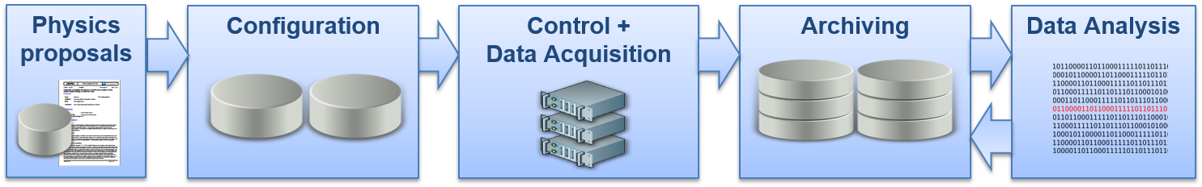
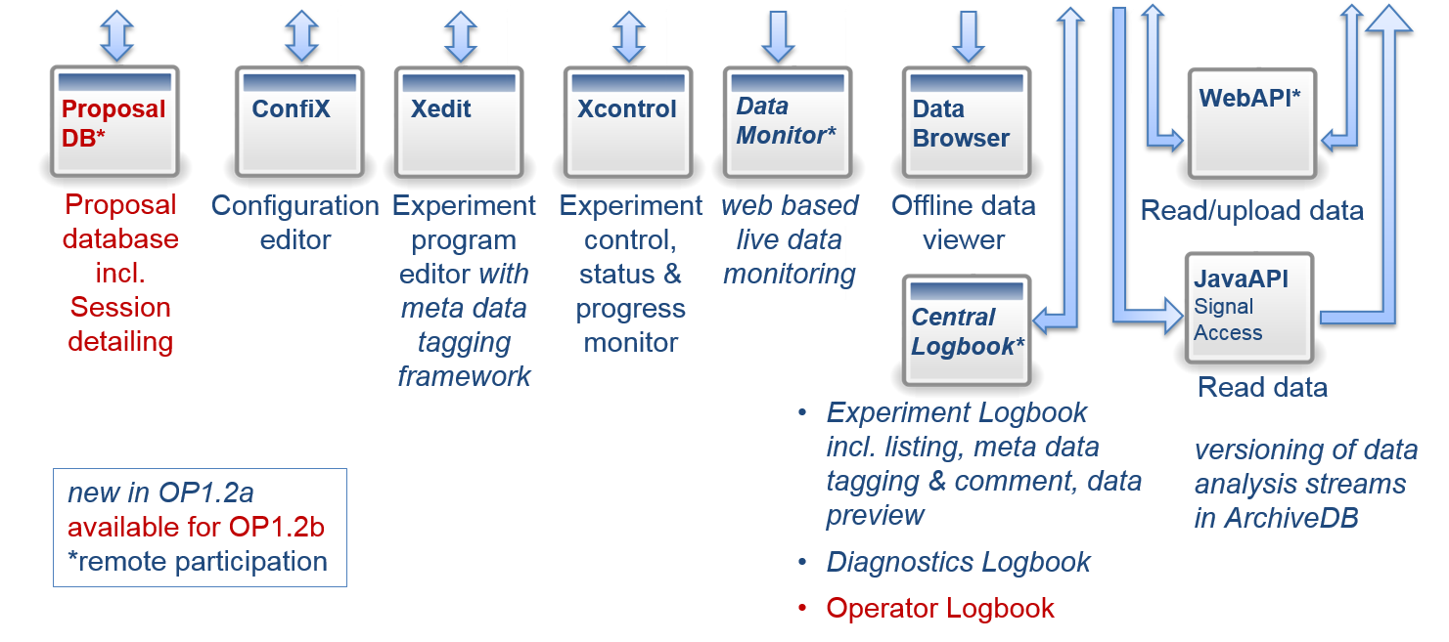
CoDaC Software Tool Chain
Integrated application tool chain:

Slide 18
Upgrades to central software
Real-time systems
  Migration from VxWorks to Real-time Linux – currently ongoing
  Requirements for enhanced feedback algorithms are coming in
  Real-time protection for divertor is large work package
Archive/Logbook
  Performance enhancements
  Extension of API to better cater to video data
  Lossless compression algorithms
  Logbook API improvements for experiment metadata (→ Poster P/3-8)
General performance improvements for all components (especially experiment configuration, databases, physics web services)
Useability improvements based on lessons learned from OP 1.2a/b

Slide 19
Outlook and Conclusion
The CoDaC group at W7-X has a number of challenges ahead before the next operation phase in 2021.
Major upgrades to practically all central systems
Implementation of several new diagnotics and the integration of a number of upgraded exisiting systems
Efforts to standardize the hardware and software portfolio are well underway and will allow to achieve the goals with the given resource profile
A new standard for camera systems will be implemented
We are on track towards achieving an environment for OP2 where most/all diagnostics are integrated into W7-X CoDaC (either via GeRI or natively).

