Slide 1
Design and Development of a Cost Optimized Timing System for Steady State Superconducting Tokamak (SST-1)
J. DHONGDE, A. Kumar, D. Raju & SST-1 Operations Division
Institute for Plasma Research,
Gandhinagar
India
Acknowledgements
Praveena Kumari & Rachana Rajpal, Front End Electronics Division (Resources for prototype development)
Kirit Vasava & Drafting section ( For design of 1U Rack mountable enclosures)
Vijaykumar Patel & Workshop division ( For fabrication of 1U Rack mountable enclosures)
Hitesh Chudasma, Atish Sharma, Kirti Mahajan & Data Acqusition – Control Division (For testing and validation)
Institute for Plasma Research
ID - 443
13 May 2019
The 12th IAEA Technical Meeting on Control, Data Acquisition and Remote Participation for Fusion Research (CODAC 2019), Daejeon, Republic of Korea

Slide 2
SST-1 sub systems
TF Power
Supply
RCC Power
Supply
ECRH
LHCD
Cryogenics
Magnet
Ohmic
Power
Supply
Vacuum
Central
Control
Room
SST-1
~ 256 m
ICRH
Plasma
Control
System
DAQ
Systems-1
DAQ
Systems-2
Spatially distributed & Heterogeneous Platform systems
#Not actual scale (for visualization only)

Slide 3
SST-1 sub systems – with Timing System interface
TF Power
Supply
RCC Power
Supply
t= -500ms
t= -50ms
ECRH
t= 150ms
LHCD
Magnet
Cryogenics
Ohmic
Power
Supply
Vacuum
SST-1
Central
Control
Room
t= 0ms
t= -2441ms
~ 256 m
ICRH
DAQ
Systems-2
Plasma
Control
System
t= 50ms
DAQ
Systems-1
t= 0ms
t= 0ms
t= 0ms
Clock =
10kHz,
100kHz
1MHz, 10MHz
Clock =
10kHz,
100kHz
1MHz, 10MHz
All trigger timings are configurable for all Timing system modules

Slide 4
SST-1 old Timing System
Based on VME Platform ( ~ 15Years). Custom VME Timing System cards were in house designed and developed.
Master – Slave configuration connected in star configuration. Optical Network – Multimode, 62.5/125 µm.
Provide fast timing signals (clock & triggers) to various sub systems during plasma discharges
Master VME Node (Central Control Room)
- Broadcast experiment sequence @ minimum resolution of 1µs
- Provide 20MHz Stable OCXO based clock to slave
Record events with 32bit time stamp
Slave VME Node (ECRH, Power Supply etc.)
- Recover & regenerate different clocks (10MHz,1MHz etc.) from 20MHz clock
- Generate different channel outputs
- Provide optically isolated channel inputs
Power
Supply
ECRH
LHCD
Ohmic
Power
Supply
SST
Central
Control
Room
ICRH
DAQ
Systems-2
DAQ
Systems-1
Timing System card inventory got exhausted
Sub system hardware advancement also started ( Systems migrated from VME to PXI, PXIe etc.)
Reference:(1)

Slide 5
New Timing System Requirement
1. Timing System with performance
parameters comparable
to old system
Power
Supply
3. Timing System – provide single interface to heterogeneous platform systems
ECRH
LHCD
VME >> PXIe
Ohmic
Power
Supply
SST
Central
Control
Room
ICRH
DAQ
Systems-2
4. Easy integration
with sub system i.e. minimal modification on hardware as well as on software part at sub system end
2. Timing System which supports existing optical fiber network and star topology
DAQ
Systems-1

Slide 6
SST-1 Timing System
Power
Supply
ECRH
Power Supply
ECRH
LHCD
LHCD
Ohmic
Power
Supply
SST
Central
Control
Room
Central Module
Ohmic Power Supply
ICRH
ICRH
DAQ
Systems-2
DAQ
Systems-1
Sub system
module
DAQ Systems
Plasma Control System
Simplified block diagram- Timing System modules with fiber optic network
Central module(Master ), Sub system module (Slave )

Slide 7
SST-1 New Timing System
Power Supply
ECRH
LHCD
A platform independent
Standalone, 1U Rack mountable modules
Central module (Master)
Sub system module (Slave)
Master – Slave configuration connected in star configuration. Optical Network – Multimode, 62.5/125 µm
Provide real time event ( trigger) distribution to various sub systems during plasma discharges #
Modules designed using Xilinx’s Artix-7 FPGA
Ohmic Power Supply
Central Module
ICRH
Sub system
module
DAQ Systems
Plasma Control System
# Version -1 development boards

Slide 8
SST-1 New Timing System v/s Old
Few Specifications | Old Timing System | New Timing System
Synchronous, Shutdown sequence generation resolution | 1 µs | 10 µs
Time Stamp resolution of events | 50 ns | 1 µs
Event latency | 3.8 µs (100m optical fiber) | 4µs ( 3m optical fiber)
Real time, Deterministic | Yes | Yes
No. of sub systems that can be connected | 16 | 8
Sub system Asynchronous inputs | 16 | 8
Sub system channel outputs ( as triggers) | 4 (expandable) | 8
Total number of events (reserve events, sync, shut down events …) | 65535 | 255
Trigger output, Asynchronous input signal interface | TTL | TTL
Synchronous Clock distribution | 1kHz/10kHz/100kHz/1MHz/10MHz | Not in present version#
GPS – IRIG B Interface | Yes | Not in present version#
# Version -1 does not include clock synchronization

Slide 9
Timing System - Central & Sub system modules
Sub system module -1
Central module
Xilinx
Artix-7
FPGA
Optical Transmitter
HFBR-1414Z
Optical Receiver
AFBR-2418Z
Xilinx
Artix-7
FPGA
Optical Receiver
AFBR-2418Z
Optical Transmitter
HFBR-1414Z
10-bit Serial
Asynchronous
6.25Mbps
50MBd
TTL Compatible
62.5/125 µm multimode fiber
Sub system module -8
Xilinx
Artix-7
FPGA
Optical Transmitter
HFBR-1414Z
Optical Receiver
AFBR-2418Z
Optical Receiver
AFBR-2418Z
Optical Transmitter
HFBR-1414Z
Reference:(2,3,4)

Slide 10
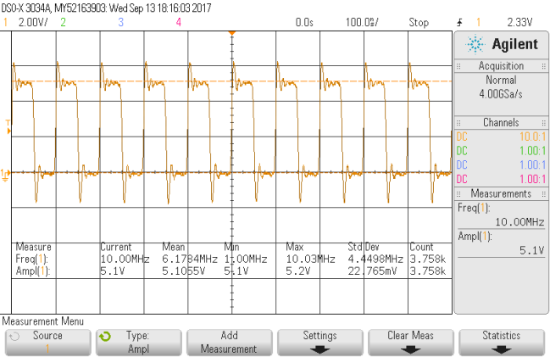
Complete Sub System module
Artix-7 FPGA
Optical Transmitter
HFBR-1414Z
Ethernet
10/100Mbps
RAM
Transmit FIFO
Transmit Section
Orange Pi
Board
BAUD generator
Timing Logic
UART
Optical Receiver
AFBR-2418Z
Configuration logic
100MHz
Receive FIFO
Receive Section
Buffer (Output)
Opto – Coupler ( Input)
Note : Central module – additional Multiple Transmitter and receiver sections are present.
Input Output Interface
OrangePi (open-source single-board computer) runs Linux
Orange Pi provides Ethernet interface (10/100Mbps) to sub system and central module ( for non real time data communication)
OrangePi to FPGA communication – UART 9600bps
Timing System configurations for either sub system module or central module are communicated to FPGA through OrangePi
10 bit data Transmit at 6.25Mbps (8 bit data, 1 start, 1 stop)
Optical Transmitter and receiver test with 10MHz signal
Reference:(5,6,7,8)

Slide 11
New Timing System – What’s difference ?
2. No use of dedicated discrete hardware resources for optical data transmission interface
E.g. Serializer , Deserializer
1. No use of dedicated discrete hardware resources for memory
E.g. RAM, DPRAM
Artix-7 FPGA
Optical Transmitter
HFBR-1414Z
Ethernet
10/100Mbps
RAM
Transmit FIFO
Transmit Section
Orange Pi
Board
BAUD generator
Timing Logic
UART
Optical Receiver
AFBR-2418Z
Configuration logic
100MHz
Receive FIFO
Receive Section
3.
No specific platform based development
E.g. VME
Buffer (Output)
Opto – Coupler ( Input)
Input Output Interface

Slide 12
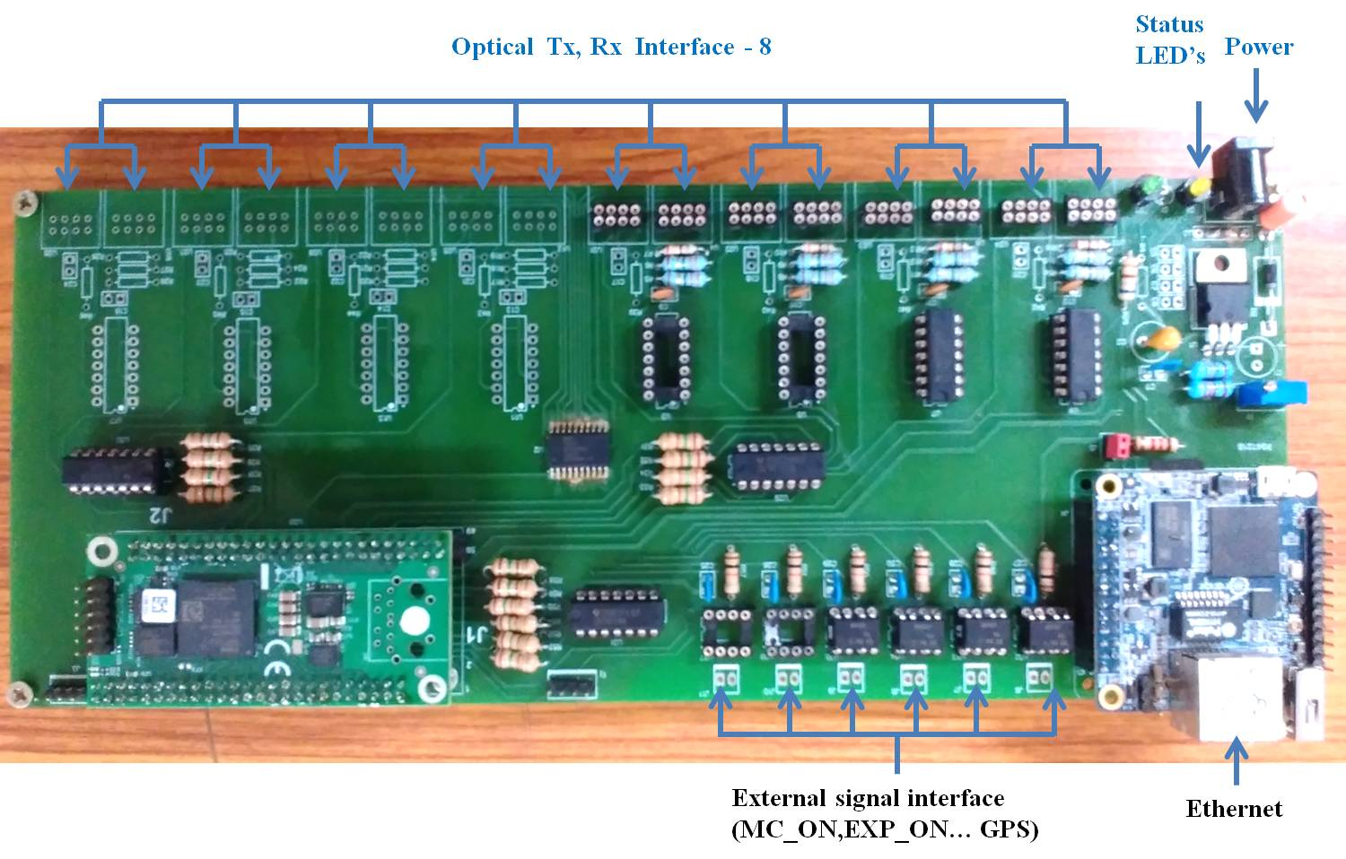
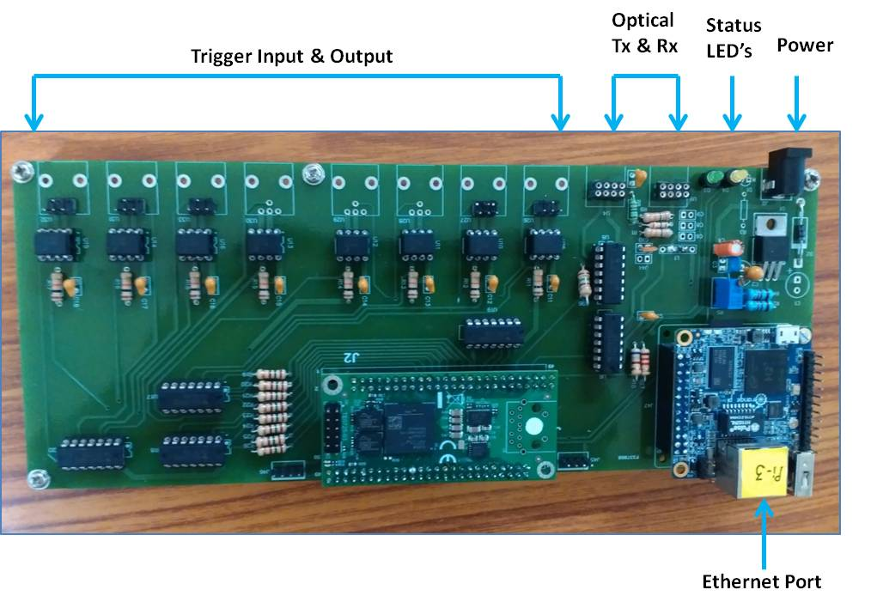
Central & Sub system modules
Maximum Slave modules that can be connected = 8
Synchronous & Shut down sequence event generation time
resolution = 10 μS
Event time stamp resolution = 1μs
Maximum number of synchronous & shut down
sequence events = 255
Maximum event time stamp duration = 4294.96s (~ 71.58 min)
Central Module board
1U Rack mountable central module
TTL Channel Outputs = 8 ( Low to High )
TTL Channel Inputs = 8 ( Rising edge i.e. low to high logic)
Minimum pulse width for channel outputs = 1µS
Maximum pulse width for channel output = 429.49 sec
Minimum pulse width at channel input = 500ns (as event)
Channel outputs for multiple events or same event
Sub system Module ( slave ) board
1U Rack mountable sub system module

Slide 13
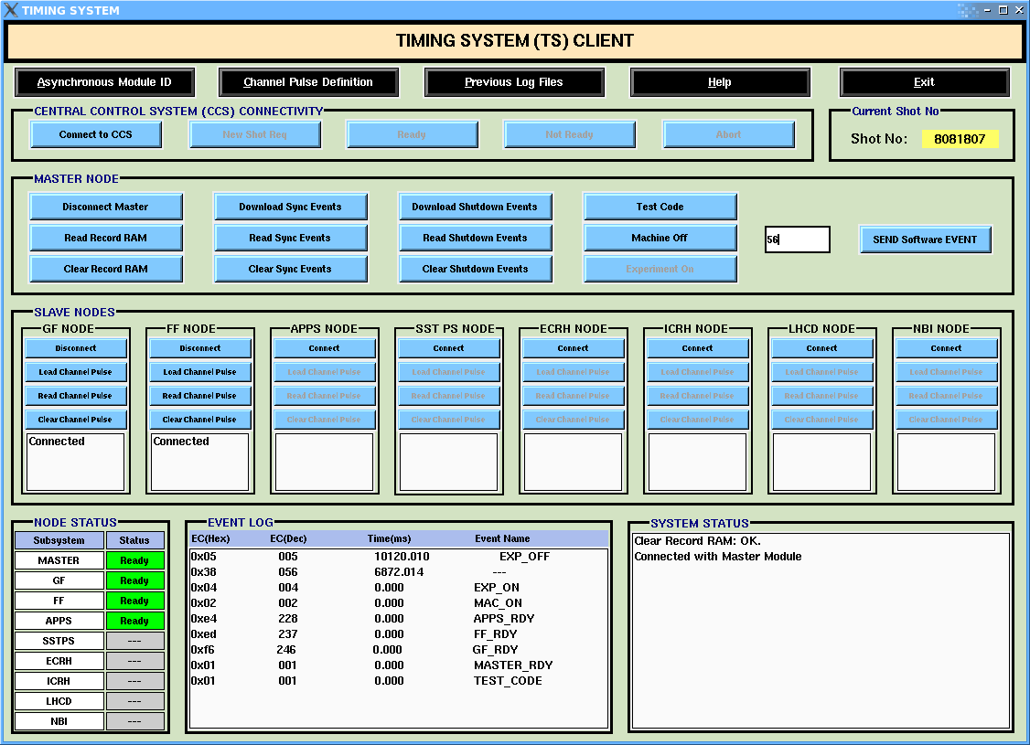
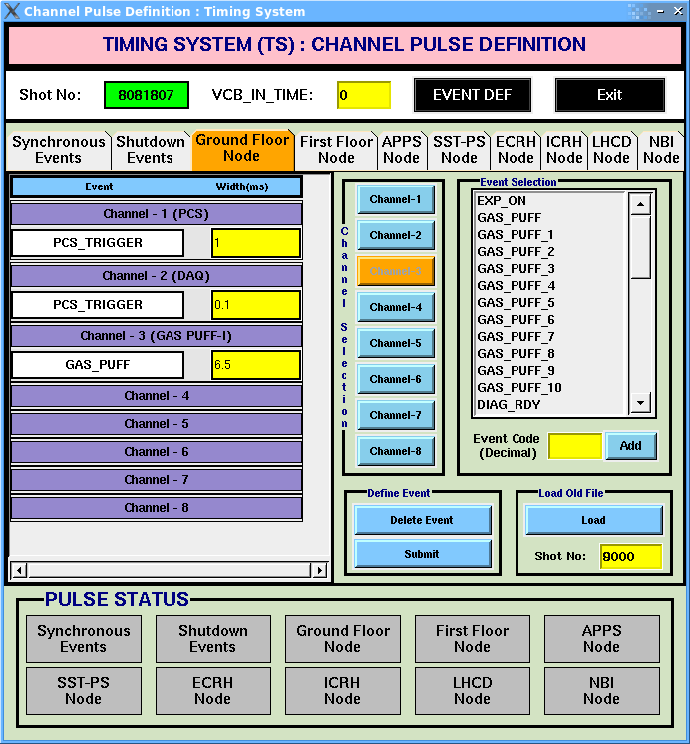
Timing System Client application
Channel Pulse Definition
Configures experiment sequence
Configures sub system modules for trigger pulse outputs
Timing System Client
Linux based application
Client-Server architecture
Connects & Configures all Timing System modules
Issues commands to generate experiment sequences
Online event information to operator
Event log

Slide 14
Timing System - Performance, Results & Validation
Power Supply
ECRH
LHCD
Central Module
Ohmic Power Supply
ICRH
Sub system -1
module
DAQ Systems
Sub system -2
module
Input
Output
Output
Input
OSCILLOSCOPE (4 Analog, 16 DIGITAL CH)
DI0 – DI7
DI0 – DI7
DO0 – DO7
DO0 – DO7
Set Up - Central Module ( Master) – and Two Sub system modules (Slave)

Slide 15
Performance, Results & Validation
Output
Pulse
missed
Trigger
Sub system 2
Output
Pulses
appeared
Sampling data bits (@ Receiver -16 x Bit rate)
But, only single sampling point to decode received data bit
Sub system 1
Output
Pulses
missed
Multiple sampling points with averaging – to decode received data bit
Reference:(9)

Slide 16
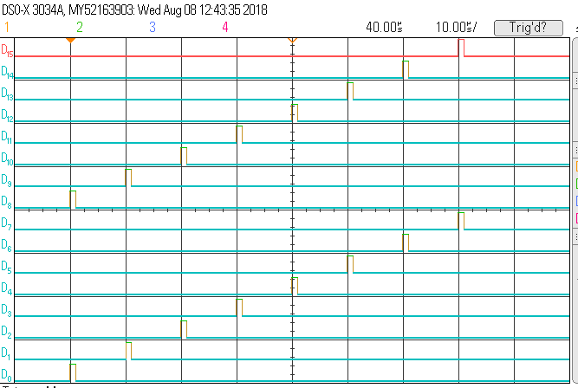
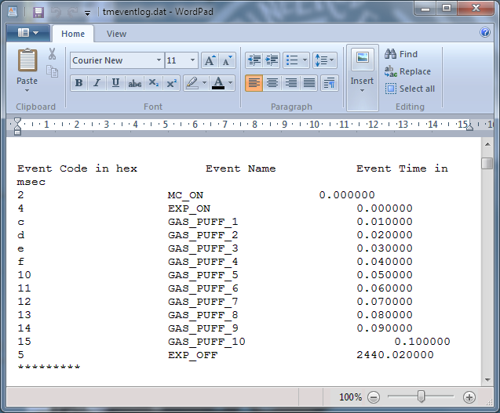
Performance, Results & Validation
Central Module (Master) – Experiment events (Synchronous) sequence at resolution of 10 µs
Pulse outputs corresponding to Synchronous Events on Two sub systems
D0-D7 : Sub system1 outputs
D8-D15 : Sub system 2 outputs
Event Log file

Slide 17
Performance, Results & Validation
Central Module (Master) – Experiment events (Synchronous) sequence test
Synchronous events at slaves- Generate pulse outputs on receiving synchronous events (7x8) and shutdown events (7x8) on all eight outputs of two different slave modules
D0-D7 : Sub system1 outputs
D8-D15 : Sub system 2 outputs

Slide 18
Performance, Results & Validation
Central Module ( Master) board – Event log resolution of 1µs
Event time stamp at Master – Two asynchronous events generated simultaneously by two slaves
(* Note – Sub system1 – Async event 0xf7
Sub system 2 – Async event 0xee)
Event time stamp at Master – 16 asynchronous events generated simultaneously by two slaves
(* Note –
Sub system1 – Async events from 0xf7 to 0xfe
Sub system2 - Async events from 0xee to 0xf5)

Slide 19
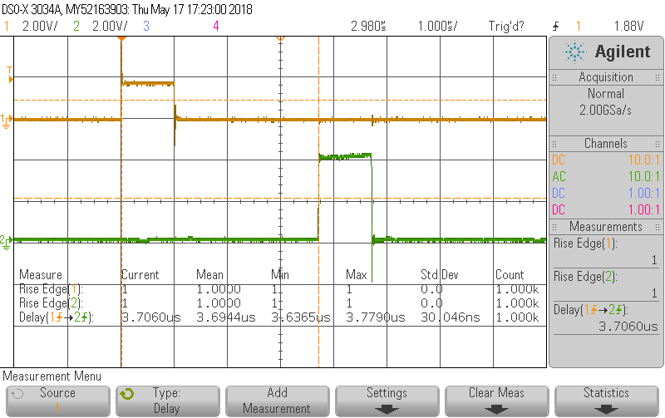
Performance, Results & Validation
Sub system Module – Event Latency Test on two different sub system modules (3m optical fiber)
1000 Pulses at 1 sec interval on any one of input of slave module 1, which then generates an event to Master module. Generate a channel pulse output for this event on other slave module 2.
Ch1: Pulse input also observed on oscilloscope ( as an input to sub system module 1)
Ch2: Output generated on sub system module 2 by the corresponding event generated due to above pulse input
#Note- Voltage level of Ch1 on oscilloscope is less, as it is measured across opto-coupler input.

Slide 20
Performance, Results & Validation
Sub system Module – Simultaneous Asynchronous events (3m optical fiber)
Asynchronous events - Generate asynchronous events by simultaneously applying 7 consecutive pulses on all eight inputs of two different slave modules. Configure pulse outputs for the generated asynchronous events.
D0-D7 : Sub system1outputs
D8-D15 : Sub system 2 outputs

Slide 21
Field Testing – Similar to actual plasma shot scenario
Real time event sequence generation (ECRH Launch trigger in reference to actual plasma shot scenario)
Generate experiment sequence similar to actual scenario
Log file – registers all events with time stamp

Slide 22
New Timing System Cost (Estimations)
Central module ( Per unit) | Rs. 41,698 /- approx. (600$)
Sub system module ( Per unit ) | Rs. 25,168 /- approx. (360$)
Timing System with 1 Central module and 8 sub system modules | Rs. 2,43,042/- approx. (3475$)
#Version1 - Module Costs* (Indian Rupees Rs)(U.S $)
# Version 1 ( Without Clock Synchronization & GPS IRIGB interface)
* Excludes the cost of material available with Institute for Plasma Research Stores department, Workshop, Job hours etc.

Slide 23
Further Development - Clock Synchronization ( In Progress)
Clock source under test | Frequency (MHz) | Stability (ppm) | CTE over 10 second | CTE over 60 second | CTE for 3600 second
Local Artix-7 oscillator SiT8008 | 100MHz | 20 ppm | 200 µs | 1.2 ms | 72 ms
OCXO-2050 (Old Timing System) | 20 MHz | 0.1ppm | 1 µs | 6 µs | 360 µs
Proposed | 20 MHz | 0.02 ppm | 0.2 µs | 1.2 µs | 12 µs
Power Supply
ECRH
LHCD
Ohmic Power Supply
Central Module
ICRH
Sub system -1
module
DAQ Systems
Sub system
Clocks and their calculated Cumulative Time Errors (CTE)
Input
Output
Clock
DI0 – DI7
DO0 – DO7
Clock Outputs
(10MHz / 1MHz / 100kHz/10kHz/
1kHz)
Clock
Trigger
Clock
Outputs
Reference:(10)

Slide 24
Further Development - GPS IRIG-B Interface, Event prioritization, Error handling ( In progress)
Propagation delay compensation
Event prioritizing logic at Central sub system module
Error handling features ( Parity, CRC …)
Develop GPS IRIG-B interface for the modules. (For GPS synchronization and GPS time)

Slide 25
Summary
A Platform independent, stand alone, 1U rack mountable timing system is designed, developed and tested.
The performance test results are comparable and acceptable.
The development cost is observed to be optimized considering the simple design adopted.
Design can be implemented with other FPGAs ( different make).
New in-house design will be advantageous and it can be easily adapted for time synchronization applications in small, medium size tokamaks or experimental devices irrespective of hardware/ software platforms.

Slide 26
References
Overview of time synchronization system of steady state superconducting tokamak SST-1 , 1A. Kumar, H. Masand, J. Dhongde et. al, Fusion Engineering and Design 112 (2016) 683–686
https://www.xilinx.com/products/silicon-devices/fpga.html
HFBR-14xxZ and HFBR-24xxZ Series (Broadcomm), Low-Cost, 820 nm Miniature Link Fiber Optic Components with ST®, SMA, SC and FC Ports - Data sheet
AFBR-24x8xZ(Avago Technologies) DC-50MBd Miniature Link Fiber Optic Receiver-Data sheet
Ultra-Compact UART Macros for Spartan-6, Virtex-6 and 7-Series, Ken Chapman, 29th March 2013
The Design of High Speed UART, J. Norhuzaimin and H.H Maimun, 2005 Asia Pacific Conference on Applied Electomagnetics Proceedings, December 20-21, 2005
FPGA Module with Xilinx Artix-7 XC7A35T (TE0725-03-35-2C), Trenz Electonic (https://shop.trenz-electronic.de/en/TE0725-03-35-2C-FPGA-Module-with-Xilinx-Artix-7-XC7A35T-2CSG324C-2x50-pin-header-3.5-x-7.3-cm)
http://www.orangepi.org/orangepizero/
UART Receiver Synchronization: Investigating the Maximum Tolerable Clock Frequency Deviation, Indian Journal of Science and Technology, Vol 10(25), July 2017
The AD9548 as a GPS Disciplined Stratum 2 Clock, Ken Gentile ( Analog Devices – AN 1002 Application Note)

Slide 27
Thank You

