Slide 1

ID: 437 Poster Board: P/1-9
The 12th IAEA Technical Meeting on Control, Data Acquisition and Remote Participation for Fusion Research
Preparations for the control of HL-2M first plasma campaign
B Li ，X.M Song, J Zhou, J Sun, L.L Ren
Southwestern Institute of Physics (SWIP), China
lib106@swip.ac.cn
13-17 May 2019
Daejeon, Republic of Korea

Slide 2
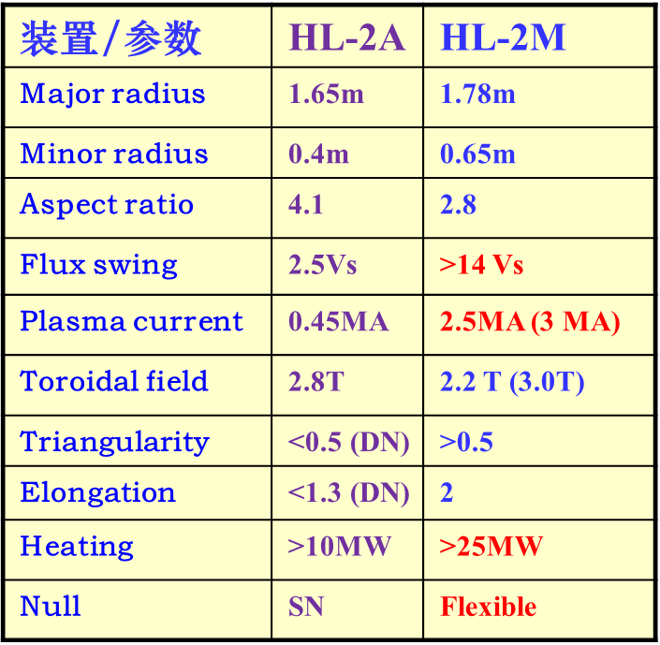
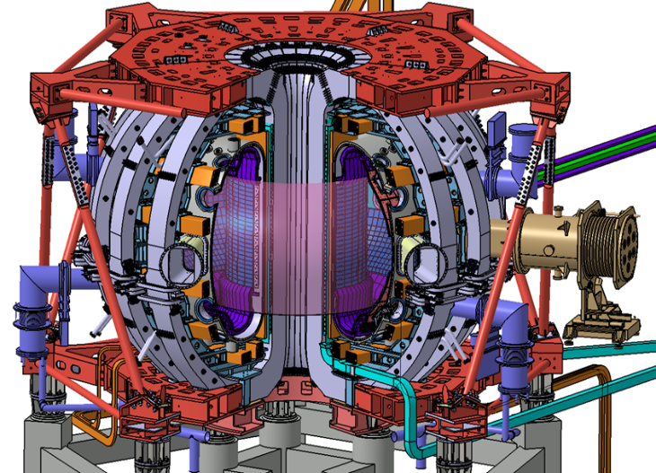
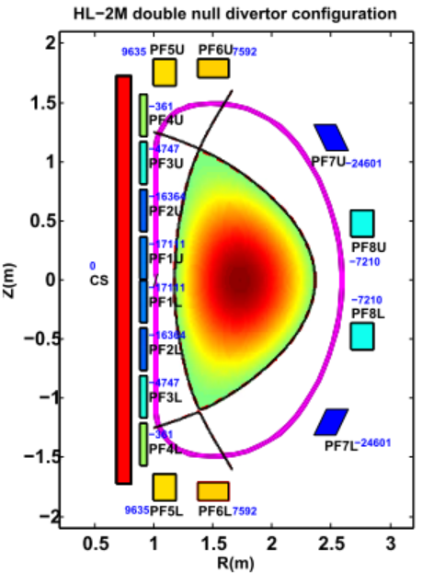
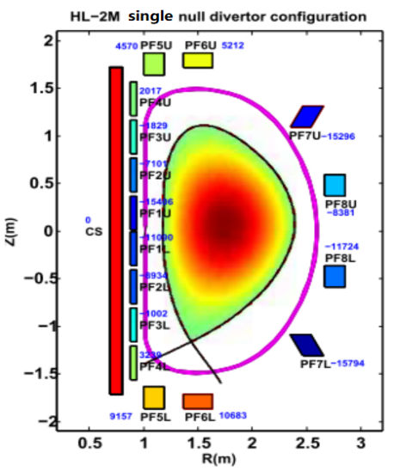
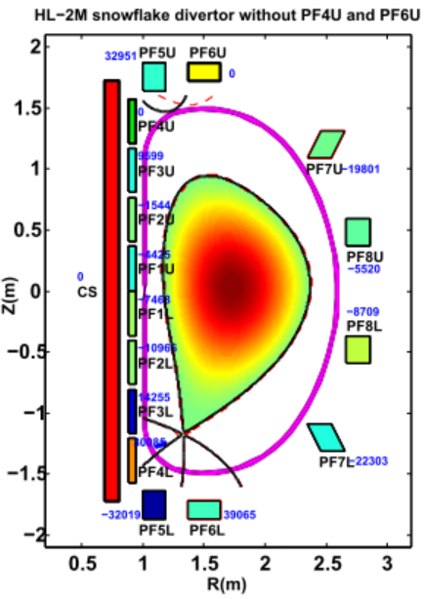
Progress of HL-2M Construction
HL-2M is a medium-size copper tokamak under construction in China as a modification to HL-2A, with Ip=3MA, R=1.78m, a=0.65m, Bt=2.2T, k≈2, δ>0.5.
Main components assembly is expected to be finished in 2019.
First plasma campaign is planned in 2020.
Manufacture of vacuum vessel ,supporting structure, PF and TF coils completed
Tokamak assembly is now in progress
16 PF and one CS coil are powered separately, providing more control freedom and flexibility for advanced plasma shape exploration

Slide 3
Overview of Plasma Control System

Slide 4
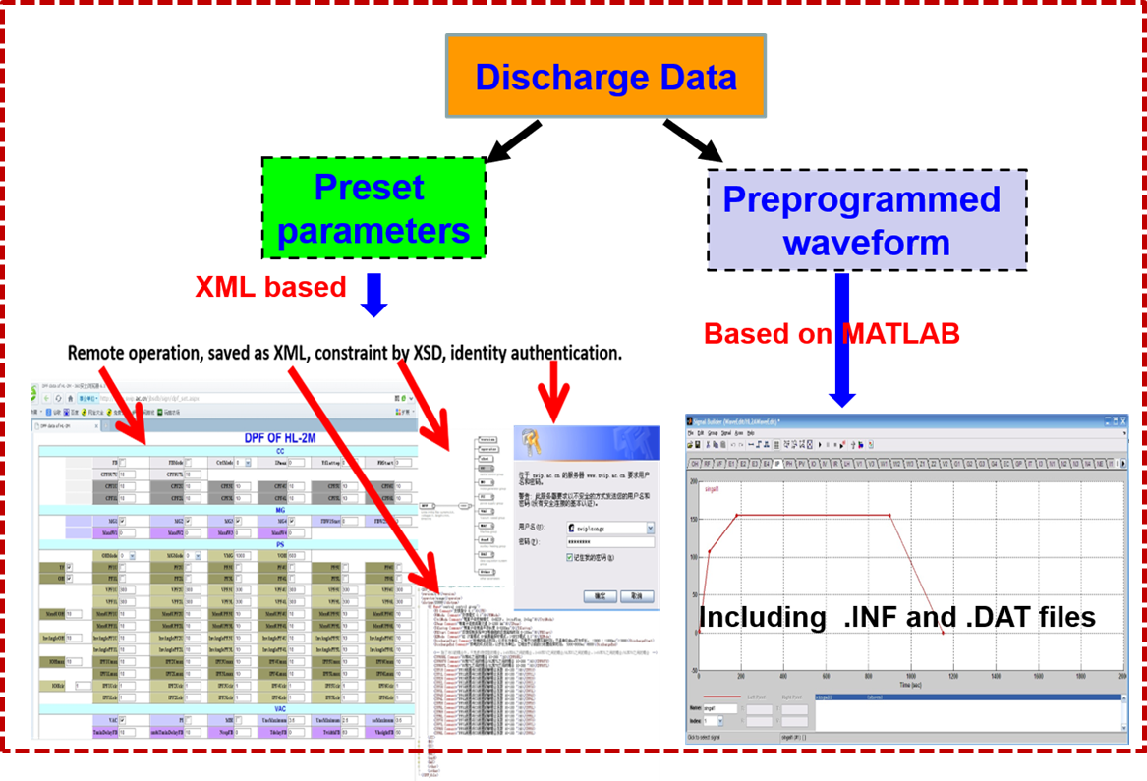
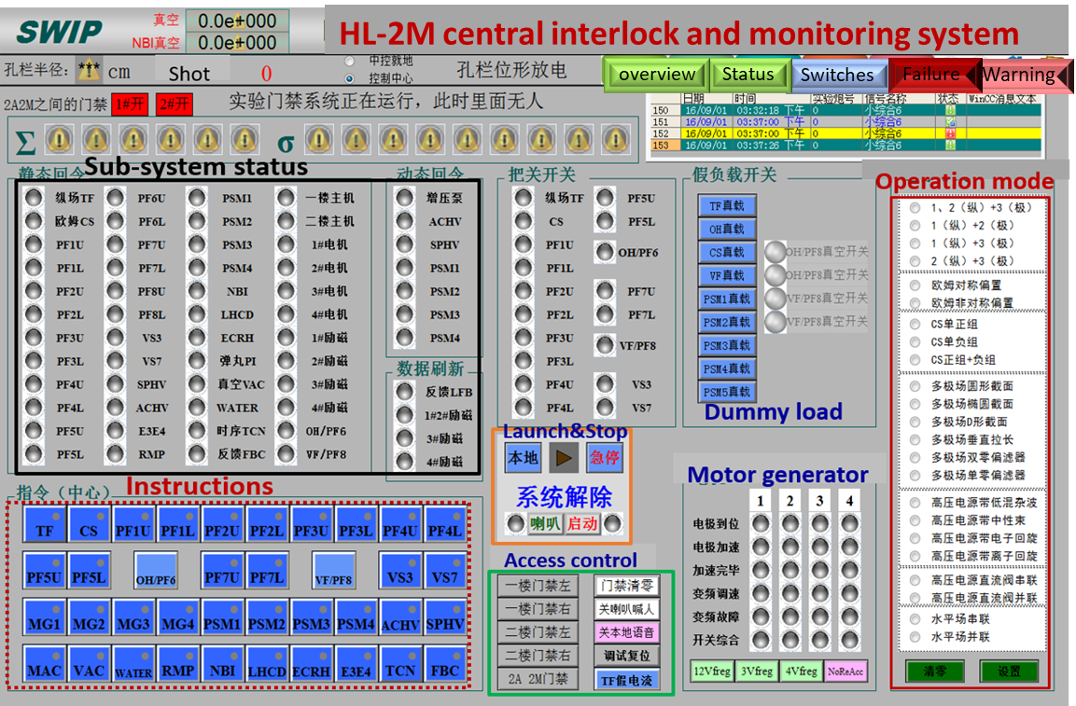
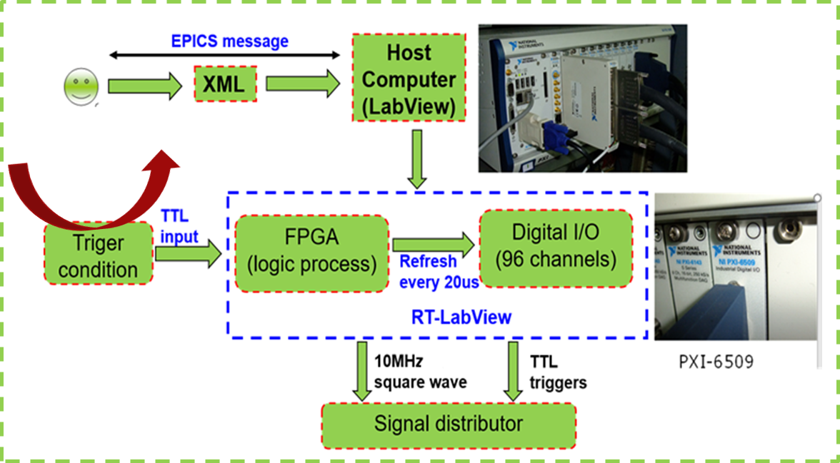
Overview of Plasma Control System
discharge scheduling
central interlock system (CIS) based on WinCC and PLC.
Timing control

Slide 5
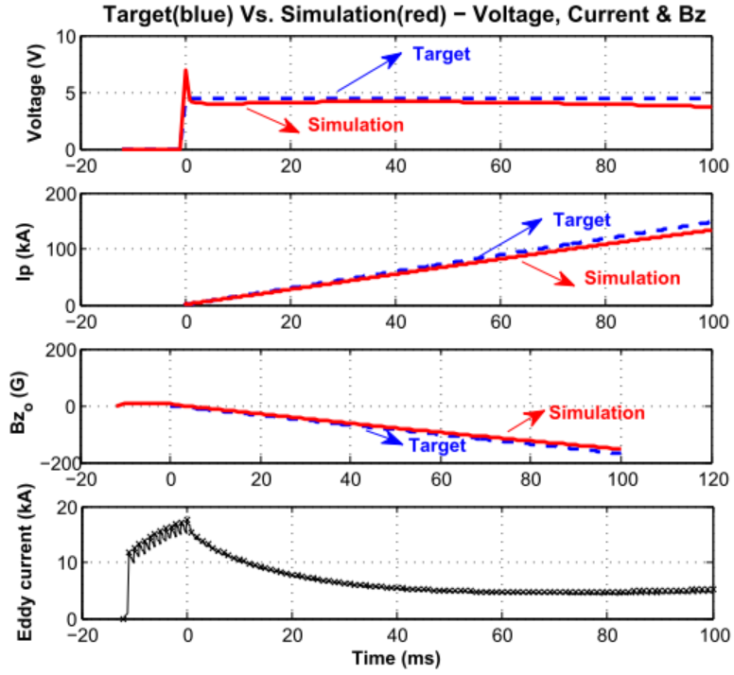
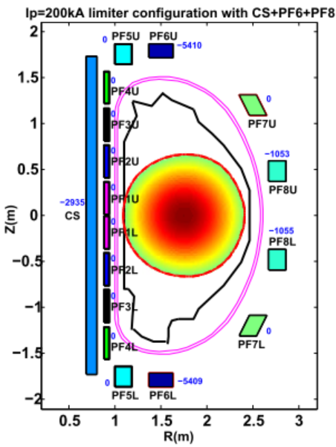
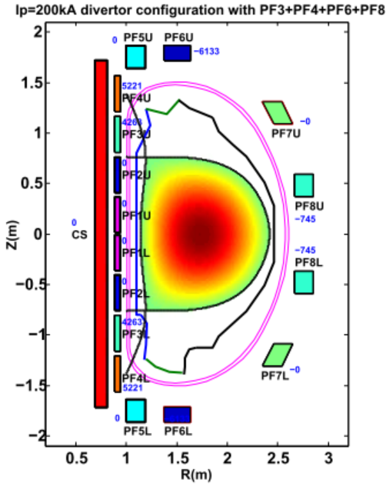
First plasma startup scenario
For the sake of simplicity and safety, only small parts of PF coils are used in first plasma campaign.
one limiter configuration (Case I) and one divertor configuration (Case II) with Bt=1.4T, Ip= 200kA, k≈1 are designed
Case I: PF6+ PF8+CS
Case II:PF3+PF4+PF6+ PF8+CS
voltage 4.1 V, Emax= 0.37 V/m
Target and simulation time history based on optimum IM state.
first plasma configuration. limited plasma(left), diverted plasma(right)

Slide 6
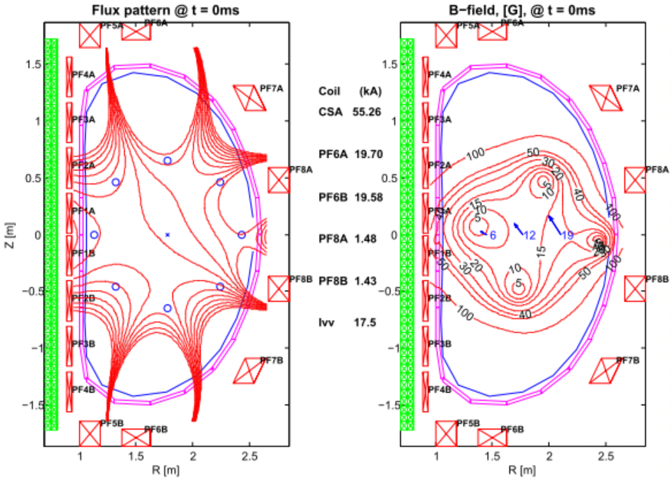
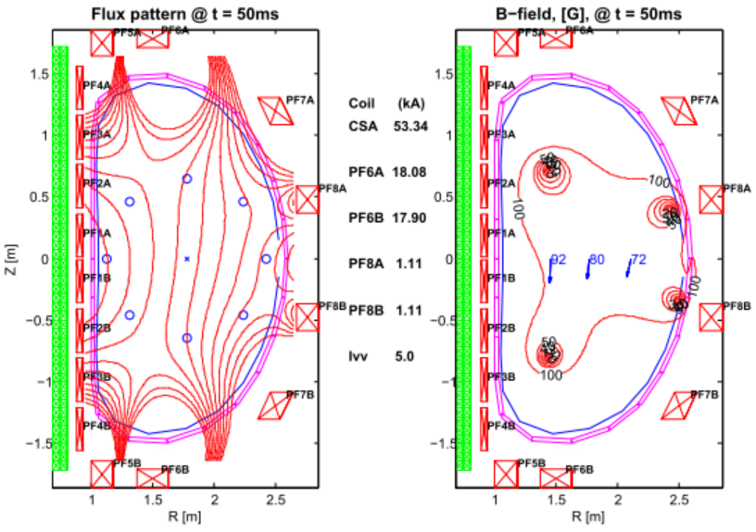
First plasma startup scenario
50 probes signals are linearly combined to
form estimates of Rp, Zp by multiplication
the coefficients in the rows of E-matrix
breakdown flux and B-field contours at plasma breakdown, 6~12 G field is shown along midplane
vacuum field contours at t=50ms after breakdown. the correct field curvature needed for vertical stability

Slide 7
Thank you very much

