Slide 1



Galaxy Serpent: A Web-Based Table-Top Exercise for National Nuclear Forensics Libraries
Jim Borgardt (US-Department of State);
Frank Wong (US-Department of Homeland Security)
IAEA CN-218; Vienna
Session 2F
08 July 2014

Slide 2
What is Galaxy Serpent?
First of its kind, entirely web-based, virtual table-top exercise using national nuclear forensics libraries (NNFLs)
Conducted under the auspices of ITWG; co-led by US State Dept and Dept of Homeland Security
Designed to address technical aspects of NNFLs
16 countries initially volunteered at ITWG-17 to participate
Notes:
ITWG

Slide 3
A Framework for Cooperation
National nuclear forensics libraries (NNFLs):
Provides an organizational knowledge framework for States investigating illicit uses of nuclear material
Consists of information pertaining to the inventory of nuclear or other radioactive material produced, used, or stored by a State
Allows a State to quickly assess the question “Is it consistent with our material?”

Slide 4
Galaxy Serpent: Purpose
Raises awareness about the technical aspects of creating and using NNFLs
  Teams create their NNFL from provided, existing data (public domain)
  Teams then use their NNFL to determine if seized material is or is not consistent with their material in their NNFL
Teams encouraged to communicate, share approaches or methods, as needed

Slide 5


Galaxy Serpent: Conduct
3-4 teams, each from a different State or organization (i.e. “Galaxy”) play in each Round
Five rounds were conducted; each about 8 weeks in duration (Feb 2013 – April 2014)
Teams receive information and post progress on a dedicated web portal (provided and managed by State Dept)

Slide 6
Galaxy Serpent: Participants
Round 1 (Feb-Apr ‘13) | Round 2 (May-July ‘13) | Round 3 (Aug-Oct ‘13) | Round 4 (Feb-Apr ‘14) | Round 5 (Feb-Apr ‘14)
Australia/ANSTO | Japan | Hungary | “Pisces” | JRC/ITU
Brazil | South Africa/ NECSA | Sweden | “Aquarius” | “Pegasus”
Canada | UK/AWE | “Shapley” | “Seyfert” | “Sagittarius”
“Cygnus” | “Hydra” | “Carina”
Italicized text indicates the team in each round which was assigned the reactor that was the source of the hypothetical seizure.

Slide 7
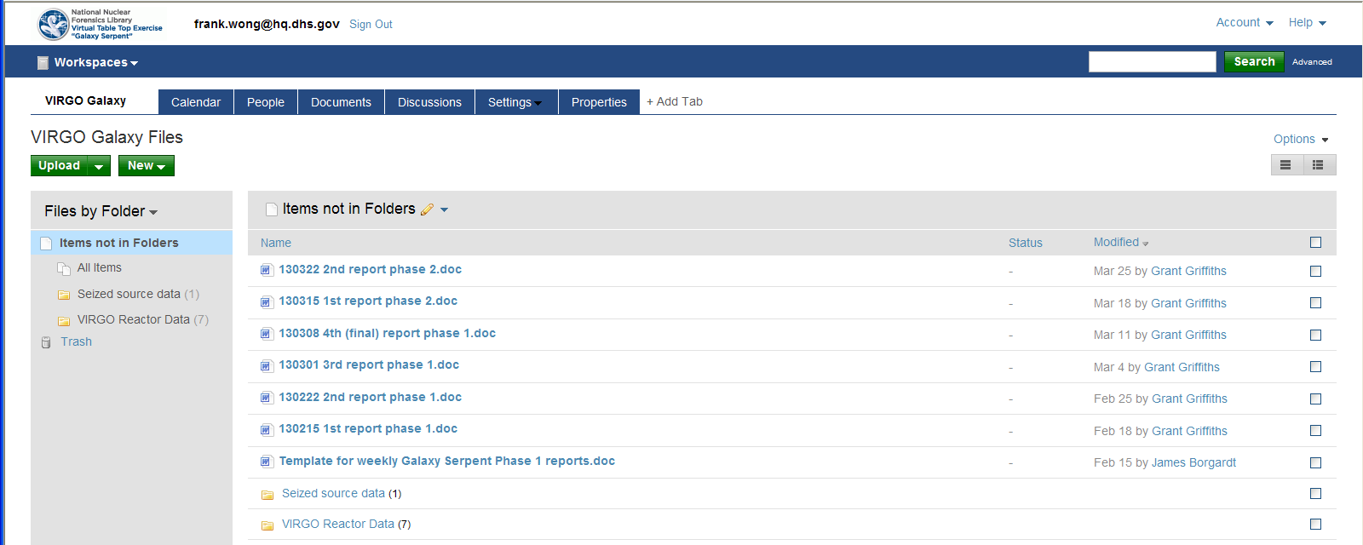
Galaxy Serpent: Web Portal
Team Virgo Sample Home Page
Progress Reports
Phase I Injects: Reactor Data
Phase II Injects: Seized Material Data

Slide 8
Galaxy Serpent: Artificialities
Uncertainties were developed, and not part of the original SFCOMPO data
The “universe” of data sets were intentionally constrained to low-enriched uranium (LEU) reactors to help bound the problem
Model NNFLs were composed of just three reactors; a combination of BWR and PWRs.

Slide 9
Galaxy Serpent: Scenario
Public domain spent fuel compositions are used (SFCOMPO; 14 nuclear reactors)
Each Galaxy is provided data from ~3 reactors (i.e. “moons of Saturn”)
Phase II
A dirty bomb with spent fuel was seized. Determine if this spent fuel is or is not consistent with spent fuel in your NNFL
Phase I
Create an NNFL from the data provided

Slide 10

Galaxy Serpent: Scenario Example
Phase I
Create NNFL from provided public domain data
Galaxy ‘A’
Galaxy ‘B’
NNFL Created from Reactors 1, 4, 12
NNFL Created from Reactors 3, 6, 8
Galaxy ‘C’
Galaxy ‘D’
NNFL Created from Reactors 2, 9, 10
NNFL Created from Reactors 5, 7, 11
Data from Hypothetical Spent Fuel Dirty Bomb Seizure
Phase II

Slide 11
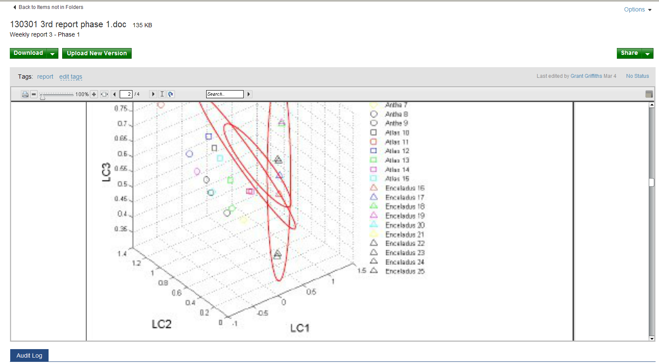
Galaxy Serpent: Progress Posting
Team Virgo: Excerpt from Phase I progress; their NNFL is complete and PCA is used to cluster reactors

Slide 12
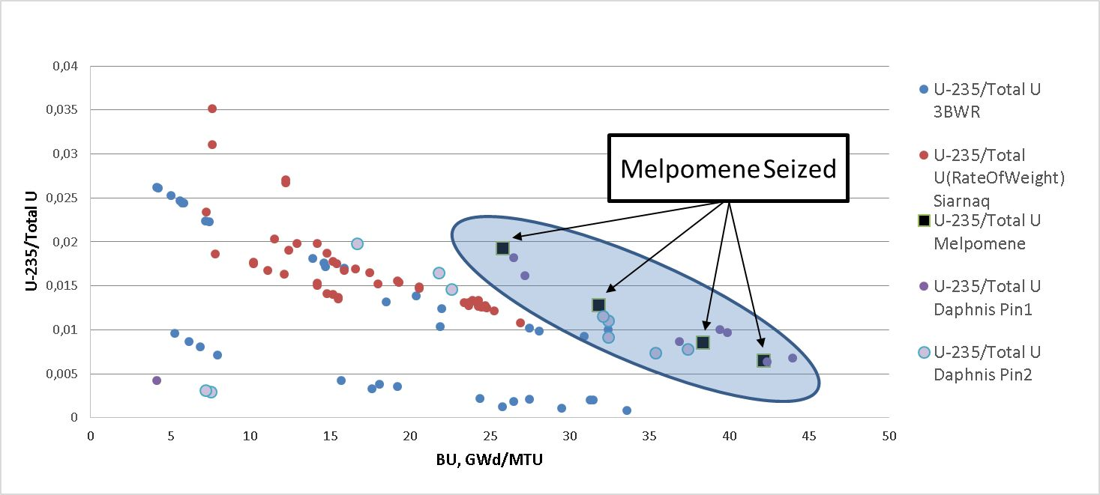
Galaxy Serpent: Evaluation
Examples: Technical assessment of results

Slide 13
Galaxy Serpent: Results
All teams benefited from the exercise
All teams that completed the exercise correctly answered “Is it consistent with our material?
All gained valuable insights into procedural issues, gaps in expertise, and similar critical infrastructure
Contributions for variety of professional expertise
Assignment of confidence levels

Slide 14
Lessons Learned
Cost effective international collaboration of scientists
Multiple analytical methodologies, with confirmed findings
Community of experts aware of NF and NNFLs expanded
Wide-ranging expertise provided valuable contributions
Demonstrated efficacy of NNFLs in drawing inferences of the origins of a hypothetical seizure of spent nuclear fuel
NNFLs provided critical insights: especially about organizing existing data, re-purposed for an NNFL
NNFLs can play a vital role in the investigative effort involving nuclear or other radioactive material

Slide 15
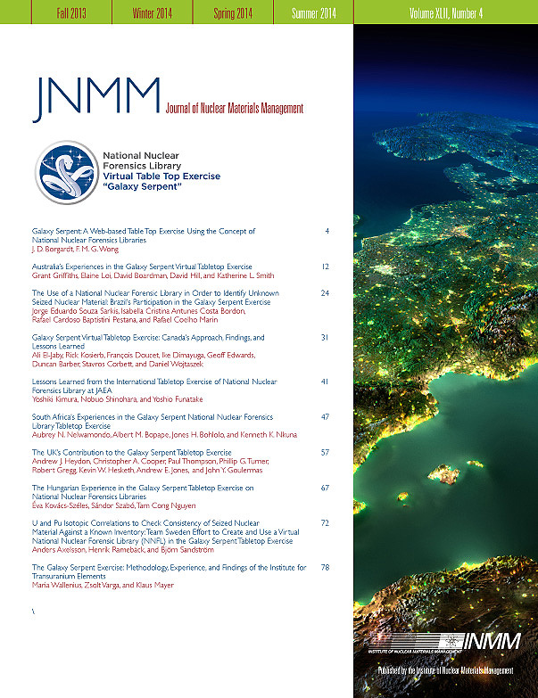
Future Efforts
Journal of Nuclear Materials Management (JNMM)
Partnered with JNMM to arrange a special issue, summer 2014, dedicated to the Galaxy Serpent TTX
10 articles, including 9 early round participants teams and 1 from organizers
Electronic release date: late July 2014
Galaxy Serpent v2.0 – tentative outline
Planning phase: Q3, Q4 2014
Exercise: To begin Q1 2015
Similar web-based, virtual format
Anticipate feedstock as material of interest

