Slide 1
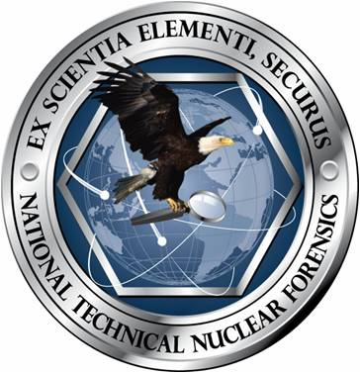
The Historical Evolution of Nuclear Forensics:
A Technical Viewpoint
IAEA International Conference on Advances in Nuclear Forensics
Sid Niemeyer* & Lothar Koch**
July 7-10, 2014
*Lawrence Livermore National Laboratory
**Institute for Transuranium Elements, European Commission

Slide 2
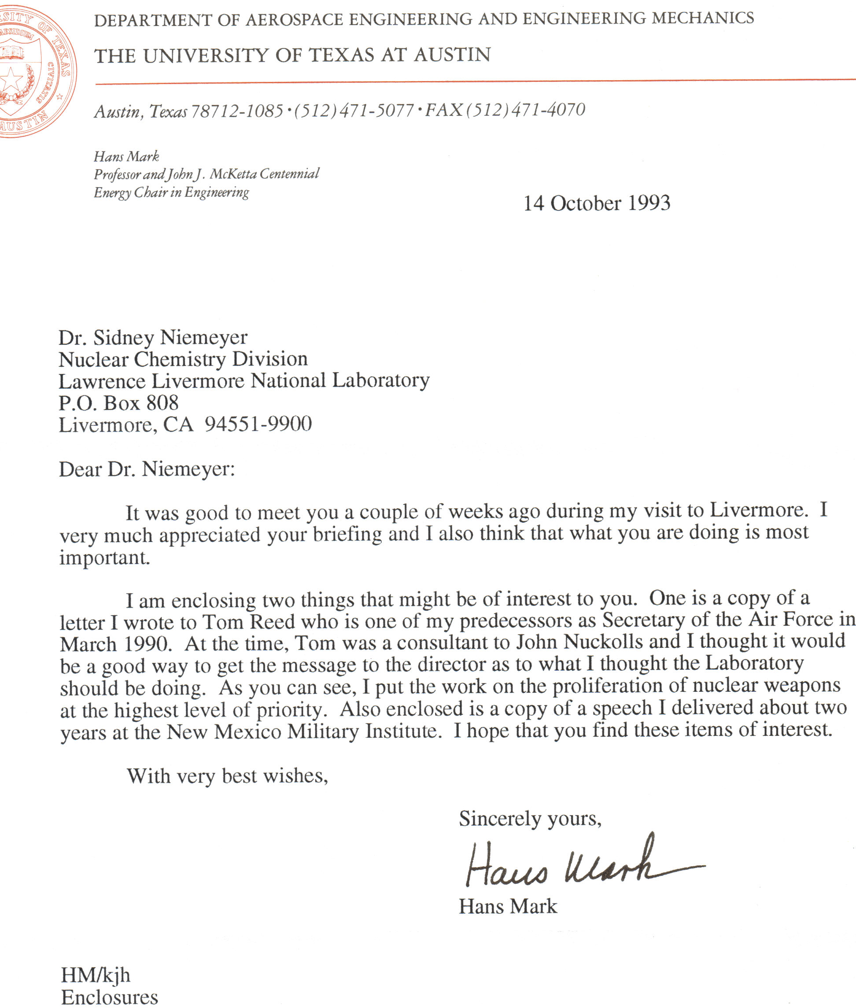
Nuclear Forensics is an evolving discipline
Address a new question:
  “From this material evidence, what can you say about the origin and history of the materials and/or device?”
Hans Mark visit to LLNL in 1991 stimulates Nuclear Chemistry Division focus
Notes:
2
For this early history, probably use Jeremy type slides, a simple slide with topic or diagram, and notes on these powerpoint slides become my personal talking points
Jay Davis and Carl Poppe
Start LDRD
I become new Nuclear Chemistry Division Leader
Three months before last test
Taking Division into the new post-Test world
Nuclear Attribution became a key focus
Started writing white papers, seeking partners with other Labs
My own interaction with Hans Mark
Possibly show or quote from his letter to me

Slide 3
Early on recognized that nuclear forensics and attribution had various applications
Different operational requirements for different scenarios
Attribution would require melding of technical, intelligence, and political information
Three scenarios outlined
  Nuclear materials
    Black market
  Nuclear device
    Unexploded
    Exploded
  Radioactive dispersal device

Slide 4
:
In 1994 several illicitly travelling nuclear materials were seized.
The European Institue of Transuranium Elements was asked to assess: the radiological hazard the intended use and origin possible production site
Notes:
See my earlier email explaining the background
4

Slide 5
To meet the request of law enforcement the capabilities had to be enlarged
A database was set up covering the places where nuclear material was produced and for what purpose
Isotope analysis of non-nuclear constituents to uncover the production site
Notes:
5

Slide 6
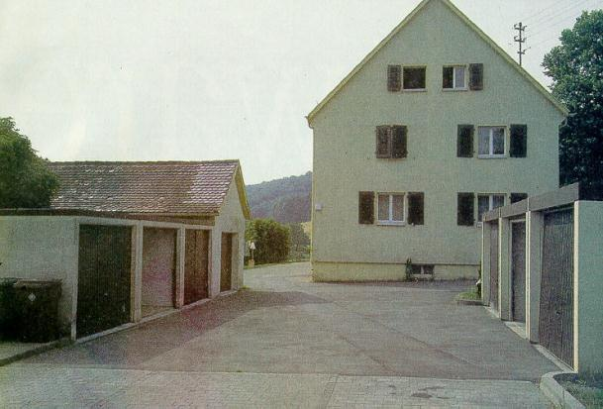
Fund 13 - Konstanz
On 10th May 1994 police in Tengen (at Lake Konstanz) searched the home of known criminal Alfred Jäckle. By chance they found a lead container and inside it a vial with reddish powder.
KT 1-20, 00900, 1980
KT=“KontainerTransportni”
as used in Russia
Photo: New Scientist

Slide 7
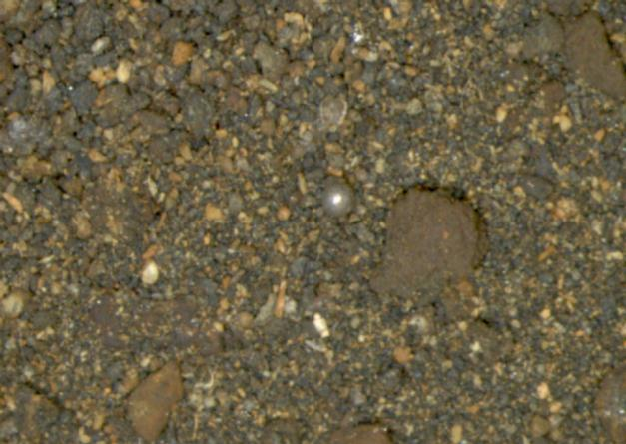
Fund 13 - Konstanz
56 g of powder containing Pu
Hg
Pu
Hg₂Sb₂O₇ = Red mercury !
Notes:
7

Slide 8
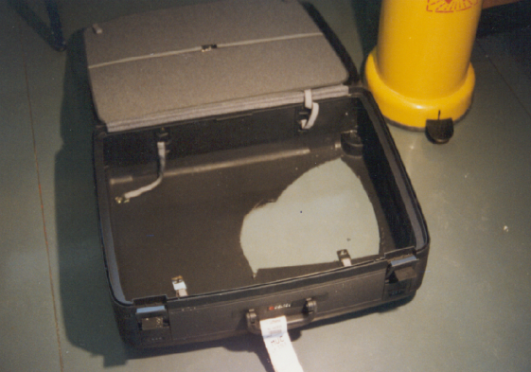
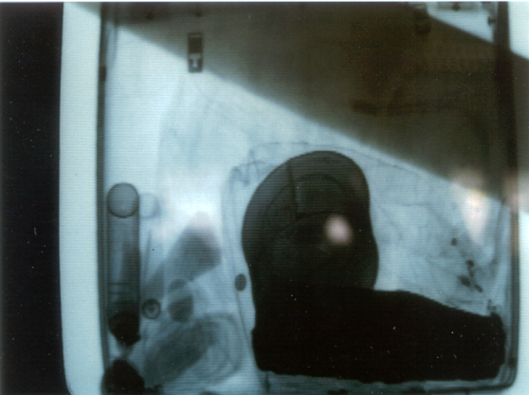
Fund 19 - Munich
A Colombian had offered to sell kg amounts of Pu. For proof he offered a small sample, which could not be analysed on-site, but had to be brought to the near-by radiochemical laboratory of the Univ. of Munich.
August 10 in 1994 a Colombian and two Spaniards landed in Munich arriving from Moscow. They were expected to bring Pu. Gamma-ray detectors did not respond when their luggage was checked. X-rays showed a stainless steel container and tin cans. Explosive experts checked for booby traps.

Slide 9
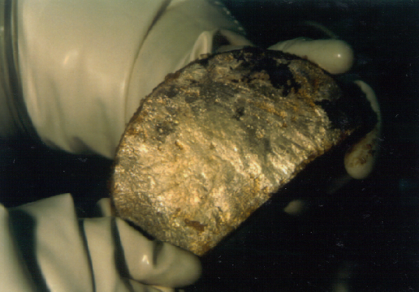
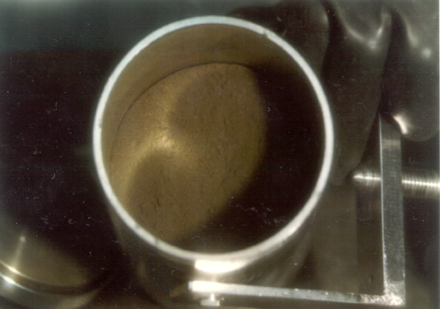
Fund 19 - Munich
Mixed plutonium and uranium oxides: 363 g Pu - 121 g U
weapons-grade Pu
not from commercial reprocessing or from military production
residues from experiments to develop a MOX process
201 g of Li-metal enriched to 89.4 % in 6Li.

Slide 10
Attribution Assessment of
Illicit Nuclear Materials
White Paper by LLNL & PNNL
February 24, 1995

Slide 11
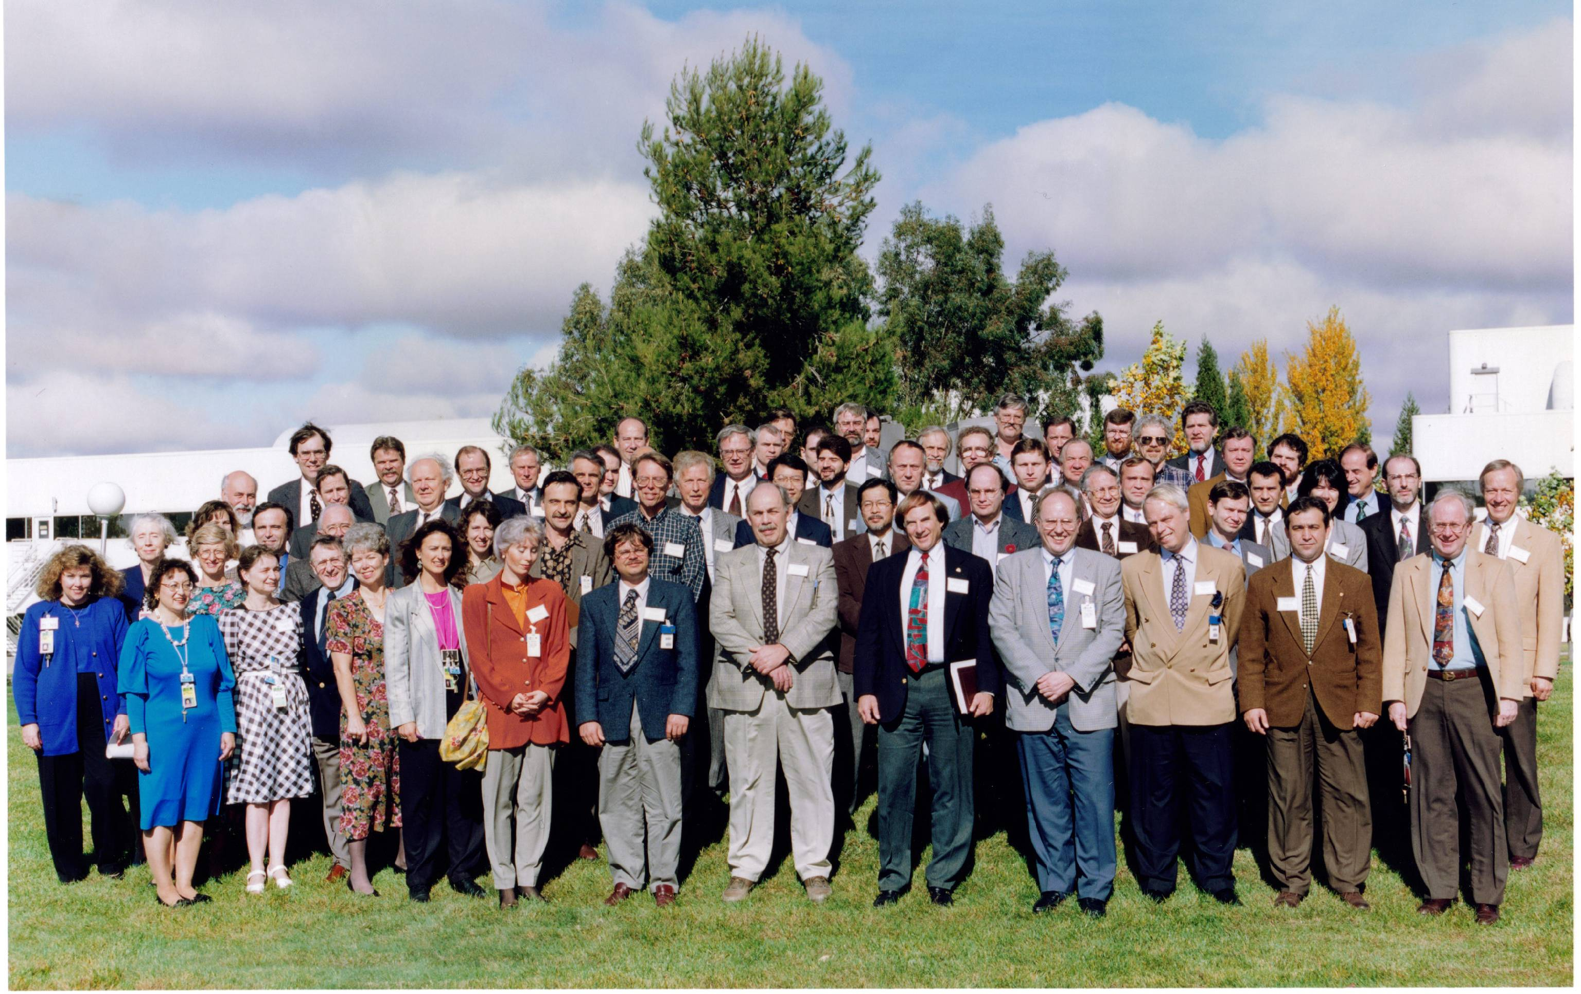
The ITWG was formed in 1995 to foster cooperation in combating illicit trafficking
The Nuclear Smuggling International Technical Working Group (ITWG) was formed in 1995 at an International Conference on the role of nuclear forensics in combating illicit trafficking of nuclear materials
The ITWG is an informal group that has maintained continuity and progress from its first meeting in 1996 until today
  Law enforcement, first responders, and scientists working together
The primary focus has been on the development of nuclear forensics
Notes:
11
Describe conference initiated by G-8’s NPEG, DOE offered to take lead, and International Conference at LLNL with me as chair; to foster international cooperation on nuclear forensics
NOTE—would be better to get picture of group at 1995 Conf
Also need to provide a definition of nuclear forensics, probably do that in this context
Note that for five years, thinking about NF largely developed in the context of ITWG
International cooperation will continue to be very important
Should use slide with IAEA publication, and then possibly bring in some points about importance of response to the scene, because likely of most interest to this group (or come back later to this point in context of development, possibly using some of the slides on the current RDD exercise, which also brings in element of RDD, not just nuclear explosion

Slide 12
NATIONAL INTELLEGENCE SERVICES ATTENDED THE ITWG MEETINGS. IN CASE THEY LACK FACILITIES TO HANDLE RADIOACTIVE MATERIALS,THEY ARE WELCOMED TO PERFORM THE INVESTIGATIONS TOGETHER – AS IN THE PAST, WHERE FINGERPRINTS ON OBJECTS WERE TAKEN.

Slide 13
ITWG’s primary goal is to develop a preferred approach to nuclear forensics investigations that is widely understood and accepted as credible
Technical elements include:
Development of protocols for collection of evidence and laboratory investigation
Prioritize techniques and methods for nuclear forensics analysis
Development of forensics databanks to assist in interpretation
Execute interlaboratory exercises
Facilitate technical assistance to countries in response to specific requests

Slide 14
A major focus has been the development of a Model Action Plan for nuclear forensics
Crime Scene Analysis
Safety
Security at the Scene
Categorization of Material
Certified Containers
Packaging Protocols
Shipping Procedures
Licensed Carriers
Chain of Custody
Radioactive Evidence Collection
Incident Response
Traditional Evidence Collection
Transportation to Laboratory Facility
In Laboratory Evidence Collection and Distribution
Laboratory Analysis Radioactive Material Evidence Processing
Specialized Facilities
Validated Protocols: Trace-to-Bulk
Evidence Handling and Storage
Iteration with Criminal Investigation
Laboratory Analysis Traditional Forensics
Evidence Processing
Case Development
Notes:
14

Slide 15
In the IAEA frame a model action plan was established and tested in several states to cope with local situations and to train law enforcement services

Slide 17
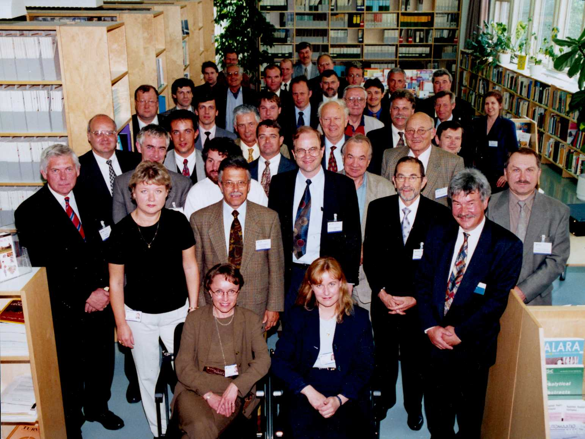
The ITWG meets annually and in the first decade included participants from more than 30 countries and organizations
Belarus Bulgaria
Canada Czech Republic
Estonia European Comm.
Europol Finland
France Germany
Hungary IAEA
Italy Japan
Kazakhstan Latvia
Lithuania Norway
Poland Romania
Russia Sweden
Switzerland Turkey
Ukraine United Kingdom
United States Uzbekistan
Georgia Tajikistan
Slovakia Australia
ITWG-5
June 9-10, 1999
Helsinki, Finland
Notes:
17

Slide 18
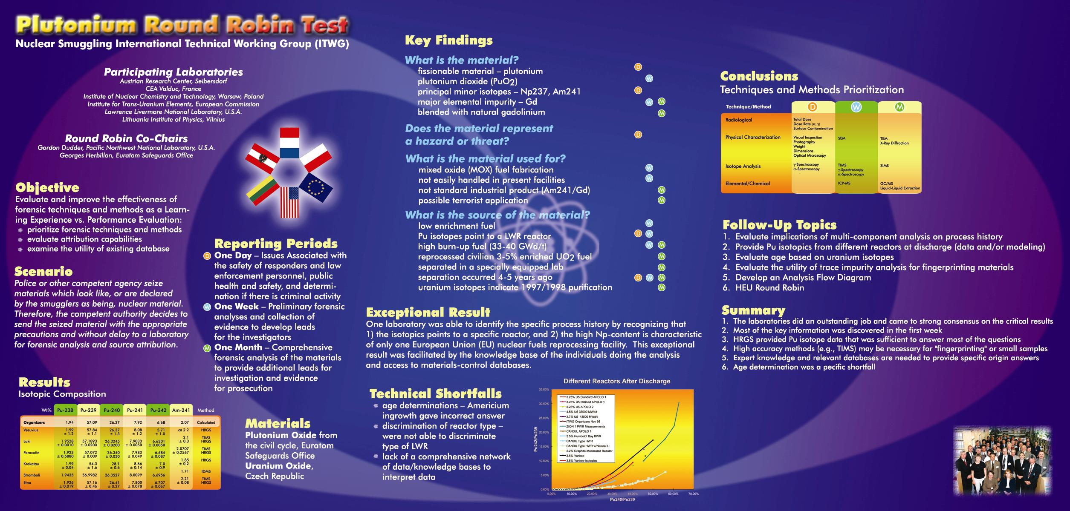
The ITWG conducts round-robin exercises to promote the development of nuclear forensics
Goal is to learn how to better conduct nuclear forensics
Three materials exercises so far
  Written reports documenting results and recommendations
First Table Top Exercise at ITWG-11 meeting
Results used to prioritize techniques for answering nuclear forensic questions
Notes:
18

Slide 19
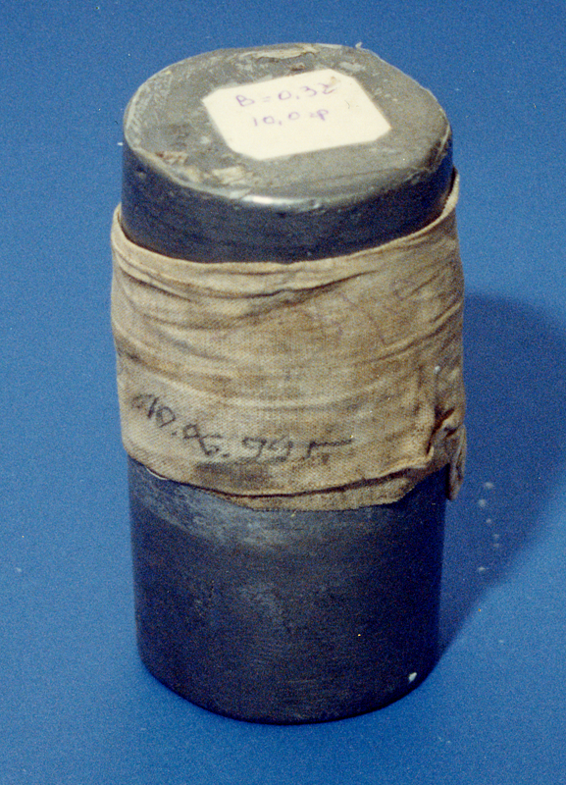
A broad range of techniques were used to examine Bulgarian HEU seizure
Wax type
Particle characterization
Wax colorant
Stoichiometry
Paper origin
Impurity elements
Pb metallurgy
Residual radionuclides
Pb isotopics
Age-dating
Ampoule material
U & Pu isotopics
Non-nuclear forensics
Nuclear material forensics
Notes:
19
Look for other briefs that give a little more detail—setting up the case and glimpse of some data, either my old brief, of Dave’s for Allison visit

Slide 20
The Post-det & Pre-det
Nuclear Forensics Programs
Begin in the U.S.:
DTRA and DHS
2001-2003

Slide 21
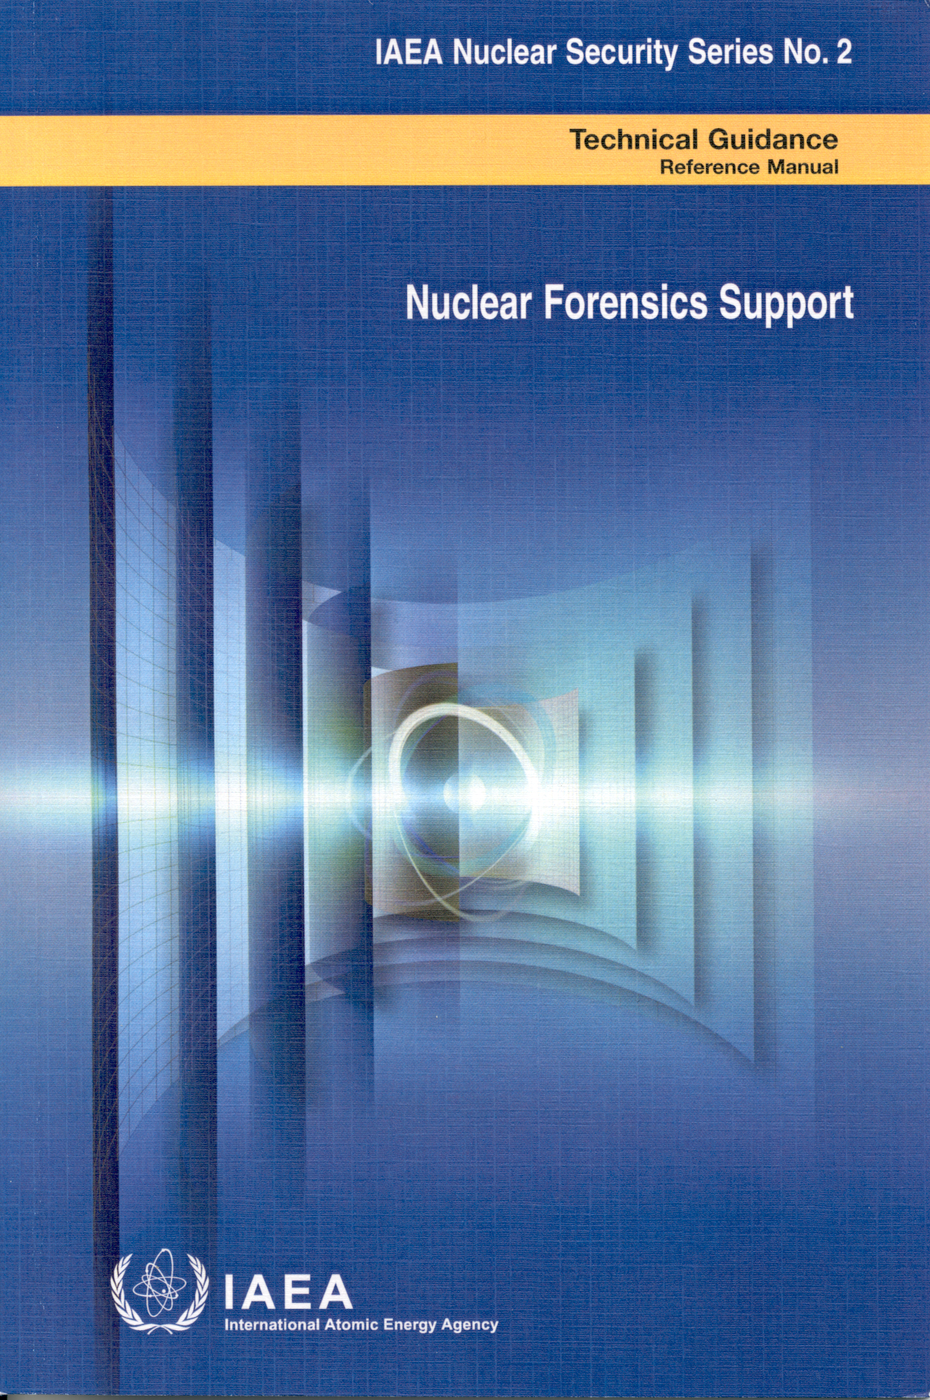
The ITWG and IAEA worked to develop a closer working relationship
IAEA convened two Consultants Group Meetings on Nuclear Forensics (2003 and 2004)
ITWG wrote a draft on “Nuclear Forensics Support”
  Published in 2006 as IAEA Nuclear Security Series No. 2 (Technical Guidance)
Developed a “Menu of Options” for countries desiring nuclear forensics assistance
Notes:
21

Slide 22
In 2003 the ITWG expanded its charter
Provided a more sustainable structure for the ITWG
  Formed an Executive Committee
  Task Groups as main vehicle for ITWG work between annual meetings
Identified numerous activities that would enhance ITWG work
  Formed a subset of “active practitioners” of nuclear forensics
  Establish guidelines for best practices
  Conduct international exercises
  Promote research and development activities
  Communicate with external organizations
  Provide a point-of-contact for nuclear forensics assistance
  Assist one another in nuclear forensics investigations

Slide 23
Key meeting with NPEG in 2005 on future of ITWG
Klaus Mayer (EC/ITU) and Sid Niemeyer (LLNL) briefed NPEG on the role of the ITWG for international cooperation in developing nuclear forensics
Provided an update of past ITWG work
Proposed a vision for international cooperation
  Maximize global ability to detect early warning signs of nuclear terrorist activity
  Draw upon global expertise for investigations
Posed questions for discussion

Slide 24
Suggested topics for discussion (2005)
Should we have some type of political advisory group
Who should participate in the ITWG?
How can ITWG better connect with policy?
How to implement envisioned IAEA role in nuclear forensics
Does NPEG support the revised ITWG charter?

Slide 25
Signatures—
The central scientific issue

Slide 26
End State for Signatures Development
The Vision
A validated set of signatures that
uniquely distinguishes the origin & history
of nuclear & radiological materials
Vision specifics
  Covers materials across the globe
  Signatures across the entire life cycle of nuclear and radiological materials
  Smallest possible set of signatures
  Understand mechanisms that control signature development
26
Notes:
26

Slide 27
Examples of cooperative research between U.S. and other countries
Nuclear Forensics Libraries Data Architecture
  6 U.S. Labs and AWE
Chronometry comparative analysis
  LANL, LLNL, EU, CEA, ROK, Japan
Uranium Ore Concentrates Sourcing
  LLNL, LANL, ORNL, ITU, AWE, IAEA
Nuclear Forensics Methodologies Course (IAEA sponsored)
  PNNL, LANL, LLNL, FBI, ANSTO, ITU, AWE
U.S.-China Experts meeting
  LANL, LLNL, SNL, PNNL
Light stable isotopes for nuclear forensics signatures
  LLNL, LANL, Bochvar

Slide 28
Examples of cooperative research between U.S. and other countries (cont.)
Relating Pu oxide morphology to production pathway
  SRNL, AWE
National Nuclear Forensics Library & Data Mining
  LLNL, ROK, Japan
Improving a “cloud-rise” module
  ORNL, AWE
U.S.-Israel Workshop (semi-annual)
  NA-40, various Labs
Forensic applications of optically stimulated luminescence
  SRNL, DRDC/Canada

Slide 29
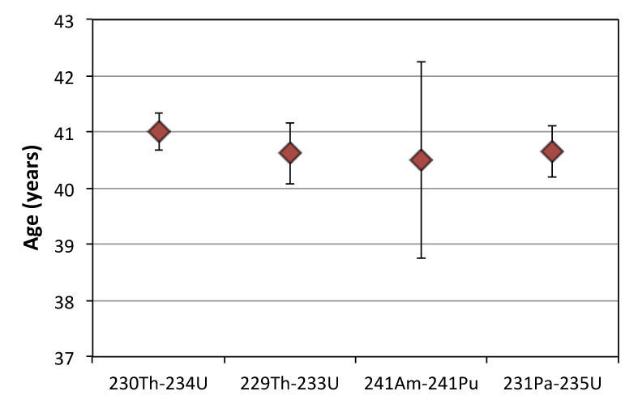
Chronometry comparative analysis
The age (time since chemical purification) of a material is one of the most useful forensic signatures
The use of age-dating in nuclear forensic investigations is hindered by lack of accepted protocols and standards
U.S. created action sheets with CEA, ROK, Japan and the EU to develop and validate the ²³⁴U – ²³⁰Th radiochronometer
Age of an HEU Sample
Common Radiochronometers
²³⁴U → ²³⁰Th; t_{1/2} = 2.5x10⁵ yr
²³⁵U → ²³¹Pa; t_{1/2} = 7.0x10⁸ yr
²³³U → ²²⁹Th; t_{1/2} = 1.6x10⁵ yr
²⁴¹Pu → ²⁴¹Am; t_{1/2} = 14.4 yr
²⁴¹Am → ²³⁷Np; t_{1/2} = 433 yr

Slide 30
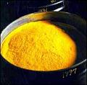
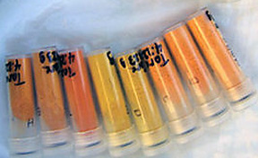
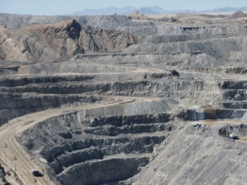
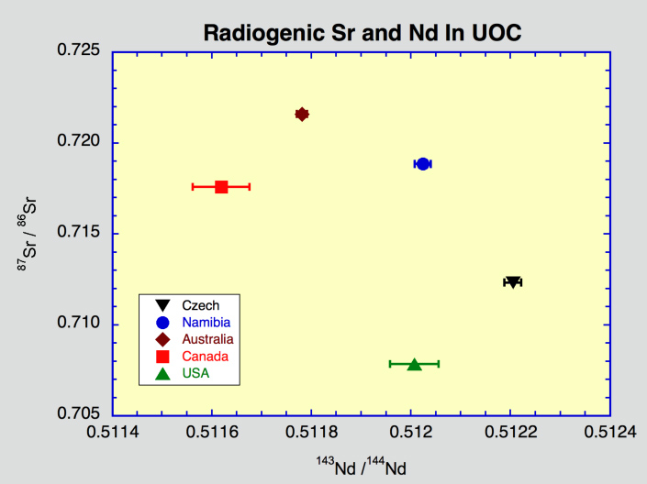
Uranium Ore Concentrate Sourcing
The U-sourcing database is a model for managing nuclear forensic data and samples
Contains >300 physical samples of UOC from around the world
Contains data on >40 parameters (trace elements, color, U-isotopes) for >4500 samples from 30 facilities
Uses isotope, chemical and physical properties as fingerprints
LLNL created the Discriminant Analysis Verification Engine (DAVE) to query the database
DAVE identifies source of UOC samples with ~90% accuracy

Slide 31
Lessons Learned—My Personal View
When developing something new, other people try to fit it into their old “narratives” (existing programs, perspectives & concerns)
Conflicting perspectives between interested organizations have impeded the understanding and development of NF
Serendipity played an important role in the development of NF
International cooperation is essential and difficult
Developing new signatures is central and challenging
It’s OK to be persistent—if you’re right about it being important

