Slide 1
Building a Nuclear Forensics Capability in South Africa
IAEA Conference on Advances in Nuclear Forensics
July 2014
Ian D. Hutcheon
Glenn Seaborg Institute

Slide 2
“In a strange turn of history, the threat of global nuclear war has gone down, but the risk of a nuclear attack has gone up.”
President Barack Obama, 2009, Prague

Slide 3
Illicit trafficking of nuclear materials & nuclear forensic investigations are international issues
No single country can hope to address this critical 21st century problem, even on a local scale, without global engagement
The NNSA Office of Nonproliferation and International Security sponsors international engagement in nuclear forensics
We have nuclear forensic cooperative engagement activities with 10 countries and 4 international organizations
Develop baseline capabilities in other countries
Build long-term trust and relationships key to meeting future national security challenges
Scientist to scientist interactions are key to building relationships
Strengthening global nuclear forensics capacity and adopting best practices serve as a potential deterrent to prospective proliferators

Slide 4
South Africa and the United States have been cooperating in nuclear forensics since 2011
2011
2011
2012
2012
2012
2013
2014
2014
MOU signed
Experts’ meeting at LLNL
Necsa begins construction of NF laboratory
Analysis of Durban UOC
Initial meeting and agreement
First NF training course at LLNL
Necsa receives new ICP-MS
Second NF training course at Necsa

Slide 5
LLNL developed and held the first training course in nuclear forensic analysis
The course provided an introduction to nuclear forensic analysis
Introduction to Nuclear Forensics
Introduction to nuclear fuel cycle
Uranium-rich materials relevant to UOC production
Basic chemistry associated with uranium ores and UOC production
Introduction to geochemistry and trace element analysis
Contamination Issues
Introduction to instrumentation
X-ray diffraction and x-ray fluorescence
Microscopy
Davies-Gray titration
ICP-MS for trace elements
Uncertainties
Introduction to nuclear forensic databases

Slide 6
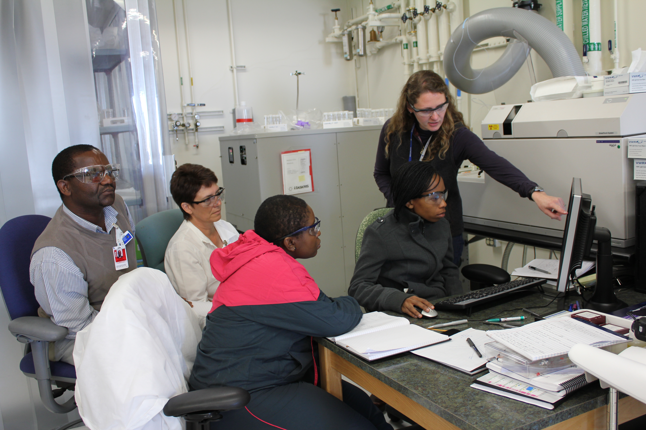
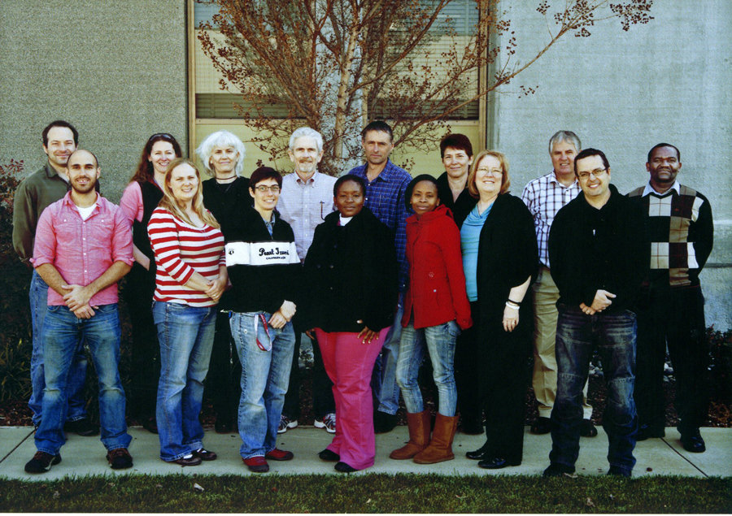
The course emphasized hands-on training in laboratory analysis
Introduction to laboratory analysis
Safe handling of radioactive materials
Chain-of-custody protocols
Basic laboratory equipment
Digestion and dissolution of U-rich materials
X-ray diffraction and x-ray fluorescence
Davies-Gray titration
Microscopy
ICP-MS for trace elements
End-to-end analysis of U-rich material
Data analysis and reporting

Slide 7
Necsa and LLNL developed a visiting scholars program to share expertise and experience
Inaugurated in January 2013
Kobus Hancke spent a month at LLNL, working in the nuclear forensic laboratories on a daily basis
Kobus also worked with Martin Robel to develop a nuclear forensics database meeting South Africa’s materials and needs
Provides an effective mechanism for enhancing nuclear forensic and nuclear security programs in partner countries
Supported by the U.S. Dept. of State’s Partnership for Nuclear Security program

Slide 8
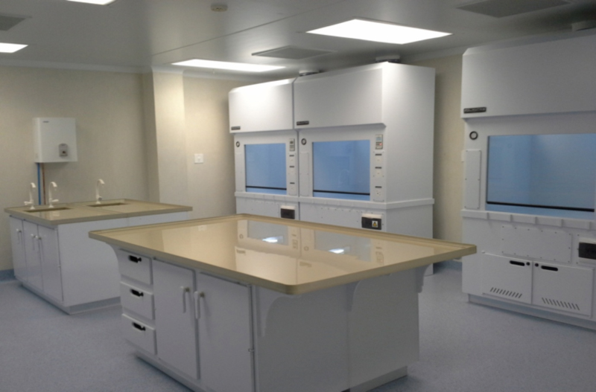
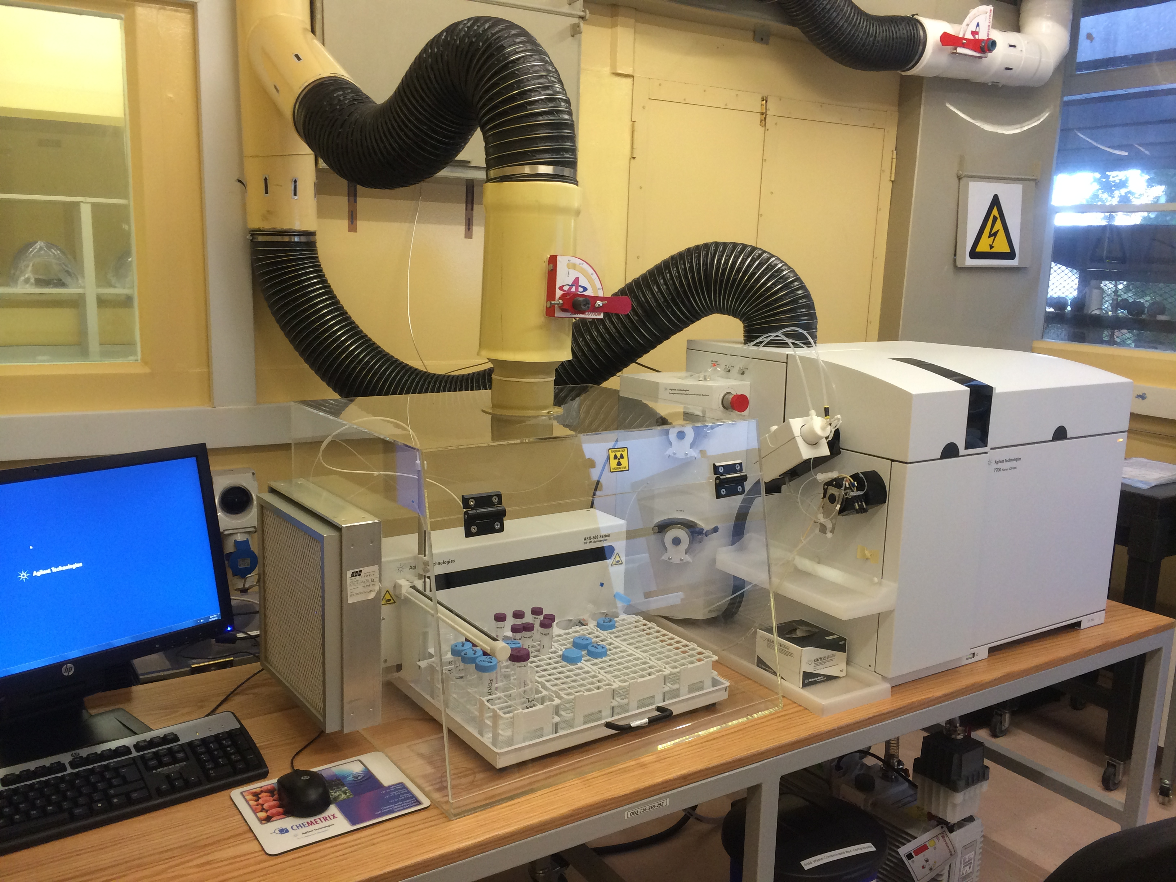
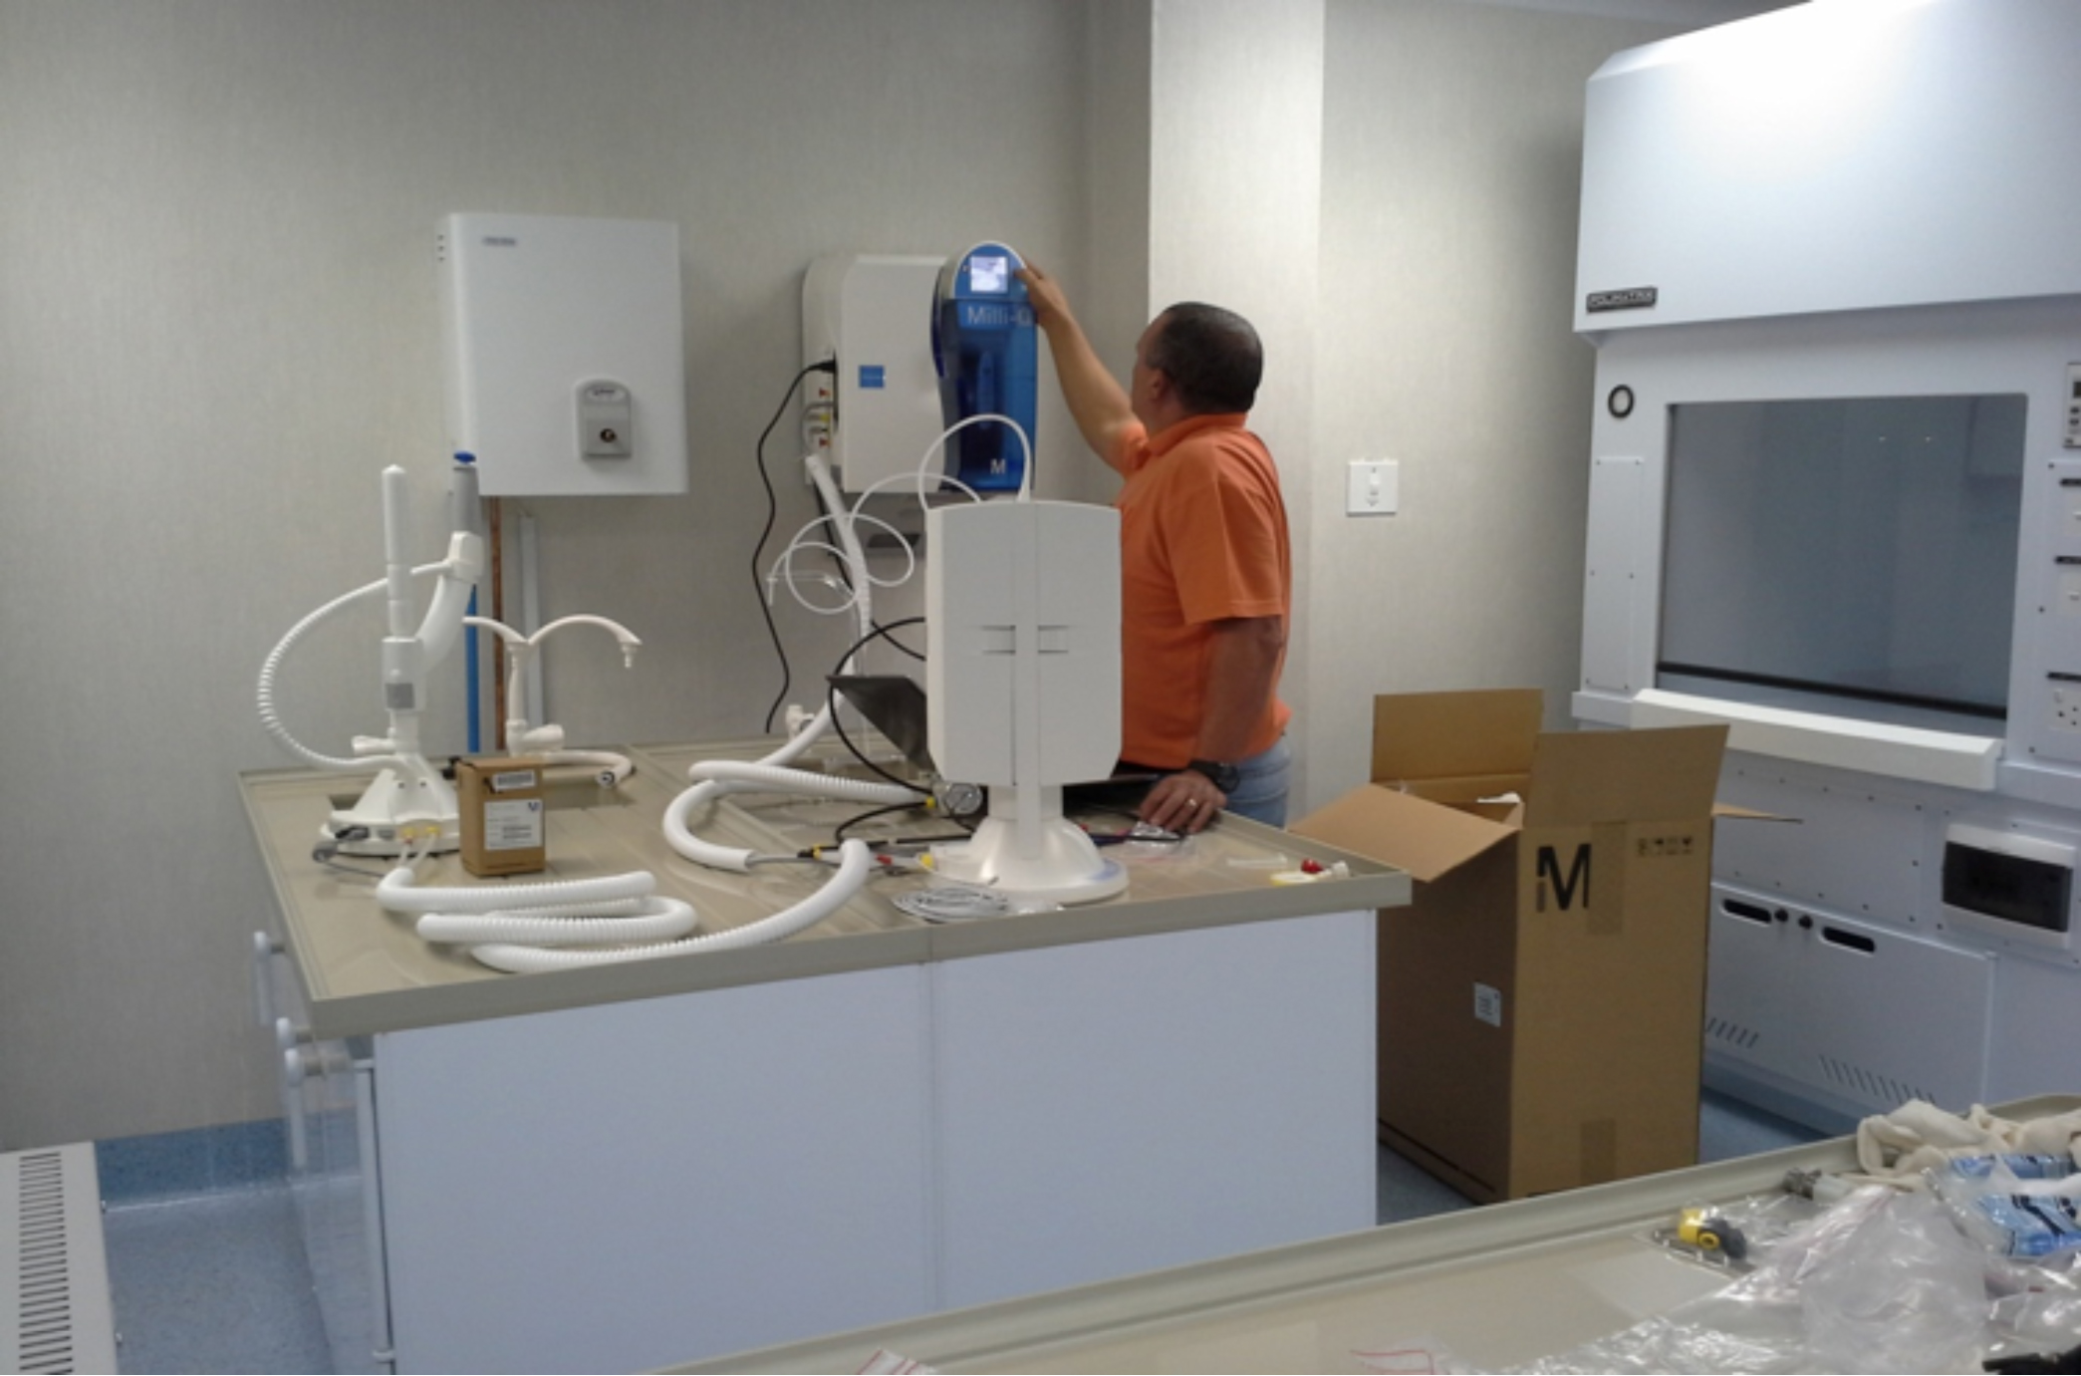
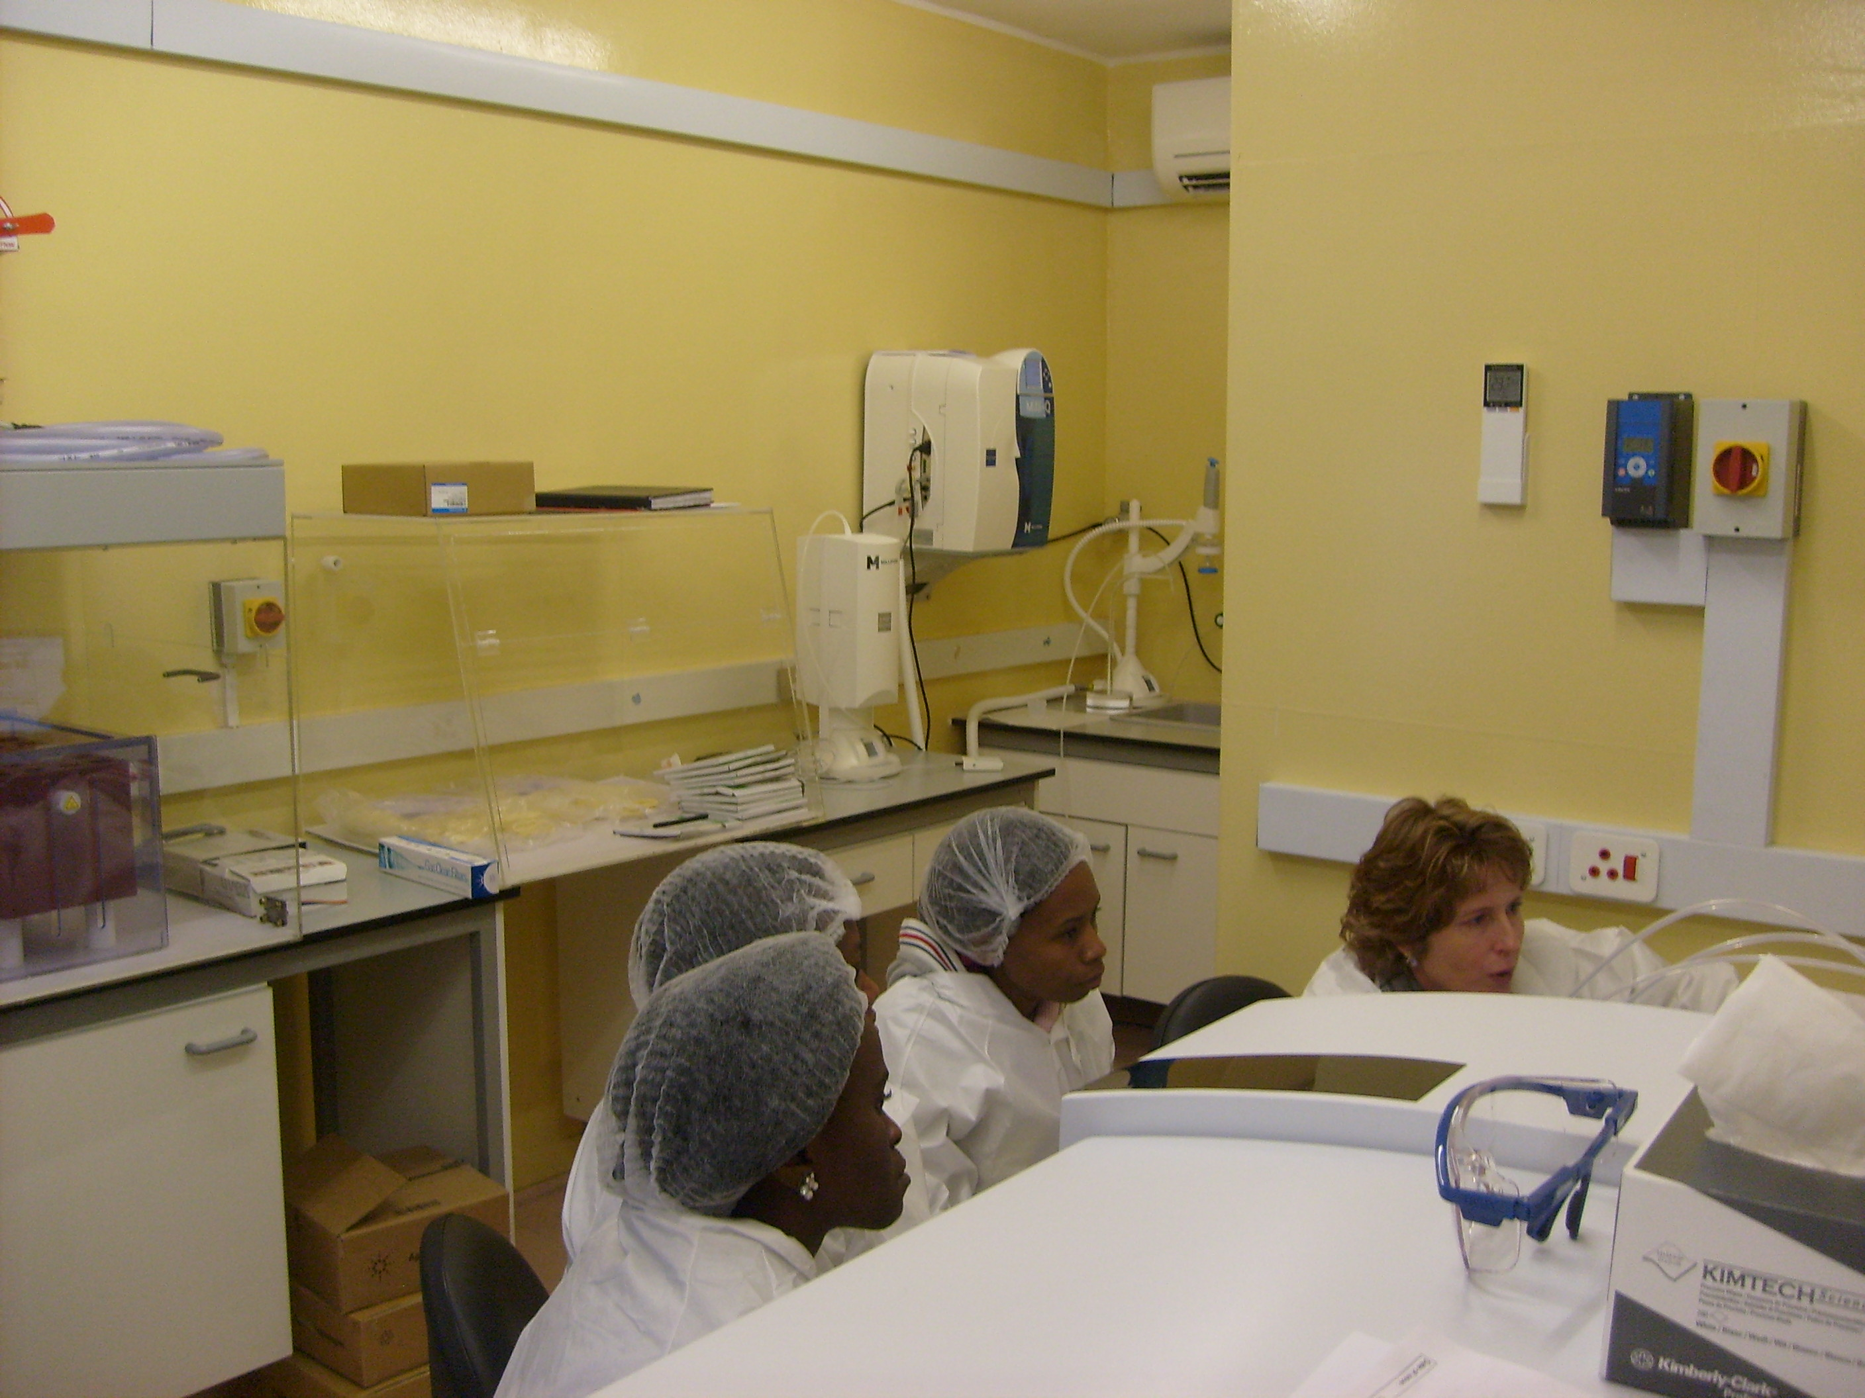
Necsa procured a new ICP-MS and installed a clean room for nuclear forensic analysis

Slide 9
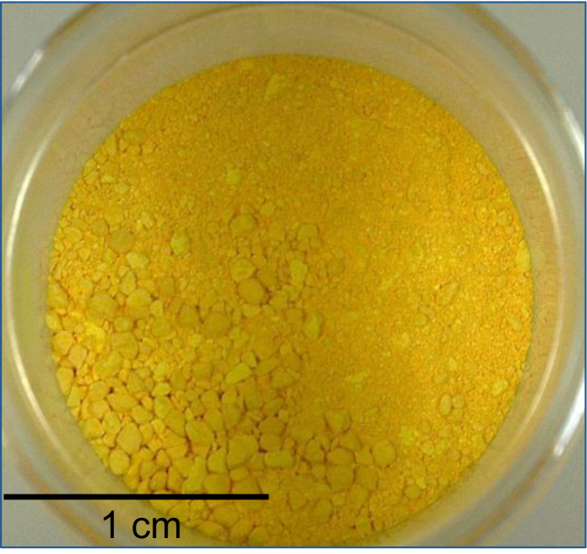
The analysis of the Durban UOC provided a good example of the value of the collaboration
Seamless and rapid transfer of a sample from Necsa to LLNL
Participation of Necsa staff in the analyses at LLNL
Rapid sharing of information between Necsa and LLNL
See presentation describing the analysis of the Durban UOC
Provides the basis for expanded joint analyses in years to come

Slide 10
The collaboration between South Africa and the United States has been highly successful
Many notable accomplishments over the part 5 years
Developed an MOU between Necsa, LLNL and LANL
Training of Necsa staff in nuclear forensic analysis
Development of a nuclear forensic library in South Africa
Enhanced capacity for nuclear forensic analysis in South Africa
Seamless and rapid transfer of an interdicted sample
Provides the basis for expanded cooperation and capacity building moving ahead

Slide 11
Acknowledgements
The LLNL/NECSA nuclear forensics team:
Lars Borg
Amy M. Gaffney
Victoria G. Genetti
Patrick M. Grant
Kobus J. Hancke
Ian D. Hutcheon
Theresa M. Kayzar
Gregory L. Klunder
Kim B. Knight
Michael J. Kristo
Rachel E. Lindvall
Naomi Marks
Reuben P. Mogafe
Aubrey N. Nelwamondo
Christina E. Ramon
Erick C. Ramon
Martin Robel
Michael A. Sharp
Michael J. Singleton
Ross W. Williams
Work supported by NNSA’s Office of Defense Nuclear Nonproliferation and the South African Nuclear Energy Corporation

