Slide 1
Populating a National Nuclear Forensics Library (NNFL)
John F. Wacker
Pacific Northwest National Laboratory
Presented at the “International Conference on Advances in Nuclear Forensics:
Countering the Evolving Threat of Nuclear and Other Radioactive Material out of Regulatory Control”
IAEA, Vienna, Austria 07-10July2014
PNNL-SA-103748
Presentation Ref. Number: IAEA-CN-218-59
International Conference on Advances in Nuclear Forensics, Vienna, Austria; 7-10 July 2014

Slide 2
Acknowledgements
Pacific Northwest National Laboratory
Andy Luksic (retired)
US Department of Energy
Marcia Brisson (Nuclear Materials Information Program (NMIP))
Stephen LaMont (Nuclear Materials Information Program (NMIP))
Heather Dion (National Nuclear Security Administration)
US Department of Homeland Security
William Ulicny
Los Alamos National Laboratory
David Olivas
Joe Watts
Savannah River National Laboratory
Donna Beals (retired)
PNNL-SA-103748

Slide 3
United States NNFL
Goal: Ensure domestic material would be recognized if interdicted or used in a terrorist event
Approach: Develop a Library and necessary support structure
National Nuclear Forensics Library
National Nuclear Material Archive
Data Interpretation and Comparative Analysis
Laboratory Analysis and Process Modeling
Entire U.S. effort is part of the U.S. Nuclear Materials Information Program (NMIP)
PNNL-SA-103748

Slide 4
U.S. NNFL: Implementation
National Nuclear Forensics Library
National Nuclear Material Archive
Data Interpretation and Comparative Analysis
Laboratory Analysis and Process Modeling
Data Dictionary: Published
Database: Under Development
DOE Laboratories
Los Alamos
Y-12
PNNL-SA-103748

Slide 5
Developing an Inventory
If some nuclear material is found outside of administrative controls anywhere in the world, can each country answer the question:
“Is it ours?”
Verifying inventory may confirm that material does not appear to be missing, but that may not be sufficient
PNNL-SA-103748

Slide 6
Developing an Inventory
Fully characterizing the US inventory of nuclear materials is a challenging and complex task
The US has been producing nuclear materials for ~70 years
The US inventory includes a wide variety of uranium and plutonium
Physically
Chemically
Isotopically
Any of these can be modified, though changing the isotopics is the most difficult
PNNL-SA-103748

Slide 7
Searching for Nuclear Materials Data
Nuclear Materials Management & Safeguards System (NMMSS)
U.S. government’s information system containing current and historic data on the possession, use, and shipment of nuclear materials.
NMMSS contains some materials information, but does not contain sufficient details needed for nuclear forensics analysis
Production facilities
Information is available on various materials, produced and recycled
But, the data are often incomplete, e.g., data showing that specifications have been met
Thus, NMIP needed to develop a more detailed database of materials characteristics
Nevertheless, information in NMMSS and other databases has proven to be valuable and is being utilized by NMIP
PNNL-SA-103748

Slide 8
Finding the Data
NMMSS
Weapons Program
Material Production
Weapons Production
Surveillance
Disposition
Fuel Fabrication
Publications/Reports
National Laboratories
Scientific Journals
PNNL-SA-103748

Slide 9
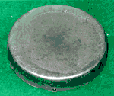
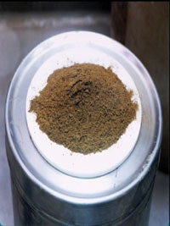
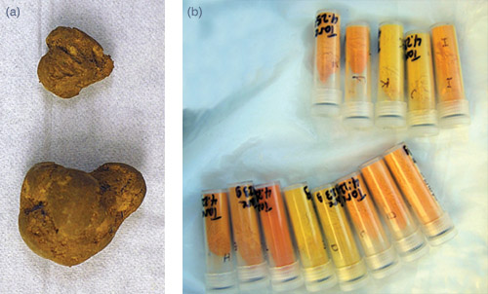
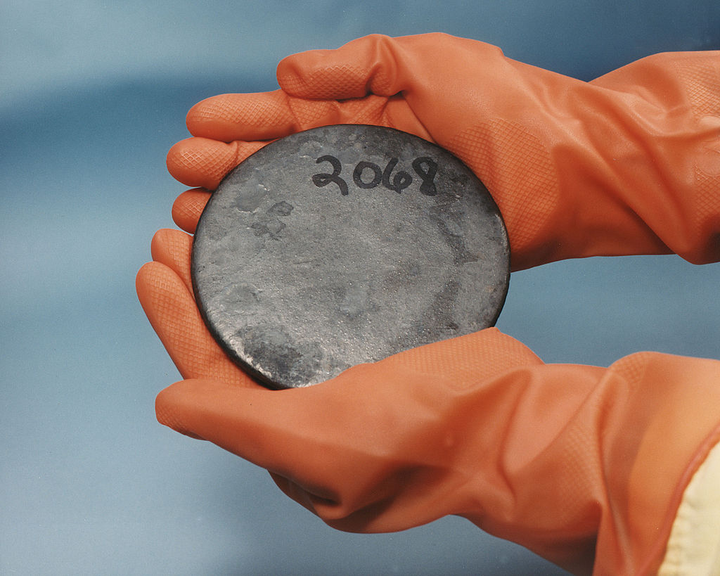
Mining Existing Data
Isotopic Composition (NMMSS)
Uranium weight and U-235 content
Plutonium weight and Pu-239 content
Initial characterization (but we require more!)
Uranium: U-232, U-233, U-234, U-236
Plutonium: Pu-238, Pu-240, Pu-241, Pu-242
Other sources have additional data, but is it useful?
PNNL-SA-103748

Slide 10
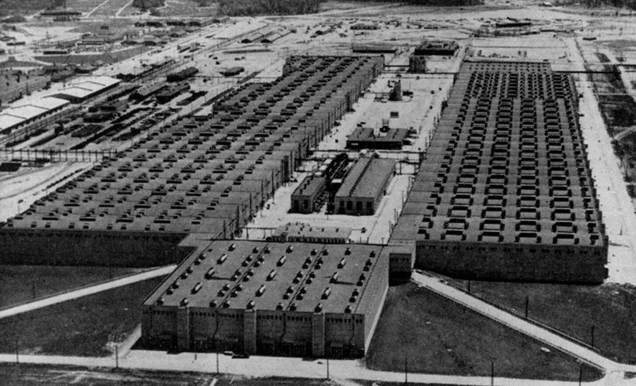
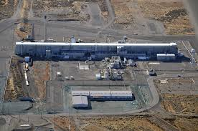
Effect of Process Histories
Different processes impart different signatures.
Identifying signatures associated with processes we used, potentially allows us to include or exclude unknown material as being “ours.”
We need to identify those signatures and acquire the associated data on our material.
PNNL-SA-103748

Slide 11
Data
Goal: Full Characterization of Nuclear Materials
Relevant material characteristics includes:
Isotopic composition
Elemental composition
Chemical form
Physical form
Processing age
Morphology
This presentation will discuss the U.S. experience
PNNL-SA-103748

Slide 12
Data
Detailed information on isotopic compositions is our initial priority
Pu-238 U-233
Pu-239 U-234
Pu-240 U-235
Pu-241 U-236
Pu-242 U-238
First, acquire available information
Identify Gaps, and work to fill them
PNNL-SA-103748

Slide 13
Data
NMMSS provides high-level characterization for most attributes
Types of historic data sets
Facility Production Records
Shipments from Production Site
Rocky Flats measurements
Integrated Surveillance Program (MOX program)
R&D Measurements
Much of the U.S. data is hard copy
Much is no longer available
PNNL-SA-103748

Slide 14
Data
Tens of thousands of records
Numerous facilities
Varying requirements
Quality determined by requirements
Accuracy may be goal of measurement
Within specification may be sufficient
Less than may be good enough
Function of time (we got better as time progressed)
Measurements performed for production purposes are generally not sufficient for forensic purposes
PNNL-SA-103748

Slide 15
Measurements
15
Characterization of plutonium changed significantly over time
1940s-1950s neutrons/g-sec
mid-1950s Pu-240
late-1960s Pu-240, Pu-241
mid-1970s Pu-240, Pu-241, Pu-242
1980s Pu-240, Pu-241, Pu-242, Pu-238
Uranium data evolved to include U-236, U-234 and other minors
Recorded data changed with time
Recorded data changed with utilization
PNNL-SA-103748

Slide 16
Measurements
NDA
DA
PNNL-SA-103748
16

Slide 17
Measurements
NDA
PNNL-SA-103748
Notes:
Hanford 327C = 600K

Slide 18
Data Vetting: Verification and Validation
1
DATA for SUBMISSION to NNFL
2
DATA INPUT
Manual Entry or
Electronic Data from another Database
3
REVIEW
INPUT DATA
4
DATA VERIFICATION
By Database Expert
5
DATA VALIDATION
By Subject Matter Expert
6
AUTHORIZE By
SME and Database Expert
&
Release Data To NNFL
PNNL-SA-103748

Slide 19
Issues for Data Vetting
Transcription errors
Typos, improperly transferred characters, etc.
Field mismatches
Truncating number strings, conversion amongst different numeric formats (for instance from integer to scientific notation)
Text to numeric conversions
e.g., parsing text information into numeric or alphanumeric fields
Less-than values, detection limits, non-reported data
e.g., “<500 ppm” or “not detected”
What should be entered when a numerical value is expected by the database?
Values with no quoted uncertainty
Very common in older database
Unit conversions or mismatched units
PNNL-SA-103748

Slide 20
Gaps and Prioritization
20
Acquiring data is a work in progress
Largest inventory categories first
Isotopics is considered the primary characteristic
Other data (elemental composition, trace elements, etc.) to be obtained as available
Conclusions to date
All historic data is not be available
All historic data is not suitable for forensic applications
Different analytical techniques produce different results
Modeled data may be required in the interim
New measurements will be required
Planning and Prioritization is in progress
PNNL-SA-103748

