Slide 1
Capabilities of Hybrid SIMS-SSAMS System for
Nuclear Forensics Applications
K. S. Grabowski, K. C. Fazel, D.L. Knies*
US Naval Research Laboratory
Washington, DC 20375
*Now at Coolescence, Boulder CO
Notes:
ETH U measurement use He stripper
“At ion energies of 330 keV a maximum transmission of about 40% is observed for
238U and 232Th [51] when using He as stripper gas. In the case of
236U measurements a higher stripper thickness has to be applied
to achieve a sufficiently high molecular dissociation rate [50]
resulting in a transmission of about 35% under real measurement
conditions. For Pu and Pa measurements the interfering UH and
ThH molecules can be efficiently suppressed by chemical preparation
so that the stripper gas thickness can be adjusted for optimal
transmission.”
References:
Leibniz Institute for Solid State and Materials Research Dresden http://www.ifw-dresden.de/institutes/ikm/organisation/dep-31/methods/secondary-ion-mass-spectrometry-sims
Benninghoven, A., Rudenauer, F. G., & Werner, H. W. (1987). Secondary Ion Mass Spectrometry: Basic Concepts, Instrumental Aspects, Applications and Trends (1st ed.). Wiley-Interscience.
Jacob, S. A. W., Suter, M., & Synal, H.-A. (2000). Ion beam interaction with stripper gas – Key for AMS at sub MeV. Nuclear Instruments and Methods in Physics Research Section B: Beam Interactions with Materials and Atoms, 172(1–4), 235–241. doi:10.1016/S0168-583X(00)00205-6
Suter, M. (1998). A new generation of small facilities for accelerator mass spectrometry. Nuclear Instruments and Methods in Physics Research Section B: Beam Interactions with Materials and Atoms, 139(1–4), 150–157. doi:10.1016/S0168-583X(97)00945-2 (shows method of extrapolating high to low E)
Christl, M., Wacker, L., Lippold, J., Synal, H.-A., & Suter, M. (2007). Protactinium-231: A new radionuclide for AMS. Nuclear Instruments and Methods in Physics Research Section B: Beam Interactions with Materials and Atoms, 262(2), 379–384. doi:10.1016/j.nimb.2007.05.017
Christl, M., Vockenhuber, C., Kubik, P. W., Wacker, L., Lachner, J., Alfimov, V., & Synal, H.-A. (n.d.). The ETH Zurich AMS facilities: Performance parameters and reference materials. Nuclear Instruments and Methods in Physics Research Section B: Beam Interactions with Materials and Atoms, (0). doi:10.1016/j.nimb.2012.03.004
BETZ, H.-D. (1972). Charge States and Charge-Changing Cross Sections of Fast Heavy Ions Penetrating Through Gaseous and Solid Media. Reviews of Modern Physics, 44(3), 465–539. doi:10.1103/RevModPhys.44.465

Slide 2
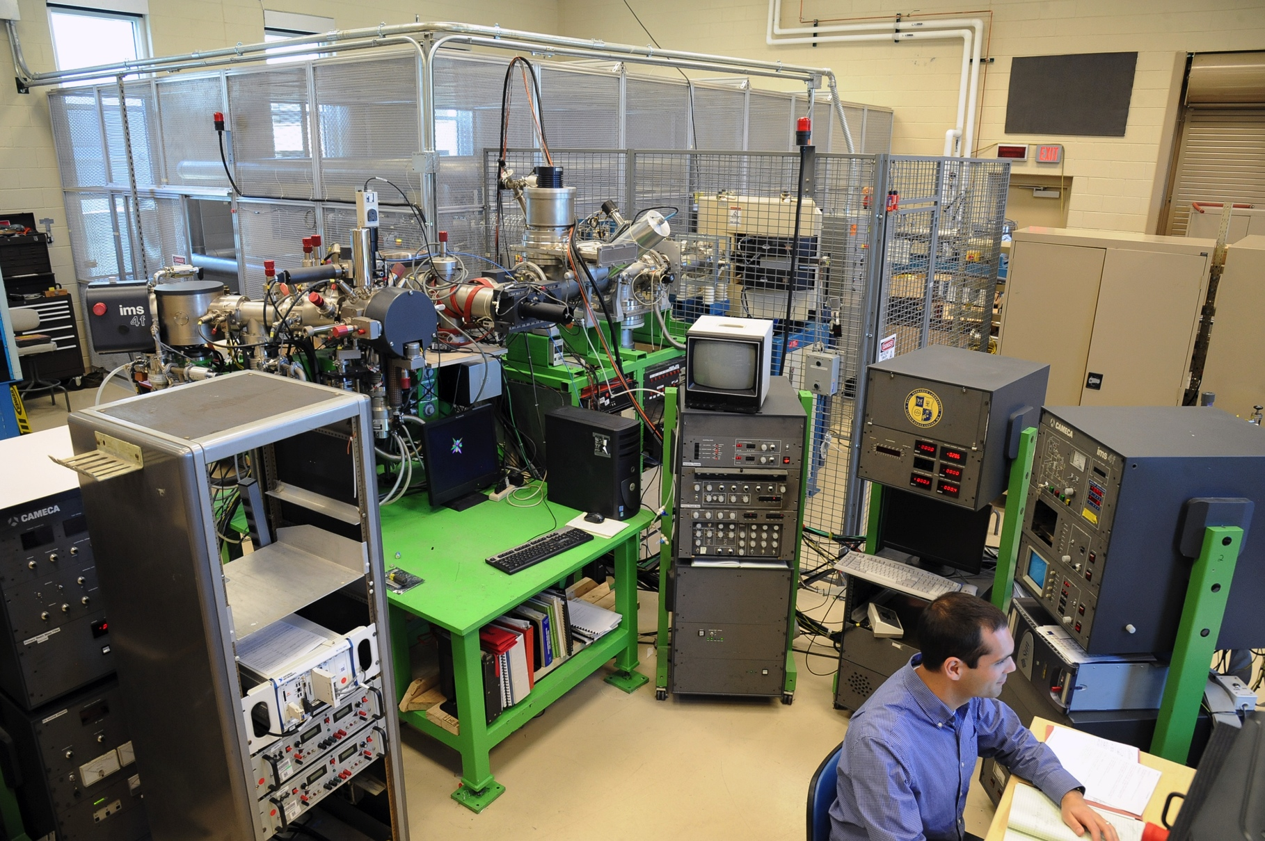
atomic ion SIMS (ai-SIMS) at NRL

Slide 3
Instrument Overview – A World Unique Tool
Achieve molecular-interference-free trace analysis with spatial resolution
Combine strong points of Secondary Ion Mass Spectrometry (SIMS) and Accelerator Mass Spectrometry (AMS) into one instrument
Uses:
Nuclear forensics
      Environmental samples of particulates
      Fingerprint of source material
Advanced Materials Science needs
        Structural
        Electronic
        Optical
        Biological
        NASA Discovery Mission samples

Slide 4
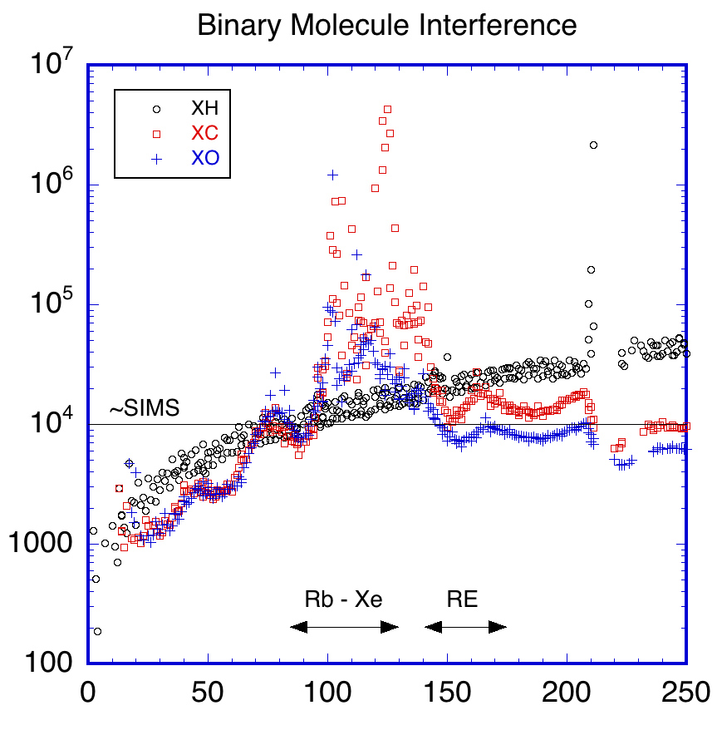
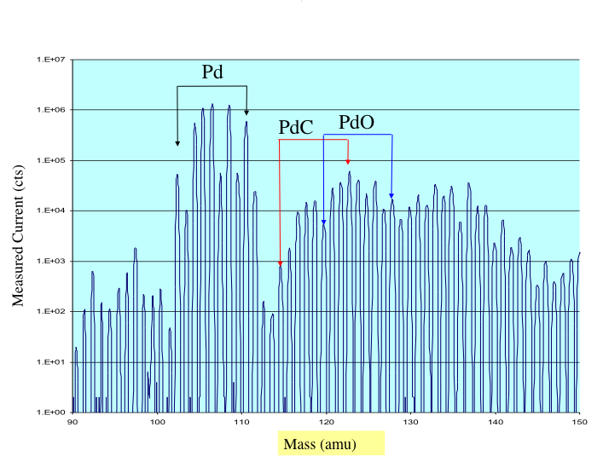
SIMS
Proven tool
Spatial information
Limited by molecular interferences (M>90)
1 10 10² 10³ 10⁴ 10⁵ 10⁶ 10⁷
Resolution Needed (M/ΔM)
Intensity (counts)
90 100 110 120 130 140 150
Mass (atomic mass units)
Mass (atomic mass units)

Slide 5
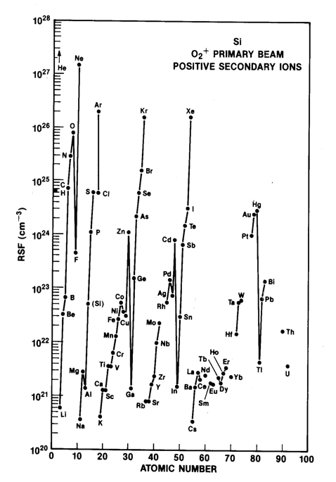
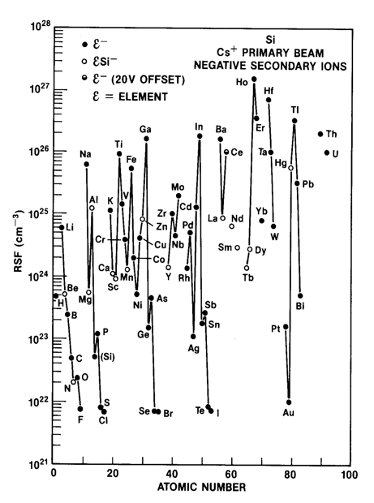
AMS
Ultra-trace capable (¹⁴C/¹²C > 10⁻¹⁵)
Molecules destroyed
Limited spatial information
Negative ions only
Sensitivity
Actinides
Lanthanides
10⁴ better with + ions

Slide 6
A Cornerstone Technique
+ ions
Molecular
Ions
~mm Resolution
ICPMS
+ SIMS
+ SIMS-SSAMS
- SIMS
AMS
- SIMS-SSAMS
No
Molecular
Ions
~µm Resolution
- ions

Slide 7
Recent Developments → ai-SIMS Now
AMS
  NRL Trace Element AMS (TEAMS) results
    Negative ion injection yields poor sensitivity
    Detection of +1 ions preferred, to remove ambiguities
  New smaller Single Stage AMS available and proven in radiocarbon analysis
    Enables injection of either + or - ions
    Abundant +1 ions for detection
Opportunity
  Employ SIMS to generate preferred + or - ions
  Inject + or - ions into small bipolar accelerator, detect +1 ions

Slide 8
Implementation of ± ai-SIMS at the
Naval Research Laboratory (NRL) in Washington DC

Slide 9
Flow Diagram of ai-SIMS
Ion Source
Sample
ESA
Magnet
Beam Switch
Injection Magnet
Analyzing Magnet
ESA
Detection
Gas Cell
300 kV Accelerator
CAMECA 4f
NEC SSAMS

Slide 10
NEC SSAMS Drawing
±300 kV Deck
28.3’
Magnet
Electrostatic Analyzer (ESA)
Molecule Destruction Chamber
Detectors
Acceleration Tube
(2) Motor/Generator Sets for AC Power on Deck
NRL injector and CAMECA 4f here
Injection Magnet

Slide 11
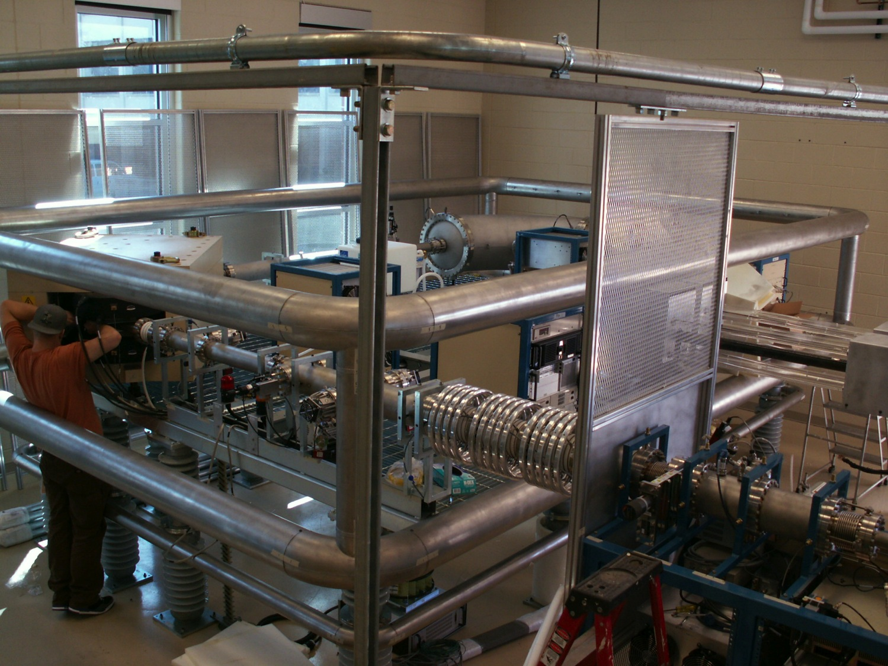
Electrostatic Analyzer (ESA)
Magnet
Insulation to “Bounce” Energy
Molecule Destruction Chamber
Acceleration Tube

Slide 12
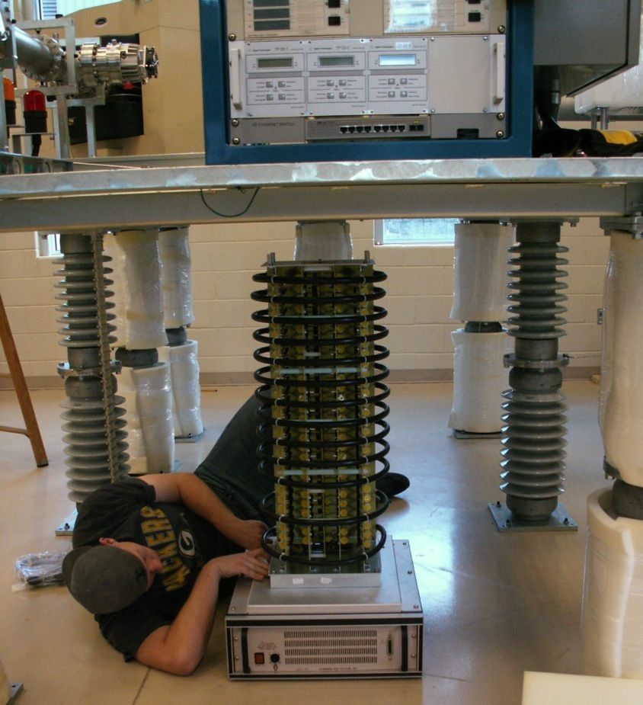
Interchangeable “Stack” for ±300 kV

Slide 13
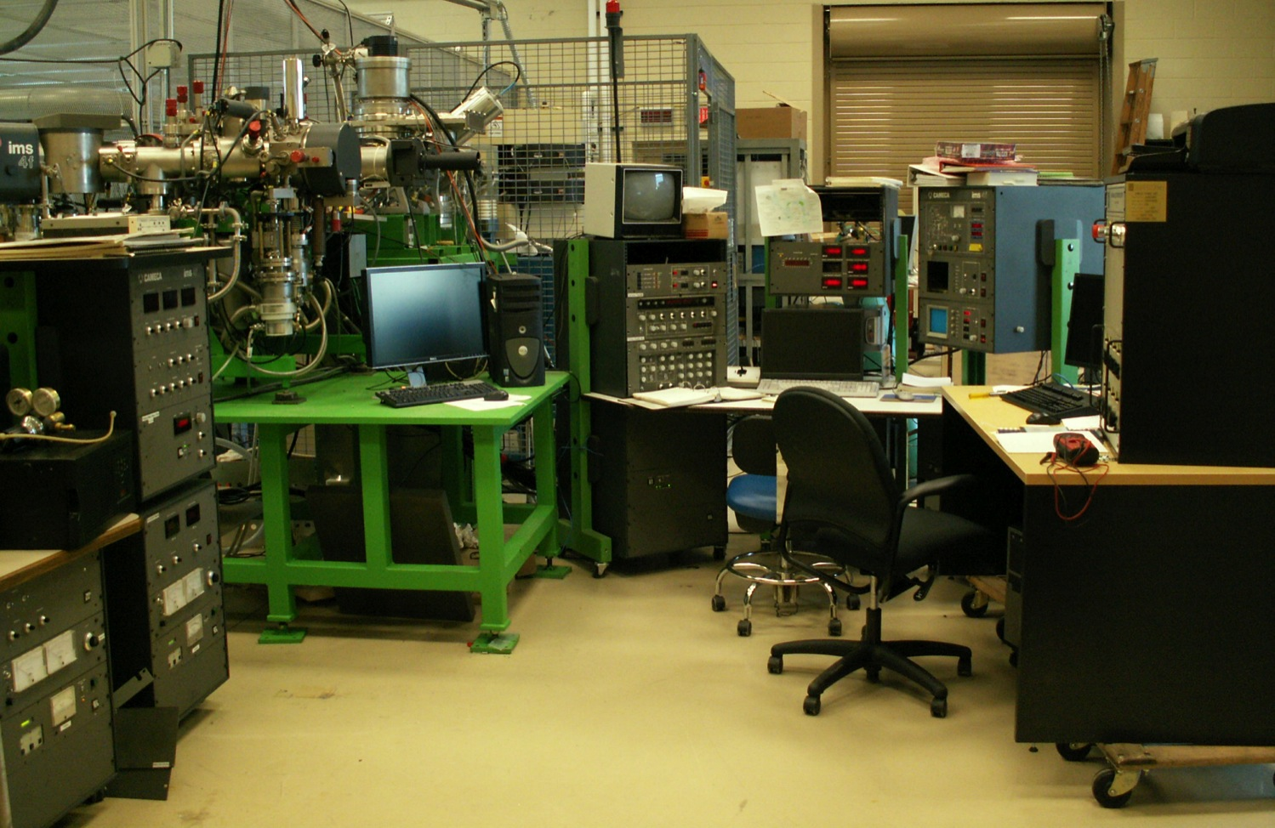
Cameca ims 4f, Coupling to NEC SSAMS, and Control Station

Slide 14
Instrument Development

Slide 15
Charge State
±1
+1,2,3,…
Gas chamber

Slide 16
Want Charge State +1 Ions for Analysis
 | Injected
Species | ¹¹⁸Sn₂ | ²³⁶U
Charge State (q) | +1 | +1
E (keV) | 300 | 300
M (u) | 236 | 236
 | Analyzed
Species | ¹¹⁸Sn | ²³⁶U
Charge State (q) | +1 | +2
E (keV) | 150 | 300
E/q | 150 | 150
M (u) | 118 | 236
M/q | 118 | 118
To avoid molecule breakup interferences

Slide 17
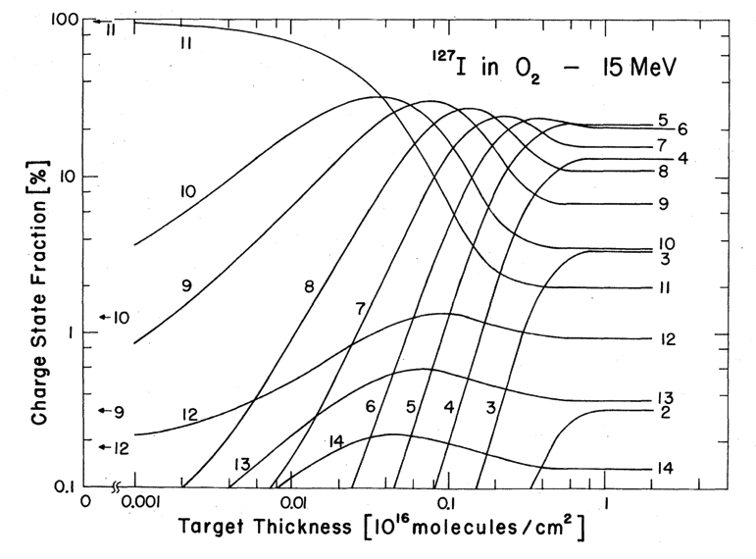
Equilibrium Conditions for Low-energy Heavy-ion Charge States Needed
Needed for each ion, energy, and gas used
Model based on charge changing cross sections can be developed
Injected Distribution
Equilibrium Distribution
Betz,H-D., Charge states and charge-changing cross sections of fast heavy ions penetrating through gaseous and solid media. Rev. Mod. Phys. 44 (1972) 465. Copyright (1972) by the American Physical Society.

Slide 18
Choose Gas and Energy to Maximize U¹⁺
Ar, Kr, Xe, H₂ better than He?
Desired
Vockenhuber, C. et al. The potential of He stripping in heavy ion AMS. Nucl. Instrum. Meth. B 294 (2013) 382. Reprinted with permission of Elsevier.

Slide 19
Molecule Dissociation and Beam Broadening
1+
Gas chamber

Slide 20
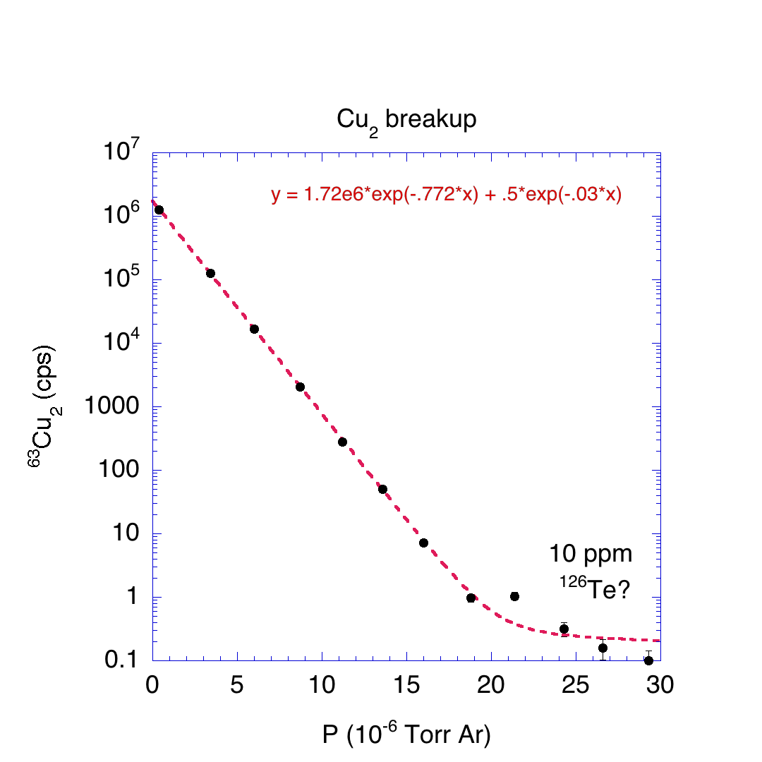
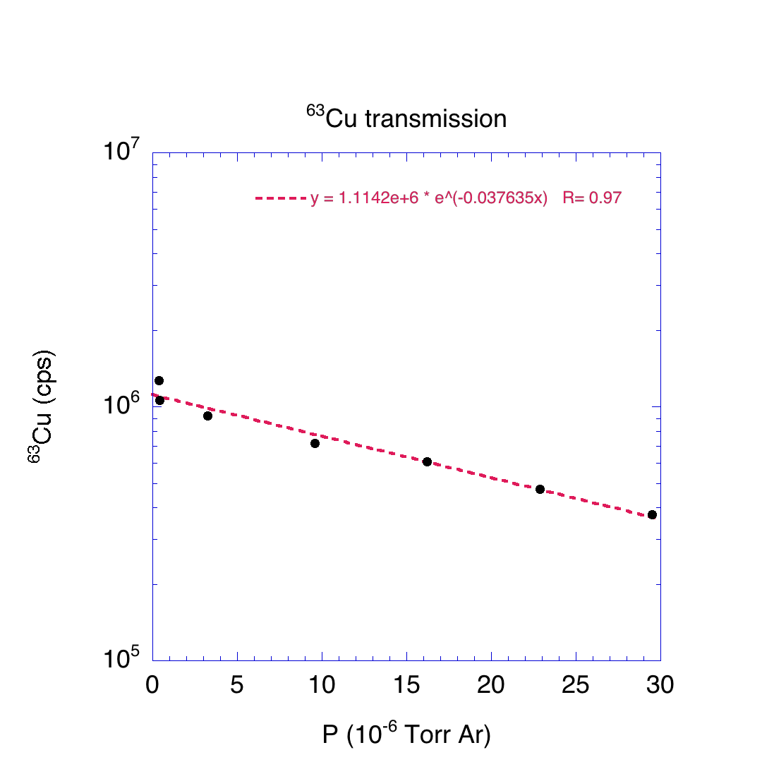
⁶³Cu₂
Ar breakup gas reduced ⁶³Cu₂ intensity by 10⁷, while reducing ⁶³Cu intensity by 70%. Residual ¹²⁶Te may appear from under ⁶³Cu₂ molecule ion peak.

Slide 21
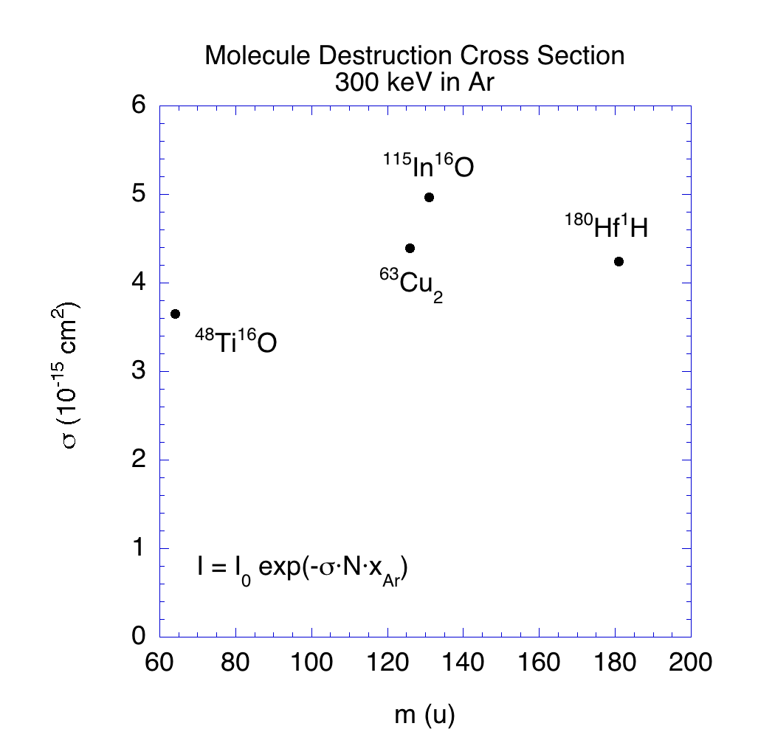
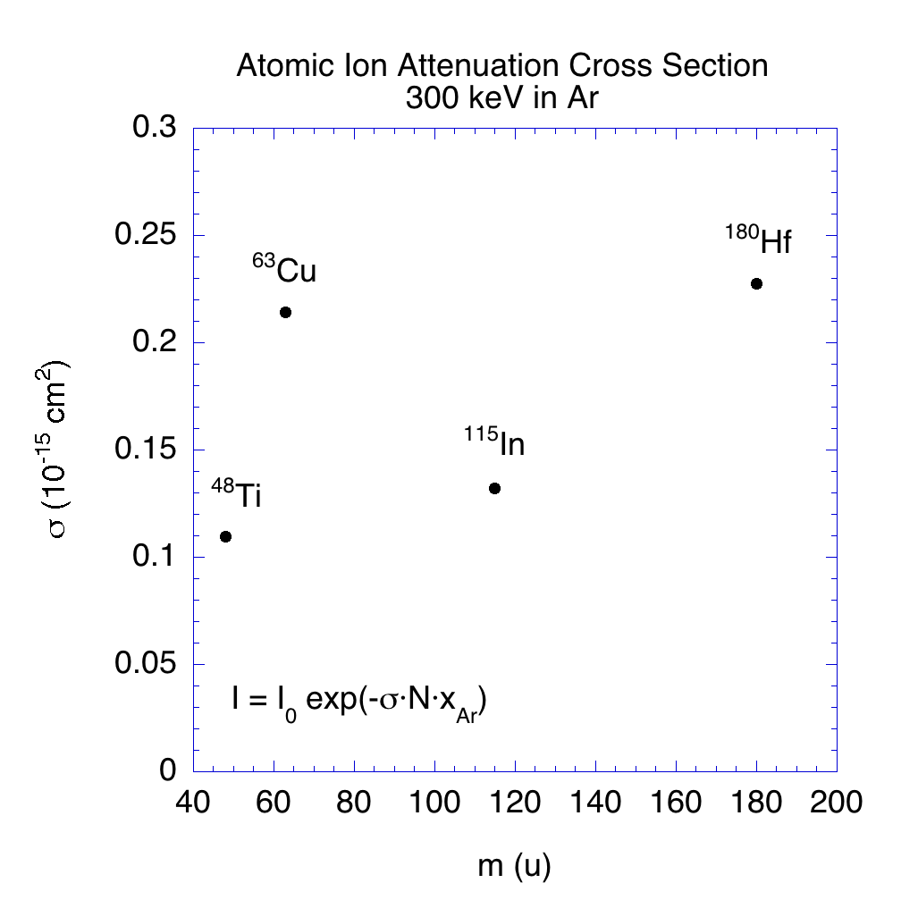
Cross Sections
Molecular ion destruction cross section ~20x that of atomic ion attenuation. Functional dependence on energy, gas, and molecule will be used to develop a predictive model to optimize methodology. Sparse data available at these conditions.

Slide 22
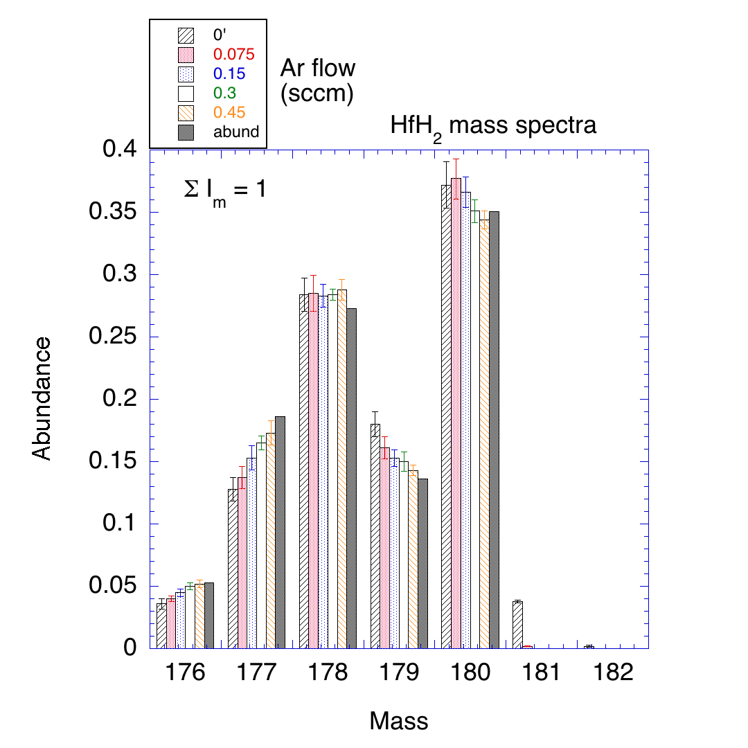
Mass Distribution of Hf Isotopes from HfH₂ Sample
Hf-isotope mass distribution perturbed by Hf hydride molecules.
Use of 0.45 sccm flow of Ar improves measurement to near natural abundance values.

Slide 23
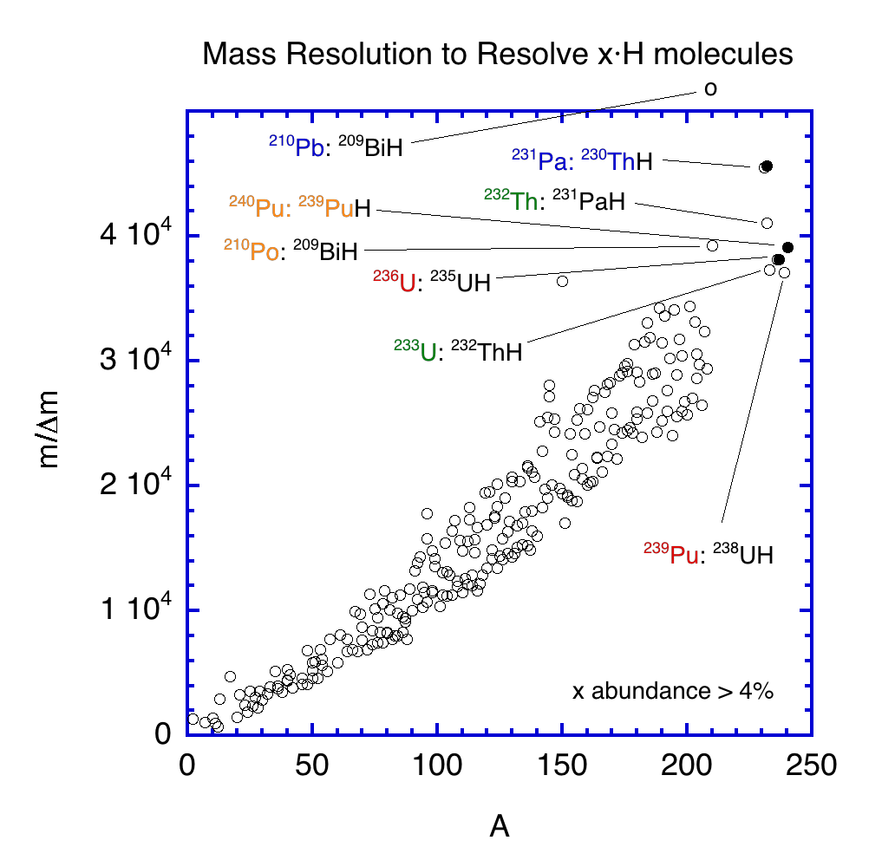
Nuclear Forensics Concerns
Monohydrides can obscure measurement of pertinent isotopes:
Neutron exposure of U
  ²³⁶U, ²³⁹Pu
Age of processed U
  ²³¹Pa, ²¹⁰Pb
Bomb component
  ²¹⁰Po, ²³⁹Pu/²⁴⁰Pu
Repurposing of ²³²Th
  ²³³Pa/²³³U

Slide 24
Instrument Applications

Slide 25
Nuclear Forensics and Safeguard Verification
Environmental samples of particulates
  Need isotope ratios: 236/238, 235/238
  Hydride molecules formed (²³⁵UH ~ ²³⁶U)
  Abundance sensitivity issue with ²³⁸U
  SIMS currently used, precision limitations
Fingerprint of source material
  ²³⁶U present
  Lanthanide levels present in natural U
  Pu isotopes in mixed U/Pu particles

Slide 26
Plan
Complete control integration and operational testing
Model and test performance characteristics of ai-SIMS as function of ion charge state, energy, stripper gas and pressure for various materials
Initiate measurement of representative samples
Determine sensitivity and precision for prototype samples
Measure isotope ratio and elemental abundance of standards, then real samples

Slide 27
Summary
Bipolar ai-SIMS =
  First in world
  10⁴ improved sensitivity for Lanthanides, Actinides
  Removes molecular interferences for M > 90 u
  Provides image and depth profile composition
  Challenges exist, but recent high-mass research shows path forward
  Has many relevant applications
  Installed at NRL, undergoing “shakedown”
Welcoming samples for analysis and collaborations

