Slide 1
Investigating macro- and micro-scale material provenancing signatures in uranium ore concentrates/yellowcake
A. Wotherspoon, L. Vance, J. Davis, J. Hester, D. Gregg, G. Griffiths, I. Karatchevtseva, Y. Zhang, T. Palmer, E. Keegan, N. Blagojevic, E. Loi, D. Hill, and M. Reinhard

Slide 2

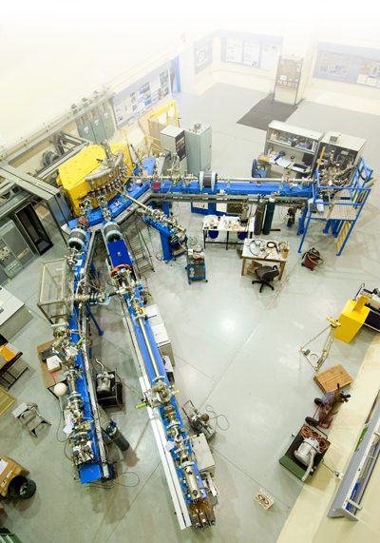
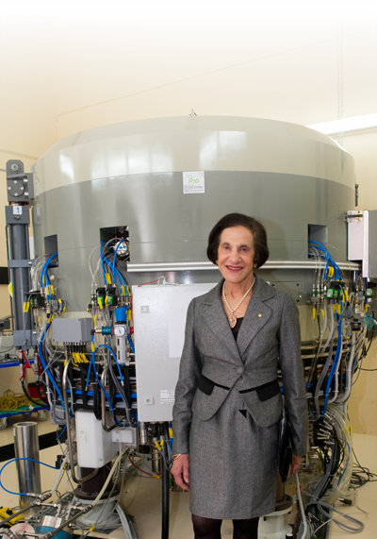
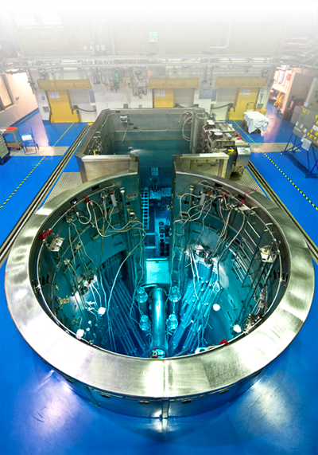
ANSTO Facilities
Synchrotron
Accelerators
Cyclotron
OPAL
Notes:
Image (L-R) Australian Synchrotron building; ANTARES accelerator; Marie Bashir in from of the National Imaging Facility Research Cyclotron in Camperdown; the OPAL pool

Slide 3
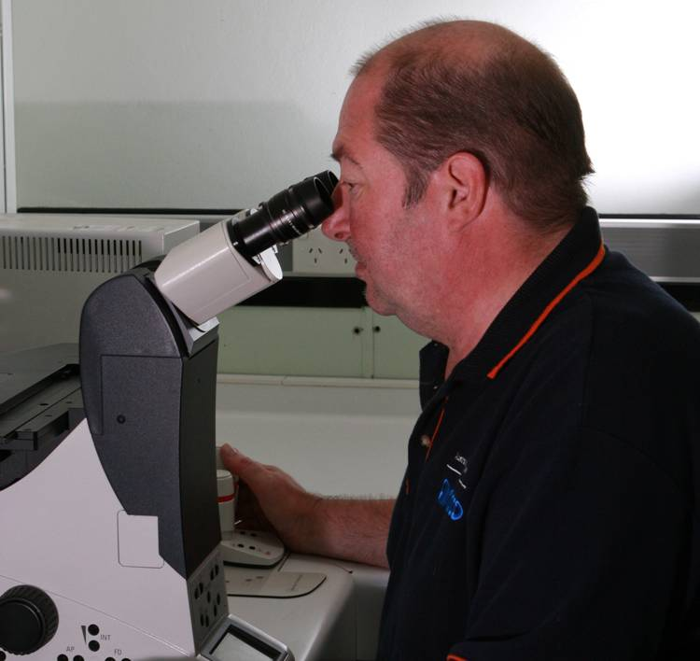
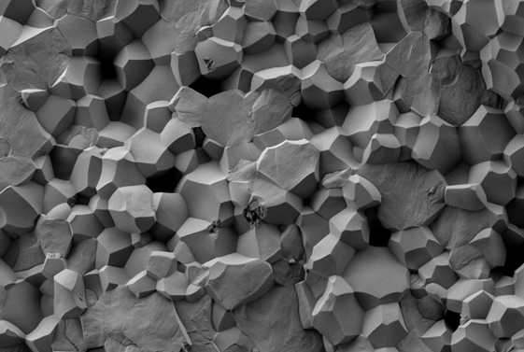
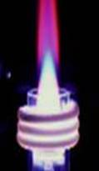
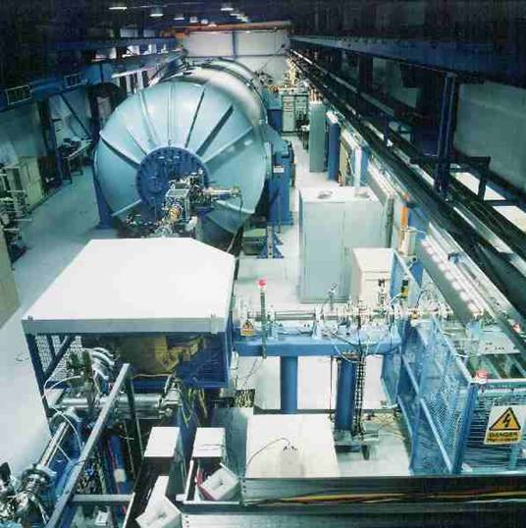
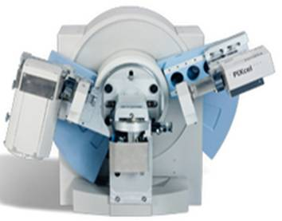
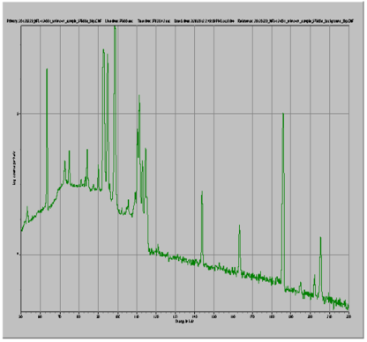
Utilising ANSTO’s Existing Analytical Capabilities
AMS
XRD & XRF
γ & α spectrometry and liquid scintillation
Microscopy & metallography
SEM & TEM
ICP-MS & ICP-AES

Slide 4

Rationale for UOC Provenance Research
Australia possesses the world’s largest estimated recoverable resources of uranium bearing ore.
Notes:
The secure export of this high value commodity is of particular relevance to the Australian economy.

Slide 5
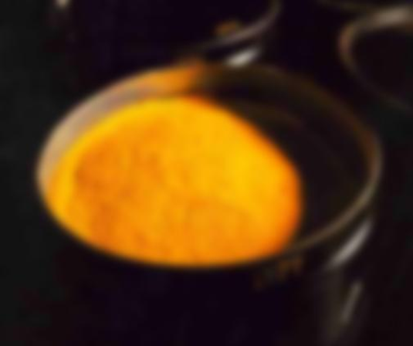
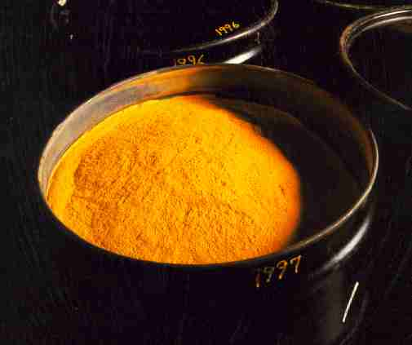
The Nuclear Forensics group
provides tools to determine with clarity
material origin(s)
No single analysis technique currently capable of discriminating all UOC materials
For this body of work we developed a systematic approach to identify sample ‘provenancing signatures’.
Techniques were based on elucidating:
Electron energy bands in the solids concerned (VIS-NIR)
Structural studies such as conformation and lattice dynamics of samples (Far IR), and phase composition (X-ray and Neutron Diffraction).
Morphology (SEM)
Notes:
Currently, no singular analysis technique has been capable of elucidating the origins of all UOC materials. However, taken as a combination information provided from different individual analytical techniques can enhance the discrimination of unknown materials. The Australian Nuclear Science and Technology Organisation’s

Slide 6


Australian uranium ore concentrate samples analysed for uranium speciation and microstructural features
Ranger
Olympic Dam
Beverley

Slide 7
Australian uranium ore concentrate samples analysed for uranium speciation and microstructural features
Ranger (Ra.) (exported as U₃O₈): Opened 1980
- Unconformity related; U mineralogy, uraninite, brannerite, pitchblende; - Gangue is chlorite, muscovite, clay minerals;
- Processing H₂SO₄ leach, SX, (NH₄)₂SO₄ strip, NH₃ pptn of U
- [3 samples, 6 months apart, from 2004]
Olympic Dam (O.D.) (exported as U₃O₈): Opened 1988
- Hematite/breccia complex; U mineralogy, uraninite, coffinite, brannerite, - Gangue, chlorite, sericite, clay minerals
- Complex processing (due to recovery of Cu, U, Ag, and Au). H₂SO₄ leach, SX, (NH₄)₂SO₄ strip, NH₃ pptn of U
- [2 samples, 8 months apart, dating from 2006]
Beverley (Bev.) (exported as uranium peroxide (UO₄.nH₂O): Opened 2001
- Sandstone, basal/palaeochannel; U mineralogy Coffinite, uraninite;
- Gangue is Quartz, clay, feldspar, traces of gypsum;
- Processing H₂SO₄ leach/H₂O₂, IX, washed with salt/dil. H₂SO₄, neutralized NaOH(aq), pptn with H₂O₂
- [3 samples, 6 months apart, dating from 2004]

Slide 8
Experimental – ‘Profiling Techniques’
VIS/NIR Spectroscopy (DRS Mode)
Transmission IR
Positron Annihilation Lifetime Spectroscopy (PALS)
Scanning Electron Microscopy (SEM)
X-ray and Neutron Diffraction (XRD/ND)
Notes:
Nuclear Forensics Research Facility (ANSTO-NFRF) is in the process of examining diffuse reflectance spectroscopy (DRS) of yellowcake materials in the range of the near-infrared (IR) (4000-12500 cm⁻¹), and as colour is an important indicator of processing, the UV/VIS wavelengths (50000-12500 cm⁻¹) amongst other techniques. We have also examined the far-infrared in transmission mode (700-20 cm⁻¹), to distinguish between UOC of known ore/mining/extraction age containing different species and polymorphs of uranium and confirmed phases/structures with XRD and/or neutron diffraction. SEM provided substantive answers on particulate morphology. Neutron and X-ray diffraction allowed identification of minor phase differences, characteristic of material provenance/processing. Positron annihilation lifetime spectroscopy showed only quite minor differences between samples.

Slide 9
Diffuse Reflectance Spectrometry
Fig.1: Full Scan Vis/NIR spectra of Beverley UOCs
Exhibiting little spectral differences between batches of Beverley UOC material
Notes:
DRS in NIR has been recently shown to be a particularly useful non-destructive technique for identifying the speciation, notably the valence, of uranium. This was demonstrated herein, with Figs. 1 and 2 showing major differences in the absorption of the two U₃O₈ samples vs the UO₄.nH₂O. Subtle differences in the absorption peaks were observed between the two U₃O₈ exporting mines (Fig. 4, ~1500 and 1560 nm) will be examined further to determine the consistency for multivariate discrimination for this uranium oxide from these two mines.

Slide 10
Diffuse Reflectance Spectrometry
Fig.2: Full Scan Vis/NIR spectra of Ranger and Olympic Dam UOCs
Exhibiting little spectral differences between batches of Ranger and Olympic Dam UOC material, with the exception of ratio of bands at ~1500 and 1560 cm-1.
Notes:
DRS in NIR has been recently shown to be a particularly useful non-destructive technique for identifying the speciation, notably the valence, of uranium. This was demonstrated herein, with Figs. 1 and 2 showing major differences in the absorption of the two U₃O₈ samples vs the UO₄.nH₂O. Subtle differences in the absorption peaks were observed between the two U₃O₈ exporting mines (Fig. 4, ~1500 and 1860 nm) will be examined further to determine the consistency for multivariate discrimination for this uranium oxide from these two mines.

Slide 11
Transmission Far IR of UOC
? diff
No shift
Absorbance
cm⁻¹
Fig.3: Transmission Far IR spectra of Beverley (Bev.), Ranger (Ra.) and Olympic Dam (O.D.) UOCs
Exhibiting little spectral differences between batches of Ranger and Olympic Dam UOC material, but substantial difference in phonon absorption for green (Ra & O.D) and red (Bev).
The Bev. Sample also differs in the region of spectra circled.
Notes:
Transmission far IR also appears to be capable of identifying the speciation of uranium. This was demonstrated herein, with Figs. 5-7 showing gross differences in the phonon absorption of the two U₃O₈ samples vs the UO₄.nH₂O. Samples from the two U₃O₈ mines (Fig. 6) will be analysed numerous times to determine the consistency for multivariate discrimination to aid identification. However, as these spectra have weak peaks due to lattice mode vibrations, they may be of limited usefulness in identifying subtle differences in common speciation from mines producing the same UOC type.

Slide 12
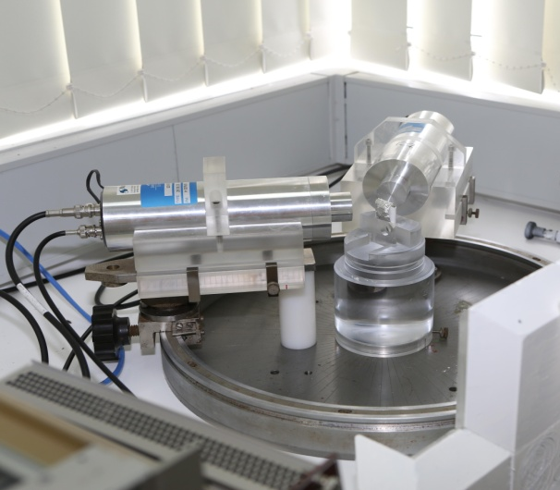
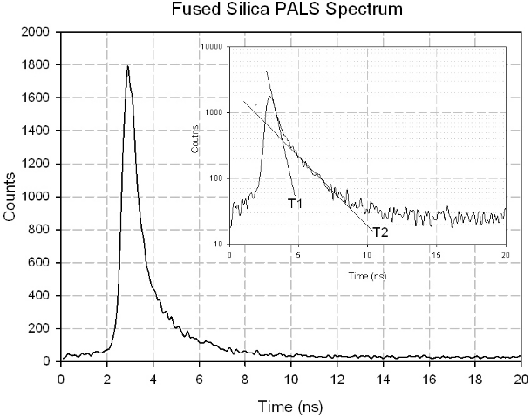
Positron Annihilation Lifetime Spectroscopy (PALS)
- A completely novel non-destructive technique to study voids and defects in solids (never been applied to yellowcake).
- Positron source is sodium-22.
- The time between the gamma rays produced from the emission and then annihilation of the positron can be measured, which corresponds to the lifetime of the positron.
- The positrons annihilate rapidly in a sample unless voids such as vacancy defects are present.
- When voids are present, positrons will reside in them and annihilate less rapidly than in the bulk of the material, on time scales up to several ns, depending on the void geometry.
http://www3.imperial.ac.uk/surfacesandparticleengineeringlab/researchthemes/pals

Slide 13
PALS
The PALS results on all four samples were similar – potential for discrimination may be limited.
We have more samples for study, and are evaluating different sample preparation techniques (e.g. formation of solid pellets) to confirm if the technique is effective in identifying the speciation of uranium.
Table I
: Positron Annihilation Lifetime Spectroscopy (PALS) of Selected UOCs
Sample ID
Intensity T1/T2
Ave.T1 Lifetime
Ave.T2 Lifetime
%
nsec
(N=2)
Ranger 1
95.
6
/4.4
0.3
2
1.6
Olympic Dam 1
97.
9
/2.
2
0.31
1.
1
Beverley 2
95.0/5.0
0.3
4
1.
7
Beverley 1
98.8/1.2
0.3
4
1.6

Slide 14
SEM
Fig. 4:
O.D. has small rounded particles adhering to larger particle surface.
Bev. has a smooth surface with scale like particles adhering to large particle.
Ra has sharper angled small particles adhering to large particle.
15 µm
15 µm
Fig. 5:
O.D. has continuous “crazy paving” structure.
Bev. has dense cloudy particles within a diffuse cloudy structure
Ra. has rod like protrusions within a less dense porous large particle.
15 µm
Fig.4: Exterior particle structure of UOC samples at magnifications of X 1500.
Fig.5: Internal particle structure of epoxy mounted and polished UOC samples at magnifications of X 1500.
Notes:
Figs.4 and 5 illustrate the different structures of intact and polished UOC materials respectively at 1,500 X magnification. All particulates in the main have similar sizes (~100 µm) and are almost spherical in shape; however intrinsic surface morphological differences could be observed. Examining both U₃O₈ containing materials, one can see that both Ranger and O.D. have large particle sizes with surficial adherence of smaller particles of approximately 1/8th the diameter of the parent. O.D. presented a much smoother surface for the large particles, quite unlike Ranger material which had rod-like protrusions. Beverley, the sole uranium peroxide hydrate, also presented a roughened surface with the appearance of scale-like features. In all cases, cutting and polishing through the particles and examination at 1,500 X more clearly illustrated the gross internal micro-structural features, and in particular the crystalline rod structure present in the Ranger UOC.

Slide 15
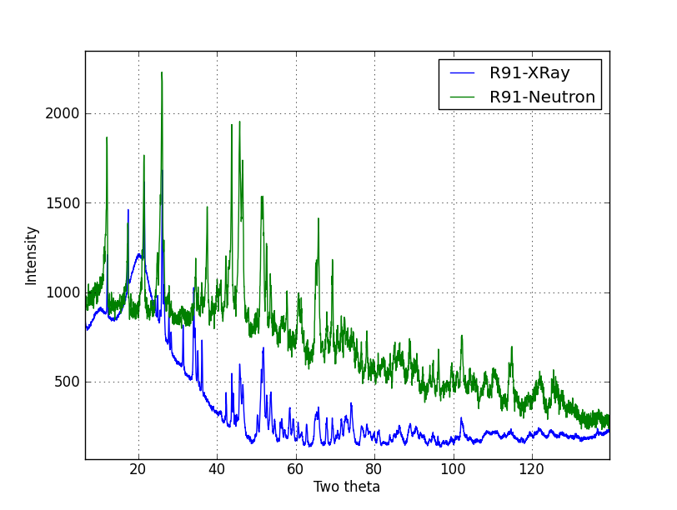
X-ray and Neutron Diffraction
The neutron diffraction patterns confirmed the XRD phase identifications, and as expected the ND displayed high backgrounds in those samples with relatively high amounts of water, due to incoherent scattering from H atoms.

Slide 16
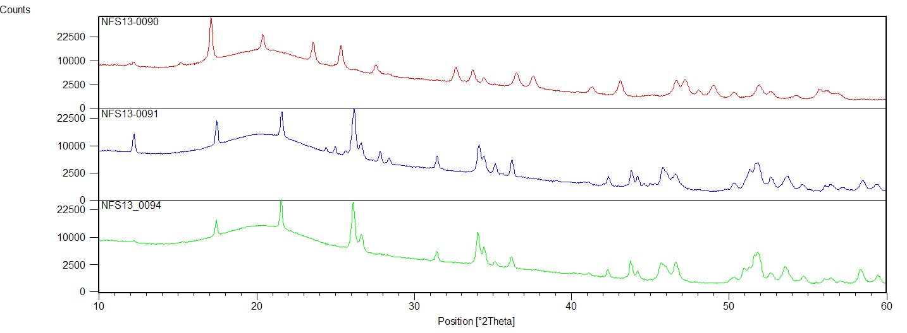
XRD Patterns
Beverley/Bev
*
Ranger
*
*
Olympic Dam/O.D.
XRD patterns of respectively Beverley, Ranger, and Olympic Dam mined UOC Samples.
Distinguishing lines differentiating Ranger from OD are indicated as shown*. Diffuse scattering due to sample holder is evident from 2θ=13-26˚.

Slide 17
Conclusion/Future Work
A collection of experimental techniques aid in differentiating properties of Australian UOC samples from three different sources.
UOC processing as defined here concerns the final steps only: precipitation and calcination.
Future work will clarify the identity of rod-like protrusions in Ranger material and perform slow scanning of the VIS/NIR region in DRS mode and transmission FIR regions. Can subtle spectral features be used to further differentiate production processes of U₃O₈ from Ranger and O.D. mines?
Technique | Morphology | U Speciation | Processing
SEM | ✓ | ✗ | ✗
DRS VIS/NIR | ✗ | ✓ | ✓/✗
Transmission FIR | ✗ | ✓ | ✗
XRD | ✗ | ✓ | ✓
PALS | ✗ | ✓/✗ | ✗

