Slide 1
Periodical Radiological Crime Scene Exercises in Germany
Helge Kröger, Jens-Tarek Eisheh

Slide 2
Contents
Introduction to the Federal Office for Radiation Protection (BfS)
Role of BfS in radiological crime scene management within ZUB
  strategy
  roles and responsibilities
Conclusions

Slide 3

The Federal Office for Radiation Protection
is a scientific and technical Federal Office
is subordinate to the Federal Ministry for the Environment, Nature Conservation, Building and Nuclear Safety (BMUB)

Slide 4
President
Wolfram König
Specialized Departments
Administration
Safety in
nuclear-
technology
Safety of
nuclear
disposal
Radiation
protection
and health
Radiation
protection and
environment
AG-NGA
Defence against
nuclear hazards

Slide 5
Defence against nuclear hazards
handled by federal states - BfS works together with other authorities (State and Federal), when called upon
involves preparing for and responding to situations in which radioactive material is out of regulatory control
  loss or discovery of radioactive materials or sources, including risk assessment
  cases where the material is being used maliciously

Slide 6

Role of BfS in radiological crime scene management within ZUB
Central Federal Support Group in Response to Serious Nuclear Threats (ZUB)
German Federal Criminal Police (BKA) provides the head of ZUB and is in charge of the overall crime scene
German Federal Police (BPOL) provides decontamination facilities and logistics
BfS handles all aspects of radiation protection including radiological safety & dosimetry of all personnel involved in actual crime scene management

Slide 7
Roles and Responsibilities (1)
On-scene commander (OSC) for all BfS personnel
Experienced member of BfS
In charge of all BfS personnel at the scene
Responsible for dosimetry (including police forces)
OSC and deputy work closely with police officer in charge of crime scene, determining who can go in and for how long
Assigns teams for all other roles and responsibilities

Slide 8
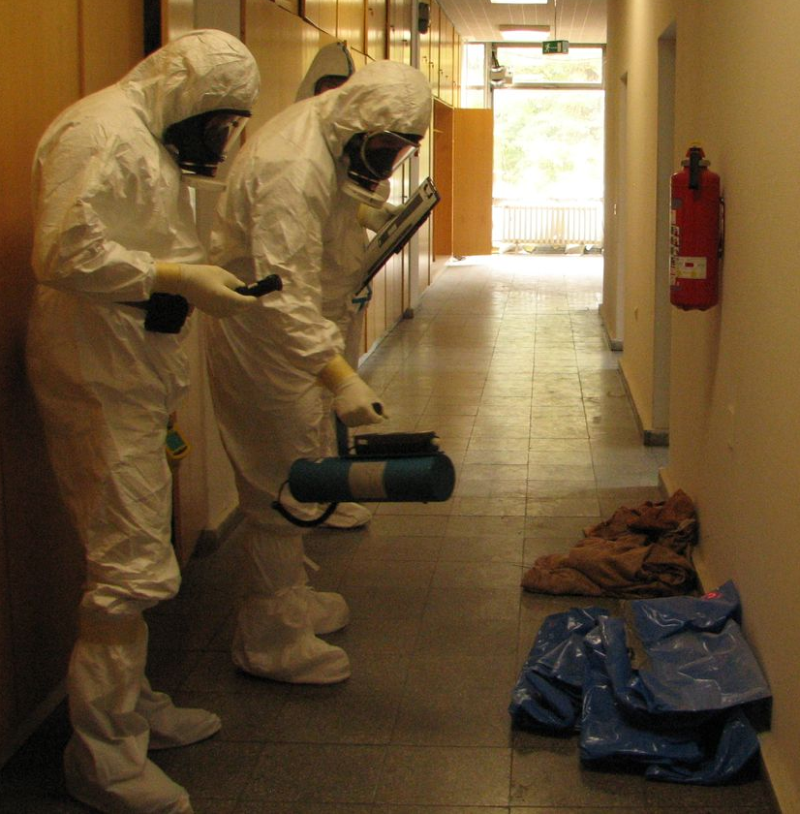
Roles and Responsibilities (2)
Detection/Search Teams
Ideally at least two teams of two BfS members each in full protection suits
Familiar with all necessary equipment
Accompany police teams assigned by BKA crime scene unit
Determine radiological situation at the crime scene, search for hidden sources and contamination
Search for possible radiological contamination, including evidence

Slide 9
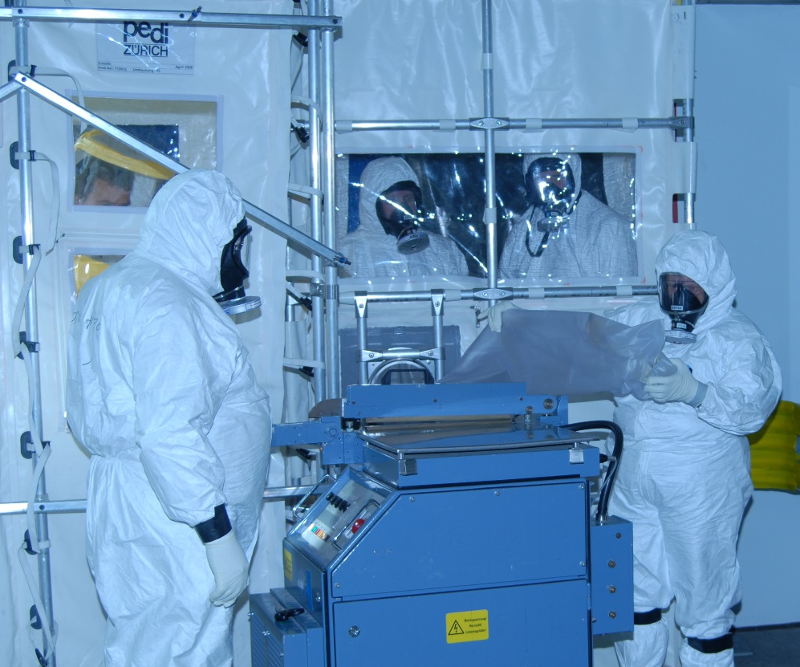
Roles and Responsibilities (3)
Airlock Operators
Any crime scene with potential for airborne radionuclides will be sealed off with an airlock
Manned by two BfS members handling evidence that needs to be heat sealed for transport to glove box
Responsible for contamination measurements of personnel leaving the crime scene and assistance with handling possible contamination
At least two teams needed for continuous operation of airlock

Slide 10
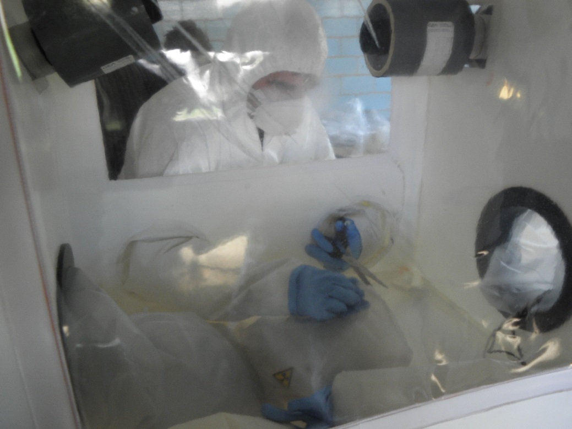
Roles and Responsibilities (4)
Glove Box Operators
Team of two BfS members is operating a mobile glove box
Contaminated evidence can be heat sealed at the airlock and then transferred into the glove box for further examination by BKA specialists
Electronics such as laptops or mobile phones can be investigated on-site
After the investigation is completed the evidence can be heat sealed again and conditioned for transport either to a storage facility or a specialised facility for further analysis like ITU in Karlsruhe

Slide 11
Roles and Responsibilities (5)
Radiological Advisors for the Decontamination unit of BPOL
Any personnel contaminated during the investigation of the crime scene will be transferred to a specialised police unit trained in decontamination processes
OSC assigns a BfS expert to advise decontamination unit of BPOL if necessary
Advisor makes sure that measurement results from airlock team get relayed to decontamination unit and gives advice on how to proceed if requested or necessary

Slide 12
Roles and Responsibilities (6)
Documentation Officers
Several documentation officers required to ensure proper documentation for possible court case
Locations:
  OSC
  Airlock
  Glove box
  Reserve

Slide 13
Roles and Responsibilities (7)
Radiological Advisors on questions of risk assessment, handling and transportation of contaminated evidence
BfS experts on special subjects are on stand by on-site or via telephone
Dose estimates (including inhalation dose and calculating maximum work hours)
Advice on necessary shielding requirements for transport
Handling of certain sources
Propagation calculations for airborne nuclides based on atmospheric conditions

Slide 14
Experience gathered by BfS (1)
Periodical radiological crime scene exercises are of great importance to maintain ability to deal with an eventual contaminated crime scene
Exercises provide valuable information on personnel requirements and necessary resources (up to 60 BfS members alone)
Roles and responsibilities are not pre-assigned, therefore written procedures need to be available for all personnel as fall back
Communication and documentation always the biggest problem
Specialised measurement protocols minimize need for communication

Slide 15
Experience gathered by BfS (2)
Large scale exercises provoke interest in higher ranks
While important to demonstrate the cooperation between BfS and police forces, important lesson learned:
  visitors need to be kept away from personnel
BfS provides monitoring equipment, visitors can view exercise via live feed in closed off area with multiple cameras and discuss questions with a dedicated BfS advisor
Most important lesson: Know thy partner!
Police forces work differently from BfS and vice versa, trust needs to be established and maintained by exercise veterans

Slide 16
Conclusions
Maintaining an annual radiological crime scene exercise is basis for BfS, BKA and BPOL to be well prepared for a radiological emergency
Roles and responsibilities have been defined by experience
Personnel is being trained specifically for these tasks
Exercises are main tool for developing and optimizing operational procedures

Slide 17
Thank you for your attention!
Dr. Helge Kröger
Federal Office for Radiation Protection (BfS)
Defence against Nuclear Hazards (AG-NGA)
Köpenicker Allee 120 – 130
10318 Berlin, Germany
hkroeger@bfs.de

