Slide 1
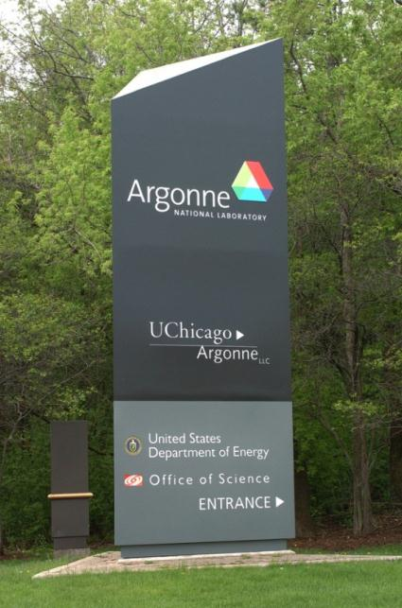
Resources and Forensics Signatures to Help Determine the Origin of Sealed Radiological Sources
David Chamberlain
International Conference on Advances in Nuclear Forensics: Countering the Evolving Threat of Nuclear and Other Radioactive Material out of Regulatory Control
Vienna, Austria
July 7-10, 2014
ANL-NTNFC-14-018
APT#105562
Notes:
1

Slide 2

CO-AUTHORS
Argonne National Laboratory
  Jodi Canaday
  Donald Graczyk
  James Morman
  Seema Naik
  Jennifer Steeb
  Vivian Sullivan
  Yu Tang
  Yifen Tsai
Idaho National Laboratory
  Kevin Carney
  Dan Cummings
  Martha Finck
  Jeff Gigilio
  James Summers

Slide 3

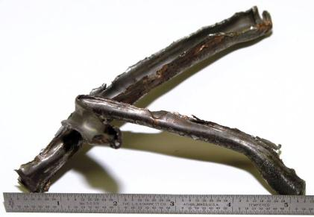
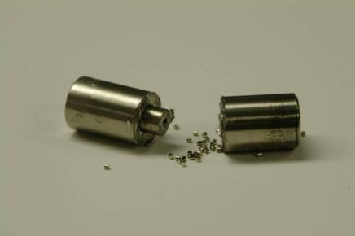
WHAT CAN FORENSIC EXAMINATIONS OF RADIOLOGICAL SOURCES TELL US?
Traditional Forensics
  Examination of fingerprints, fibers, tool marks, device design
Radiological Forensics
  Evaluation of the capsule design and radiological material to determine source manufacturer and date of production
Courtesy Fred Harper, SNL
Courtesy Mary Adamic, INL
3

Slide 4

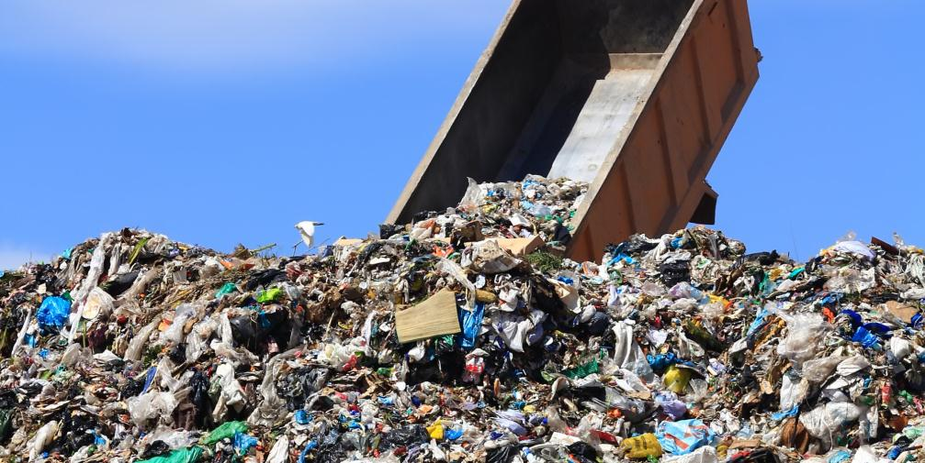
SOURCE EXAMINATIONS
What can we learn from examining an abandoned or interdicted source?
4

Slide 5
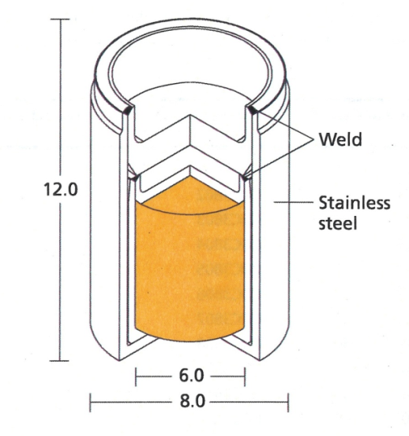
SIGNATURE INFORMATION FROM CAPSULE
Spacers?
Number of
capsules
Type of welds
Materials of
construction
Labels
Engravings
Dimensions
¹³⁷Cs Sealed Source
5

Slide 6
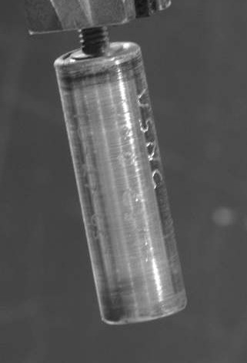
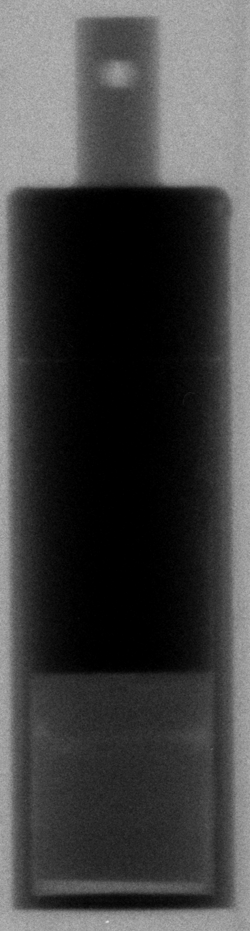
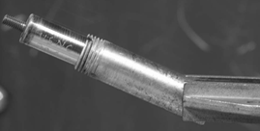
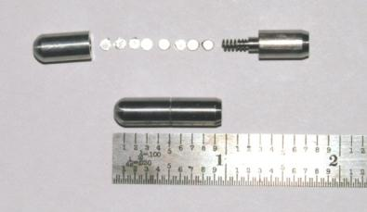
NUMBER OF POTENTIAL SIGNATURES
Appears to be a wealth of possible signatures that can be measured
  Do these signatures differentiate between source manufacturers?
  Are there libraries that can be searched to determine possible matches?
Opened Ir-192 radiography source
Cs-137 Source Examination at the
Idaho National Laboratory
6

Slide 7
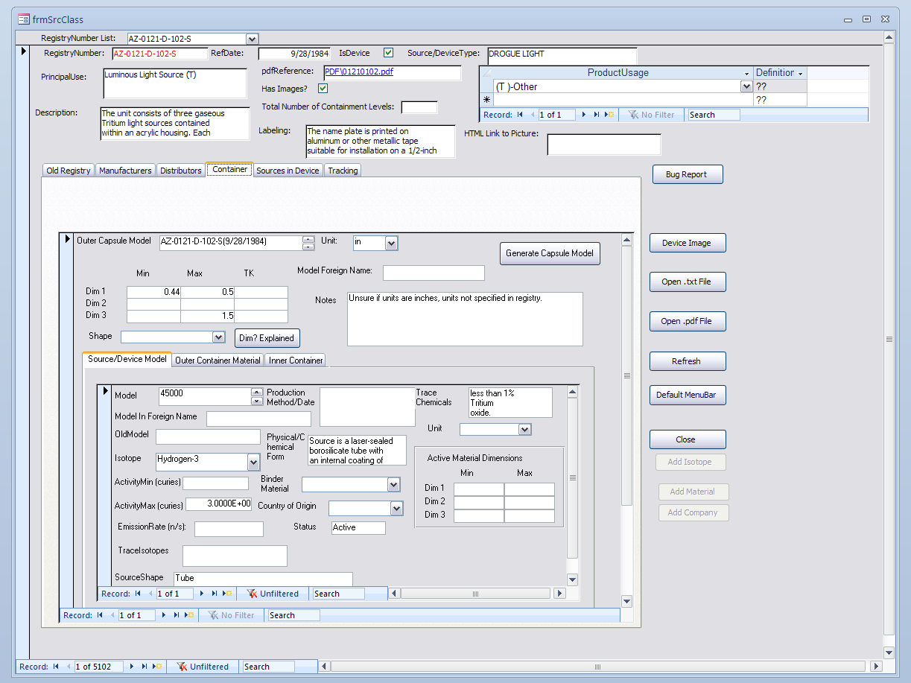
ANL/INL INTERNATIONAL SEALED SOURCE DATABASE
Database of sealed radioactive sources
Developed and populated by staff at Argonne and Idaho National Laboratories
Most complete sealed source database in the world
  More than 10,000 sealed source models described
  Approximately 1000 manufacturers/ distributors identified
7

Slide 8
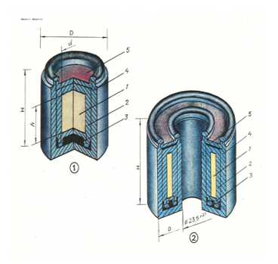
INTERNATIONAL SEALED SOURCE DATABASE
Types of info:
  Manufacturer/distributor name, address, points of contact, product lines, distribution networks
  Sources:
    Physical characteristics: schematic, design, shape, dimensions, materials, markings
    Chemical characteristics: chemical form, composition, isotopics
  Company history
MAYAK CATALOG IMAGES
8

Slide 9
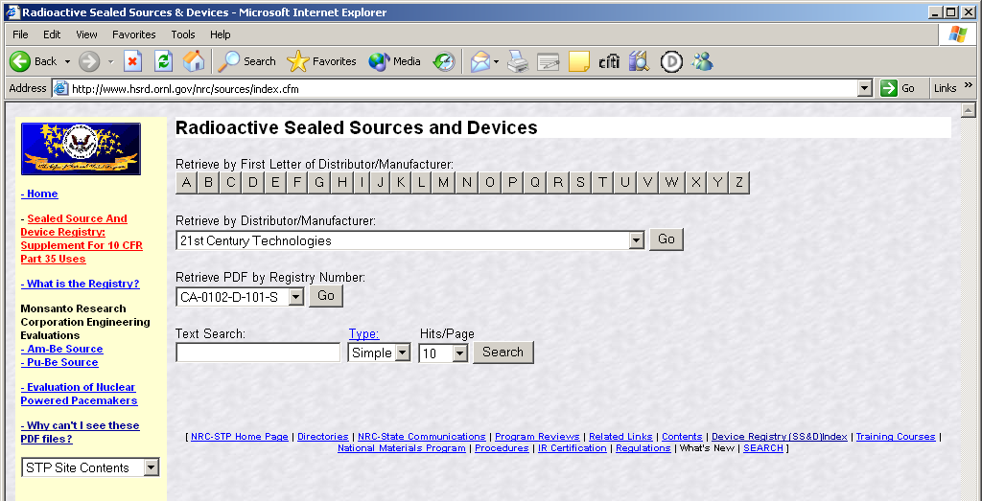
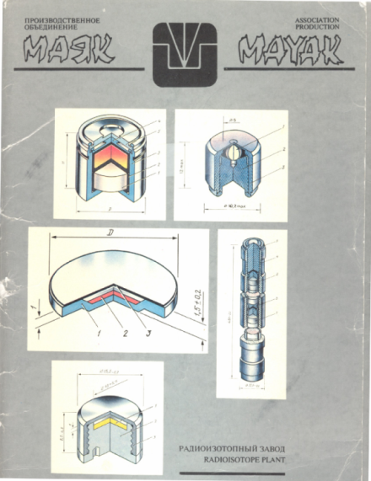
WHERE DOES INFORMATION COME FROM?
Nuclear Regulatory Commission Registry
  Download about 3600 registries every quarter
Vendor catalogs
Web pages
Non-disclosure agreements with select companies
9

Slide 10
FORENSICS EXAMPLE
10,556 Individual Source Model Numbers
Determine source is Cs-137
953 possible source models
Estimated source strength to be 200 – 500 Ci of Cs-137
30 possible source models
And, observed partial number etched in outer capsule: R60
2 possible source models
Information shown is based on database queries.
10

Slide 11

WHAT CAN THE ISSD PROVIDE?
Manufacturer: REVISS Services Limited (UK) manufactures the R6000 series of
Cs-137 sources.
*Source models vary only in dimensions, activity content and design of outer lid. All capsules have a handling pip (raised center) built into the lid of the outer capsule except the R6050 which has a female thread incorporated into the capsule lid.
CapsuleModel* | Activity (Ci) Tolerance ± 20% | Diameter (mm) | Length (mm) | QSA Global US Model Number | Previous Amersham Model Number
R6000 | 40 | 12.49 | 17.85 | RSL6000 | CDC.PE3
R6010 | 70 | 14.69 | 20.40 | RSL6010 | CDC.PE4
R6020 | 150 | 17.49 | 22.90 | RSL6020 | CDC.PE5
R6030 | 300 | 21.29 | 26.35 | RSL6030 | CDC.PE6
R6040 | 600 | 27.10 | 28.40 | RSL6040 | CDC.PE7
R6050 | 2000 | 30.15 | 70.35 | RSL6050 | CDC.PE8
R6060 | 3500 | 36.15 | 65.35 | RSL6060 | CDC.PE9
Added R6040 to possibilities to account for measurement errors, manufacturing tolerance, and decay of Cs-137 since source production.

Slide 12
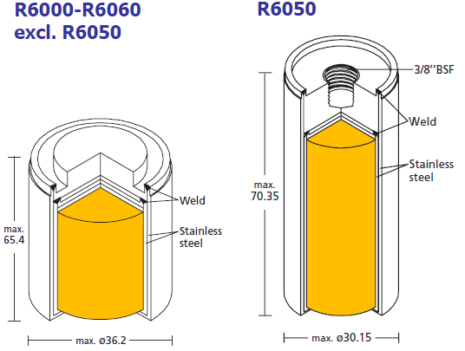
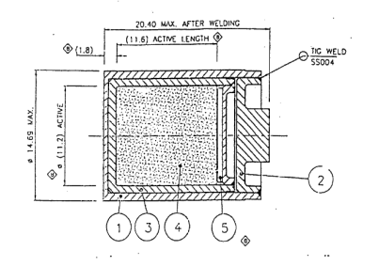
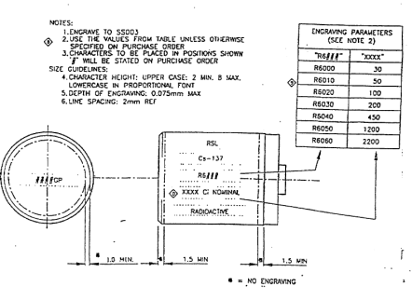
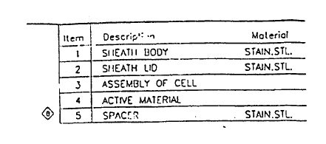
SOURCE DETAILS
Figures obtained from QSA Global Sources® Catalog
Figures obtained from NRC Registry IL-136-S-915-S
Distributors: REVISS Services Inc., Nycomed Amersham , AEA Technology, QSA Global
Material: Cesium chloride salt in the form of pressed pellets
Encapsulation: The source is doubly encapsulated with both capsules made from AISI 316L stainless steel
12

Slide 13
SIGNATURE INFORMATION FROM RADIOACTIVE MATERIAL
Isotopic composition
Dimensions
Chemical form
Daughter products
Impurities
¹³⁷Cs Sealed Source
13

Slide 14
WHAT ELSE CAN WE LEARN FROM ANALYZING THE RADIOACTIVE MATERIAL?
Chronometers
  Time since production
  Time since purification
Production method
  Ion exchange, precipitation, solvent extraction, direct irradiation
Irradiation History
  Source (starting) material
  Type of reactor
14

Slide 15
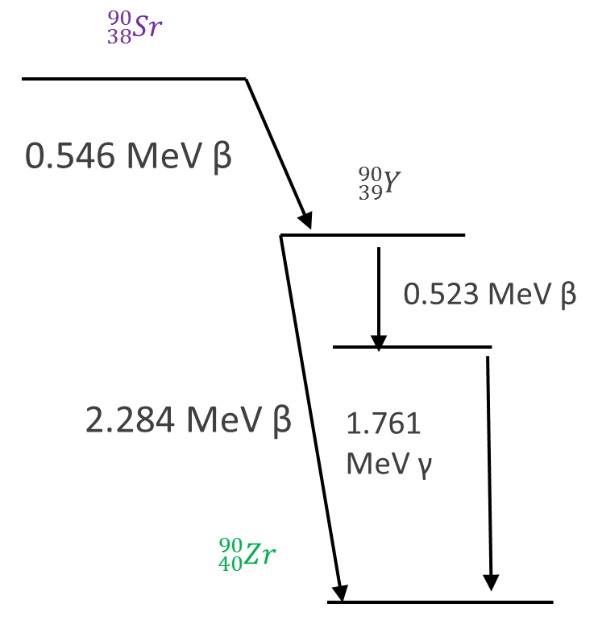
AGE DATING RADIOACTIVE SOURCES
Chronometers
  Parent/daughters are commonly isobars (same mass).
  Therefore, separations are required for mass spectrometry analysis.
  Work has been conducted on
    Cesium-137
    Cobalt-60
    Strontium-90
    Iridium-192
    Americium-241
Radioactive decay of Sr-90
15

Slide 16
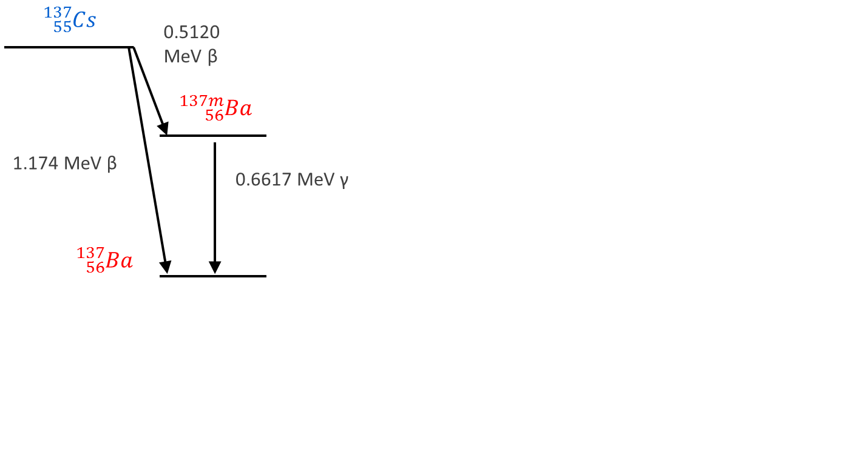
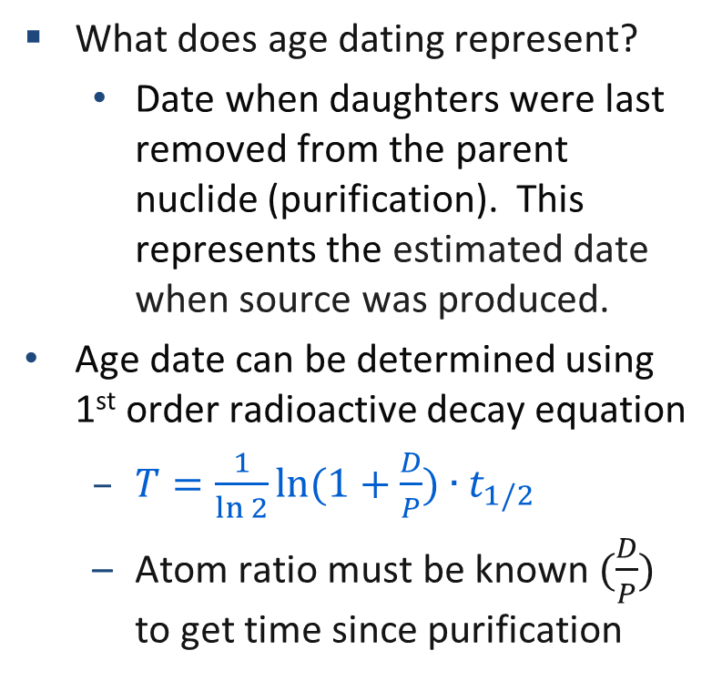
AGE DATING RADIOACTIVE SOURCES
What does age dating represent?
  Date when daughters were last removed from the parent nuclide (purification). This represents the estimated date when source was produced.
Age date can be determined using 1st order radioactive decay equation
  $T=\frac{1}{\ln{2}}\ln{(1+\frac{D}{P})∙t_{1/2}}$
  Atom ratio must be known $(\frac{D}{P})$ to get time since purification
Radioactive decay of Cs-137
16

Slide 17
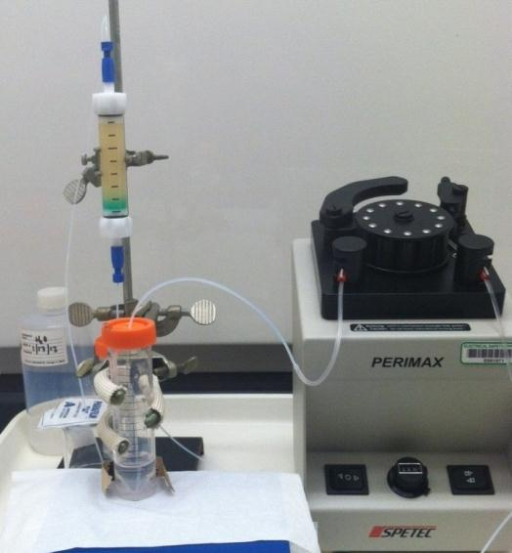
SYSTEMS USED FOR EXTRACTION CHROMATOGRAPHY
EC combines liquid-liquid extraction with column chromatography
Resin contains inert, stationary, and mobile phase
Gas pressurized extraction chromatography (GPEC)
Omnifit column system with DOWEX 1x8 resin
17

Slide 18
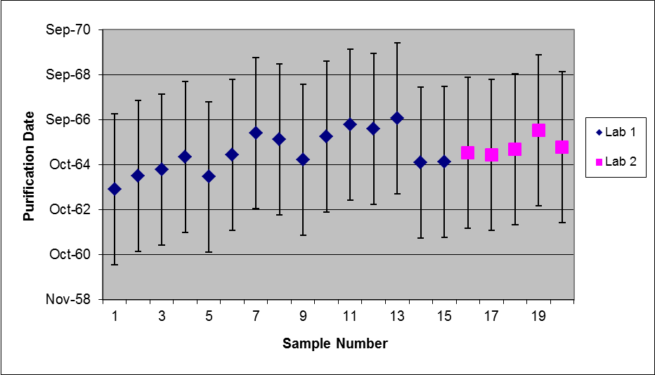
Summary Age Dating Results of a Cs-137 Source with Expanded Uncertainties using GPEC by Two Laboratories
Capsule Date 10/27/1965
Analysis conducted over a
5 year period (2003 to 2008)

Slide 19
SELECT AGE-DATING PUBLICATIONS
1. Characterization of Sealed Radioactive Sources: Uncertainty Analysis to Improve Detection Methods, Daniel Cummings, James Sommers, Mary Adamic, Marcos Jiminez, Jeffrey Giglio and Kevin Carney, Journal of Radioanalytical and Nuclear Chemistry, June 09.
2. Characterization of a Sealed Americium-Beryllium (AmBe) Source by ICP-MS, James Sommers, Marcos Jiminez, Mary Adamic, Jeffrey Giglio and Kevin Carney, Journal of Radioanalytical and Nuclear Chemistry, August 09.
3. Age Determination of Irradiated Materials Utilizing the Cs/Ba Parent Daughter Relationship via Gas Pressurized Extraction Chromatography (GPEC) with ICP-MS Detection, James Sommers, Daniel Cummings, Mary Adamic, Jeffrey Giglio and Kevin Carney, Journal of Radioanalytical and Nuclear Chemistry, June 09.
4. "Age" determination of irradiated materials utilizing inductively coupled plasma mass spectrometric (ICP-MS) detection, James Sommers, Daniel Cummings, Jeffrey Giglio, Kevin Carney. Journal of Radioanalytical Nuclear Chemistry (2009) 282:591-595.
5. JL Steeb, DG Graczyk, Y Tsai, CJ Mertz, AM Essling, VS Sullivan, JJ Giglio, KP Carney, Martha R. Finck, and David B. Chamberlain. Application of mass spectrometric isotope dilution methodology for 90Sr age-dating with measurements by thermal ionization mass spectrometry and inductively coupled plasma mass spectrometry. J. Anal. At. Spectrom. 28 (9): 1493 – 1507 (2013).
19

Slide 20
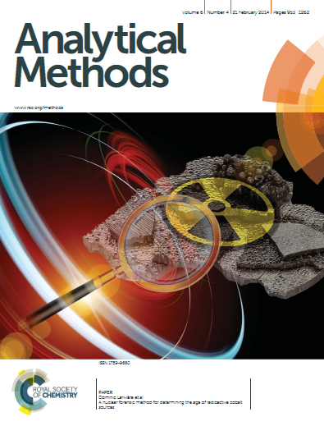
CONCLUSIONS
Radiological Forensics
  Many signatures are the same as those obtained through traditional forensic methods (e.g. labels, dimensions)
  Signatures can be obtained from the source capsule and from the radioactive material
Database of sealed radioactive sources
  Signature databases are available and are still being refined
  Detailed descriptions of +10,000 sealed source models available in our database
  Approximately 1000 manufacturers/distributors identified
Sample analysis and interpretation
  Analytical methods have been developed for forensics applications
  Methods include radioactive and stable isotope analysis (age dating)
20

Slide 21
Questions?

