Slide 1
IAEA International Conference on Advances in Nuclear Forensics: Countering the Evolving Threat of Nuclear and Other Radioactive Material out of Regulatory Control Armenian Nuclear Forensic Lab V. Atoyan, K. Pyuskyulyan Armenia 7 – 10 July 2014, Vienna, Austria

Slide 2
Background
The protection and management of the radioactive and nuclear sources and materials in Armenia after the collapse of the USSR posed a difficult situation to regulators
No clear division of responsibilities existed and the government had very limited resources

Slide 3
Background
Incidents related to the illicit trafficking of radioactive materials in 2006-2013
Total 21 cases

Slide 4
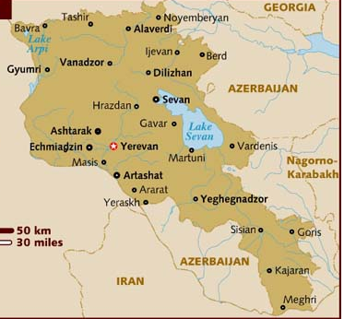
Background
Location of discovered radioactive sources and materials

Slide 5
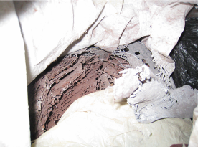
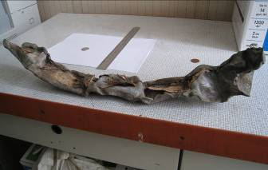
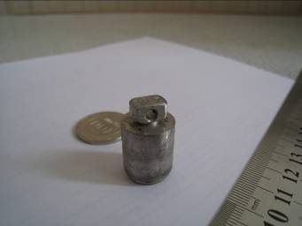
Examples of Illicit Trafficking of Radioactive Sources
A bag with a lead scrap
Layers of lead in which the source was packed
The neutron source
Customs point in Meghri (border with Iran), January, 2009
Radioactive source AM-241

Slide 6
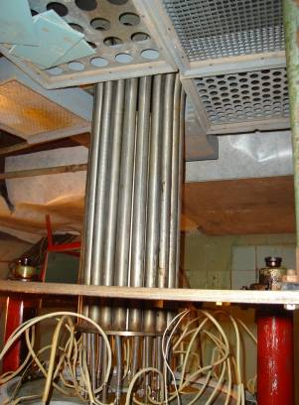
Examples of Illicit Trafficking of Radioactive Sources
Institute of Physics of the Academy of Sciences of Armenia
Robbery Attempt, March, 2010

Slide 7
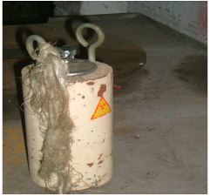
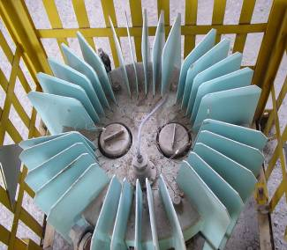
Examples of Illicit Trafficking of Radioactive Sources
12 April 2012. 6 containers with Со-60, measured activity of 3×10¹¹ Bq, were found during the Monitoring of the woodworking factory located in the Masis city
RITEG installation activity 1,1×10¹⁶ Bq

Slide 8
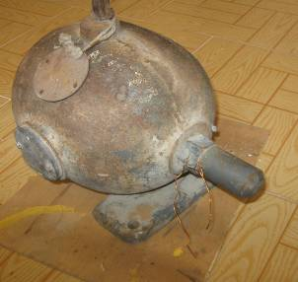
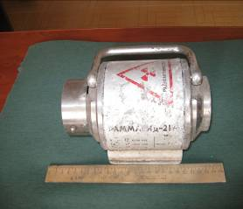
Examples of Illicit Trafficking of Radioactive Sources
Cs-137, 5×10¹² Bq Tavush Regional Branch of the Noyemberyan Police Department
21-M (Gammarid 21-М) radiograph found during monitoring of the municipal landfill area of Armavir town on 9 November, 2012

Slide 9
Examples of Illicit Trafficking of Radioactive Sources
In May 2009, during routine radiation monitoring in the village of Noraduz it was revealed that the premises of a repair truck and the territory adjoining it (an area of 300 square meters) were polluted by radioactive isotope Cs-137. Gamma radiation intensity on the premises ranged from 900 to 1200 μSv/h. Gamma radiation intensity in the surrounding area was 600-800 μSv/h. Four persons (the owner of the repair truck, his son and two technicians) received radiation doses exceeding the normally established limits. The dose for the owner’s son was 128 mSv/year, and another person’s internal dose was estimated from 7 to 12 mSv/year.

Slide 10
Nuclear Forensics Laboratory
Why there was the need for the NFL in Armenia?
awareness raising and assistance with prevention of incidents of radioactive and nuclear material smuggling;
technical and forensic analysis of materials outside of regulatory control, close cooperation with the law-enforcement authorities, support of investigations and presentation of results in the court;
response to incidents, collection of sources, transportation, storage, analysis.
Why the NFL was established at the base of the Laboratory of External Radiation Monitoring of the ANPP?
technical, human capacity,
sources storage, other.
Notes:
The points should be on (1) prevention, (2) detection and (3) response.
When discussing technical and forensic analysis of materials outside of regulatory control (2. detection) – please describe the work related to search, recovery, transportation, storage, analysis and maintaining the database of orphaned sources.

Slide 11
Project Implementation
March 2010 – first PNSP visit and needs assessment (CRDF Global and FBI)
October 2010 – CRDF Global grant funded by the Preventing Nuclear Smuggling Program.
December 2010 – ANPP obligations and contribution to laboratory stand-up fulfilled.
September 2012 – Equipment is fully operational, SOPs for equipment in place, staff trained and response activities finalized.
Total project cost - US $384,116

Slide 12
FL activity
The full set of the documents was prepared, defining the statute of the laboratory, regulating its activities and duty regulations. 22 documents were issued.
The laboratory has been equipped by the modern high-sensitivity equipment necessary for performance the gamma spectrometric analyses (both in laboratory conditions, and in situ) and, partially, for performance an alpha measurements.
It had been created the “Database of Incidents Linked with Radioactive and Nuclear Sources and Materials on Territory of Republic of Armenia”, including the detailed description of discovered radioactive souses and materials since 1999 up to now.

Slide 13
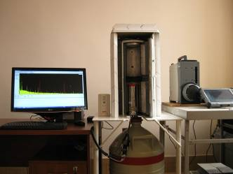
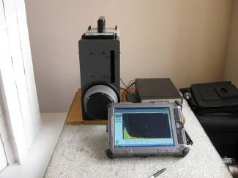
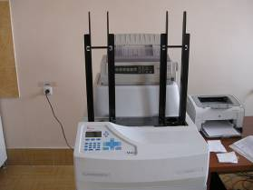
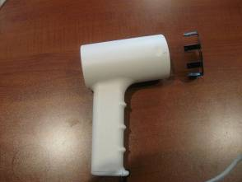
Project Implementation, Equipment
Ultra low-background cryostat 7500SL Spectroscopy System
Falcon 5000 HPGe-based portable identifier
iMatic™ Gas-less Automatic Alpha/Beta Counting System
α,β,γ Contamination meter MCB2CPM

Slide 14
FL activity
Radiation monitoring capacity in Armenia increased, and, as a result, radioactive materials out of regulatory control were discovered.
During the project implementation the FL experts trained two specialists in the field of spectrometry analysis of radioactive materials.
6 project participants were trained at the training course “Radiological Crime Scene Management and Way to Nuclear Forensics” held at the ITU in Karlsruhe.
1 participant was trained in area of combating the illegal trafficking of nuclear and radioactive materials and sources at the University of Georgia, USA’s "Center for International Trade and Security".

Slide 15
Project Implementation FL activity International Collaboration
Regular communication with curators of the project (Ms. Antsiferova, Ms. Dace Sarma and Mr. Matthew Fargo from CRDF GLOBAL)
Collaboration with FBI experts at the Chemical, Biological, Radiological, and Nuclear Sciences Unit (Dr. Michael Palian and Dr. Kevin McLeary).
Participation in PNSP-supported events.
We applied new techniques and capabilities to participate in a virtual nuclear forensic library exercise, Galaxy Serpent (Dr. James Borgardt)

Slide 16
FL activity National Collaboration
Relevant Law-enforcement Agencies
National Security Service
Armenian Nuclear Regulatory Authority
Customs Service
Ministry of the Environment Protection
National Academy of Science

Slide 17
The scheme of interaction of Armenian Nuclear Forensic Lab with other ministries to strengthen the national nuclear security infrastructure
Performance of expertise
Training of NSS staff
National Security Service
of RA (NSS)
Interaction on fast response
Monitoring of territories
Performance of expertise
Assistance at realization of
public protective actions
Radiation monitors
calibration and training
Armenian Nuclear
Forensic Lab
Police
Customs
Assistance to judicial examination
Performance of expertise
Office of Public Prosecutor
Law court
Interaction on fast response. Search of radioactive sources.
Monitoring of territories. Performance of expertise.
Armenian State Committee for Nuclear Regulation (ANRA)

Slide 18
Future Plans
Continuation of monitoring activities - searches, transportation, analysis, and secure storage of orphaned sources.
We plan to continue to work in close contact with the National Security Service of the Government of RA and Juridical Authorities, and render the expert support to State Committee for Nuclear Regulations (ANRA), Customs Service of the RA.
In addition, we plan to cooperate with the Ministry of Environment Protection of the RA and Academy of Sciences of the RA. Both organizations rely upon the FL staff’s expertise and need our support.
Training of new experts in the examination of nuclear and radioactive material from the staff of the National Security Service, as well as on-going training and competency improvement of the FL staff.

Slide 19
Future Plans
We are also interested in implementing new methods of expert examinations of nuclear and radioactive material and learning from other international experiences in this area.
We are extremely interested in the expansion of our international network of experts in the field of Preventing Nuclear Smuggling.
Serving as partners and contributors to regional and international efforts with the aim of countering radiological terrorism and smuggling of radioactive sources.
ANPP and Armenian Nuclear Forensic Lab looks forward to discussing new projects and opportunities for cooperation with international friends and partners

Slide 20
THANK YOU!
Questions?

