Slide 1
South Africa’s Nuclear forensics Response Plan Step1-In Support of Nuclear Security Investigations
Presenter: Banyana Kokwane: R&D Scientist
Authors: PR Mogafe & B Kokwane
NOMS Department, NCS Division
NECSA, South Africa
The IAEA International Conference on Advances in Nuclear Forensics, Vienna, Austria
7-10 July 2014

Slide 2
Presentation Outline:
Background
National competences, statutory and regulatory framework
Nuclear forensics in support of National Nuclear security
Nuclear Forensics capability building
International cooperation and combating illicit trafficking
National experience on illicit trafficking of radioactive material
Conclusions

Slide 3
Background
South Africa (SA)is a member of NPT since 1991
Has emerged as a champion of both global nuclear non-proliferation and equal access to peaceful nuclear energy.
SA is a possible exporter and importer of nuclear technology , and a target for state and non-state actors seeking assistance for authorized nuclear materials handling, protection and storage facility.
A producer, possessor and exporter of nuclear materials for peaceful purposes under IAEA guidelines.
Radioactive or nuclear materials are used in various sectors of the country's economy

Slide 4
Background Continues
Sectors include:
Uranium Mining
Health (radioisotope production e.g. Mo-99)
Research and development (Safari-1)
Energy-nuclear power generation (Eskom’s Koeberg 1 and 2 1,800 MWe units)
Major security threats or concerns:
Theft of radioactive sources (as may happen in many states)
Illicit trafficking of nuclear and radioactive materials
The safety and security of these materials depend on effective national regulatory control infrastructure.

Slide 5
National Statutory and Regulatory Framework
Parliament
Legislations (Acts, etc)
Regulations,
Safety Standards,
Policies
Government Departments
Directorates
Regulators
State Authorities
State Owned Entities
Co-operation Agreements,
Regulatory Practices,
Requirements & Guidance

Slide 6
RSA Nuclear forensics component in support of national nuclear security
Existing National Nuclear security in place
Role players in Nuclear Security:
Department of Energy (custodian of deployed Nuclear security plan)
National Nuclear Regulator
Department of Health,
State Security Agency,
South African Police service and department of Justice,
Defence, IAEA guidelines, etc.
Nuclear Forensics is now one component in a support of on-going national nuclear security investigations in South Africa.

Slide 7
General trend on Illicit trafficking of Nuclear and radioactive material: a global threat
Ref: CNS Global Incidents and Trafficking Database: Tracking publicly reported incidents involving nuclear and other radioactive materials 2013 Annual Report

Slide 8
Nuclear forensics capability
Although the prevention of nuclear and radiological terrorism is a global issue or initiative, the establishment of an efficient and well defined system for combating illicit nuclear material is understood to be a national responsibility.
In this regard South Africa took an initiative to enhance its nuclear security by developing Nuclear forensics capability in order to support:
Prevention
Investigations
And response to a nuclear event

Slide 9
Nuclear forensics capability
This program (Nuclear forensics) falls under the Nuclear Obligations Management Services(NOMS) department within The South African Nuclear Energy Corp (Necsa)
Necsa
National key point in nuclear
Contact point for IAEA conventions (convention on early notification of a nuclear event, accident and convention on assistance in the case of a nuclear accident & radiological emergency)
The program includes:
A national nuclear forensics laboratory to analyse the evidence contaminated with radioactive material.

Slide 10
Nuclear forensics capability
A National NF database (library) for the matching and interpretation of multiple nuclear forensics signatures (e.g. questioned/unknown vs known samples).
A Nuclear security response training component (establishing the procedures to respond to nuclear security events, the collection and transportation of evidence linked to nuclear or radioactive material out of control).
A Storage facility for all law-enforcement nuclear materials brought over to Necsa for nuclear forensic analyses.

Slide 11
RSA Nuclear Security Response plan

Slide 12
RSA Nuclear Security Response plan Cont’
Response to a nuclear event
At the scene:
Critical steps
Safety first (Response team, environment, etc)
Chain of custody consideration
Sample collection and preservation of the evidence:
Traditional forensic
Nuclear forensics
Responsibility
In-field NDA screening of material (identification, etc)
Handling of evidence contaminated with radioactive materials
Admin arrangements for material transportation to Necsa site
NOMS Department taking over material for storage & nuclear forensic analyses

Slide 13
RSA Nuclear Security Response plan Cont’
NOMS(NFM)
(Interim owner of the sample)
Security services
Nuclear Liabilities
Nuclear Safeguards

Slide 14
Collaborations in combating illicit trafficking of nuclear and radioactive materials
South Africa through Necsa has entered and signed Memorandum Of Understanding (MOU) with USA national laboratories (LLNL and LANL) for collaboration in NF field.
Collaboration aims mainly for establishment of NF capabilities:
To develop national NF laboratory and national NF database (library).
Nuclear security response training component.
South Africa continues to participate in the IAEA’s illicit Trafficking Database (ITDB).
IAEA and US DoE continue in supporting our country to enhance its Nuclear Security

Slide 15
Cases of Illicit trafficking of nuclear or radioactive material reported to NOMS (NECSA)
Fewer criminal cases of suspected illicit materials were reported to NOMS department for analysis:
2011: 5l bottle containing yellow sediments and clear supernatant liquid – ADU,
2012: two bags of materials were received – Unat,
2013: a Durban seized material in November 2013 – DU.

Slide 16
Conclusions
Nuclear security remains a priority to the country and is regarded as an ongoing process that requires regular review, monitoring and adequate resources to ensure effective prevention, detection and response to malicious acts involving nuclear and radioactive materials,
Hence the Nuclear forensics capability initiative is necessary.
The NFP was developed at Necsa within Nuclear Obligations Management Services Department.
The IAEA together with US DOE are playing a critical role in supporting South Africa’s efforts towards establishing the national nuclear forensics capability. SA representatives participated in numerous training courses, workshops, meetings and conferences that were funded and organized by these organization.
The national nuclear forensics laboratory is completed and is currently in its commissioning phase

Slide 17
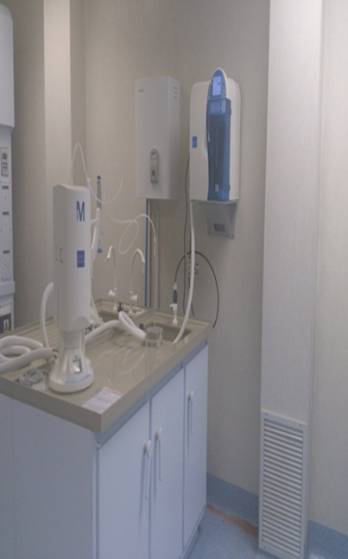
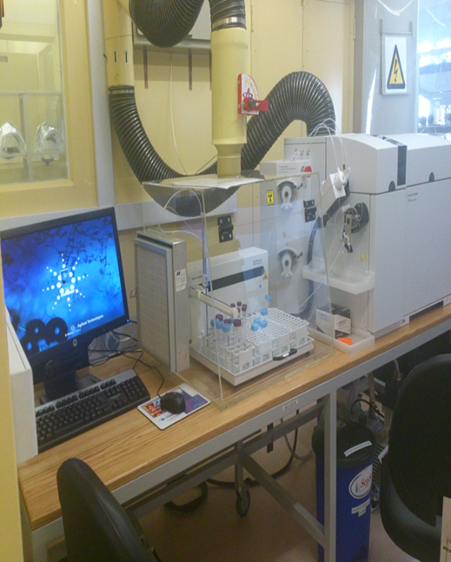
Conclusion Cont.’

Slide 18
Thank you

