Slide 1
Establishing Canada’s National Nuclear Forensics Laboratory Network
Ike Dimayuga
Atomic Energy of Canada Ltd.
Elizabeth Inrig
Defence Research and Development Canada – Ottawa Research Centre
International Conference on Advances in Nuclear Forensics: Countering the Evolving Threat of Nuclear and Other Radioactive Material out of Regulatory Control
7 -10 July 2014
IAEA, Vienna

Slide 2
Introduction
  Nuclear Forensics
  Comprehensive scientific analysis of nuclear or other radioactive materials or evidence contaminated with radioactive materials that contributes to the broader investigation of a nuclear security event.
  Iterative process that exploits material inventory tracking identifiers, as well as, isotopic, chemical, and physical signatures inherent to nuclear and other radioactive material in order to provide insights to its history and origin as well as to potentially link these materials to people, places and events.
  International consensus that nuclear forensics and attribution constitute the new “deterrence” mechanisms against the illicit use of nuclear and radioactive materials.
2

Slide 3

2012 Seoul Nuclear Security Summit
Joint Communiqué
  Recognize that nuclear forensics can be an effective tool in determining the origin of detected nuclear and other radioactive materials and in providing evidence for the prosecution of acts of illicit trafficking and malicious uses.
  Encourage States to work with one another, as well as with the IAEA, to develop and enhance nuclear forensics capabilities.
  Underscore the importance of international cooperation both in technology and human resource development to advance nuclear forensics.
National Report by Canada
  Canada is finalizing a strategy to enhance its domestic nuclear forensics capabilities, which will include the formalization of the Canadian nuclear forensics laboratory network, the creation of a national library of nuclear and radiological signatures, and the enhancement of Canada’s capacity for the forensic analysis of radiologically-contaminated evidence.
3

Slide 4



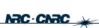

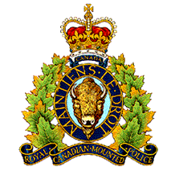


Canadian National Nuclear Forensics Capability Project
Framework: Under the auspices of the Canadian Safety and Security Program, Centre for Security Science (Defence Research & Development Canada) initiated the CNNFCP.
Approach: Whole-of-government, involving several federal S&T agencies, with the active participation and guidance of law enforcement agencies: DRDC CSS, AECL, CNSC, DRDC Ottawa, NRC, RMC, HC, RCMP, DND, PSCan, DFATD.
4

Slide 5
Canadian National Nuclear Forensics Capability Project
Goal: To develop a coordinated, comprehensive, and timely national Nuclear Forensics capability within Canada
Scope: Establishment of a National Laboratory Network for comprehensive NF analysis, including a capability to perform classical forensic analysis on evidence contaminated with radioactive material; and development of a National Nuclear Forensics Library (NNFL) cataloguing characteristics and signatures of RN material holdings under regulatory control.
5

Slide 6
Canadian National Nuclear Forensics Capability Project
Goal: To develop a coordinated, comprehensive, and timely national Nuclear Forensics capability within Canada
Scope: Establishment of a National Laboratory Network for comprehensive NF analysis, including a capability to perform classical forensic analysis on evidence contaminated with radioactive material; and development of a National Nuclear Forensics Library (NNFL) cataloguing characteristics and signatures of RN material holdings under regulatory control.
6

Slide 7
National NF Lab Network: Strategy
  Mobilize several government agencies and formalize a network of these organizations, with a framework for collaboration.
  Build up the capability based on existing knowledge, expertise, and facilities
  Labs with complementary capabilities in radioactive measurements, analytical chemistry, and physical characterization, as well as access to radioactive and nuclear material handling facilities.
  Law enforcement agencies and other federal departments are partners in the project, providing advice and guidance in order to ensure that the outputs are consistent with the requirements and expectations of the user community.
  Establish strong collaboration among radiation scientists, forensic scientists, law enforcement, policy makers, and operational support specialists.
7

Slide 8

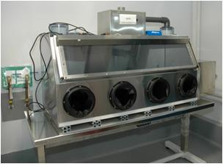
National NF Lab Network: Tasks
  Establish requirements for nuclear forensics labs and for facilities handling evidence contaminated with radioactive material.
  NF labs must be capable of providing timely, scientifically valid data in a manner that is legally defensible.
  Operation in accordance with defined and documented structure is also a cornerstone of the nuclear forensics process.
  QA requirements based on standards (e.g., ISO 17025), published literature (e.g., from the IAEA), and practitioners, including Canadian and international forensic laboratory best practices.
    Lab organization and management, sample control (particularly in terms of chain of custody considerations), document and data control, personnel qualifications and training, and analytical methodology.
8

Slide 9
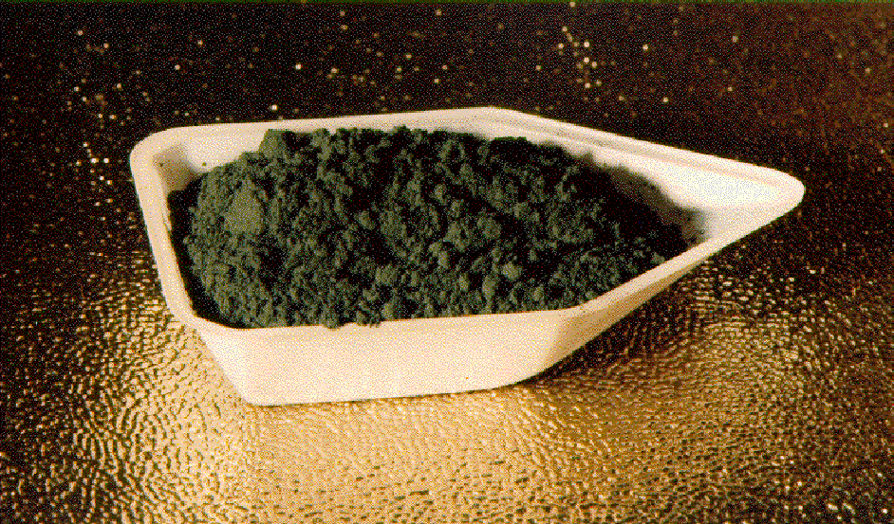
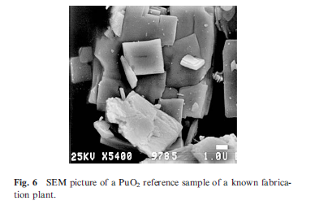
National NF Lab Network: Tasks
  Catalog current analytical capabilities.
    Various categories of capabilities
    This is a living document with an update cycle
9

Slide 10
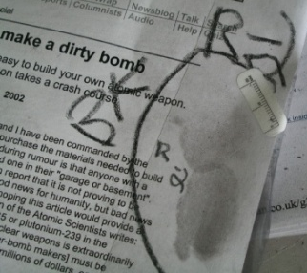
National NF Lab Network: Tasks
  Identify gaps in current knowledge and capability and determine actions to close the gaps
  Ideal set of capabilities vs. minimum acceptable capability (risk-based approach)
  Literature review of what’s been done or is on-going in Canada and other countries.
10

Slide 11


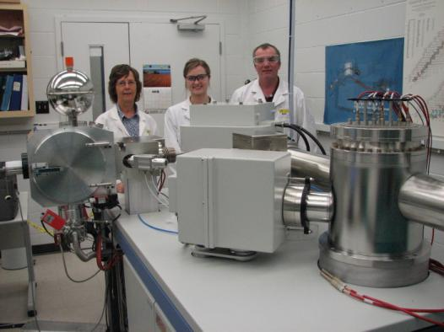
National NF Lab Network: Tasks
  Implement appropriate actions (e.g., R&D, protocol development) to address the gaps
    Realistic and practical expectations
    Prioritize actions into short-term and long-term
    Participation in both national and international collaborative effort to address common gaps
    Participation in international nuclear forensics meetings, workshops and exercises to leverage what is being developed in Canada with other international partners
TIMS
11

Slide 12
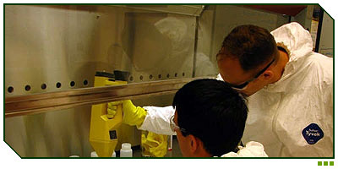
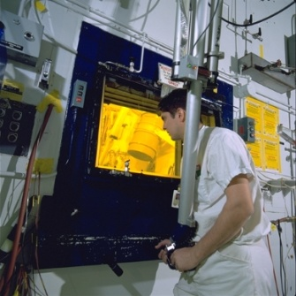
National NF Lab Network: Tasks
  Develop and implement training plan for nuclear and classical forensics specialists
    Identify training requirements and potential sources of training
    Training implementation will consider using or modifying material from existing sources
    Effectively a cross-training program, i.e., forensic awareness training for RN lab scientists, especially, chain-of-custody aspects of handling evidence materials, and RN training for classical forensic scientists.
    Informal workshop-type, hands-on training appropriate
12

Slide 13
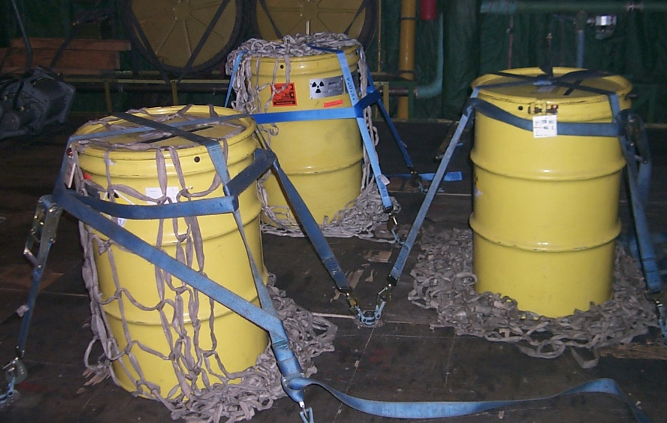
National NF Lab Network: Tasks
  Develop protocols for collection, packaging, and domestic transportation of RN materials to the labs; and protocols for handling of evidence material at the labs
    Identify best practices / guidelines for collection, packaging, transportation of RN materials, and evidence material handling
    Consult existing information developed for first responders and field personnel
    Expect that each lab will need their own SOPs based on guidelines (i.e., not prescriptive)
13

Slide 14
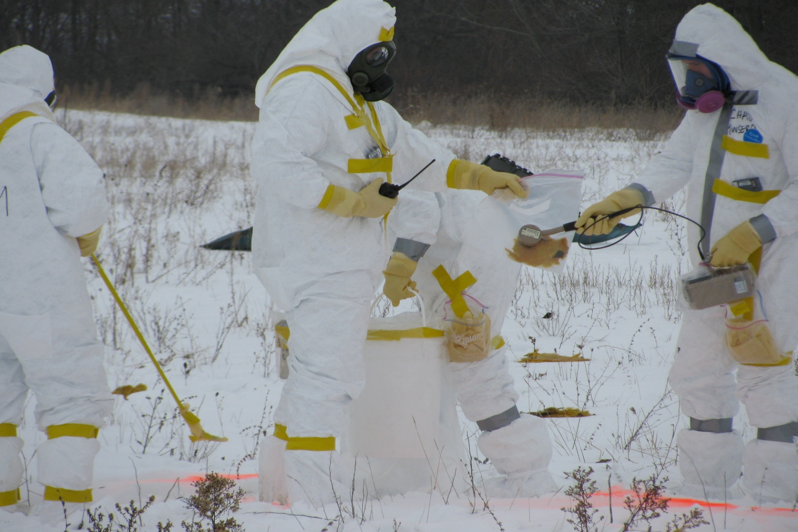
National NF Lab Network: Tasks
  Plan and execute operational exercise geared towards lab network implementation
    Develop test objectives and assessment criteria as input to exercise design/planning
    Tabletop activity as a dry run
    If feasible, plan a lab inter-comparison, followed by an operational exercise covering the entire "life cycle" - incident, evidence collection, analysis, presentation of evidence
    Test the nuclear forensics capability during an (existing) operational exercise with end user communities
14

Slide 15
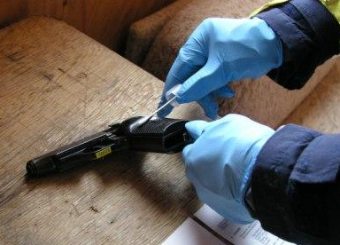
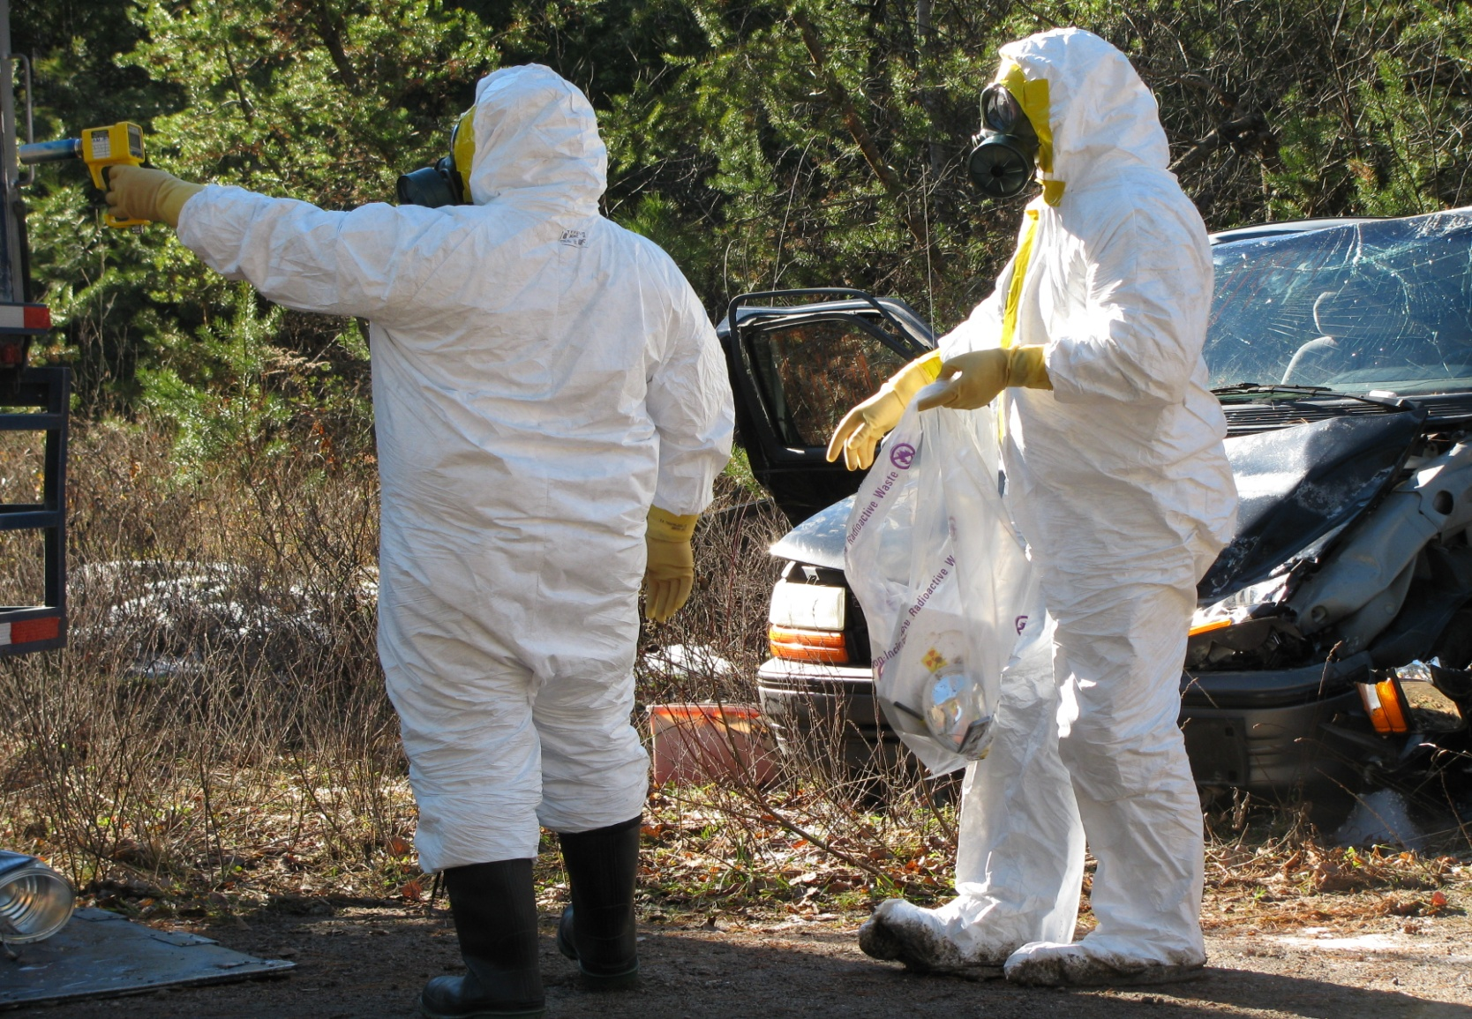
National NF Lab Network: Outputs
  Guidelines for NF Labs
  Catalogue of current NF analytical capabilities
  Action plan to address any identified gaps
  Protocols and procedures for the collection, transportation, and handling of evidence
  Improved techniques for analyzing evidence including those contaminated with RN materials
  Trained nuclear and classical forensics specialists and first responders on handling of material/evidence
  Operational exercise geared towards lab network implementation
15

Slide 16
National NF Lab Network: Progress To-Date
  Project Charter signed by all partners in Sept 2013
  Work on several tasks is underway
    Completed Task 1 (Guideline document for NF labs issued)
    Completed Task 2 (Catalogue of current NF analytical capabilities)
    Initiated Task 3 (Capability gap assessment) and Task 5 (Develop training plan)
  Established communication protocol for project
  SharePoint site for document sharing
  Bi-weekly teleconference ongoing
  Quarterly face-to-face project meeting on a rotating-host basis (each meeting hosted by a different lab)
16

Slide 17
CNNFC Project:
Interaction Between Streams 1 and 2
17

Slide 18
National NF Lab Network: Summary
  Within the Canadian National Nuclear Forensics Capability Project, establishment of Lab Network is underway
    The national network of laboratories for comprehensive NF analysis, including a capability to perform classical forensic analysis on evidence contaminated with radioactive material
    Build up the Network based on existing knowledge, expertise & facilities
    Whole of government approach, multi-departmental coordination of complementary S&T capabilities
    Important role for law enforcement and other government departments, to ensure that the outputs are consistent with the requirements of the user community
    Establish strong collaboration among radiation scientists, forensic scientists, law enforcement, policy makers, and operational support specialists.
18

