Slide 1
Characterization of a Uranium Ore Concentrate Sample Interdicted in Durban, South Africa
IAEA Conference on Advances in Nuclear Forensics
July 2014
Ian D. Hutcheon
Glenn Seaborg Institute

Slide 2
A 1-kg uranium-rich sample was interdicted in Durban, South Africa on 14 November 2013
South Africa police seized a shopping bag containing ~1 kg of a uranium-rich material in a “sting” operation
Two individuals arrested
Material analyzed by Necsa
Uranium ore concentrate, depleted in ²³⁵U: 0.38% ²³⁵U
10 g aliquot transferred to LLNL in December 2013 under the MOU describing cooperation in nuclear forensics between South Africa and the United States
Kobus Hancke visited LLNL in January 2014 to participate in the analyses

Slide 3
We used a variety of analytical techniques to characterize the Durban UOC
Gamma ray spectroscopy
X-ray diffraction
X-ray fluorescence
Optical spectroscopy
Scanning electron microscopy
Davies-Gray titration
Inductively-coupled plasma mass spectrometry (ICP-MS)
Thermal ionization mass spectrometry (TIMS)

Slide 4
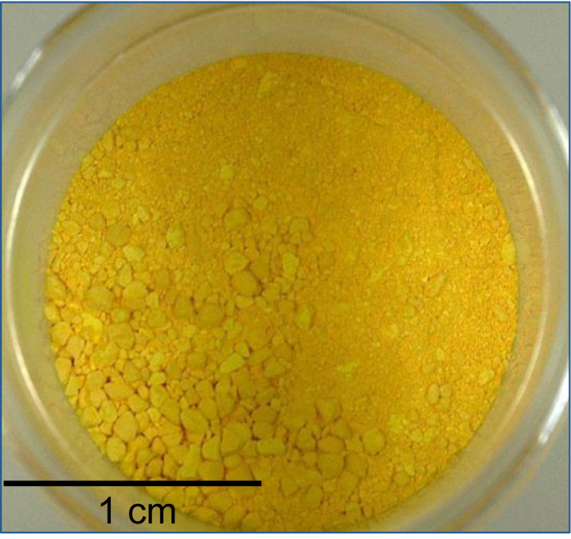
The sample is a fine-grained yellow powder

Slide 5
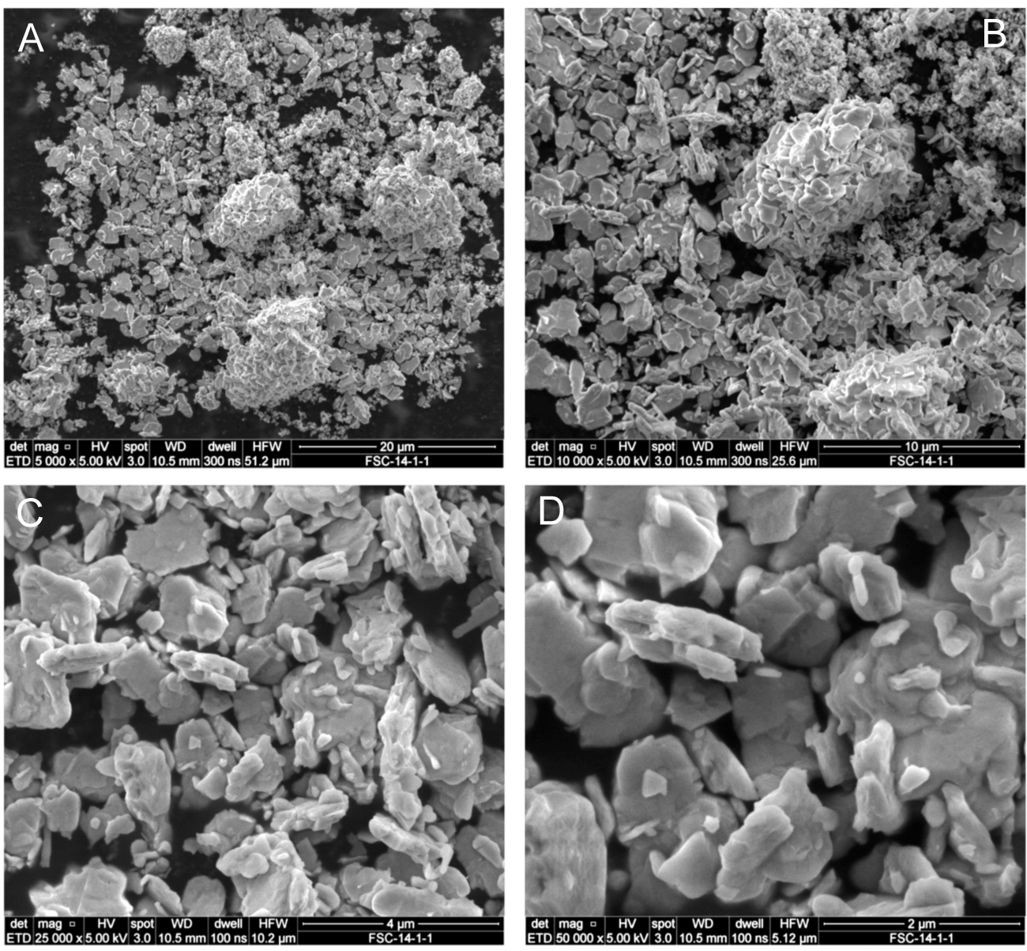
The sample is a fine-grained yellow powder

Slide 6
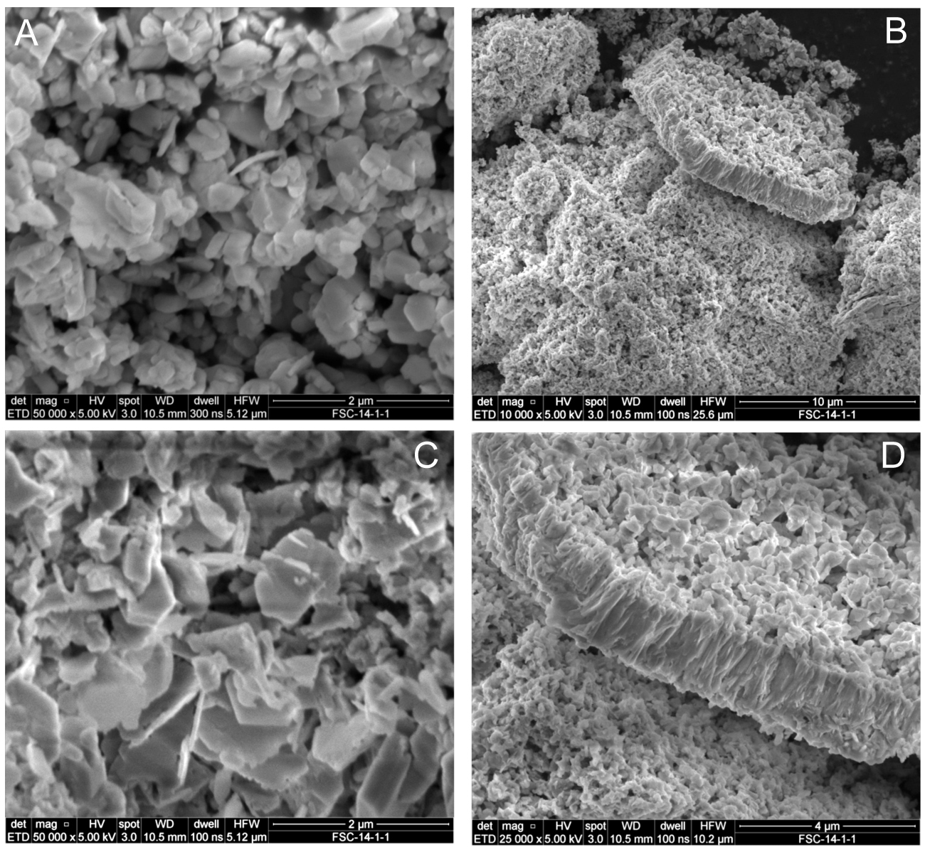
The sample is a fine-grained yellow powder

Slide 7
VIS/near IR spectroscopy indicates the sample is an ammonium uranate

Slide 8
Gamma ray spectroscopy confirmed the depleted U-isotope composition of the UOC

Slide 9
X-ray diffraction indicated four phases are present in the UOC

Slide 10
U-assay and trace element abundances are unremarkable and do not point to a specific location or process
Davies-Gray titration yields a U-content of 74.9 ± 0.5 wt.%
Compares to 67.5 wt.% measured by Necsa
Total impurity content of ~300 μg/g
Major impurities are Na, K, Ca, Fe, Mo and Cs
Cs makes up over 50% of the total
Pu is ~10 pg/g

Slide 11
Mass spectrometry confirms depleted uranium with high ²³⁶U and very low Pu

Slide 12
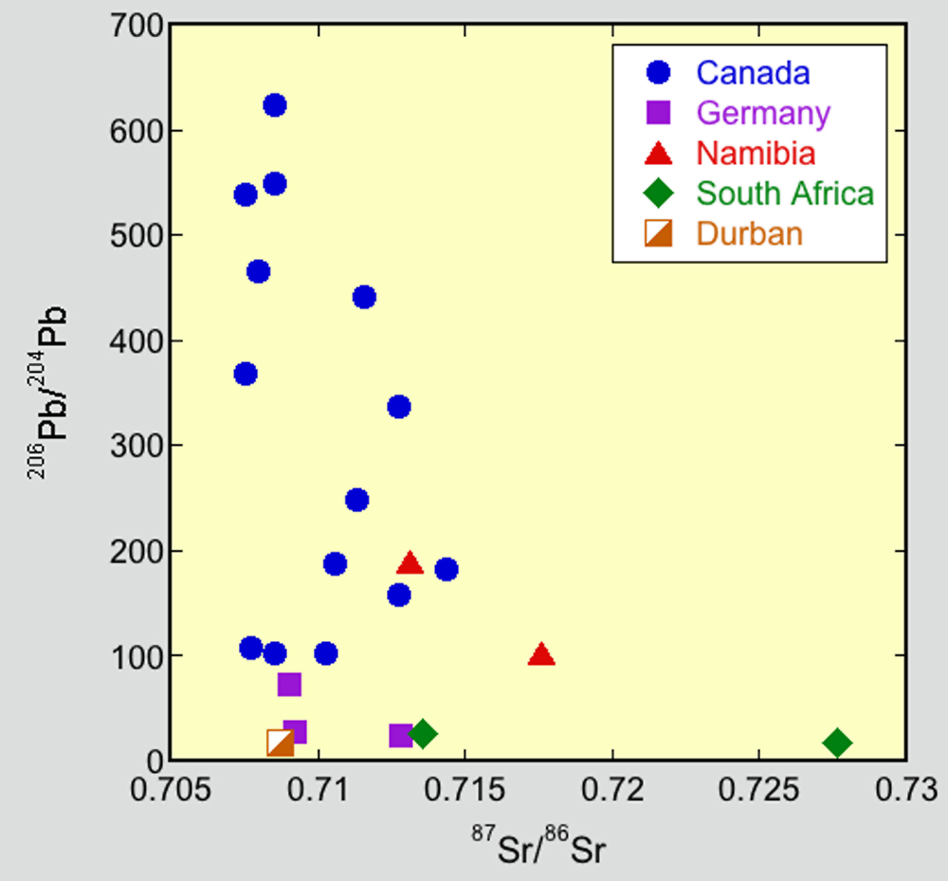
Sr and Pb isotopes indicate the UOC source is not represented in the U-Sourcing Database

Slide 13
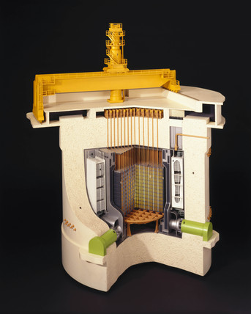
Reactor modeling suggests the UOC could represent reprocessed, irradiated fuel from a graphite-moderated reactor
Modeled a graphite moderated, natural uranium (NU) fueled reactor using the MAGNOX reactor model included in the Origen-ARP component of SCALE 6.1
NU fuel irradiated for ~100 days to a burnup of 1.6 GWD/MTU would have a ²⁴⁰Pu content of ~14% at discharge
Using this fuel as feed for an enrichment cascade producing ²³⁵U enriched to 2%, the ORNL MSTAR program calculates ²³⁴U /²³⁵U = 9.1 x 10⁻³ and ²³⁶U /²³⁵U = 4.2 x 10⁻², both values consistent with measurements

Slide 14
Summary
The UOC is ammonium uranyl flouride plus two hydrated uranyl oxides
Total impurity content of ~300 μg/g
Major impurities are Na, K, Ca, Fe, Mo and Cs
The UOC is depleted in ²³⁵U with a ²³⁵U/²³⁸U ratio ~2x lower than that of natural uranium (NU)
The elevated ²³⁶U content indicates the parent material was irradiated in a nuclear reactor
The UOC likely originated as NU fuel irradiated in a graphite-moderated reactor and used as feedstock for an enrichment cascade

Slide 15
Acknowledgements
The LLNL/NECSA nuclear forensics team:
Lars Borg
Amy M. Gaffney
Victoria G. Genetti
Patrick M. Grant
Kobus J. Hancke
Ian D. Hutcheon
Theresa M. Kayzar
Gregory L. Klunder
Kim B. Knight
Michael J. Kristo
Rachel E. Lindvall
Naomi Marks
Reuben P. Mogafe
Aubrey N. Nelwamondo
Christina E. Ramon
Erick C. Ramon
Martin Robel
Michael A. Sharp
Michael J. Singleton
Ross W. Williams
Work supported by NNSA’s Office of Defense Nuclear Nonproliferation and the South African Nuclear Energy Corporation

