Slide 2
INTERPOL
CBRNE Sub-Directorate
Alan King A/Assistant Director
IAEA International Conference on Advances in Nuclear Forensics
7-10 July 2014

Slide 3
Conventional Forensics
Forensics in a contaminated environment
Nuclear Forensics
INTERPOL & its CBRNE Sub-Directorate

Slide 4


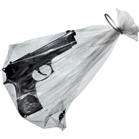
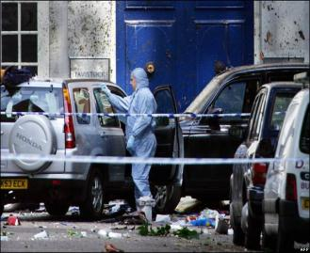
Conventional Forensics
Evidence to convict people
Notes:
Evidence to convict people

Slide 5
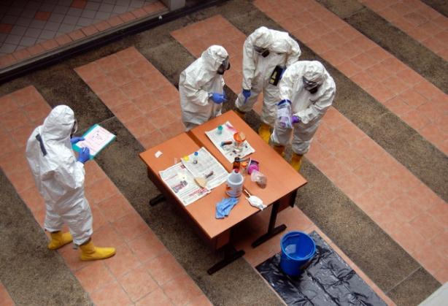
Forensics in a contaminated environment
Evidence to convict people
But more complicated in terms of procedure
Notes:
Evidence to convict people, but more complicated in the procedure

Slide 6

Nuclear Forensics
Evidence of attribution –Part of the judicial process to convict people
Notes:
Evidence of attribution – material
Useful in the judicial process to convict people

Slide 7
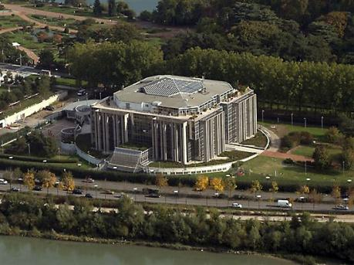
INTERPOL’s Strategic Mission
INTERPOL facilitates cross-border police co-operation, and supports and assists all organizations, authorities and services whose mission is to prevent or combat international crime.
Neutral & Apolitical
Notes:
INTERPOL is the world’s largest international police organization, with 190 member countries.
Created in 1923, it facilitates cross-border police co-operation, and supports and assists all organizations, authorities and services whose mission is to prevent or combat international crime.
INTERPOL aims to facilitate international police co-operation even where diplomatic relations do not exist between particular countries.
Action is taken within the limits of existing laws in different countries and in the spirit of the Universal Declaration of Human Rights.
INTERPOL’s constitution prohibits ‘any intervention or activities of a political, military, religious or racial character.’
Great strength – INTERPOL is neutral and apolitical.

Slide 8
CBRNE Sub-Directorate
Intelligence
Prevention
Response
Notes:
The INTERPOL methodology for countering the CBRNE terrorist threat consists of three main pillars:
1) Intelligence analysis for police services;
Information Sharing and Intelligence Analysis
Information Exchange Networks (WCO, IAEA, OPCW)
Analysis of international trends
Outreach programs
2) Programmes preventing the illegal dispersal of CBRNE materials;
Capacity building
Capacity Building Teams (CBRNE awareness)
Specialist courses (Bio, Rad, ChemEx)
3) Responding to and investigating CBRNE threats and malicious incidents.
Operational and investigative support
Coordination of resources
Analysis of intelligence
Searches of databases

Slide 9
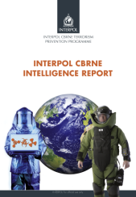
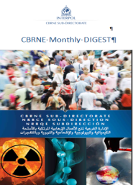

Intelligence
Developing our capability

Slide 10
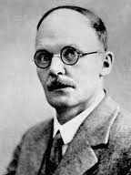
Project Geiger
Analysis of R/N trafficking
Open source
Since 2005 –monthly
IAEA partnership - ITDB
Operational/Investigative support
Notes:
Total number of cases currently entered in the database: 2722
2197 of these have been documented in reporting received by:
IAEA
NCBs
Other official reports
Law enforcement focus
Global overview and approach
Integration of terrorism, crime, and nuclear issues
Larger strategic context considered
Capability to use other analytical techniques (phone call, link, financial flow, etc.)

Slide 11
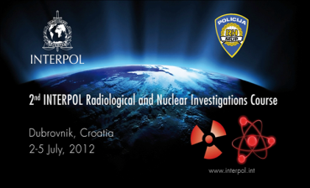
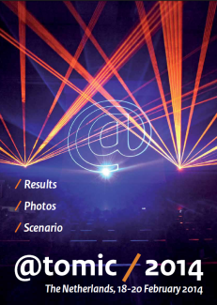
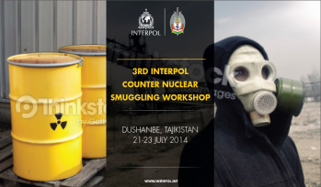
Prevention
Training
Exercising
Workshops
Conferences
Guidance Documents
Notes:
It achieves this through the delivery of:
Radiological Nuclear: Courses Table Top Exercises and Workshops, as well as All Hazards Countermeasures Programmes.
All of which are regionally delivered and have a practical interactive element and involve host country capabilities.
The common theme is:
Multi agency targeting mid – senior level LE; Borders; Customs; Intelligence; Regulatory Authorities; Public Health; Government (MoFA & Interior) and Academia.

Slide 12
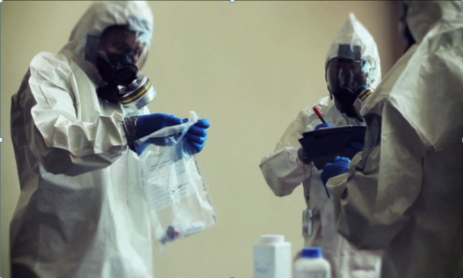
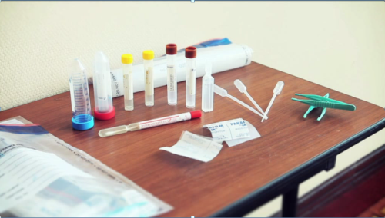
Forensics
Techniques & Processes
Equipment

Slide 13

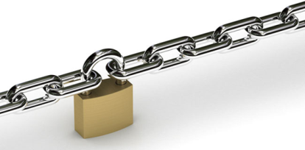

Chain of Custody
190 Countries
Notes:
In Criminal Law the Chain of Custody is vitally Importance

Slide 14
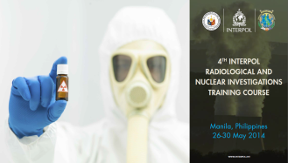
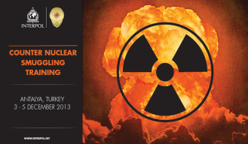
Training to Date
Radiological Nuclear Investigations Course
Warsaw September 2011 – Northern &Eastern Europe
Dubrovnic July 2012 – Southern & Eastern Europe
Panama City July 2013 – Central & South Americas
Manila May 2014 – S.E Asia
Counter Nuclear Smuggling Training
Warsaw February 2012 – NSS Countries
Antalya December 2013 – Black Sea & Surrounding Region
Dushanbe July 2014 – Caucasus & Central Asia
Notes:
Each course is modified to suit the host country & regions specific needs.
Each course is evaluated and the content amended to improve future delivery.
Contains input on:
Forensics/Nuclear Forensics
Response & Mitigation

Slide 15
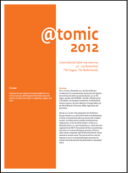

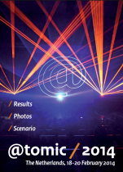
TTX to Date
Radiological Nuclear Table Top Exercise
The Hague November 2012
Kiev October 2013
Maastricht February 2014
Notes:
Each TTX is modified to suit the host country & regions specific needs.
Each TTX is evaluated and the content amended to improve future delivery.
Contains input on:
Forensics/Nuclear Forensics
Response & Mitigation

Slide 16

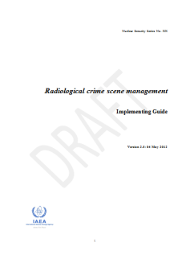
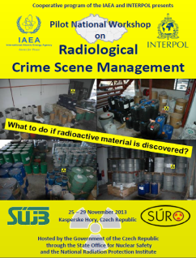
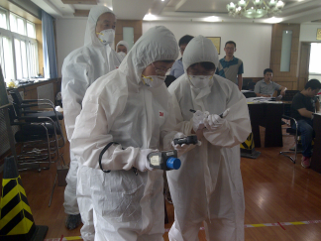
Joint Training
Beijing 16 – 20 June 2014
Notes:
IAEA: Joint IAEA/INTERPOL Guidance & Training Courses
Radiological Nuclear Investigations (INTERPOL)
Radiological Crime Scene Management (IAEA)
Counter Nuclear Smuggling (INTERPOL)
Radiological Nuclear TTX (INTERPOL et al)

Slide 17

Formal Recognition
Radiological Nuclear Investigations
Radiological Crime Scene Management

Slide 18
Close Partnership Working
IAEA Division for Nuclear Security
Notes:
IAEA: Joint IAEA/INTERPOL Guidance & Training Courses
GICNT IAG: Nuclear Detection; Nuclear Forensics; Response & Mitigation Guidance Documents
EC Joint Research Centre, Institute for Transuranium Elements
EU CBRN CoE: INTERPOL ‘All Hazard’ conferences – Jordan; Panama; Malaysia + other activity
NNSA: DoE SLD Member embedded into INTERPOL CBRNE TPP to support Rad Nuc TPU & Operation Fail Safe + Operation STAB – Wider border control
UNODA: Support to UNSC 1540 Committee’s work
G8 Global Partnership: NRSWG
And others…

Slide 19

Close Partnership Working
Nuclear Forensics Working Group
Notes:
IAEA: Joint IAEA/INTERPOL Guidance & Training Courses
GICNT IAG: Nuclear Detection; Nuclear Forensics; Response & Mitigation Guidance Documents
EC Joint Research Centre, Institute for Transuranium Elements
EU CBRN CoE: INTERPOL ‘All Hazard’ conferences – Jordan; Panama; Malaysia + other activity
NNSA: DoE SLD Member embedded into INTERPOL CBRNE TPP to support Rad Nuc TPU & Operation Fail Safe + Operation STAB – Wider border control
UNODA: Support to UNSC 1540 Committee’s work
G8 Global Partnership: NRSWG
And others…

Slide 20

Close Partnership Working
Netherlands Forensic Institute
Notes:
IAEA: Joint IAEA/INTERPOL Guidance & Training Courses
GICNT IAG: Nuclear Detection; Nuclear Forensics; Response & Mitigation Guidance Documents
EC Joint Research Centre, Institute for Transuranium Elements
EU CBRN CoE: INTERPOL ‘All Hazard’ conferences – Jordan; Panama; Malaysia + other activity
NNSA: DoE SLD Member embedded into INTERPOL CBRNE TPP to support Rad Nuc TPU & Operation Fail Safe + Operation STAB – Wider border control
UNODA: Support to UNSC 1540 Committee’s work
G8 Global Partnership: NRSWG
And others…

Slide 21
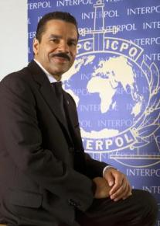
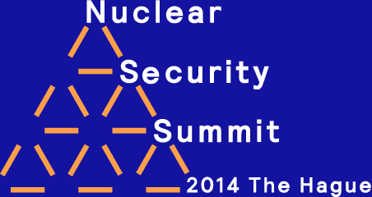
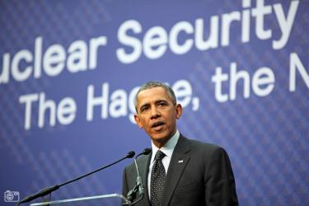

2014 Nuclear Security Summit
Toward 2016 in Chicago
Notes:
The US President, Barak Obama in his closing address to the NSS said:
‘The second thing we’ll be doing is soliciting ideas from each of you about the ultimate architecture that should be constructed to ensure that beyond 2016 we are able to keep this process alive and effective, and that we are able to sync up the efforts of the Nuclear Security Summit with existing institutions like the IAEA, Interpol, the United Nations, some of the treaties that are already in force’.

Slide 22
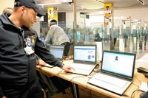
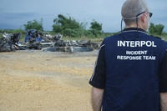
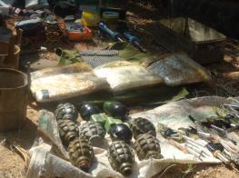
Response
Major Event Support
Pre planned events
Incident Response Teams
Coordination of CBRNE support
Support to Operations
Notes:
The ultimate objective is to provide support, in terms of a CBRN expertise, to the investigators who are facing this non-conventional type of crime. A CBRNE Investigation is based on 2 main pillars:
1- The material susceptible of being used in an attack (here is posed the questions of access to and the security of dual-use CBRN materials)
2- People who have the scientific and/or technical expertise necessary to use CBRN material in a malicious act.
According to best practices, investigations, based on Intelligence and Threat and Risk assessments, serve not only for a better response to CBRN incidents (by looking for perpetrators and bringing them to justice), but also for preventing them. According to international best practices, the best strategy to prevent and respond to CBRN criminality is the adoption of an all-hands approach that assembles different governmental and international agencies of relevance
We refer to this strategy by the concept of:
- CBRN Governance at strategic level of decision-making
- Inter-Agency on the tactical level
It is strongly recommended that each country has a prevention policy associating specialists from the police, intelligence services, emergency services, civil and military authorities, without forgetting public health authorities and scientific research institutions.
IMEST: (2011)
France - G20 - Oct/Nov
Lithuania – Euro Basketball – Aug/Sep
China – World University Summer Games – Aug
Colombia – FIFA Under 20’s World Cup Jul/Aug
Croatia - Protection of Foreign Tourists Operation – Jun/Aug
IRT: (2012)
Burgas, Bulgaria – Bomb explosion – July
IRT: (2011)
Nigeria – Explosion UN Building – Sep
South Africa – Maritime Piracy Case – Apr
Congo – Plane Crash – Mar

Slide 23
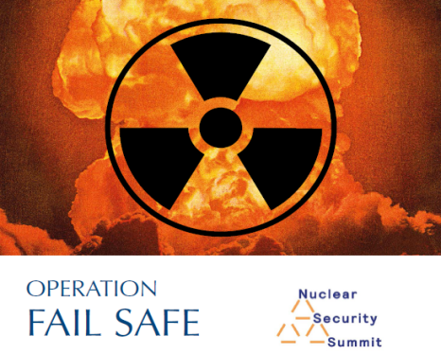
Operation Fail Safe
International Counter Nuclear Smuggling
Notes:
Operation Fail Safe
In support of the 2012 International Nuclear Security Summit held in Seoul S. Korea, INTERPOL initiated Operation Fail Safe as an international operational support initiative to increase global nuclear security. This has now been continued in a very positive manner following the SG’s address to the 2014 NSS in The Hague. Numerous countries called on INTERPOL to continue its excellent work stating that it, together with the IAEA is the most effective way to tackle nuclear terrorism by non-state actors and to combat nuclear smuggling. The UK has funded INTERPOL 500,000 GBP to continue its work in this field through till the next NSS in March 2016.
INTERPOL Operation Fail Safe introduced a capability to the international law enforcement community to track the movements of individuals involved in the trafficking of nuclear or other radioactive material.
Operation Fail Safe leverages existing INTERPOL tools and processes including the I-24/7 network; the INTERPOL system of Regional Bureaus, NCBs, the General Secretariat; the CCC; and the Notices system, including i-Link, to identify and track individuals involved in the trafficking of radioactive or nuclear materials.
The main tool to inform member countries about these individuals will be the Green Notice.
The Green Notice information is provided by the NCBs through their participation in Operation Fail Safe or at the request of the IPSG in furtherance of Operation Fail Safe.
Operation Fail Safe
To date 23 Green Notices (18 from Georgia and 5 from Bulgaria) and representing five different nationalities.
There are currently 95 other cases being researched that could involve a possible 285 additional suspects.

Slide 24
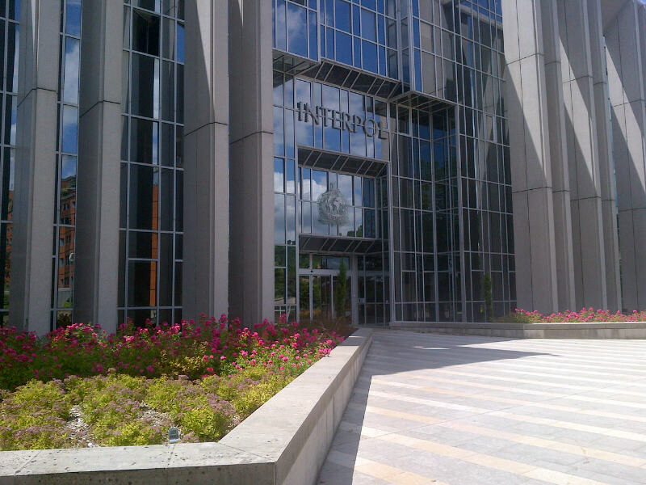
Thank You
a.king@interpol.int

