Slide 1
NNSA’s Confidence Building Measures Program (CBM)
Heather Dion, Ed Fei, Caterina Fox
National Nuclear Security Administration
U.S. Department of Energy

Slide 2
CBM Mission
Build international capacity in nonproliferation nuclear forensics to support global nuclear security efforts.
CBM Vision
Work bilaterally, multilaterally, and through international organizations to support states as they develop a pre-detonation nuclear forensics capacity as an integral part of their nuclear security framework.
CBM Program Mission

Slide 3
DOE National Laboratory Complex
Notes:
17 National Laboratories
Science & Technology
Energy & Environment
National Security
Life & Physical Sciences

Slide 4
CBM: Key Objectives
Objective 1: Build global nuclear forensics awareness
Objective 2: Build confidence in foreign forensic analyses through direct capacity-building efforts
Objective 3: Facilitate peer laboratory interactions
Notes:
Objective 1: Building a global nuclear forensics regime
CBM works through international organizations to build a global security regime in which nuclear forensics provides critical capabilities that assist governments in identifying the source of illicit material and preventing future security breaches.
Objective 2: Building confidence in foreign forensic analyses through direct capacity-building efforts
CBM works bilaterally and multilaterally to build international nuclear forensics capacity. Given CBM’s limited ability to support direct bilateral engagement, it has developed a prioritization matrix that focuses on countries with the most advanced nuclear fuel cycle capabilities and the greatest quantities of nuclear material. Is it politically-correct to say “weapons-usable” material? I’m thinking probably not.
Objective 3: Facilitating joint research and development (R&D)
Today, the scientific community is only starting to explore the vast applications of technical nuclear forensics for nuclear security. Fundamental R&D continues to expand the understanding of nuclear attribution and signatures that hold great forensic value. CBM has a small but important role in funding such basic R&D.

Slide 5
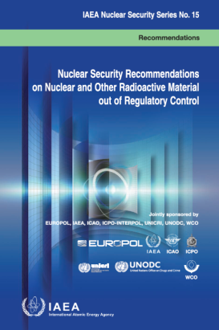
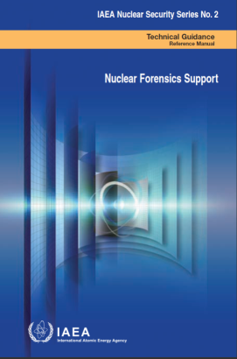
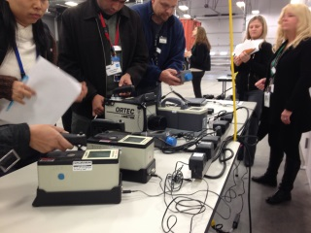
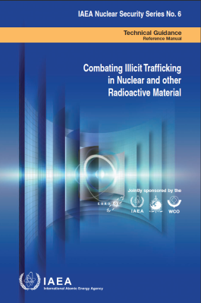
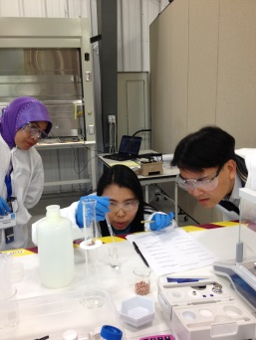
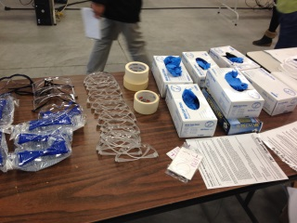
Objective 1: Build global nuclear forensics awareness
Develop international guidance for nuclear forensic best practices
Develop international recommendations and implementing guidance
Raise awareness of nuclear forensics in the global community
Notes:
Developing an international bureaucratic structure
- Support for the Nuclear Security Summit
- Support for the International Atomic Energy Agency (IAEA), the International Technical Working Group on Nuclear forensics (ITWG), and (GICNT)
Developing a conceptual framework and international guidelines
- IAEA guidance documents (Nuclear Security Series Nos. 2, 6, 15)
- GICNT Nuclear Forensics Fundamentals
Raising international awareness of nuclear forensics
- IAEA methodologies courses (hosted at Pacific Northwest National Laboratory)
- Support for GICNT exercises (Tiger Reef, Mystic Deer, etc.)
- Participation in ITWG

Slide 6
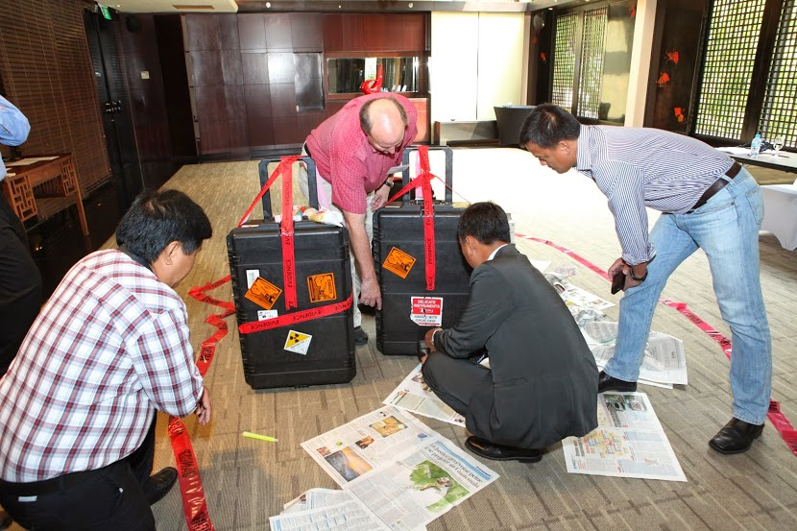
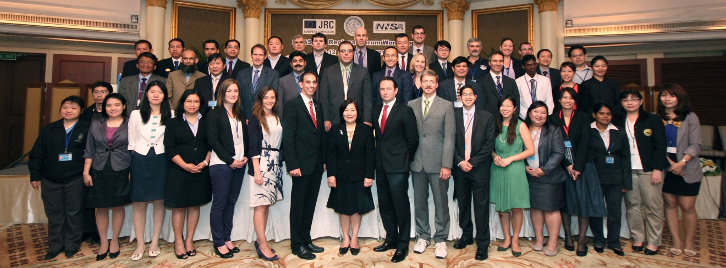
Objective 1: Build global nuclear forensics awareness
Multilateral awareness raising efforts
IAEA Nuclear Security Series
NSS #2 Revision
National Nuclear Forensics Libraries
Support to the GICNT Nuclear Forensics Working Group
TTX Karlsruhe, Iron Koala, Tiger Reef
ASEAN Regional Forum engagement
Notes:
Partnering with EC

Slide 7
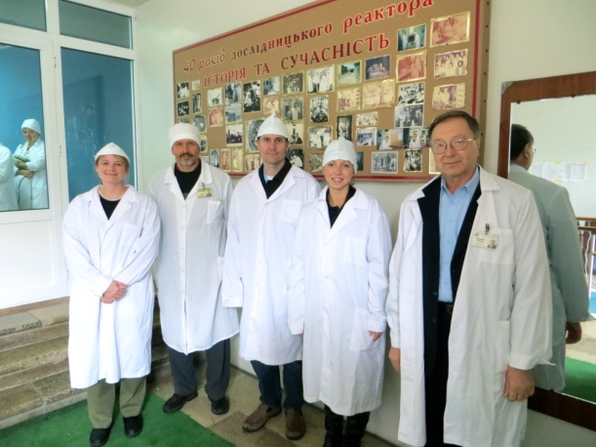
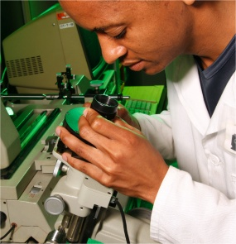
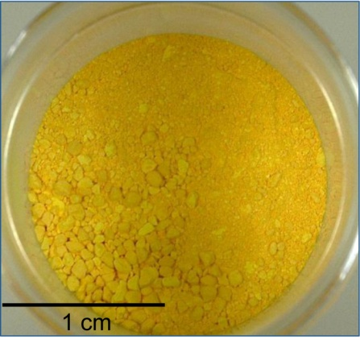
Objective 2: Build confidence in foreign forensic analyses through direct capacity-building efforts
Provide support to strategic partner States to improve nuclear forensic programs
Support development of analytical capabilities
Support renovation of laboratory space
Support development of a National Nuclear Forensics Library
South Africa
Support development of a National Nuclear Forensics Library
Ukraine

Slide 8
Objective 3: Facilitate peer laboratory interactions
Bilateral and multilateral projects of interest to the international nuclear forensics community
Radiochronometers provide insight into separation date and quality
Areas for improvement
Certified Reference Materials
Development of ²²⁹Th
Measurement and interpretation of multiple parent-progeny pairs
²³⁰Th/²³⁴U
²³¹Pa/²³⁵U
Work with partners to increase precision and accuracy in uranium age dating
Historically interlaboratory has been a bias with these measurements
Focus on a single topic to maximize CBM’s investment
Current Focus: Uranium Chronometry

Slide 9
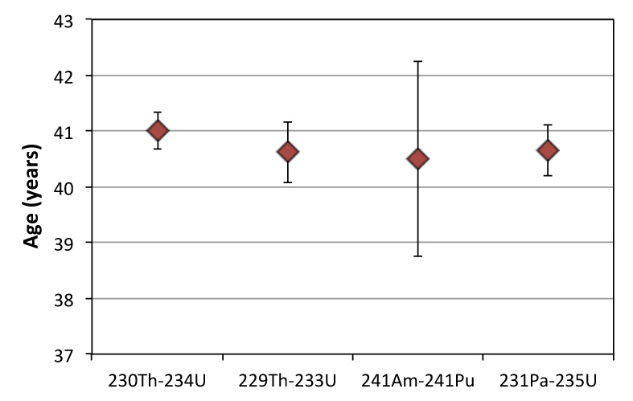
Radiochronometry Examples
Example from ITWG: Behavior of U, Pa, Pu, Am during U metal casting
Common Radiochronometers
Age of an HEU Sample
²³⁴U → ²³⁰Th; t_{1/2} = 2.5x10⁵ yr
²³⁵U → ²³¹Pa; t_{1/2} = 7.0x10⁸ yr
²³³U → ²²⁹Th; t_{1/2} = 1.6x10⁵ yr
²⁴¹Pu → ²⁴¹Am; t_{1/2} = 14.4 yr
²⁴¹Am → ²³⁷Np; t_{1/2} = 433 yr
Notes:
Material production age very useful forensic discriminator
The power of using multiple radiochronometers has yet to be fully investigated
ITWG round robin exercise highlighted need

Slide 10
Summary
Continue to provide technical support to awareness raising activities through various multilateral initiatives (IAEA, GICNT, ARF, and others)
Increase global technical capacity to conduct nuclear forensic analyses in accordance with established best practices and community norms
Encourage partner States to sustain and grow nuclear forensic capabilities though scientific exchanges and development of best practices

Slide 11
Collaborators
United States
Lawrence Livermore National Laboratory
Los Alamos National Laboratory
Pacific Northwest National Laboratory
Department of State
Department of Homeland Security
Federal Bureau of Investigation
Australia
Australia Nuclear Science and Technology Organization
Canada
Canada Nuclear Safety Comission
China
China Institute for Atomic Energy
European Commission
Joint Research Center-Institute for Transuranium Elements
France
Commissariat a l’Energie Atomique
International Atomic Energy Agency
Division of Nuclear Security
Japan
Japan Atomic Energy Agency
Republic of Korea
Korea Atomic Energy Research Institute
Korea Institute of Nuclear Nonproliferation and Control
South Africa
Nuclear Energy Corporation of South Africa
Ukraine
Kyiv Institute for Nuclear Research

