Slide 1
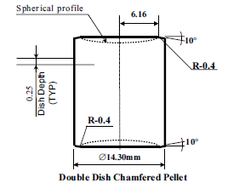
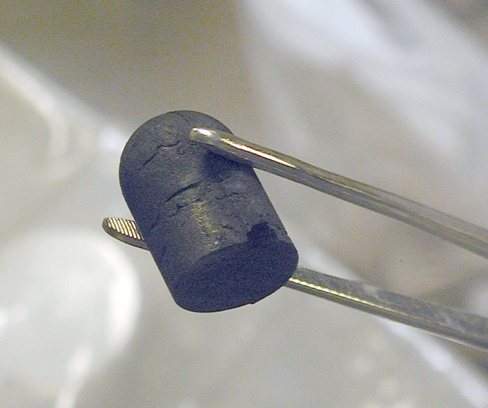
Strategies and Considerations for Developing a National Nuclear Forensics Library
Stephen LaMont, Marcia Brisson, and Lindsay Minnema
Nuclear Materials Information Program
Heather Dion, Ed Fei, and Jerry Davydov
Confidence Building Measures
U.S. Department of Energy
Sarah Fendrich and Michael Curry
Weapons of Mass Destruction Directorate
U.S. Department of State

Slide 2
Overview
Nuclear forensics is a comparative science where data from unknowns can be compared with known material characteristics to assess nuclear or other radioactive material provenance
Hence, the need exists for:
  Information on the location and characteristics of nuclear and other radioactive material produced, used or stored within the State
  Expertise in identifying and interpreting the characteristics of material produced, used or stored within the State
  A mechanism for conducting comparative assessments of material encountered out of regulatory control
  A mechanism for encouraging international cooperation during nuclear forensics investigations
The administrative organization of data and subject matter expertise forms the framework for a national nuclear forensic library

Slide 3
Fundamental Requirement: Is it ours?
If nuclear material is found outside of administrative controls anywhere in the world, then each country should be able to answer the question:
  “Is this consistent with our material?”
Verifying inventory may confirm that material does not appear to be missing, but that may not be sufficient
A national nuclear forensic library is extremely valuable for answering this question with timeliness and confidence
Notes:
“Is it ours?” - part of each country’s responsibility to be able to identify nuclear or radioactive materials used, produced, or stored within their borders.

Slide 4
National Nuclear Forensics Library Model
NNFLs give countries the capability to identify materials used, produced or stored within their borders
What is needed to answer “is it ours?”
Requirements
Options for Success
National-level mandate
Defined query protocol
Organize necessary resources
  Government and industrial material holders
  Data
  Subject matter expertise
Centralized or formally federated databases
Formal effort to understand useful material characteristics
Accompanying material archive and analysis capability

Slide 5
General Process for Building a NNFL
Establish mandate to build a NNFL
Coordinate with subject matter experts, regulators, and law enforcement
Identify materials for inclusion in NNFL and existing data
Evaluate characteristics necessary for comparative analysis
Compare necessary characteristics against existing data
Identify and fill gaps in data (may require laboratory analysis)
Build or modify databases as needed
Develop comparative analysis tools as required
Notes:
General guidance for the development and use of national libraries has been available for several years from the ITWG, IAEA, and GICNT. For the most part, the steps identified here are the basic steps needed to establish a functional NNFL.
Can go through the steps individually if you like
However, there is very little guidance on the level of effort necessary to develop a library, and this is likely to vary widely depending on each country’s unique situation. The rest of the presentation will explore this concept, and hopefully stimulate discussion about how ITWG might develop better guidance to tailor the above steps to countries with vastly differing situations.

Slide 6
NNFL Effort and Complexity
The level of effort required to develop a library varies greatly between countries
NNFL complexity is largely dictated by the nuclear activities within a state
Not every country needs to capture the same material characteristics to have a functional NNFL
Quantity of radioactive sources
Variety of radioactive sources
Quantity of nuclear materials
Variety of nuclear materials
Production or processing of nuclear or radioactive materials
Research and development activities
Complexity of NNFL and Associated Materials Databases
∝
Notes:
It is potentially helpful to think about how the level of effort required to establish a NNFL scales with the types and complexity of nuclear-related activities found within a country.

Slide 7
Practical Approach to Implementation
To date, guidance for developing a NNFL has not adequately addressed variable complexity of nuclear activities
Proposed approach
  Evaluate nuclear activities to guide NNFL development
  Adapt general guidance already available to categories (e.g. draft IAEA guidance)
This approach should improve understanding regarding the level of effort necessary to attain a functional national nuclear forensics library

Slide 8
Nuclear Fuel Cycle Activities and Complexity
Group 1
Radioactive Sources
Mining & Milling
Group 2
Radioactive Sources
Mining & Milling
Group 3
Radioactive Sources
Group 4
Group 5
Research Reactors
Nuclear Power Plants
Mining & Milling
Research Reactors
Nuclear Power Plants
Radioactive Sources
Mining & Milling
Research Reactors
Nuclear Power Plants
Radioactive Sources
Mining & Milling
Research Reactors
Nuclear Power Plants
Fuel Fabrication
Nuclear R&D
Fuel Fabrication
Nuclear R&D
Enrichment
Reprocessing
Fuel Fabrication
Nuclear R&D
Enrichment
Reprocessing
Nuclear Weapons
Isotope Production
Isotope Production
Isotope Production
Increasing NNFL Complexity
Notes:
One way it might be useful implement a graded approach to library development is to consider the scope of nuclear activities within a country. One possible approach is outlined here, grouping countries based on the types of nuclear fuel cycle operations they possess. As the extent of activities increases, the necessary complexity of their NNFL also increases, as does the level of effort that will be required to establish and maintain a NNFL.

Slide 9
IAEA Member States and Fuel Cycle Activities
For 219 IAEA Member States, developing a functional NNFL should be a relatively easy task (Groups 1&2)
Notes:
A survey of the IAEA member states shows that the majority fall into Groups 1& 2, and the level of effort necessary for these states to develop a NNFL should be relatively small and rely largely on existing nuclear security information resources.

Slide 10
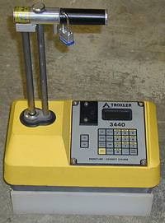

Group 1 & 2 Countries
Most countries fall into these two categories
National radioactive source registries may largely fill these nations’ NNFL needs
  Supplemental information may be necessary to uniquely identify some sources
  Additional information on reactor or non-accountable source materials may need to be captured separately or as part of an existing source registry
Notes:
For Group 1&2 countries, many already have high-quality source registries that could serve as the basis for an NNFL. A careful evaluation by subject matter experts is needed to identify any additional information that may be necessary to include in a source registry so it meets the functional requirements of an NNFL. This highlights the importance of considering existing information and how that might prove useful to a NNFL. It also emphasizes that having a functional NNFL does not take the level of effort that might be implied by some of the existing generic guidance.

Slide 11
Group 1 & 2 NNFL
Regulator’s licensing or tracking system likely has most of the information necessary for a NNFL
Some additional information might be required for non-sealed source materials
Not all recommended characteristics may be needed for all libraries
Characteristics table for radiological sources*
Characteristic | Characteristics – Data elements | Notes
Description of the source/package | Source type (emission type, use type) Quantity Description and dimensions Encapsulation or cladding Serial number Radiograph/photograph Shipping/receiving history | Identifying information from the supplier
Source activity information | Activity Reference date of the activity Neutron intensity/yield | Activities in Bq, [neutron/sec] with a radioactive decay reference date
Chemical form | Compound name
Elemental concentrations (in matrix) | Element concentration Element concentration uncertainty | Expressed in g/g sample
Major and minor isotopes | Isotope name Isotope activity Isotope activity uncertainty | Expressed as activities in Bq, include reference date
* IAEA National Nuclear Forensics Libraries document provided to Nuclear Security Summit participants
Notes:
If we look at recommendations from the IAEA’s guidance on the development of a NNFL distributed at the 2012 Nuclear Security Summit, we can see that for radiological sources, a source registry likely contains most, if not all of this information.
Another key concept here is that each country needs to be able to identify what pieces of information is necessary to make credible assessments of whether or not a material is consistent or not with material they know exists within their borders. This list of characteristics may be different for each country, even for same types of materials, depending on the type of information available and variety of materials. For example, a country with 10 AmBe sources likely needs less information to uniquely identify those sources that a country with 10,000.

Slide 12
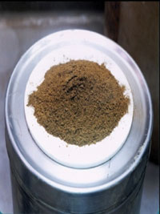
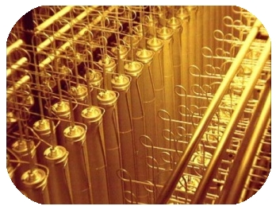
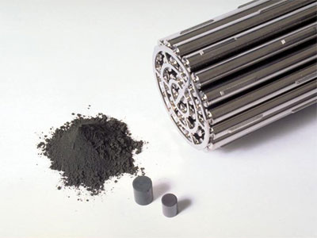
Group 3, 4, & 5 Countries
NNFL’s are supported by source registries, nuclear materials accountancy information, production data
Additional material characteristic information is required to uniquely identify most materials
  Analytical measurements and subject matter expert evaluation necessary to identify distinguishing characteristics
Candu Fuel
Uranium enrichment cascade
PuO₂
Notes:
Group 3, 4, and 5 countries will require a higher level of effort to establish a library given the quantity and variety of nuclear materials. While source registries and nuclear material accounting databases likely contain valuable information that could support the establishment of an NNFL, they do not contain everything needed to associate unknown materials with known origins.
A much larger effort on the part of subject matter experts to evaluate the material characteristics needed to populate a library will be required. The level of effort, however, is still country specific depending on what they deem necessary to be able to uniquely identify their own materials.

Slide 13
Group 3, 4, & 5 Level of Effort
Substantial effort may be required to establish a functional national nuclear forensic library
Large number of material types
Understanding of material flow through fuel cycle
Statistical expertise for identifying material populations and comparative analyses
Organizing available data and subject matter expertise essential
Notes:
13

Slide 14
Establishing an NNFL
Group
1
2
3
4
5
Direct comparison of material characteristic data
Subject matter expertise, difficulty of gathering data, sophistication of comparative analysis tools, and overall level of effort gradually increase with each group level
Data from regulator / source or fuel manufacturers
Fuel cycle / isotope production knowledge
Analytical measurement capability
Specialized databases and comparative analysis tools
Notes:
A collection of subject matter experts in fuel cycle activities, material characterization, and comparative analysis methods need to work together and decide which characteristics are useful to include in a NNFL. The effort required to carry out this task increases from group-to-group. Similarly, the level of effort necessary to develop the infrastructure needed to measure characteristics and capture those characteristics in a useful format (e.g. databases) increases from very little to a large effort.

Slide 15
Summary
Each country’s situation is unique with regard to nuclear activities and NNFL development
  Necessary mandate, organization, and technical approach
  The characteristics included in each country’s library may be different for the same materials
  The sophistication of databases and comparative analysis tools increase with scale of nuclear activities
Groups of countries can be defined based on complexity and variety of activities
  Facilitates developing guidance for groups of countries with similar NNFL needs
  Important for establishing the level of effort required to develop a NNFL early in the process
Notes:
Some questions to stimulate conversation –
What do participants think of the suggested country groupings and how the level of effort required to establish a NNFL correlate?
Does it make sense for ITWG to develop “implementing guidance” for establishing NNFLs that follows the suggested groupings based on complexity of activity?
An additional tool to help with getting started with developing a NNFL might include a gap analysis; i.e. an evaluation of existing data to identify were additional data might be beneficial and an overall estimate of the work scope necessary to have a functional NNFL. Would it be useful for ITWG to develop this type of tool? Would it be beneficial to also adapt this tool based on the suggested country groupings?

Slide 16
Acknowledgements
John Wacker
  Pacific Northwest National Laboratory
Frank Wong
  Department of Homeland Security
Ian Hutcheon, Mike Kristo, Martin Robel, Kim Knight
  Lawrence Livermore National Laboratory

Slide 17
Backup Slides

Slide 18
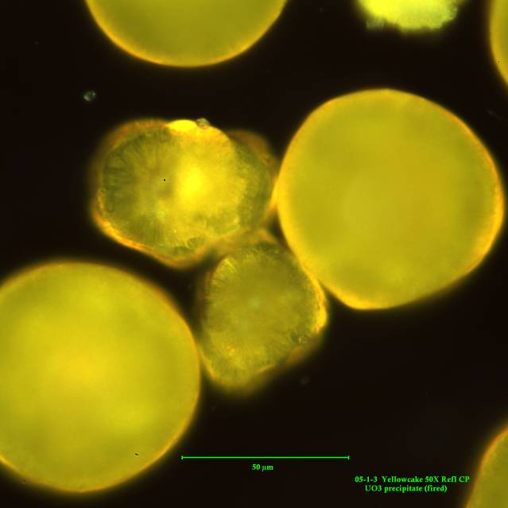
The National Nuclear Forensic Library Model
National nuclear forensics libraries
  Organized data describing nuclear material characteristics (measured and modeled)
  Enables comparative analysis by subject matter experts during forensics investigations
  Centralized or distributed, but rapidly accessible when needed
  Complexity tailored to each country’s situation
National point-of-contact (POC)
  Single national level POC to respond to international queries
UO₃
National library and point-of-contact model designed to protect proprietary and sensitive nuclear material characteristics and inventories
Notes:
Nuclear forensics libraries provide a source of comparative information to determine if an illicit material is consistent with any material known to exist within a country. (First set of bullets)
Another important element is that each country would have a national-level point-of-contact who could respond to queries from international partners. The IAEA would maintain a list of country contacts.
Last bullet

