Slide 1
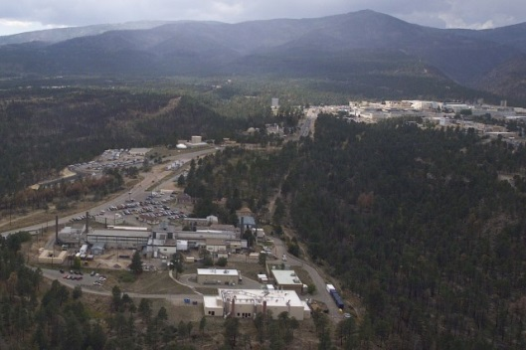
Probing Forensic Signatures of Nuclear Materials
Marianne P. Wilkerson, S. D. Conradson, J. Ellis, S. Kozimor, R. Martin, A. Pugmire, B. Scott, A. Tamasi, G. Wagner, J. Walensky, M. Zimmer
11 July 2014
Transformational and Applied Research Directorate, National Technical Nuclear Forensics Center
U.S. Department of Homeland Security
LA-UR 14-24839
Notes:
Content Slide Notes
“UNCLASSIFIED” marking of slides is not a security requirement and may be deleted from the Slide Master (View › Master › Slide Master). In general, slides should be marked “UNCLASSIFIED” if there is potential for confusion or misinterpretation of something that could be deemed classified. For guidance on marking slides containing classified and unclassified controlled information, see the Protecting Information Web site at http://int.lanl.gov/security/protectinfo/.

Slide 2

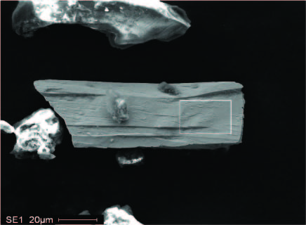
What is the problem that a Molecular and Chemical Forensic approach is addressing?
Increasingly varied and asymmetric threats are expanding the scope of nuclear forensics
Signatures are varied and can evolve, while any given sample may include multiple signatures
The scale of a signature may be tiny or LARGE
Accurate, effective technical analysis depends on
- identifying new signatures
- understanding measurement limitations
- evaluating complementary nature between traditional and new measurements
- assessing the value of the information
Production, conversion and aging of actinide materials are chemical in nature
Pu chip
LA-UR 14-24839

Slide 3

What do we mean by chemical speciation?
Levels of “Chemical Analysis”
Physical (or Phase) Speciation
Refers indirectly to the phase association: dissolved, or associated with various mineral or colloidal phases
Chemical Speciation
Refers to the chemical form and generally includes a knowledge of phase
Depending on the type of information, various levels exist
  Identity of the element
  Physical state
LA-UR 14-24839

Slide 4
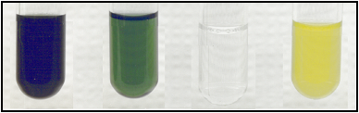
What do we mean by chemical speciation?
Levels of “Chemical Analysis”
Physical (or Phase) Speciation
Refers indirectly to the phase association: dissolved, or associated with various mineral or colloidal phases
U(III) U(IV) U(V) U(VI)
Chemical Speciation
Refers to the chemical form and generally includes a knowledge of phase
Depending on the type of information, various levels exist
  Identity of the element
  Physical state
  Oxidation state
LA-UR 14-24839

Slide 5
What do we mean by chemical speciation?
Levels of “Chemical Analysis”
Physical (or Phase) Speciation
Refers indirectly to the phase association: dissolved, or associated with various mineral or colloidal phases
U(III) U(IV) U(V) U(VI)
Chemical Speciation
Refers to the chemical form and generally includes a knowledge of phase
Depending on the type of information, various levels exist
  Identity of the element
  Physical state
  Oxidation state
  Empirical formula
UO₂(OH)⁺
LA-UR 14-24839

Slide 6
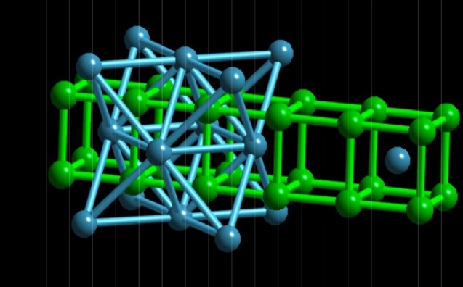
What do we mean by chemical speciation?
Levels of “Chemical Analysis”
Physical (or Phase) Speciation
Refers indirectly to the phase association: dissolved, or associated with various mineral or colloidal phases
U(III) U(IV) U(V) U(VI)
Chemical Speciation
Refers to the chemical form and generally includes a knowledge of phase
Depending on the type of information, various levels exist
  Identity of the element
  Physical state
  Oxidation state
  Empirical formula
  Molecular formula
  Molecular structure
UO₂(OH)⁺
LA-UR 14-24839

Slide 7
Actinide processing is rich in chemical information
Uranium
Ore
> 10 phases between UO₂
and UO₃, in addition to
hydrated forms of UO₃
Deceptively simple formula
and cubic structure of UO₂
masks incredibly complex
speciation
Weathering under
environmental conditions may
effect changes in morphology, chemical speciation
Can chemical speciation of major and minor constituents be measured?
Do signatures of chemical speciation change over time?
How can we ground these measurements with standards?
LA-UR 14-24839

Slide 8
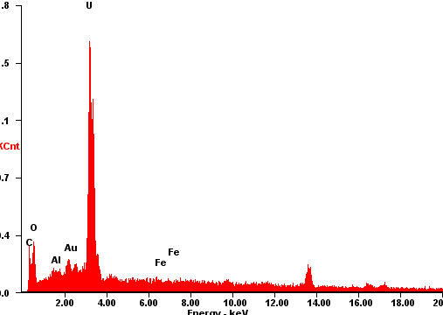
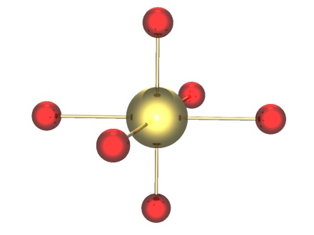
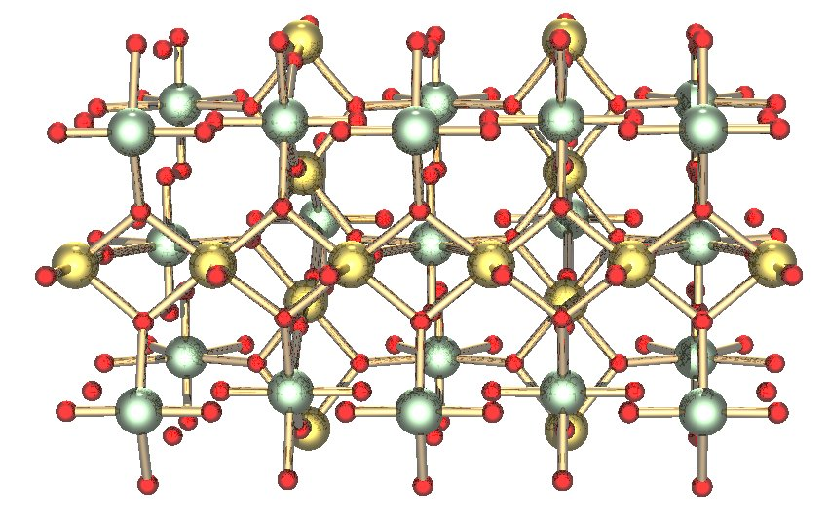
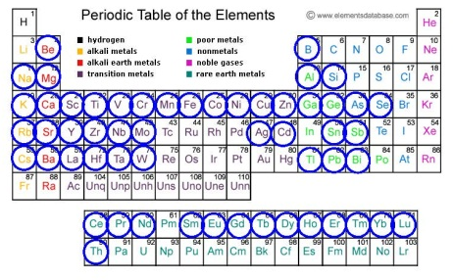
What tools provide access to chemical speciation?
Morphology
Elemental
Structural (lattice)
γ-UO₃
SEM-Energy
Dispersive
Spectroscopy
Inductively Coupled
Plasma – Mass Spectrometry
Scanning Electron Microscopy
X-ray diffraction analysis
X-ray Absorption
Spectroscopy
LA-UR 14-24839

Slide 9
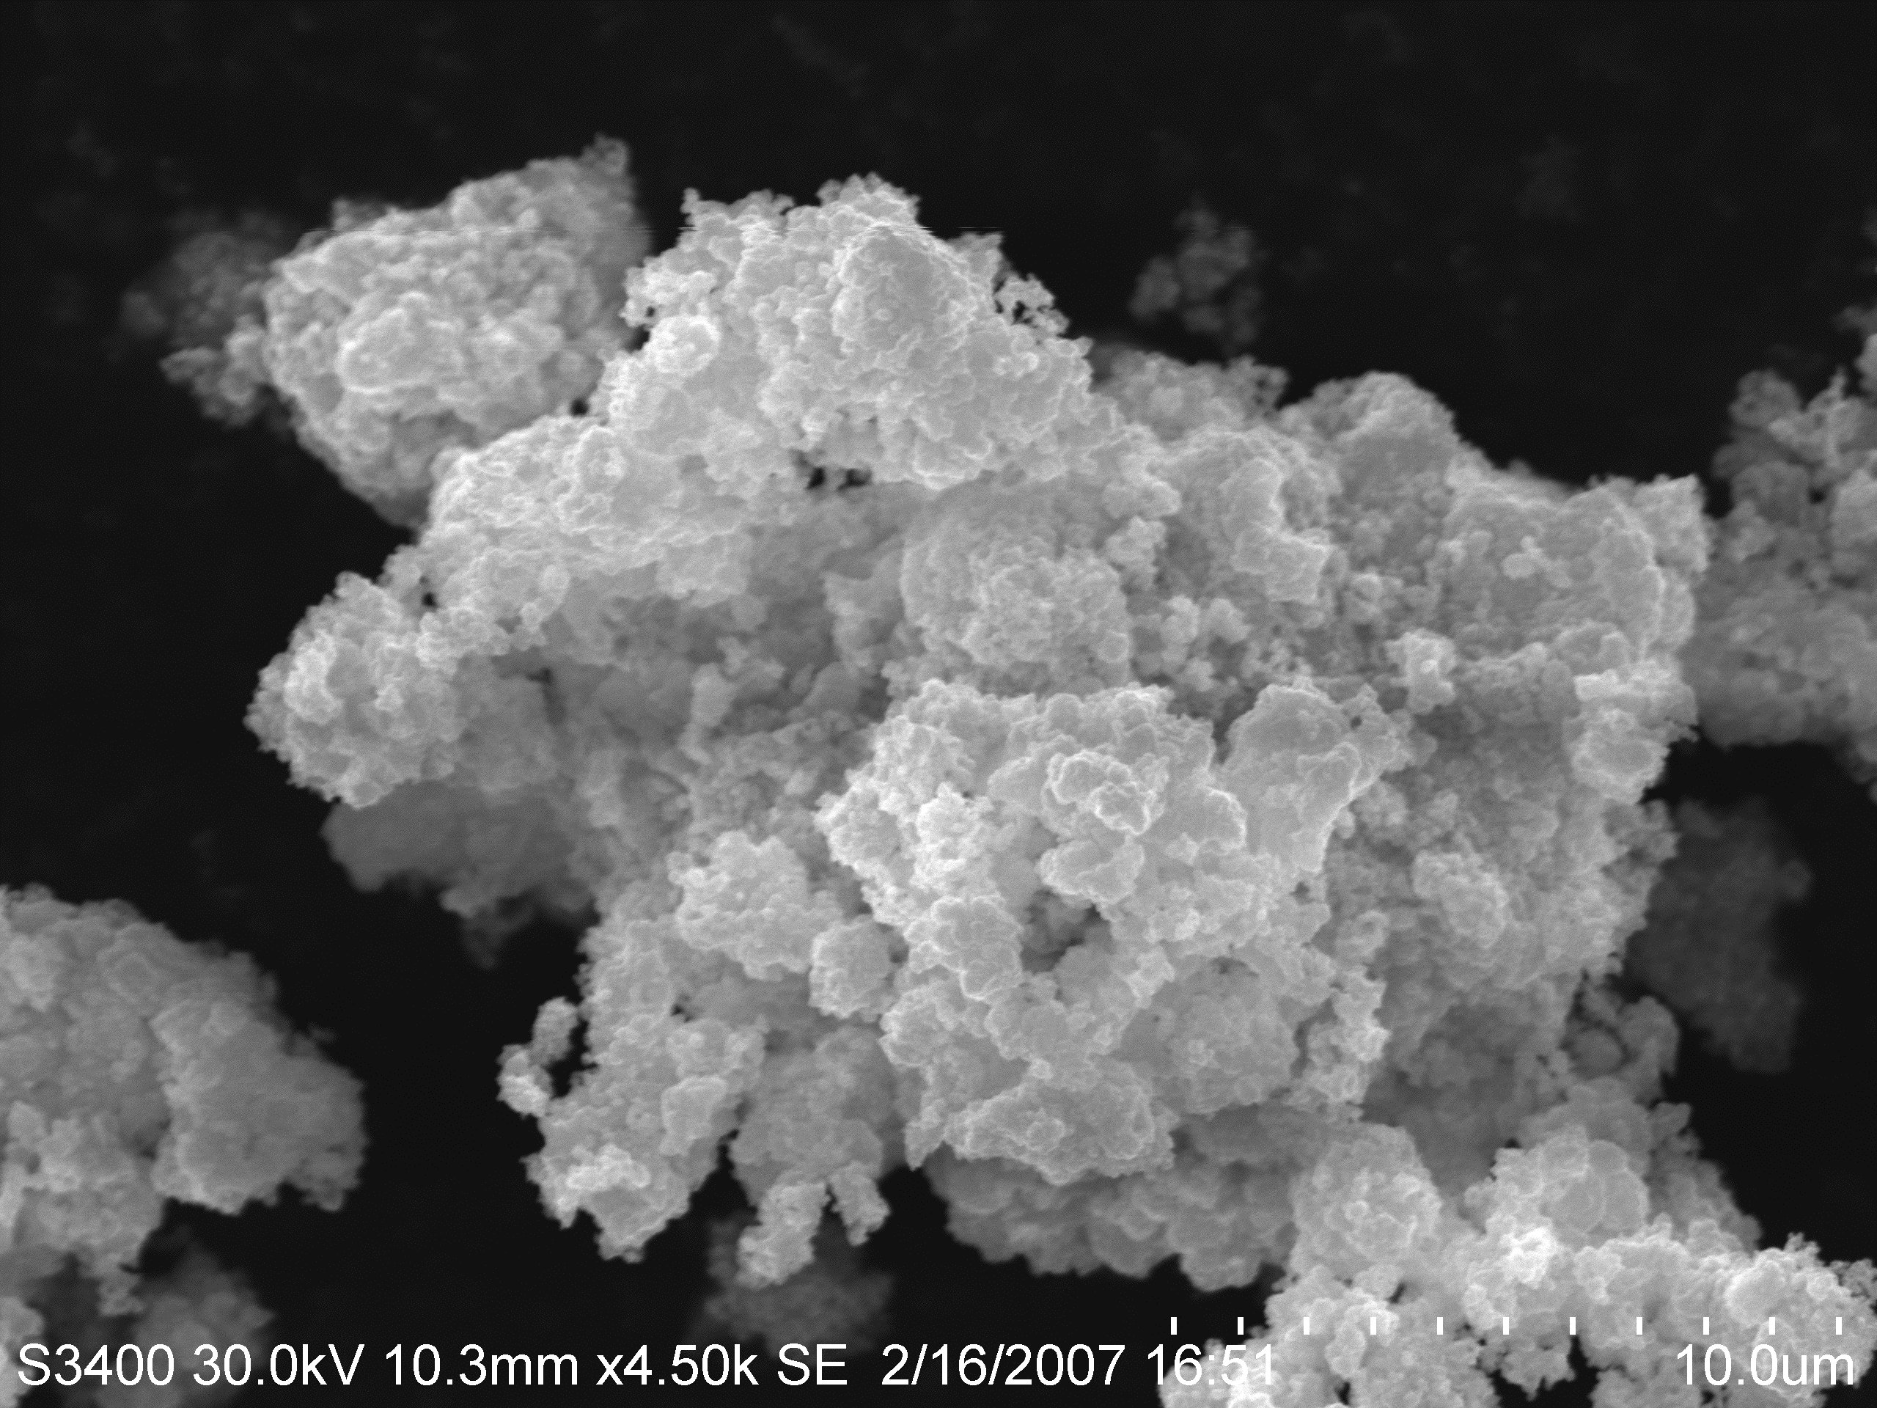
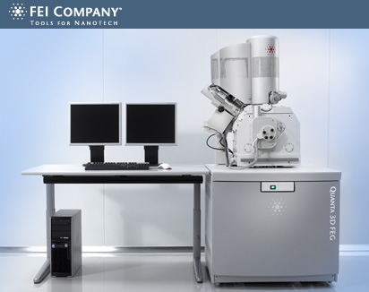
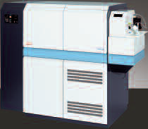
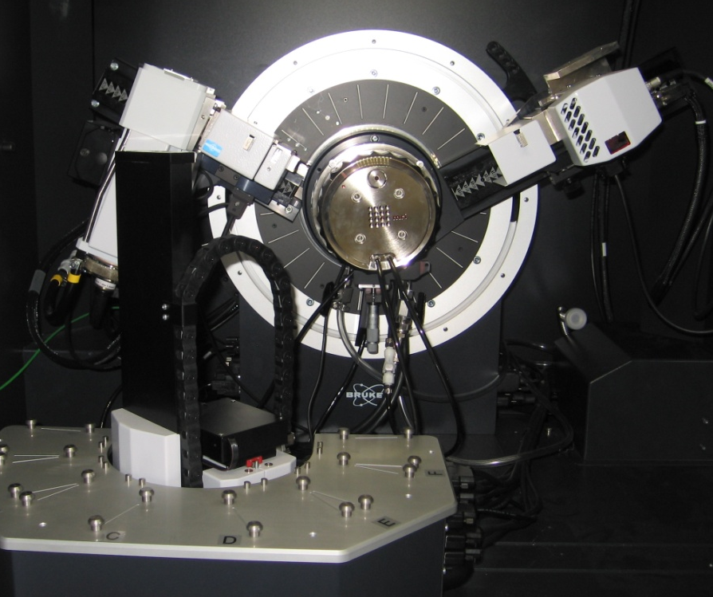
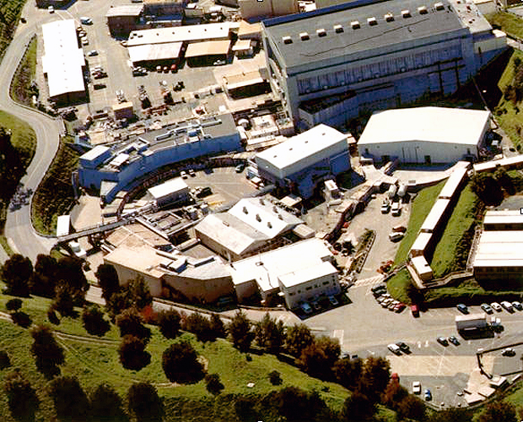
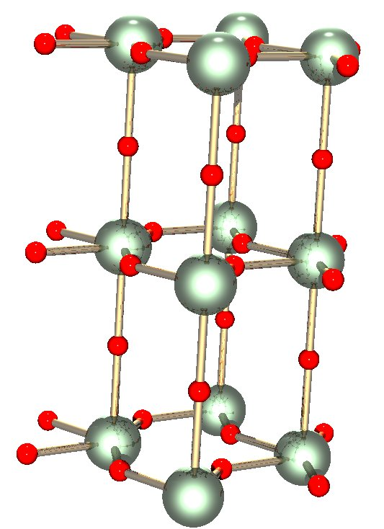
Measurement Capabilities
Morphology
Elemental/isotopic Analysis
FEI Quanta 200F Field Emission Scanning Electron Microscope
Thermo Finnigan Element XR ICP-MS
Chemical Speciation
Bruker D8 ADVANCE
powder X-ray
diffractometer
Stanford Synchrotron Radiation Lightsource
Menlo Park, CA
LA-UR 14-24839

Slide 10
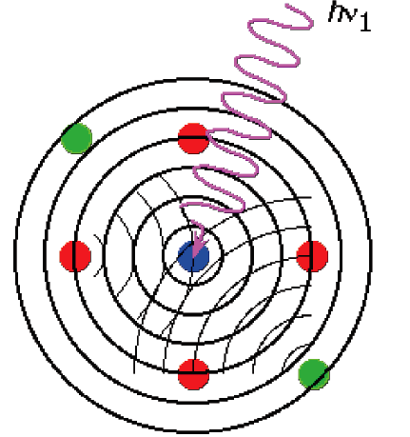
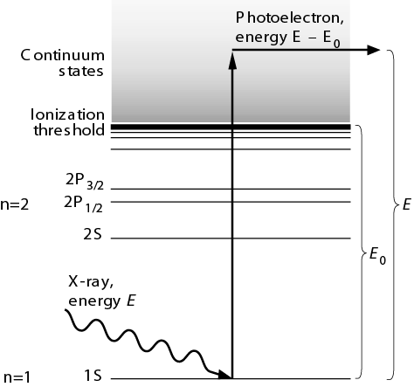
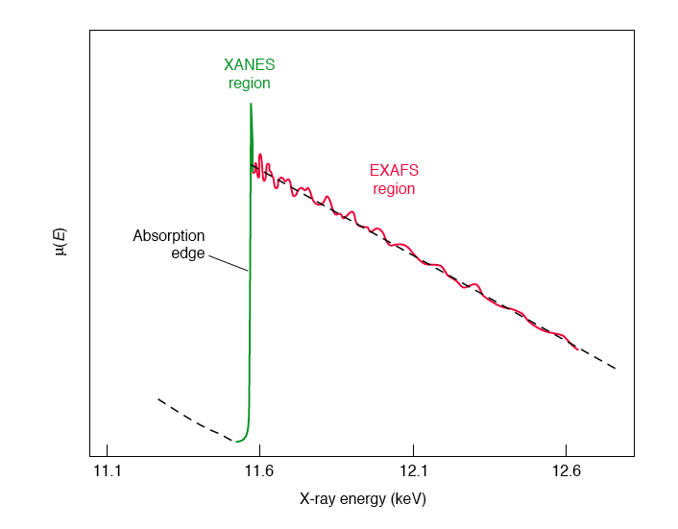
How is local structure through XAFS determined?
XAFS- X-ray Absorption Fine Structure
high energy X-rays allow for excitation of core electrons to bound states
XANES- X-ray Absorption Near Edge Structure
arises from differences in oxidation state, local structure
EXAFS- Extended X-ray Absorption Fine Structure
distribution of interatomic distances around atoms
22 keV
100 keV
21 keV
17 keV
LA-UR 14-24839

Slide 11
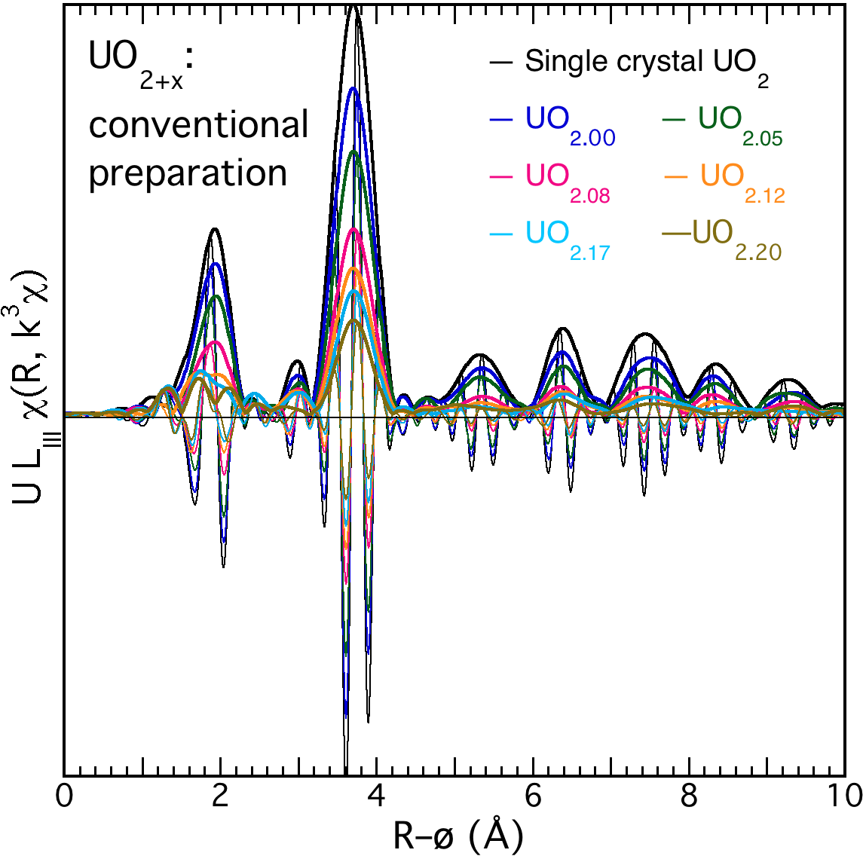
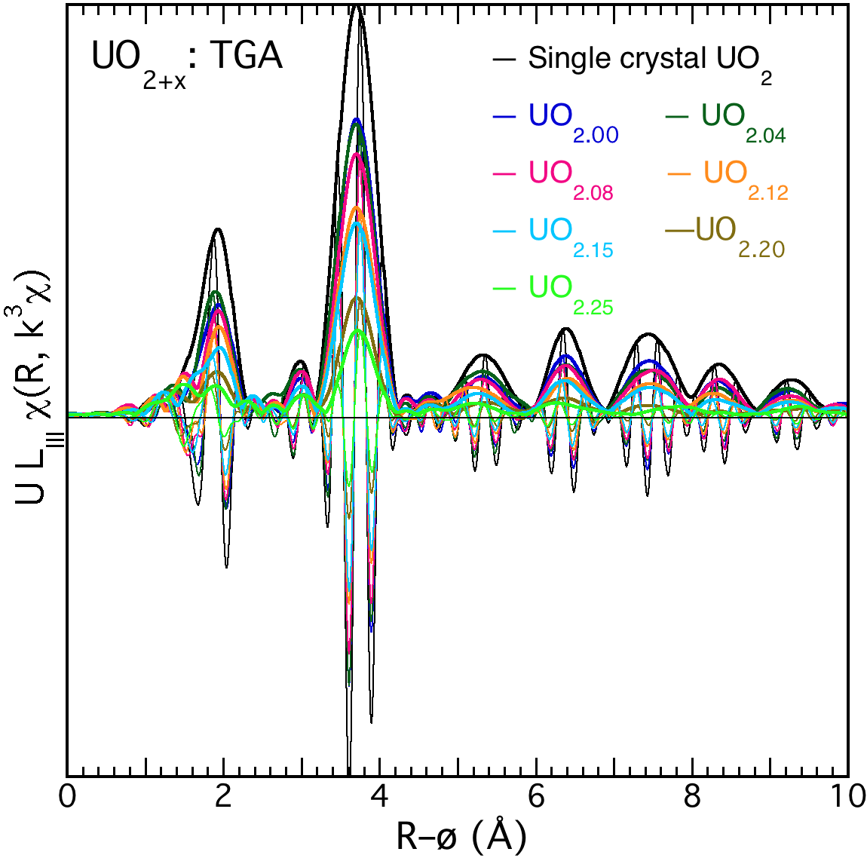
Systematic experiments on UO₂ using EXAFS to measure sensitivity to oxidation.
With H₂O, intermediate temperature Weak CO:CO₂ oxidizer, high temperature
Increased oxidation yields monotonic changes.
Conradson, S. D.; Manara, D.; Wastin, F.; Clark, D. L.; Lander, G. H.; Morales, L. A.; Rebizant, J.; Rondinella, V. V. . Inorg. Chem. 2004, 43(22), pp 6922-6935.
LA-UR 14-24839

Slide 12
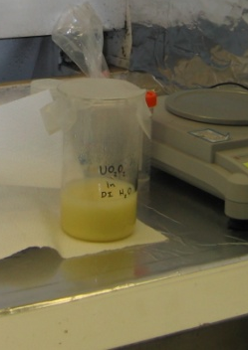
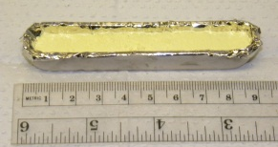
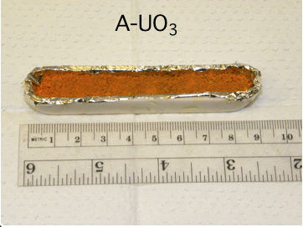
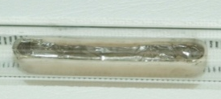
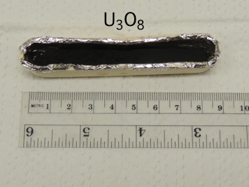
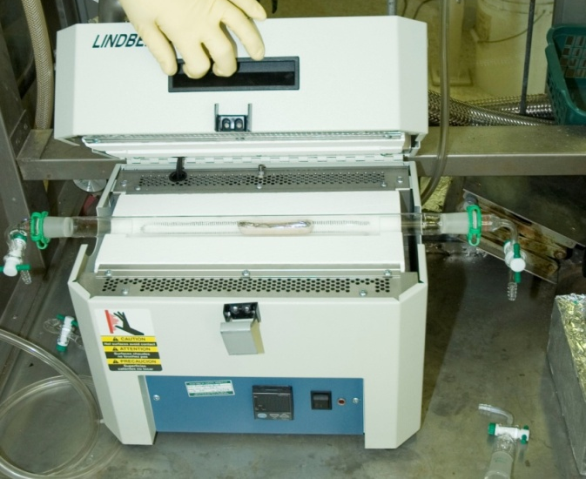
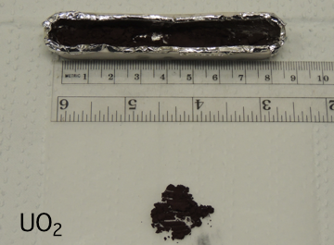
Reference information is derived from high-purity uranium oxide bulk materials
Uº UO₂²⁺
UO₂²⁺ + H₂O₂ UO₂(O₂)·xH₂O
UO₂(O₂)·2H₂O A-UO₃
A-UO₃ U₃O₈
A-UO₃ UO₂
NIST SRM U960
NBL A112A
UO₂(O₂)
precipitate
pH 3
air
400ºC
air
Reaction vessel
900ºC
air
Tube furnace
500ºC
H₂
UO₂
LA-UR 14-24839

Slide 13
Can trace chemical species be measured from legacy samples of U₃O₈
Precipitate Source Precipitate Sample Product
pH 1
20ºC
800ºC
UNH
UO4
U3O8
pH 1
20ºC
975ºC
UNH
UO4
U3O8
pH 8.4
20ºC
800ºC
UO2F2
ADU
U3O8
Age of samples: ~2-3 years
Common source of starting material
Preparation scale: 10 g
LA-UR 14-24839

Slide 14
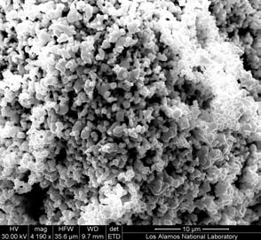
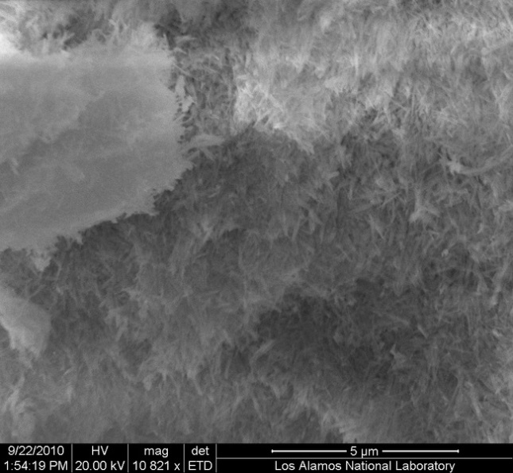
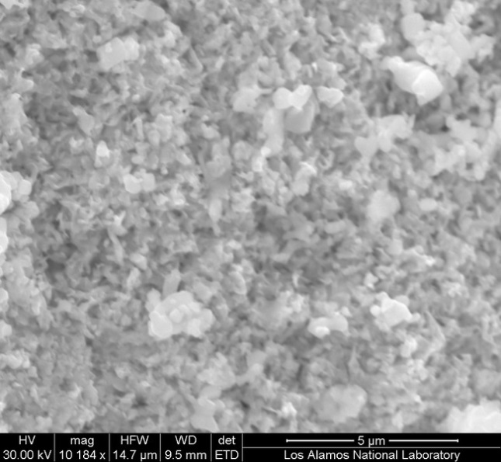
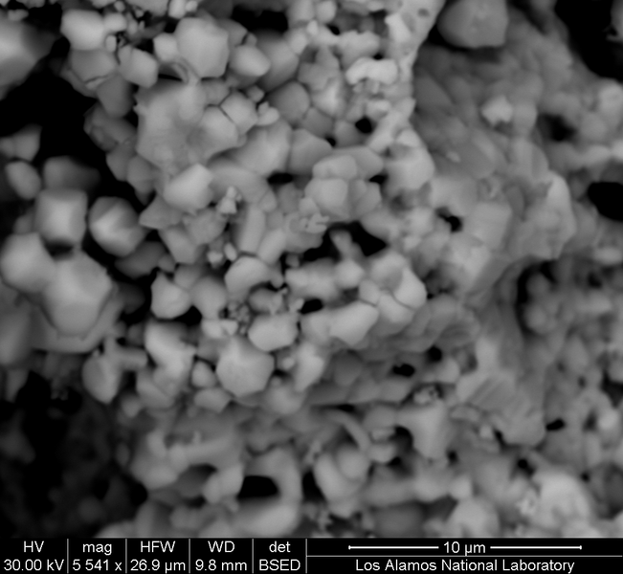
Comparison of SEM images of U₃O₈ materials at time 0
S1
900ºC
L1
20ºC
800ºC
A-UO₃ → U₃O₈
UNH → UO₄ → U₃O₈
air
pH 1
L2
20ºC
975ºC
L3
20ºC
800ºC
UNH → UO₄ → U₃O₈
UO2F2 → ADU → U₃O₈
pH 1
pH 8.4
LA-UR 14-24839

Slide 15
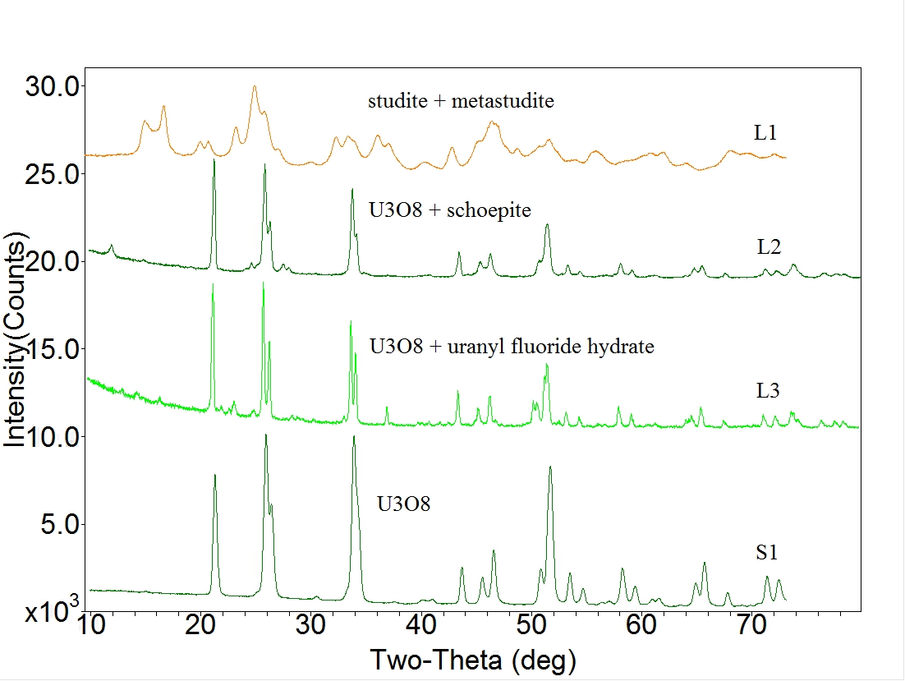




Comparison of reference lines with pXRD patterns of U₃O₈ materials identifies speciation
L1
20ºC
800ºC
UNH → UO₄ → U₃O₈
pH 1
L2
20ºC
975ºC
UNH → UO₄ → U₃O₈
pH 1
L3
20ºC
800ºC
UO2F2 → ADU → U₃O₈
pH 8.4
S1
900ºC
A-UO₃ → U₃O₈
air
LA-UR 14-24839

Slide 16
EXAFS of U₃O₈ materials reveals disorder
S1
900ºC
A-UO₃ → U₃O₈
air
L1
20ºC
800ºC
UNH → UO₄ → U₃O₈
pH 1
(UO₂(O₂)·xH₂O)
L2
20ºC
975ºC
UNH → UO₄ → U₃O₈
pH 1
(U₃O₈ + UO₃·xH₂O)
L3
20ºC
800ºC
UO2F2 → ADU → U₃O₈
pH 8.4
(U₃O₈ ₊ UO₂F₂·xH₂O)
LA-UR 14-24839

Slide 17
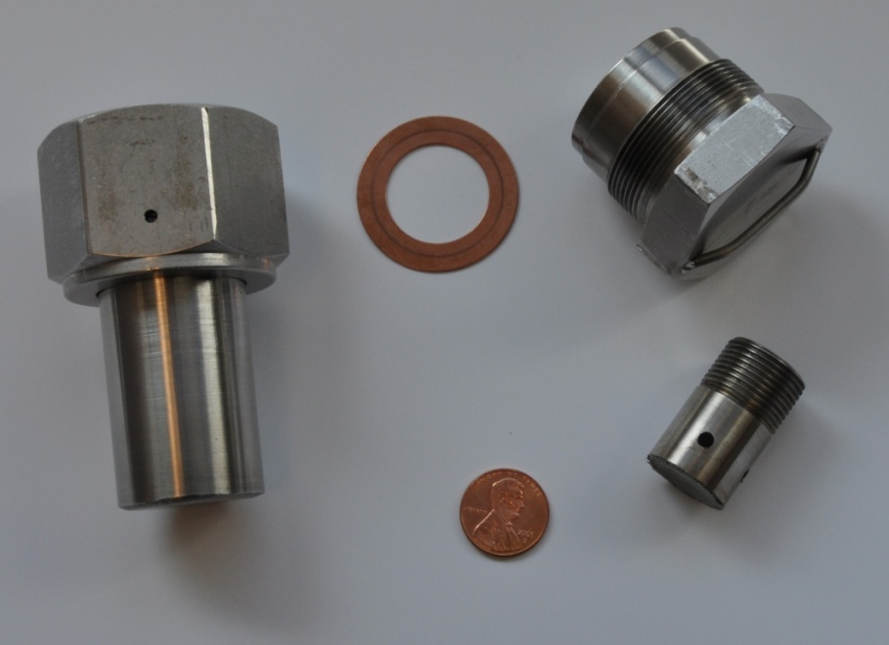
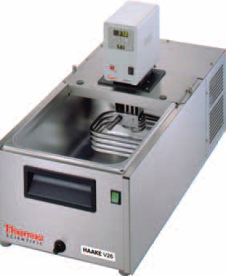
Aging Vessels and Circulating Bath
Anovitz, L. M.; Riciputi, L. R.; Cole, D. R.;
Gruszkiewicz, M. S.; Elam, J. M. J.
Non-Cryst. Solids 2006, 352, 5652.
LA-UR 14-24839

Slide 18
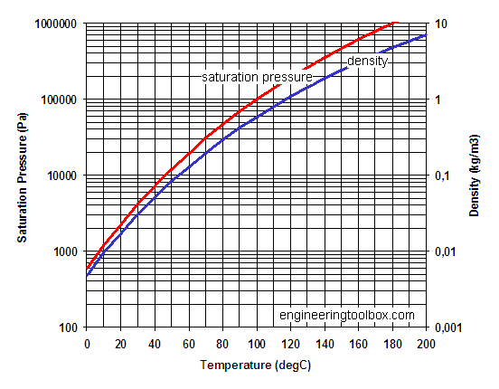
Do these chemical signatures change over time?
Constant relative humidity (+/- 2%) is produced by an excess of a water soluble salt in contact with its saturated solution.
  ASTM International, Designation: E104-02, Standard Practice for Maintaining Constant Relative Humidity by Means of Aqueous Solutions
  CRC Manual, Constant Humidity Solutions
RH = A*exp(B/T)
Lithium Iodide: 25% RH at 278.15 K
15% RH at 310.15 K
Potassium Nitrate: 97% RH at 278.15 K 89% RH at 310.15 K
Relative Humidity = Actual Vapor Density
Saturation Vapor Density
Conditions | Water vapor density
LTLH | 1.7e-06 g/cm³
HTLH | 6.6e-06 g/cm³
LTHH | 6.7e-06 g/cm³
HTHH | 39e-06 g/cm³
Liquid water | ~1 g/cm³
LA-UR 14-24839

Slide 19
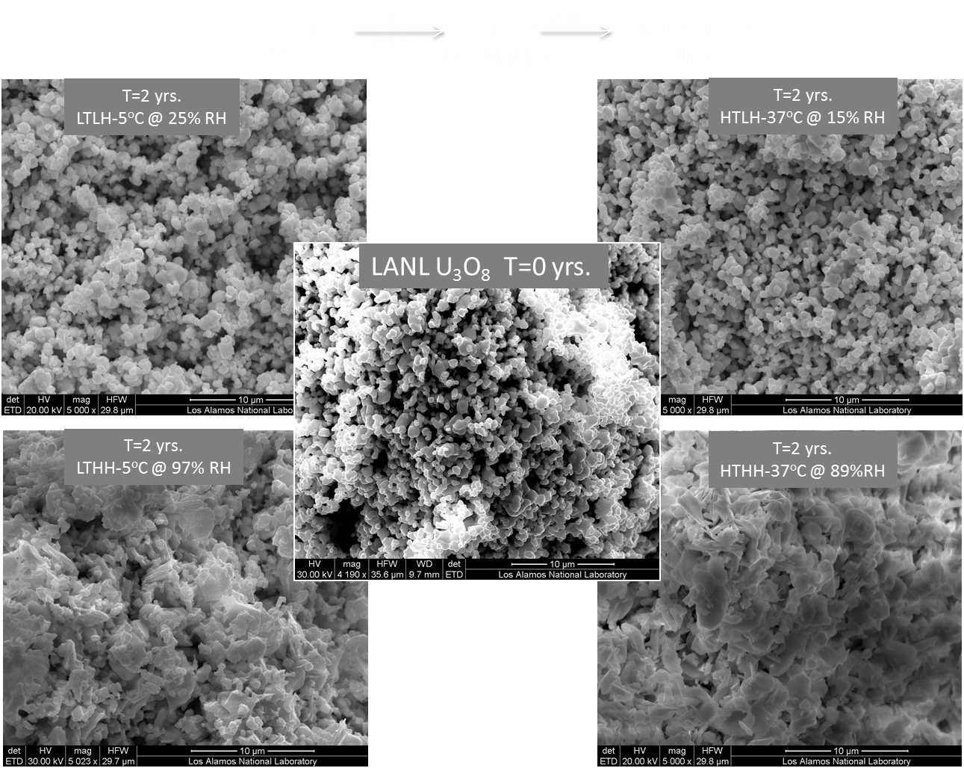
Morphology of S1 at all conditions after 0 and 2 years
900ºC
A-UO₃ → U₃O₈
air
LA-UR 14-24839

Slide 20
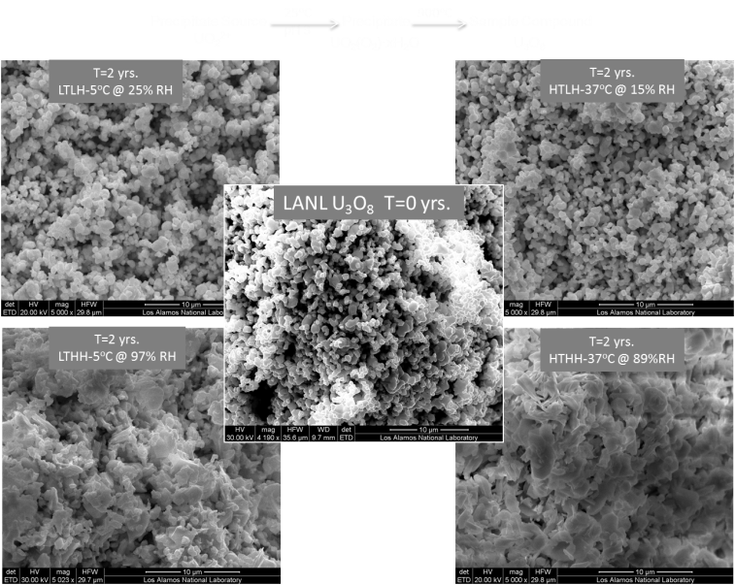
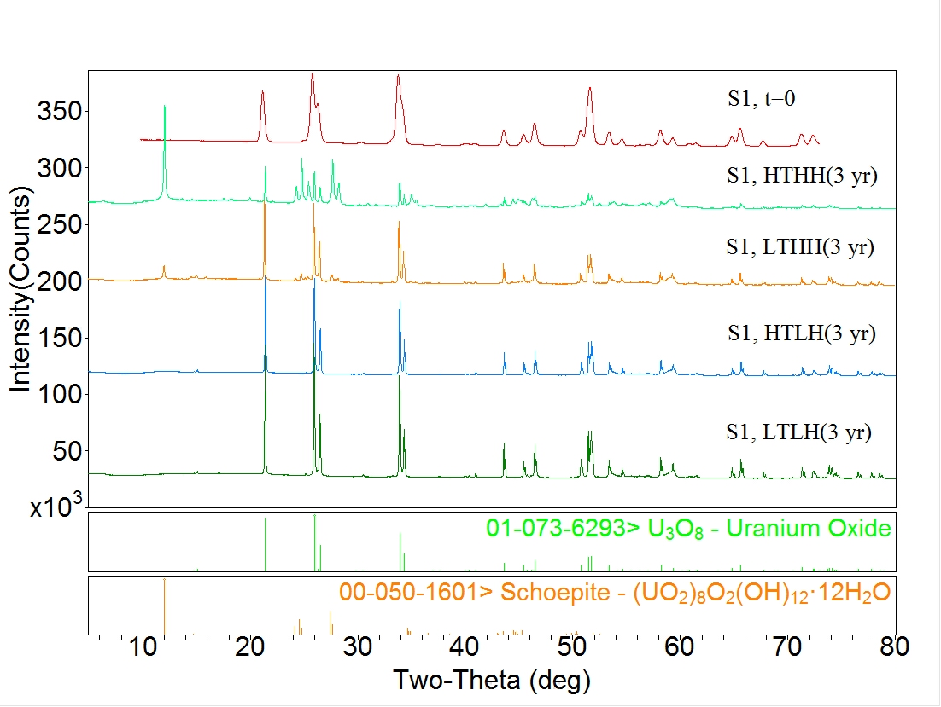
pXRD patterns of S1 at all conditions after 3 years reveals speciation
900ºC
A-UO₃ → U₃O₈
air
LA-UR 14-24839

Slide 21
EXAFS of S1 at all conditions after 0 and 3 years
900ºC
A-UO₃ → U₃O₈
air
LA-UR 14-24839

Slide 22
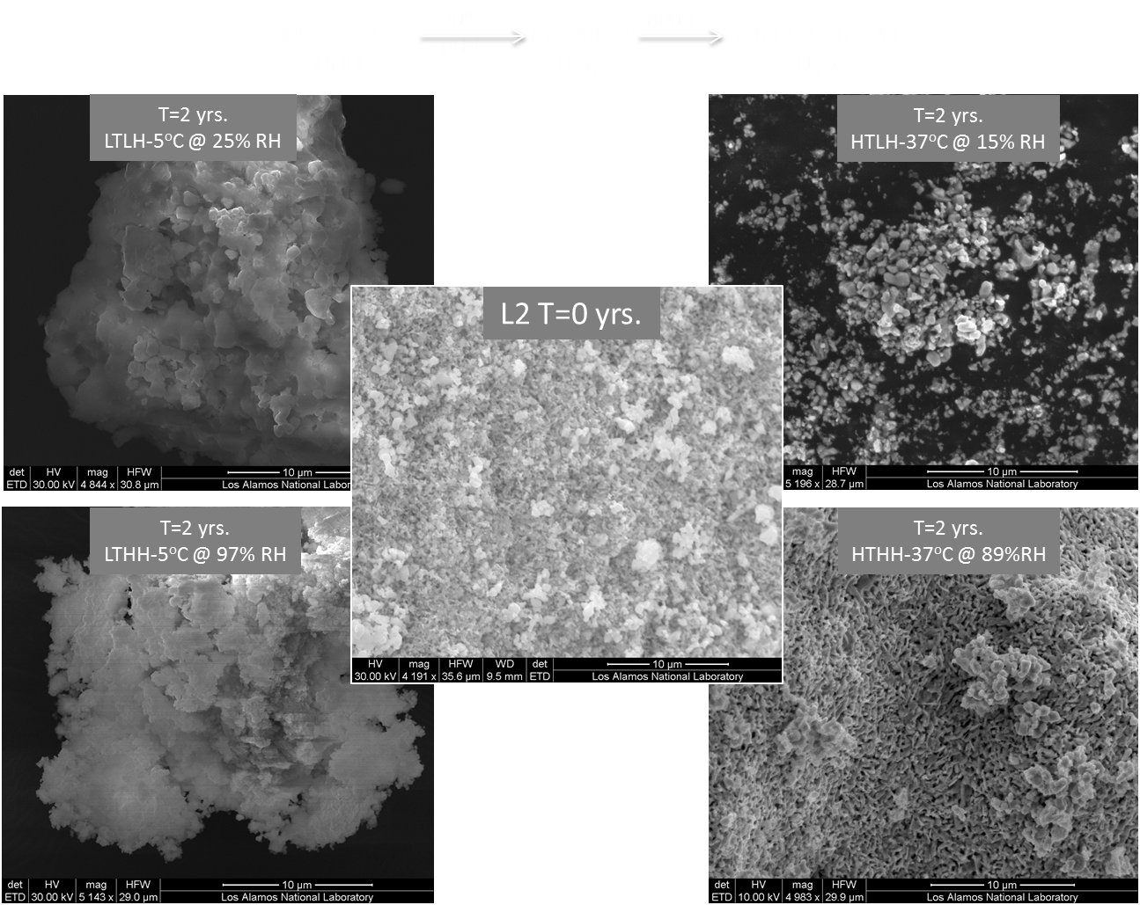
Morphology of L2 U₃O₈ at all conditions after 0 and 2 years
20ºC
975ºC
UNH → UO₄ → U₃O₈
pH 1
(U₃O₈ + UO₃·xH₂O)
LA-UR 14-24839

Slide 23
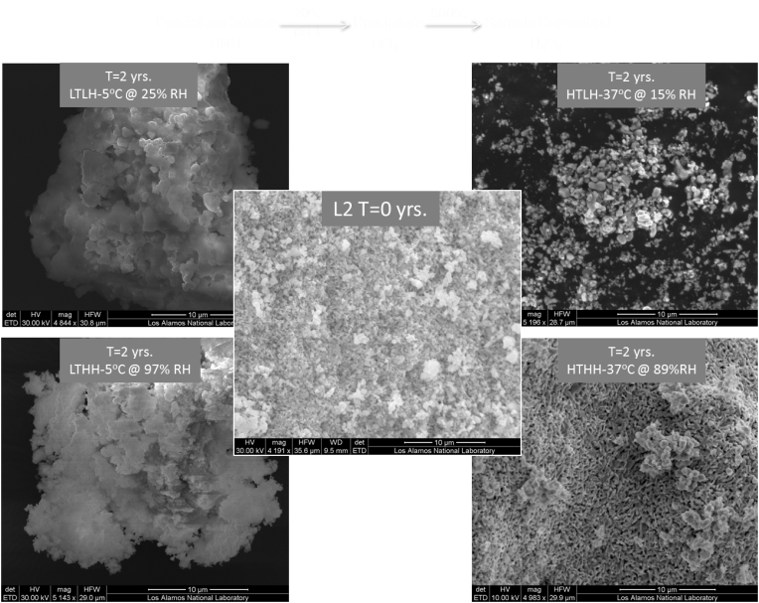
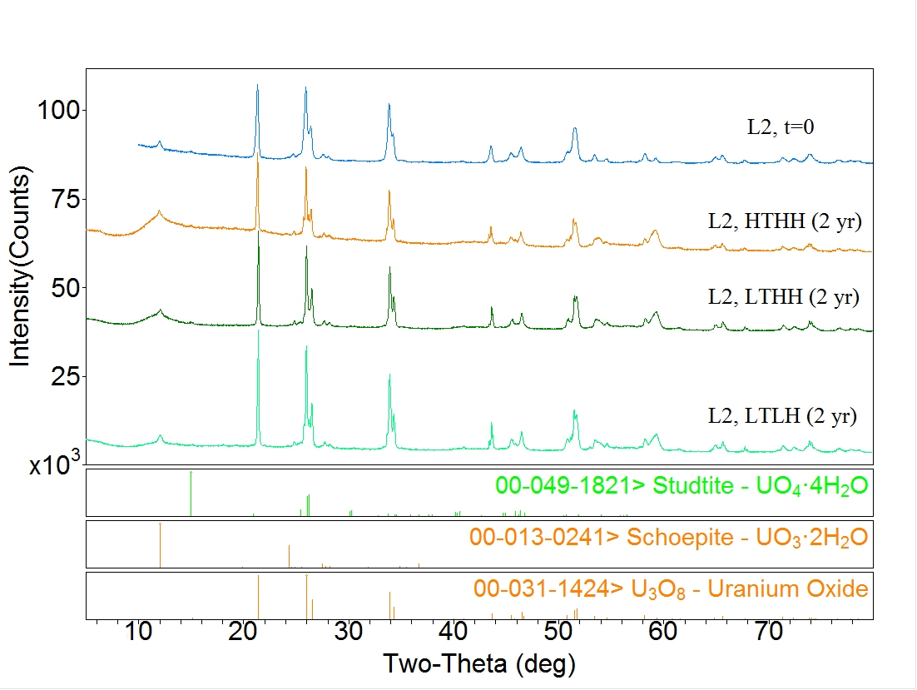
pXRD patterns of L2 U₃O₈ at all conditions after 2 years reveals speciation
20ºC
975ºC
(U₃O₈ + UO₃·xH₂O)
UNH → UO₄ → U₃O₈
pH 1
LA-UR 14-24839

Slide 24
EXAFS of L2 U₃O₈ at all conditions after 0 and 2 years
20ºC
975ºC
(U₃O₈ + UO₃·xH₂O)
UNH → UO₄ → U₃O₈
pH 1
LA-UR 14-24839

Slide 25
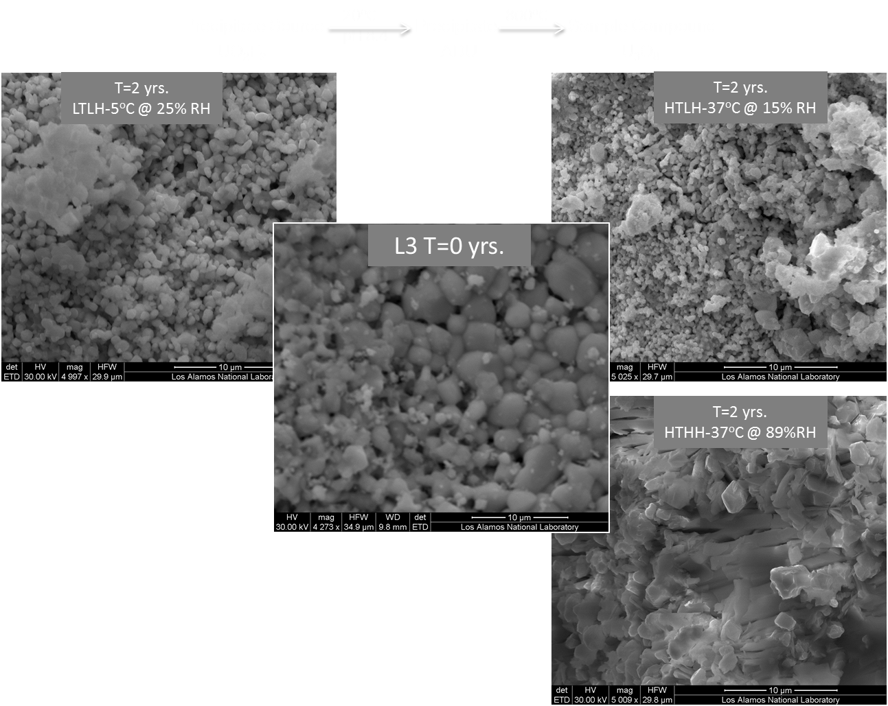
Morphology of L3 U₃O₈ at all conditions after 0 and 2 years
20ºC
800ºC
UO2F2 → ADU → U₃O₈
pH 8.4
(U₃O₈ ₊ UO₂F₂·xH₂O)
LA-UR 14-24839

Slide 26
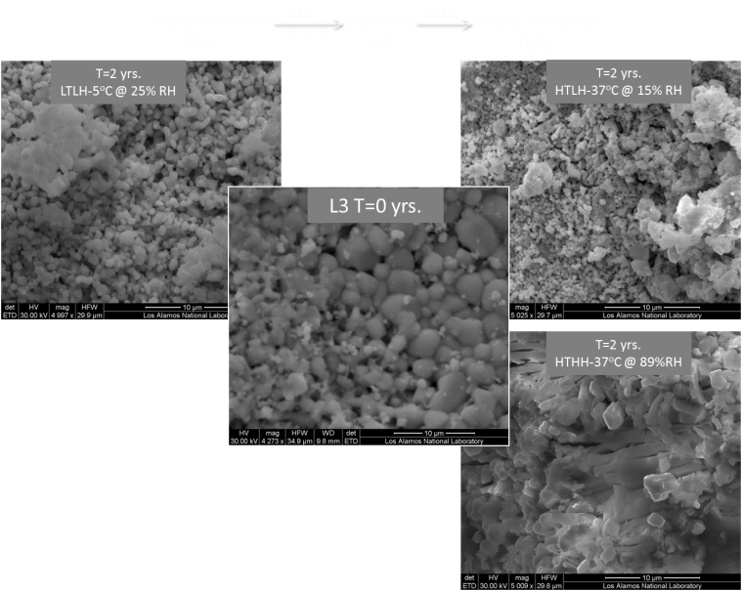
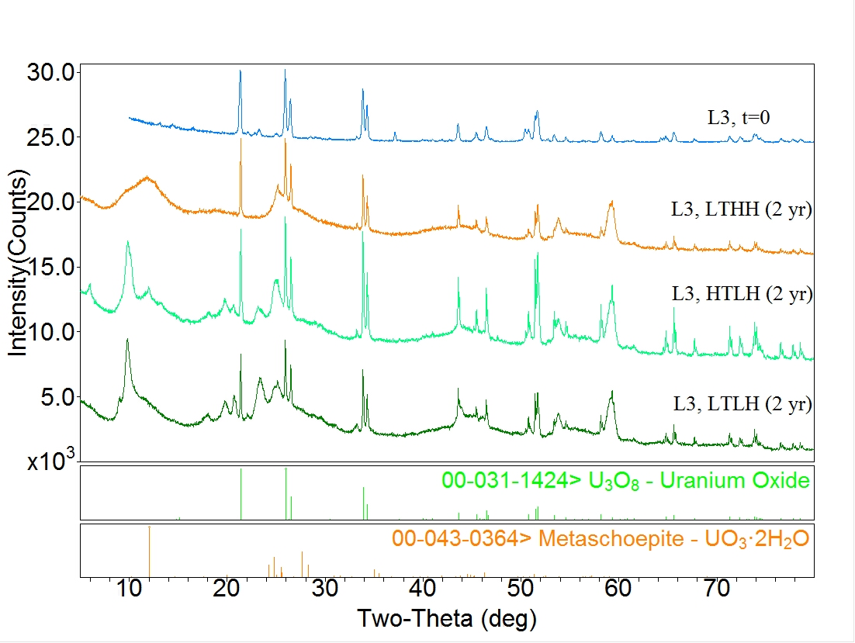
pXRD patterns of L3 U₃O₈ at all conditions after 2 years reveals oxidation
20ºC
800ºC
(U₃O₈ ₊ UO₂F₂·xH₂O)
UO2F2 → ADU → U₃O₈
pH 8.4
LA-UR 14-24839

Slide 27
EXAFS of L3 U₃O₈ at all conditions after 0 and 2 years
20ºC
800ºC
(U₃O₈ ₊ UO₂F₂·xH₂O)
UO2F2 → ADU → U₃O₈
pH 8.4
LA-UR 14-24839

Slide 28
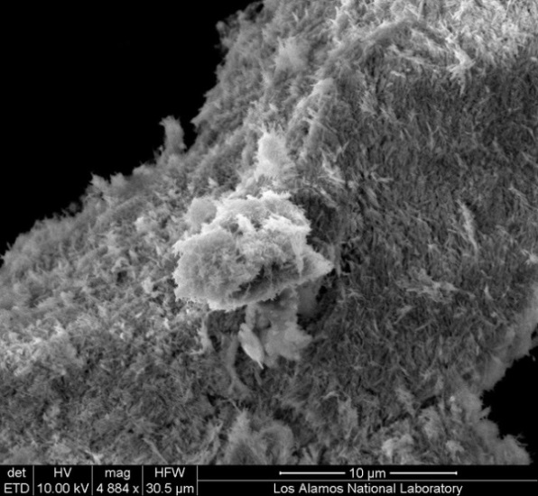
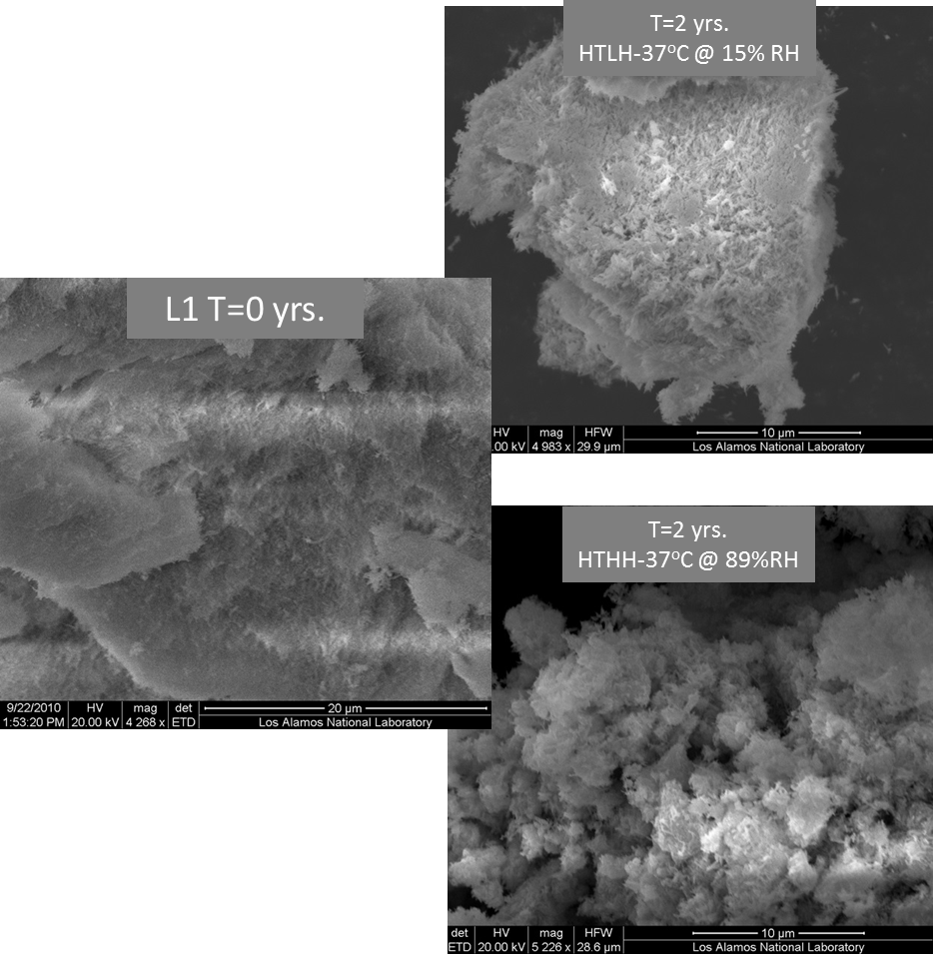
Morphology of L1 at all conditions after 0 and 2 years
T=2 yrs.
LTLH-5°C @ 25% RH
20ºC
800ºC
UNH → UO₄ → U₃O₈
pH 1
(UO₂(O₂)·xH₂O)
LA-UR 14-24839

Slide 29

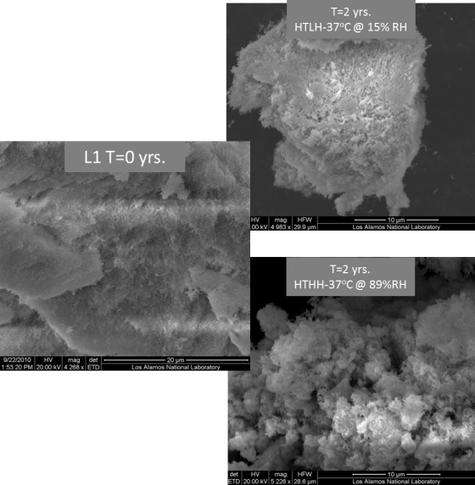
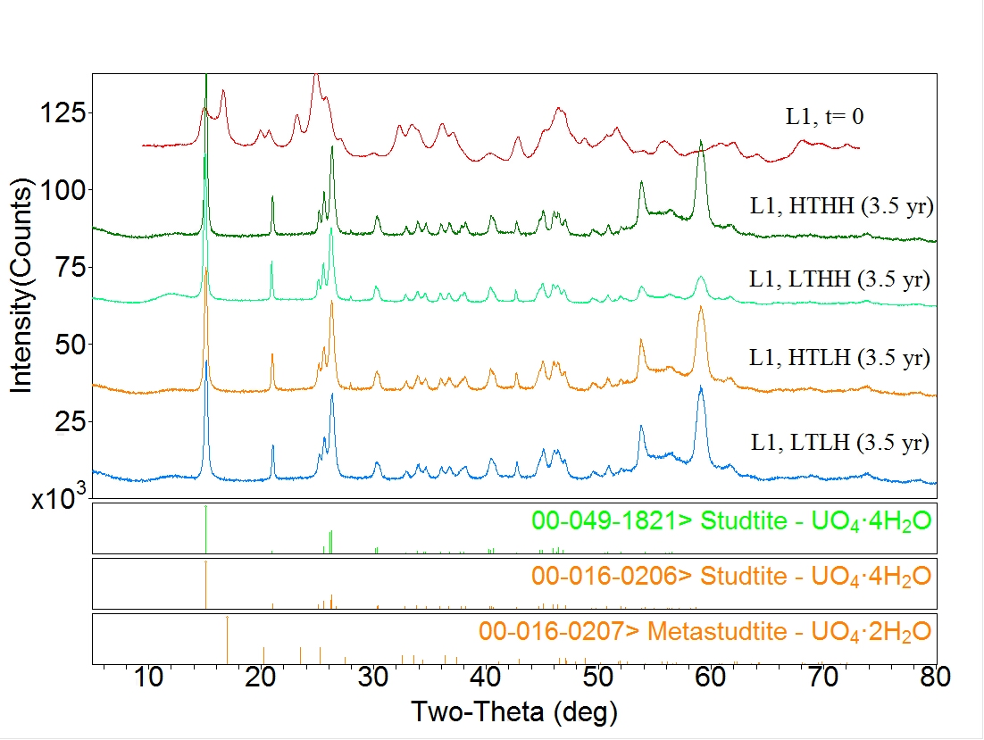
pXRD patterns of L1 U₃O₈ at all conditions after 3 years reveals hydration
T=2 yrs.
LTLH-5°C @ 25% RH
20ºC
(UO₂(O₂)·xH₂O)
UNH → UO₄ → U₃O₈
pH 1
LA-UR 14-24839

Slide 30

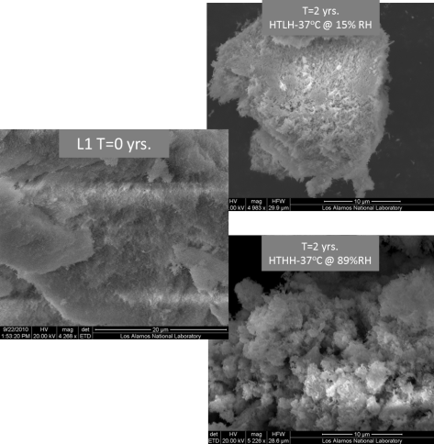
EXAFS of L1 U₃O₈ at all conditions after 0 and 3.5 years
20ºC
(UO₂(O₂)·xH₂O)
UNH → UO₄ → U₃O₈
pH 1
LA-UR 14-24839

Slide 31
Conclusions
Processing of uranium oxides is chemical in nature, providing opportunities for measurements of chemical signatures
Results from an integrated approach rely upon synthesis, spectroscopy and morphologic characterization of a variety of materials
Chemical speciation following aging under environmental conditions is providing insights into chemical transformations
Speciation can be characterized, not only by μ-XRD and μ-XANES spectroscopy, but also via μ-EXAFS measurements, an incisive technique for determining chemical speciation and changes in local structure
LA-UR 14-24839

Slide 32
Acknowledgements
Synthesis
Dallas D. Reilly, Univ. Nevada-Las Vegas
Alison L. Tamasi, Univ. Missouri-Columbia (NTNFC Graduate Fellow)
Morphology
Beau J. Barker, LANL Seaborg Institute Postdoc Fellow
Gregory L. Wagner, Technologist 2
Sandra A. Zerkle, UCSD undergraduate
Mindy M. Zimmer, Postdoc
Powder X-ray Diffraction Analysis
Brian L. Scott
X-ray Absorption Spectroscopy
Steven D. Conradson
Stosh A. Kozimor
Alison L. Pugmire (LANL LDRD Early Career Award)
Isotopic Analysis
William S. Kinman
Computational Analysis
Tyler Mullen, High School Co-Op
Reid B. Porter
Christy E. Ruggiero
Lav Tandon
Theory
Jason K. Ellis, Postdoc
Richard L. Martin
Additional Collaborators
Larry Anovitz, University of Tennessee
Corwin H. Booth, LBNL
Carol J. Burns
David L. Clark
Kenneth Czerwinski, Univ. Nevada-Las Vegas
Julianna E. Fessenden-Rahn
Susan D. Hanson
Justin Holland, Y-12 NSC
Andrew Sutton
Larry E. Ussery
Gregory J. Van Tuyle
Justin R. Walensky, Univ. Missouri
Sam Webb, SSRL
This work has been supported by the U.S. Department of Homeland Security, Domestic Nuclear Detection Office, under competitively awarded IAA HSHQDC-08-X-00805. This support does not constitute an express or implied endorsement on the part of the Government.
LA-UR 14-24839

