Slide 1
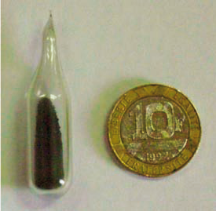
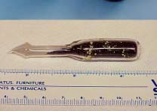
Nuclear Forensic Science:
An Emerging Discipline
Stephen LaMont
U.S. Department of Energy
July 2014
Notes:
This presentation is designed to give an overview of nuclear forensics best practices and the elements needed to establish a successful and effective national nuclear forensics program.

Slide 2
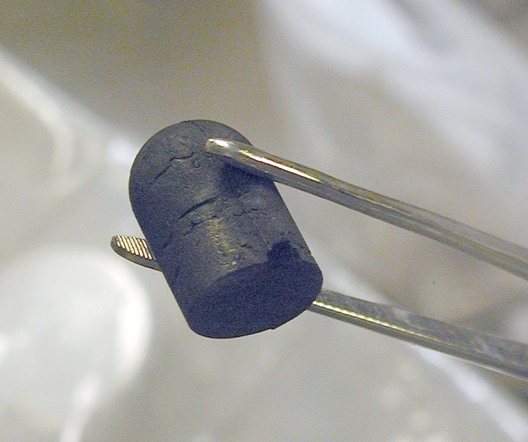
Nuclear Forensics Background
Nuclear forensics is the collection and analysis of nuclear or radiological material to support investigations into the diversion, trafficking, or illicit use of those materials
These are examples of the many questions possibly answered through a nuclear forensics examination
  What is the material?
  Is the material possessed illegally?
  When was the material removed from legitimate control?
  Where or how was the material produced?
  Who is associated with a material?
Notes:
Definition at top
Nuclear forensics answers the questions associated with an illicit trafficking investigation through the laboratory analysis of nuclear material. The material characteristics provide insight into the history of the material, and help answer questions, for example (see middle bullets).

Slide 3


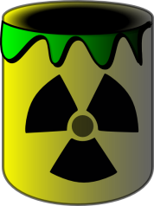
The first nuclear forensic analysis request
The conversation between law enforcement and nuclear scientists, early 1990s
We recovered this stuff we think is radioactive – can you tell us about it?
Sure – I have a laboratory full of the best instruments and scientists in the world – I can tell you everything you want to know and more!

Slide 4
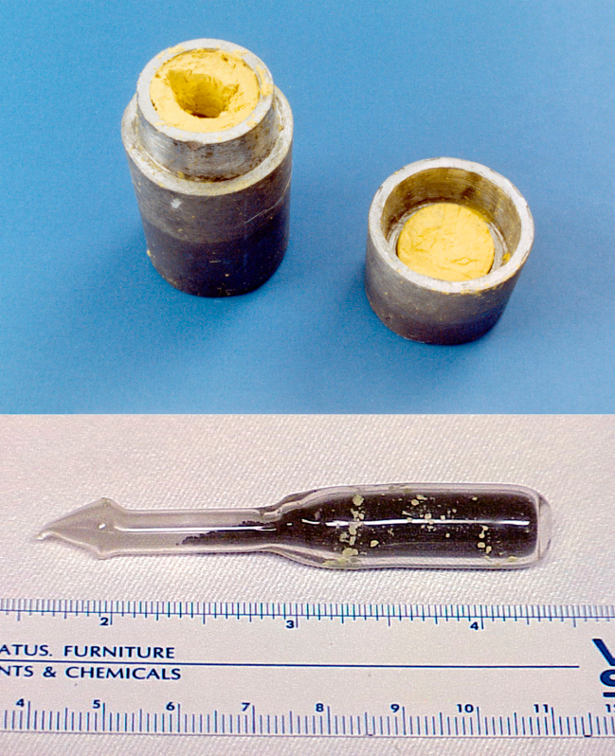
1999 Bulgaria 73% HEU Example
Non-nuclear forensics
Nuclear material forensics
Wax type
Particle characterization
Wax colorant
Stoichiometry
Paper origin
Impurity elements
Pb metallurgy
Residual radionuclides
Pb isotopics
Age-dating
Ampoule material
U & Pu isotopics
Nearly all nuclear and non-nuclear forensics available at LLNL with support from other DOE labs used to characterize the material and assess its history
Excellent demonstration of what could be done!

Slide 5
1999 Bulgaria 73% HEU Example
Outstanding example demonstrating the power of nuclear forensics
  Characterization and assessment of production history through nuclear signatures
  Geographic insights through geochemical signatures
Bulgaria and other early cases demonstrated the limited availability of comparative data sets

Slide 6
Nuclear Forensics Expertise
Nuclear Forensics
Traditional Forensics
Treaty Monitoring
Law Enforcement
Fuel Cycle
Safeguards
Measurement Science
Many Subdisciplines
Radiochemists
Geochemists
Analytical chemists
Reactor physicists
Nuclear engineers
Process engineers
Enrichment engineers
Statisticians
Quality assurance

Slide 7
Nuclear Forensics Matures – 20 years Later
What is really required to support a case
  Admissible forensic evidence
  Investigative leads generated through forensic examination
  Material attribution
Law Enforcement & Prosecution
Nuclear Forensic Scientists
Case needs drive the forensic examination

Slide 8
Nuclear Forensics Part 1: Evidence
Part 1: Traditional Forensics:
Link individuals to criminal activity
Important for criminal proceedings
Requires high-quality, legally defensible analyses
    What is it?
    How much is there?
    Was a law broken?
Does not require a detailed analysis of all material attributes
Most countries have the technology, equipment and expertise for these analyses
Material Analysis
Criminal Proceedings
Trafficker Convicted
Notes:
There are aspects to most nuclear forensics investigations. The first is to support the criminal investigation through analysis that identifies the material and confirms it is illegal for the individual to posses. In addition to identifying the material, it is often important to answer questions like “how much is there?” and “what is the isotopic composition?”. It is important to note that the analyses needed for most criminal investigations are relatively simple and do not require expensive or sophisticated equipment. Many universities and government labs already possess this type of equipment.

Slide 9
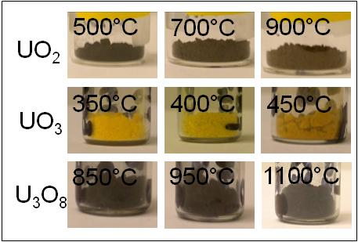
Nuclear Forensics Part 2: Investigations
Detailed analysis of material attributes
Expert evaluation and comparative analysis
Assessment of domestic or foreign material origin
Enhanced nuclear security
Requires advanced capabilities:
  Laboratory analysis
  Data interpretation
  National nuclear forensics library
Part 2: Investigative Forensics: History of nuclear material
Full Characterization
Precision isotopics
Chemical composition
Age dating
Morphology
Comparative Analysis
Intended use
Process history
Fuel cycle information
Outcome
Possible origins
Connections between cases
Enhanced security
Notes:
The second aspect is to identify the history of the nuclear material through a much more detailed laboratory analysis. This requires an advanced analytical laboratory capability with sophisticated instrumentation, and the expertise to interpret the data and assess possible origins or at least process history. Ideally, this data will enhance nuclear security through the identification of possible facilities where the diversion happened. These facilities can then implement improved safeguards and physical protection measures to prevent future diversions.

Slide 10


Getting Organized: NF Best Practices
Develop and implement a national response plan
  Organizations and responsibilities
  Crime scene response protocols
    Coordination between nuclear and traditional evidence collection
  Identify, secure, and transport of radioactive material
  Define analysis requirements in advance
    Determine what is needed for criminal prosecution
    Quality assurance
  Laboratory analysis alternatives
    Limited vs. full characterization
    Domestic analysis vs. foreign assistance
  Reporting and documentation
    Domestic and IAEA reporting requirements
  Develop a national nuclear forensics library to determine if source is consistent with domestic material
Notes:
One the key best practices for establishing a successful nuclear forensics program is to develop a model action plan. Some of the most important elements to include in a model action plan are: see bullets
Additional details on national nuclear forensics libraries will be addressed later in the talk.

Slide 11
Integration of Quality Assurance (QA)
Quality assurance is now an important part of any nuclear forensics program
  Ensures admissibility of evidence during criminal proceedings
  Provides reliable investigative information
International Organization for Standards (ISO)
  ISO 17020 for Field Work
  ISO 17025 for Laboratory Analysis
  ISO 17043 for Proficiency Testing
Regularly evaluate capabilities using table top, laboratory proficiency, and end-to-end test exercises
Notes:
Quality assurance for any nuclear forensics program should be consistent with the requirements of law enforcement to produce legally defensible data in a court of law. There are international standards that address the documentation requirements for the various aspects of a forensics investigation including field work conducted during the initial response to an incident and any subsequent laboratory analysis. In addition to following international standards, it is important to use practical exercises to test and validate forensics analysis capabilities including laboratory proficiency tests, table top exercises, and end-to-end process tests.

Slide 12
Investigating Possible Material Origin
If some nuclear material is found outside of administrative controls anywhere in the world, then each country should be able to answer the question:
  “Is it consistent with our material?”
Verifying inventory based on material accountancy data or source registries may not be sufficient
  A serious problem for small quantities
  Materials that pre-date implementation of good accounting practices
This question forms a basic requirement for developing a national nuclear forensic library

Slide 13
Data Evaluation and Comparative Analysis
Three methods are commonly used to assess nuclear forensic measurement data
Point-to-point comparisons
  Not very common, only used in special cases to link materials from exactly the same batch
Point-to-population comparisons
  Used to connect forensic sample to a known population of materials, e.g. uranium ore concentrate from a particular mine
Point-to-model comparisons
  Used to identify production history and possible origins, e.g. are isotopics consistent with a particular reactor type
The need for comparative data was recognized by early practitioners, who recognized the lack of complete or accessible data.

Slide 14
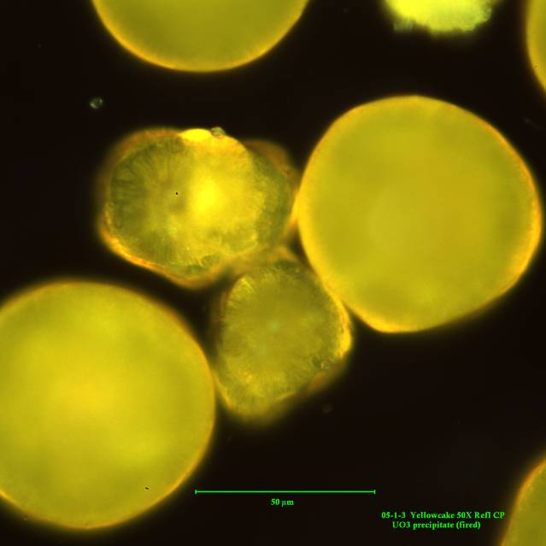
The National Nuclear Forensic Library Model
National nuclear forensics libraries
  Sources of nuclear material characteristic data that could support an investigation (centralized or distributed databases)
  Includes subject matter expertise required to make comparative analyses and develop forensic conclusions
  Complexity tailored to each country’s situation
National point-of-contact (POC)
  Single national level POC to facilitate response to international queries
UO₃
National library and point-of-contact model designed to protect proprietary and sensitive nuclear material characteristics and inventories
Notes:
Nuclear forensics libraries provide a source of comparative information to determine if an illicit material is consistent with any material known to exist within a country. (First set of bullets)
Another important element is that each country would have a national-level point-of-contact who could respond to queries from international partners. The IAEA would maintain a list of country contacts.
Last bullet

Slide 15
Summary
Nuclear forensics has matured significantly as a multidisciplinary science over the last 20+ years
  Coordination between scientists, law enforcement, and policy makers
  National response plans
  Ensuring nuclear forensic evidence is admissible
  Establishing a workable model for national nuclear forensics libraries
Recognized as a valuable tool to assist with many types of investigations beyond illicit trafficking
  Illegal waste disposal
  Treaty compliance
Demonstrated capability of nuclear forensics serves as a deterrent to would-be smugglers

Slide 16
Nuclear Security and Forensics:
Looking Ahead and Broader Applications
Nonproliferation
Counterproliferation
Counterterrorism
Attribution
Retribution
Prevent
Deter
Respond
Detect
Deter undeclared activities or material diversion through treaty monitoring
Respond to illicit trafficking or nuclear event
Prevent material diversion through safeguards and physical security
Detect material outside of legitimate control
Nuclear Forensics

Slide 17
Acknowledgements
U.S. Department of Energy
  Marcia Brisson, Heather Dion & Ed Fei
U.S. Department of State
  Michael Curry & Sarah Fendrich
U.S. Department of Homeland Security
  Frank Wong
U.S. Federal Bureau of Investigation
  Ben Garret, James Blankenship, Brian Kile
Lawrence Livermore National Laboratory
  Ian Hutcheon, Michael Kristo, Martin Robel, Kim Knight, Ross Williams
Los Alamos National Laboratory
  Lav Tandon, Robert Steiner
Pacific Northwest National Laboratory
  John Wacker

Slide 18
Backup Slides

Slide 19
Detection and Response
Detection
  Radioactive or nuclear material determined to be outside legitimate control
Categorization
  Early (e.g. in-field) measurements
  Material ID, approximate amounts, health & safety, transportation info.
Characterization
  Detailed laboratory analysis
  Designed to answer investigative questions
Interpretation
  Comparative analysis / attribution
Detect
Nuclear Forensics

Slide 20
Current NNFL Model
NNFLs give countries the capability to identify materials used, produced or stored within their borders
What is needed to answer “is it ours?”
Requirements
Options for Success
National-level mandate
Defined query protocol
Understand and organize necessary resources
  Government and industrial material holders
  Data
  Subject matter expertise
Centralized or formally federated databases
Formal effort to understand useful material characteristics
Accompanying material archive and analysis capability
Ability to accept queries during trans-national investigations
National library model is the combination of comparative data sets and the subject matter expertise necessary draw forensics conclusions.

