Slide 1
Tiger Reef: Cross-Disciplinary Training Workshop and Tabletop Exercise
Kuala Lumpur
Malaysia
4-6 February 2014

Slide 2
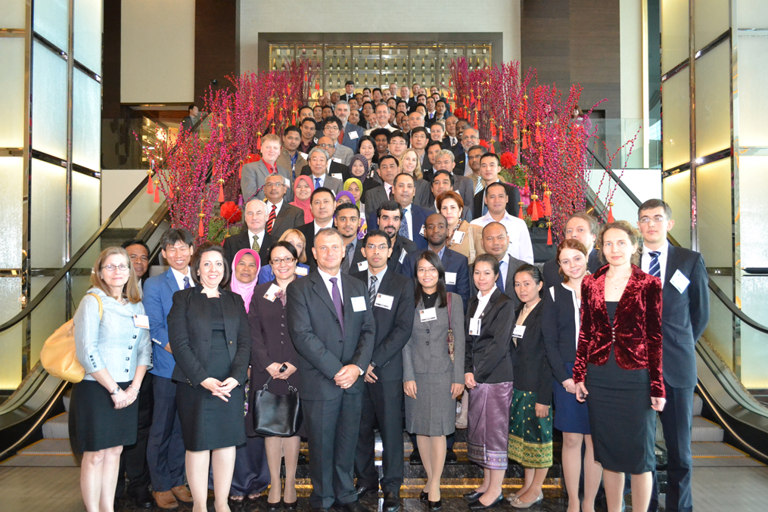
Participants
21 countries, 2 official observer organisations
More than 100 participants

Slide 3
Objectives
Emphasise communication and cooperation between the different communities responding to an incident involving radioactive materials
Explore the complementary missions but often conflicting goals of the response and forensics communities
Increase awareness of international resources available to assist in developing the capabilities to manage such a crime scene

Slide 4
Objectives
Underscore the value of cross-training the various communities, and help identify gaps.
Provide information on resources that may assist with cross-training.

Slide 5
Target Audience
Response organisations (police, fire brigade, medical services, customs services etc.)
Radiation and nuclear health and safety officials
Nuclear science and technology organisation officials
Senior-level policy and decision makers

Slide 6
Organisational Culture
Each organisation has a set of assumptions, practices, beliefs and values that allow it to effectively function as a problem-solving system
When separate organisations come together, rather than a smooth operation it can be a collision of cultures

Slide 7
Gaps Identified
The SOP for the management of a radiological crime scene is not fully developed
Conflicting priorities among different communities responding to an incident involving radioactive materials
Level of awareness on radiological crime scene is still low among relevant agencies

Slide 8
Lessons Learned
Tiger Reef participants effectively demonstrated that coordination and communication among groups of experts is not just possible, but ideal.
Efforts to learn, coordinate, and collaborate across expert communities before an event occurs will enhance how these communities communicate and work together in a real world event.

Slide 9
Lessons Learned
Important and useful training resources are currently available through many sources, including the IAEA, INTERPOL, the European Union, various centres of excellence, private industry, and bilateral government arrangements.
Available training resources should be adapted to encourage cross-disciplinary training, or training across organisational or agency lines, to enhance coordination and communication in a crisis environment.

Slide 10
Outcomes
Participants identified the following areas as focus points of interaction between organizations or groups of experts when developing national response plans or training programs for responding to a nuclear security event:
establishing radiation zones;
establishing access points;
handling perimeter and other security issues;
triage/rescue recovery/evacuation;
decontamination;
collecting and controlling evidence;
coordinating public messaging; and
responding to additional threats.

Slide 11
Outcomes
Tabletop and field exercises are particularly valuable (even necessary) as part of a national cross-disciplinary training program.
Countries should incorporate a graded approach to training and exercises, in which the complexity and scale of the training and exercises is gradually increased over time.

Slide 12
Next Steps
Present analogies at future events: Tiger Reef included two presentations outside the nuclear sphere, namely cross-organisation communication and Malaysia’s national response to a biological incident. Each of these presentations allowed participants a chance to break down barriers and begin interacting openly with one another, while also providing an opportunity to think outside of their typical day-to-day work.

Slide 13
Next Steps
Promote training programs and activities of partner organisations: the GICNT will work with other partner organisations such as the IAEA and INTERPOL to uplift their current activities and collaborate to enhance training opportunities.

Slide 14
Next Steps
Plan a follow-on event: the GICNT will hold a follow-on exercise on cross-disciplinary training in another region to draw new perspectives and continue the important work started in Malaysia.

Slide 15
THANK YOU

