Slide 1
Analysis of incidents reported during 2007-2012 to the IAEA’s Incident and Trafficking Database International Conference on Advances in Nuclear Forensics - IAEA CN-218 07 July 2014, IAEA HQ
Malcolm Nicholas
Division of Nuclear Security

Slide 2
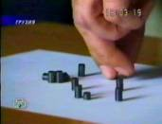
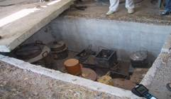
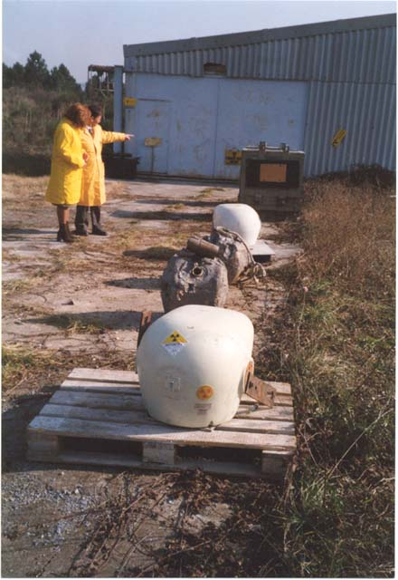
Scope of ITDB information
The ITDB covers incidents involving:
unauthorized acquisition, provision, possession, use, transfer or disposal of nuclear and other radioactive materials, whether intentionally or unintentionally, with or without crossing international borders.
unsuccessful or thwarted acts of the above type;
loss of materials;
discovery of uncontrolled materials.
Notes:
The scope of the ITDB information essentially covers any circumstance leading to the acquisition or movement of nuclear material. Importantly, these include circumstances regardless of whether there is intent or not. In other words we are concerned with any situation in which the materials are out of regulatory control. We are also interested in any failed attempts to acquire such materials and also any accidental losses of control. So we have a very comprehensive interest in materials that are out of regulatory control.

Slide 3
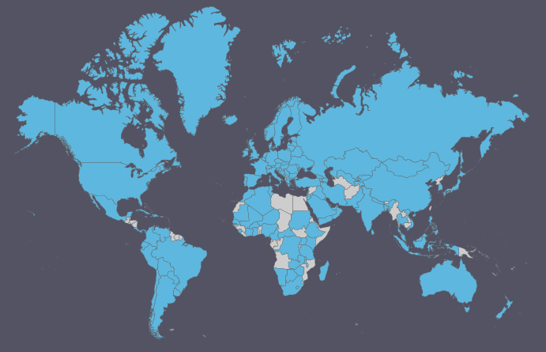
ITDB membership
126 Participating States
OFFICIAL USE ONLY
Notes:
The ITDB has 126 participating States including virtually all with significant nuclear industrial or research activities (except DPRK). There are some States that have uranium deposits that are not participants. Some other States may have significant numbers of radioisotopes for use in industry that are also not member States. Overall, participants represent virtually all significant global nuclear material and radioisotope owners, which is a major strength in the information sharing infrastructure internationally.

Slide 4
Confirmed Incidents 1993-2013

Slide 5
Confirmed Incidents 1993-2013

Slide 6
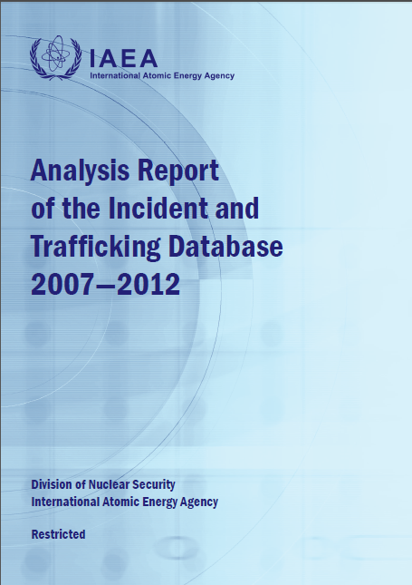
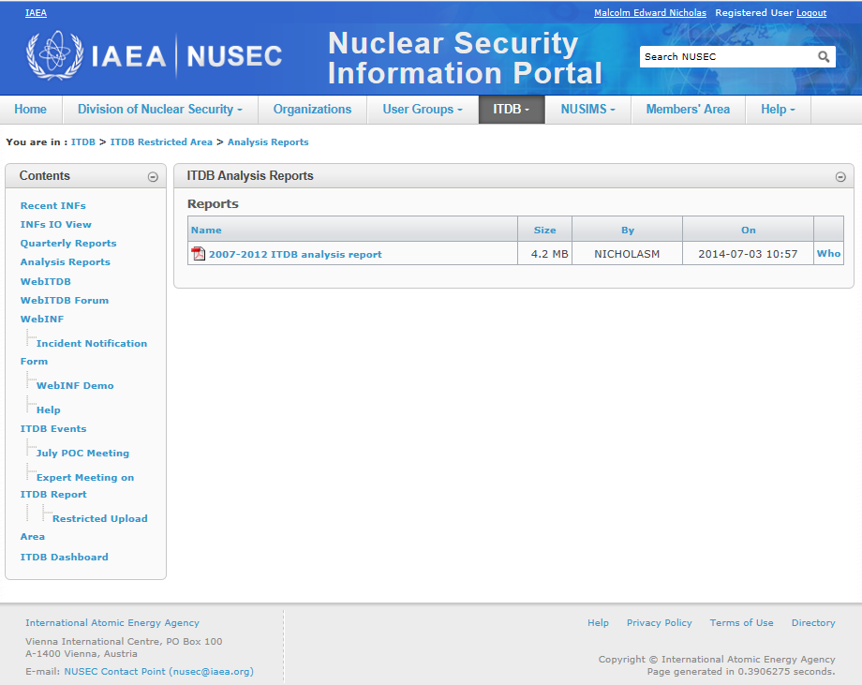

Slide 7
Incidents by material type reported in 2007-2012
1242 incidents in total

Slide 8
Incidents by groups
 | Annual average 2007–2012 | Annual average 1995–2006
Group A: unauthorized possessions and related criminal activities | 45 | 42

Slide 9
Incidents by groups
 | Annual average 2007–2012 | Annual average 1995–2006
Group A: unauthorized possessions and related criminal activities | 45 | 42
 | Annual average 2007–2012 | Annual average 1995–2006
Group C: other unauthorized activities | 140 | 34

Slide 10
Incidents by groups

Slide 11
Nuclear material incidents by material type
121 incidents in total

Slide 12
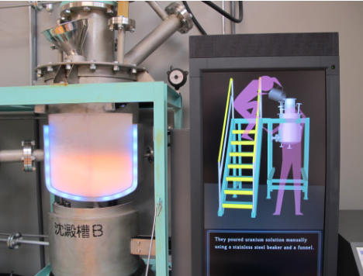
Nuclear criticality accident (1999)
Model of ‘blue flash’ accidentally achieved by adding dissolving ~ 16 kg of low enriched uranium
Intermittent criticality lasted 20 hours before being shutdown manually
Two fatalities. Five hours after start of criticality, 160 people evacuated from 39 houses within a 350 metre radius from accident point. 10 kilometre ‘stay-indoors’ zone established after 12 hours.
Reportedly over 50 nuclear criticality accidents have occurred globally

Slide 13
Nuclear material incidents by material type
121 incidents in total

Slide 14
Radioactive sources incidents by RS-G-1.9 categories (1-5)
656 incidents in total

Slide 15
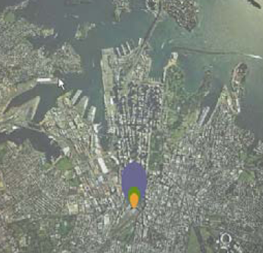
Modelled dispersion of 40 GBq Am-241 source with 1 kg TNT
50 year Committed Effective
Dose Equivalent received
by an individual remaining
at a specific location during
The radioactive material
release:
>10 milli-Sieverts
>5 milli-Sieverts
>1 milli-Sieverts
Colella, Logan, McIntosh and Thomson “An introduction to nuclear terrorism”,
The Australian Journal of Emergency Management, Vol.20 No.2 May 2005
(modelled using “HOTSPOT” code, LLNL).
Results do not necessarily reflect the opinion of the IAEA.
Notes:
However, although Category 4 is relatively low risk of harm, there have been studies such as this concerning the explosive release of Am-241 that show that disruption and clean-up would be expensive. This study involves a Cat 4 source (top end of Cat 4) and its modelled effect. Not much personal risk but costly.
IT SHOULD ALSO BE SAID THAT IN THE ITDB WE HAVE SEVERAL INCIDENTS IN RECENT YEARS THAT INVOLVE AM-241 SOURCES THAT ARE MANY TIMES MORE RADIOACTIVE THAN THAT USED IN THIS MODEL.
15

Slide 16
Radioactive sources incidents by RS-G-1.9 categories (1-5)
656 incidents in total

Slide 17
Border detections

Slide 18
Border detections

Slide 19
Some points to ponder related to ITDB information
1. Due to the ITDB’s information contents on approximately 2500 incidents reported by States,
the ITDB is a tool that may assist States in some forensics tasks including those that involve
HEU and Pu

Slide 20
Some points to ponder related to ITDB information
1. Due to the ITDB’s information contents on approximately 2500 incidents reported by States,
the ITDB is a tool that may assist States in some forensics tasks including those that involve
HEU and Pu
2. It could be important for a State to have the capability, or to know where to seek assistance,
to determine if any “bulk” Pu detected in an incident was from Pu-Be sources

Slide 21
Some points to ponder related to ITDB information
1. Due to the ITDB’s information contents on approximately 2500 incidents reported by States,
the ITDB is a tool that may assist States in some forensics tasks including those that involve
HEU and Pu
2. It could be important for a State to have the capability, or to know where to seek assistance,
to determine if any “bulk” Pu detected in an incident was from Pu-Be sources
3. It is important for the State from which nuclear material was lost, missing or stolen
to determine (or exclude) the location/facility involved (particularly HEU detected in scrap metal)

Slide 22
Some points to ponder related to ITDB information
1. Due to the ITDB’s information contents on approximately 2500 incidents reported by States,
the ITDB is a tool that may assist States in some forensics tasks including those that involve
HEU and Pu
2. It could be important for a State to have the capability, or to know where to seek assistance,
to determine if any “bulk” Pu detected in an incident was from Pu-Be sources
3. It is important for the State from which nuclear material was lost, missing or stolen
to determine (or exclude) the location/facility involved (particularly HEU detected in scrap metal)
4. There is a risk of some complacency because none of the nuclear material in individual
incidents was close to the amount needed for an Improvised Nuclear Device – however,
remember a) the threat of organized criminal interests and b) criticality devices (especially LEU)

Slide 23
Some points to ponder related to ITDB information
1. Due to the ITDB’s information contents on approximately 2500 incidents reported by States,
the ITDB is a tool that may assist States in some forensics tasks including those that involve
HEU and Pu
2. It could be important for a State to have the capability, or to know where to seek assistance,
to determine if any “bulk” Pu detected in an incident was from Pu-Be sources
3. It is important for the State from which nuclear material was lost, missing or stolen
to determine (or exclude) the location/facility involved (particularly HEU detected in scrap metal)
4. There is a risk of some complacency because none of the nuclear material in individual
incidents was close to the amount needed for an Improvised Nuclear Device – however,
remember a) the threat of organized criminal interests and b) criticality devices (especially LEU)
5. The annual average of more than 10 radioactive sources in RS-G-1.9 cat’s 2&3
(and the occasional cat 1 source) stolen, lost or missing is also a serious nuclear security issue
– forensics may benefit from the knowledge that there are only about 4 radioisotopes in the
overwhelming majority of such incidents, and that they are generally used in very few
types of equipment

Slide 24
Thank you and questions

