Slide 1
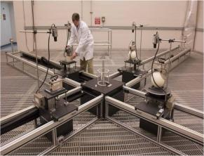
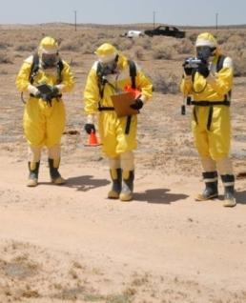
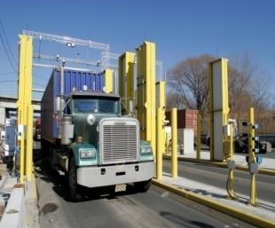
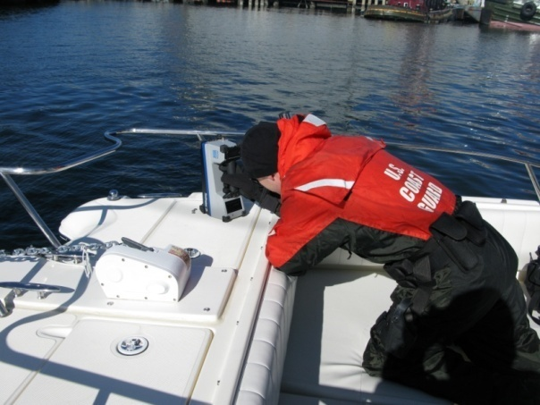

Domestic Nuclear Detection Office
Nuclear Forensics Expertise Development: Transferring Knowledge to the Next Generation
July 9, 2014
Samantha K. Connelly
Program Manager

Slide 2
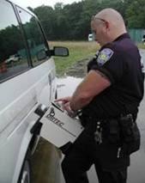
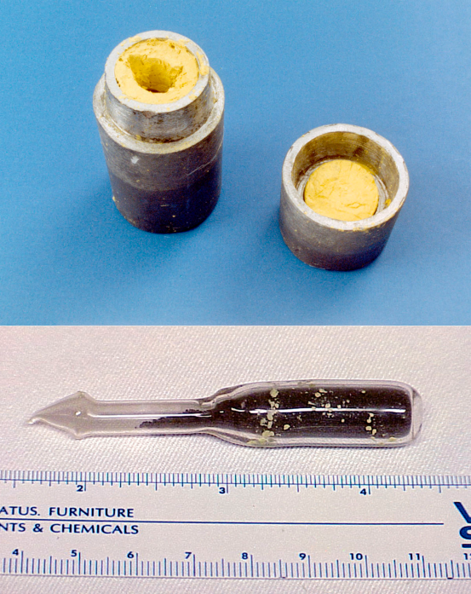
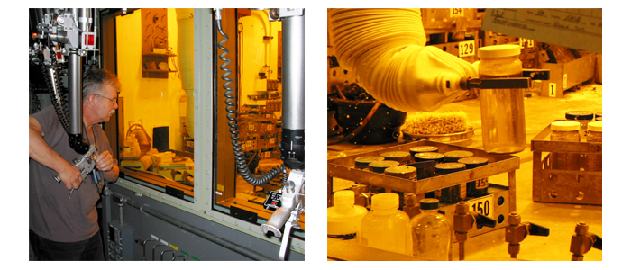
DHS Domestic Nuclear Detection Office
Established by Presidential Directive in 2005-2006 and authorized in 2006 SAFE Port Act / 2010 Nuclear Forensics and Attribution Act
Mission: Prevent nuclear terrorism.
“I continue to believe that nuclear terrorism remains one of the greatest threats to global security. That’s why working to prevent nuclear terrorism is going to remain one of my top national security priorities as long as I have the privilege of being President of the United States.”– President Obama (National Defense University, 2012)
Notes:
DNDO established in 2005 w/ mission to combat nuclear terrorism through both nuclear detection and nuclear forensics efforts.
Preventing / combating nuclear terrorism is a top US national security priority
Priority placed on preventing nuclear terrorism is also evident in our US declaratory policy.
“Renewing the U.S. commitment to hold fully accountable any state, terrorist group, or other non- state actor that supports or enables terrorist efforts to obtain or use WMD, whether by facilitating, financing, or providing expertise or safe haven for such efforts.” (NPR 2010)
Part of DNDO’s mission is to help support this policy.
How do we discover those accountable?
Background:
DNDO was established in DHS as an interagency office in 2005 (NSPD 43/HSPD 14) and authorized by the 2006 SAFE Port Act; NTNFC was established in 2006 (NSPD 17/HSPD 4) and authorized by 2010 NFAA (P.L. 111-140).

Slide 3
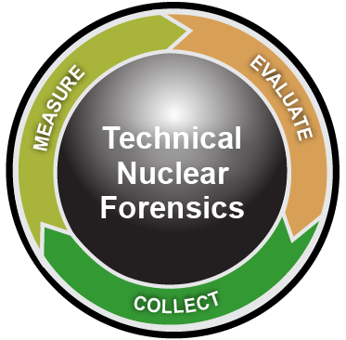
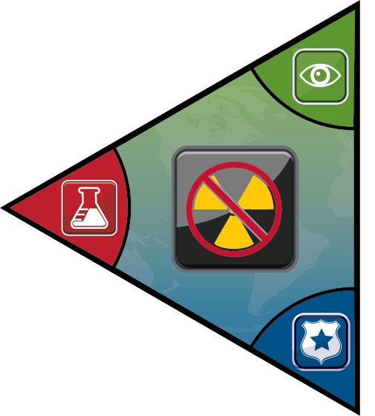

Nuclear Forensics: Process and Priorities
Trace origin of materials to help identify and close smuggling networks.
Inform national response decisions.
Disrupt follow-on event.
Support prosecution.
Enhance deterrence.
Intelligence
Community
}
Technical
Nuclear
Forensics
All-source
info fused
Law
Enforcement
Materials
Device
Debris
Deter-
Dissuade
Render
Safe
Post-Det
Cons. Mgmt.
Secure
Detect
Interdict
Recovery
Attribution
Nuclear Defense Spectrum
Notes:
Here you can see how the NF process spans the defense spectrum (explain) and how feeds into the subsequent attribution process (explain).
Also the national priorities for TNF – i.e., the contributions it can make to preventing/countering nuclear terrorism.

Slide 4








President and Congress → Whole-of-Government Approach
DoD
FBI
DOE
POST-DET
LEAD AGENCY INVESTIGATION
PRE- TO
POST- DET
DOS
DHS
ODNI
INTERNATIONAL
PRE-DET
MATERIALS
INTELLIGENCE
ANL
INL
LANL
LLNL
NBL
NIST
ORNL
PNNL
SRNL
SNL
Y-12
DoD Labs
Notes:
In order to make this process function, President and Congress had to establish roles and responsibilities and national-level goals and objectives for the mission. Did this through both legislation and policy documents.
Created the structure we have today: a whole-of-government or interagency approach to the mission.

Slide 5
Nuclear Forensics Expertise
Material Characterization
Weapons & Energy
Treaty Monitoring
Nuclear Material Forensics
Nuclear Event Forensics
Relies on Multi-Disciplinary Expertise:
Radiochemists, Geochemists, Analytical Chemists
Nuclear / Reactor / Process Engineers
Physicists / Nuclear Physicists
Statisticians
Metallurgists
BUT, Challenging Trends:
Nuclear Chemistry Ph.D.s, US Universities 1968-2004
Notes:
This is the expertise critical to accomplishing the TNF mission / maintaining an advanced US TNF capability. Reference puzzle piece slide – labs at foundation – the foundation of our NTNF capability is the strong scientific expertise within the national laboratory system.
In the early 2000s, a number of expert groups published studies recognizing that the cadre of experienced nuclear forensics experts at U.S. National Laboratories and in academia had been rapidly diminishing since the end of the Cold War, and the outlook for replacing them was grim. A 2004 DOE National Science Foundation Nuclear Science Advisory Committee report assessed that within ten years, “more than three quarters of the workforce in nuclear engineering and at the National Laboratories will reach retirement age.” At the same time, the decline in U.S. academic programs in technical areas directly relevant to nuclear forensics, such as radio- and nuclear chemistry, had reached alarmingly low levels. Few universities still offered graduate programs in radiochemistry, and in most of these, only one faculty member remained. By 2008, the total number of Ph.Ds. awarded nationwide had decreased to fewer than six per year. The National Academy of Sciences, a Joint Working Group of the American Association for the Advancement of Science and the American Physical Society, and the U.S. Government Accountability Office all highlighted these gaps as a crisis and recommended they be addressed in a swift, targeted manner.

Slide 6
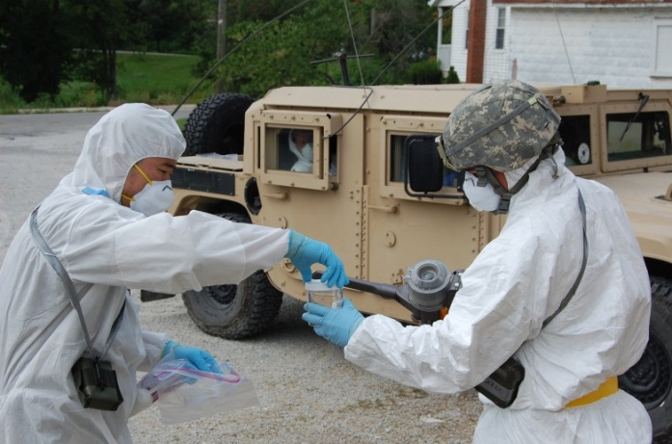
NNFEDP: A Model for NF Expertise Development
Key elements of the National Nuclear Forensics Expertise Development Program (NNFEDP):
Strategic Academic to Career Pathway
Undergraduate → Graduate → Post-Doctoral Fellowships
University Programs
Scientist-Student Mentoring
Notes:
In the face of a dire situation both at the National Laboratories and in academia, the USG established the NNFEDP in 2008 to reverse declining trends & develop the next gen of NF scientists in US

Slide 7
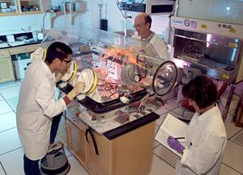
Academic Pathway to a Nuclear Forensics Career
Undergraduate
Scholarships, Summer School
Post-doctoral
Fellowships
Junior Faculty Awards
Nat’l Lab Mentoring
NF Career
Graduate
Fellowships, Internships
University Education Awards
Multi-Year R&D Projects
National Nuclear Forensics Expertise Development Program
Notes:
In the face of a dire situation both at the National Laboratories and in academia, the USG established the NNFEDP in 2008 to reverse declining trends & develop the next gen of NF scientists in US
**Overarching key points: Goal – vibrant, enduring, seamless pipeline from academia into career in NF at national level:
NNFEDP initiatives include graduate and undergraduate scholarships, fellowships, internships and mentoring, post-doc fellowships, and U/ jr. faculty awards for studies and research in NF-related disciplines.
Unique interdisciplinary approach emphasizing collaboration among students, academic departments, universities, and nat’l labs
Unique – deliberately narrow focus on specific, identified tech needs in NF
All efforts integrated, aligned, and inextricably linked at every point to USG NF priorities, projects, and cadre of expert scientists at labs
Accomplished through one-on-one mentoring, practical internships, and focused collab. applied research
11 National Labs and 23 Universities
ALL PARTICIPANTS MUST BE US CITIZENS
BACKGROUND:
2008 NFSP Education Sub-Panel Workforce Workshop and Report. Also, first NTNFC lab census. Used results and recommendations from the Sub-Panel’s final report, “A Plan for Augmenting the Nuclear Forensics Workforce,” and census to design the NNFEDP.
Need 30-35 new Ph.D. scientists trained in NF-related disciplines over next 10 years
3-5 universities and 6-7 national laboratories should be involved – emphasis on university-lab collaboration

Slide 8
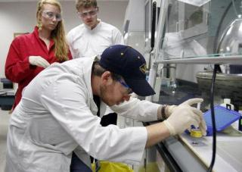
Nuclear Forensics Undergraduate Programs
Goals: Increase awareness, recruit students into graduate studies, develop student and university relationships with labs
NF Undergraduate Scholarship Program:
  5 scholars/year
  Practicums conducted at 10 different national labs; dedicated mentoring
  Scientific report and presentation
NF Undergraduate Summer School:
  University/national laboratory partnership
  10 students/year, six weeks
  Classroom + laboratory work
“Summer students study nuclear forensics at MU”
Kansas City Star // 07/08/2012
Notes:
The NNFEDP undergraduate-level programs are designed to introduce undergraduate students to the field of nuclear forensics as a viable career path, increase the number of qualified undergraduates pursuing graduate studies in technical fields related to nuclear forensics, develop enduring relationships between the students and National Laboratories, and foster collaborations between university partners and laboratory staff conducting nuclear forensics research
NFUSP practicums so far at: INL, ORNL, LLNL, LANL, ANL, PNNL, SRNL, Y-12, SNL, NBL; this summer at LANL, LLNL, Y-12, ORNL, SNL
NFUSS: UNLV (x2), WSU, Missouri (x2)

Slide 9
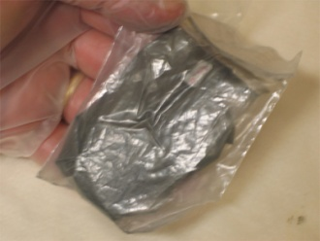
Nuclear Forensics Graduate Programs
Goals: Encourage students to pursue doctoral degrees in radiochemistry and other NF-related disciplines and encourage universities to invest
Nuclear Forensics Graduate Fellowship Program
  Successful to date – excellent candidates – 20 total fellows/year
  23 participating universities
  Tuition, stipend, travel, publishing, lab practicums, post-grad service
Seaborg Institute Nuclear Science Summer Internship Program
  Lawrence Livermore & Los Alamos National Labs; 10-15 students/year
Graduate Mentoring Assistance Program
Academia
National Lab
Notes:
NNFEDP emphasis at grad/post-doc level: 65% of investment here
23 currently approved universities (universities apply to participate and are evaluated based on criteria)
Fellowship awards are renewable for up to 5 years – full tuition + $2400/month stipend; travel reimbursements; encourage publishing/presenting work; 2 practicums at lab(s) w/ mentoring
Post-graduation service / payback requirement: Two years at a national lab or Federal D/A
1st international practicum summer 2013 (ITU): quantifying uncertainties in radiochronometry (“age dating”) methods for U/Pu; LANL/LLNL mentoring as well
Already NFGF graduates into workforce – ~75% retention/success rate
GMAP: one-on-one mentoring at 9 labs; building relationships; includes training, assistance with design, execution, and publishing of research projects, and interaction with student’s faculty advisor and home university

Slide 10
Nuclear Forensics Post-graduate and University Programs
Post-Doctoral Fellowships at National Labs
  Goal: Encourage PhD’s to enter workforce; provide career track for Grad Fellows
  13 post-docs at 8 different labs
NF Junior Faculty Award Program
  Goal: Recruit, promote, and retain highly qualified personnel for teaching and research
  5 current awards
NF Education Award Program
  Goal: Encourage universities to develop sustainable interdisciplinary programs in NF-related disciplines in partnership with national labs
  4 current awards
NF Minority Serving Institution Collaboration Award Program
  Goal: Strengthen science/engineering programs at Minority Serving Institutions and enhance partnerships with other U.S. universities and national labs
Notes:
All awards linked to USG NF priorities, projects, and cadre of scientists at labs; all three-year appts.
POST-DOCS:
3-year renewable post-doc appointments at $150K/year; research spans across NF mission spectrum
Fellows currently at SRNL, ORNL, LANL, AFIT, PNNL, LLNL, SNL, NIST
JFAP:
3-year renewable awards; $75K/year with additional $25K if school matches that $25K
Current awardees: NC State; Iowa; Missouri, Columbia; Clemson; Colorado School of Mines; Penn State
NFEAP:
3-year renewable awards; $100K/school with mandatory university matching (50%) – ensure commitment/sustainability – current awardees: Washington State; Texas-Austin; Cincinnati; Oregon State
Universities can use NFEAP awards for curriculum development, faculty, students, lab facilities, etc.
NF MSI: These three-year renewable awards can be used to support faculty salaries, student scholarships and fellowships, travel, laboratory and equipment improvements, coursework, and other collaborative academic activities with university and national laboratory partners → diverse and highly-trained workforce
$75K/school, first awardee just announced (pilot year)

Slide 11
Progress Summary
  Support to over 300 students and faculty and 23 universities since 2008, in close partnership with 11 national labs
  Undergraduate programs spreading awareness and feeding graduate programs
  19 new Ph.D. nuclear forensic scientists into the workforce; on track to meet near-term milestone of 35 new PhD’s by 2018
  NF-related academic programs strengthened at 14 universities nationwide through direct support – broad impact
University-lab collaboration growing; mentoring has flourished
International collaborations beginning
Continual assessment underway
Notes:
14 PhDs at national labs, 4 at USG D/As, 1 at university (post-doc at UC-Berkeley)
2 PhDs who traversed entire pipeline
University of Cincinnati, UT-Austin, Washington State University, University of Missouri Columbia, Texas A&M, Penn State, North Carolina State University, University of Iowa, Clemson University, University of Michigan, University of Utah, Oregon State University, Colorado School of Mines, 1 new MSI school
68 direct program participants currently, but that does not include students indirectly participating through NFEAP/NFJFAP initiatives (research, courses, etc.)
Total budget = ~$5M/year

Slide 12
Key Lessons Learned: Model Strategy
Appropriate expertise needs be recruited & retained to ensure a credible, enduring nuclear forensics capability
  Guiding objective: Establish a seamless pipeline from academia into an attractive career in nuclear forensics
  Identify specific expertise needs in workforce and target recruitment
  Whole-of-government involvement ensures integrated approach
Diversified, coordinated approach is best – academic pathway spanning undergraduates, graduates, post-docs, and faculty at universities and labs
  Use undergraduate-level initiatives and outreach to raise awareness
  Focus efforts at graduate/post-doctoral/university levels – most direct and broadest impact for investment
  University and faculty commitment key to long-term program sustainability

Slide 13
Key Lessons Learned: Model Implementation
Interdisciplinary approach focused on fundamental science with strong links among students, academic departments, universities, and national labs
  Develop cadre of students with solid base in fundamental sciences and develop core academic programs at universities – specific forensic expertise will be learned “on-the-job” through practical experience
  Closely align and link student and university research efforts with national priorities, projects, and existing cadre of expert nuclear scientists
  Hands-on experience is key – practical student internships and focused collaborative applied research
Implement mentoring across all aspects of program – critical knowledge transfer from experts to next generation
Unique and significant opportunity to help your country prevent nuclear terrorism – emphasize in publicizing your program – Good Marketing

Slide 14
Questions?

