Slide 1
The Uranium Sourcing Database Project: Practical Insights into the Establishment and Application of a Nuclear Forensics Library
International Conference on Advances in Nuclear Forensics
Martin Robel, Naomi Marks, Ian Hutcheon,
Rachel Lindvall, and Mike Kristo
Lawrence Livermore National Laboratory
Vienna, Austria, July 7-10, 2014

Slide 2
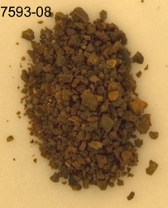
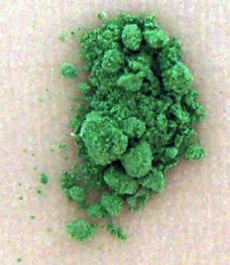
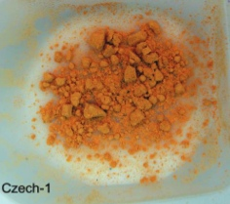
NNSA/NA-24 sponsored the development of a UOC sourcing capability
The U-sourcing database provides the empirical foundation for developing a comparative signature approach
The Uranium Sourcing Database contains >300 physical UOC samples and “material fingerprints” for over 4000 samples from >30 countries
~50 discrete signature variables
Major and trace element abundances
Isotopic composition (U, Pb, Sr, Nd, C, N, O)
Molecular species (U₃O₈, UO₄, ADU, AUC, …)
~190,000 individual entries (data)
Discriminant Analysis Verification Engine (DAVE) uses Partial Least Squares Discriminant Analysis (PLSDA) to query the database

Slide 3
Database design, administration, and personnel considerations: internal vs. external database developer
External -advantages
Experience, specialization
Efficiency
Potential cost savings (less training)
Reduced burden on internal staff
External –disadvantages
Unfamiliar with NF db needs
Still R&D; not production; internal staff will still need to administer and modify db
Internal –advantages
Greater familiarity with NF db data and requirements
Increased interaction between developer and analytical staff likely to result in more successful design

Slide 4
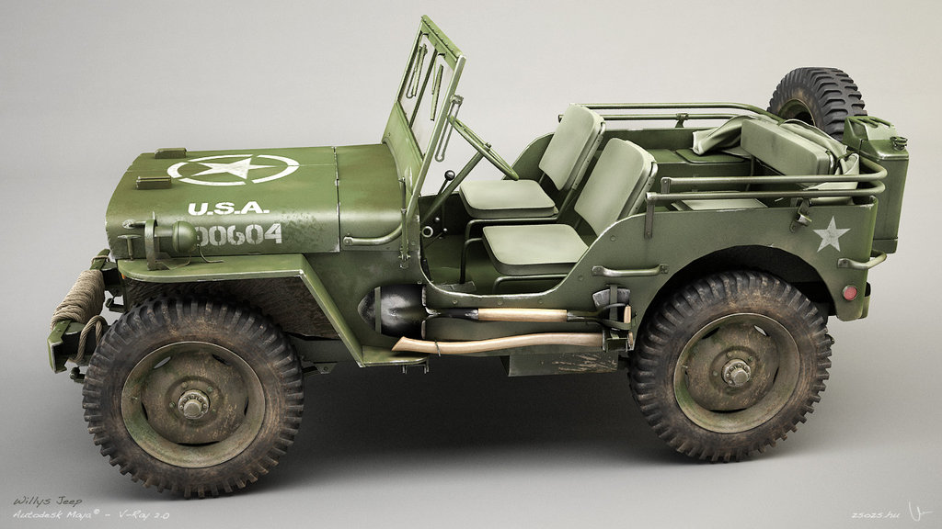
Designing a database for nuclear forensics
Flat vs relational database format
Flat: easy, familiar, single user, limited scale, limited queries
Relational: complex, unfamiliar to most, multiple user, unlimited scale, sophisticated queries, industrial strength
The benefits of simplicity in design
Not a production environment; frequent changes likely
More transparent = more efficient for humans
Production environment –commuting to work
Get a Tesla. Sophisticated, powerful, efficient, impossible to work on
R&D environment –driving across the tundra
Get a Jeep. Slower, more robust, fewer features (which you don’t really need), easy to diagnose, fix, and alter

Slide 5
A data model for nuclear forensics data
Many ways to organize data; good structure mirrors inherent relationships in data
Iterative design process led to current structure of Uranium Sourcing Database
Primary tables: Sample and Result
Numerous satellite tables
Primarily “lookup tables” –standardized lists to enforce consistency

Slide 6
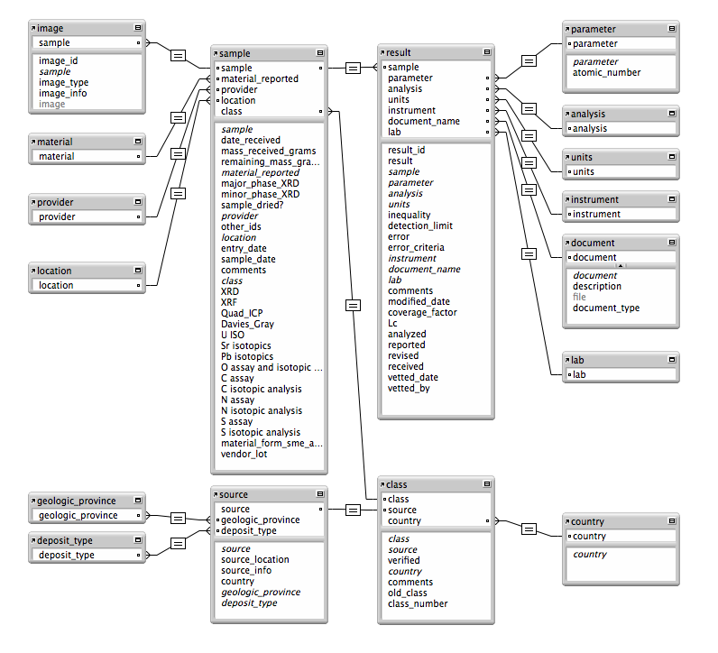
Uranium Sourcing Database -structure

Slide 7
Analytical Laboratory to Database Interface
U Sourcing Database effort includes lab analysis
Analytical database lead
Receives
Vets
Formats
Uploads
External analysis reports generated by database queries
Database also used for tracking status of analyses

Slide 8
The U-Sourcing Database Organizes Samples According to Chemical, Physical and Isotopic Properties
Bimodal core data model: Samples and Results
Each sample may have ~70 results (measurements)
Samples
Sample ID
Mass
Source
Material type
Current Location
Results
Analysis
Result
Uncertainty
Parameter
Units
Sample ID | Result | Parameter | Unit
201 | 0.00733 | ²³⁴U/²³⁸U | Atom ratio
201 | 82,000 | P | μg/g
201 | 70.5 | U | wt. %

Slide 9
Database structure allows rapid querying of samples
Sample properties (data) are contained in a bimodal core structure holding variable measurements/sample
Related tables contain meta-data and supporting information
Related Tables
Related Tables
Bimodal Core (most data here)
Analysis
Source
Samples
(e.g., sample ID, sample mass)
Measurements (e.g., result, uncertainty, detection limit)
Parameter
Provider
Units
Material
Lab

Slide 10
Database Architecture Allows Both Simple and Multi-faceted Queries
Simple query: find source & sample ID for all U₃O₈ with ²³⁴U greater than 57 μg/g
Analysis
Source
Samples
(e.g., sample ID, sample mass)
Measurements (e.g., result, uncertainty, detection limit)
Parameter
Provider
Units
Material
Lab
²³⁴U (μg/g)

Slide 11
Selecting a database platform
Many choices of relational database platform
Microsoft SQL Server
MySQL
Microsoft Access
Etc…
Desirable features
User friendly
Multi-user (excludes MS Access)
Conventional (for ready supply of developers; excludes FileMaker Pro)
Existing institutional support
Free versions of most platforms available
No customer support
But generally good “crowd sourced” support (forums)

Slide 12
Database data types
Broad categories of data type
Text (text, varchar, char, etc…)
Numeric (int, bigint, tinyint, float, double, long, etc…)
Time/date (date, time, timestamp, etc…)
The problem of significant figures
There is no numeric data type that meets the specific requirements of nuclear forensic analytical data
Numeric data types won’t preserve significant figures properly
Rounding issues
Text will preserve sig figs, but at a cost (can’t sort or do calcs)
Best solution we’ve found is to use text and implement a work-around for associated issues

Slide 13
Populating a NF database
Units and conventions
Two ways to deal with units/reporting
Just import as is and then convert units as necessary after making a query
Requires less up-front work
Reduces potential for conversion errors creeping into database
Makes it much harder to perform searches on data
Standardize before importing to database
Requires more up-front work
Makes database much more useful
Can use file repository to preserve original data

Slide 14
The file repository
All data is likely to be received in some document
Those documents used to populate the database should be permanently stored in a file repository
Database fields can point to source documents
Uranium Sourcing Database does this by use of a document field in the Result table
Links to the document table
Links to the document file in the repository

Slide 15
Data Entry
Manual vs batch/bulk upload
Some fields best updated manually
Most better with batch upload
Use a SQL (Structured Query Language) script -command line interface
Use upload utility in graphical user interface
Preparation for upload
Data not likely received in database format
Manual copy and paste re-formatting tedious and error prone
Automation of standardized reporting template from analysts is ideal (e.g., MS Visual Basic macro in Excel)

Slide 16
Database user interface(s)
Two categories of user interface
Off the shelf (OTS)
No development work necessary
Powerful
General purpose
Relatively difficult for non-specialist to use
Custom
Best for end-user with repetitive query needs
Requires significant development effort
Best solution is probably off-the-shelf admin interface and custom user interface(s) for non database specialists

Slide 17
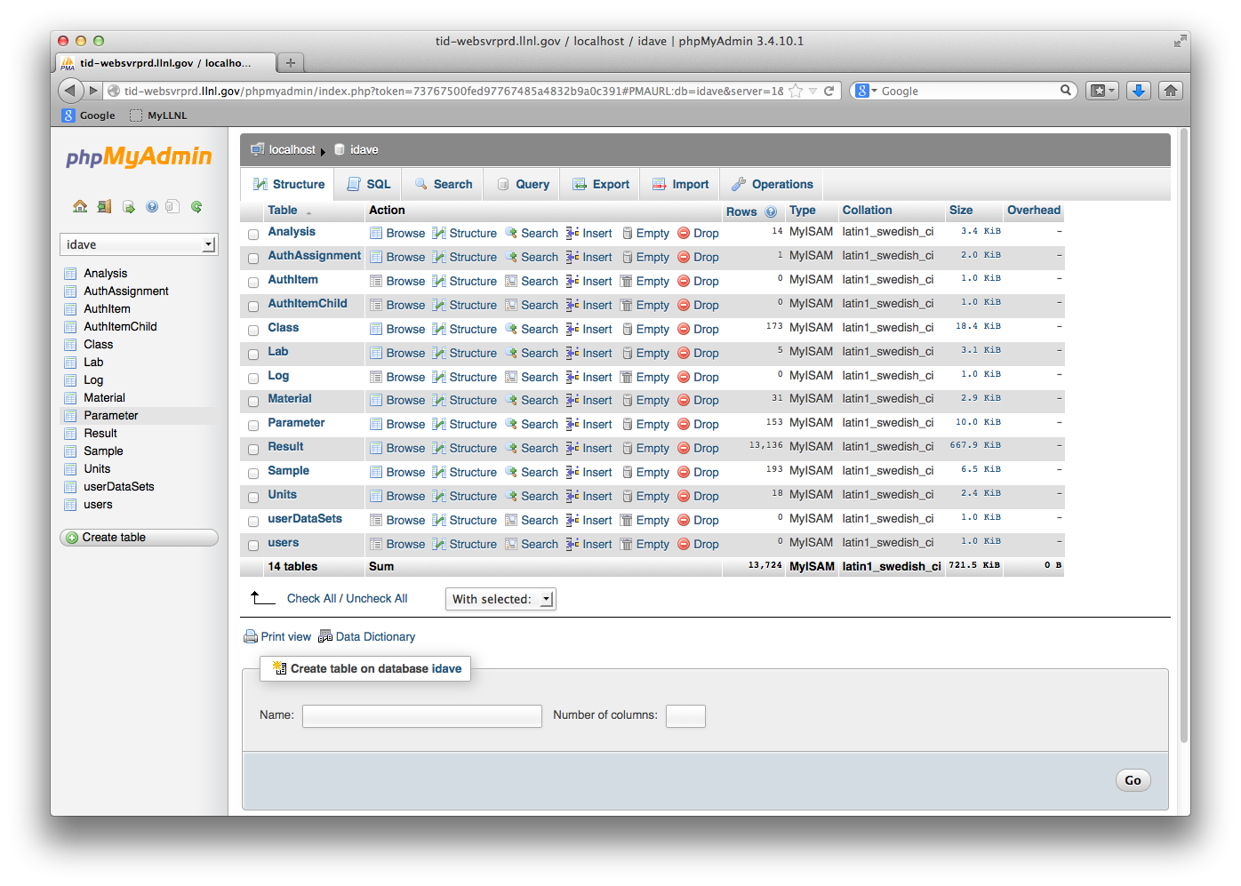
Example OTS Interface: phpMyAdmin and MySQL

Slide 18
Database utilization
Queries
Query is only the beginning; subject matter expert review/interpretation is essential
Technical experts should directly query the database
For input to technical reports to external request originator
For research and development
For complex (e.g., multivariate) signatures, post-processing will be necessary
Export to Excel or analysis environment (e.g., MATLAB) for analysis
UOC signatures well suited to multivariate analysis
PCA
PLS-DA

Slide 19
Database summary reports
Particular type of query with special requirements
Two types of summary information
That which can be derived by a direct query of the data
E.g., number of samples in the database from a specific location
Should be easily accomplished with well designed database
That which requires synthesis and interpretation of database contents
E.g., number of sources added to the database in the past year
Requires a date added field in the appropriate table(s)
May require interpretation of whether a source is new
Recommend trying to anticipate such requests during development, since may require less than obvious fields

Slide 20
From database to analysis application
Two ways to link analysis application to database
Direct queries of database
Requires rigorous cleansing and standardizing of database
Most flexible
Queries of “cached” data in form of datasets
Easier to ensure quality control of data utilized by application
Easier to track/document exactly which data were used as training set for a particular analysis/conclusion
More robust; no direct interface with database
Requires periodic re-construction of datasets (not automatic)

Slide 21
The Uranium Sourcing Database and iDAVE
iDAVE is the pattern classification application that utilizes the data stored in the Uranium Sourcing Database
Example of advanced post-processing of a database query

Slide 22
The Uranium Sourcing Database and iDAVE

Slide 23
Conclusions
All but the most elementary nuclear forensic database should use a relational database system
Internal vs. external database development entails trade-offs
Simpler db structure is easier to maintain/modify
Iterative design process recommended
Preserving significant figures in database is tricky
File repository is highly recommended
At least two user interfaces recommended
NF data may be best utilized with multivariate analysis

Slide 24
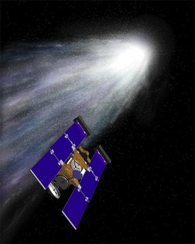
Acknowledgements
The LLNL nuclear forensics team:
Richard K. Bibby
Lars Borg
Amy M. Gaffney
Victoria G. Genetti
Julie M. Gostic
Richard Gostic
Patrick M. Grant
Roger A. Henderson
Ian D. Hutcheon
Gregory L. Klunder
Kimberly B. Knight
Carolyn Koester
Michael J. Kristo
Laurence Lewis
Rachel E. Lindvall
Naomi Marks
Audrey N. Martin
Kenton J. Moody
Christina E. Ramon
Erick C. Ramon
Martin Robel
Frederick J. Ryerson
Kerri Schorzman
Michael A. Sharp
Michael J. Singleton
Paul E. Spackman
Leonard T. Summers
Scott Tumey
Ross W. Williams
Paul T. Wooddy
Cutting-edge science validates forensic analysis capabilities
Isotopic Compositions of Cometary Matter Returned by Stardust
Science 314, 15 Dec. 2006
Work supported by NNSA’s Office of Defense Nuclear Nonproliferation and the DHS Domestic Nuclear Detection Office

