Slide 1
Announcing the 4th Collaborative Materials Exercise (CMX-4) of the Nuclear Forensics International Technical Working Group (ITWG)
PNNL-SA-103799
International Conference on Advances in Nuclear Forensics:
Countering the Evolving Threat of Nuclear and Other Radioactive Material out of Regulatory Control
IAEA Headquarters, Vienna, Austria
7–10 July 2014
Jon Schwantes Pacific Northwest National Laboratory, Richland, Washington, USA
Olivia Marsden AWE, Aldermaston, UK

Slide 2
Overview
Introduction to the ITWG Exercise Task Group (ETG)
  Purpose
  Philosophy
  Participants
CMX-4
  Objectives
  Scenario
  Materials
Examples from Past Exercises
  Receipt & Handling
  Likely Analyses
  Evaluations
Schedule
Interest in Future Participation

Slide 3
Nuclear Forensics International Technical Working Group (ITWG)
…is a forum for informal technical collaboration among official nuclear forensics practitioners
Mission: …to advance the best practices of nuclear forensics largely through the participation in a series of Collaborative Materials Exercises (CMXs)
Task Groups
Communication & Outreach Task Group
National Nuclear Forensic Libraries Task Group
Evidence Collection Task Group
  Guidelines Task Group
  Exercise Task Group
Notes:
Communication & Outreach Task Group
Cooperates closely with IAEA Office of Nuclear Security and Global Initiative to Combat Nuclear Terrorism (GICNT). Works both with local experts who require technical information and with government officials who require an orientation to nuclear forensics
National Nuclear Forensic Libraries Task Group
To drive forward discussions on national databases and co-operation in conjunction with IAEA
Evidence Collection Task Group
Concentrates on post-incident management with focus on preservation of evidence and a catalogue of national first responder exercises
Guidelines Task Group
Is developing consensus guidelines that can be referenced by analytical laboratories represented at ITWG meetings

Slide 4
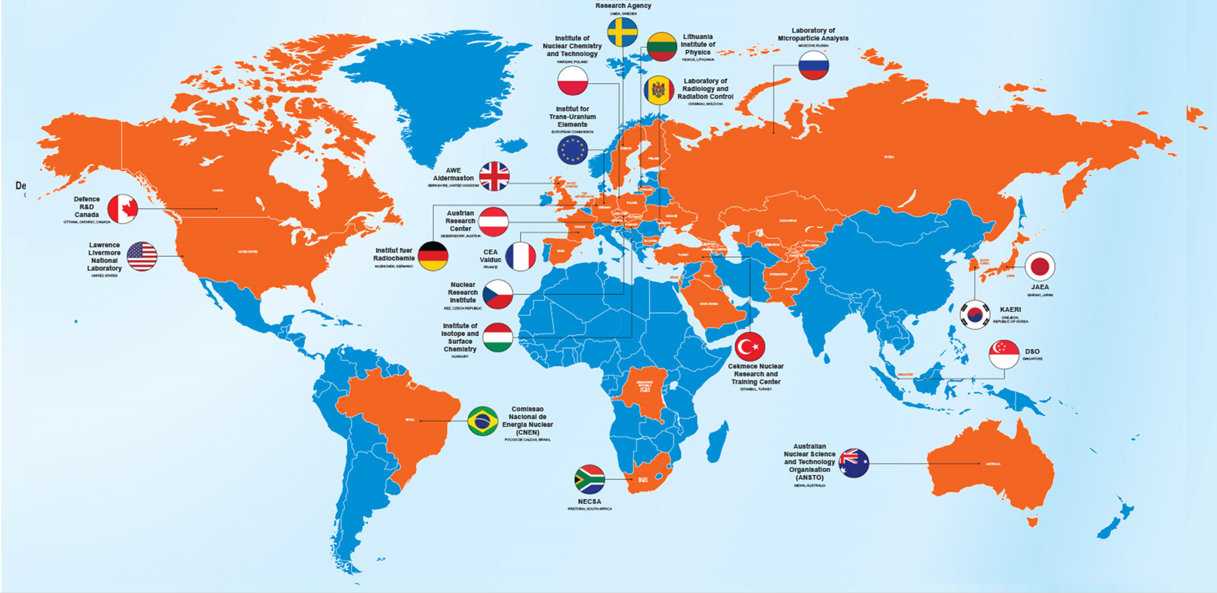
What Countries / Organizations Comprise the ITWG

Slide 5
Purpose of the Exercise Task Group
…to evaluate and improve the effectiveness of nuclear forensics techniques and methods through international collaborative exercises.
The ETG uses Collaborative Materials Exercises (CMXs) and Table Top Exercises (TTXs) to:
  identify and prioritize techniques and methods needed to characterize and categorize seized nuclear and radiological materials
  advance the science and practice of nuclear forensic analyses
  strengthen the community that will be called upon for these types of investigations

Slide 6
ITWG Exercise Goals and Objectives
Evaluate and improve the effectiveness of nuclear forensics techniques and methods
Prioritize analytical techniques and methods
Evaluate attribution capabilities
Evaluate the utility of existing data/knowledge libraries
Assess the capability to address non-nuclear forensic techniques and methods
Provide tools to assist participants in developing new and improving existing programs within their countries

Slide 7
Benefits of participating in
Collaborative Materials Exercises (CMX)
Exercise lab capability
Test novel (experimental) techniques to answer questions that may be asked when nuclear material is seized by law enforcement agencies
Compare results with other nuclear forensics laboratories
Exchange information and share best practices with the global community of nuclear forensics experts

Slide 8
ETG Materials Exercise Philosophy
Each Laboratory’s results are held in confidence
A summary of exercise results is published
Exercises use “real world” samples
Designed as a Learning Experience (…not a Performance Test)
Scenario based exercises that balance the needs for both rapid answers and accurate and precise results
Designed to target questions of both a (1) legal and (2) national security nature
  Is the material radioactive? Dangerous? LEU? HEU? Illegal to possess?
  Can we identify the origin? Can we include or exclude it from other materials?

Slide 9
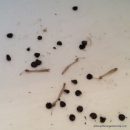
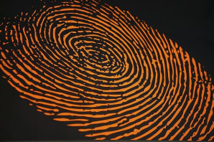
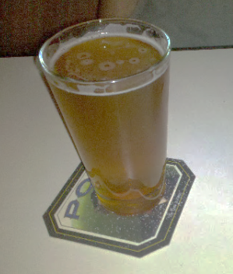
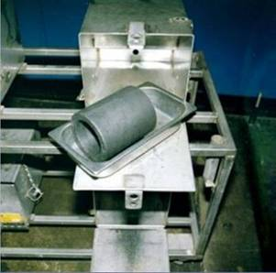
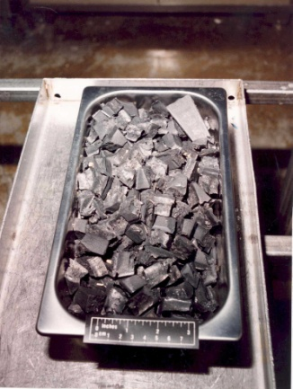




HEU International Round Robin (CMX-2/RR-2)
Past ITWG Materials Exercises
Pu International Round Robin (CMX-1/RR-1)
  Participants (6):
    Materials / Evidence:
    Reprocessed plutonium oxide from the European Civilian Cycle
  Participants (10):
    Materials / Evidence:
    Highly enriched uranium (90% ²³⁵U) oxide powder, Nuclear Research Institute at Rez, Czech Republic for the exercise
    Non-nuclear "classical" forensic evidence (i.e. fingerprints, seeds, plastic shopping bags, and handwritten map) included
Comparison of HEU Metal Characteristics (CMX-3/RR-3)
  Participants (9):
  Materials / Evidence:
    Highly enriched uranium metals (>90% ²³⁵U), DOE Y-12 Security Complex, U.S.A.
9
9

Slide 10
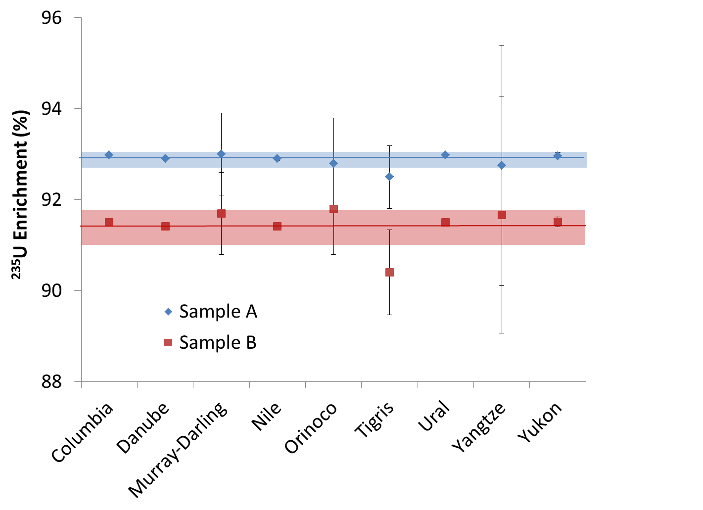
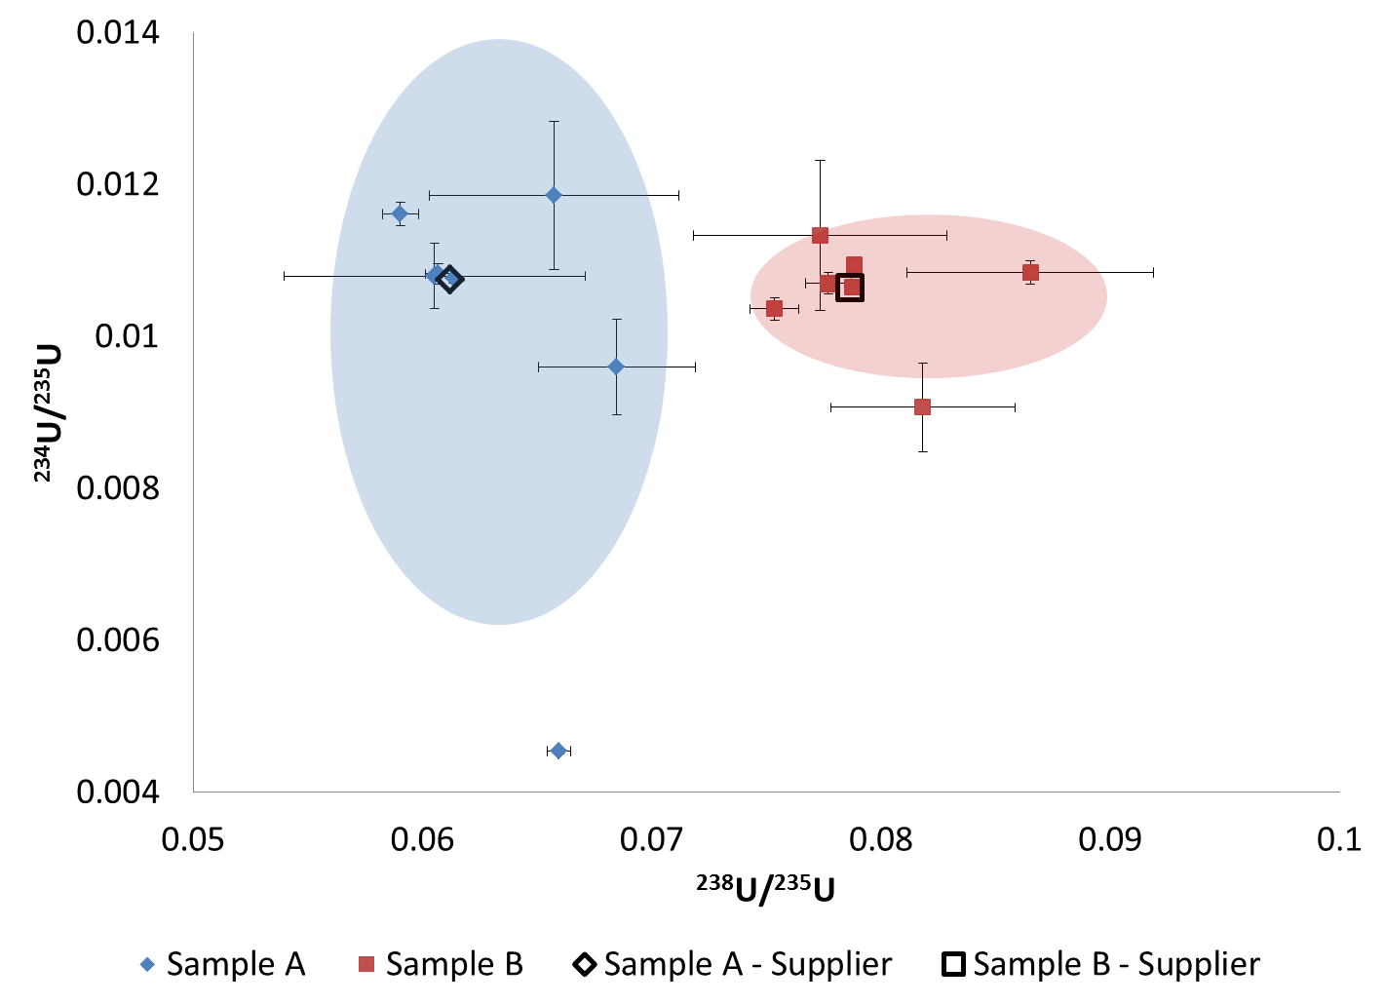
Examples of Nuclear Forensic Analysis during CMX-3 (aka, RR3)
Isotopic Enrichment Determination
²³⁴U/²³⁵U vs. ²³⁸U/²³⁵U for samples A & B.

Slide 11
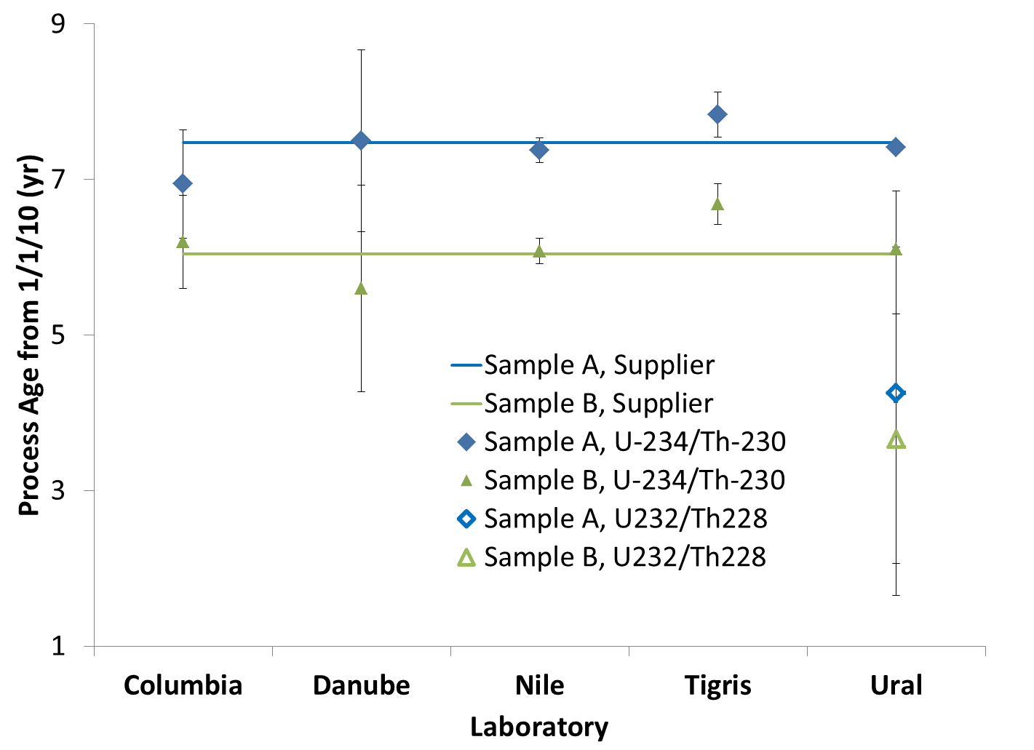
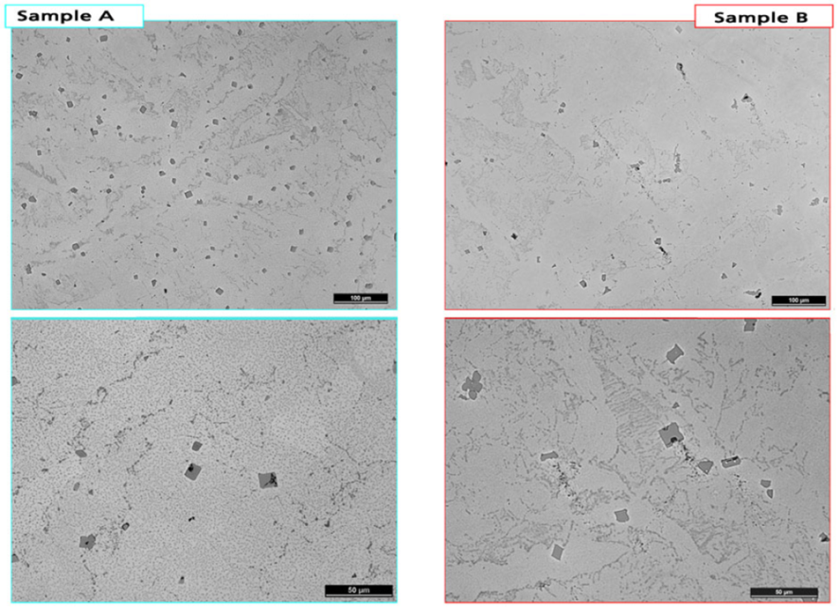
Examples of Nuclear Forensic Analysis during CMX-3 (aka, RR3)
Radiochronometry as a means of
differentiating Samples A & B
SEM Images of inclusions within samples A&B (size and population used in inclusion/exclusion analysis).

Slide 12
Exercise Task Group Strategic Plan
Major Goals of ETG Outlined:
Continue Assessing the Status of Nuclear Forensic Analysis
Grow Participation in CMXs
Increase Regularity and Frequency of Exercises
Formalize CONOPS of Exercises
Target Technical Questions that Currently Limit the Application of Nuclear Forensic Analysis (group inclusion/exclusion, radiochronometry, morphology)
Better Integrate Law Enforcement Community & Traditional Forensic Evidence

Slide 13
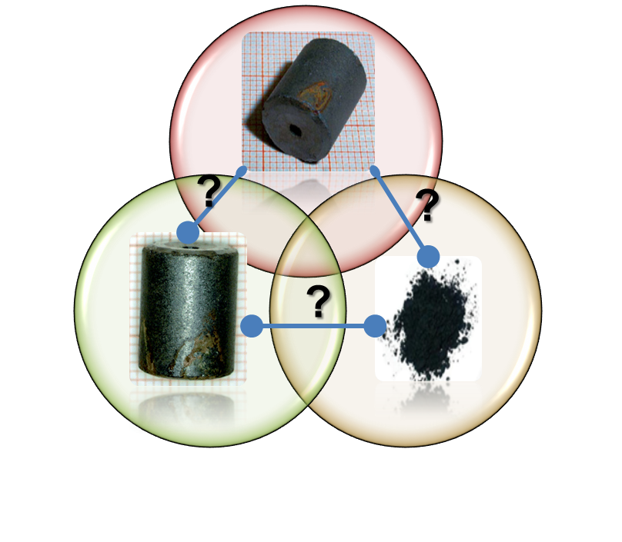
Fourth ITWG Collaborative Materials Exercise (CMX-4)
To Commence September, 2014 and End November, 2014
Paired Comparison Exercise of Three LEU Samples
Exercise Objectives
  Assess the ability for rapid nuclear detection techniques to adequately categorize low-enriched uranium (LEU)
  Explore the capabilities and limitations of Bulk Analysis
  Exploit material characteristics other than isotopic abundances (e.g., trace elemental analysis, morphology, phase ID)
  Apply nuclear forensic evidence to identify a facility of origin
  Utilize the Graded Decision Framework to comprehensively report findings

Slide 14

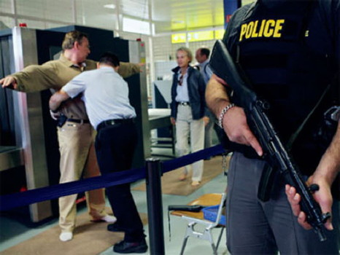
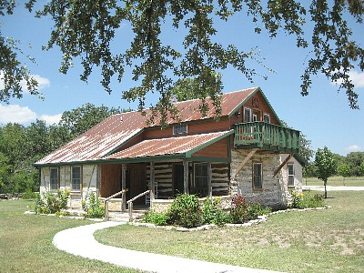
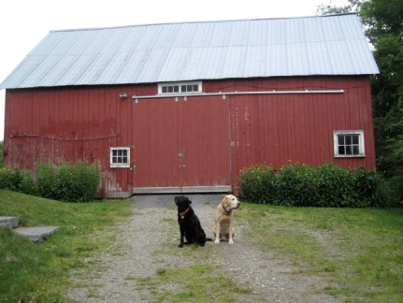
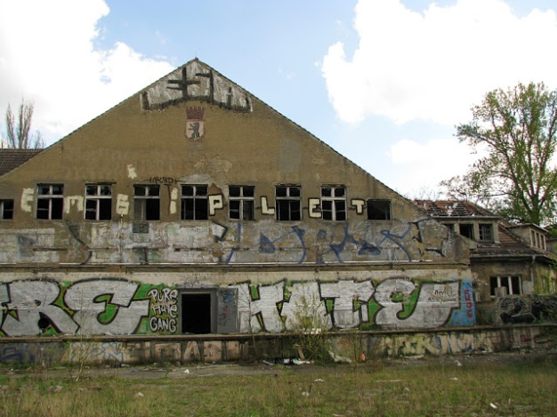
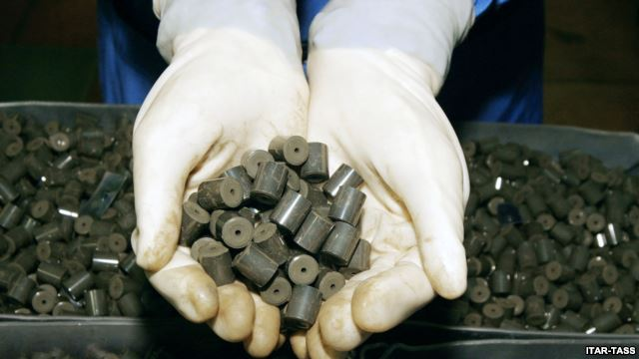
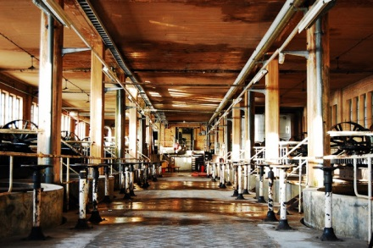

CMX-4: Scenario
Man stopped at DFW airport for “simple possession” of a radioactive substance while attempting to board a flight to Frankfurt, Germany
  Black powdery radioactive substance (alleged to be U)
  Separate search of subject’s residence in Shiner, Texas, turned up what is believed to be a uranium fuel pellet
Similar pellets were seized five years earlier from an abandoned warehouse outside of Frankfurt, Germany
Laboratory Support Requested by Authorities. Help authorities determine if:
  A law has been broken
  If there is a connection between the black powder seized at the DFW airport, the suspected fuel pellet confiscated at the farm house in Texas and the fuel pellets seized near Frankfurt, Germany five years earlier

Slide 15
Likely Characteristics of Future Collaborative Exercises
Nuclear forensic analysis: Group inclusion / exclusion questions – what does it mean for two materials to be similar or dissimilar?
Radiochronometry: which chronometers are most appropriate for particular types of materials (metals, oxides, liquids)
Integration of LE and Traditional evidence: radiologically contaminated fingerprints, DNA, documents, etc.
Signatures in heterogeneous materials: morphology, evidence of mixing, etc.

Slide 16
Exercise Schedule
Schedule
  CMX every other year, includes shipping TTX
  Analytical TTX’s alternating every other year with CMX’s (designated as TTX-20XX)
  CMX-4 will begin September, 2014
Commence
CMX-4
Commence
CMX-5
Commence
CMX-6
TTX-2015
TTX-2017
2014 | 2015 | 2016 | 2017 | 2018
Shipping
TTX-4
Shipping
TTX-5
Shipping
TTX-6
CMX-4
Data Review
Meeting
CMX-5
Data Review
Meeting

Slide 17
Information about Participating in Future Exercises??
Co-Chairs for the Exercise Task Group:
  Olivia Marsden, AWE, U.K., Olivia.Marsden@awe.co.uk
  Jon Schwantes, Pacific Northwest National Lab, USA, Jon.Schwantes@pnnl.gov
Thank you for your attention!
Questions??

