Slide 1
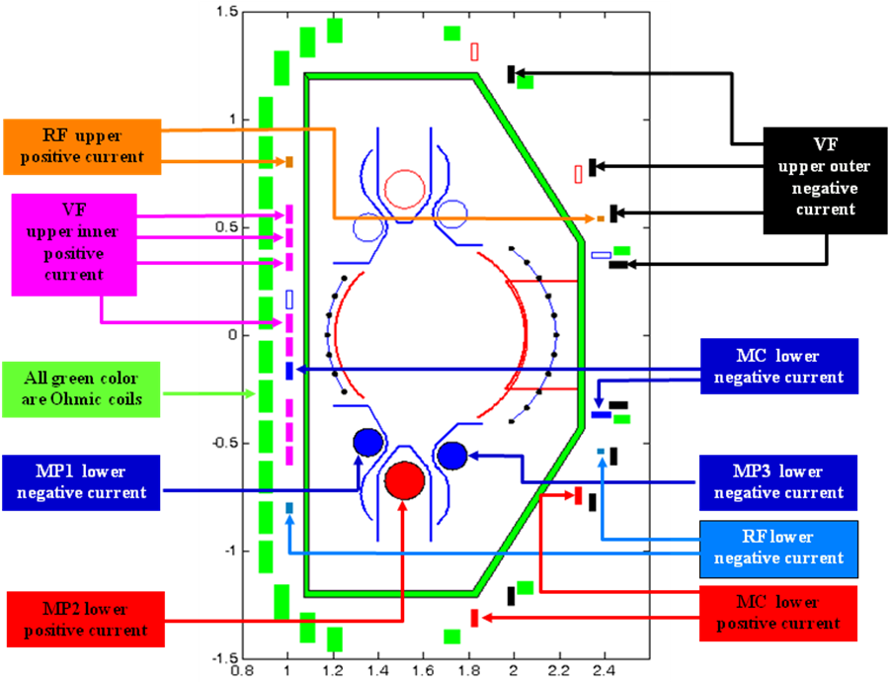
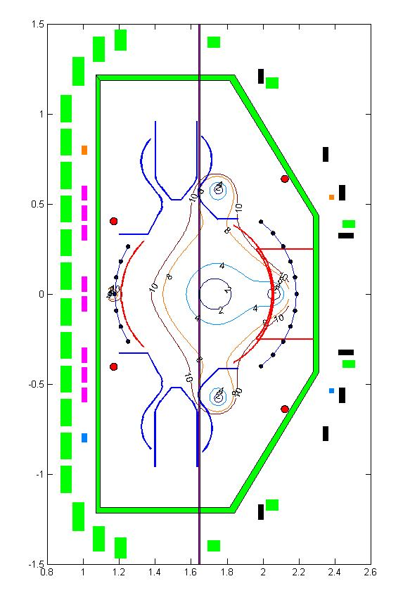
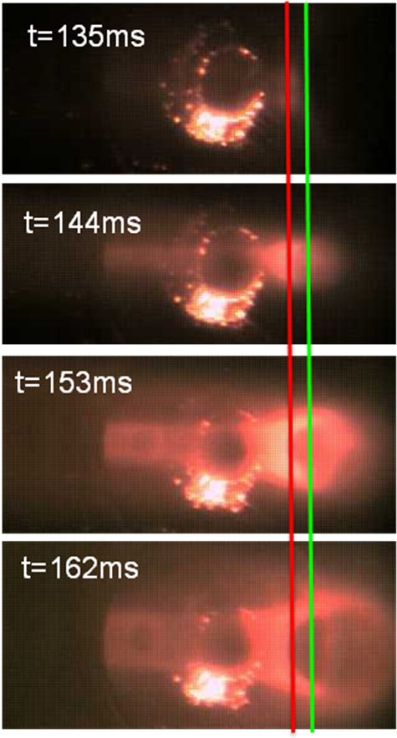
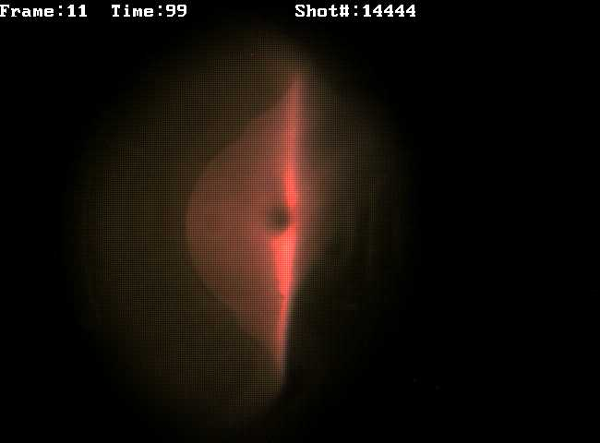
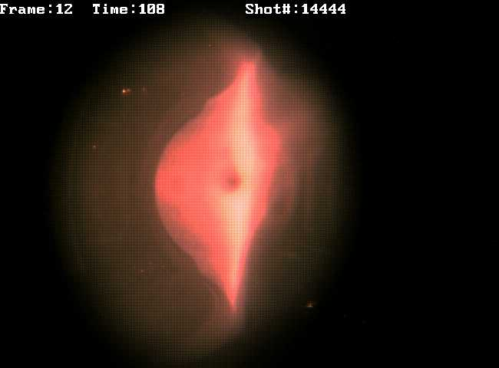
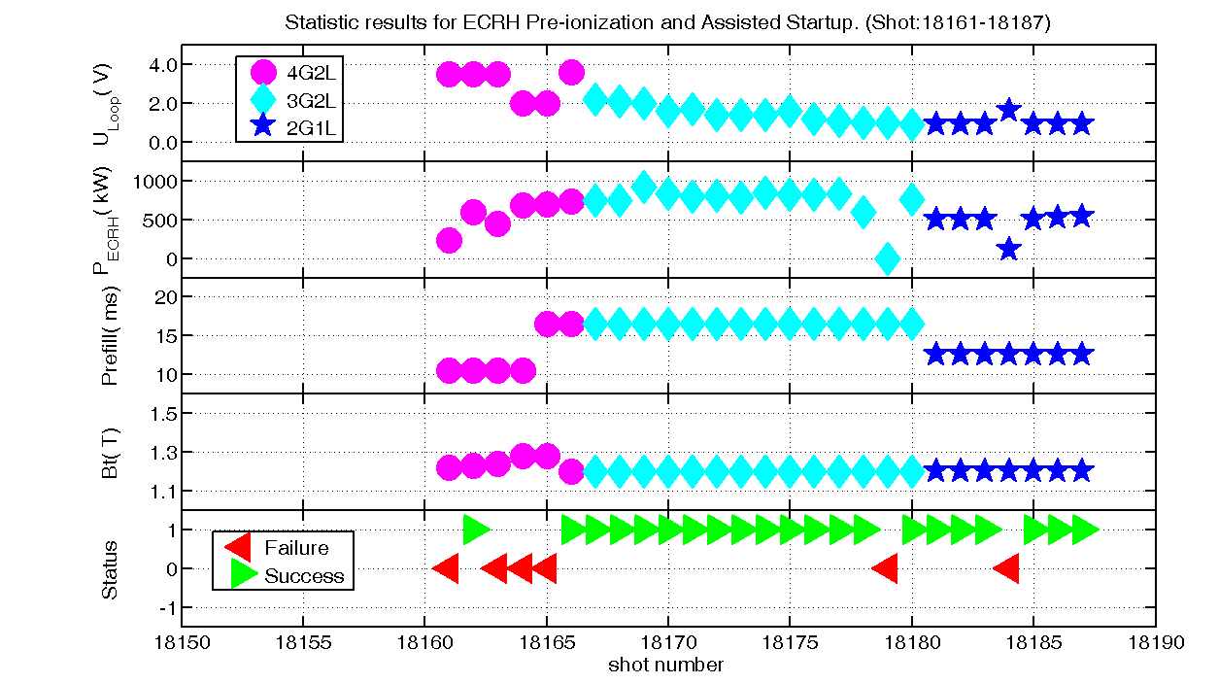
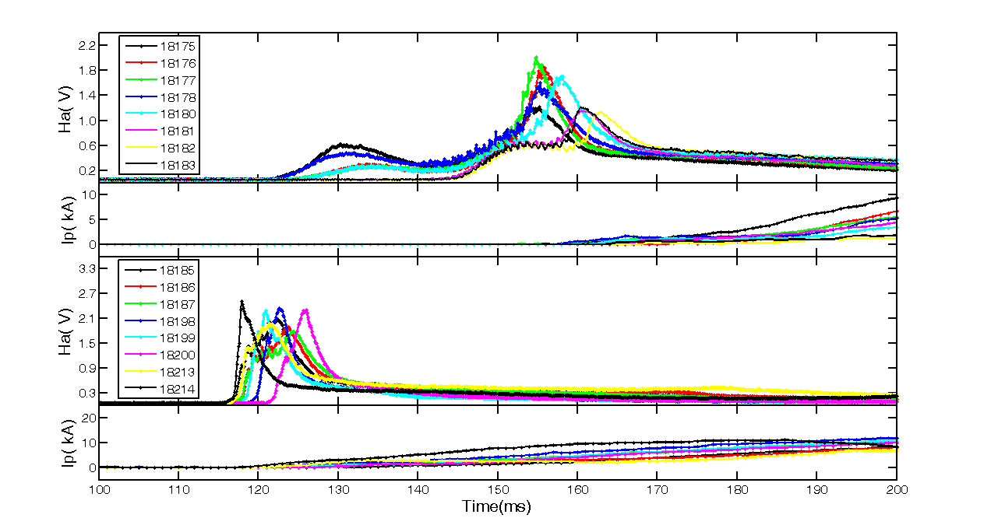
24th IAEA Fusion Energy Conference, 8-13 October 2012, San Diego, United States
EX/P2-15
ECRH Pre-ionization and Assisted Startup
in HL-2A Tokamaks
HL-2A
Xianming SONG*, Liaoyuan CHEN, Jinghua ZHANG
Jun RAO, Jun ZHOU, Xiao SONG, Jiaxian LI and HL-2A team
SouthWestern Institute of Physics (SWIP), Chengdu, China
Motivation:
On HL-2A, in order to build up scenarios for ECRH pre-ionization and assisted startup to relax the conditions required to breakdown and startup plasma on its next generation Tokamak HL-2M, and to gain the physics understanding of ECRH pre-ionization and assisted startup, especially to clarify the ITPA IOS2.3 open issue, ECRH pre-ionization and assisted startup experiments have been carried out during 2010, 2011 and 2012 experiment campaigns.
Typical results of ECRH pre-ionization and assisted startup experiments. Shot 14444 (magenta solid line with a point marker) is O1-mode, 16289 (cyan dash-dot line without marker) is X2-mode with perpendicular injection, and 16617 (red dotted line with a plus marker) is X2-mode with toroidal injection angle 20⁰. Ip is plasma current, Ha is hydrogen alpha emission, U_{Loop} is loop voltage, P_{ECRH} is ECRH power.
HL-2A is an ideal testbed to study field null structure and plasma initiation due to its two insulated gaps in VV( with toroidal resistance R=10 Ω), zero mutual inductances between PF coils and the independent way to power PF coils .
Shot: 14444, O1-mode, P=200kW, t=108ms, 117ms
Shot: 16289, X2-mode, P=600kW, t=108ms, 117ms
Shot: 16617, X2-mode, P=800kW, t=126ms, 135ms
The position of pre-ionization and current formation. In the left picture, the vertical line indicates the ECRH resonance position. The field null structure is calculated by a Matlab Code developed in SWIP. In the right picture, the red vertical line indicates the ECRH resonance position, the green vertical line indicates the field null position. The times at which the CCD camera generates a images are labeled at the corresponding images.
CCD image for shot 14444, 16289 and 16617. The images for shot 14444 are very bright, The images for shot 16289 are brighter than that of shot 16617 but dimmer than that of shot 14444. There are apparent light spots on the vacuum wall in the images for shot 16289 and 16617.
The statistics results of shots (18161-18187). U_{Loop} is loop voltage, P_{ECRH} is ECRH power, prefill is the width of voltage pulse to control prefill gas, Bt is the toroidal magnetic field, the Status indicates whether plasma is successfully established. 4G2L (magenta circle) indicates the scenario in which ECW of 4 gyrotrons was launched by two launchers, 3G2L (cyan diamond) indicates 3 gyrotrons by two launchers, and 2G1L (blue pentagram) indicates 2 gyrotrons by one launchers.
IOS2.3 proposal. Ip is plasma current, Ha is hydrogen alpha emission. ECRH power for all shots start at 105ms and end at 405ms. Loop voltage for Shots (18175-18188, 18180-18183) start at 130ms, 25ms after ECRH power. Loop voltage for Shots (18185-18187, 18198-18200, 18213-18214) start at 80ms, 25ms before ECRH power.
Email: songxm@swip.ac.cn 24th IAEA Fusion Energy Conference, 8-13 October 2012, San Diego, United States
EX/P2-15

Slide 2
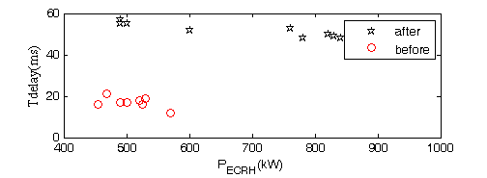
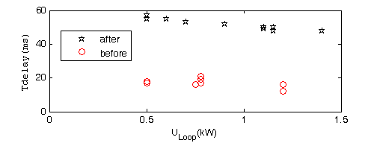
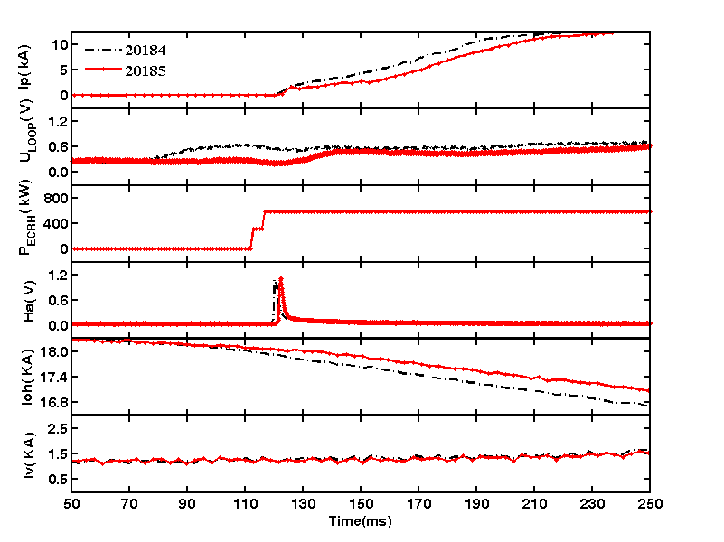
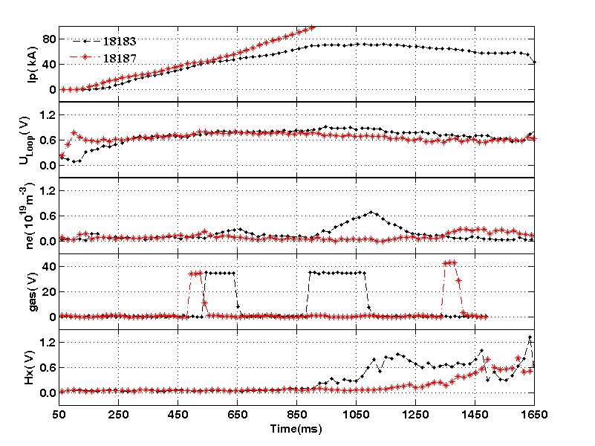
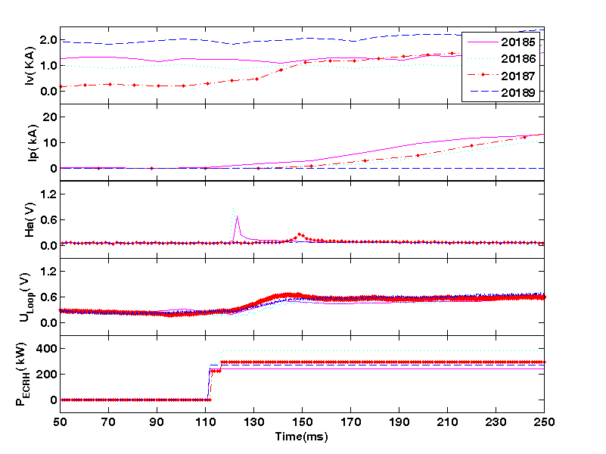
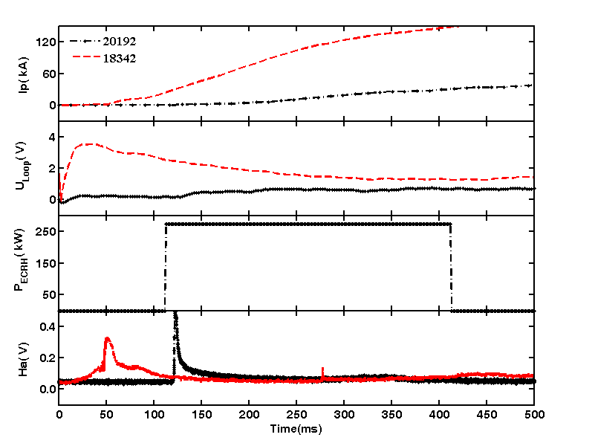
24th IAEA Fusion Energy Conference, 8-13 October 2012, San Diego, United States
EX/P2-15
HL-2A
It is concluded that the earlier application of loop voltage does not delay or hinder the avalanche formation on HL-2A, and even better than that of later application of loop voltage. There is no problem for earlier application of loop voltage. The shorter delay times for earlier application of loop voltage may explain as follow: the earlier application of loop voltage may accelerate the initial free electrons (with energy about 0.03 eV) to a higher energy value close to subcritical energy, when X2 mode ECRH switches on, the X2 mode absorption rate by electron is faster due to its higher energy, which causes the earlier breakdown.
Tdelay is the delay time, U_{Loop} is loop voltage, P_{ECRH} is ECRH power. Black pentagram indicates the shots for earlier application of loop voltage, the red circle indicates the shots for later application of loop voltage.
The typical waveforms for IOS2.3 experiment. Ip is plasma current, U_{Loop} is loop voltage, P_{ECRH} is ECRH power, Ha is hydrogen alpha emission, Ioh is the current in ohmic coils, Iv is the current in vertical field coils.
Runaway phenomena in low voltage start up discharge. U_{Loop} is loop voltage, ne is plasma density. Gas is the voltage to control GAS PUFF, Hx is hard X-ray radiation.
The effect of vertical field. Iv is the current in vertical field coils, Ip is plasma current, Ha is hydrogen alpha emission, U_{Loop} is loop voltage, P_{ECRH} is ECRH power.
Waveform for minimum ECRH power and pure ohmic start up. Ip is plasma current, U_{Loop} is loop voltage, P_{ECRH} is ECRH power, Ha is hydrogen alpha emission.
Summary:
ECRH pre-ionization and assisted startup experiments have been carried out on HL-2A. The results show that minimum power and low loop voltage for successful establishment of plasma is strongly dependent on wall condition, and also dependent on other parameters such as prefill gas pressure, field null structure and toroidal injection angle. The results also clarify the IOS2.3 issue that there is no problem when ECRH power is launched after the application of the reduced loop voltage, which is the situation operating in ITER during its commissioning phase. The minimum breakdown voltage was successfully reduced down to 0.5V, corresponding to toroidal electric field of 0.05V/m, which is 6 times smaller than the ITER value of 0.3V/m, it is also the smallest value ever obtained by Tokamak. The minimum ECRH powers are about 200kW for O1- mode and 300kW for X2-mode. The minimum loop voltage for successful pure ohmic breakdown without optimization is 3.4V. There is no any detected plasma current ( about 1kA) observed during pre-ionization phase as reported on KSTAR.
This work is partially supported by the National Nature Science Foundation of China under Grant No.10835009 and partially by the Chinese National Magnetic Confinement Fusion Science Program under Grant No. 2009GB103005.
Email: songxm@swip.ac.cn 24th IAEA Fusion Energy Conference, 8-13 October 2012, San Diego, United States
EX/P2-15

