Slide 1
Technical challenges in the construction of the steady-state stellarator Wendelstein 7-X
Hans-Stephan Bosch
for the Wendelstein 7-X Team
Max-Planck-Institute for Plasma Physics,
Wendelsteinstr. 1, D-17491 Greifswald, Germany

Slide 2
Outline
Introduction
Technical challenges of components
Assembly status and future work packages
Outlook: commissioning, operation
Conclusions

Slide 3
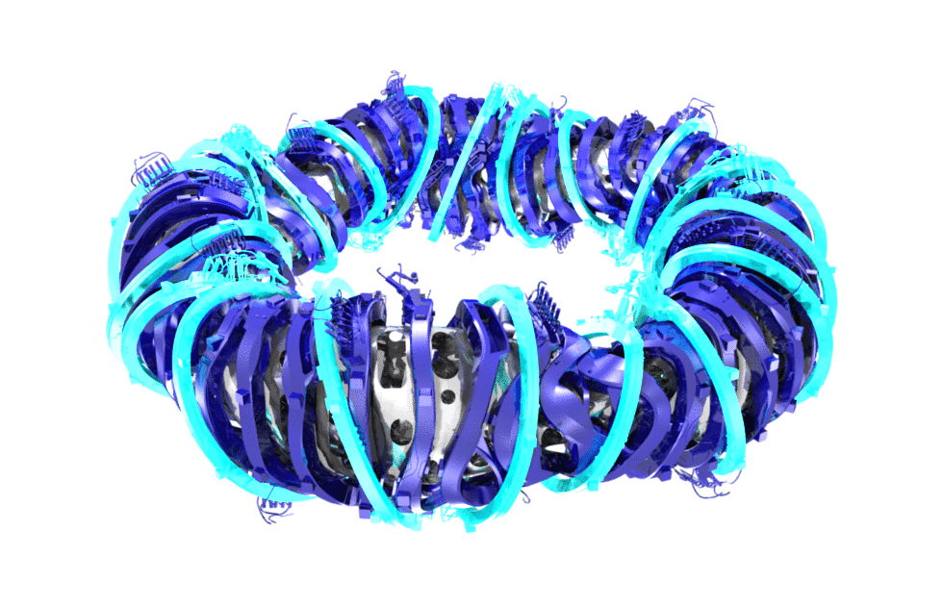
Stellarator optimisation
Seven criteria for physics optimisation
high quality of vacuum magnetic surfaces
good equilibrium properties @ <β > = 5%
good MHD stability properties @ <β > = 5%
reduced neoclassical transport in 1/ν -regime
small bootstrap current in lmfp-regime
good collisionless fast particle confinement
feasible modular coils

Slide 4
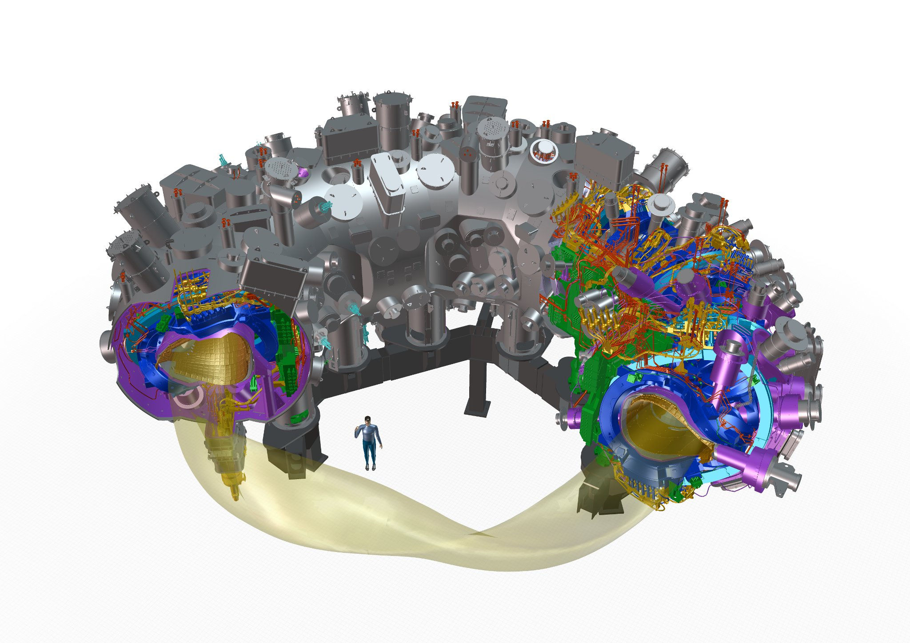
Major components of Wendelstein 7-X
cryostat vessel
~ 500 openings
254 ports
5.5/0.53 m major/minor plasma radius
30 m³ plasma volume
70 superconducting NbTi coils
3 T magnetic induction on axis
254 ports of 120 different types
725 t mass with 425 t cold mass
265 m² in-vessel components
height 4.5 m diameter 16 m
access domes and instrumentation plugins
SC bus bar
3d-shaped
plasma vessel
He pipes
2500 in-vessel
components
14 HTSC
current leads
plasma
50 non-planar
20 planar SC coils
central support ring

Slide 5
Outline
Introduction
Technical challenges of components
Assembly status and future work packages
Outlook: commissioning, operation
Conclusions

Slide 6
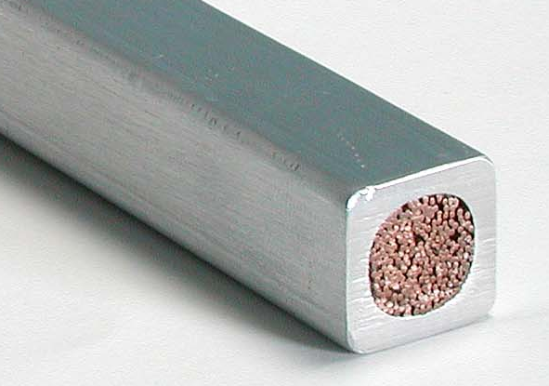
Challenge: superconducting coil system
Symmetry of the device:
five periods (modules)
2 flip-symmetric half-modules
⇒ 10 half-modules
In one half-module:
5 different non-planar coils
2 different planar coils Spulen
⇒ 70 coils of 7 types
common superconductor:
243 single NbTi/Cu strands
cable-in-conduit conductor
soft Al-alloy for winding accuracy
He-cooling through the voids

Slide 7
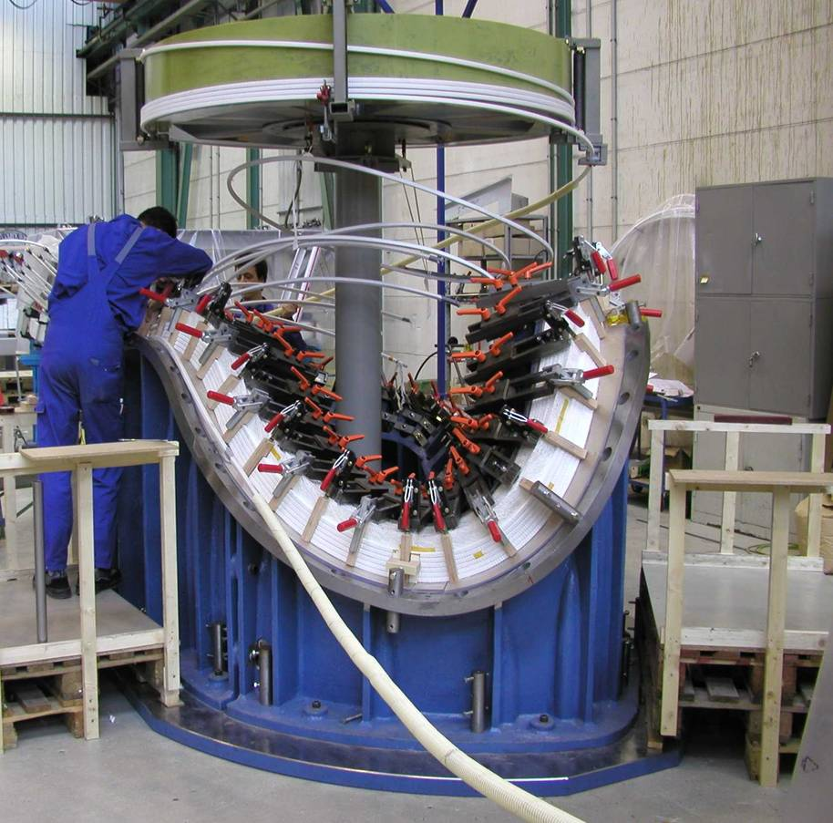
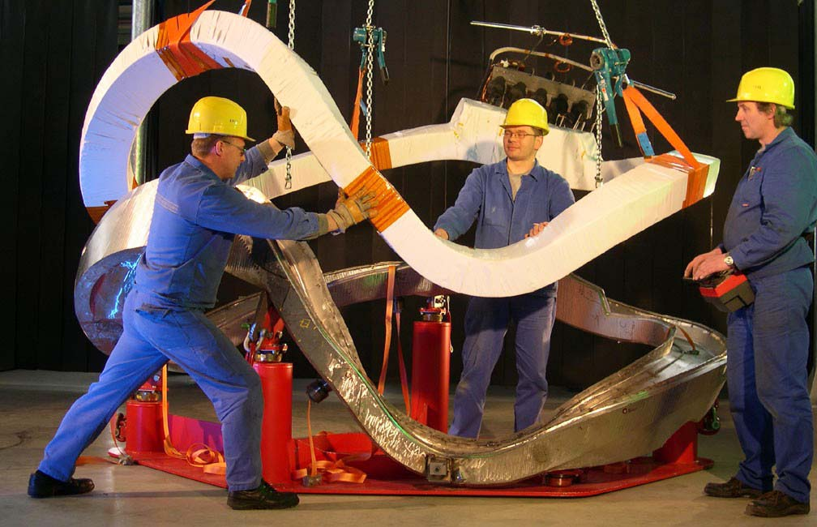
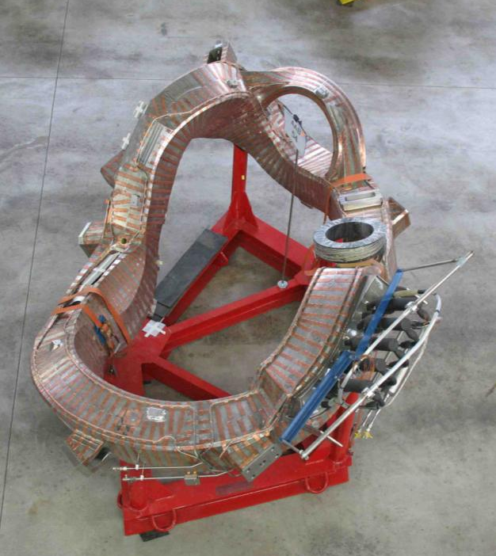
Non-planar coils

Slide 8
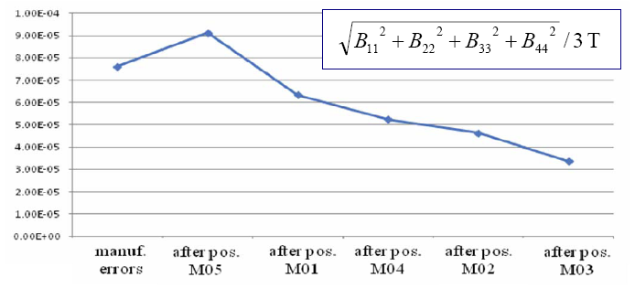
Accuracy of the modular coils
All fourier components B_{mn} have to be smaller than 2⋅10⁻⁴ B₀ (in particular B₁₁ and B₂₂ )
Manufacturing (soft Al-conduit)
Assembly
Careful adjustments of single coils
and coil modules has improved the
symmetry
- systematic errors
(maintaining symmetry)
- statistical errors
(break of symmetry)
2 mm
1 mm
B_{mn} /B₀ ≈ 0.4-0.8 ⋅10⁻⁴
8⋅10⁻⁵
Andreeva et al.,
Fusion Engineering and Design 84(2009) 408
type 1
type 2
type 3
type 4
type 5
3⋅10⁻⁵

Slide 9
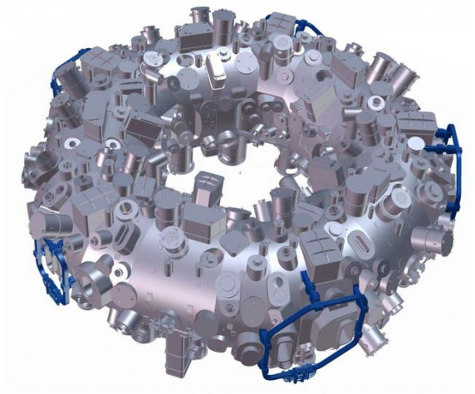
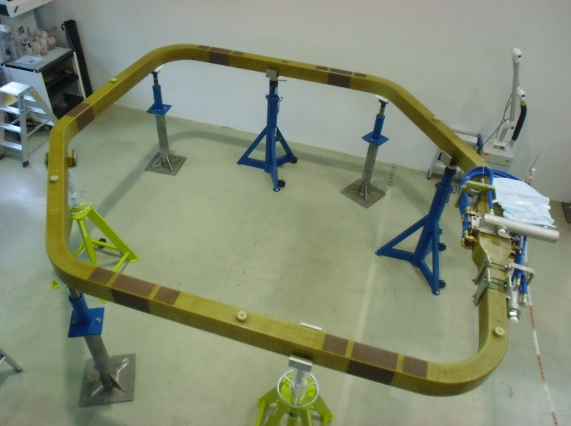

The trim coils
five external saddle coils
controlling the helical magnetic axis and the magnetic edge region
water cooled copper coils
2 kA maximum nominal current
maximum sweep frequency 10 Hz
PPPL collaboration US DOE funded
fabrication of coils ongoing, 4/5 have been delivered

Slide 10
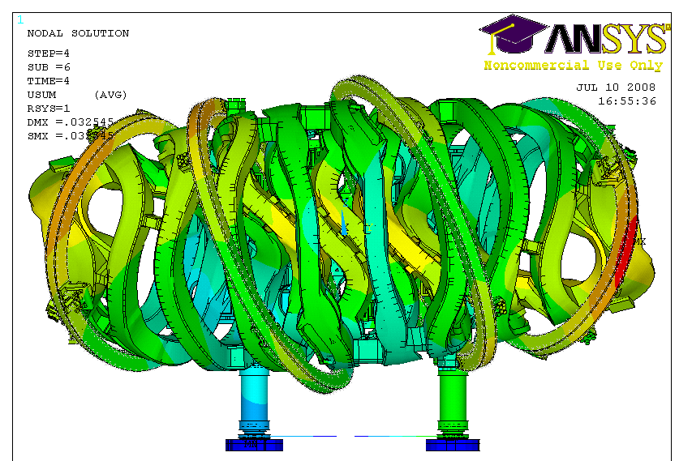
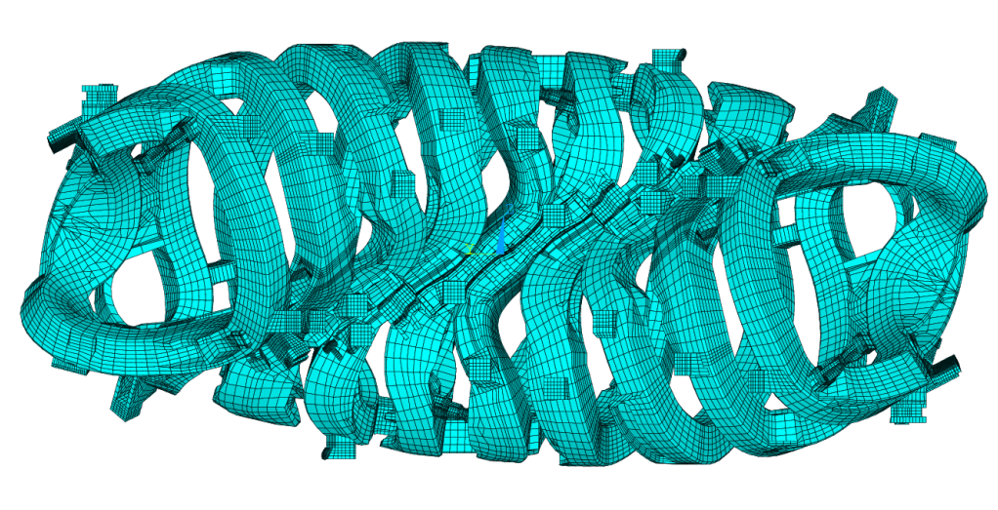
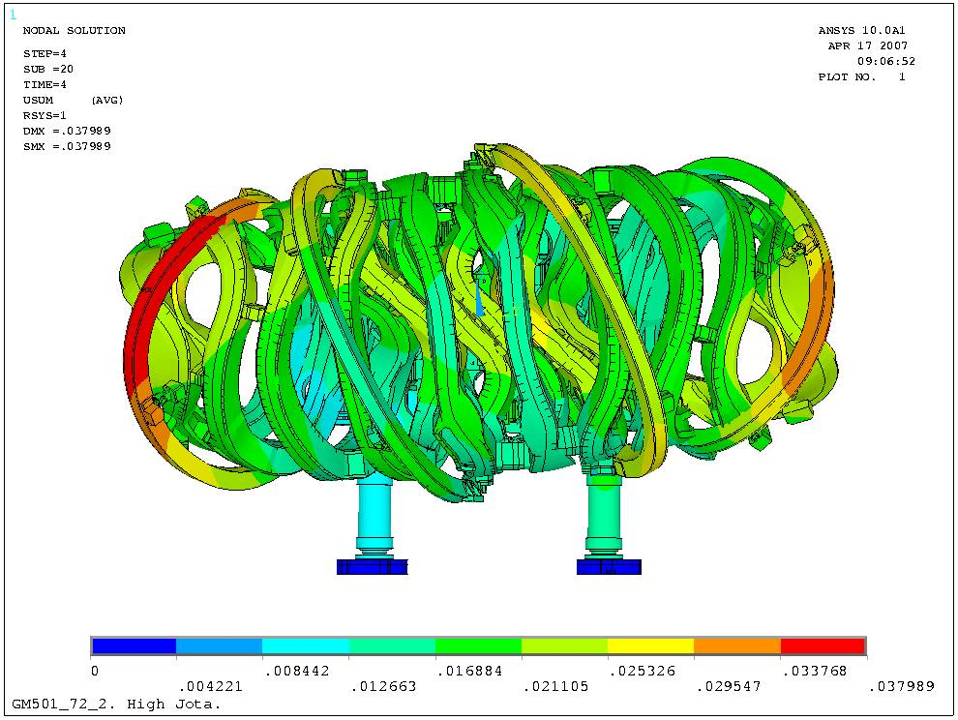
Challenge: mechanical structure
Magnet global ANSYS® model
72° = 1/5 of the torus = 1 module
0.85M nodes
0.0036
0.0109
0.0181
0.0253
0.0326
0.0072
0.0146
0.0217
0.0289
[m]
Bykov et al., Fusion Engineering and Design 84(2009) 215
Serious overloads in support structure
No solution for narrow supports (forces up to 1.5 MN, sliding by 5 mm)

Slide 11
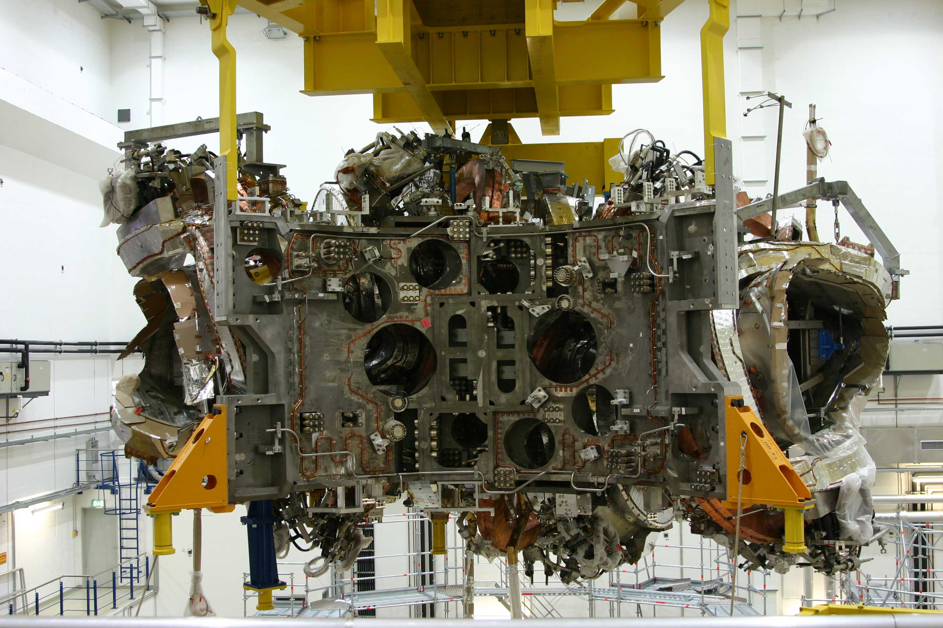
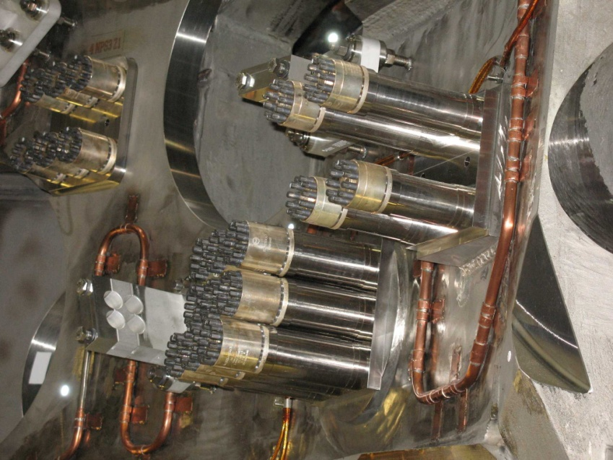
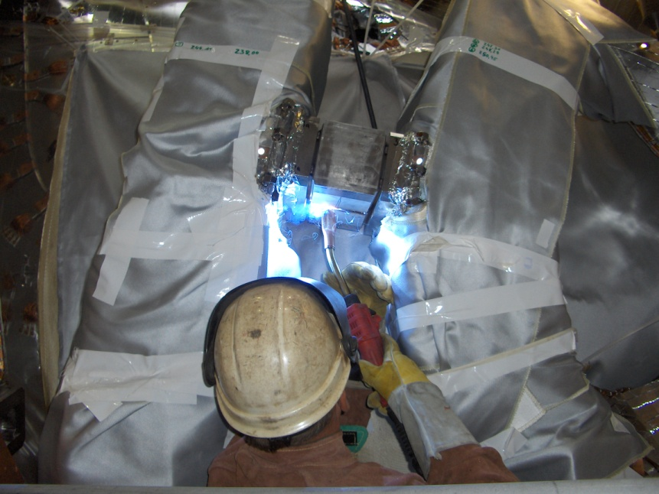
Final structural concept
Massive increase/modification of welds, ribs, stiffeners
Combination of welded, bolted and sliding contact elements
  Inconel bolts, inconel sleeves, and superbolt nuts
  Sliding Al-bronze elements with MoS₂ coating
  Welded steel blocks where unavoidable, challenging
  welding techniques

Slide 12
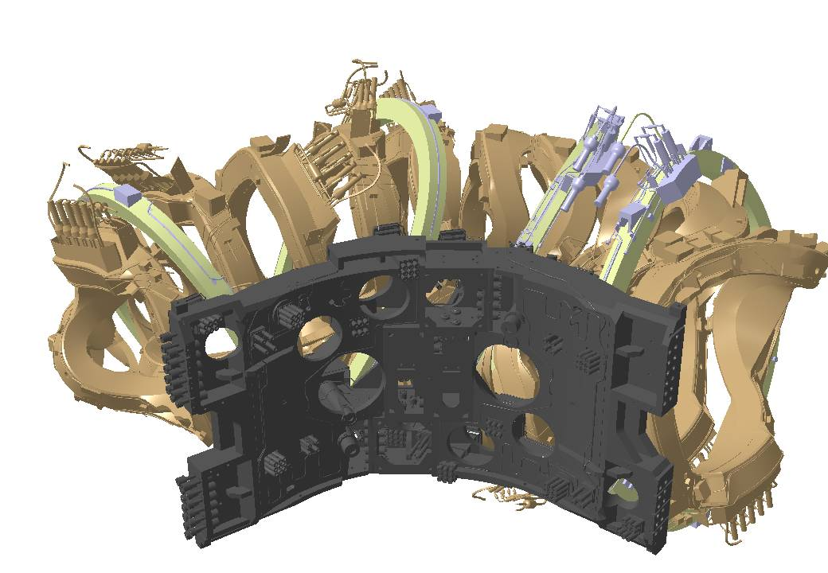
Challenge: Electric/hydraulic connection of magnets

Slide 13
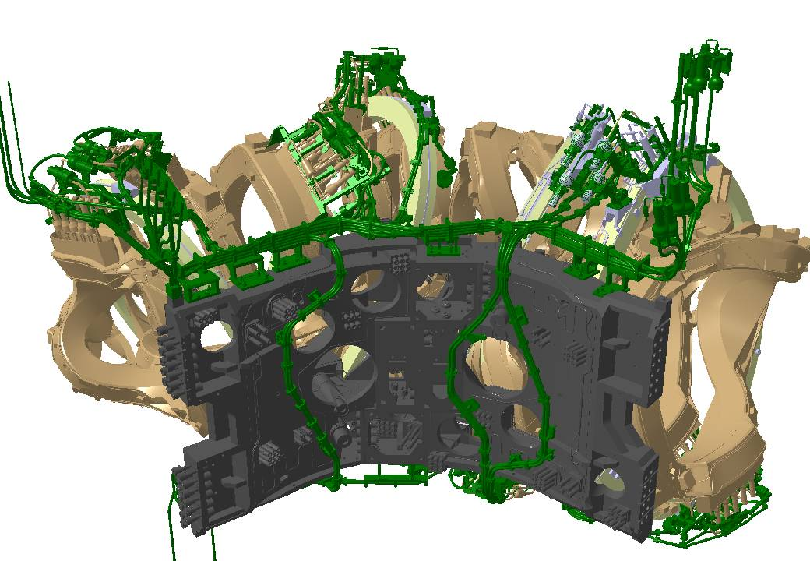
Magnet module with bus-bars

Slide 14
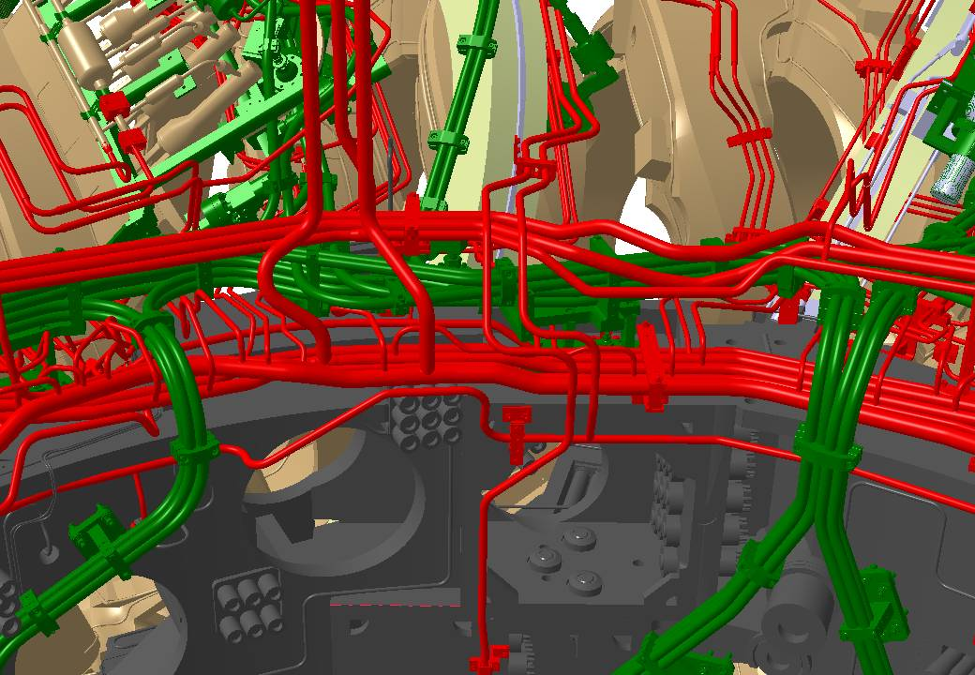
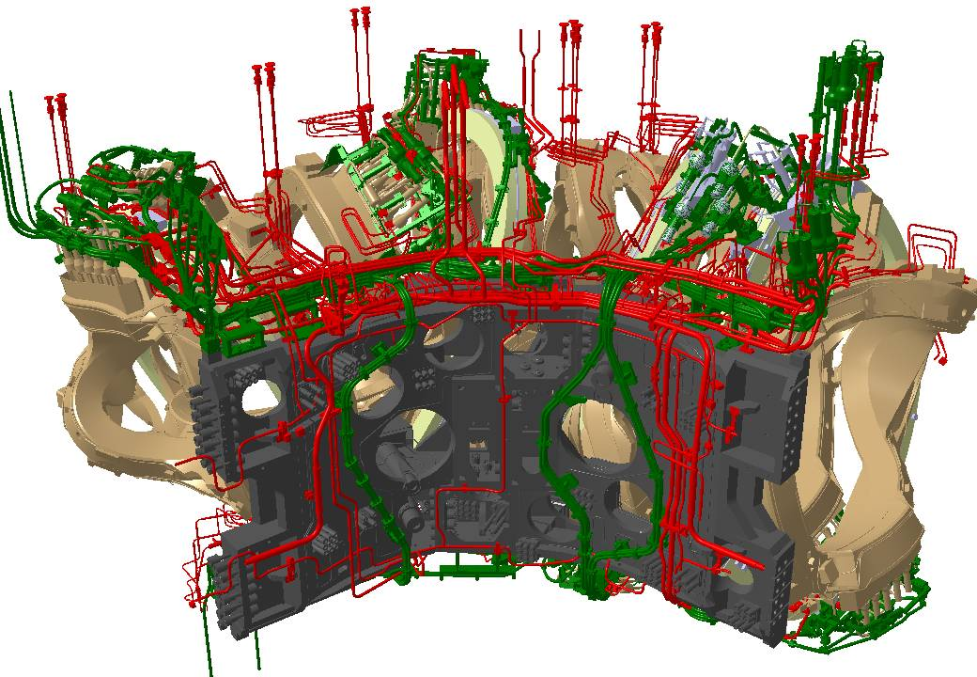
Magnet module, bus-bars and cryo-piping

Slide 15
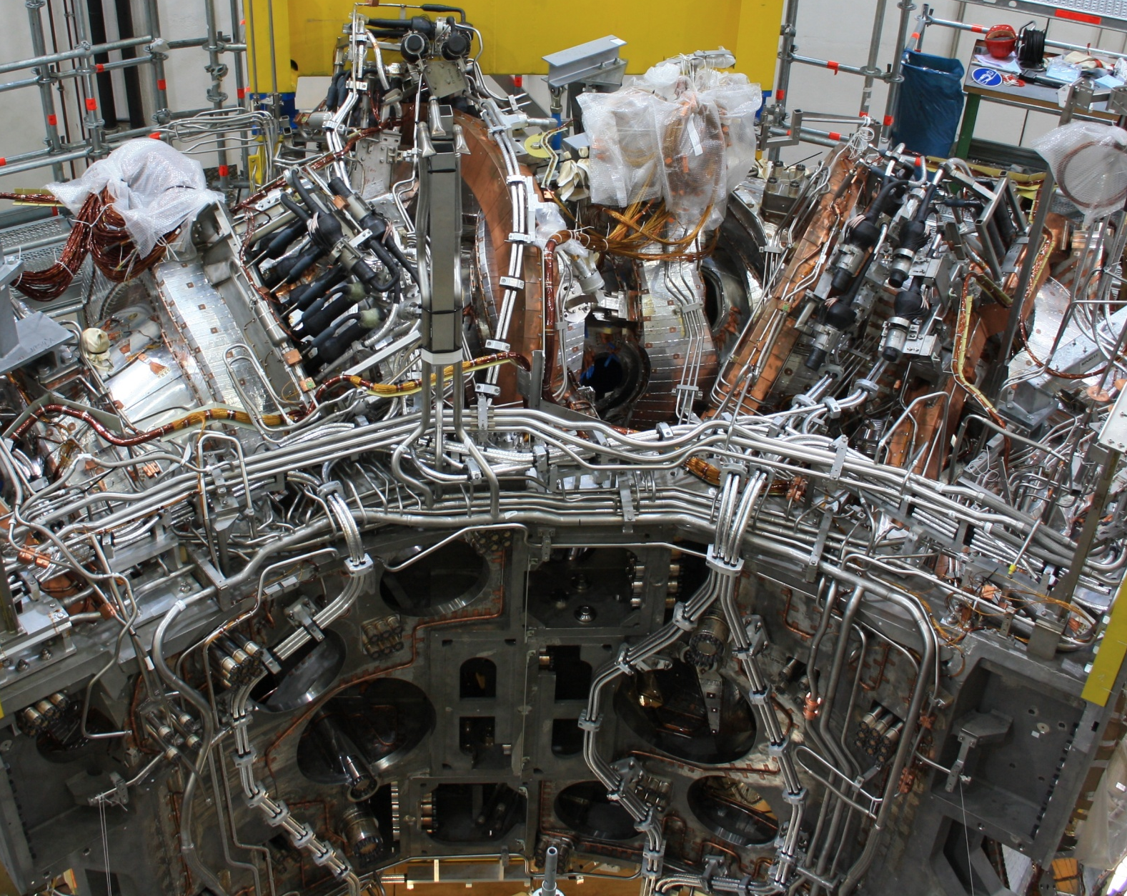
Reality
300 steel pipes and 24 superconducting bus-bars per module
more than 500 welds and 24 superconducting joints per module
three-dimensional stellarator geometry
motion of magnets for different magnetic configurations up to
+/- 15mm
extremely limited space available in the cryostat
  ⇒ - complex system of clamps and holders, stiff
  and flexible at the same time
- demanding design, engineering & manufacturing,
- complex change management
- intense metrology

Slide 16
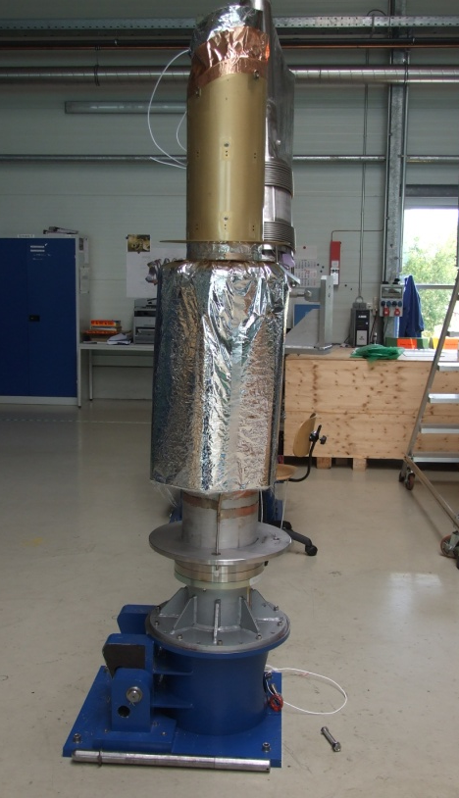
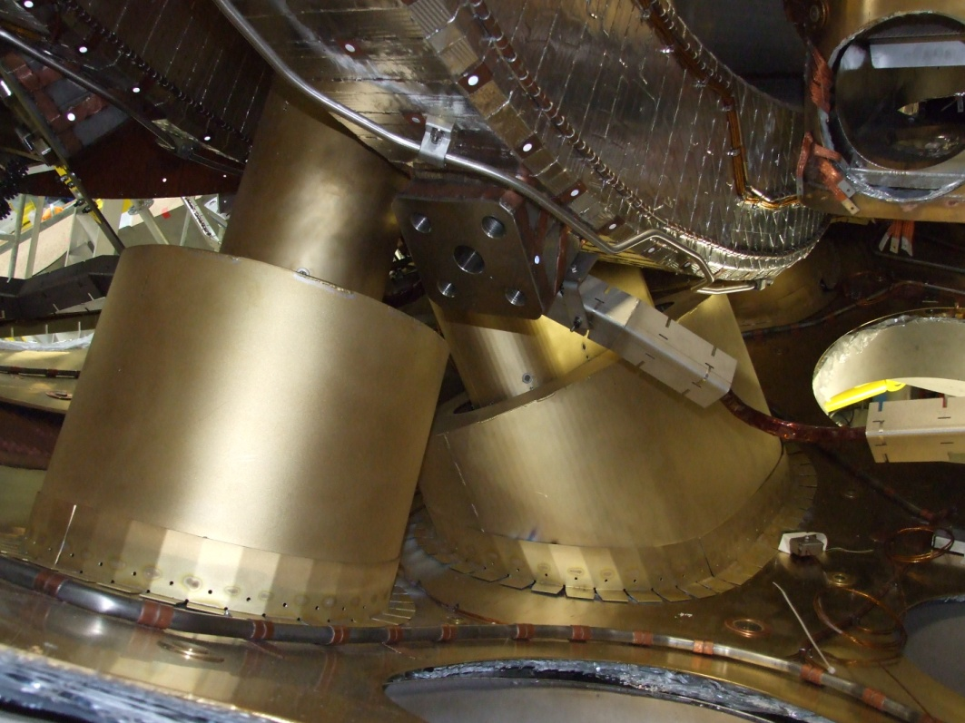
Challenge: welding of ports
ports cross the cryo-vacuum
to be welded to plasma vessel and outer vessel
intermediate bellows allow for small deviations only
tight space conditions in cryo-vacuum
thermal insulation has to be fitted to vessel TI
⇒ high positioning and welding accuracy required

Slide 17
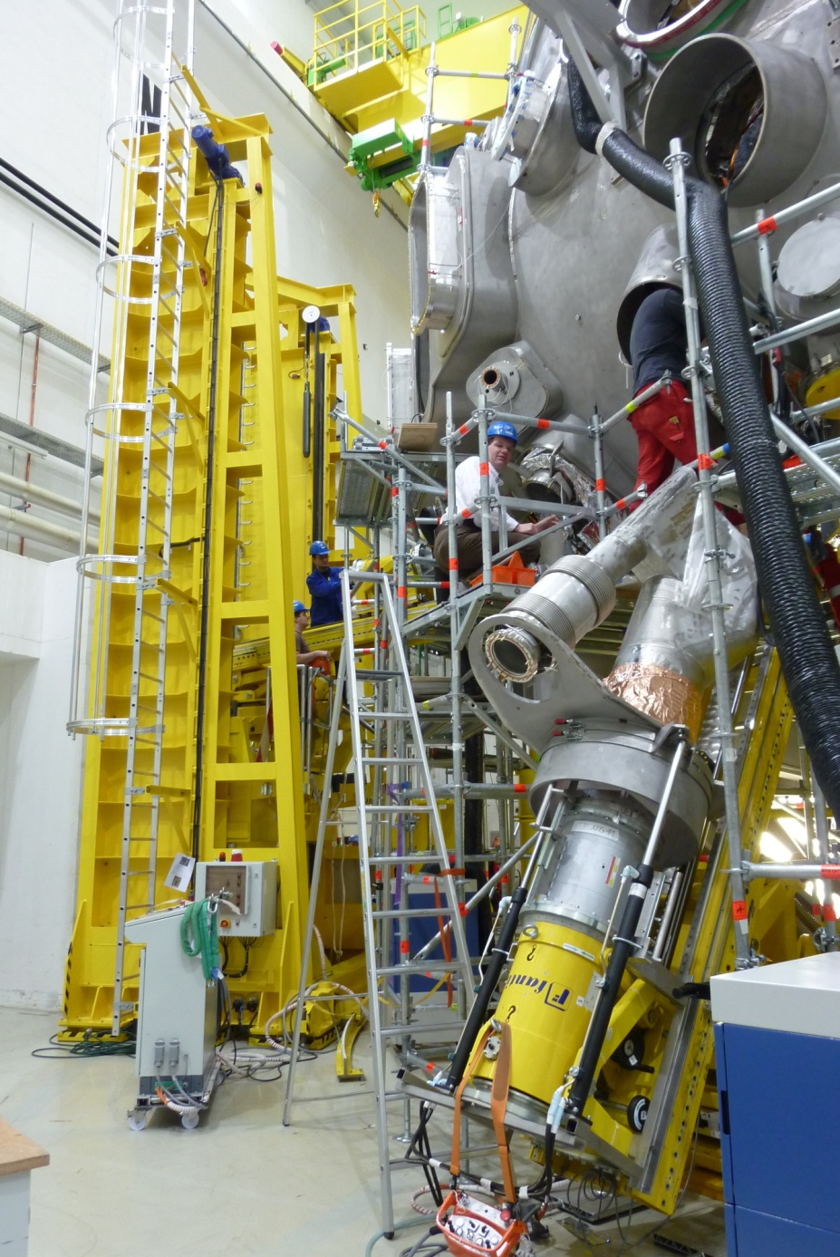
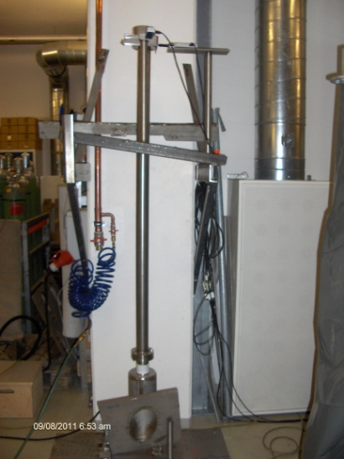
Demanding requirements for installation of ports
1) exact positioning of port with thermal insulation
⇒ special port assembly tool developed
2) extremely high welding accuracy required
⇒ - extended metrology effort
- development of new welding procedures
- parallel welding/cooling to avoid distortions
- hot straigthening to correct deformations

Slide 18
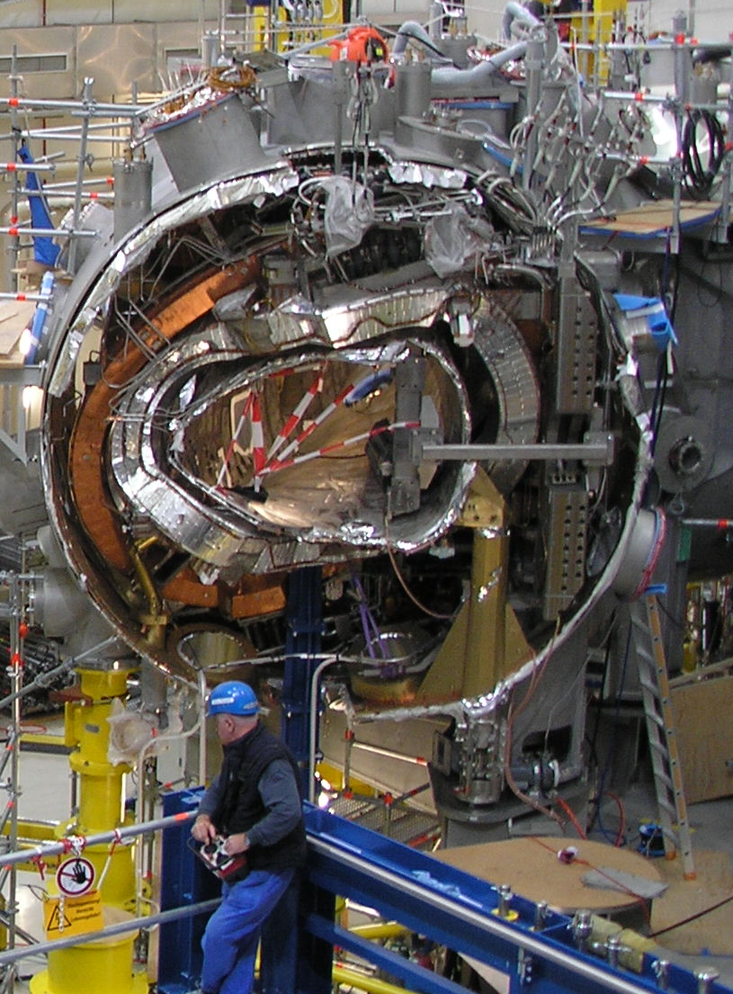
Challenge: connection of modules
  Bolting the central magnet support structure
  Assembly of connection elements between coils
  Connection of the thermal insulation of the Plasma Vessel
  Welding of the Plasma Vessel
  Connection of the Outer vessel’s thermal insulation
  Welding of the Outer vessel
  Connection of He lines and bus bars
  Installation of ports
connection of coils with +/- 0.1 mm,
welding of vessels with +/- 5 mm
required extensive developments

Slide 19
Outline
Introduction
Technical challenges of components
Assembly status and future work packages
Outlook: commissioning, operation
Conclusions

Slide 20
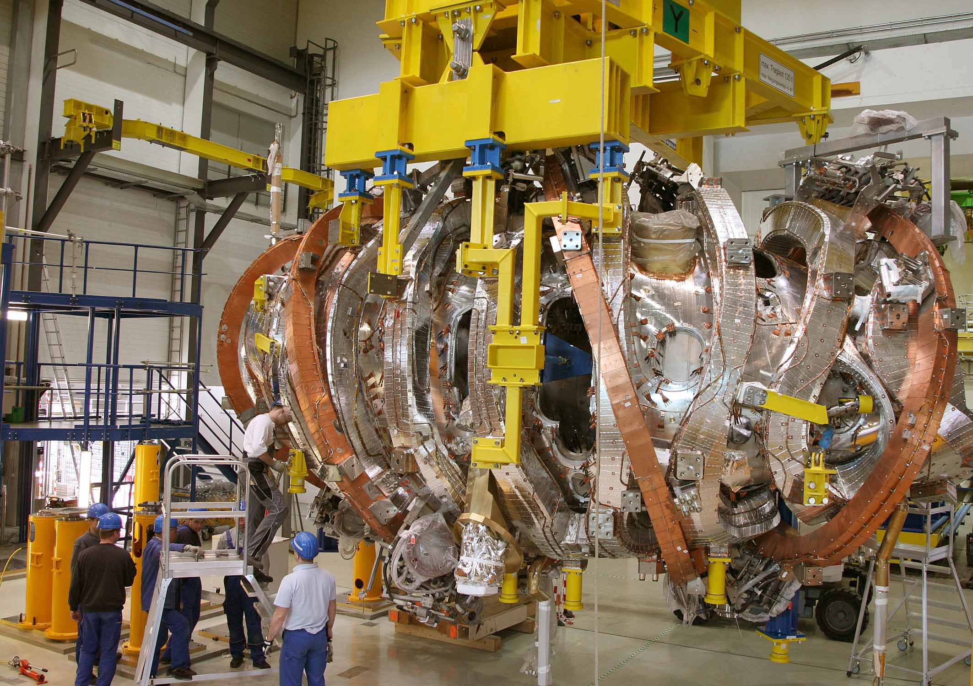
All magnet modules completed (12/10)

Slide 21
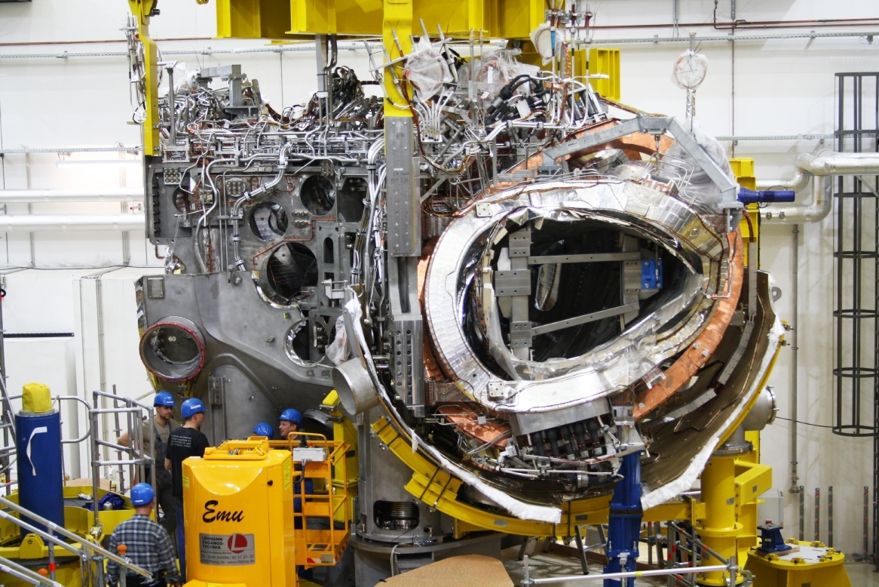
1st magnet module in lower shell of cryostat (10/09)

Slide 22
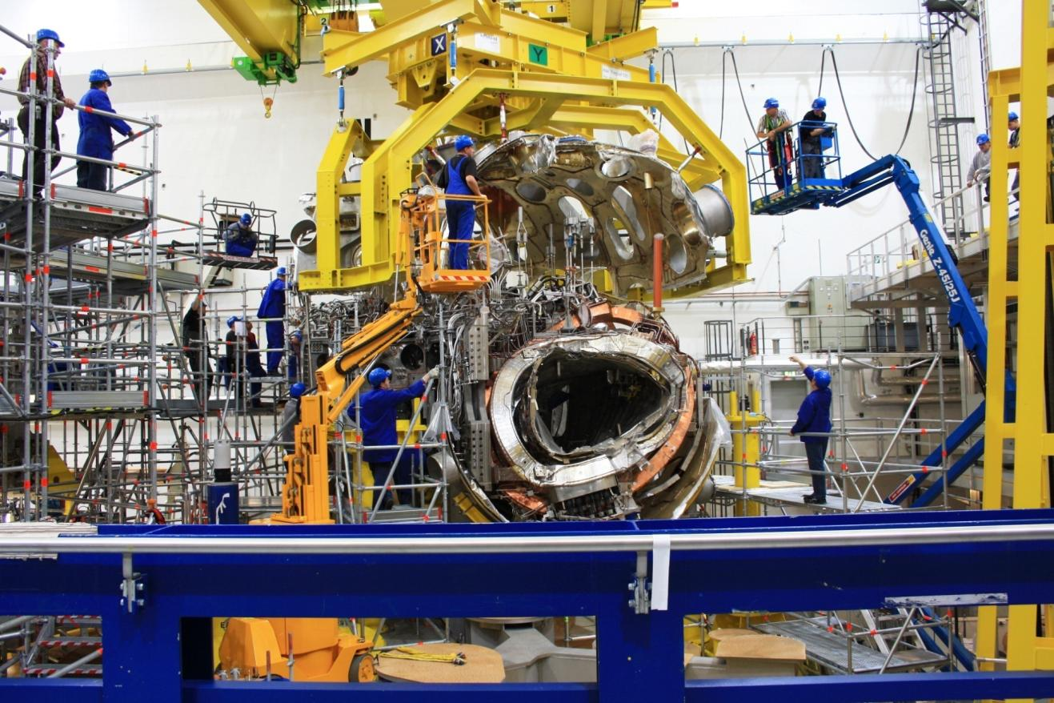
1st upper shell of cryostat assembled (11/09)

Slide 23
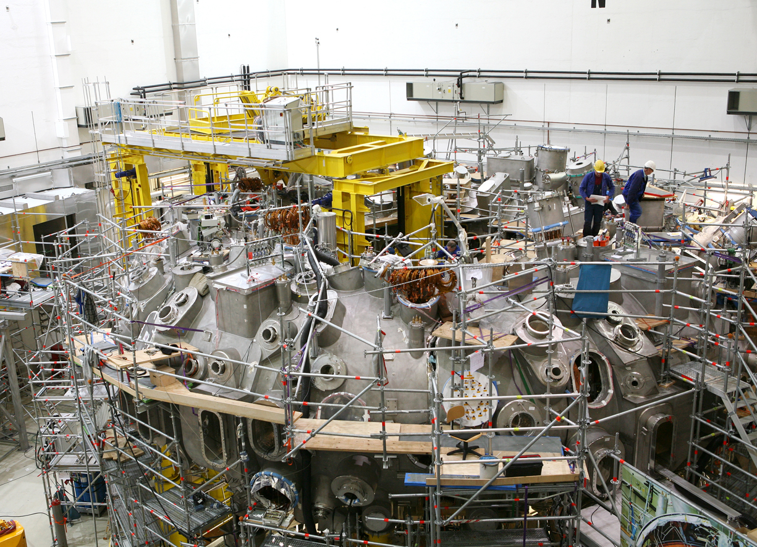
Today‘s view of the torus hall
all 5 modules are completed on the machine base
assembly of the 254 ports close to completion
3 out of 5 module separation planes closed
In-vessel assembly works have started

Slide 24
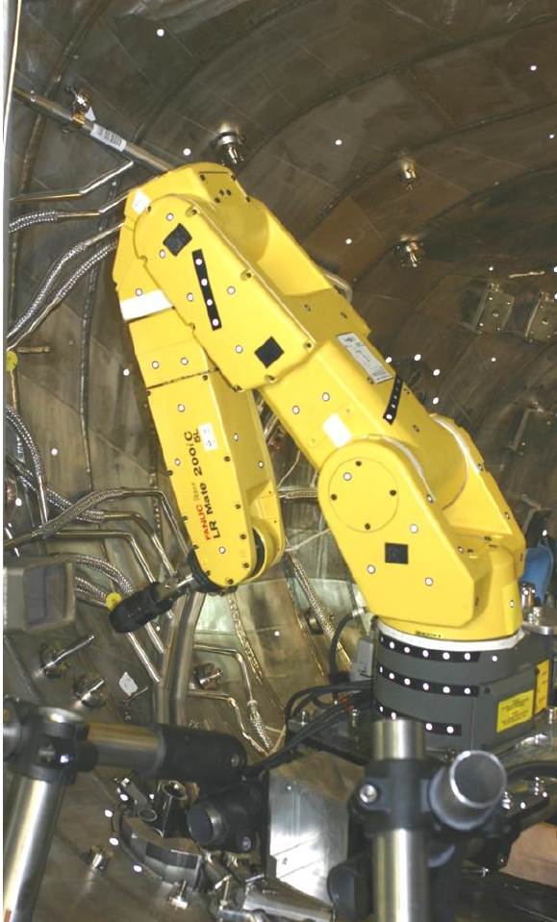
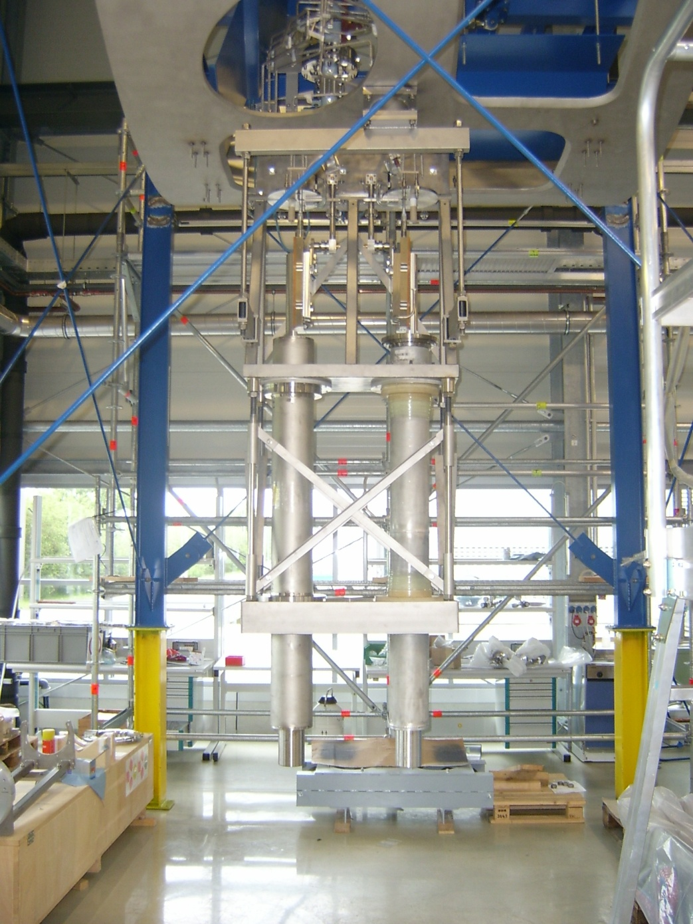
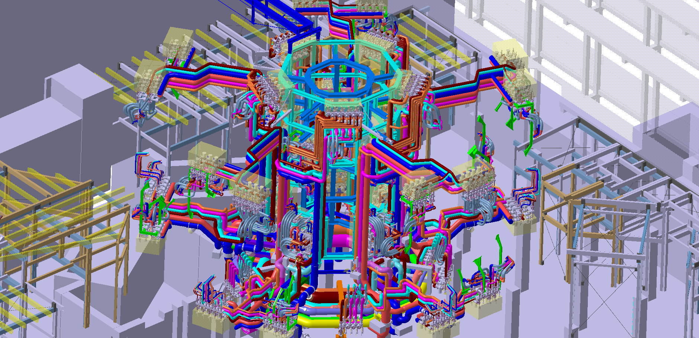
Three remaining work packages
assembly of ~ 2500 large
3d-shaped water-cooled
in-vessel components
1
assembly of 14 HTSC
current leads for seven
18kA current circuits
2
3
assembly of water cooling pipes, cryo supply, cable trays,
platform, heavy duty structure, diagnostics, heating systems

Slide 25
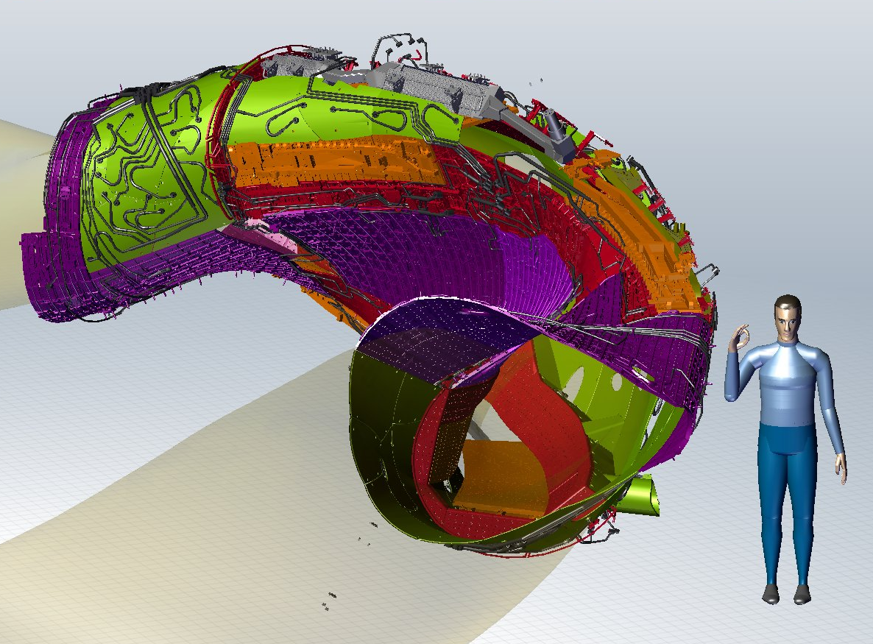
In-vessel components
control coil
cryo pump
test divertor unit
baffle
wall panels
divertor closure
complete coverage of plasma vessel
2500 major components
265 m², ∼34 tons

Slide 26
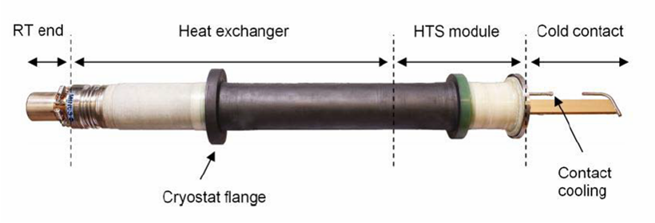

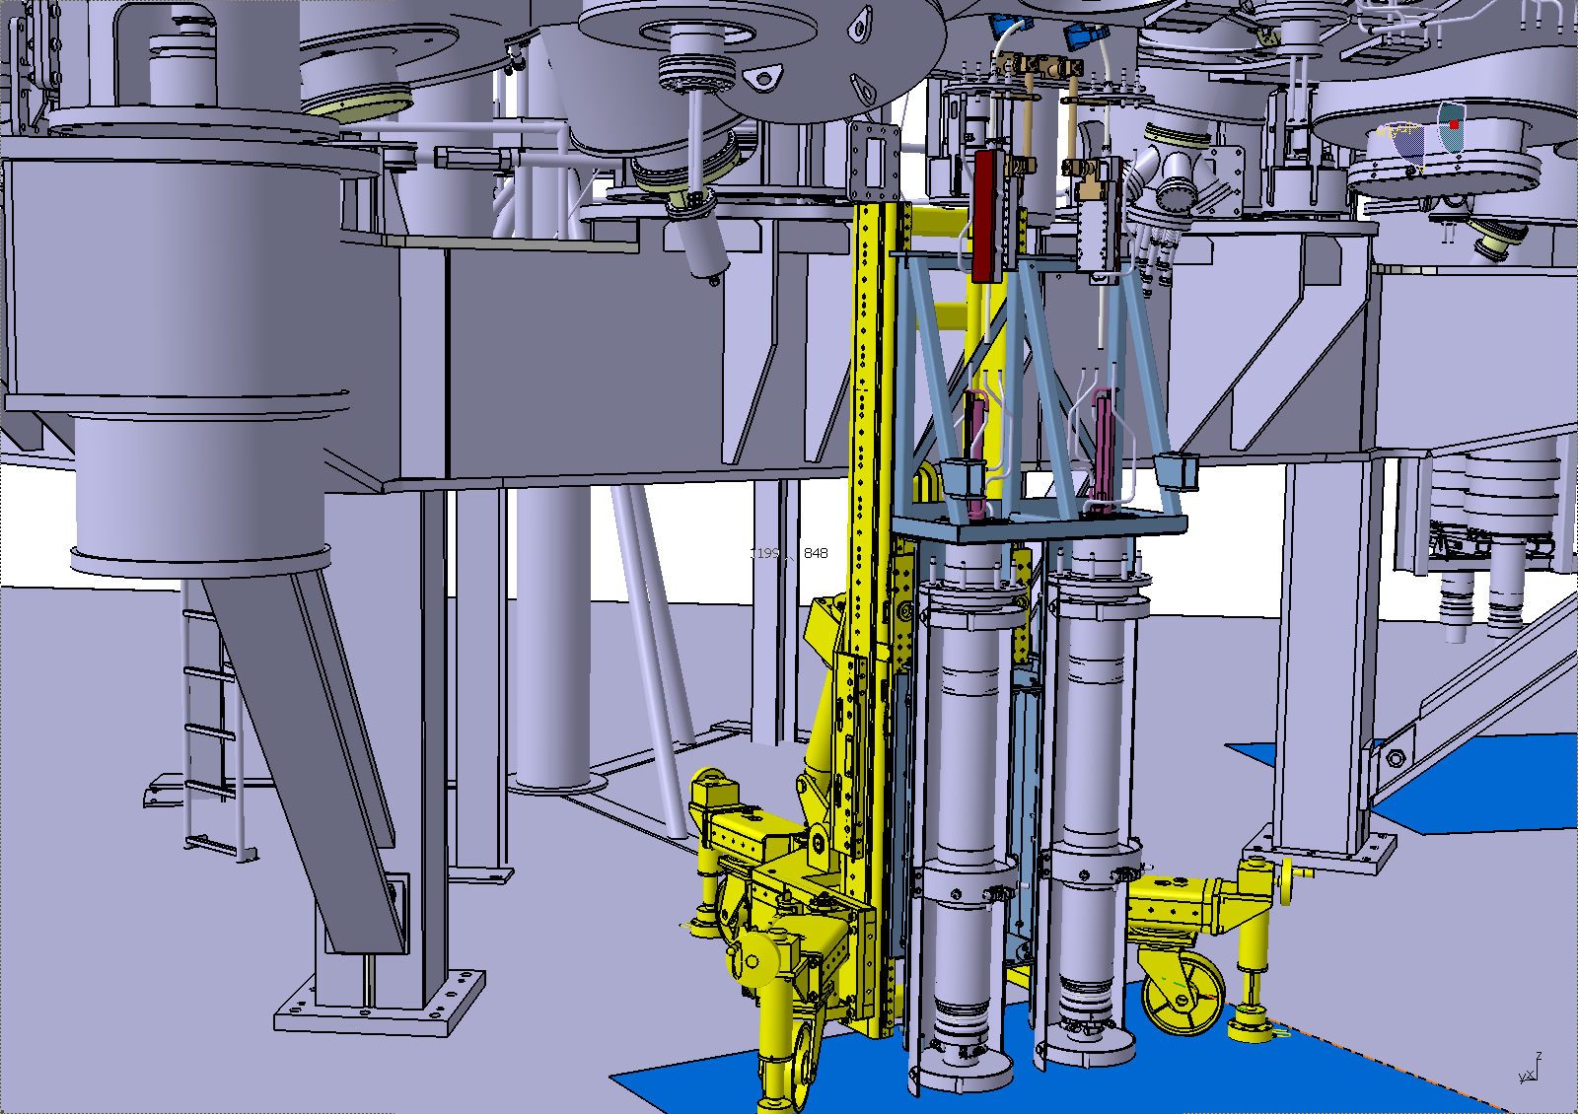

Current lead assembly
18.2 kA upside-down design
successfully tested @ 4K
Heller et al., Fusion Engineering and Design 86(3-6) 1422-1426 (2011)
assembly concept
based on port ramp design
fixing box concept tested
complex He-piping
narrow assembly space
qualified on a 1:1 mock-up

Slide 27
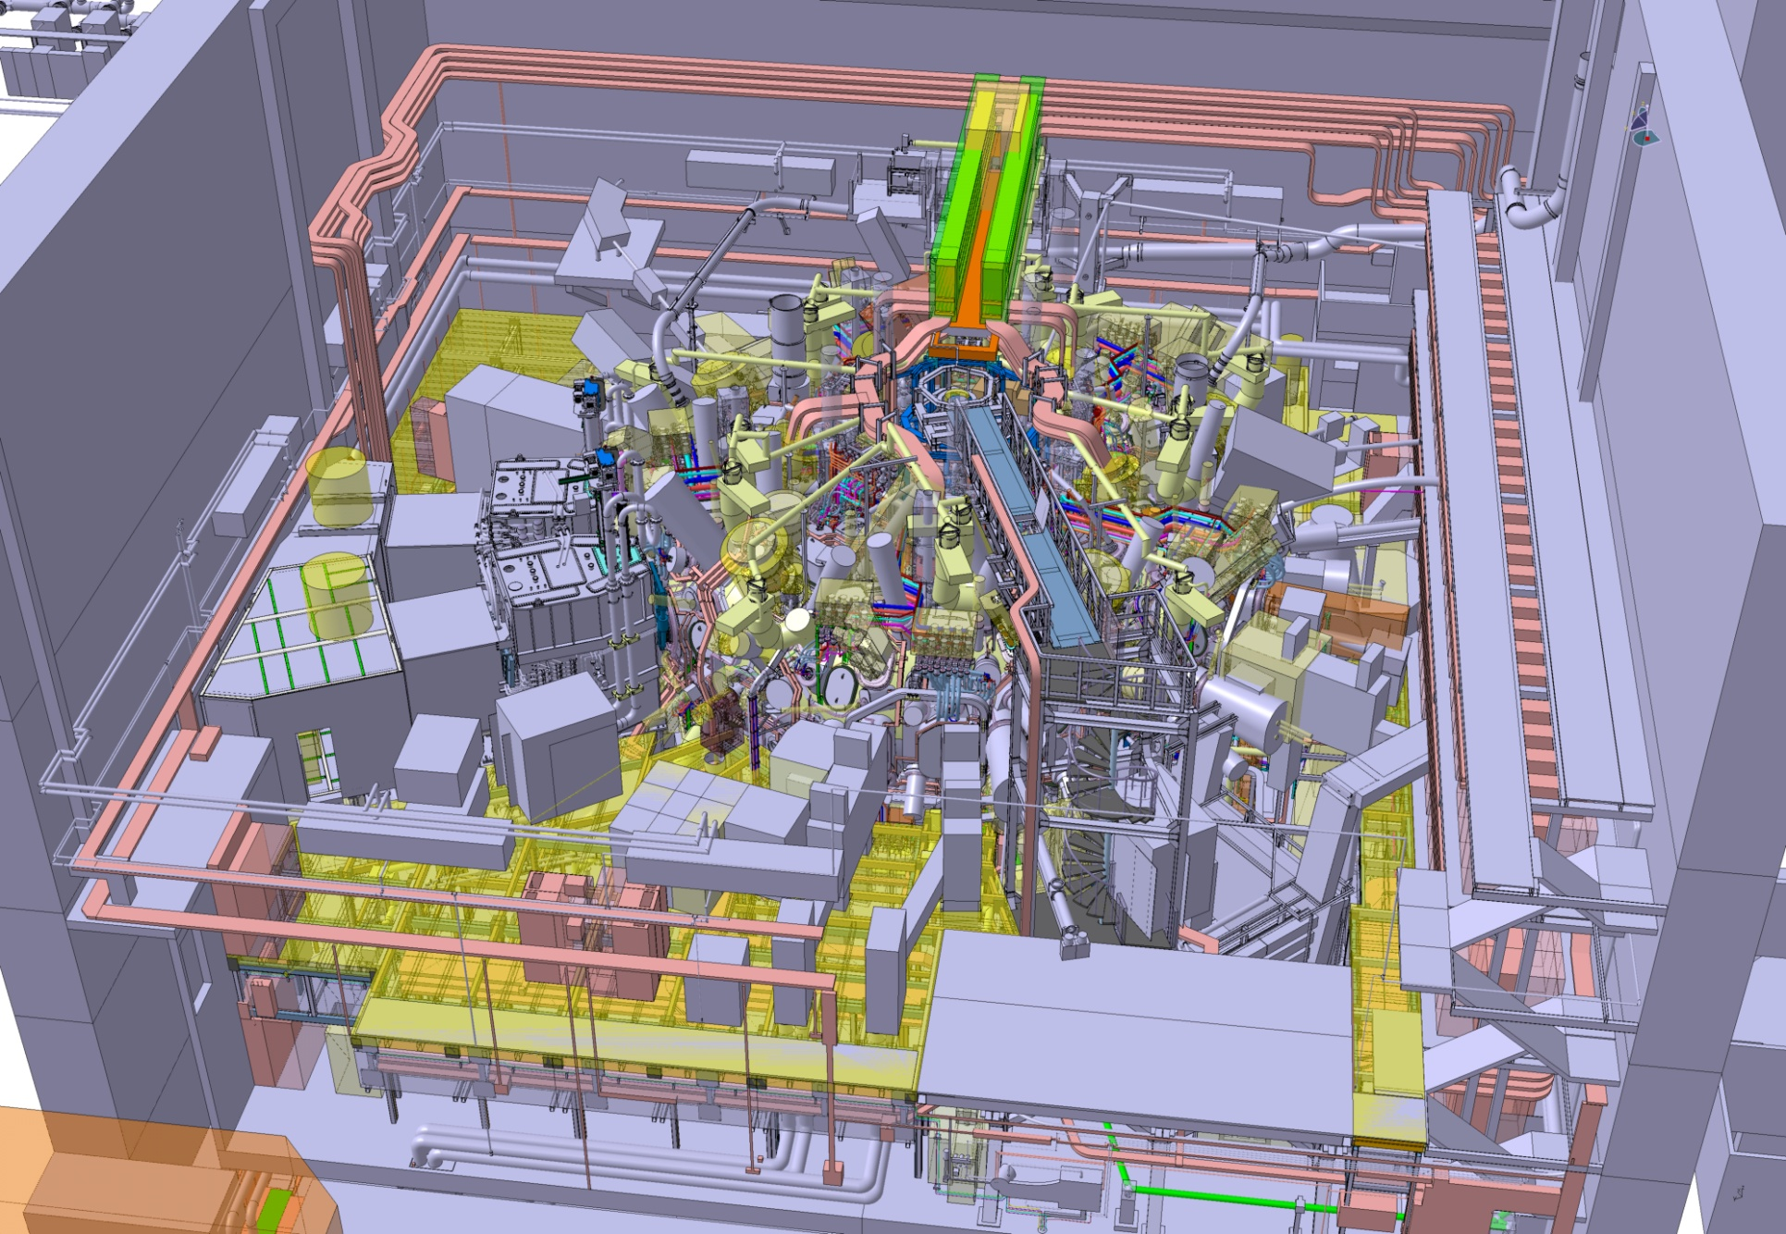
Periphery
60 single projects- project teams
diagnostics
cable trays
Thomson bridge
racks
NBI
platform

Slide 28
Outline
Introduction
Technical challenges of components
Assembly status and future work packages
Outlook: commissioning, operation
Conclusions

Slide 29
Overall schedule
completion
HHF-divertor,
diagnostics, ICRH
assembly
commissioning
commissioning
OP-1
OP-2….
2014
2015
2016
2017
2018
2019
2020
2021

Slide 30
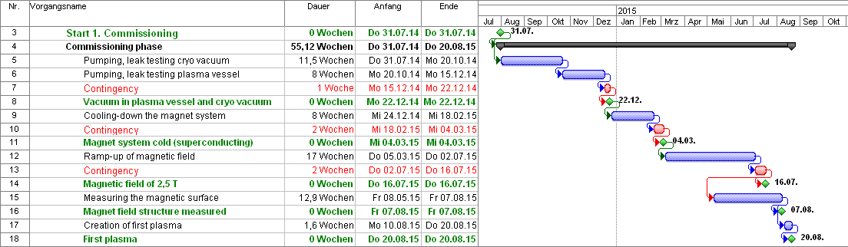
Integrated commissioning of Wendelstein 7-X
Vacuum
Cool-down
Magnetic
field
First
plasma
  All components have to bee commissioned “stand-alone” before this phase
  Integrated commissioning of the system of four major work packages
  first planning of the four work packages available
  milestones have been identified
  detailed planning has to be worked out (optimization of work steps)

Slide 31
Research program
Operational phase 1 (OP-1)
inertially cooled divertor, only partial cooling of in-vessel components
up to 10 s at 10 MW, 50 s at 1 MW heating power
check of the optimisation concept of Wendelstein 7-X
development of steady state scenarios (high-density scenario with
configuration control and edge conditions suitable for divertor operation)
Operational phase 2 (OP-2)
High Heat Flux divertor, water cooling of in-vessel components
steady state at 10 MW, 10 s at 18 MW heating power
transition to high power steady state operation (30 min)
for details of the scientific program see
FTP/P1-23
R. Wolf

Slide 32
Conclusions
Most components for Wendelstein 7-X have been finished and tested
Assembly of the device has progressed well
Schedule has been constant for the last five years
Still challenging work packages are ahead of us
Assembly will be finished in 2014
Commissioning is being prepared
A research plan for the first two years (OP-1) is being developed
W7-X programm committee will be established shortly

Slide 33
Thank you very much!

Slide 34
Major components of Wendelstein 7-X
cryostat vessel
~ 500 openings
254 ports
access domes and instrumentation plugins
SC bus bar
3d-shaped
plasma vessel
He pipes
2500 in-vessel
components
cryo feet
machine base
14 HTSC
current leads
plasma
50 non-planar
20 planar SC coils
thermal insulation
MLI and He gas cooled shield
central support ring

