Slide 1
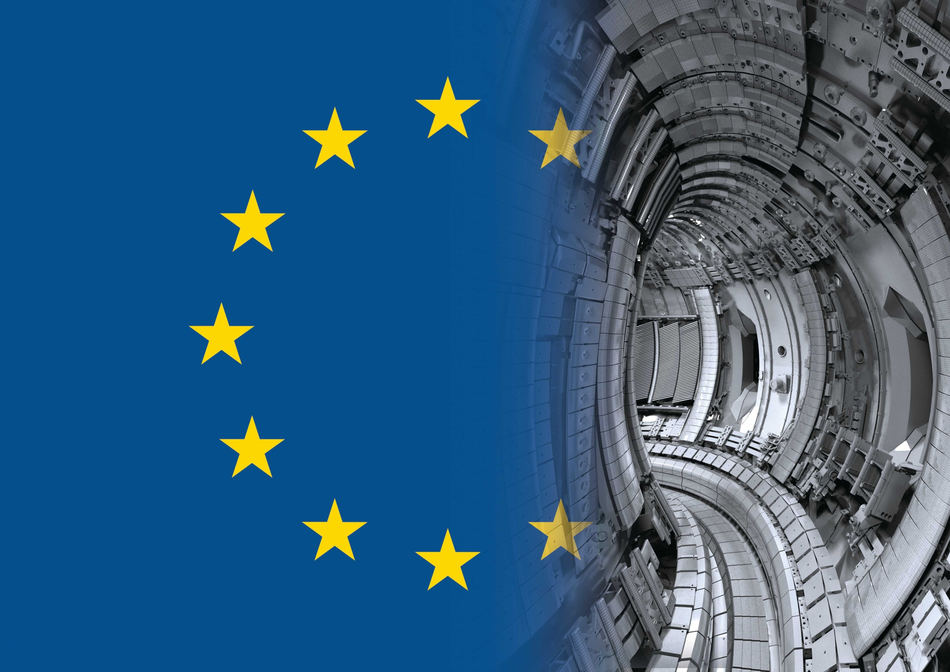
Fuel Retention Studies with the ITER-like Wall in JET
S. Brezinsek
T. Loarer
V. Phillips
H.G. Esser
S. Grünhagen, R. Smith
R. Felton, U. Kruezi and JET-EFDA contributors
IAEA 24th Fusion Energy Conference / San Diego / 8.-13. October 2012

Slide 2

Contributors
S. Brezinsek¹, T. Loarer², V. Philipps¹, H.G. Esser¹, S. Grünhagen³, R. Smith³, R. Felton³
U. Kruezi¹, J. Banks³, P. Belo⁴, J. Bucalossi² , M. Clever¹, J.W. Coenen¹, I. Coffey⁵, D. Douai²
M. Freisinger¹, D. Frigione⁶ , M. Groth⁷, A. Huber¹, J. Hobirk⁸, S. Jachmich⁹, S. Knipe³
G.F. Matthews³, A.G. Meigs³, F. Nave⁴, I. Nunes⁴, R. Neu⁸, J. Roth⁸, M.F. Stamp³
S. Vartagnian², U. Samm¹ and JET EFDA contributors
¹Institute of Energy and Climate Research - Plasma Physics, Forschungszentrum Jülich,
Association EURATOM-FZJ, Trilateral Euregio Cluster, 52425 Jülich, Germany
²CEA, IRFM, F-13108 Saint-Paul-lez-Durance, France
³EURATOM/CCFE Fusion Association, Culham Science Centre, Abingdon, OX143DB, UK
⁴Institute of Plasmas and Nuclear Fusion, Association EURATOM-IST, Lisbon, Portugal
⁵Queen's University Belfast, BT71NN, UK
⁶Associazione EURATOM-ENEA sulla Fusione, CP 65, Frascati, Rome, Italy
⁷Aalto University, Association EURATOM-Tekes, Espoo, Finland
⁸Max-Planck-Institut für Plasmaphysik, EURATOM Association, D-85748 Garching , Germany
⁹Association EURATOM-Belgian State, ERM/KMS, B-1000 Brussels, Belgium
Main author contact:
S.Brezinsek@fz-juelich.de

Slide 3
Outline
Motivation: Limitation in long term fuel retention in ITER
Retention mechanisms and measurement techniques
Experimental results with the ITER-like Wall in JET
Conclusions for ITER

Slide 4
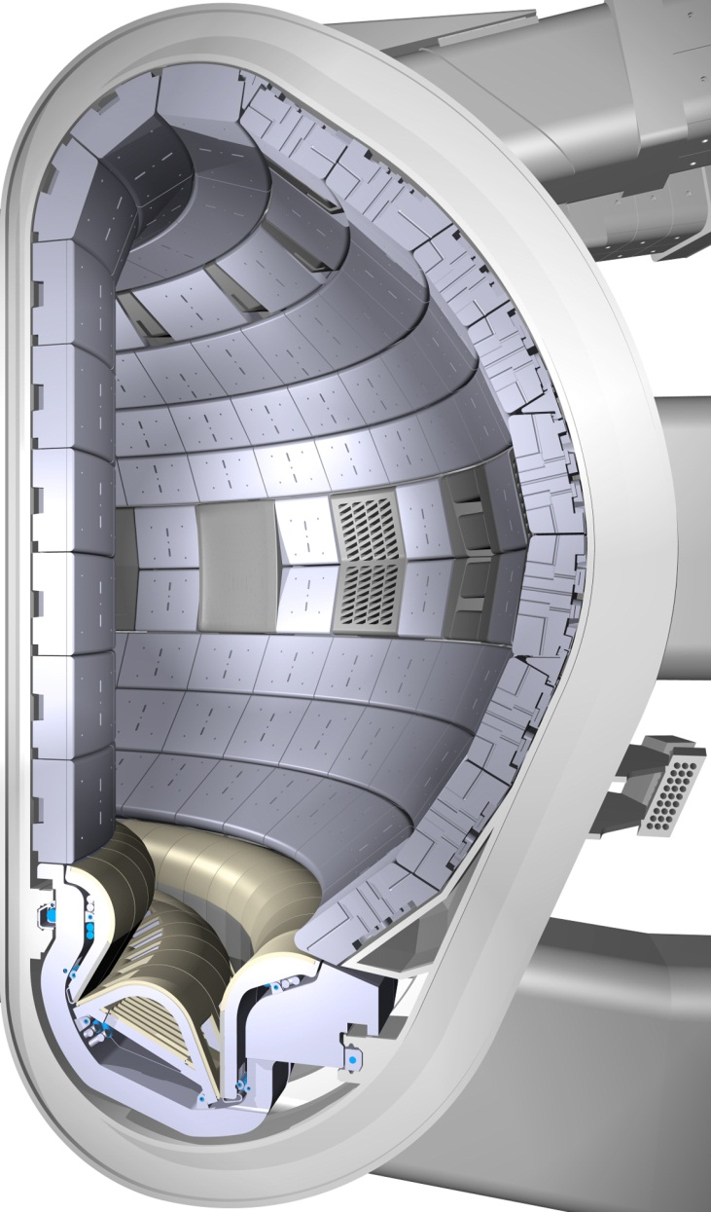
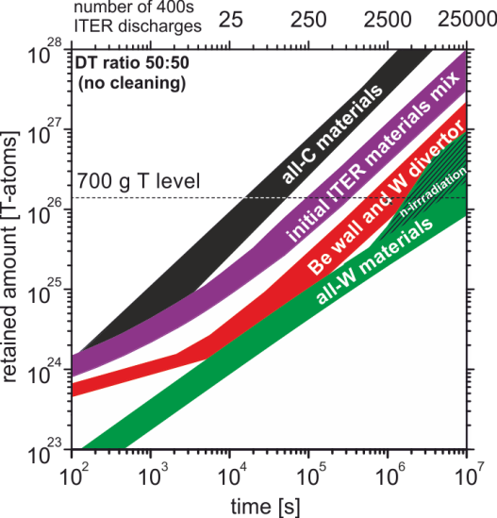
Material Combinations in ITER
Critical issues: safety and lifetime
„or“ fuel retention and first wall erosion
ITER
Beryllium
ITER
Tungsten
~1 year full DT
operation
J. Roth et al.
JNM 2009
http://www.iter.org/
Fuel retention predictions made on basis of CFC devices, laboratory experiments and modelling
Benchmark tokamak experiment required
Carbon

Slide 5
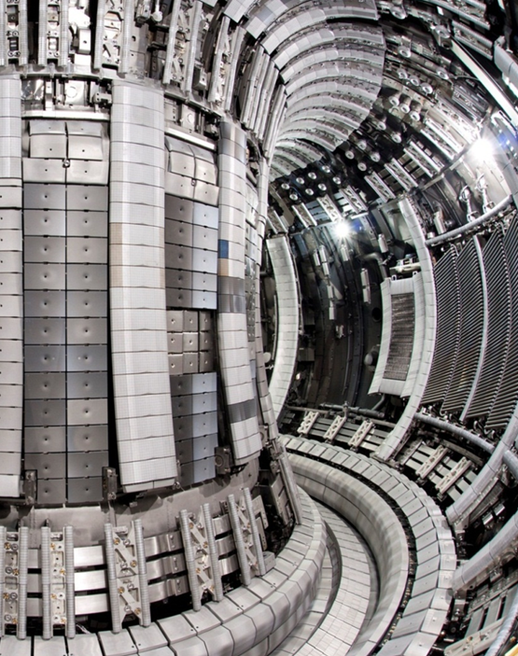
Metallic Walls: ITER-Like Wall at JET
JET ITER-Like Wall
ITER-material mix used for the first in a tokamak
Expected “carbon-free” environment
  Reduced migration to remote areas
  Reduced tritium retention in codeposits
  Loss of carbon as main radiator
Beryllium
Expected change in operational space
  Better plasma control required
  Heat load mitigation schemes required
Main goals of the ILW experiment
Demonstrate low fuel retention, migration
and possible fuel recovery
Demonstrate plasma compatibility
with metallic walls
Tungsten
E. Joffrin Ex1/1
Compare ILW experiments with carbon walls
Input to the decision about the first ITER divertor

Slide 6
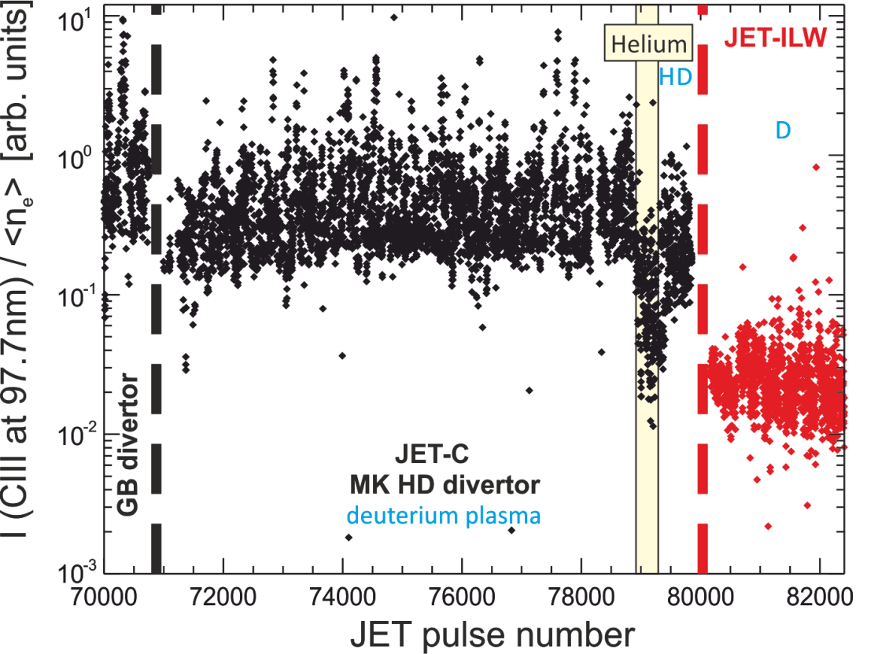
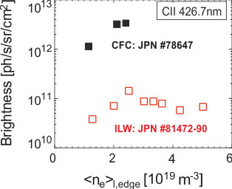
Residual C-content with the JET-ILW
Main chamber CIII and outer divertor CII edge fluxes:
Residual C dropped with ILW installation by one order of magnitude (statistical)
Dedicated JET-C/JET-ILW comparison pulses show a drop of about a factor 20
Comparison pulses: JET-CFC vs. JET-ILW
C_{C}=0.50%
C_{C}=0.05%
x20
S. Brezinsek et al.
PSI 2012
J. Coenen EXP/P5-04
Comparable C reduction also observed in core and edge concentrations by CXRS
Typical Be core concentration about 2% (comparable averaged level to C in JET-C)
Averaged Z_{eff} dropped from 1.9 (JET-C) to 1.2 (JET-ILW)

Slide 7
Retention Mechanisms
Codeposition
J. Roth et al.
JNM 2009
At JET wall temperature:
fuel content in laboratory Be layers one order lower than in C layers!
Dynamic retention: mostly recovered by outgassing in between pulses
Long term retention: remains in walls and global gas balance provides upper limit

Slide 8
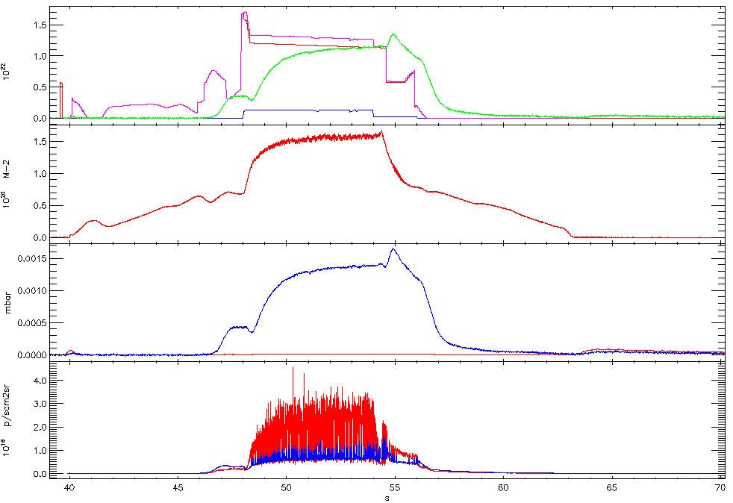
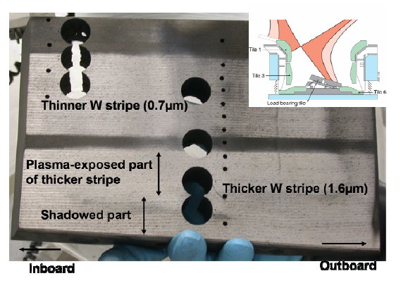
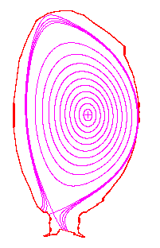
Retention Measurement Techniques
Intershot
gas balance
Global
gas balance
Post mortem
analysis
Single discharge only
Transient effect
Short-term retention
Multiple identical discharges
Includes inter-shot outgassing
Long-term retention (1 day)
All discharges of a campaign
Includes outgassing in
campaign / intervention
Long-term retention (1 year)
Γ_{in}
Γ_{out}
JET-C with W test stripe
on outer target plate
Gas
injected
n_{e}
Gas
retained
n_{pres}
Gas recovered
P. Coad et al.
Phys. Scripta 2012
φDα
This contribution:
Upper limit of D remaining in vessel
Expected in 2013:
D remaining in vessel
in codeposits and implantation
Safety Aspect: Tritium Inventory

Slide 9
Global Gas Balance Measurements
Regeneration of cryogenic pumps before and after experiment
Repeat sets identical discharges
Typical: 10-35 => one day of operation
Fuel retention:
long (co-deposition and implantation) +
short term (surface)
Calibrated particle source
(here: gas injection modules)
Gas collection on divertor cryo pumps
Injected gas = Pumped gas+ Short term retention + Long term retention
T. Loarer, V. Philipps
JNM 2010, PSI 2012
Variant 1: ohmic / L-mode => divertor cryo pumps only – rest closed (standard)
Variant 2: higher statistics / L-mode => turbo molecular pumps only – rest closed
Variant 3: H-mode => divertor and NBI cryo pumps => fraction of gas pumped by NB cryo is
calculated from pumping speed ratio with divertor cryo pump
Precision:
Better than 1.2% measured in mulitple reference calibrations
with temperature monitoring at gas injection side

Slide 10
Global Gas Balance Measurements
Regeneration of cryogenic pumps before and after experiment
Repeat sets identical discharges
Typical: 10-35 => one day of operation
Fuel retention:
long (co-deposition and implantation) +
short term (surface)
Calibrated particle source
(here: gas injection modules)
Gas collection on divertor cryo pumps
Injected gas = Pumped gas+ Short term retention + Long term retention
T. Loarer, V. Philipps
JNM 2010, PSI 2012
General observation of JET-C vs. JET-ILW comparison:
Stronger gas consumption during limiter phase and stronger outgassing after end of the discharge in comparison with JET-C => JET-ILW dynamic retention higher
High purity of recovered gas of more than 99% D => absence of hydrocarbons in later phase
Strong reduction of integrated retention by gas balance measured over one day
=> Long term retention one order magnitude lower in JET-ILW than in JET-C

Slide 11
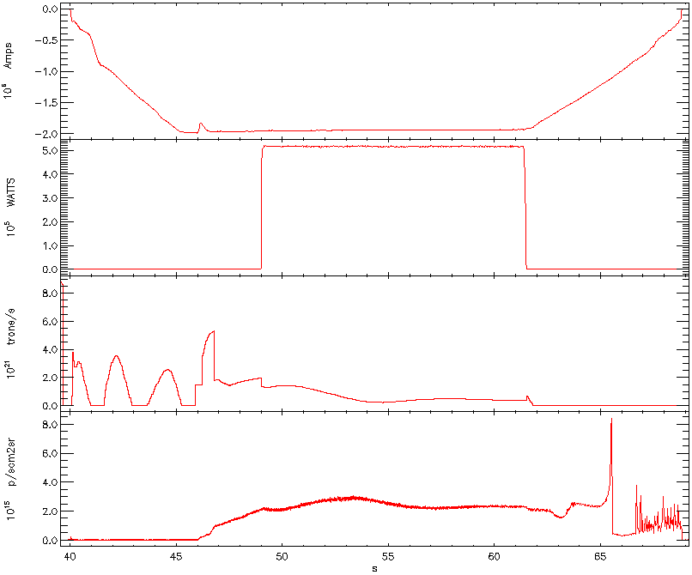
Normalisation and Fuel Retention Rates
Example: L-mode plasma experiment
Balance: particles retained = Injected particles - recovered particles
Time normalisation: time with main particle flux to divertor PFCs
-I_{p}
Divertor time ~19s
#81973
MA
P_{ICRH}
Heating time~12s
10⁵ W
L-mode
34 discharges
646 s divertor time
without divertor
cryogenic pump
Gas
10²¹ e s⁻¹
φD_{α}
(In Div)
10¹⁹ ph
s⁻¹m-² sr⁻¹
0
5
10
15
20
25
time [s]

Slide 12
Long Term Fuel Retention: Experiments
Reduction
Long term fuel retention rate below 1.5x10²⁰Ds⁻¹ (w.r.t. to divertor operation time / all scenarios)
Moderate increase of retention rate with divertor flux
Retention rate reflects the upper limit as long term outgassing reduces the inventory further
Direct comparison of JET-C and JET-ILW possible for low power discharges => for high power discharges inter-shot outgassing time is twice as long for JET-ILW

Slide 13
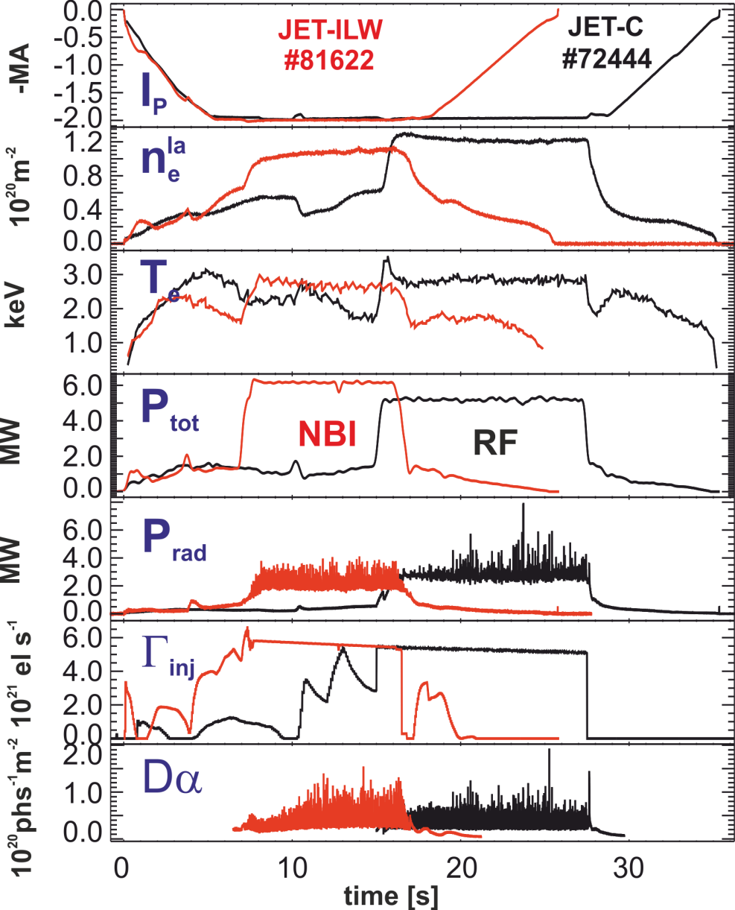
Example: type III ELMy H-mode
Comparison discharges JET-C vs. JET-ILW:
Type III ELMy H-mode at B_{t}=2.4T
Main and edge plasma conditions are
comparable in JET-C and JET-ILW
Change of auxiliary heating required
Shorter limiter phase in JET-ILW
Retention rate drop:
JET-C => JET-ILW
1.37x10²¹ Ds⁻¹ => 7.2x10¹⁹ Ds⁻¹
JET-ILW experiment:
18 discharges
Divertor time: 317 s
Injected D₂: 2495 Pam³
Retained D₂: 47 Pam³
Normalisation to T=293.15K gas temperature

Slide 14
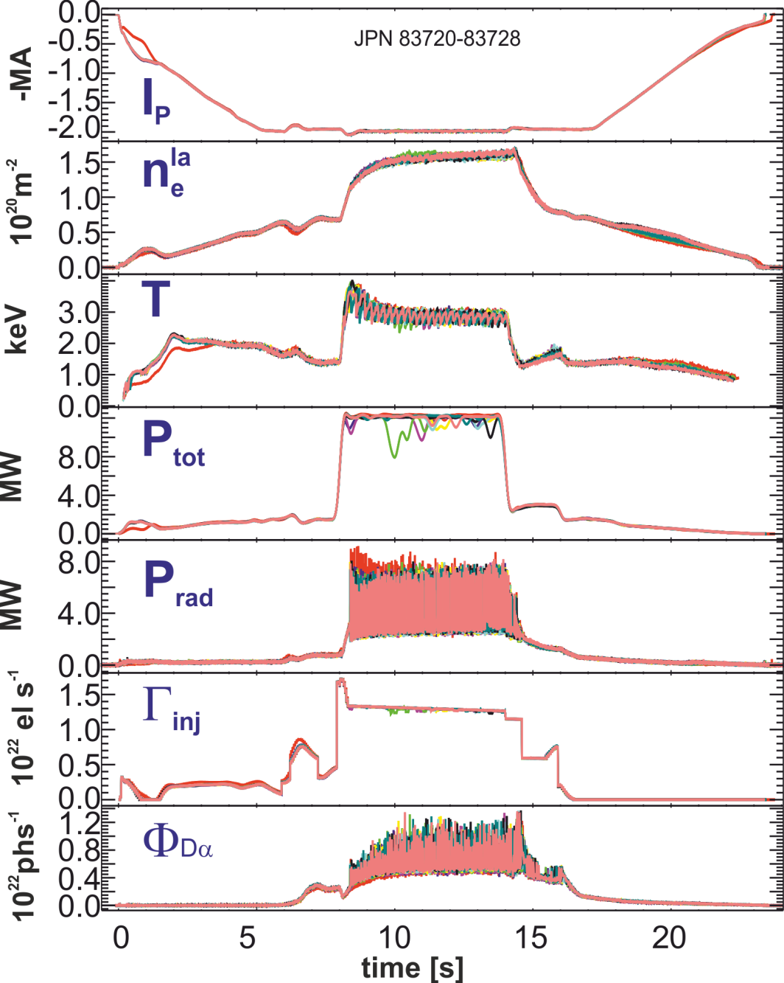
Last Experiment before Tile Intervention
151 comparable discharge in H-mode
(I_{p}=2.0MA, B_{t}=2.4T, Z_{eff}=1.2, P_{aux}=12MW)
High reproducibility of discharges
2500 s plasma in divertor configuration
Time between discharges ~55 min
Divertor fluence: 5.25x10²⁶ Dm⁻²
corresponds to ¼ ITER pulse
3 dedicated gas balances over 1 day
with comparable retention rates
Comparable retention to mid-campaign gas balance experiment

Slide 15
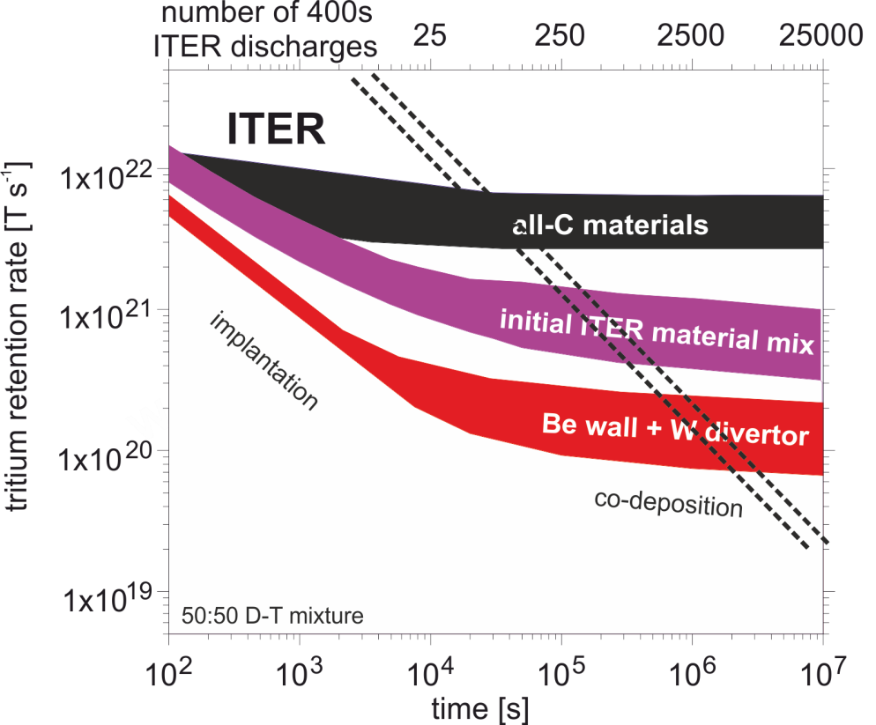
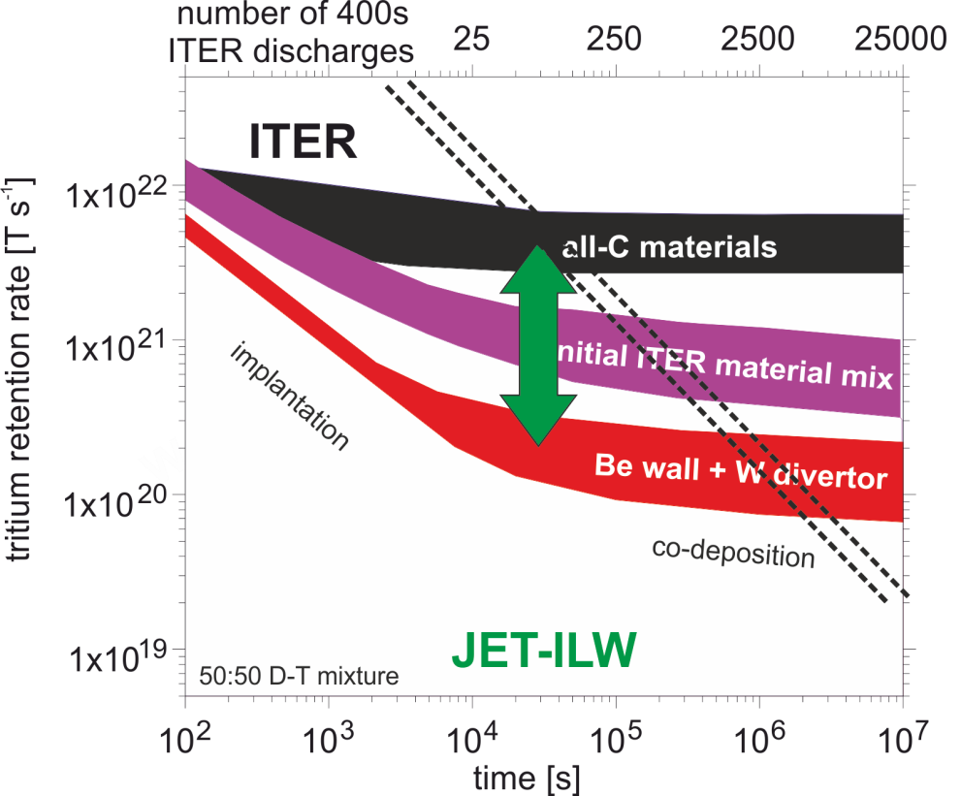
Fuel Retention in ITER
JET shows in the covered range of plasma conditions the same trend in reduction: comparable reduction in retention rate from all-C to Be/W plasma-facing component mix
Assumption: quasi steady-state conditions reached and co-deposition process dominates
Comparison with ITER predictions by Roth et al.: from hypothetical all-C to Be/W material mix
JET (exp.)
ITER (model.)
all C: 1.0-3.0x10²¹ D/s
all C: 0.4-1.2x10²² D/s
:10-20
:20
Be/W: 0.5-1.5x10²⁰ D/s
Be/W: 2.0-6.0x10²⁰ D/s
Roth et al. JNM 2009
Simple comparison: factor 4 in absolute value of retention rate between JET and ITER
JET measured upper limit of 1.5x10²⁰Ds⁻¹ translates to 3.0x10²⁰Ts⁻¹ in D:T mixture
Significant increase of number of ITER-discharges before cleaning is required (>1250)
Scaling in particle flux to PFCs would lead to further increase
Long term outgassing will lead to a reduction of retention in PFCs by a factor ~4-5
=> Detailed JET modelling comparable to Roth predictions for ITER started
Notes:
Number of discharges before cleaning interverntion from Roth (median):
75 (all C)
250 (C/Be/W)
2500 (Be/W)

Slide 16
Summary
Experiments with global gas balance executed in JET with Be/W material mix
Reduction in retention rate by one order of magnitude from JET-C to JET-ILW
Robust result of upper limit of the long term retention rate of 1.5x10²⁰Ds⁻¹
Higher dynamic retention and outgassing with metallic walls observed
Post-mortem analysis results expected for 2013, but if outgassing comparable to
JET-C at least a factor 4 lower long term retention to be expected
Main mechanism for retention in Be/W mix: implantation and codeposition
Reduction in retention rate in line with laboratory experiments for codeposition
Confirmation of the trend in reduction of retention rates with change of material mix according to predictions for ITER
Extension of the operational time before cleaning intervention in ITER

Slide 17
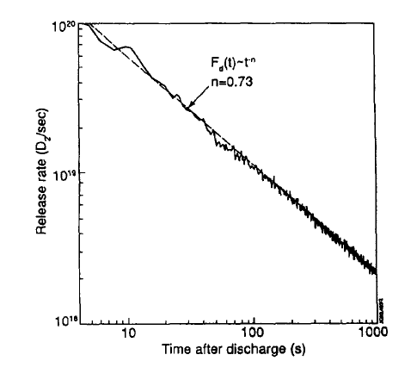
Long Term Outgassing
Long term outgassing observed in old JET limiter configuration
Total Pressure
Deuterium
F(t)~t^{-n}
n=0.8
Philipps et al.
J. Vac. Soc.1993
V. Philipps et al.
PSI 2012
outgassing after operation without cryo pump
Similar observations with new JET-ILW
Continuous outgassing after operation / nights / weekends
In JET-C not as important as retention in co-deposits dominated whole retention
In JET-ILW this becomes a significant process in the overall analysis

Slide 18
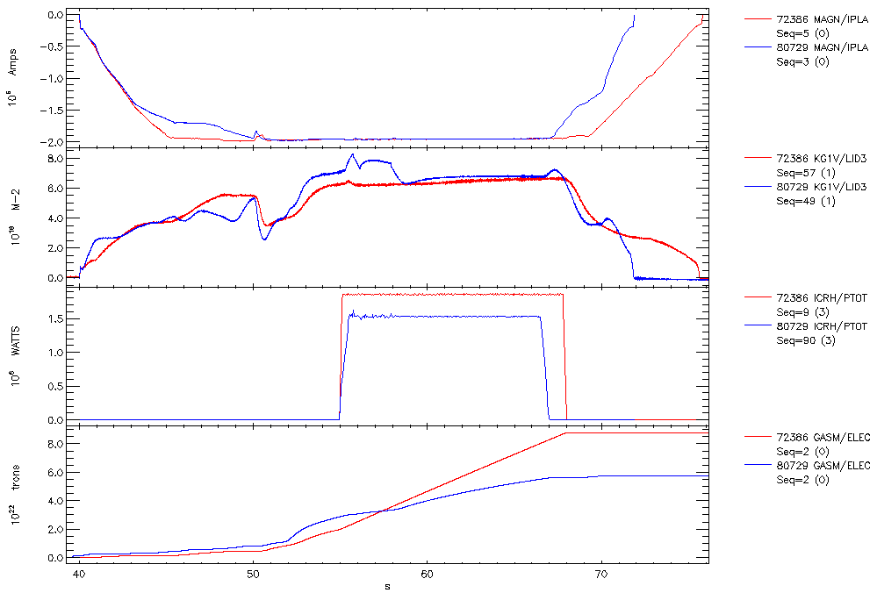
Phases During a Discharge
I_{p}
72386 (Carbon)
80729 (Be/W)
2.0MA/2.4T
P_{ICRH}=1.5-1.8 MW
Ramp-up
Divertor and Heating
Recov
n_{l}
3 phases
1. I_{p}/n_{e} Ramp up (limiter Be)
2. Divertor & Heating (W)
3. Recovery by outgasing in
between pulses
70% pumped during pulse
30% in between pulses
P_{ICRH}
Gas injected
Limiter phase
~5x10²¹ D
1 - More gas injected in limiter ramp up phase: ~5x10²¹D for C and 1.0x10²²D for Be/W
2 - Less gas injection during divertor phase for Be/W (Plasma scenario, particle fluxes)
3 - More gas recovered by outgasing in between pulses ~1x10²²D more recovered

