Slide 1

Technology R&D Activities
for the ITER full-Tungsten Divertor
Presented by Patrick Lorenzetto
Fusion for Energy, Barcelona, Spain
The views and opinions expressed herein do not necessarily reflect those of the ITER Organization
24th IAEA - Fusion Energy Conference
San Diego (CA), 08-13.10.2012
Notes:
Use preferably the corporate colours
Use the Calibri font
Don't centre text. All body text should be aligned left.
Don't enlarge pictures beyond their actual size/resolution.
Make sure you understand how bulleted lists work.

Slide 2
List of co-authors
B. Riccardi, P. Gavila, M. Bednarek, G. Saibene
Fusion for Energy, Carrer Josep Plà 2, B3, 08019 Barcelona, Spain
F. Escourbiac, T. Hirai, M. Merola, R. A. Pitts,
ITER Organization, Route de Vinon / Verdon, 13115 St. Paul lez Durance, France
S. Suzuki, Y. Seki
Japan Atomic Energy Agency, Naka, Ibaraki, Japan
A. Makhankov, N. Litunovsky, S. Mazaev, I. Mazul
Center "SINTEZ", Efremov Institute, Metallostroy, St.Petersburg, 196641, Russia

Slide 3
Content
Introduction
Full-Tungsten divertor design
ITER full-Tungsten divertor qualification programme
EU Domestic Agency R&D activities
for the procurement of the Inner Vertical Target (IVT)
JA Domestic Agency R&D activities
for the procurement of the Outer Vertical Target (OVT)
RF Domestic Agency R&D activities
for the procurement of the Dome
Conclusion

Slide 4
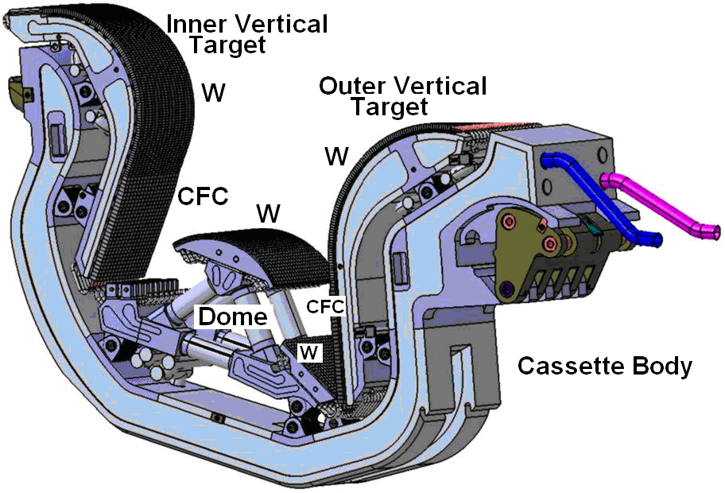
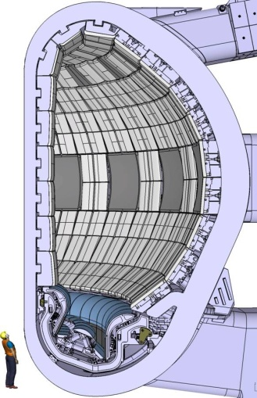



Introduction
The current ITER Baseline foresees the use of carbon fibre composite (CFC) as armour material in the high heat flux (HHF) strike point regions of the 1st divertor and Tungsten (W) on all other plasma-facing locations.
Extensive Research and Development (R&D) programme in the three Domestic Agencies (DA), Europe, Japan and the Russian Federation, who will supply the first ITER divertor components.
Fabrication technologies developed for the W parts can achieve much higher performance than originally specified (up to 20 MW/m²).

Slide 5
Introduction
In November 2011, the ITER Council endorsed a cost containment proposal from the ITER organization (IO) to delay the decision on the choice of the divertor materials and to investigate the possibility to begin operations with a full-W divertor, and requested that a work programme be implemented to
- (i) develop a full-W divertor design,
- (ii) qualify the corresponding fabrication technologies and
- (iii) investigate critical physics and operational issues with support from the R&D Fusion Community.
This paper presents the status of progress of the technology R&D work programme implemented by IO and the DAs to prepare for the procurement of a full-W divertor.

Slide 6
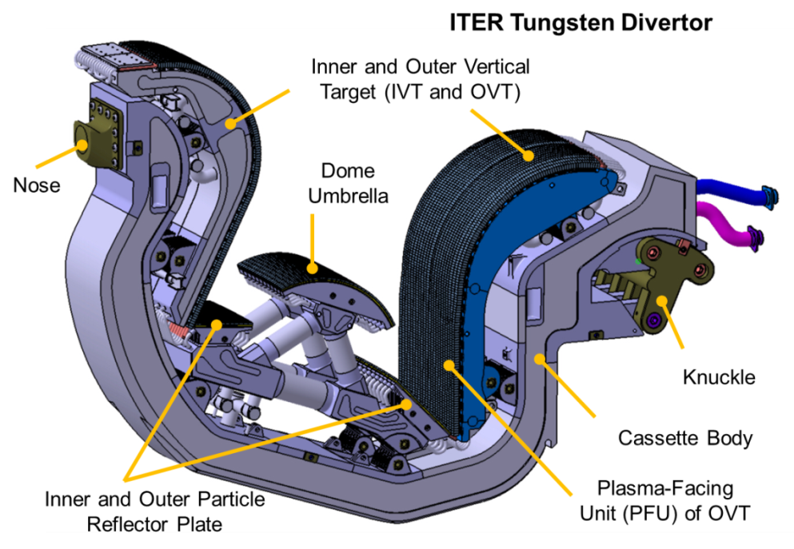
W-Divertor Design Development
Three phases of design development (see poster from F. Escourbiac ITR/P5-08):
Pre-detail design phase for cost estimation
Preliminary design phase to finalize the structural parts
Final design phase to deliver the design and 2D drawings of the structural parts and PFUs
Main features of the full–W divertor remain largely unchanged to minimize impacts on other interfacing systems (e.g. cassette body),
making modifications only where necessary, e.g. to mitigate as much as possible against melting during slow and fast transient heat pulse events.
Design Validation by Analysis
Neutronic Analysis
3-D Heat Load Distribution Study
E.M., thermal and stress analyses
Plasma Facing Surface Shaping Study
Armour lifetime study
ITER full-W Divertor
Technology R&D activities for the ITER full-W divertor – ITR/2-3 24th IAEA-FEC 2012, San Diego (CA), 08-13.10.2012
6

Slide 7
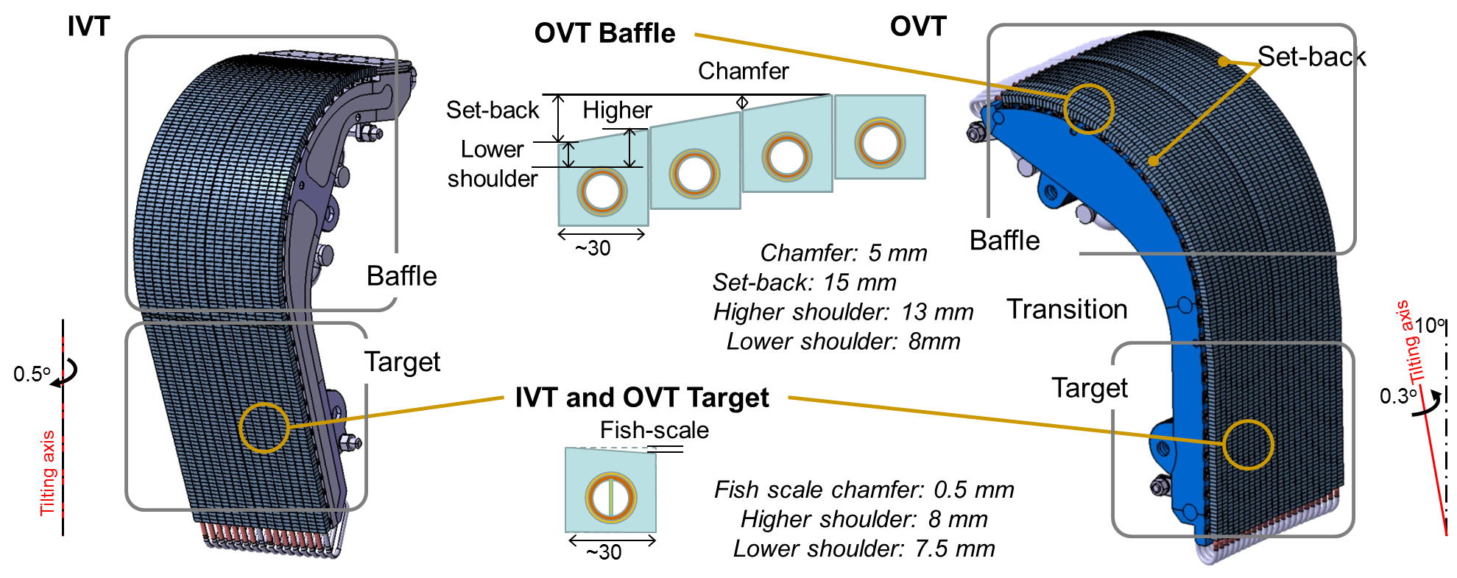
W-Divertor Design Development
Tilting of PFCs Aim: Full shadowing of PFC edges under steady state and slow transient loads;
Design parameters: Tilting axis and tilting angle.
Fish-Scale Aim: Full shadowing of PFU edges, under steady-state and slow transient loads;
at Target Design parameter: monoblock chamfer depth.
OVT Baffle Aim: Full shadowing of PFC edges, under Downward VDE loads;
toroidal shape Design parameters: Set-back depth and No. of PFU consisting the set-back.
Technology R&D activities for the ITER full-W divertor – ITR/2-3 24th IAEA-FEC 2012, San Diego (CA), 08-13.10.2012
7

Slide 8
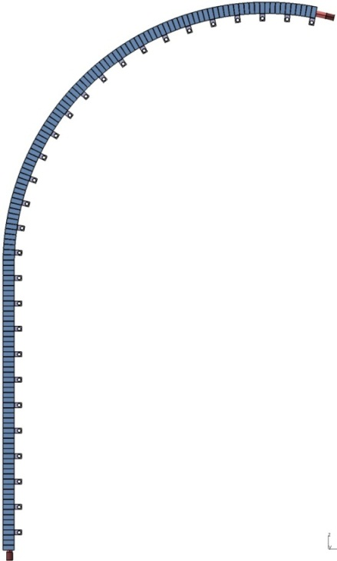
W-Divertor Qualification Program
Tungsten Divertor Qualification Programme
  to address the most critical issues
Technology Development and Validation: Demonstration of the fitness-for-purpose of the proposed technology by means of full-W small-scale mock-ups;
Full-scale demonstration: Demonstration of the feasibility via
full-scale prototype manufacturing and testing.
HHF tests for small-scale and full-scale-prototype PFU straight part
• 5000 cycles at 10 MW/m² + 300 cycles at 20 MW/m²
HHF test for prototype PFU curved part
• 5000 cycles at 5 MW/m²
~2 m
Full-scale OVT PFU or IVT PFU
~ 60 mm
Small-scale mock-ups
Task Agreements to support DAs activity are ready to be implemented
Design development at the IO and R&D activities for full-W divertor at DAs
→ Strong collaboration between IO and DAs put in place.
Technology R&D activities for the ITER full-W divertor – ITR/2-3 24th IAEA-FEC 2012, San Diego (CA), 08-13.10.2012
8

Slide 9
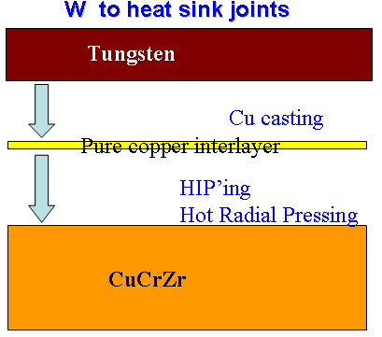
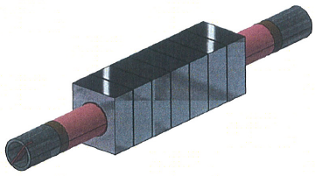
EU Domestic Agency R&D activities for the procurement of the IVT
IVT fabrication technologies developed in EU
Monoblock design concept
Two joining techniques have been developed in EU to bond the soft Cu to the CuCrZr heat sink tube: - Hot Isostatic Pressing (HIPing)
  - Hot Radial Pressing (HRPing)
  HIPing is done at 900°C then solution annealing, quenching and age hardening (480 °C for 2 h) to achieve the required mechanical properties on the CuCrZr alloy.
  HRPing is done at 580 °C for 2 h.
Technology R&D activities for the ITER full-W divertor – ITR/2-3 24th IAEA-FEC 2012, San Diego (CA), 08-13.10.2012

Slide 10
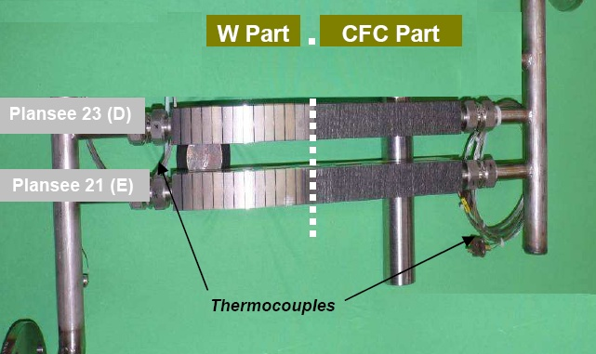
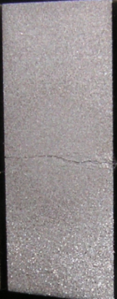
EU Domestic Agency R&D activities for the procurement of the IVT
  Thermal fatigue tests of divertor medium scale mock-ups
  (CFC/W divertor design variant, 12 ID pipes)
Baseline tungsten monoblock concept was developed for low heat flux values (5 MW/m²) representative of the baffle region.
However, un-irradiated and irradiated W mock-ups (up to 0.5 dpa at 200 °C) with 10 mm inner diameter (ID) cooling pipes sustained thermal fatigue testing at 18-20 MW/m² for 1000 cycles.
  W surface condition
1000 cycles at 10 MW/m² | 1000 cycles at 15 MW/m² | 300 cycles at 20 MW/m²
No significant visible effect. | Surface alteration but no W melting. | W surface cracking with no disbonding at cooling tube interface. Surface alteration but no W melting.
Technology R&D activities for the ITER full-W divertor – ITR/2-3 24th IAEA-FEC 2012, San Diego (CA), 08-13.10.2012

Slide 11
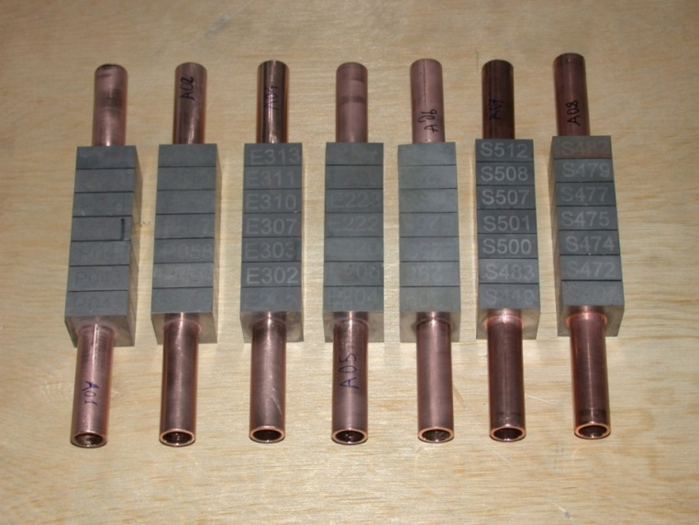
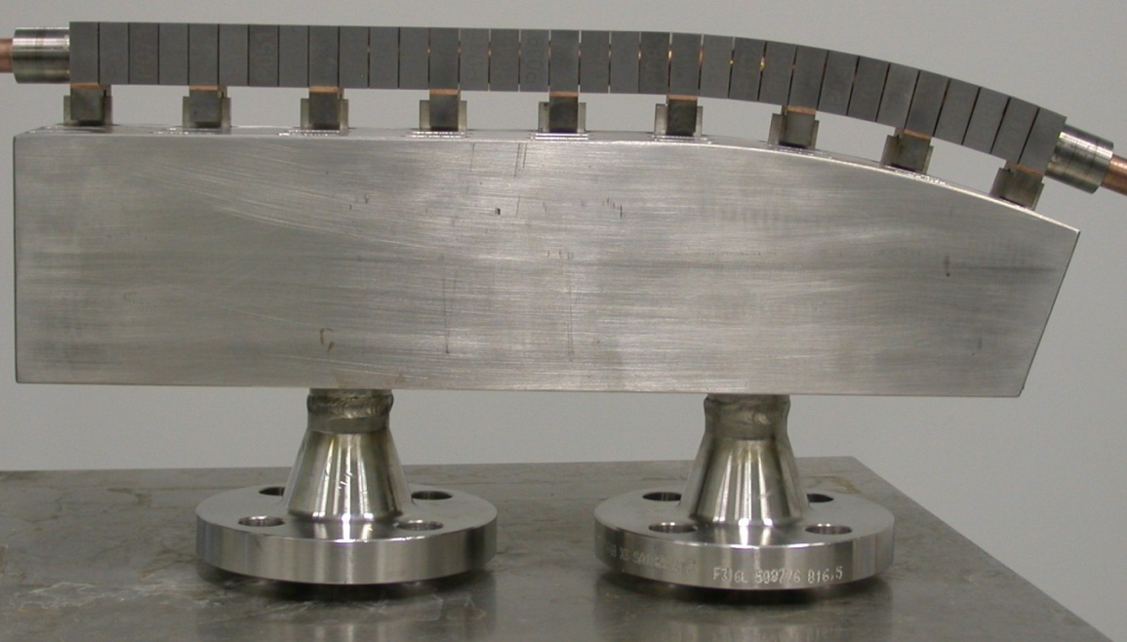
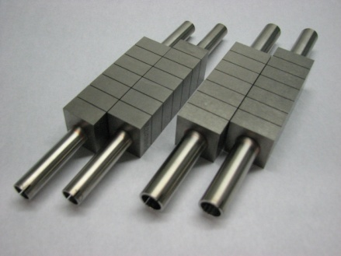
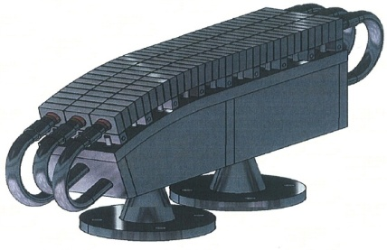
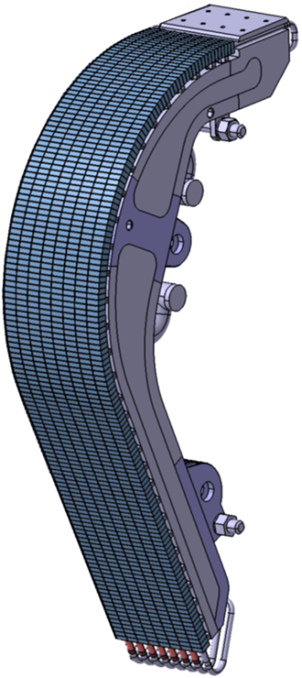
EU Domestic Agency R&D activities for the procurement of the IVT
Launching of an extensive fabrication and testing development program to confirm the manufacturing feasibility
15 mock-ups and 2 pre-qualification prototypes by HRP (600 °C) at Ansaldo Nucleare.
3 different W grades have been used.
  Small scale mock-ups
  Pre-qualif. prototypes
25 mock-ups (of 5 different monoblock geometries) and 1 pre-qualification prototype by HIPing at Plansee.
2 full-scale IVT prototypes by HRPing and HIPing at Ansaldo and Plansee respectively.
  Full-scale prototypes
Technology R&D activities for the ITER full-W divertor – ITR/2-3 24th IAEA-FEC 2012, San Diego (CA), 08-13.10.2012

Slide 12
JA Domestic Agency R&D activities for the procurement of the OVT
Status of full-tungsten divertor development
in JAEA/JADA
In JAEA/JADA, tungsten-armored divertor components have been developed not only for the baffle part of the ITER divertor outer target (OVT) but also for DEMO divertor components.
JAEA/JADA has ever developed a small-scale tungsten-armored divertor mock-up which survived a heat flux of 20 MW/m² for 1000 cycles (See poster from Y. Seki "ITR/P5-06"). However, the specification of the tungsten armor used in this mock-up (HIP-molded tungsten, not rolled one) is slightly different from the ITER requirement.
In 2012, 12 small-scale divertor mock-ups with ITER divertor relevant tungsten armor has been developed and will be HHF tested in 2012-2013 at JAEA/JADA.
Technology R&D activities for the ITER full-W divertor – ITR/2-3 24th IAEA-FEC 2012, San Diego (CA), 08-13.10.2012
12

Slide 13
JA Domestic Agency R&D activities for the procurement of the OVT
Fabrication route developed by the JADA
Specification of W: ASTM B760-86 standard material (ITER requirement).
Bonding method of soft Cu interlayer:
  NDB ("Non-defect bonding" patented by Nippon
  Tungsten Co., Ltd.): Cu casting onto W monoblock;
  HIP bonding;
  Diffusion bonding.
Joining of CuCrZr pipe by brazing with Ni-Cu-Mn braze alloy at 980 ºC for 30 min.
Quenching rate to recover the mechanical strength of the CuCrZr pipe after ageing heat treatment at 480 ºC for 2 hours.
Soft Cu interlayer
W
 | 986ºC→867ºC | 867ºC→622ºC | Vickers Hardness
1st batch | 0.12ºC/s | 4.9ºC/s | 104 Hv_{300gf}
2nd batch | 0.10ºC/s | 3.2ºC/s | 94.6 Hv_{300gf}
 | Heater Off-->N₂ gas injection to furnace | N₂ gas injection + Fan cooling
Technology R&D activities for the ITER full-W divertor – ITR/2-3 24th IAEA-FEC 2012, San Diego (CA), 08-13.10.2012
13

Slide 14
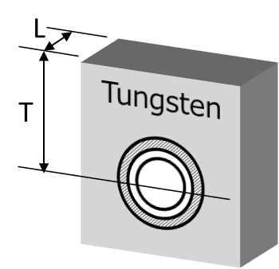
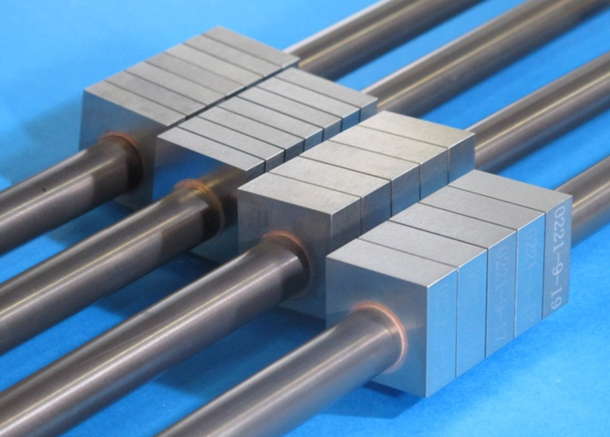
JA Domestic Agency R&D activities for the procurement of the OVT
Qty. | W thickness [T] | W longitudinal length [L] | Tiles No. / mock-up | Bonding method of soft Cu interlayer
3 | 16.5 mm | 12 mm | 5 | NDB (Cu casting)
2 | 15.0 mm | 12 mm | 5 | NDB
2 | 16.5 mm | 8 mm | 7 | HIP
3 | 16.5 mm | 12 mm | 5 | Diffusion bond
2 | 16.5 mm | 12 mm | 5 | HIP
W monoblock with 12/15 mm CuCrZr pipe
These mock-ups will be HHF tested in an e-beam facility in JAEA mainly. Some of those mock-ups will be tested under the collaborative research program with Osaka-Univ. and Hyogo-Univ. using a plasma gun facility and e-beam facility.
In addition, a collaborative experiment with FZJ under the IEA-NTFR agreement is planned to perform HHF test simulating cyclic ELM-like loading.
The implementation of a formal R&D task on W divertor target is under negotiation with IO.
CuCrZr tube
Pure Cu interlayer
Technology R&D activities for the ITER full-W divertor – ITR/2-3 24th IAEA-FEC 2012, San Diego (CA), 08-13.10.2012
14

Slide 15
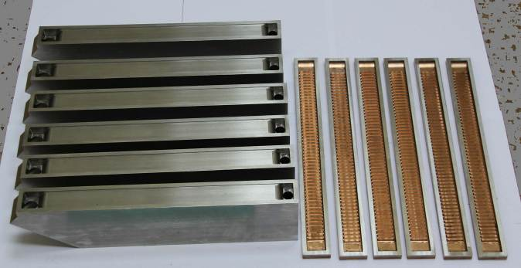
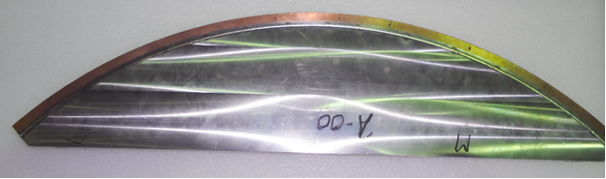
RF Domestic Agency R&D activities for the procurement of the Dome
Fabrication of PFU substrates
Dome PFUs substrates consist of 316L(N)-IG steel base structures joined by full penetration laser welding onto bimetallic CuCrZr alloy / 316L(N)-IG steel covers. The bimetallic covers are manufactured from CuCrZr alloy plates and 316L(N)-IG steel plates by explosion bonding and have an hypervapotron design.
316L(N) steel base structures and CuCrZr alloy /316L(N) steel covers prepared to laser welding
Technology R&D activities for the ITER full-W divertor – ITR/2-3 24th IAEA-FEC 2012, San Diego (CA), 08-13.10.2012
15

Slide 16
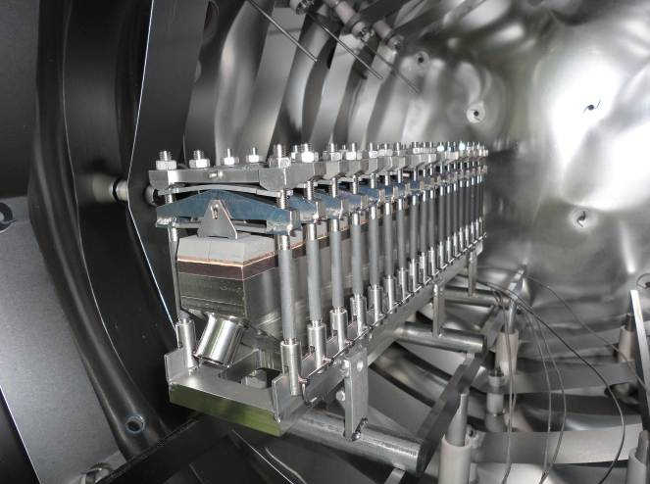
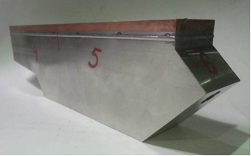
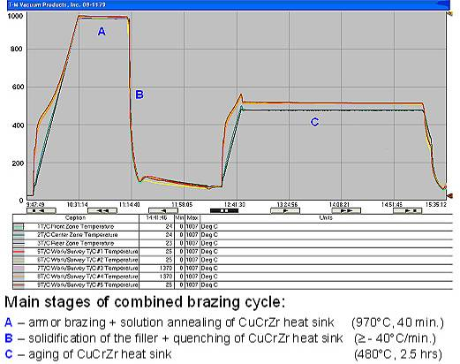
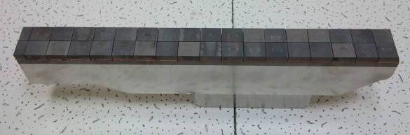
RF Domestic Agency R&D activities for the procurement of the Dome
Armouring of Dome PFUs
Dome Armour consists of flat bimetallic W/Cu tiles of ~ 23×24×(8W+2Cu) mm³ dimensions produced by casting technique. The tiles are bonded onto a CuCrZr alloy substrate by brazing with STEMET® 1108 Cu-based braze alloy. Brazing is performed in industrial vacuum furnaces with ohmic heaters.
The heating cycle combines armour joining process with subsequent recovery of the CuCrZr alloy properties.
OPRP in brazing furnace Inner PRP mock-up
Heat cycle combining armour brazing and ageing heat treatment of the CuCrZr heat sink
Full-scale mock-up of the outer particle reflector plate (OPRP)
Technology R&D activities for the ITER full-W divertor – ITR/2-3 24th IAEA-FEC 2012, San Diego (CA), 08-13.10.2012
16

Slide 17
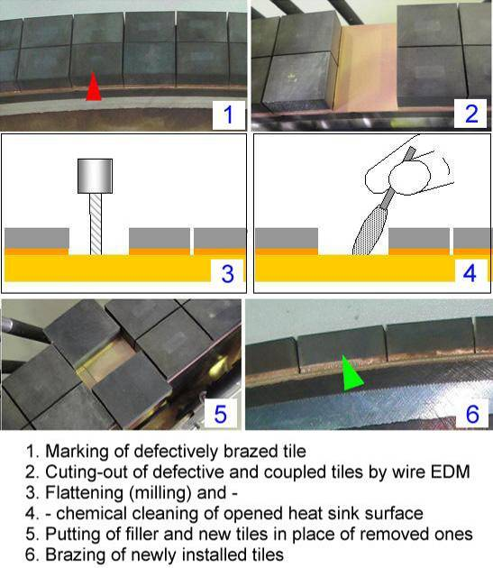
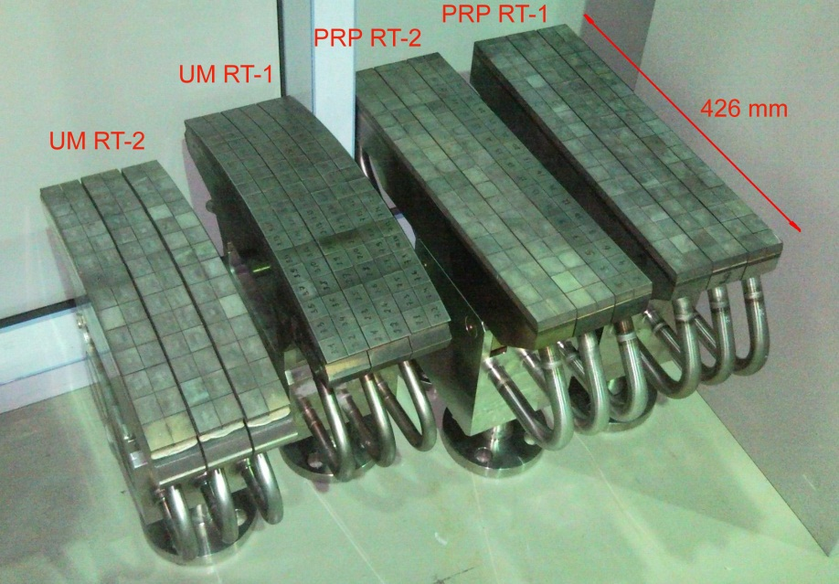
RF Domestic Agency R&D activities for the procurement of the Dome
Development of armour repair technique
Such W armour repair technique was developed and successfully demonstrated on Dome mock-ups with both flat and curved armoured surfaces through high heat flux testing for 1000 cycles at 3 MW/m² + 1000 cycles at 5 MW/m².
Repaired Dome mock-ups
Technology R&D activities for the ITER full-W divertor – ITR/2-3 24th IAEA-FEC 2012, San Diego (CA), 08-13.10.2012
17

Slide 18
Conclusion
The design of a full-W Divertor is being prepared by IO leaving the baseline design largely unchanged and making modifications only where necessary, e.g. ensuring no leading edges on the plasma facing components.
Manufacture and testing of small-scale mock-ups and full-scale qualification prototypes are being performed by DAs for adapting and validating the fabrication technologies developed for the CFC/W divertor to the more demanding heat load requirements of the full-W divertor.
Promising preliminary results give confidence of success of this development work programme.
If confirmed, such a successful outcome will be an important milestone for the decision to be taken by the end of 2013 to begin ITER operations on a full-W divertor.
Technology R&D activities for the ITER full-W divertor – ITR/2-3 24th IAEA-FEC 2012, San Diego (CA), 08-13.10.2012

Slide 19



Thank you for your attention
Follow us on:
www.f4e.europa.eu
www.twitter.com/fusionforenergy
www.youtube.com/fusionforenergy

