Slide 1
ITER Diagnostics – Technology and Integration Challenges
D. Johnson, P. Andrew, R. Barnsley, L. Bertalot, D. Bora, J.M. Drevon, T. Fang, R. Feder, Y. Kusama, H. G. Lee, B. Levesy, D. Loesser, S. Pitcher, R. Reichle, V. Udintsev, P. Vasu, G. Vayakis, C. Walker, M. Walsh, C. Watts, A. Zvonkov on behalf of ITER Organization and the Domestic Agencies
“The views and opinions expressed herein do not necessarily reflect those of the ITER Organization”
Notes:
Talk about Technology and Integration Challenges in ITER Diagnostic Devepment…
Very broad topic -- pick a few recent highlights
There are around 45 diagnostic systems on ITER and most are housed in port plugs which are shown circled in red.

Slide 2
ITER Diagnostic Development
08 09 10 11 12 13 14 15 16
Define Requirements
Port-Based Diagnostics
Conceptual Design
Procurement Arrangements
Preliminary Design
Port Plug Structures
Final Design
Define Req’ts, Interfaces
Generic Conceptual Design
Generic Preliminary Design
Generic Final Design
Procurement Arrangements
Specific Preliminary Design
ITER Organization
Lead
Oversee
Domestic Agencies
Support
Lead
Notes:
CDRs for the port based diagnostics began a little over 2 years ago, and now the majority have been through the process
There is a large activity now in completion of the PAs for these systems
For the port pliug structures, there is a need to define more generically a spatial framework for diagnostic development, which I will describe, prior to the PAs.
This process is now nearing completion, and the first PA governing port integration is very close to signoff.
The PA negotiation process marks an important transition, where the lead shifts from the IO to the domestic agencies to completer the R&D and designs, and buitd the systems.

Slide 3
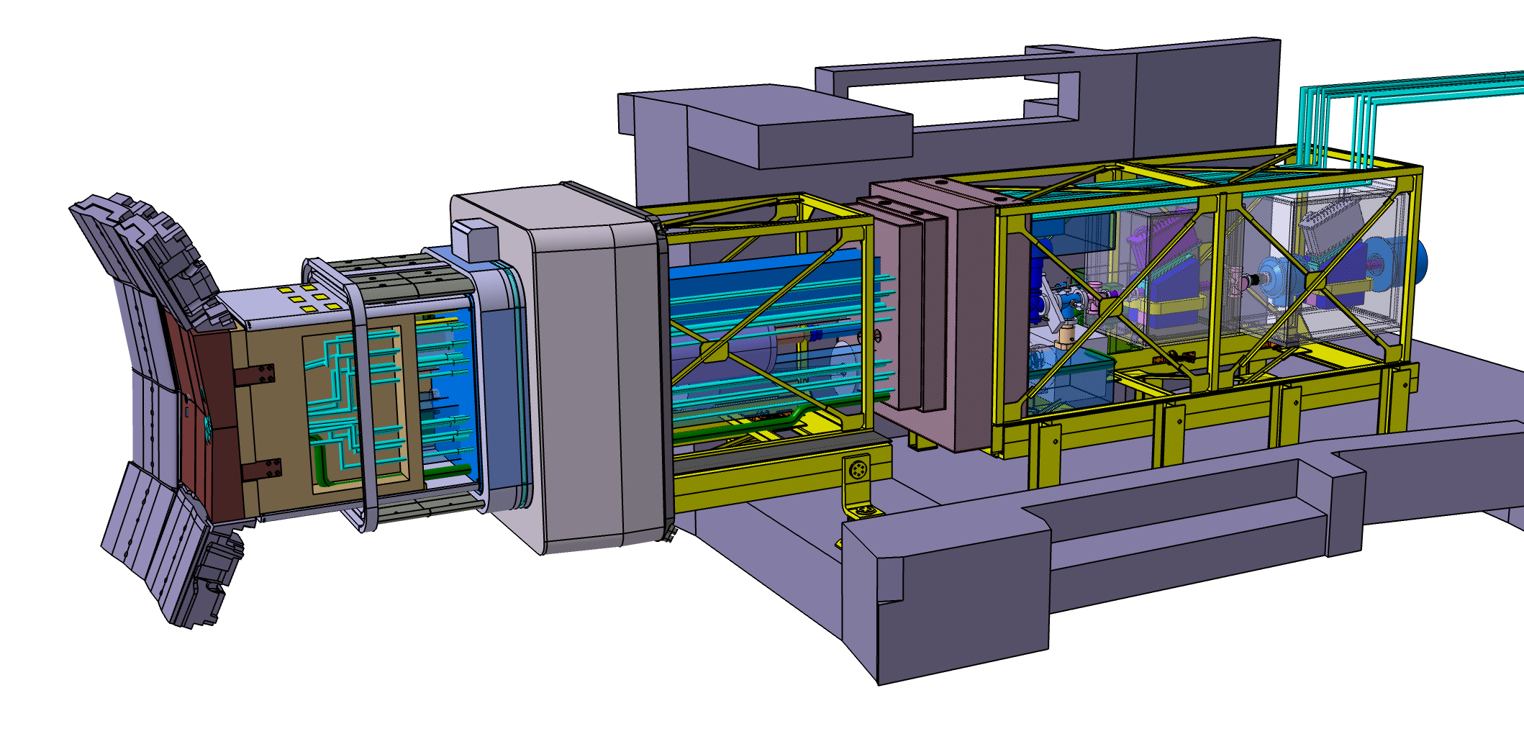
Port Integration
Cryostat
Bioshield
Port
Plug
Structure
Diagnostic First
Wall
Diagnostic Shield
Module
Interspace
Support
Structure
Port Cell
Support
Structure
V. Udintsev, ITER
Notes:
Port integration is the process of fitting the diagnostic hardware in the available space, not only in the plug, but also in the space available in the building as you move back from the plugs.
Starting at the plasma end, the 1st digngostic components are the DFW panels. 6 such panels are mounted in pairs on 3 diagnostic shield modules, which fit into the port plug structure.
Each of the 8 equatorial diagnostic plugs has 4-10 systems, which have now been allocated into the left, central or right shield modules.
Between the cryostat and the bioshield, components are mounted on an interspace support structure., and outside the bioshield on a port cell support structure.
These are also meant to be modular, permitting efficient removal to provide access to the port plugs.

Slide 4
Diagnostic First Wall
DFW is set back 10 cm, allowing stainless steel plasma-facing surface.
Peak heating is ≈ 0.5 MW for 1 panel
  Max surface heat load is 35 W/cm²
  Max nuclear heating is 8 ➔ 1 W/cm³
For surface heat removal, coolant channels are milled into DFW front surface, before bonding a 5 mm thick stainless plate.
Gun-drilled holes in the bulk of the panel are used to remove nuclear heat.
Bolted tabs attach DFW to the diagnostic shield module with bolts protected at a distance from plasma.
Apertures require custom cooling designs.
DFW in preliminary design and R&D phase.
DFW
10cm
blanket
cutaway top view
3.25 l/s for
ΔT ≈ 50°C
diagnostic first wall panel
(5 mm plate removed)
D. Loesser, PPPL

Slide 5
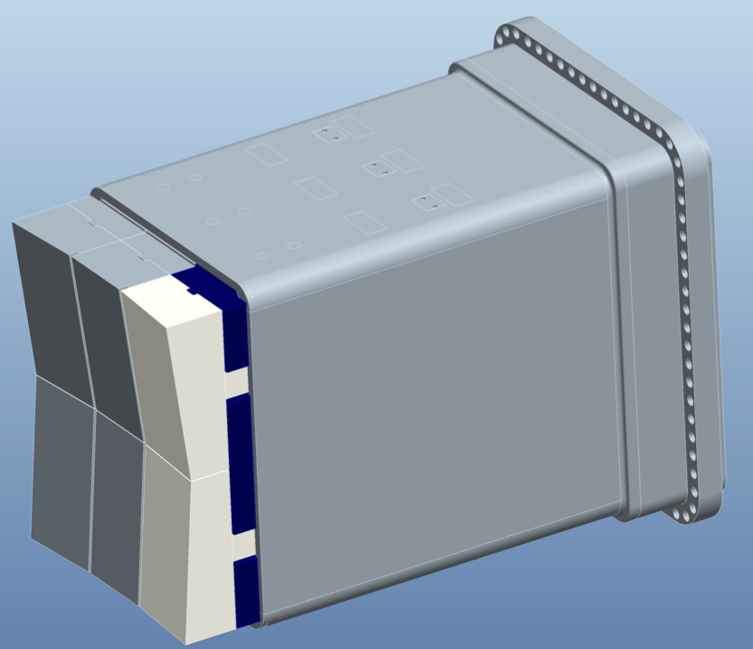
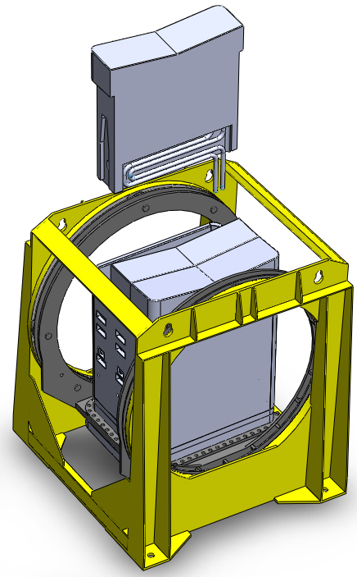
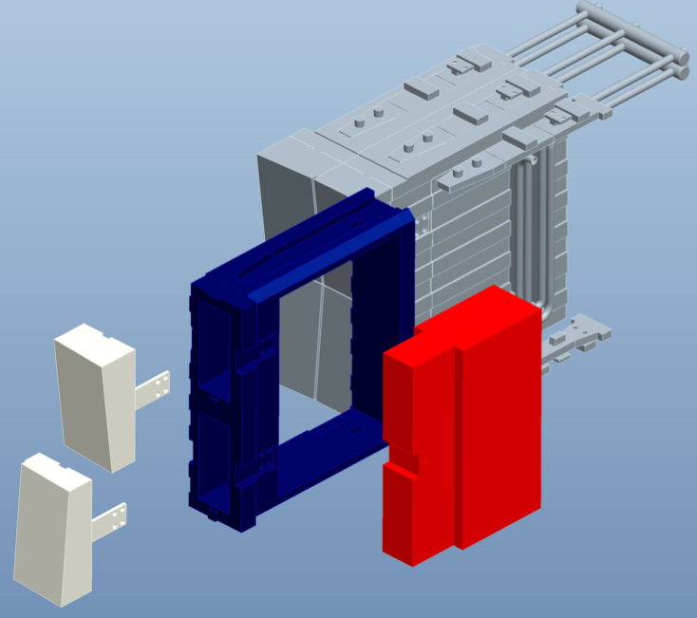
Modular Approach to Packaging
Vertical shield modules are inserted along radial rails from the plasma side of the box.
Configuration provides vertical electrical breaks, needed to reduce eddy-current forces.
Multiple diagnostics, often supplied by different DAs, are housed in each equatorial plug.
Modular approach results in considerable simplification of interfaces, permitting parallel design, assembly, and qualification efforts to proceed efficiently.
Module standardization also simplifies remote handling of the diagnostics.
  Standardized hot cell tooling can be designed to extract and position the modules for robotic maintenance and repair operations.
S. Pitcher, ITER

Slide 6
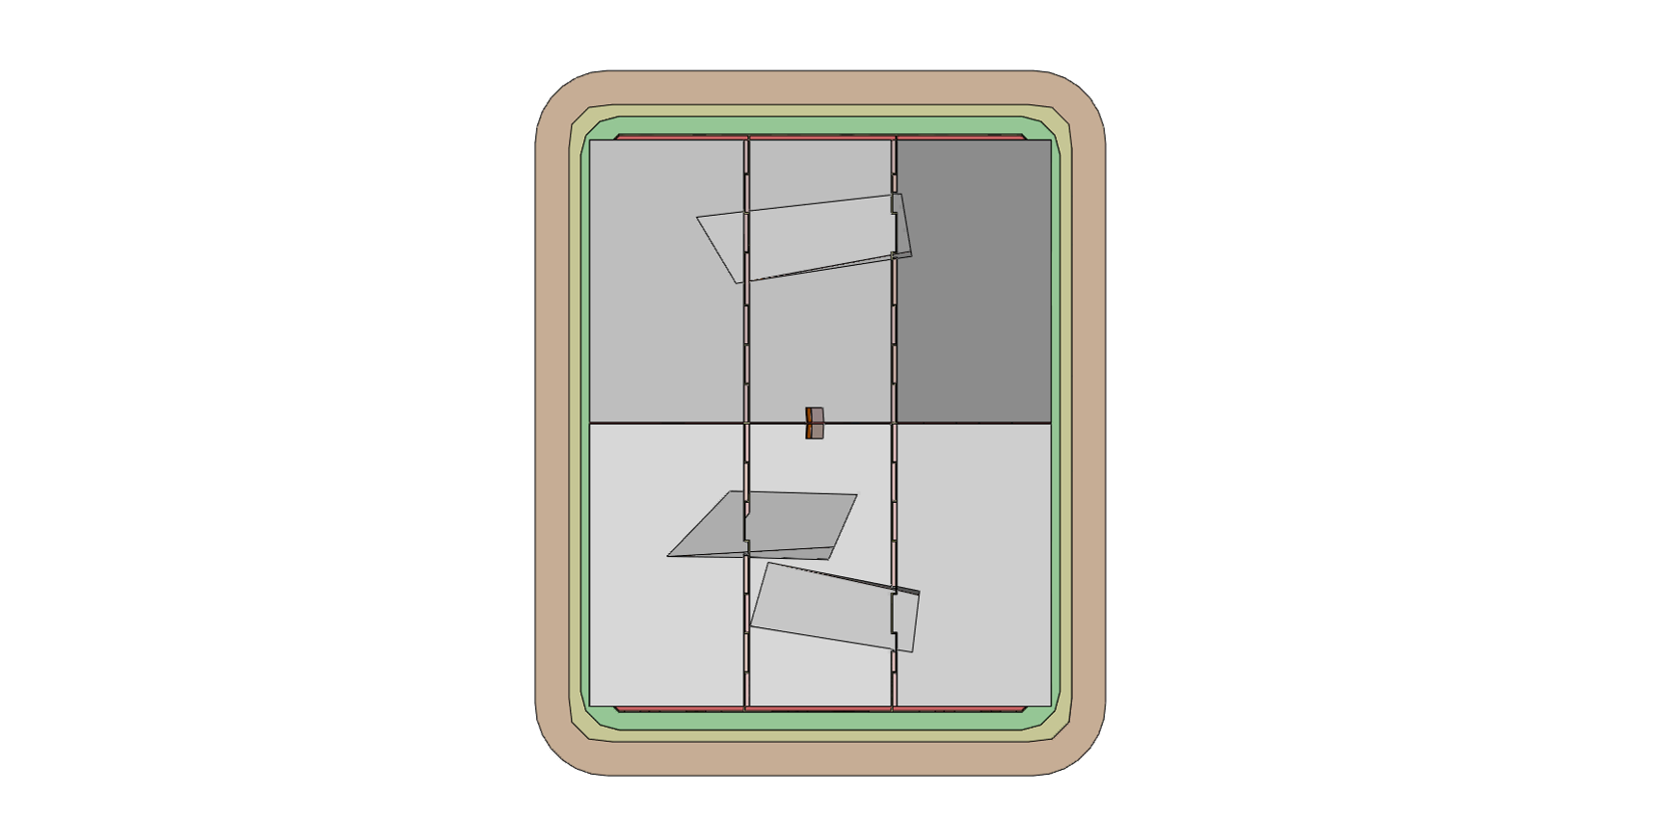
Example E3 Plug, Central Drawer (CXRS)

Slide 7
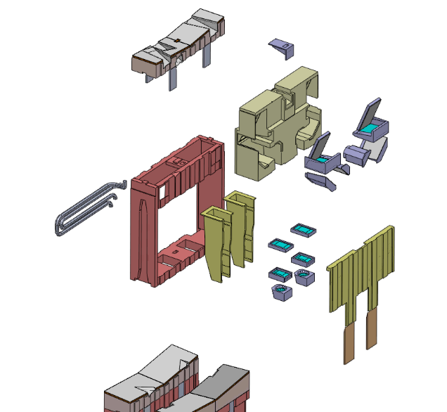
Example E3 Plug, Central Drawer (CXRS)
DFW panels
TIP mirror
main shield block
CXRS mirrors
water pipes
drawer shell
lens housings
drawer side plate
CXRS lenses
weight ≈ 10T

Slide 8
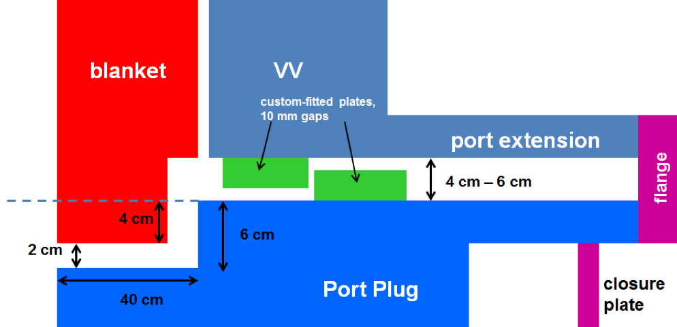
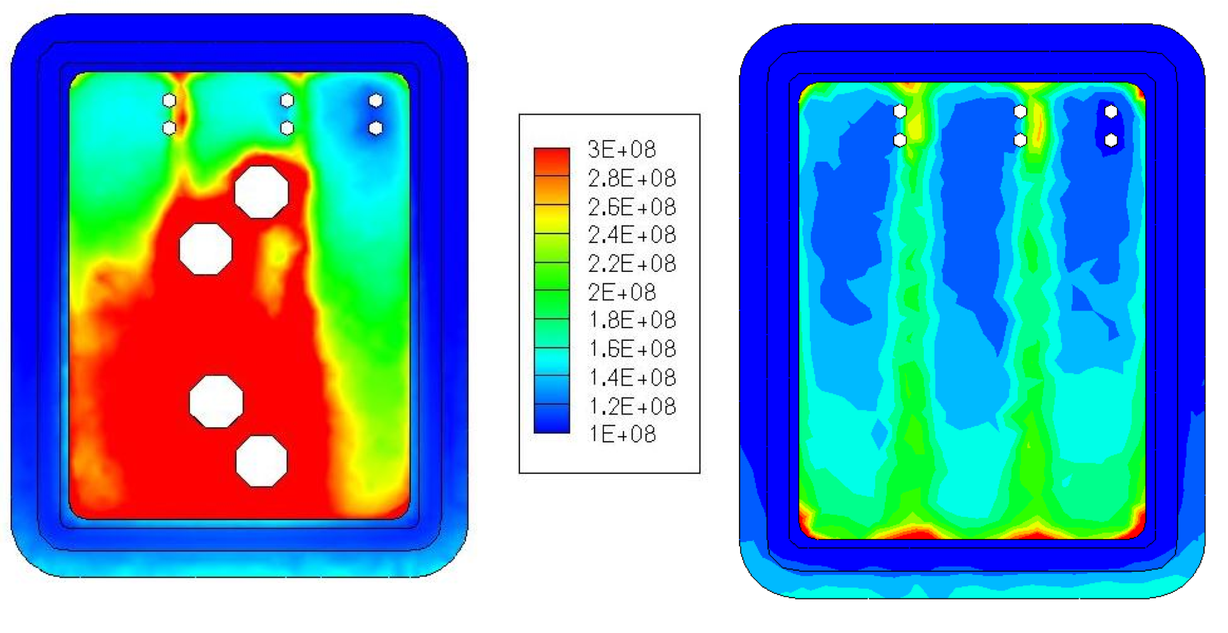
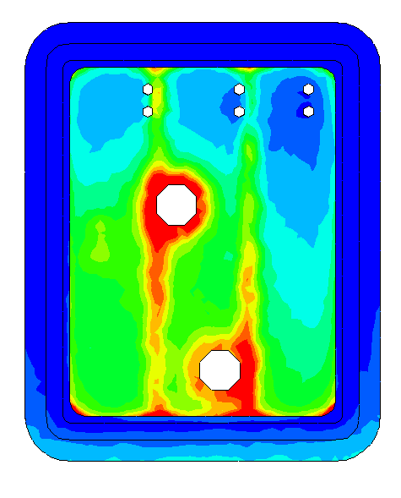
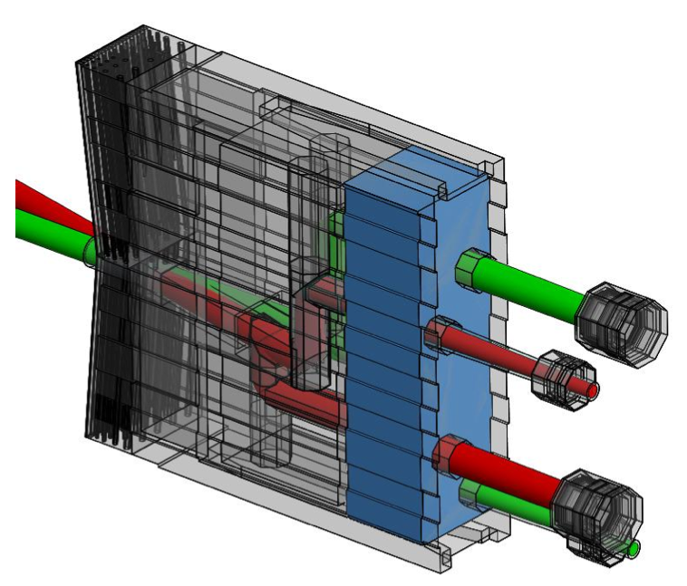
Shielding Challenges
A. Serikov, KIT
Only recently has the effectiveness of shielding labyrinths begun to be assessed.
Streaming down the gaps between the plug and the vacuum vessel has been reduced with multiple dog-legs.
Even so, steaming down gaps accounts for ≈ 1/2 of maximum dose rate of 100 μS/hr in interspace region.
Comparison of cases with/without labyrinths permit diagnostic contributions to be assessed relative to targets.
Shown is a study used to optimize the configuration of the ECE diagnostic.
  Calibration sources will have to be within the shield module to reach dose-rate target of 17μS/hr.
neutron streaming contours
baseline
Δ=36μS/hr
Δ=13μS/hr
solid drawers
no labyrinths
labyrinths for ECE views & calibration sources
labyrinths for
views only
R. Feder, PPPL
hot sources
windows

Slide 9
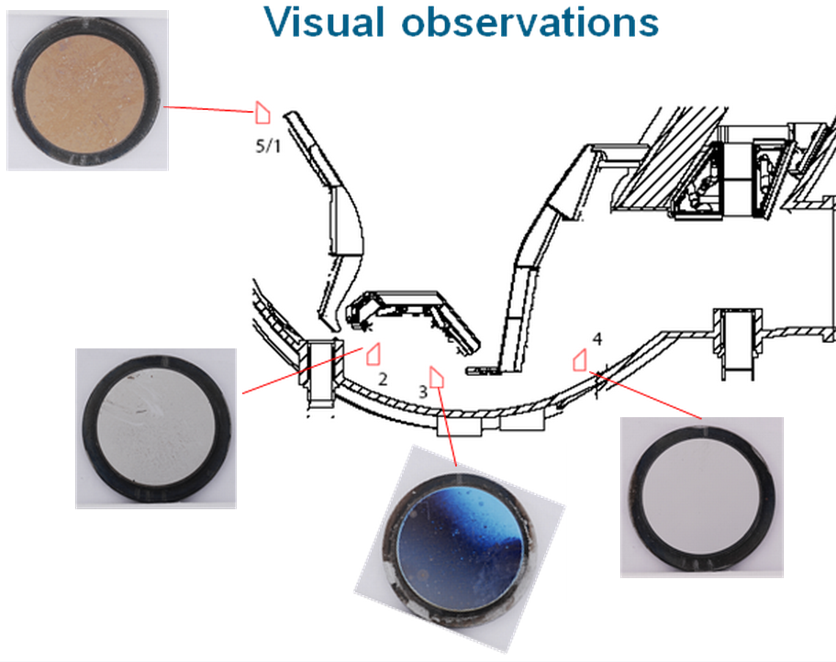
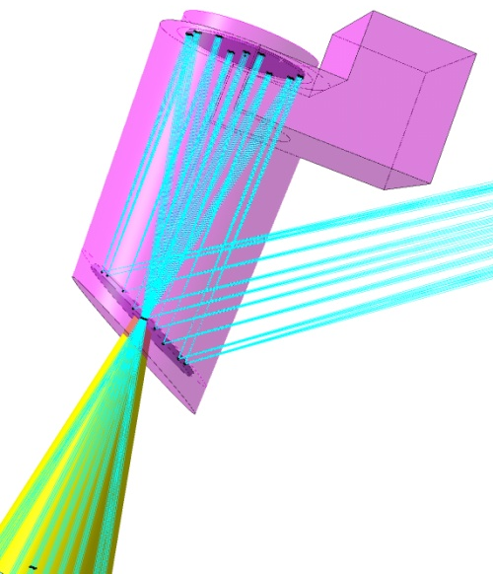
Lifetime of Diagnostic Mirrors
Diagnostic mirrors are subjected to deposition from sputtered material (mainly Be).
  Modeling of deposition and mirror exposure experiments on present devices both indicate a risk that some mirror lifetimes could be short.
  Lifetime estimate uncertainties are very large.
Concepts for protecting and cleaning mirrors have been under investigation, coordinated by ITPA WG.
  Ideas include protection by gas curtain, cleaning by laser ablation, and cleaning by sputtering of the deposited layer by energetic ions produced in DC, RF, or microwave plasmas.
  Solution that is compatible with ITER environment and realistic diagnostic mirror configurations has not yet been demonstrated.
New results from mirror exposure experiments on JET with the ITER-like wall will help to evaluate the severity of this risk.
ASDEX-U
A. Litnovsky, IPP
ITER
Endoscope
Configuration
R. Reichle, ITER

Slide 10
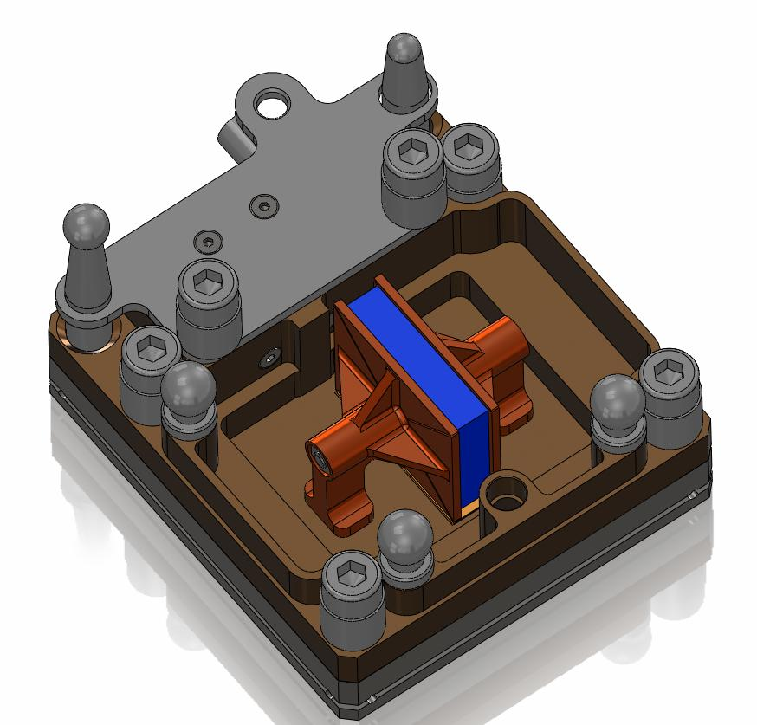
Radiation-Tolerant Inductive Sensors
Discrete sensors made of MI cable are unsuitable for some locations due to noise from RIEMF and RITES.
The latter drives designs to miniaturization to avoid temperature gradients from nuclear heating.
Coils made from Low-Temperature Co-Fired Ceramic (LTCC) are being developed.
With proper mounting, such sensors can be kept at temperatures uniform to within < 1°K, adequate for suppression of noise due to RITES.
Mounts can be remote-handled, and incorporate short thermal conduction paths, metrology points, and a connector for sensor leads.
S. Peruzzo, Consorzio RFX

Slide 11
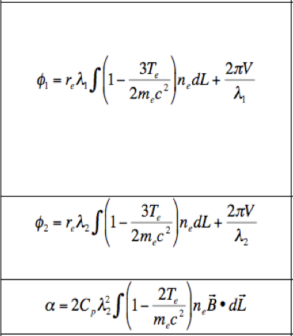
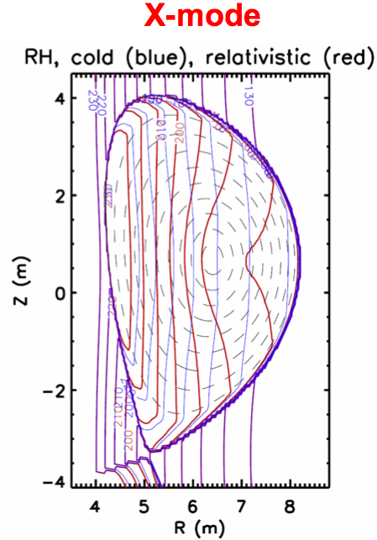
Impacts of High Electron Temperatures
Two-Color Interferometer/Polarimeter
At the high temperatures expected for ITER, relativistic effects are important.
  at T_{e}=25 keV, T_{e}/(m_{e}c²) ≈ .05
For the poloidal and toroidal interferometer/polarimeter diagnostics, T_{e} along the sightline will be needed for high precision.
  will complicate real-time density control
Relativistic effects severely impact the X-mode cutoff contours for the low-field-side reflectometer.
  Complicates strategy to obtain robust reflected signal
  Also complicates data interpretation
Phase
Faraday Rotation
LFS Reflectometer
(X-mode)
Scenario 2
Flat n_{e}(r)
T_{e}(0)=25 keV
T. Peebles, UCLA

Slide 12
Damage from Stray Microwave Power
Stray microwave power from ECH heating (170GHz, 10s of MW), CTS (60 GHz, 2 MW) and fast electron transients (ELMs, etc.) pose a threat to components.
  Reflected ECH power is a particular hazard at plasma startup.
Passive and active mitigation measures are planned.
  Development of reliable triggers for active mitigation also needed.
Absorbing
Coatings
170 GHz
Notch Filter
Switch or
splitter
Shield Module
Window
To
Michelson
Splitter Box
O-mode
waveguide
In-Vessel
Shutter
Viewing
Mirrors
Polarization Splitter
To Radiometer
Hot Source
X-mode
waveguide
Splitter Box
Fast Shutter
Maintainable
Location
ECE Diagnostic
Notch, Lowpass, Bandpass
and/or Highpass Filters
to reject 170 GHz
WR-4, -5, -6 or -8
IF
Filter
Fast Acting
Power Limiter –
Ferrite or Pin Switch?
Mixer
Voltage Controlled
Attenuator –
Ferrite or PiN?
G. Hanson, ORNL

Slide 13
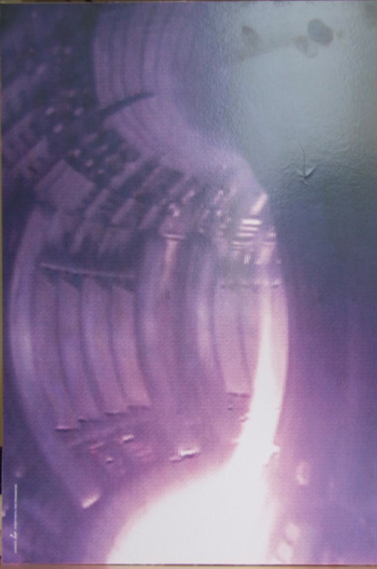
Stray Light Contamination
Light originating in the divertor region will contaminate measurements of visible line emission.
  This light can undergo multiple reflections from the ITER metal walls and be collected on spectroscopic sightlines.
  For measuring D/T fuel ratio and main chamber recycling at the edge of the ITER plasma with spectrometers tuned to Hα, “stray light” can be >10² times brighter than the desired signal.
JET image
Solutions - Vary depending on diagnostic
  Viewing into dark slots between first wall panels or embedded viewing dumps.
  Zeeman splitting may also be useful to separate these components through line fitting.
  Tangential views of the SOL improve the ratio of signal to stray light.
Analysis is currently underway to assess the impact of reflected light on other spectroscopy diagnostics and on the 3 Thomson scattering systems.

Slide 14
Summary
The ITER Organization and the Domestic Agencies have been working together to provide a framework for coherent diagnostic development.
Standardized, modular approach to diagnostic packaging is proposed.
  Helps to define the roles of host and tenants in the plugs.
  Permits parallel designs at the DAs to proceed efficiently.
  Permits shield module qualification prior to integrated plug testing.
  Facilitates the use of common tools for installation and maintenance.
The Conceptual Design Review process has identified many technical challenges in developing ITER diagnostics.
  A few of the many examples were shown.
  R&D plans are proposed to address these challenges
With the completion of Procurement Arrangements, we are entering a new phase of diagnostic development on ITER.
  Baton is being passed to design teams in the DAs to carry out R&D and complete designs, and then to build the diagnostics.

Slide 15
Backup

Slide 16
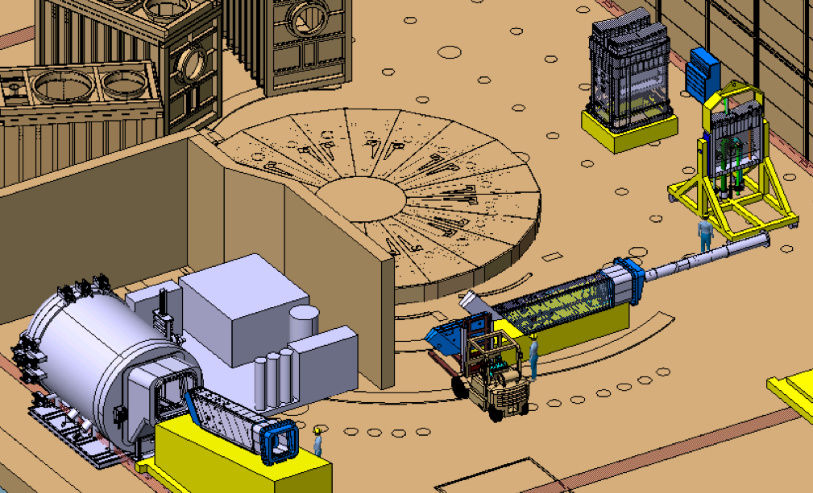
Qualification of Integrated Port Plugs
Included in the port integration responsibilities are environmental and functional testing of the fully assembled plugs in a port plug test facility.
Plugs are subjected to repeated thermal cycling, leak checking, and outgassing measurements.
Functional tests such as shutter cycling, imaging and alignment stability, calibration source testing are also planned.
B. Levesy, ITER

Slide 17
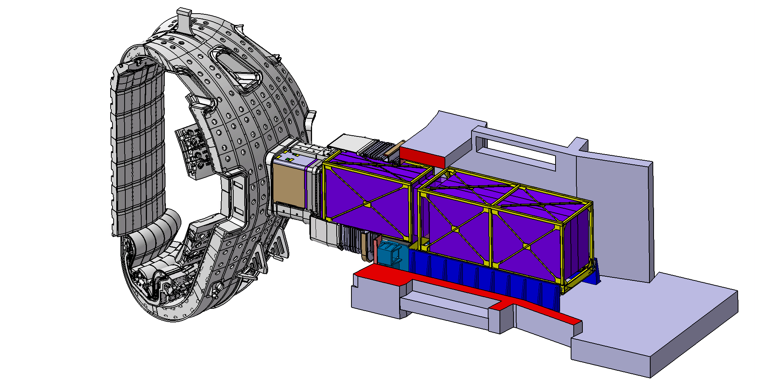
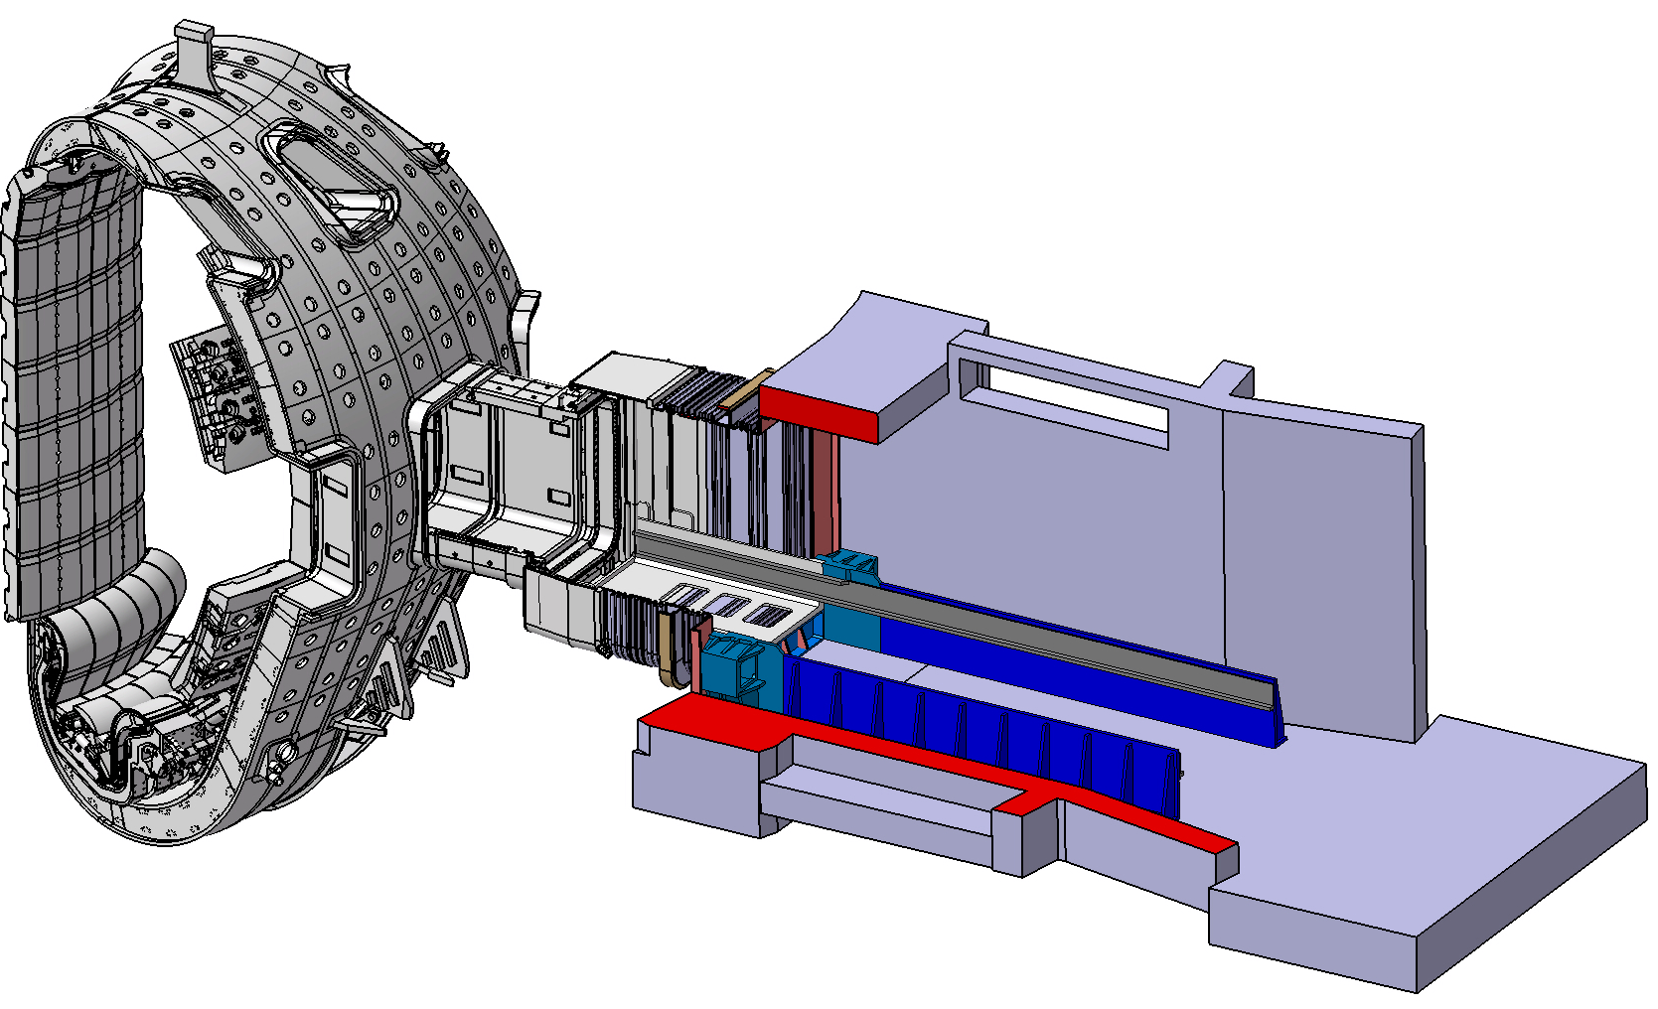
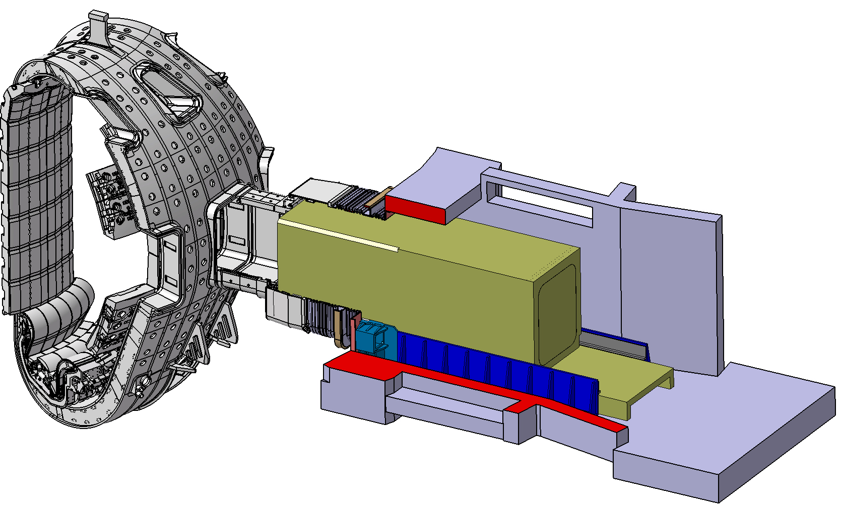
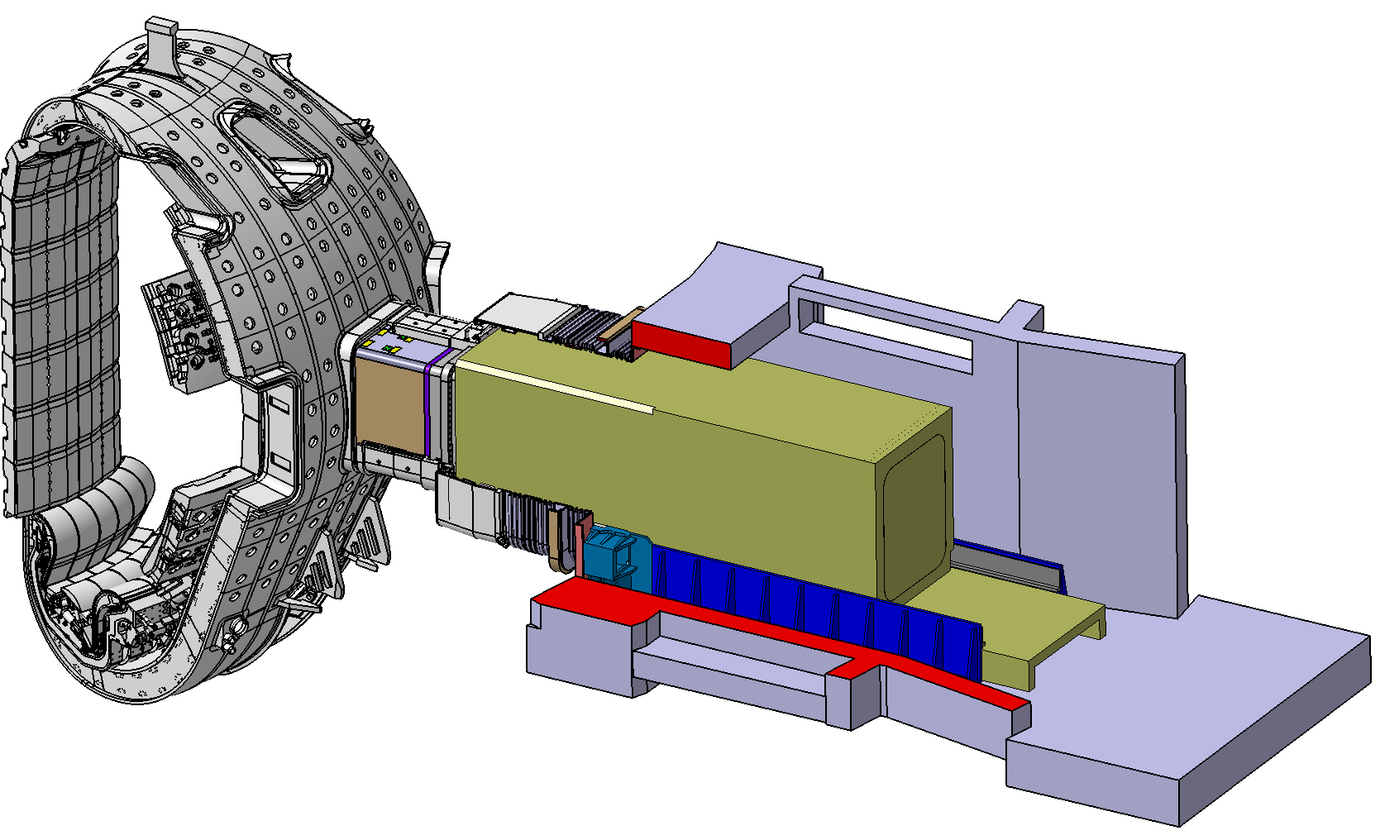
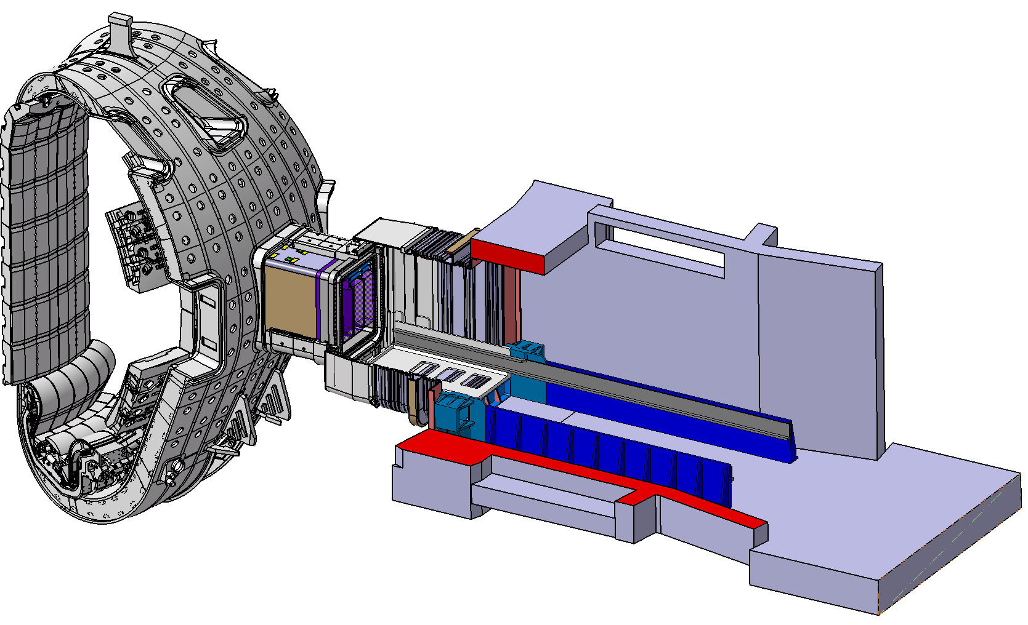
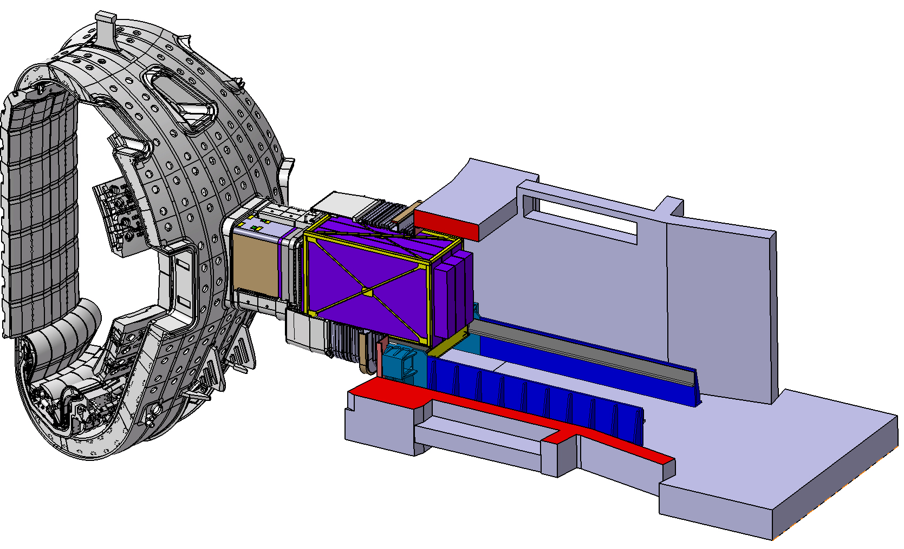
Standardization of Ex-Vessel Structures
ISS
PCSS
Port Cell Rails
Standardization of external structures will facilitate installation and maintenance.
A common rail system is planned for use be remote-handling cask and interspace and port cell diagnostic support structures.

Slide 18
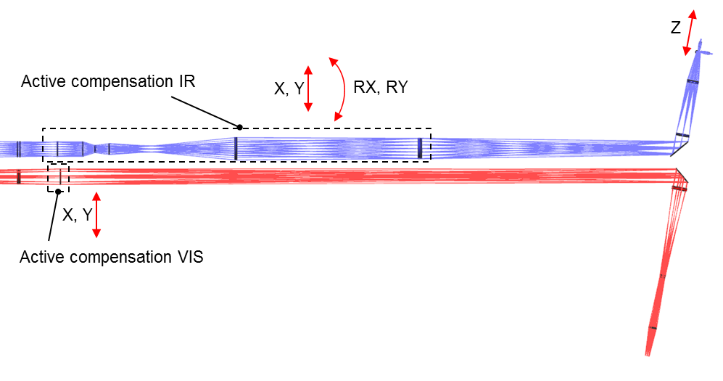
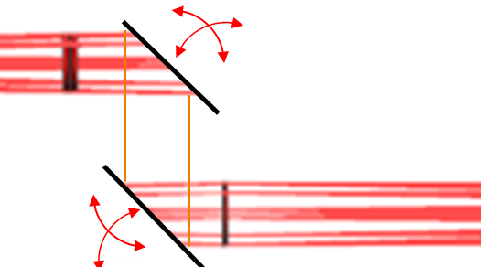
Compensating for Vessel Motion
Compared to room temperature, a point on the back of the equatorial plug will move outward and upward ~ 1 cm at 70°C and ~ 3 cm at bakeout (240°C) relative to the building.
Toroidal motions of ~ 1 cm are expected during disruptions, and shot-to-shot changes of a few mm are expected.
Vacuum extensions must be compliant to this motion.
Diagnostics such as imaging systems, laser systems, waveguide systems, are planning feedback systems to maintain alignment.
A recent manufacturing study of the upper camera diagnostic suggested compensators in the optical and IR relays
deformable tube IR compensator
tilting mirror optical compensator
O. Van der Togt, TNO

Slide 19
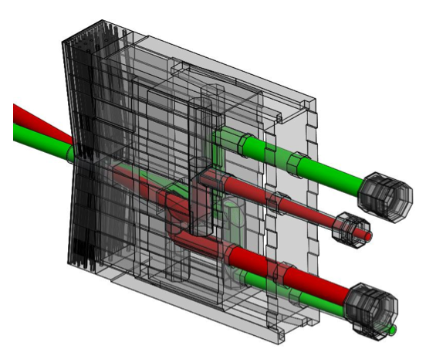
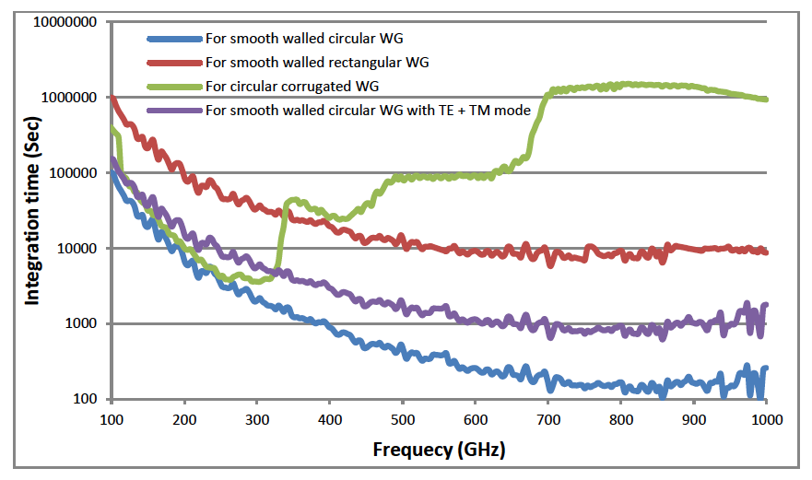
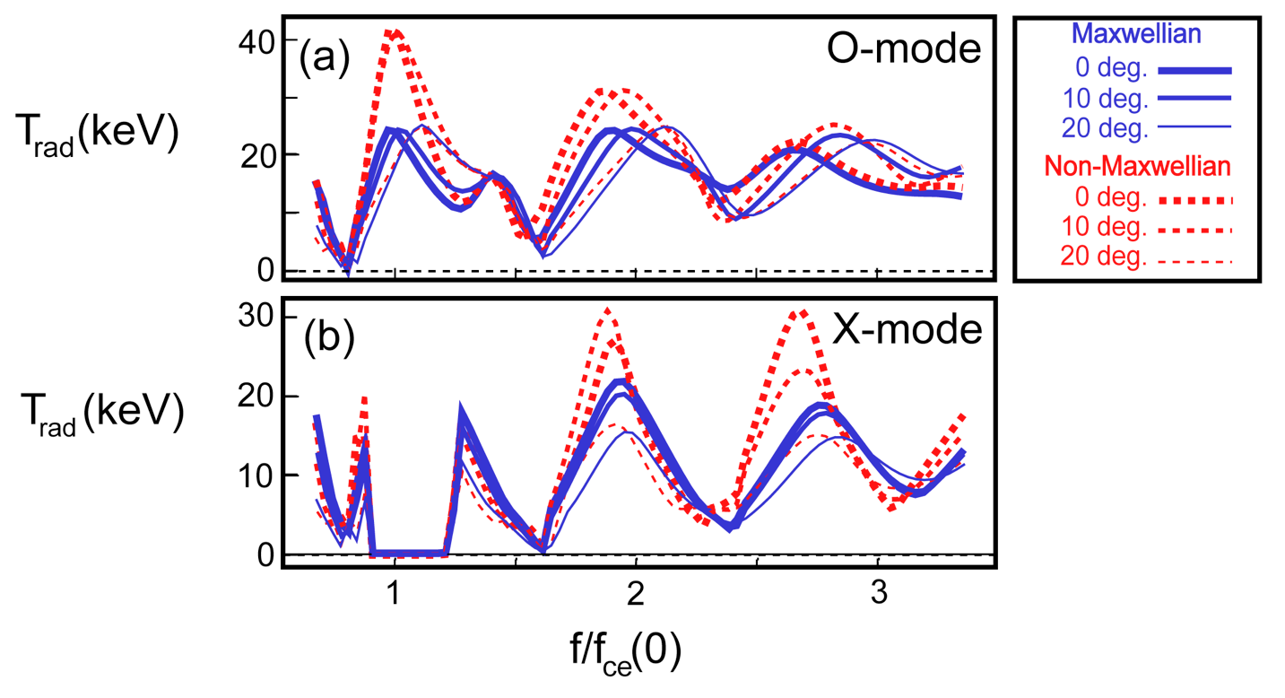
ECE Measurement Strategy
T_{e} measurements at 6 ≤ T_{e} ≤ 13 keV on TFTR and JET gave evidence of a non-Maxwelian electron distribution.
With T_{e} up to ~ 40 keV expected on ITER, the design concept for the ITER ECE radiometer has features to probe for such distortions.
Radial and oblique (~13°) views are planned with capability to make O- and X-mode, calibrated measurements of several harmonics to I THz.
Recent measurements indicate losses with circular, corrugated waveguide are too high at high frequency.
For reasonable calibration time periods, present design features smooth-walled circular waveguide and a high-throughput Michelson interferometer.
R&D is planned to confirm these design choices.
H. Pandya, IN-DA
G. Taylor, PPPL

