Slide 1

Hydrogen Isotope Trapping at Defects Created with
Neutron- and Ion-Irradiation in Tungsten
Y. Hatano¹, M. Shimada², Y. Oya³, T. Otsuka⁴, M. Hara¹, V. Kh. Alimov¹, J. Shi¹, T. Nozaki¹, M. Kobayashi³, T. Oda⁵, G. Cao⁶, K. Okuno³, T. Tanaka⁷, N. Yoshida⁴, N. Futagami⁴, K. Sugiyama⁸, J. Roth⁸, B. Tyburska-Püschel⁸, J. Dorner⁸, I. Takagi⁹, M. Hatakeyama¹⁰, H. Kurishita¹⁰, M. Sokolov ¹¹, Y. Katoh¹¹
¹U. Toyama (Japan), ²Idaho National Laboratory (USA), ³Shizuoka U.(Japan), ⁴Kyushu U.(Japan), ⁵U. Tokyo (Japan) , ⁶U. Wisconsin (USA), ⁷National Institute for Fusion Science (Japan), ⁸Max-Planck Institute für Plasmaphysik (Germany), ⁹Kyoto U.(Japan), ¹⁰Tohoku U. (Japan), ¹¹Oak Ridge National Laboratory (USA)
Outline
Background & Experimental Procedures
Radionuclides in neutron-irradiated W specimens
Effects of neutron irradiation (0.025 and 0.3 dpa) on D retention and release
Trapping mechanism (with additional information on ion-damaged W)
Tritium removal techniques
Summary
TITAN (Tritium, Irradiation and Thermofluid for America and Nippon)
T. Muroga et al., FTP/P7-14: Research on Tritium/Heat Transfer and Irradiation Synergism for First Wall and Blanket in the TITAN Project
The 24th IAEA Fusion Energy Conference, October 8-13, 2012, San Diego, USA

Slide 2
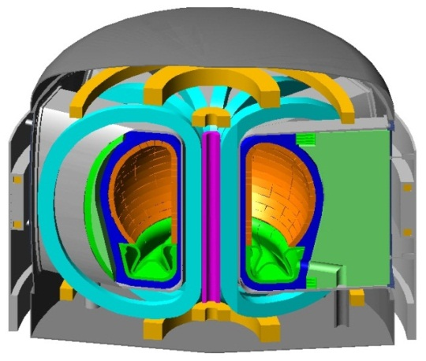
2
1. Background
We need to control tritium (T) inventory in neutron-irradiated plasma-facing materials, which may release T through the generation of decay heat under the conditions of loss-of-coolant accidents of fusion reactors.
Tungsten (W) materials are primary candidates of plasma-facing materials.
SlimCS by JAEA
T retention in W is dominated by trapping effects of radiation defects such as vacancies and voids, because the solubility of hydrogen isotopes in W lattice is extremely low.
Tungsten damaged by ion-irradiation showed that the concentration of hydrogen isotopes can reach 1 at.%. However, neutron-irradiation experiment has been scarcely carried out.
The main objectives of this presentation are to show D retention and release in/from neutron-irradiated W examined in Japan-US joint research project TITAN and to discuss trapping mechanisms.

Slide 3
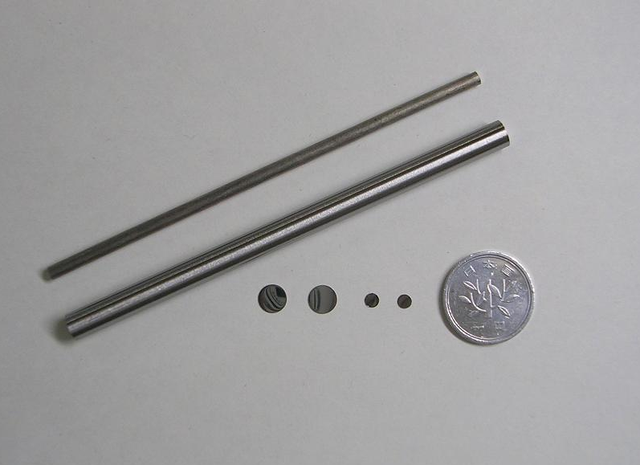
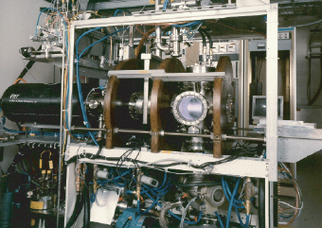
2. Experimental Procedures
(1) Neutron Irradiation and Post-Irradiation Examinations
3
(i) Irradiation in ORNL
Specimen: Disks of pure W (99.99%)(A.L.M.T. Corp., Japan)
Stress-relieve treatment (900 ºC, 1.5 h)
φ 6 mm , t = 0.2 mm
Grains are elongated in direction perpendicular to surfaces like ITER-Grade W.
n-irradiation: 0.025 and 0.3 dpa at 50 ºC (coolant temp.) in the High Flux Isotope Reactor (HFIR) (dpa = displacement per atom) ~0.5 dpa in ITER.
W specimens
(ii) Deuterium retention measurements in INL
γ-ray spectroscopy to check activation of specimens.
Exposure to D plasma in Tritium Plasma Experiment (TPE)
Specimen temp.：200 and 500 ºC.
Energy：100 eV
Flux：(5-7)×10²¹ D m⁻²s⁻¹
Fluence：(5-7)×10²⁵ D m⁻² (10 ks)
D retention was measured by Nuclear Reaction Analysis (NRA) and Thermal Desorption Spectroscopy (TDS)
TPE in INL

Slide 4
4
2. Experimental procedures (cont’d)
(2) Thermal stability of traps (to identify defects playing dominant roles in trapping )
Specimens: ITER-grade W plate (supplied by JAEA), 10 x 10 x 2 mm
Damaging: 20 MeV W ions to 0.5 dpa at room temperature
Annealing: 700–1300 ºC, 6 hours in vacuum
D₂ gas exposure: 1.2–100 kPa, 400 and 500 ºC
Measurements: TDS and NRA
Ion-damaging forms defects only in near-surface region (a few μm depth), while n-irradiation induces defects uniformly in the bulk.
To avoid any modification of damaged structure, we exposed ion-damaged W to D₂ gas instead of high-flux D plasma.
defect
At comparable damage level, total number of defects in n-irradiated W is far larger than ion-damaged one due to far larger damaged volume.
Ion-damaging
Neutron-irradiation
(3) Simulation
TMAP4 (Tritium Migration Analysis Program ver. 4) was used.
G. R. Longhurst et al., TMAP4 User’s Manual, 1992, DOI: 10.2172/7205576.

Slide 5
3. Results and Discussion
(1) Neutron irradiation and post-irradiation examinations
5
(i) Activation of W specimen after irradiation up to 0.3 dpa (16.3 days in HFIR)
Most hazardous radiation/188-Re
¹⁸⁸W T_{1/2} = 69.4 d, 0.349 MeV β
¹⁸⁸Re T_{1/2} = 17 h, 2.12 MeV β
Daughter of 188-W
Secular Equilibrium
γ-spectroscopy carried out in INL agreed with prediction by FISPACT-2001 code.
Presence of ¹⁸¹W (121 d, EC) and ¹⁸⁵W (75.1 d, 0.433 MeV β, small fraction of γ) was also predicted but not detected by γ-ray spectroscopy.
Evaluation of radioactivity in W irradiated in HFIR for 30 full-powder days (with FISPACT-2001 code).
The evaluation agreed with the values obtained by γ-ray spectrometry within factor of 2.
Dose of γ-rays was not a problem, but that of high energy β-rays was the most important issue for safe handling of n-irradiated specimens.

Slide 6
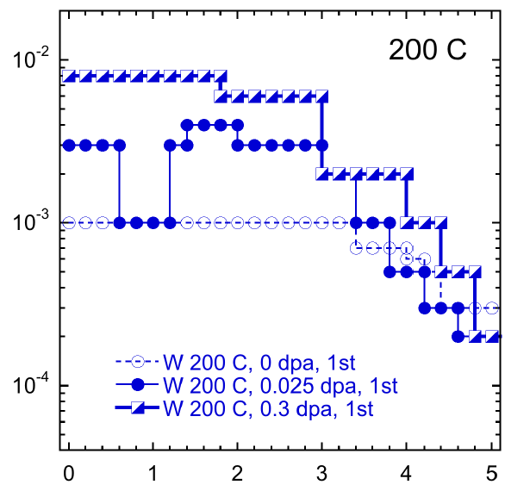
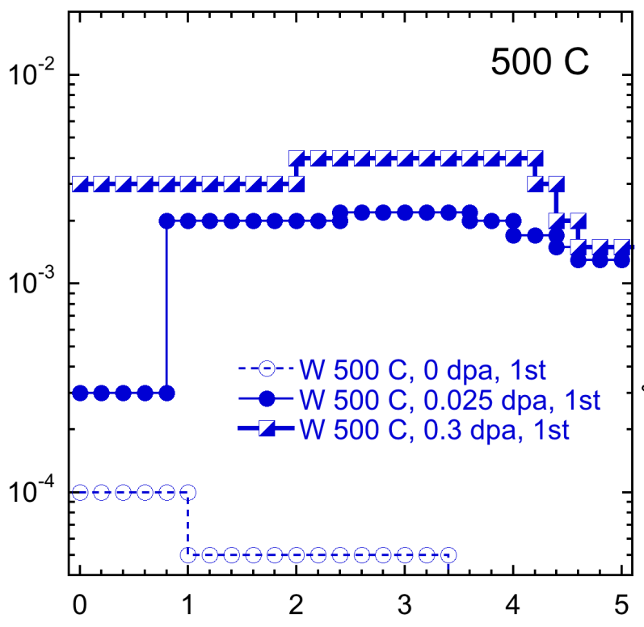
3. Results and Discussion (cont’d)
(1) Neutron irradiation and post-irradiation examinations
6
(ii) D depth profiles by NRA
Deeper penetration of D at 500 ºC!
D conc. Reached ca. 1 at%!
200 ºC
500 ºC
[D]/[W]
[D]/[W]
Depth (μm)
Depth (μm)
Depth profiles of D in n-irradiated W after exposure to D plasma at 200 and 500 ºC. D profiles for 0.3 dpa specimens are preliminary; the specimens have been exposed to plasma only one time, and no guarantee on saturation of traps with D.
Significant increase in D concentration by n-irradiation!

Slide 7
3. Results and Discussion (cont’d)
(1) Neutron irradiation and post-irradiation examinations
7
(iii) Comparison of trap density between n-irradiation and ion-damaging
★
Present study
(n-irradiated W)
Other symbols indicate data for the near-surface regions in ion-damaged W specimens.
after Roth and Schmid,
Phys. Scr. T145 (2011) 014031.
Correlation between damage level and trap density in W.
Density of traps formed by n-irradiation was comparable with that induced by damaging with high energy W self ions and H ions.
The value for 0.3 dpa specimens are preliminary; the specimen has been exposed to plasma only one time, and no guarantee on saturation of traps with D.

Slide 8
3. Results and Discussion (cont’d)
(1) Neutron irradiation and post-irradiation examinations
8
(iv) Thermal desorption spectroscopy (TDS)
Desorption of D from n-irradiated W continued up to 900 ºC!
Far larger retention in n-irradiated W than ion-damaged one.
D retention at T_{ex} = 500 ºC was
6.4 × 10²¹ D m⁻².
Because D concentration was 0.1–0.2 at.% (= 6.3–12.6 × 10²⁵ D m⁻³), penetration depth of D at T_{ex} = 500 ºC was evaluated to be 50 – 100 μm.
TDS spectra of n-irr. (0.025 dpa), ion-damaged (0.5 dpa) and non-irr. W. T_{ex} is temperature for D plasma and D₂ gas exposure.
A large D retention at T_{ex} = 500 ºC was ascribed to deep penetration of D into the bulk.

Slide 9
9
3. Results and Discussion (cont’d)
(1) Neutron irradiation and post-irradiation examinations
(v) Simulation of TDS spectrum with TMAP4 code
200 μm
Detrapping energy: 1.83 eV
Trap level (0.2 at%)
D plasma
Traps filled with D (50 μm)
Empty traps
Front side
Back side
Initial conditions for TMAP4 simulation corresponding to n-irradiated W (0.025 dpa) exposed to D plasma at 500 ⁰C.
Simulation of TDS spectrum with TMAP4 code (linear scale)
Position of main peak agreed by adjusting detrapping energy to ca. 1.8 eV.
The absence of high temperature shoulder in measured spectrum was due to annealing of defects at high temperatures (see next slide).

Slide 10
10
3. Results and Discussion (cont’d)
(2) Thermal stability of traps
What type of defect plays dominant role in trapping ?
We examined thermal stability of traps. Ion-damaged specimens (0.5 dpa) were annealed in a vacuum for 6 hours and then exposed to D₂ gas at 400 ºC and 100 kPa.
Traps were stable up to 700 ºC !
At temp. ≥800 ºC (“stage V” in recovery stages of irradiated W), annealing of defect clusters takes place.
Detrapping energy observed for n-irradiated W at T_{ex} = 500 ºC (ca. 1.8 eV) corresponds to hydrogen isotopes chemically-adsorbed on inner surfaces of vacancy clusters.
It is plausible that defects playing dominant roles in trapping at high temp. are vacancy clusters.
Effects of post-irradiation annealing on trap density

Slide 11
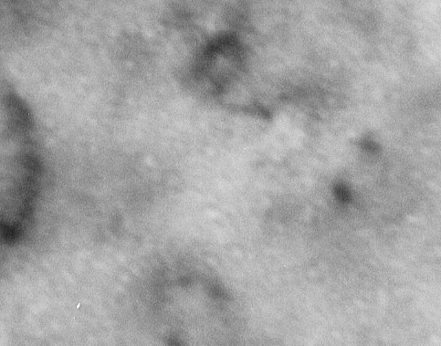
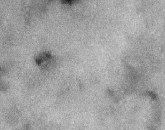
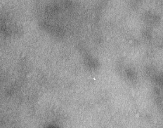
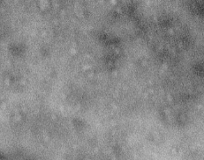
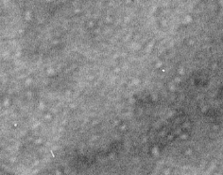
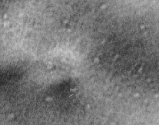
11
Formation of voids and their Thermal stability
pre-thinned recrystallized W, 2.4MeV-Cu²⁺, 1dpa 25 min at each temperature
RT
600 ºC
700 ⁰C
800 ºC
900 ºC
1000 ⁰C
10 nm
Voids are formed by cascade collision even at 300K, where single vacancies are not mobile.
Their size is about 1nm or less.
There is little change up to 973K. The voids grow above 1073K.
N. Yoshida et al. (Kyushu U.)

Slide 12
12
3. Results and Discussion (cont’d)
(2) Thermal stability of traps (cont’d)
No annealing of vacancy clusters
annealing of vacancy clusters
Due to high release temperature of hydrogen isotopes from n-irradiated W, annealing of defects during TDS measurements are not negligible.
We need to
develop desorption model with annealing effects, and/or
carry out release measurements at constant temp. below 800 ºC (with T).
Simulation of TDS spectrum with TMAP4 code (linear scale)

Slide 13
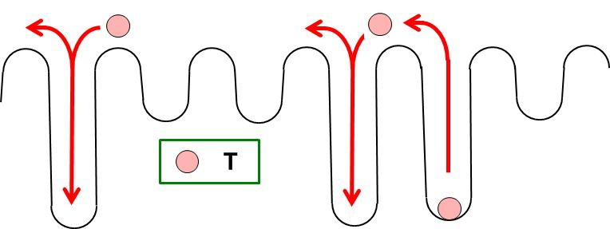
13
3. Results and Discussion (cont’d)
(3) Tritium removal techniques
(i) Simulation of T release from n-irradiated W using TMAP4
Detrapping energy = 1.8 eV.
Trap density = 0.2 at.% (uniform distribution).
Sufficiently high surface reaction rate.
No defect annihilation during heating.
Thickness of material was adjusted to 600 μm as typical thickness of armor layer of FW.
Because of small effective diffusion coefficient due to trapping effects, it is not easy to remove T from n-irradiated W by heating at moderate temperatures.
Change in T concentration with time in n-irradiated W calculated using TMAP4.

Slide 14
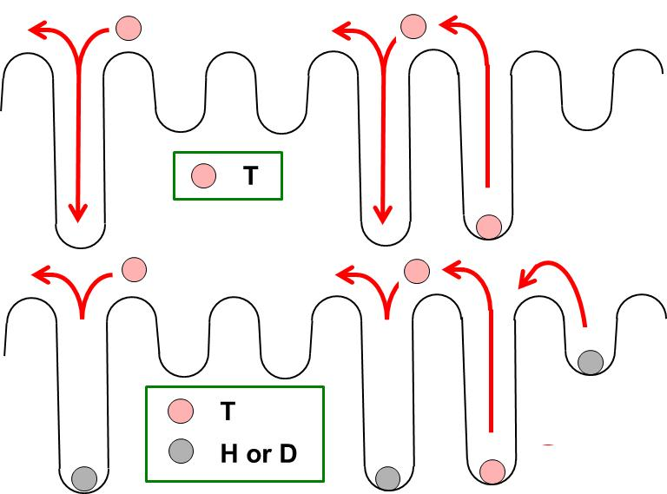
14
(ii) Enhancement of D release under the presence of H
Specimens irradiated with 20 MeV W ions were exposed to D₂ gas to saturate traps.
Heat treatments in a vacuum or H₂ gas at 673 K for 10 h
NRA analysis.
Schematics of diffusion of T in W without or with excess H or D
Strongly enhanced release of D under the presence of excess H.
D profiles after loading and after heating under the absence or presence of H

Slide 15
15
4. Summary
Neutron irradiation led to significant increase in D retention. D concentration reached ca. 1 at.% after n-irradiation to 0.3 dpa and D plasma exposure at 200 ºC. The extent of increase in D concentration was comparable with ion-damaging.
Exposure of n-irradiated W to plasma at 500 ºC resulted in deep penetration of D (50–100 μm). The D desorption was incomplete even at 900 ºC because of long diffusion distance under the trapping effects.
Defects playing dominant role in trapping at high temperatures appeared to be vacancy clusters.
A simulation showed T removal from n-irradiated W by baking in a vacuum at moderate temp. (≤ 400 ºC) could not be so effective.
Release of T should be significantly enhanced under the presence of H and/or D.
Acknowledgements
This work was supported mainly by Japan-US joint project TITAN and also by Kakenhi on Priority Areas 476 “Tritium for Fusion” and NIFS Bilateral Collaboration (NIFS10KUMR004).
Non-radioactive part of the work was carried out as volunteer-base collaboration between Max-Planck Institute für Plasmaphysik, Germany and Japanese universities.
ITER-grade W specimens were supplied by JAEA.

Slide 16
New project in Japan-US collaboration: PHENIX (2013-2018)
PFC evaluation by tritium Plasma, HEat and Neutron Irradiation eXperiments
Representatives Y. Ueda (Osaka U.) and P. Pappano (DOE)
The objective of this project is to evaluate the feasibility of He gas-cooled divertor with tungsten material armor for DEMO reactors.
Neutron irradiation experiments for W materials will be carried out also in PHENIX project to understand effects of irradiation on thermo-mechanical properties of W materials and T behaviors.

