Slide 1
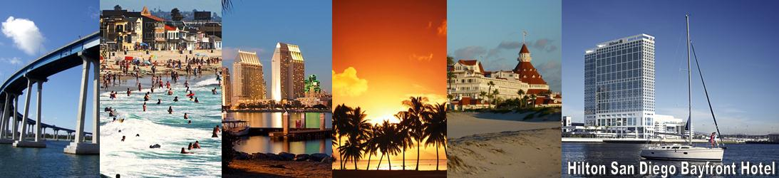
24th IAEA Fusion Energy Conference – IAEA CN-197
San Diego, USA 8-13 Oct.
EX/4-4
Control of 3D edge radiation structure with RMP fields applied to stochastic layer and stabilization of radiative divertor plasma in LHD
M. Kobayashi¹, S. Masuzaki¹, I. Yamada¹, Y. Narushima¹, C. Suzuki¹, N. Tamura¹, B.J. Peterson¹, S. Morita¹, C.F. Dong¹, N. Ohno², S. Yoshimura¹, Y. Feng³, M. Goto¹, K. Sato¹, T. Akiyama¹, K. Tanaka¹, and the LHD experimental group¹
¹ National Institute for Fusion Science, Toki 509-5292, Japan
² Nagoya University, Nagoya 464-8603, Japan
³ Max-Planck-Institute fuer Plasmaphysik, D-17491 Greifswald, Germany

Slide 2
Introduction : Control of enhanced radiation at divertor region
Necessity of divertor heat load reduction for future devices:
Divertor detachment, radiative divertor is prerequisite to meet the engineering limit of PFC heat load (< several MW/m²).
→Control of enhanced radiation region in its location & intensity is one challenging issue.
Involved issues in the physics:
A/M processes with strong non-linearity in cold plasma
Energy transport in parallel/perpendicular to field lines
Impurity transport, plasma recycling with volume recombination, momentum loss process
3D magnetic field configuration:
Seeking divertor optimization in helical devices, RMP application to tokamaks
→ Effects of three dimensionality/symmetry breaking on radiating edge plasma are not yet fully understood.
This paper reports recent experimental results of radiative divertor stabilization with RMP application to the edge stochastic layer of LHD.
Radiative Divertor stabilization with RMP
RD transition induced by RMP
Compatibility with main plasma confinement
Magnetic structure dependence of RD stabilization

Slide 3
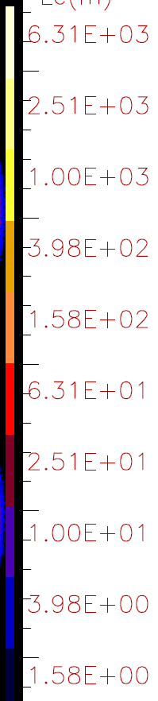
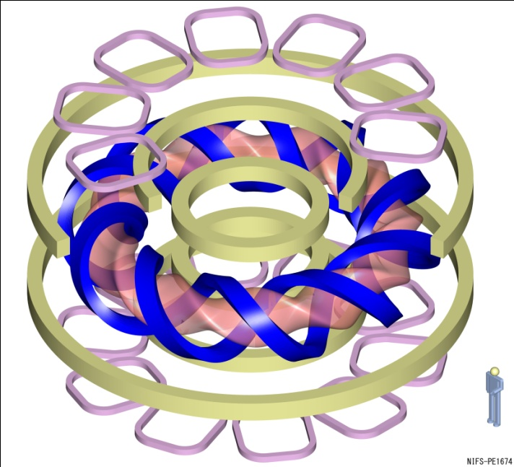
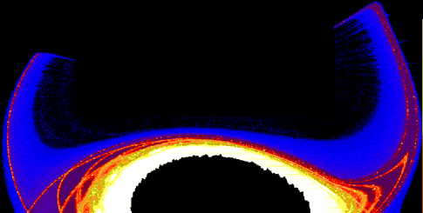
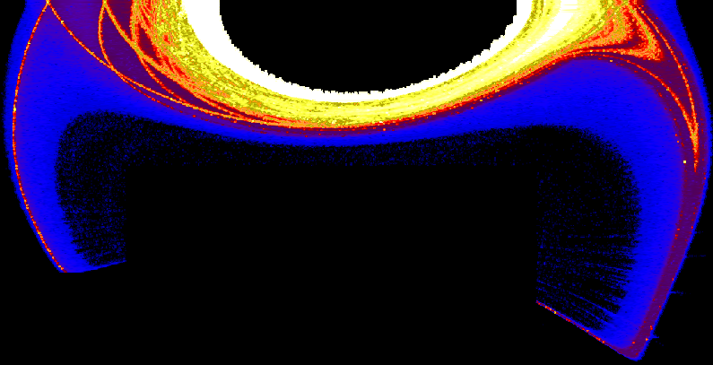
Magnetic field structure of LHD: RMP (m/n=1/1) application
→ remnant island in stochastic region
R = 3.9 m, a ~ 0.7 m, 10 field periods (toroidal)
Divertor : carbon, Fist wall : Stainless steel
Connection length (m)
10⁰
10¹
10²
10³
10⁴
RMP coils
(m/n=1/1)
1.0
Divertor legs
Helical coils
Edge surface layers
0.5
Without RMP
Plasma shape
Z (m)
0
With RMP (m/n=1/1)
Without RMP
-0.5
Stochastic region
Magnetic island O-point
Resonance value
With RMP
Rotational transform ι
-1.0
2.5
3.0
3.5
4.0
4.5
5.0
R (m)

Slide 4
With RMP → Stable sustainment of radiative divertor operation (RMP assisted RD)
Without RMP → Radiation collapse due to thermal instability
Significant increase in carbon emission
Radiative divertor
CIII (a.u.)
Radiative divertor
Stable operation around density limit
CIV (a.u.)
With RMP
Without RMP
CV (a.u.)
Radiation
(a.u.)
Radiation increase by a factor of ~ 3
CVI (a.u.)
With RMP
Reduction of divertor power load by a factor of 3 ~ 10
Divertor power
load (MW/m²)
No noticeable high Z impurity (Fe) emission at high density range.
Plasma shrinks at RD phase due to radiative energy loss and RMP penetration
W_{p} (kJ)
No significant degradation of main plasma confinement
Attach
(n_{e} = 2.0x10¹⁹ m⁻³)
RD (6.6x10¹⁹ m⁻³)
S. Morita et al. EX/P5-18

Slide 5
Increased volume of low T_{e} region (~10 eV) at remnant island with RMP leads to enhanced carbon radiation
T_{e}, n_{e} profiles at outboard midplane
(Thomson scattering)
n_{e} dependence of radiation power (bolometer)
Resonance layer
Without RMP
Radiation collapse
With RMP
T_{e} flattening at island
RD
Radiation Power (a.u.)
Radiation enhanced
With RMP
Without RMP
Carbon radiation
(Estimated with n_{carbon}=0.01n_{e}
n_{e}τ = 10¹⁷ m⁻³ s)

Slide 6
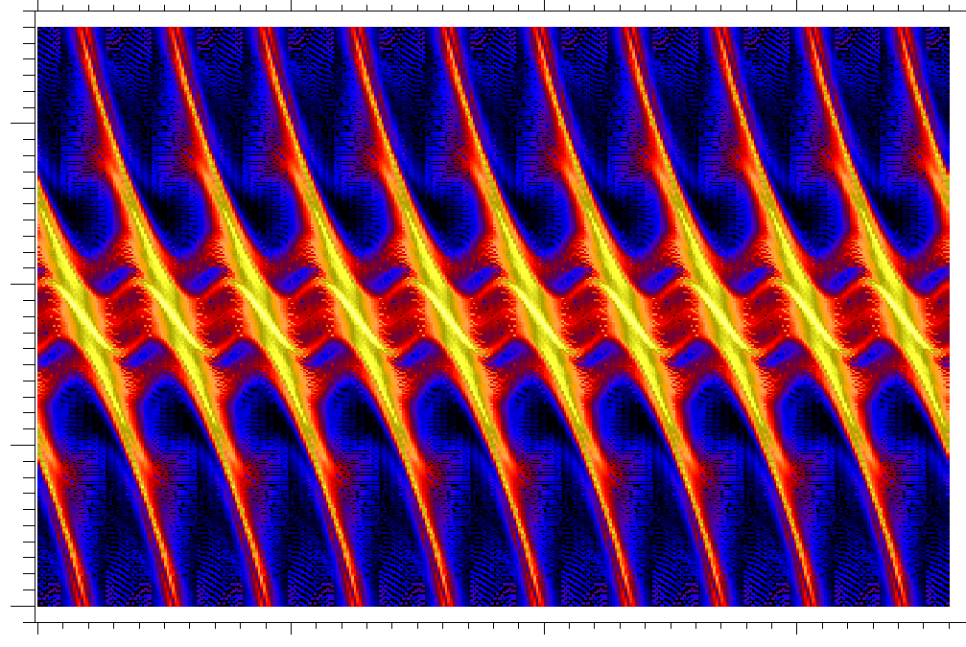
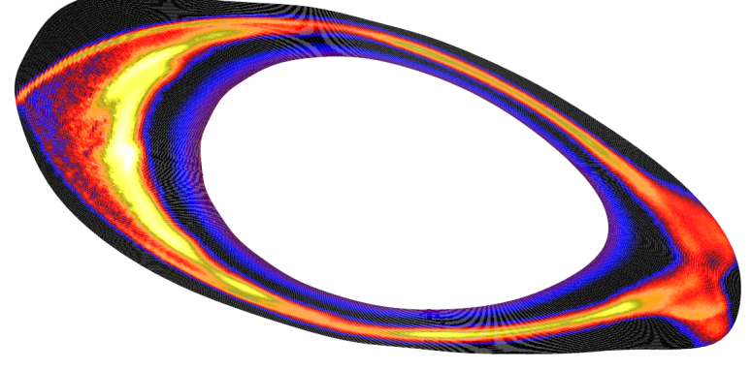
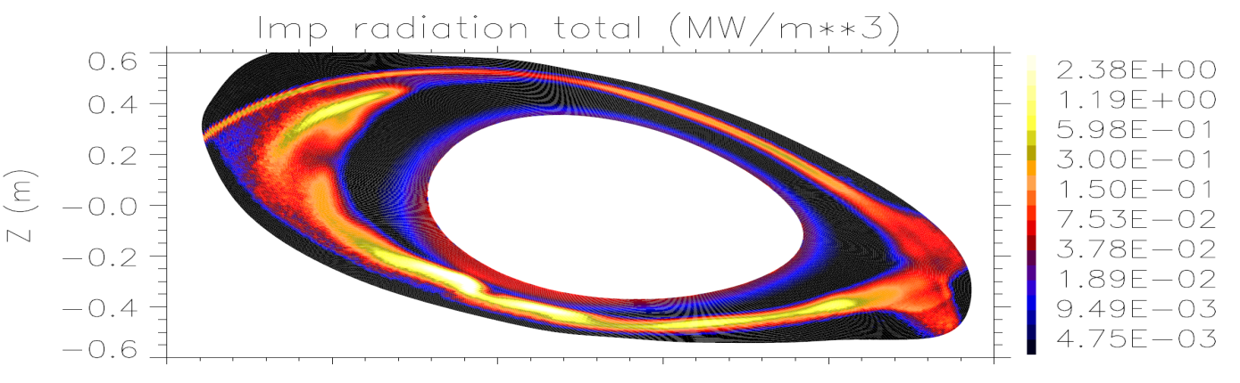
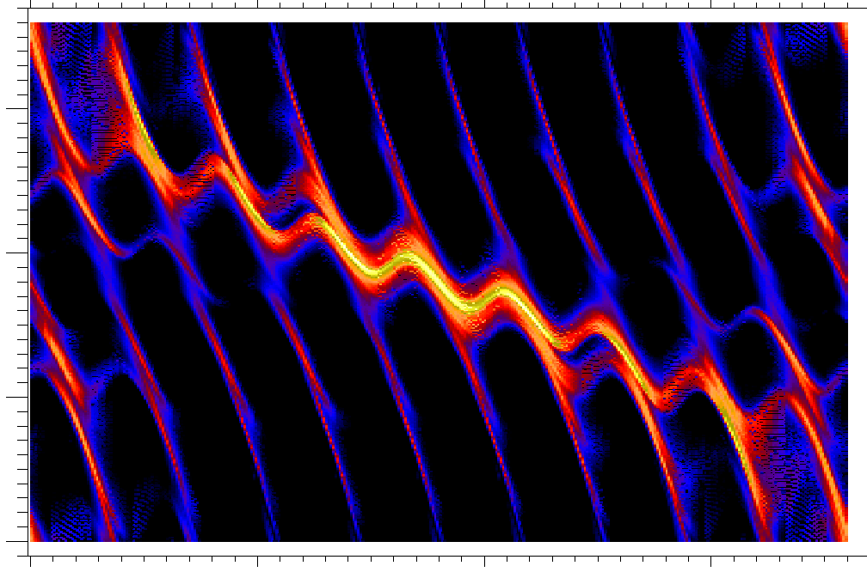

Modification of 3D edge radiation structure by RMP : 3D numerical simulation
Carbon radiation distribution by EMC3-EIRENE
Without RMP
Outboard
300
Inboard
side
Outboard
side
Without RMP
200
Poloidal angle (deg.)
Inboard
100
Radiation peak at inboard side
2.0x10⁰
2.0x10⁻¹
2.0x10⁻²
2.0x10⁻³
MW/m³
Outboard
0
With RMP
Outboard
300
Z
With RMP
200
Poloidal angle (deg.)
Inboard
Localization around X-point of m/n=1/1 island
R
100
X-point of island
0
Outboard
0
100
200
300
Without RMP → Radiation peak appears at inboard side.
With RMP → X-point of m/n=1/1 island is selectively cooled.
Toroidal angle (deg.)

Slide 7
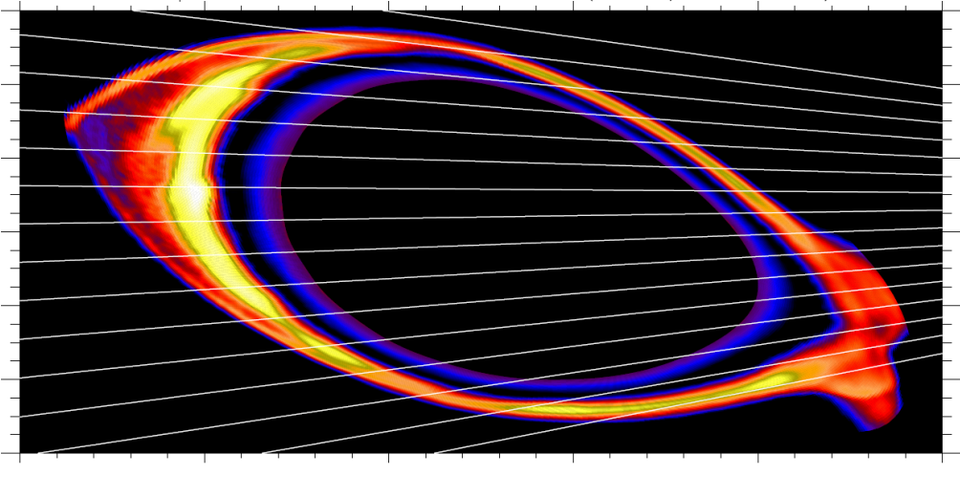
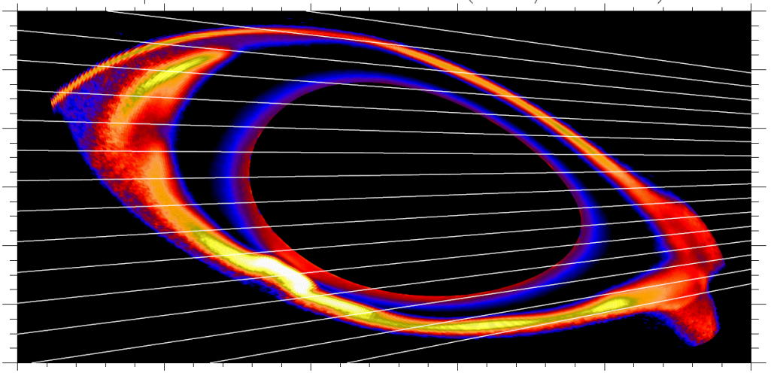
Radiation profile : Comparison between experiments & simulation
Intensity (mW/m²)
Carbon radiation distribution by EMC3-EIRENE
Ch16
Experiments
Systematic downward shift of peak location by 2 channels in experiments.
Fine structure in simulation is not observed in experiments.
The qualitative change of profiles due to RMP application roughly agrees between experiments & simulation.
Inboard side
LOS of
measurements
Channel
Without RMP
Ch1
Simulation
Results implies selective cooling at X-point of m/n=1/1 island in experiments.
Channel
The well-structured magnetic field “catches” the radiation and prevents it from penetrating inward?!
X-point of island
With RMP
Intensity (a.u.)

Slide 8
RD transition can be induced by RMP ramp-up
→ new control knob for divertor power load reduction
Time evolutions of RMP ramp-up experiment
Density & NBI heating are kept constant before RD transition.
RMP strength is increased during discharges.
Radiation increase & divertor particle flux reduction occurs when RMP ( ) reaches 0.07~0.08%.
plasma
RMP is suppressed in attached phase
→ Sudden penetration of RMP at RD transition
Healing
ΔΦ
r
plasma
ΔΦ
(10⁻⁴ Wb)
r
Growth
Phase of
(π rad)
Compatibility with Ne seeding scheme is confirmed.

Slide 9
Main plasma confinement : Recovery of energy confinement after RD transition ( ) due to pressure profile peaking
Confinement enhancement factor vs n_{e}
Without RMP
With RMP
(radiative divertor)
p_{e} profiles with & without RMP
With RMP
(radiative divertor)
Without RMP
exp
ISS04
τ
τ
E
/ (f_{ren} )
E
RD transition
With RMP
(attach)
With RMP (attach)
Increase of n_{e} leads to confinement degradation without RMP.
Significant degradation in RMP attached phase ← due to large magnetic island in the edge.
Energy confinement recovers after RD transition with RMP ← due to pressure peaking.
The cause of the pressure peaking is under investigation.

Slide 10
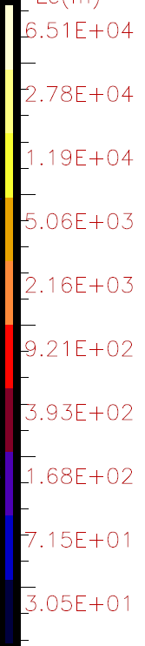
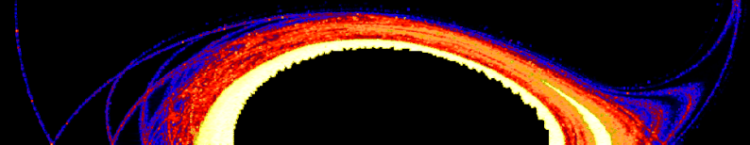
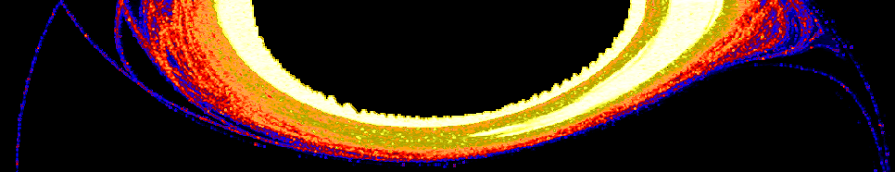
Realization of RMP assisted RD depends on RMP strength & radial location of island with respect to LCFS
RD controllability in terms of magnetic field structure
Stable RD
Healing
Radiation collapse
(r _{X point} – r _{LCFS} ) _{vac} ( m )
No T_{e} flattening due to plasma healing
Stable RD
Radiation collapse
0
2.0x10⁻⁴
1.0x10⁻³
2.0x10⁻³
Connection length (m)
6x10¹
6x10²
6x10³
6x10⁴
Lower threshold of RMP strength depends also on MHD plasma response
Separation between radiation region (island) & confinement region is important factor for stable RD operation
←Radial extension of radiation region ~ several cm
S. Sakakibara et al. EX/P4-30
LCFS
Clearance between island & LCFS is too small

Slide 11
Summary
Effects of edge magnetic structure on RD plasma have been investigated with RMP (m/n=1/1) application to stochastic layer of LHD.
With RMP → stable sustainment of RD (RMP assisted RD)
Without RMP → radiation collapse due to rapid growth of thermal instability
The remnant island created by RMP modulates the radiation distribution
Increased volume of cold and dense plasma around island → enhanced radiation
Strong radiation condensation around island X-point ← radiation profile measurements and 3D transport simulation
Selective cooling around the island is considered responsible for stabilization of RD operation
RD transition can be induced by RMP ramp-up → New control knob for divertor heat load reduction
RMP assisted RD is compatible with Ne seeding scheme
Good main plasma energy confinement factor ~ 0.96 during RMP assisted RD
Due to pressure peaking after RD transition
Operation space of RMP assisted RD investigated in terms of & distance between the island and main plasma
Lower threshold of is affected by MHD plasma response (healing of island)
Separation between island and main plasma should be large enough > radial extension of radiation region (~ several cm)
Further investigations
♠ Power balance : consistency between divertor heat load reduction and total radiated power
♠ Divertor heat load distribution : toroidal and poloidal direction
♠ Compatibility with medium – high Z impurity (Ar, Kr, Xe etc) seeding schemes
♠ Mechanism of the stabilization : transport in 3D magnetic field structure

Slide 12
Backup materials

Slide 13
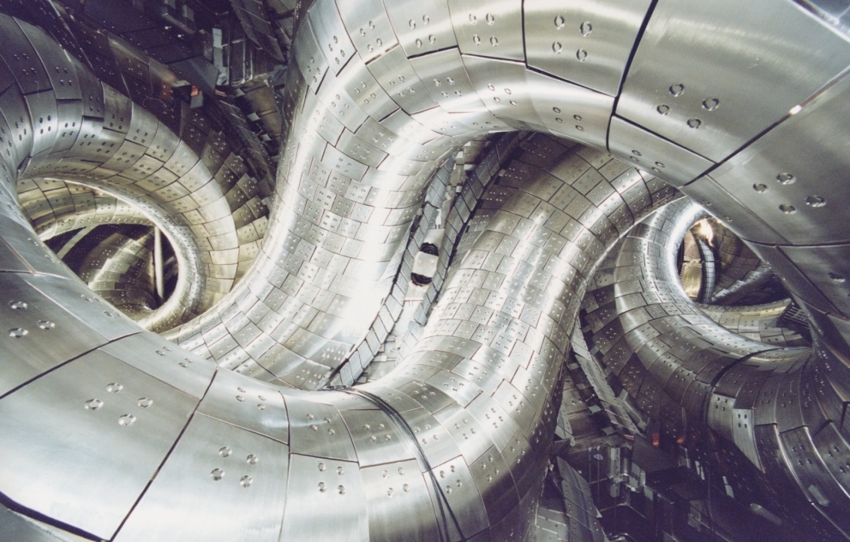
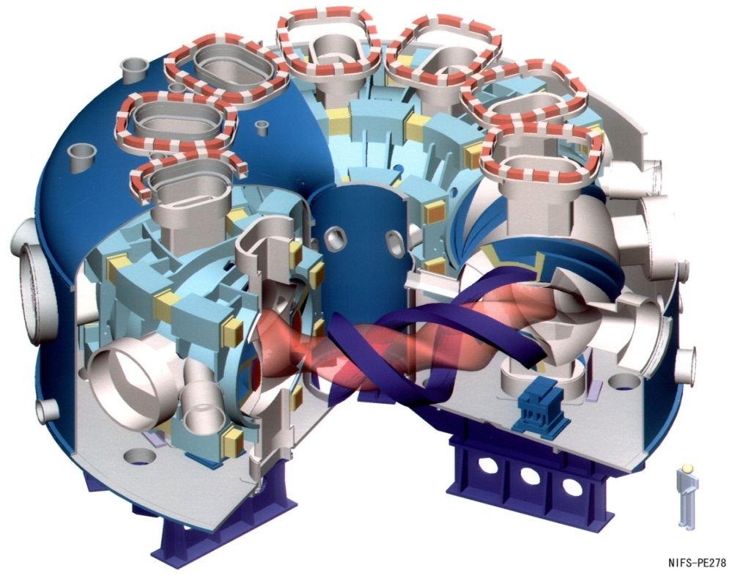
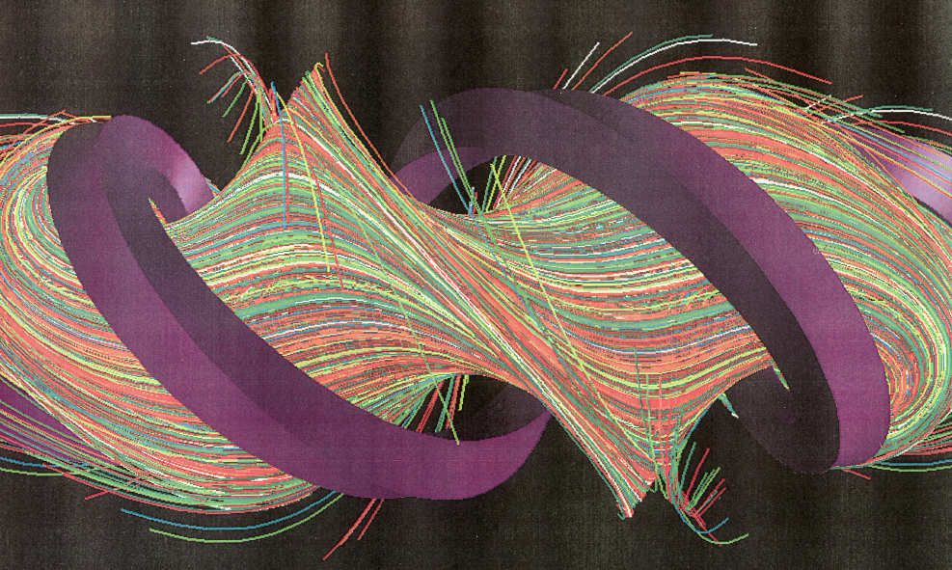
Large Helical Device (LHD) and magnetic field structure
(a)
Perturbation coils m/n=1/1
(b)
Inside view of vacuum vessel
divertor plate
Helical coils
Helical coils
R=3.90 m
a~0.70 m
Plasma shape
divertor leg field lines
Major Specification
Major radius =3.90 m
Averaged plasma minor radius ~ 0.7 m
Plasma volume ~ 30 m³
RMP: m/n=1/1
Divertor: carbon
First wall: stainless steel
B_{t} ~ 3T
NBI heating ~ 23 MW
Field line trajectories in the edge of LHD

Slide 14
Divertor probe measurements indicates non-uniformity of divertor power load in the RD phase (m/n=1/1?) → Toroidal distribution is under investigation
Inboard divertor
Decrease of Divertor flux at strike point:
Factors of 1/6 @ inboard, 1/3 @ upper divertor
Flux broadening to private region (the pattern has n/m=1/1 mode structure)
1/6
Flux broadening
Toroidal profile of private particle flux
Upper divertor
1/3

Slide 15
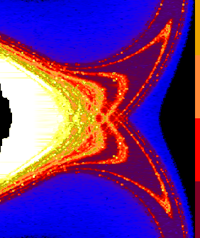
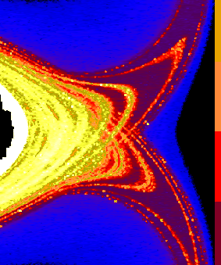
Close correlation between radiation profile and magnetic field structure
With RMP, radiation penetration is “blocked” by island (?!) → RD stabilization
Without RMP
With RMP
1x10⁴
Long flux tubes of m/n=1/1 remnant island
1x10³
midplane
Connection length (m)
Confinement region
1x10²
1x10¹
1x10⁰
Radiation penetration is “blocked” by remnant island (?!)
→stabilization
10¹
n_{carbon}=0.01n_{e}
n_{e}τ = 10¹⁷ m⁻³ s
10⁰
Radiation at midplane
(MW/m³)
10⁻¹
Radiation penetration to core
→collapse
Radiative divertor
10⁻²
R (m)
R (m)

Slide 16
Compatibility with Ne seeding scheme is confirmed.
Radiation enhanced with Ne seeding
RMP assisted RD
Divertor particle flux (A)

Slide 17
T_{e}, n_{e} profiles at attach & RD phase with RMP
With RMP
Attach
Radiative divertor

Slide 18
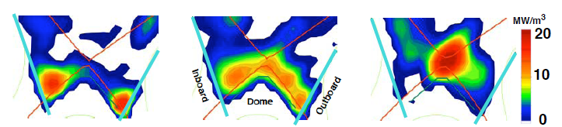
Detachment onset
X-point MARFE
X-point
(S. Konoshima JNM 2003)

Slide 19
RMP assisted RD
Divertor power
load (MW/m²)
Without RMP
With RMP
W_{p} (kJ)

Slide 20
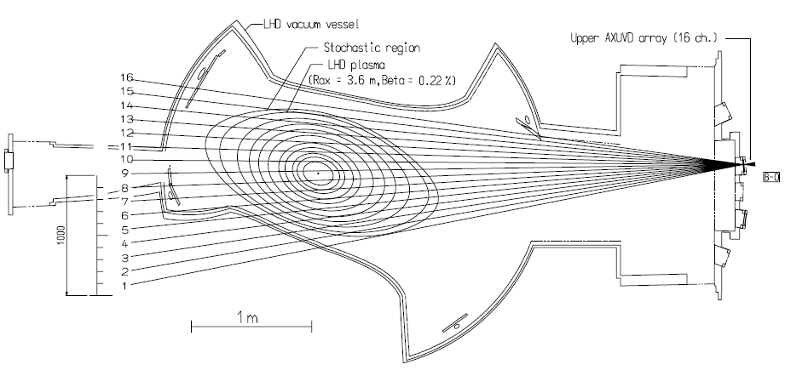
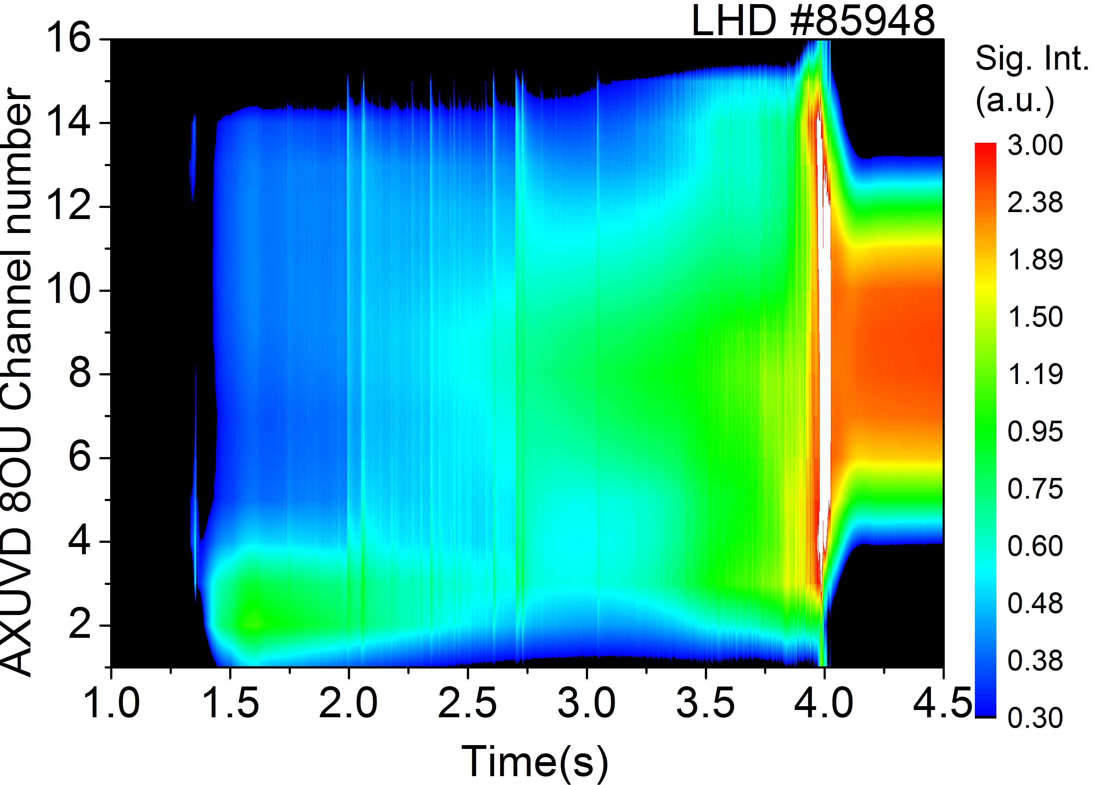
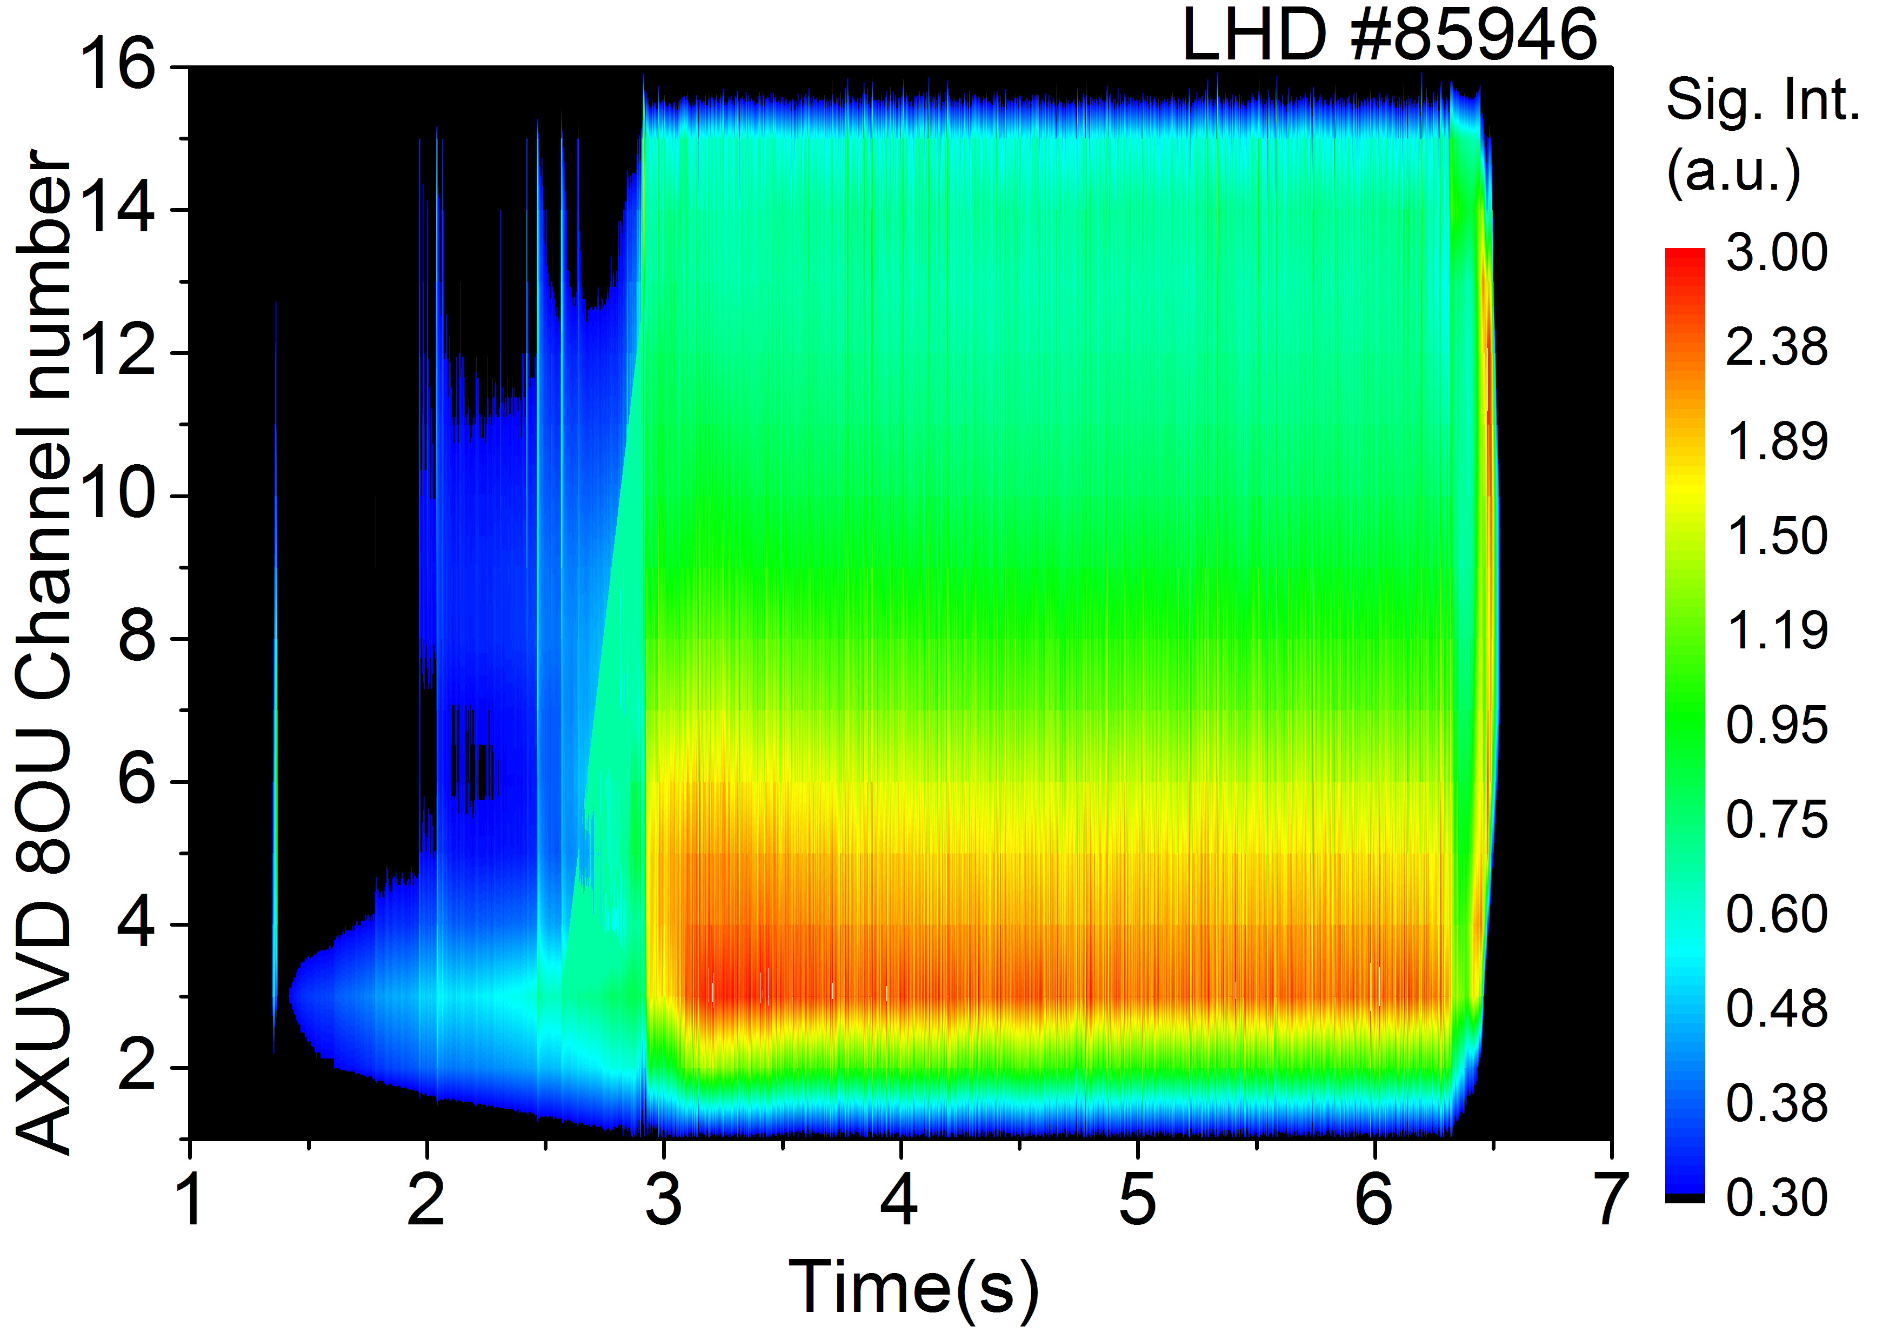
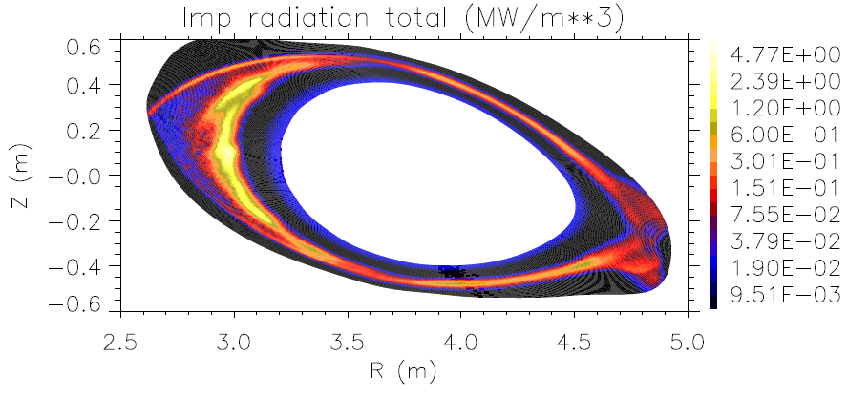
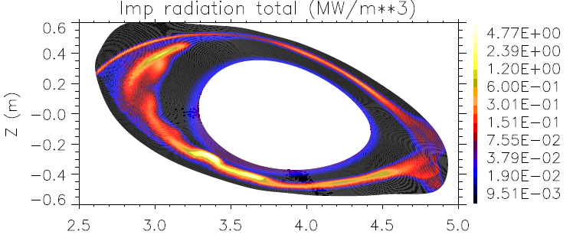
Radiation profile measurement & transport simulation indicate localized radiation around X-point of m/n=1/1 island
Upper
Ch.16
Viewing lines
Viewing lines of radiation measurements
Ch.4
Lower
Ch.1
radiative collapse
<Experiments>
Without RMP
With RMP
Line integrated radiation profiles (AXUVD)
RMP assisted RD
Channel number
Ch.4
<Simulation>
Without RMP
With RMP
(MW/m³)
t~3.0 s
t~3.1 s
8.0x10⁰
Impurity radiation distribution
Island X-point
8.0x10⁻¹
Z (m)
8.0x10⁻²
8.0x10⁻³
R (m)
R (m)

