Slide 1
Towards an Emerging Understanding of Nonlocal Transport
K.Ida¹⁾, Z.Shi²⁾, H.J.Sun^{2,3)}, S.Inagaki⁴⁾, K.Kamiya⁵⁾, J.Rice⁶⁾, N.Tamura¹⁾, P.H.Diamond³⁾, T.Estrada⁷⁾, C.Hidalgo⁷⁾, X.L.Zou⁸⁾, G.Dif-Pradalier⁸⁾, T.S.Hahm⁹⁾, U.Stroth¹⁰⁾, A.Field¹¹⁾, K.Itoh¹⁾, X.T.Ding²⁾, J.Dong²⁾, S.-I.Itoh⁴⁾, Y.Sakamoto⁵⁾, S.Oldenbürger¹²⁾
¹National Institute for Fusion Science, Toki, 509-5292 Japan,
²Southwestern Institute of Physics, Chengdu, China,
³WCI Center for Fusion Theory, National Fusion Research Institute, Daejeon, Korea,
⁴Research Institute for Applied Mechanics, Kyushu Univ., Kasuga, 816-8580, Japan,
⁵Japan Atomic Energy Agency, Naka, 311-0193 Japan,
⁶MIT Plasma Science and Fusion Center, Cambridge MA 02139 U.S.A.,
⁷Laboratorio Nacional de Fusion, Asociacion EURATOM-CIEMAT, 28040 Madrid, Spain,
⁸Association Euratom-CEA, CEA/IRFM, F-13108 Saint Paul-lez-Durance cedex, France,
⁹Seoul National University, Seoul, Korea,
¹⁰ Max-Planck-Institut für Plasmaphysik, Boltzmannstrasse 2 , 85748 Garching, Germany,
¹¹Culham Centre for Fusion Energy, Abingdon, Oxfordshire, OX14 3DB, UK,
¹²Itoh Research Center for Plasma Turbulence, Kyushu Univ., Kasuga, 816-8580, Japan
8 -13 October 2012
IAEA Fusion Energy Conference
San Diego, U.S.A.
Notes:
I will present overview paper on the issue of nonlocal transport on behalf of international research group on transport study both in experiment and theory, that are aiming the deep understanding of nonlocal transport.

Slide 2
OUTLINE
Introduction
Violation of local closure in the transport
2-1 Transition between concave and convex ITBs
2-2 Appearance of violation of local closure by perturbations
2-3 Interference between energy and momentum flux
3 Fluctuations associated with “non-local” response
3-1 Long range fluctuations
3-2 Fast changes of turbulence spectra
3-3 Modulation of micro-scale turbulence with meso-scale fluctuations
4 Brief survey of relevant theoretical approaches
5 Summary
Notes:
This is outline of my talk. At first I would like to give a short introduction of non-local transport and violation of local closure in the transport.
Then I will discuss the experimental evidences that clearly shows the violation of local closure in the transport. For example, the transition between the concave and convex ITBs, appearance of violation of local closure by perturbation and interference between energy and momentum transport.
The second topics in my talk is fluctuation associated with non-local response presented in the examples. In this part, I will discuss three issues, long range fluctuations, fast change of turbulence spectra and modulation of micro-scale and mesp-scale turbulence. Finally I would like to summarized my talk.

Slide 3
Local closure of Heat and momentum transport ?
Formulae of transport relations are NOT always expressed in terms of LOCAL plasma parameters.
Heat transport
Local expression in terms of fluctuations
Local closure
How fluctuations are given by mean plasma parameters?
If mean free path of fluctuations is zero, local diffusion
However, there are meso- and macroscopic fluctuations
→ Local closure is broken
So is for Momentum transport
Key issue: Experimental identification of violation of local closure;
Similarity/difference in energy and momentum transport?
’Turbulence property' in terms of mean plasma parameters?
Notes:
In this viewgraph I will explain the local closure in the transport.
Formulae of transport relations are NOT always expressed in terms of LOCAL plasma parameters.
For example when the heat transport is expressed with this expression, the formulae is local expression in terms of fluctuations.
When the heat flux is expressed with mean plasma parameter, it is local closure.
Then the question is how fluctuations are given by mean plasma parameters?
If mean free path of fluctuations is zero, the transport becomes local diffusion,
However, there are meso- and macroscopic fluctuations with the scale of k_perprhoI is much lower than unity or inverse of minor radius.
In this case the local closure is broken.
Momentum transport is expressed similar to the heat transport.
So the key-issue is Experimental identification of violation of local closure;
and
Similarity/difference in energy and momentum transport?
’Turbulence property' in terms of mean plasma parameters?

Slide 4
How to find the violation of local closure
When the transport is simple (diffusive and local) the transport analysis with steady state would be enough
In order to evaluate the non-diffusive contribution in transport, transport analysis during the transient phase is necessary.
Gas puff modulation in particle transport
NBI modulation in the momentum transport.
This is because the radial profile in the steady state can be reproduced by arbitrary diffusion coefficient in many cases.
In order to evaluate the non-local contribution in transport, transport analysis during the transient phase by transition or perturbation is necessary.
ITB curvature transition, L/H transition
Edge cooling by SMBI, TESPEL laser blow off.
Non-local contribution always exists similar to that the non-diffusive contribution always exists in the particle and momentum transport.
Notes:
Then I will explain How to find the violation of local closure from the analogy of finding non-diffusive term of transport in this view graph.
When the transport is simple (diffusive and local) the transport analysis with steady state would be enough.
In order to evaluate the non-diffusive contribution in transport, transport analysis during the transient phase is necessary.
For example Gas puff modulation is necessary. in particle transport and NBI modulation necessary in the momentum transport.
This is because the radial profile in the steady state can be reproduced by arbitrary diffusion coefficient in many cases.
Therefore
In order to evaluate the non-local contribution in transport, transport analysis during the transient phase by transition or perturbation is necessary.
I will present the ITB curvature transition as a example of “transition” and
Edge cooling by SMBI, TESPEL laser blow off as a example of perturbation.
Non-local contribution always exists similar to that the non-diffusive contribution always exists in the particle and momentum transport.

Slide 5
Transition between concave and convex ITBs
The transition to convex shaped ITB is spontaneous without any change in q-profiles shows a clear evidence of violation of local closure, because the local parameters except for ∇Ti are unchanged.
JT-60U
The "oscillation" between two states clearly shows that the non-locality of heat transport can occur in space and time
(as a memory effect).
→Non-Markovian property of transport.
Change in heat flux is 50%
→ Significant contribution of non-local transport
JT-60U
K.Ida Phys Rev Lett 101 (2008) 055003
Notes:
This view graph shows the clear experimental evidence in JT-60U where the local closure is broken in ion heat transport.
The transition to convex shaped ITB is spontaneous without any change in q-profiles shows a clear evidence of violation of local closure, because the local parameters except for ∇Ti are unchanged.
This is the transition between two state of ITB observed in JT-60U, one is concave ITB indicated by blue and convex ITB indicated with red symbols.
In the convex ITB the second derivative of ion temperature (namely curvature) becomes mainly negative.
It is interesting that the oscillation between convex and concave ITB is observed in the time evolution of ion temperature gradient at the normalized minor radius of 0.58 and 0.71.
The "oscillation" between two states clearly shows that the non-locality of heat transport can occur in space and time (as a memory effect).
This experiment suggest the Non-Markovian property of transport.
This figure shows the change in heat flux during the transition phase between two state.
And the Change in heat flux is 50% which shows that there is a significant contribution of non-local transport

Slide 6
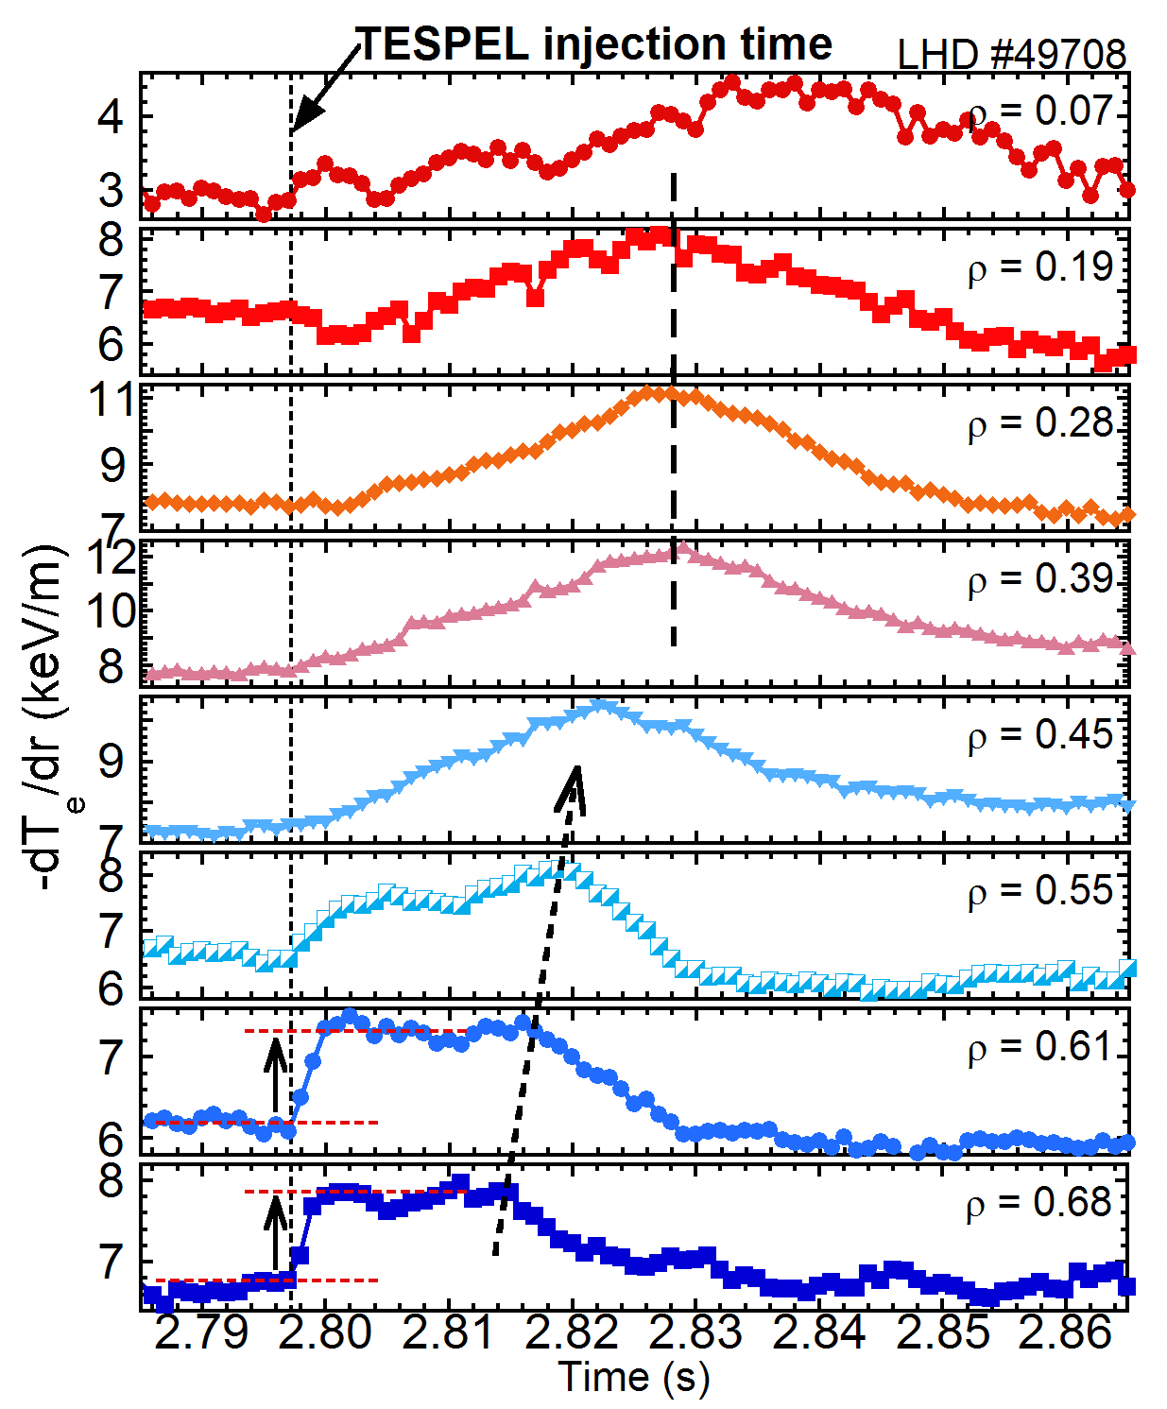
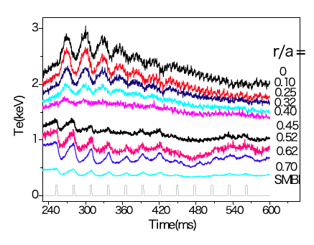
Appearance of violation of local closure by perturbations
In the steady state plasma, non-local transport contribution can not be identified because of profile resilience (stiffness) → perturbation is necessary
LHD
HL-2A
Non-local response (core Te rise by edge cooling) appears in the plasma with SMBI, TESPEL, Laser blow off in many devices when the density is low enough. (It disappears as the density is increased)
Meta-stable state in transport is observed in the temperature gradient after the perturbation.
EX/P3-09(Wed) : HL-2A exp. by H.Sun EX/P7-13(Fri) : HL-2A exp. by Z.Shi
Notes:
It has been recognized that the violation of local closure appears in the discharge with perturbation.
Here I will shows two examples by SMBI in HL-2A and pellet injection in LHD.
In the steady state plasma, non-local transport contribution can not be identified because of profile resilience (stiffness)
This is time evolution of electron temperature in the discharge with several SMBI.
The core temperature increases after each SMBI,
Non-local response (core Te rise by edge cooling) appears in the plasma with SMBI, TESPEL, Laser blow off in many devices when the density is low enough.
(It disappears as the density is increased)
The non-local response appears or becomes more visible in the low collisionality regime.
It is important to investigate the non-local response in the time evolution of temperature gradient.
Here the meta-stable state in transport is observed in the temperature gradient after the perturbation.

Slide 7
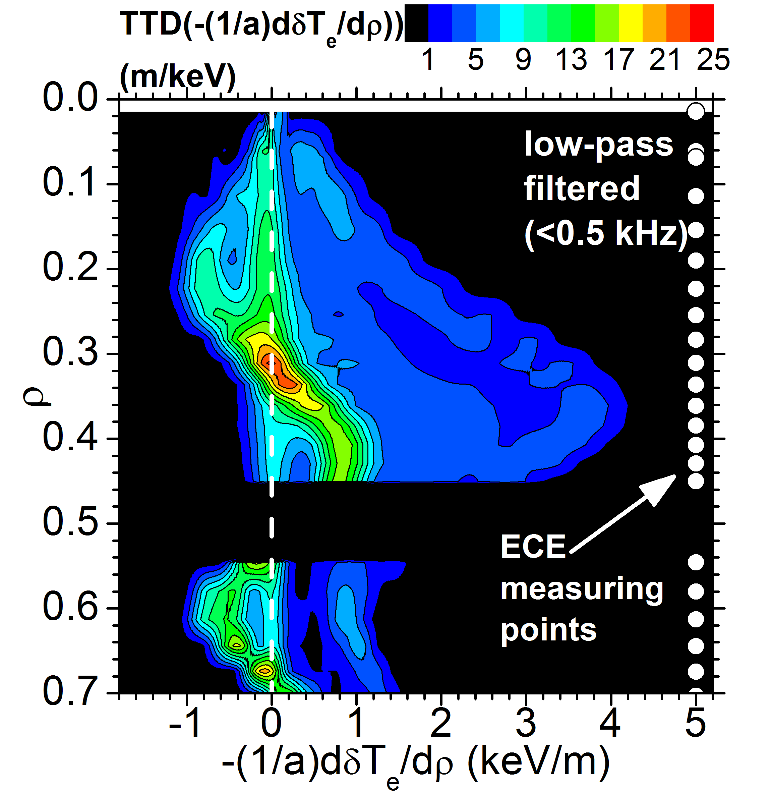
Appearance of meta-stable state of transport
LHD
LHD
PDF(-δ∇T）= exp(-S)
S: transport potential
PDF and transport potential show the existence of meta-stable transport state at the edge in the non-local response → this is a clear evidence of violation of local closure (not determined by local ∇T）
Notes:
The existence of meta-state becomes more significant in the probability distribution function of displacement of temperature gradient from the steady state value.
Here the transport potential S is defines with PDF of temperature gradient displacement with this formula.
This the contour map of time period for the given temperature gradients as a function of minor radius and magnitude of displacement of temperature gradient.
The positive value represent increase of temperature gradient during non-local temperature rise.
PDF and transport potential show the existence of meta-stable transport state at the edge of normalized minor radius of 0.65 in the non-local response.
This is the clear evidence of violation of local closure (heat flux is not determined by local ∇T）.

Slide 8
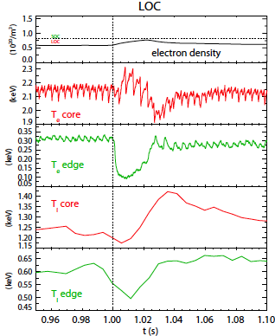
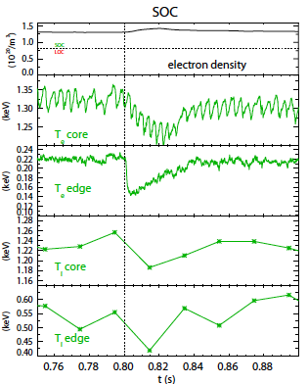
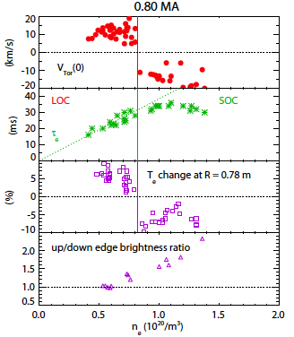
Interference between energy and momentum flux
Alcator C-mod
Alcator C-mod
Linear ohmic confinement (LOC) : core Te and Ti rise (non-local response)
: intrinsic rotation (co-rotation)
Saturated ohmic confinement (SOC) : core Te and Ti drop (diffusive transport response)
: intrinsic rotation (counter-rotation)
Relation between non-local transport and intrinsic rotation
EX/2-2(Tue) : Alcator C-mod exp. by J.Rice
Notes:
This view graph shows the Interference between energy and momentum flux observed in Alcator C-mod.
When the density and collisionality is low and the plasma is in the linear ohmic confinement (LOC)
non-local response is observed as core temperature rise associated wit the edge cooling by laser blow off and the intrinsic rotation is co-direction.
However at the higher density the in the regime of saturated ohmic confinement (SOC) there is no temperature rise and temperature drops as
a diffusive transport response and the intrinsic rotation is counter-direction.
This is the very important experimental results that shows the clear interference between non-local heat and non-diffusive momentum transport and they are very sensitive to confinement regime where the dominant turbulence switches one to other.

Slide 9
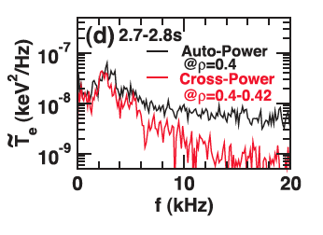
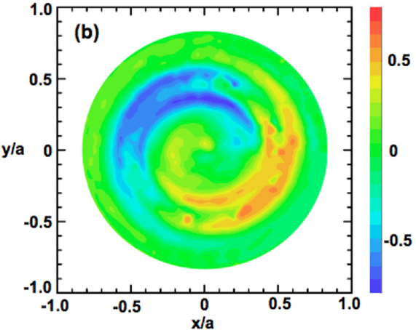
Fluctuations with long range correlation
Temperature fluctuation with long radial correlation has been measured
Reconstructed image plot of low frequency turbulence (1.5–3.5 kHz)
LHD
LHD
Cross-power spectrum between two adjacent channels of temperature fluctuation shows peak at ~ 2.5 kHz.
The spiral structure has a long range correlation both in the poloidal and radial direction
S.Inagaki Phys Rev Lett 107 (2011) 115001
S.Inagaki Nucl. Fusion 52 (2012) 023022
Fluctuation with long range correlation is a candidate of “agent” to couple the micro-scale between the different radii separated (core and edge)
Notes:
Since the mezo-scal and macro-scale turbulence is one of the candidate to connect the transport in the different location such as core and edge,
It is important to investigate the existence of macro-scale turbulence with long range correlations.
Temperature fluctuation with long radial correlation has been measured with ECE in LHD.
Cross-power spectrum between two adjacent channels of temperature fluctuation shows peak at 2.5 kHz.
One can reconstruct the fluctuation image by assuming the fluctuation pattern is rotation with the ExB rotations.
The spiral structure reconstructed has a long range correlation both in the poloidal and radial direction
Fluctuation with long range correlation is a candidate of “agent” to couple the micro-scale between the different radii separated (core and edge)

Slide 10
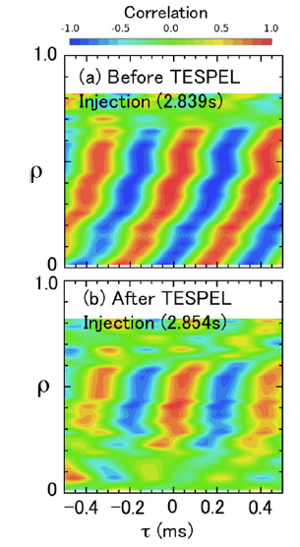
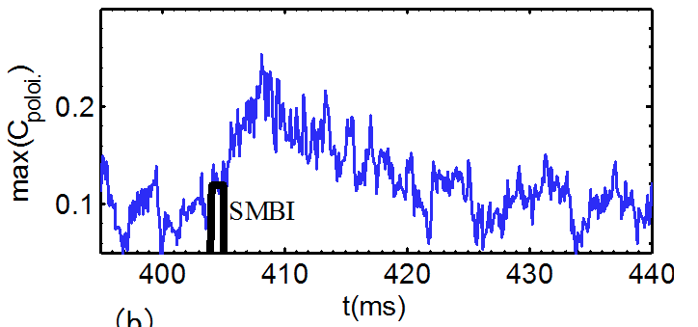
Fast changes of turbulence spectra
LHD
During the core Te rise after the edge cooling (non-local phenomena)
HL-2A
micro-scale turbulence
→ decreases
meso-scale turbulence
→ increases
HL-2A
Poloidal cross-correlation function of meso-scale turbulence increases→ poloidally elongated
Radial correlation becomes shorter.
EX/P7-13(Fri) : HL-2A exp. by Z.Shi
EX/P3-09(Wed) : HL-2A exp. by H.Sun
S.Inagaki Nucl. Fusion 52 (2012) 023022
Notes:
The fast changes of turbulence spectra are observed in experiment during the core Te rise after the edge cooling (non-local phenomena) .
In LHD, the radial correlation before the pellet is injected becomes shorter after the pellet where the non-local response is observed.
In HL-2A, the micro-scale turbulence decreases and meso-scale turbulence increases during the non-local response after the SMBI.
Poloidal cross-correlation function of meso-scale turbulence with the frequency of few kHz increases.
These experiment clearly shows the deformation of turbulence structure in the radial and poloidal wave number space during the non-local response.

Slide 11
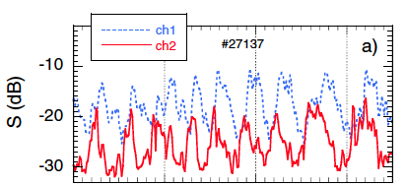
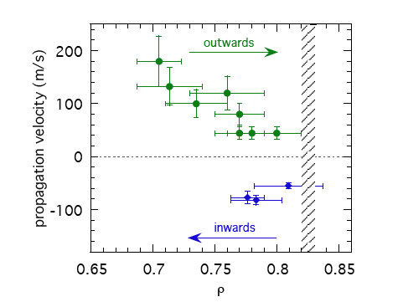

Modulation of micro-scale turbulence with meso-scale fluctuations
TJ-II
TJ-II
The fluctuation level at r/a = 0.8 (ch1) and 0.75 (ch2) show clear oscillation associated with the oscillation of radial electric field near the plasma edge.
→ Radial propagation velocities are evaluated from the phase difference between two channels.
Direction of the propagation depends on the density.
lower density → outward propagation
Higher density → inward propagation
Two possible mechanisms
1 Radial spreading of turbulence (should be in-coherent similar to Blob?)
2 Modulation of fluctuation level by the oscillating zonal flow
EX/10-2 (Sat) : TJ-II exp. by T.Estrada
Notes:
Another interesting experimental result is a modulation of the micro-scale turbulence by the meso-sclae fluctuations observed in TJ-II.
The fluctuation level at r/a = 0.8 (ch1) and 0.75 (ch2) show clear oscillation associated with the oscillation of radial electric field near the plasma edge.
Radial propagation velocities are evaluated from the phase difference between two channels.
The right figure shows the radial propagation velocities.
Direction of the propagation depends on the density.
At the lower density the propagation is outward and at the Higher density the propagation is inward.
There are two possible mechanisms
1 Radial spreading of turbulence (should be in-coherent similar to Blob?)
2 Modulation of fluctuation level by the oscillating zonal flow

Slide 12
Basic mechanisms for the violation of local closure
Radial wave number
turbulence spreading
Front propagation
Avalanche
Self-selected
Mesoscale dynamics
Global dynamics
and organization
1/ρ_{i}
Micro-scale turbulence
turbulence zonal flow coupling
Meso-scale zonal flow
Micro- and macro- turbulence coupling
OV/P-03(Mon) and EX/P4-2(Wed) by P.H.Diamond
PD/ by S.-I. Itoh
1/a
Macro-scale turbulence
core
r/a
edge
There are several candidate of mechanism causing the violation of local closure.
Ref: G.Dif-Pradalier, et al.: Phys. Rev. E 82 (2010) 025401, P.H.Diamond, et al.: PPCF (2005),
Itoh et al: PPCF (2001)
Spatiotemporal measurements of micro- meso- macro- scale turbulence and zonal flow are necessary to investigate which is more or most dominant in the plasma for each experiments.
Notes:
This view graph shows the Basic mechanisms for the violation of local closure.
This is the image of turbulence in the wave number and real space.
There are Micro-scale turbulence, Meso-scale zonal flow, and Macro-scale turbulence.
Turbulence spreading can take place between the Micro-scale turbulence.
Turbulence zonal flow coupling exits between the Micro-scale turbulence, Meso-scale zonal flow.
And furthermore Micro- and macro- turbulence coupling exists between Micro- and macro-scale turbulence.
In experiment, turbulence spreading appears as Front propagation Avalanche.
Turbulence zonal flow coupling is observed in Self-selected Mesoscale dynamics
Micro- and macro- turbulence coupling play a important role in Global dynamics and organization
There are several candidate of mechanism causing the violation of local closure.
Spatiotemporal measurements of micro- meso- macro- scale turbulence and zonal flow are necessary to investigate which is more or most dominant in the plasma for each experiments.

Slide 13
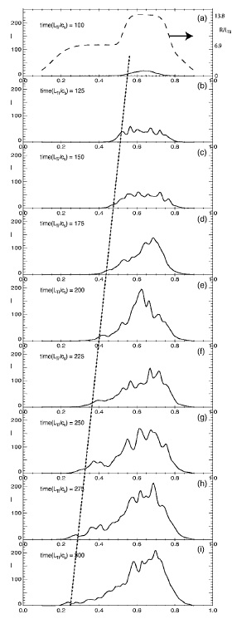
Propagation of fronts of turbulence intensity
Combined with temperature gradient front, the deviation (from average) of microscopic fluctuation intensity can propagate in ballistic manner.
simulation
P.Diamond et al.: Nucl. Fusion 41 (2001) 1067
Mean driving parameter (gradient A)
P. H. Diamond et al. PoP (1995)
P. Beyeret al. PRL (2000)
O.D. Gurcan, et al. PoP (2005)
X. Garbet, et al. PoP (2007)
Z. H. Wang et al. PoP (2011)
S. Sugita et al. PPCF (2012)
Fluctuation intensity : I
time
Ballistic propagation formula
V_{r} ~
~ V_{dia}
(Fisher front speed)
Waiting experimental verification!
T.S.Hahm et al.: Phys. Plasmas 12 (2005) 090903
radius
Notes:
I would like to discuss briefly the theoretical work on the propagation of turbulence front.
Combined with temperature gradient front, the deviation (from average) of microscopic fluctuation intensity can propagate in ballistic manner.
The first one is the equation for the mean driving parameter of gradient A. The second equation is for the fluctuation intensity I.
By combining these two equation the turbulence front can propagates with Fisher front speed determined by the ballistic propagation formula.
This is the example of simulation how the turbulence intensity propagates radially.
.

Slide 14
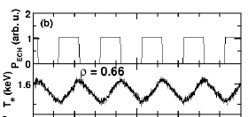
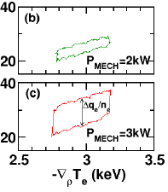

Beyond 'non-local in space'
Observations indicate that heating power directly influence transport flux without change of global plasma parameters.
Experiment : LHD result EX/10-1(Sat) Is Turbulence Determined by Local Temperature Gradient? by S.Inagaki
Historically, D-IIID, W7-AS, etc.,…..
In this IAEA conference
Theory: PD-paper → Immediate Influence of Heating Power on Turbulent Plasma Transport by S.-I.Itoh
Extension of closure to ‘nonlocal-in-space’ is necessary, but NOT sufficient.
Unified understanding momentum and heat transport
Intrinsic rotation ←→Turbulence ←→ Nonlocal
OV/P-03(Mon) : Theory overview by P.H.Diamond EX/2-2(Tue) : Alcator C-mod exp. by J.Rice EX/P3-09(Wed) : HL-2A exp. by H.Sun EX/P4-2(Wed) : L-H H-L transition P.H.Diamond EX/P7-12(Fri) : ExB shear suppression by T.S.Hahm EX/P7-13(Fri) : HL-2A exp. by Z.Shi EX/10-2 (Sat) : TJ-II exp. by T.Estrada
on
off
2MW
on
off
3MW
Multiple-points and dynamical measurements of fluctuations are urgently necessary.
Notes:
Before the summary I will discuss the issue beyond the “non-local in space”.
Observations indicate that heating power directly influence transport flux without change of global plasma parameters.
Historically it has been observed in many devices, but recently more clear evidence was observed in LHD.
The heat flux significantly increases associated with the increase of heating power not increases of temperature gradient.
The clear hysterisis is observed in the ECH modulation experiment.
The theoretical model for this experiments is also presented in this conference.
There are many papers relating non-local transport in this conference as listed below.
Multiple-points and dynamical measurements of fluctuations are urgently necessary.

Slide 15
Summary
Heat flux can be expressed in terms of local turbulence intensity and gradient: However, formulation by local plasma parameters and gradient (local closure) is inaccurate (local closure is broken)
The violation of local closure can be observed in the meta-stable state during the the transient phase after the transition (convex and concave ITB transition) or edge perturbation by SMBI, TESPEL, laser blow-off. So is in the momentum transport. This issue appears in almost all of transport problems.
The micro- meso- macro-scale turbulence and meso-scale zonal flow and the coupling between them are experimentally observed during the transient phase.
There are theoretical models causing the violation of local closure: turbulence spreading, turbulence-zonal flow coupling, micro- and macro-scale turbulence coupling. Quantitative experimental tests are looked for.
The understanding of non-local transport is essential to predict the structure and dynamics of plasma in future device.
Notes:
This is the summary of my talk
Heat flux can be expressed in terms of local turbulence intensity and gradient: However, formulation by local plasma parameters and gradient (local closure) is inaccura(local closure is broken)
The violation of local closure can be observed in the meta-stable state during the the transient phase after the transition (convex and concave ITB transition) or edge perturbation by SMBI, TESPEL, laser blow-off. So is in the momentum transport. This issue appears in almost all of transport problems
The micro- meso- macro-scale turbulence and meso-scale zonal flow and the coupling between them are experimentally observed during the transient phase.
There are theoretical models causing the violation of local closure: turbulence spreading, turbulence-zonal flow coupling, micro- and macro-scale turbulence coupling. Quantitative experimental tests are looked for.
The understanding of non-local transport is essential to predict the structure and dynamics of plasma in future device.

