Slide 1

TS Hahm S/1-3
Theory Summary
T.S. Hahm
Seoul National University, Seoul, KOREA
The 24th IAEA Fusion Energy Conference, October, 2012

Slide 2
Statistics
TS Hahm S/1-3
Total (Oral)
TH/C : Confinement 64 (8) papers
TH/S : Stability 38 (3) papers
TH/W : Wave-Plasma Interactions
Current drive, heating,
energetic particles
TH/D : Plasma-material interactions
Divertors, Limiters, SOL
Total 157 (18) papers
36 (3) papers
19 (4) papers

Slide 3
Outline
TS Hahm S/1-3
Validations of Gyrokinetic Simulations
Nonlocal Transport from Flux-driven Gyrokinetic Simulations
Intrinsic Rotation / Momentum Transport / L-H Transition
Pedestal Stability / ELM Simulations
Suppression / Mitigation of ELMs
Boundary Physics
Self-Organization in Boundary Physics, MHD, and W-P Physics.

Slide 4
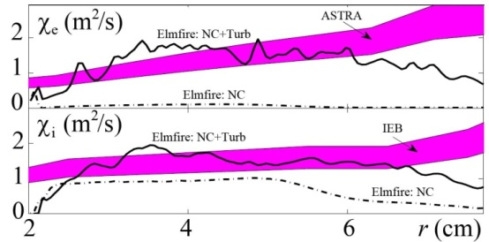
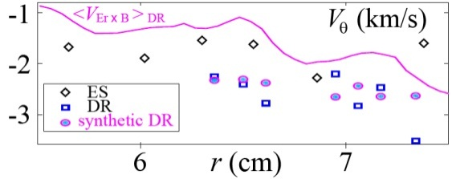
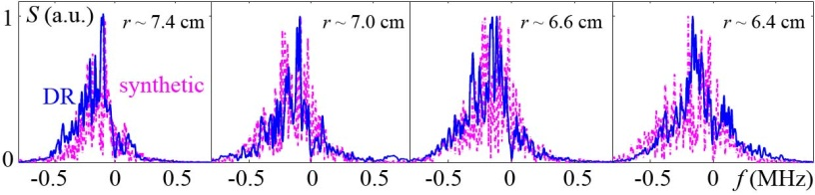
Validations against FT-2 Tokamak by
full-f Gyrokinetic ELMFIRE-code
Turbulence Spectra, Transport, and ExB Flows in Helical Plasmas
[Gusakov et al., 460-TH/8-1]
[T.-H. Watanabe et al., 460-TH/8-1]
At the macro-scale electron and ion thermal diffusivities and poloidal rotation profiles are reproduced by the code
At the micro-scale the similarity of the Doppler reflectometry spectra provided by the FT-2 experiment and by the Elmfire synthetic diagnostics is demonstrated
Gyrokinetic simulation of ITG turbulent transport is successfully validated against high-T_{i} LHD exp. (Fig. 1), providing a basis for transport modeling with explicitly including effects of zonal flows (Fig. 2).
Fig. 1: Ion heat flux in high-T_{i} LHD discharge
Fig. 2: Correlation between χ_{i}, T and Z

Slide 5
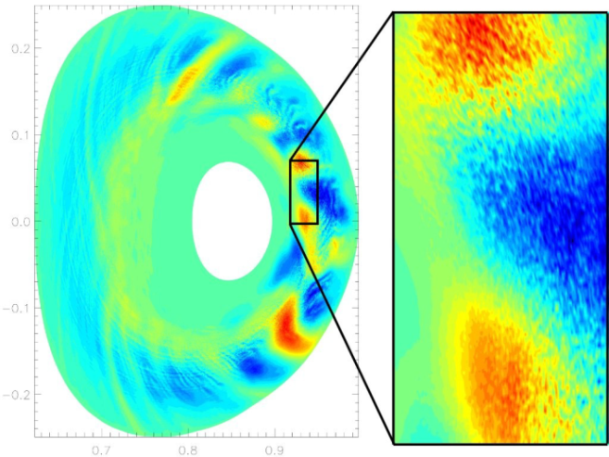


There can be multiple contributors to
Electron Thermal Transport
Gyrokinetic turbulence simulations with GENE:
From the system size to electron gyroradius scales
[Jenko et al., 615-TH/6-4]
TH-C/6-1: Progress in simulating turbulent electron thermal transport
in NSTX [W. Guttenfelder et al., 174-TH-C/6-1]
Microtearing transport : First nonlinear microtearing simulations based on experimental NSTX NBI H-mode which lead to stochastic field lines, experimental level of transport from magnetic flutter
ETG transport : Nonlinear ETG simulations for lower beta discharges can predict experimental levels of transport
Hybrid KBM/TEM transport : ion scale ballooning modes often overlap microtearing modes at high beta
Multi-scale effects in global simulations
of TCV plasmas with electron ITBs:
In the barrier, TEM & ETG contributions
to the electron heat flux are comparable

Slide 6
Outline
TS Hahm S/1-3
Validations of Gyrokinetic Simulations
Nonlocal Transport from Flux-driven Gyrokinetic Simulations
Intrinsic Rotation / Momentum Transport / L-H Transition
Pedestal Stability / ELM Simulations
Suppression / Mitigation of ELMs
Boundary Physics
Self-Organization in Boundary Physics, MHD, and W-P Physics.

Slide 7
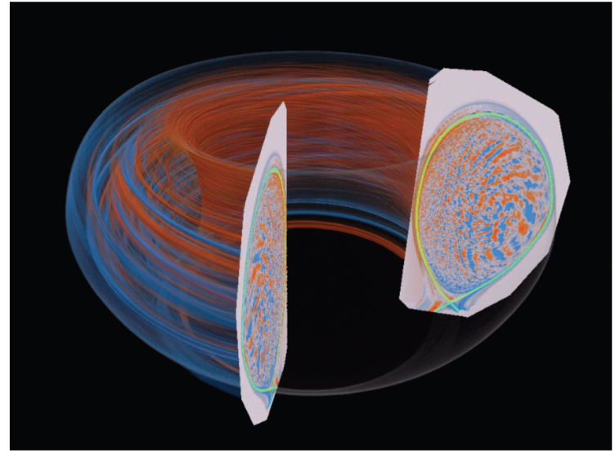
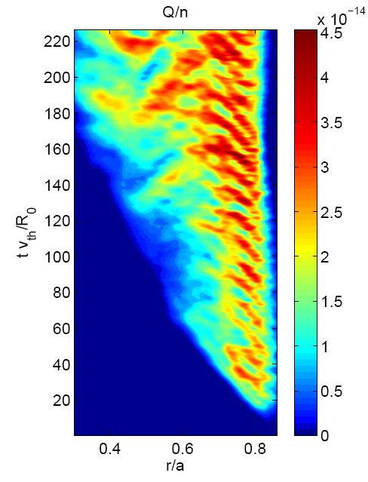
TH/P7-13: Flux-driven Full-f Gyrokinetic Study of the Nonlocal Influence of Edge T_{i} on core T_{i}
S. Ku, C.S. Chang, P. H. Diamond, J. Lang, D.P. Stotler, G. Dif-Pradalier, W. Tang
First-principles understanding of how edge T_{i} influences core T_{i} has been obtained.
Full-f gyrokinetic simulation of the whole-volume plasma in realistic DIII-D geometry, including separatrix, wall, and neutral particles
Heat flux from core and edge cooling from neutral CX yields high η_{i} at pedestal top.
Edge ITG turbulence spreads to core and self-organize with global ∇T_{i} (and heat flux) from core to achieve SOC → profile stiffness
Core-edge ∇T_{i} interaction time is the turbulence spreading time (<10ms)
Heat transport and turbulence spreading is self-controlled by zonal flow staircase interaction.
Numerical cold pulse experiments confirms ballistic inward propagation of ITG turbulence and of the associated ∇T fronts.
Also; K. Ida [OV/3-4] and Ö.D. Gürcan et al. [TH/P2-12] on Nonlocal Transport

Slide 8
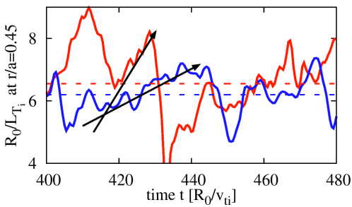
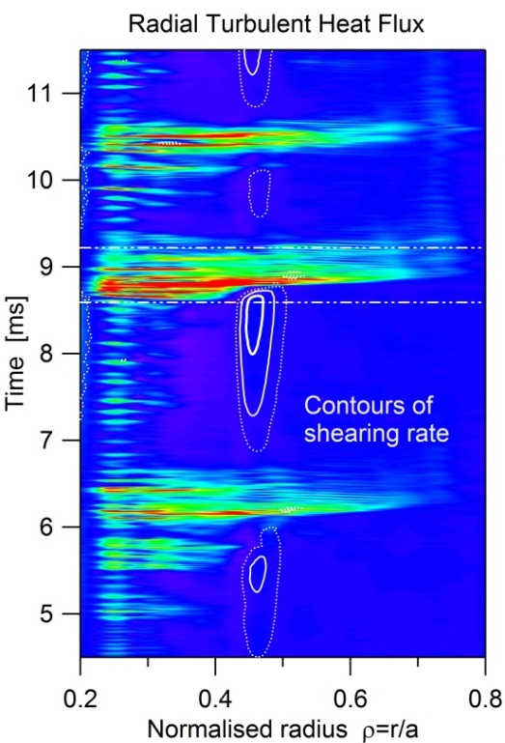
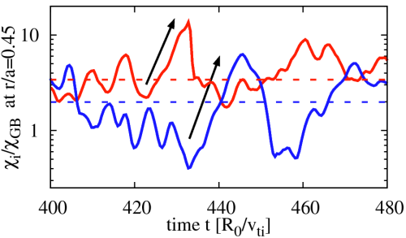





Flux-driven ITG turbulence
-gyrokinetic GYSELA code
Bohm-like bursty transport from Fixed-flux Gyrokinetic simulations using GT5D
[Sarazin, 512-TH/P7-09]
With Vorticity Source S_{Ω}:
Some control of E×B shear
S_{Ω}>S_{Ω,crit}(P_{add}) ⇒ Transport Barrier
triggered by E_{r}′
Quasi-periodic crashes
[M. Nakata and Y. Idomura., 393-TH/P7-07]
Plasma size scan with scaled heating power towards a local limit regime ($ρ^{∗−1}≥$ 300) has been investigated by using a fixed-flux gyrokinetic Eulerian code GT5D.
Stiff $T_{i}$-profiles show the similar mean $R_{0}/L_{Ti}$ (flux-tube results give ~7% difference in $χ_{i}$), but variations of the local power balance before bursts produce faster build-up of $R_{0}/L_{Ti}$ at $ρ^{∗−1}$=450.
Higher super-critical level at $ρ^{∗−1}$=450 leads to the Bohm-like burst amplitude.
[Strugarek et al.,
submitted to PRL]

Slide 9
Outline
TS Hahm S/1-3
Validations of Gyrokinetic Simulations
Nonlocal Transport from Flux-driven Gyrokinetic Simulations
Intrinsic Rotation / Momentum Transport / L-H Transition
Pedestal Stability / ELM Simulations
Suppression / Mitigation of ELMs
Boundary Physics
Self-Organization in Boundary Physics, MHD, and W-P Physics.

Slide 10
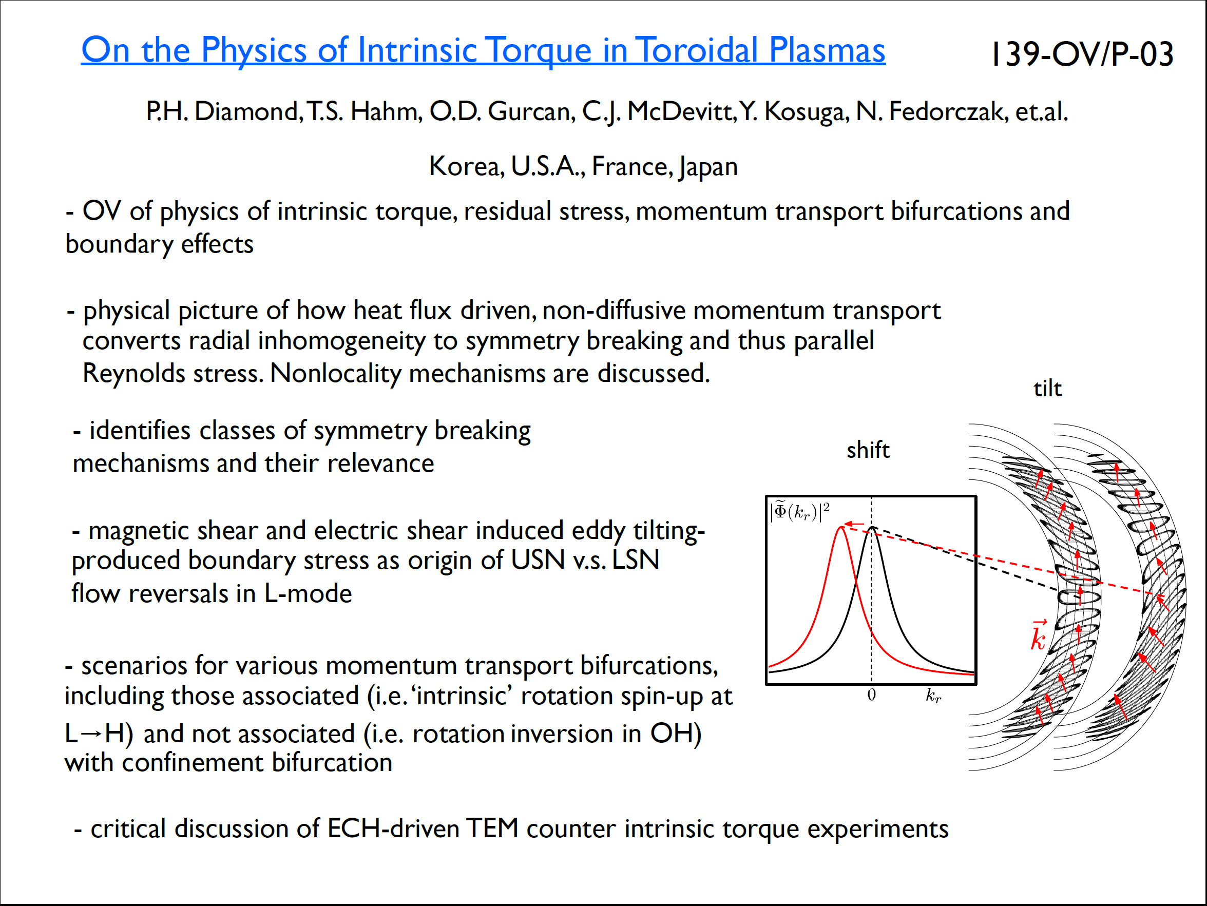
[EX/2-1] McDermott on AUG
[EX/2-2] Rice on C-Mod
[EX/2-3] Shi on KSTAR

Slide 11
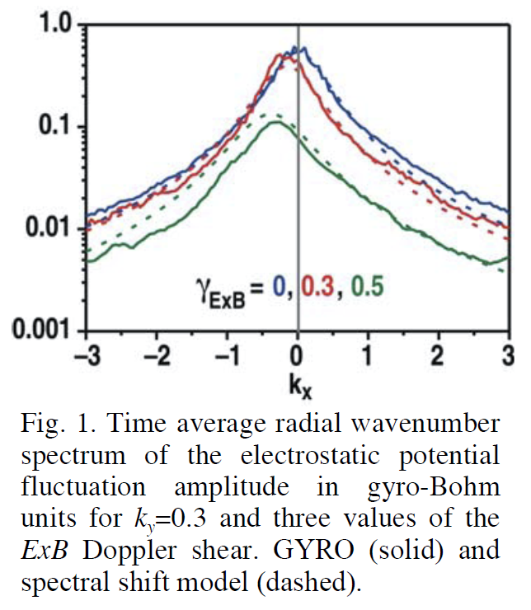
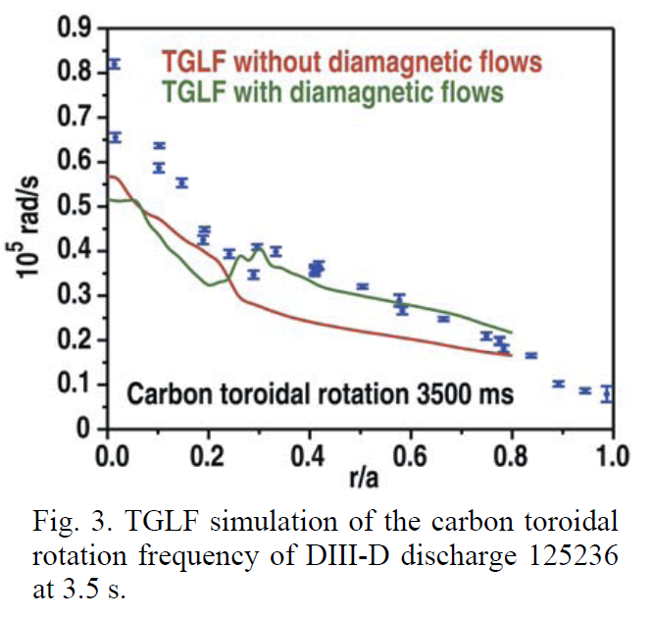
A New Paradigm for ExB Velocity Shear Suppression of
Gyro-kinetic Turbulence and the Momentum Pinch
G.M. Staebler, R.E. Waltz, J.E. Kinsey, and W.M. Solomon

Slide 12
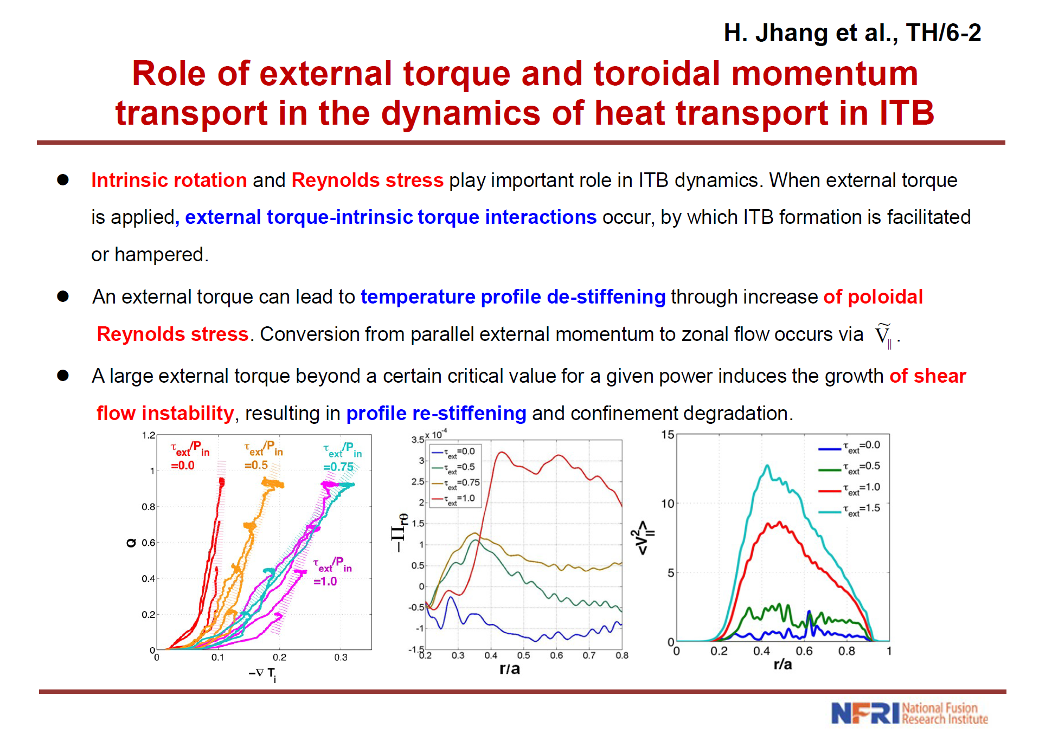

Slide 13
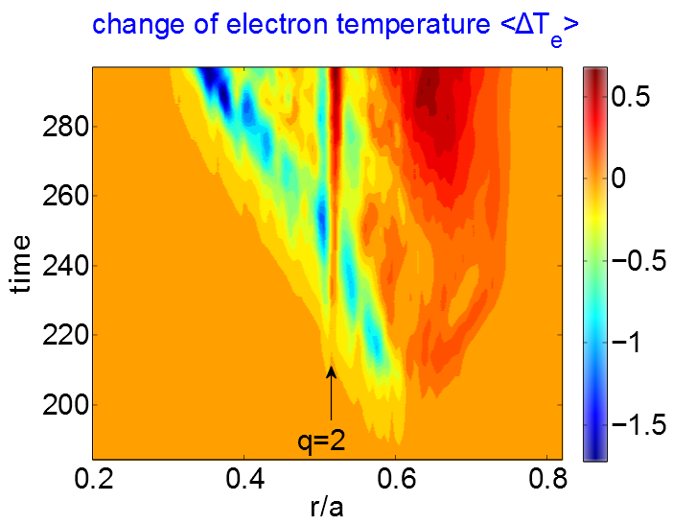

I. Shear Flow Driven Turbulence and Transport and
[TH/P7-14] II. Turbulence Generated Non-inductive Current in Tokamaks W. X. Wang
• Strong shear flow drives turbulence & transport in tokamaks → flow optimization needed
-- significant momentum & energy transport, including an intrinsic torque (left)
-- fluctuations peak at integer (not fractional!) rational surfaces, consistent with theory
-- local corrugations generated in all plasma profiles near integer rational surfaces (middle)
• CTEM turbulence is found to drive a significant, quasi-stationary current (right)
-- mainly carried by trapped electrons and driven by electron residual stress
-- increases with pressure gradient (similar to NC j_{bs} but with different physics origin)
-- decreases with equilibrium current and increases with magnetic shear dq/dr
(Global gyrokinetic simulation by GTS code)

Slide 14
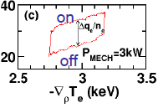

Immediate Influence of Heating Power on Turbulent Plasma Transport
PD/P8-11
S.-I. Itoh, K. Itoh
Turbulence and transport jump at on/off of heating power (without change of global parameters).
Inagaki, EX/10-1
LHD
New theory that explains immediate influence of heating on turbulent transport is presented. New ‘force’ that accelerates grad-p driven turbulence is identified.
=3MW
Coupling of phase-space source with fluctuations
δ
provides new driving source:
γ
δ
Growth rate and quasi-linear transport respond right after on/off,
because immediately responds at on/off of heating;
Enhancement if .
Effect is more prominent for long wavelength fluctuations.
γ

Slide 15


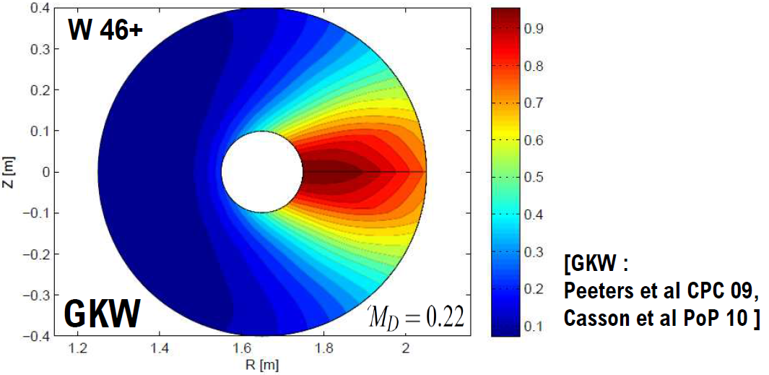
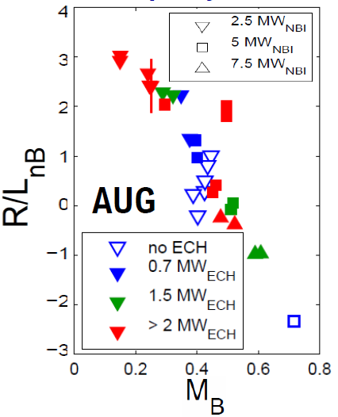
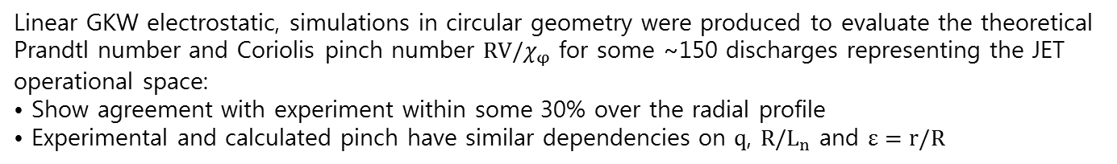
Non-diffusive momentum transport in JET H-mode regimes:
modeling and experiment [H. Weisen et al., 231-TH/P2-17]
A large scale JET database (>1000 samples) study has established the presence and parameter
scaling of substantial non-diffusive momentum transport in all JET H-modes (including hybrids):
• Confirmed and vastly extended, using an entirely different analysis method, previous results using NBI torque modulation: T. Tala et al, NF 123002 51 (2011)
Linear GKW electrostatic, simulations in circular geometry were produced to evaluate the theoretical Prandtl number and Coriolis pinch number $RV/{\text{χ}}_{φ}$ for some ~150 discharges representing the JET operational space:
• Show agreement with experiment within some 30% over the radial profile
• Experimental and calculated pinch have similar dependencies on $q$, ${R/L}_{n}$ and $ε=r/R$
Impact of rotation on impurity transport: Progress in
theory models and experimental characterization
[C. Angioni, F.J. Casson et al., 328-TH/P2-21]
Centrifugal effects investigated in theory, GK model implemented in GKW allows
consistent 2D reconstructions of the density distribution on poloidal cross section
In AUG experiments, rotation observed to flatten Boron density profiles

Slide 16
Outline
TS Hahm S/1-3
Validations of Gyrokinetic Simulations
Nonlocal Transport from Flux-driven Gyrokinetic Simulations
Intrinsic Rotation / Momentum Transport / L-H Transition
Pedestal Stability / ELM Simulations
Suppression / Mitigation of ELMs
Boundary Physics
Self-Organization in Boundary Physics, MHD, and W-P Physics.

Slide 17
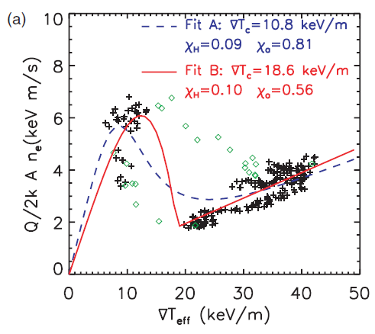


L→H Transition can be understood in terms of S curve
KSTAR #5681
A. Hubbard et al, PPCF 44, A359 (2002)
W.H. Ko et al, IAEA 2012
Thermal Transport Barrier
Momentum Transport Barrier

Slide 18
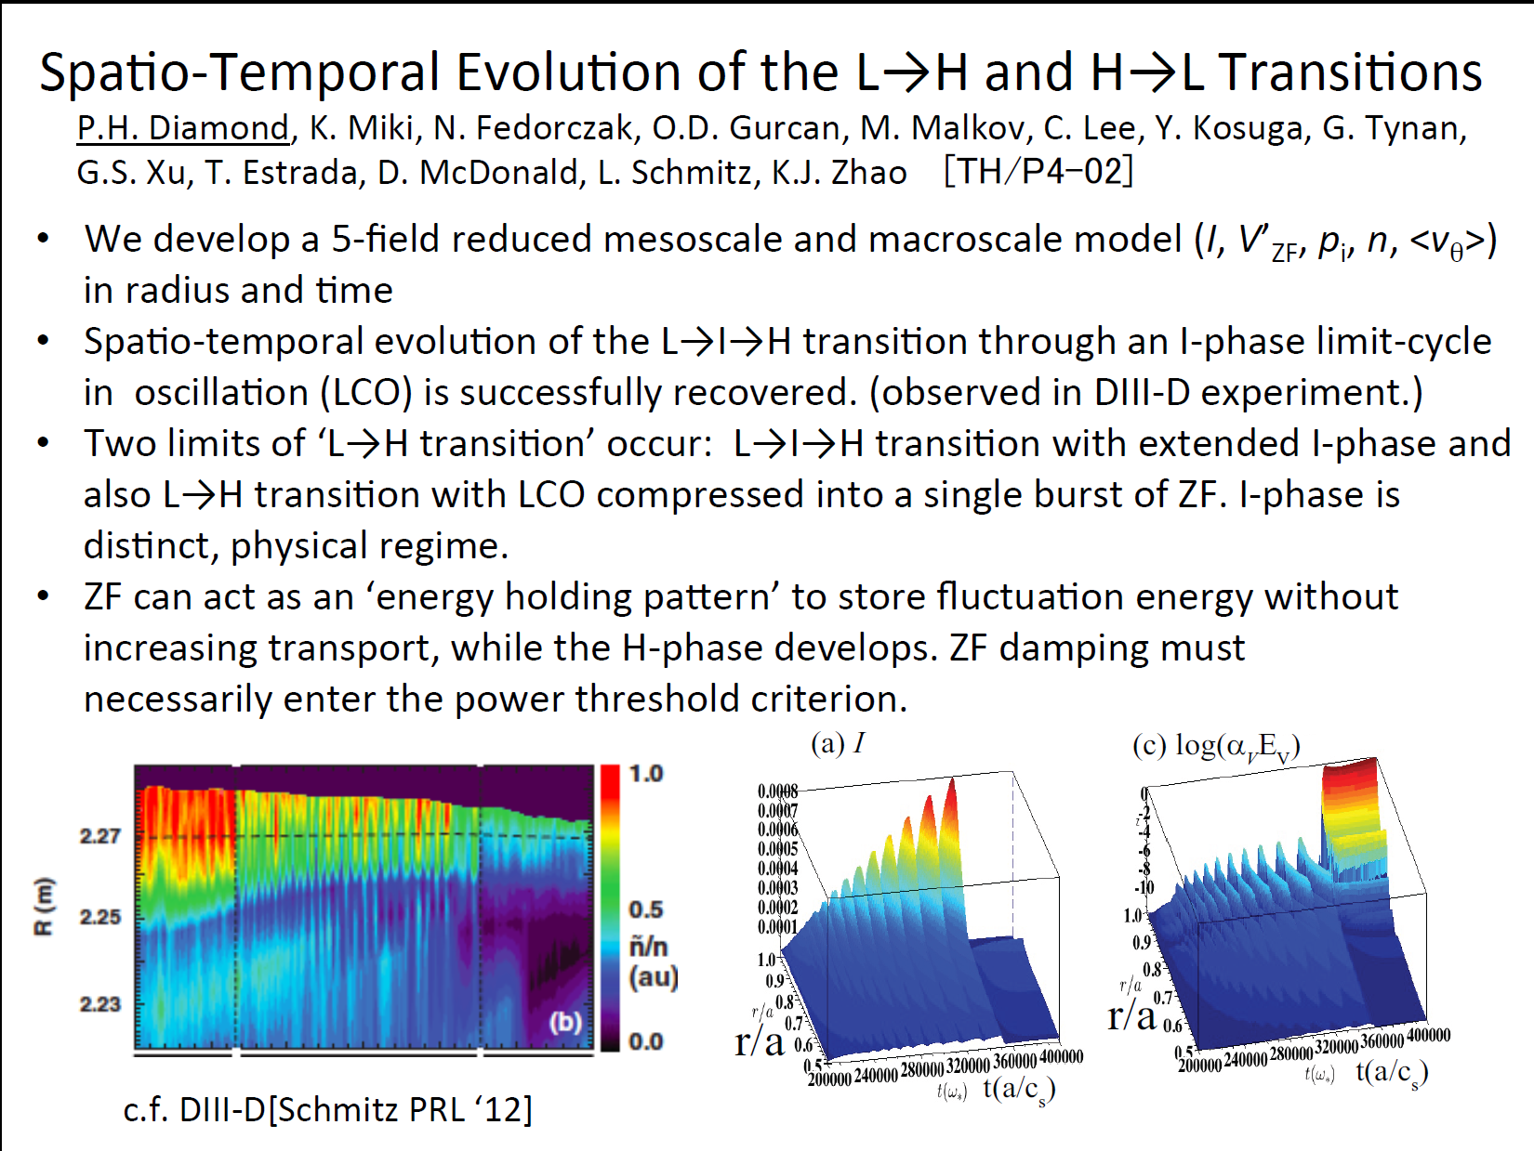

Slide 19
Outline
TS Hahm S/1-3
Validations of Gyrokinetic Simulations
Nonlocal Transport from Flux-driven Gyrokinetic Simulations
Intrinsic Rotation / Momentum Transport / L-H Transition
Pedestal Stability / ELM Simulations
Suppression / Mitigation of ELMs
Boundary Physics
Self-Organization in Boundary Physics, MHD, and W-P Physics.

Slide 20
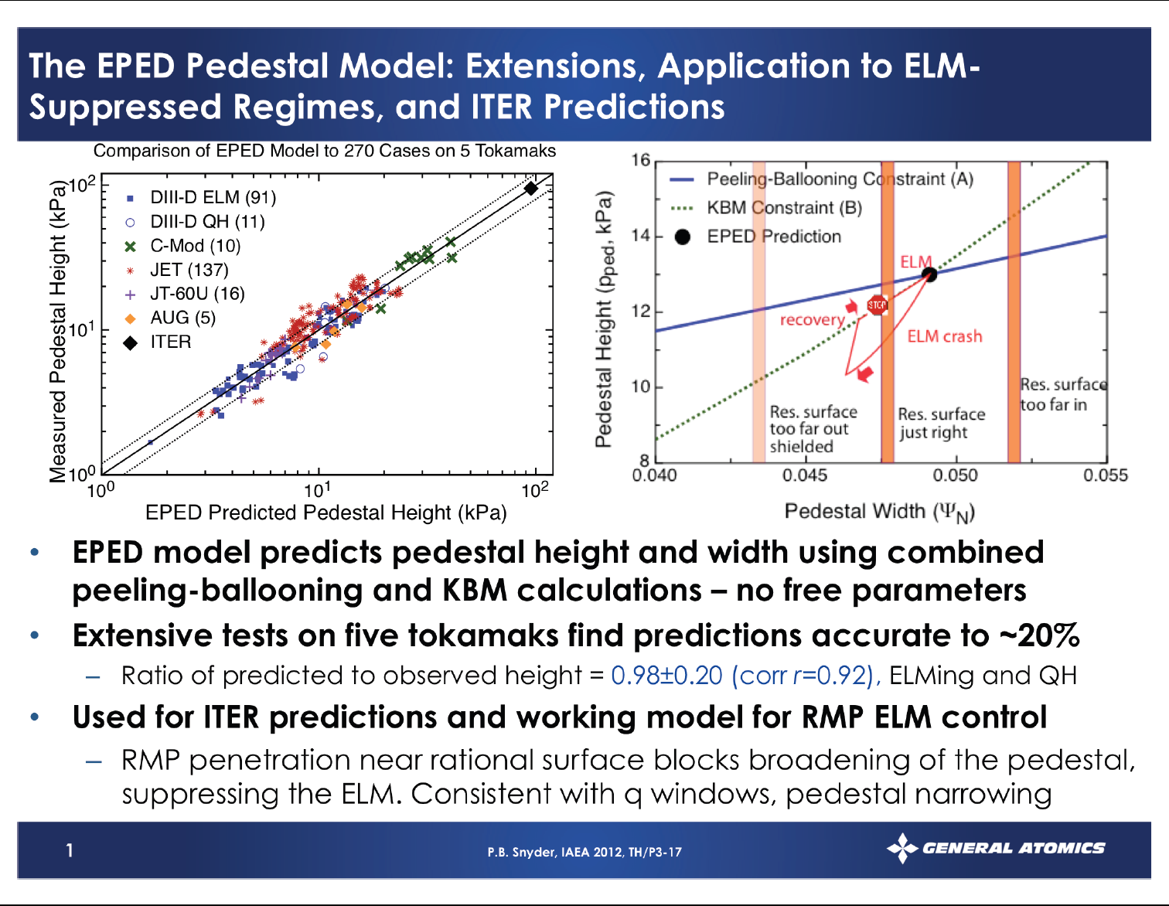

Slide 21
Pedestal Modelling Based on Ideal MHD and Gyro-kinetic Stability Analyses on JET And ITER Plasmas
S.Saarelma et al. TH/P3-10
Marginally stable ITER baseline edge plasma has T_{e,ped}=5.9 keV.
No unstable kinetic ballooning modes in pedestals with high j_{BS}
JET experimental plasmas
ITER transport simulations
JET pedestals limited by peeling-ballooning modes at the end of the ELM cycle.[1]
➔ Robust limit for pedestal height.
No local unstable pressure gradient limiting kinetic ballooning modes in the JET pedestal due to high j_{BS}. [2]
Peeling-ballooning mode stability analysis of ITER baseline finds the edge plasma marginally stable for T_{e,ped}=5.9keV corresponding to p_{ped}=107 kPa. [3]
No unstable KBMs found in the local linear gyro-kinetic runs.
stable
unstable
[1] Experimental α (~p’) and the peeling-ballooning mode stability limit (α_{crit}) during a JET ELM cycle
[2] Local ideal n= ∞ MHD and KBM stability in JET ELM pedestal.
[3] ITER 15MA baseline edge stability diagram for T_{e,ped}=5.9 keV

Slide 22
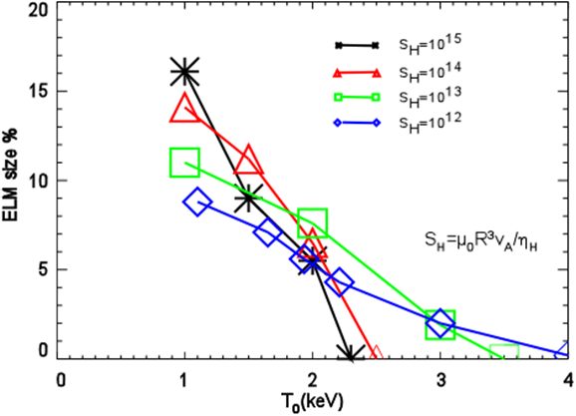
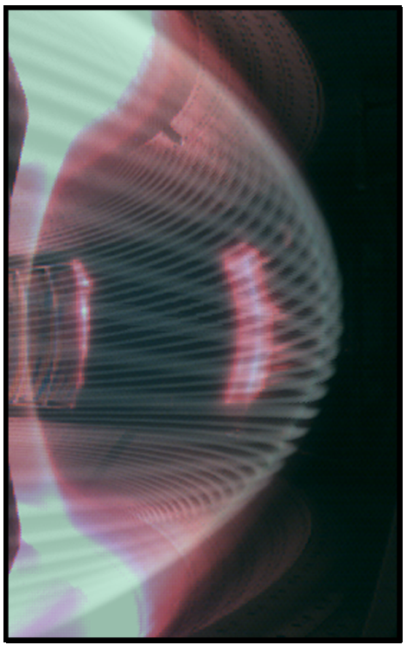
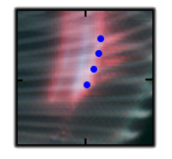
5-field Peeling-Ballooning modes simulation with BOUT++
T. Y. Xia^{1,2}, X. Q. Xu², Z. X. Liu¹, S. C. Liu¹, B Gui^{1,2} and J. G. Li¹ [¹ASIPP (China), ²LLNL (USA)]
Theory and Gyro-fluid Simulations of Edge-Localized-Modes
X.Q.Xu¹, P.W.Xi^{1,2}, A.Dimits¹, I.Joseph¹, M.V.Umansky¹, T.Y.Xia^{1,3}, B.Gui^{1,3}, S.S.Kim⁴, G.Y.Park⁴, T.Rhee⁴, H.Jhang⁴, P.H.Diamond^{4,5}, B.Dudson⁶, P.B.Snyder⁷ (¹LLNL,²PKU,³ASIPP,⁴NFRI,⁵UCSD,⁶U.York,⁷GA)
TH/5-2Ra
TH/5-2Rb
Gyro-fluid and multi-field two-fluid simulation models have been developed to simulate ELM crashes based on peeling-ballooning (P-B) model with non-ideal physics effects.
Due to the additional FLR-corrected nonlinear ExB convection of the ion gyro-center density, the gyro-fluid model further limits the radial spreading of ELMs.
The ELM size is found to be insensitive to the hyper-resistivity for large ELMs.
BOUT++ simulations show that the stripes from visible camera match ELM filamentary structures
Ion temperature T_{i}(keV)
(3) Retaining complete first order FLR corrections as resulting from the incomplete “gyro-viscous cancellation” in two-fluid model is necessary to obtain good agreement with gyro-fluid results for high ion temperature cases in pedestal plasmas.
Pitch match!
Mode number match!
The gyro-fluid and multi-field two-fluid simulations on ELM and validation of BOUT++ ELM simulations on DIII-D, EAST and KSTAR are reported (EX/11-3, EX/P7-11 & TH/5-2ab)

Slide 23
Outline
TS Hahm S/1-3
Validations of Gyrokinetic Simulations
Nonlocal Transport from Flux-driven Gyrokinetic Simulations
Intrinsic Rotation / Momentum Transport / L-H Transition
Pedestal Stability / ELM Simulations
Suppression / Mitigation of ELMs
Boundary Physics
Self-Organization in Boundary Physics, MHD, and W-P Physics.

Slide 24
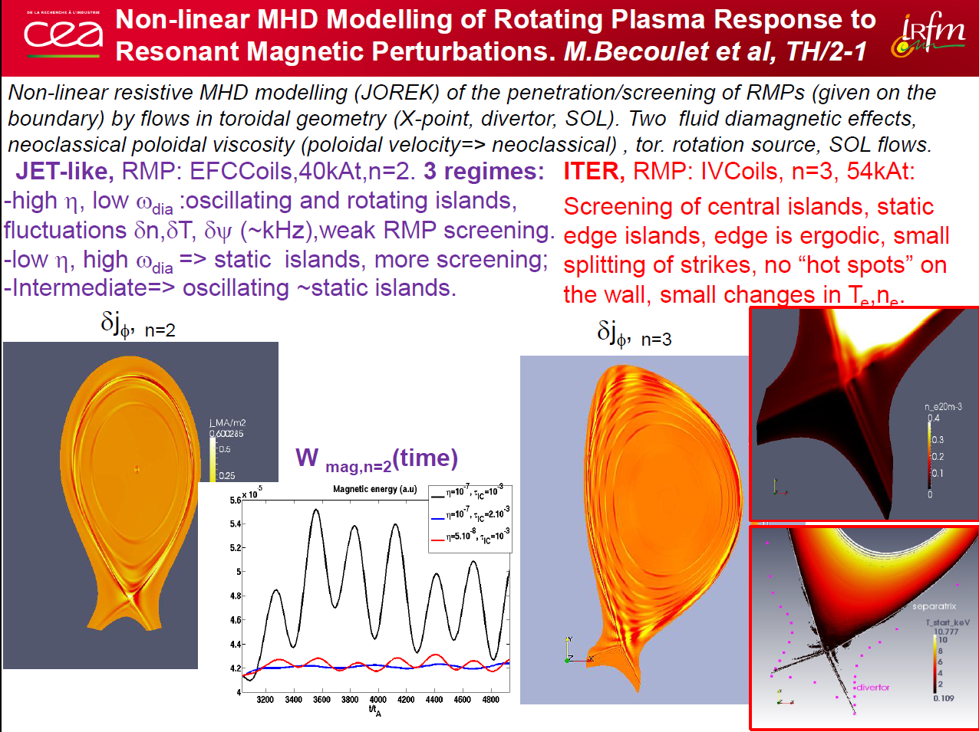

Slide 25
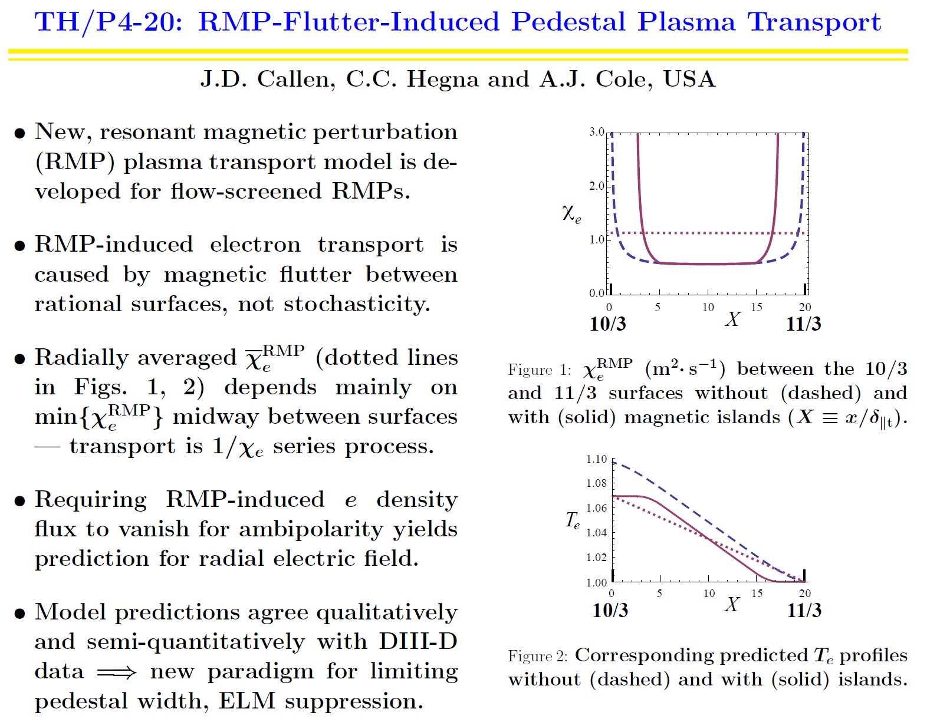

Slide 26
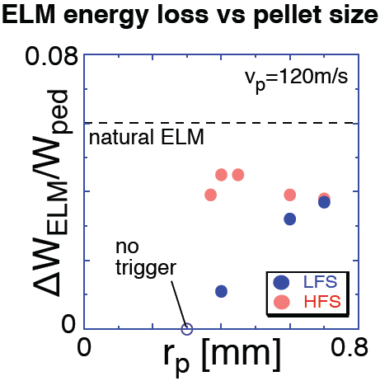

ELM energy loss reduction by pellet for ELM pacing
[N. Hayashi, 384-TH/5-3]
Simulations with integrated code TOPICS-IB
Energy loss can be reduced by a pellet, which penetrates deeply into the
pedestal and triggers high-n ballooning modes with localized
eigenfunctions near the pedestal top.
This reduction is realized by a small pellet injected from the low-field-side
(LFS).
ELM Mitigation by Supersonic Molecular Beam Injection:
KSTAR and HL-2A Experiments and Theory
[W.W. Xiao, P.H. Diamond, W.C. Kim et al.]
(c) The density profiles at
different times in HL-2A.
Red suqures, before SMBI; blue circles, during SMBI;
blue triangles, at the end of τ_{I}; black triangles, without SMBI.
Particle flux measmurement for the ELM mitigation by
SMBI in HL-2A.
(a) is the measurement results by LP in outer divertor with and without SMBI for shot 6352. (b) is the spectrum analysis of J_{sat}
in KSTAR.
ELM mitigation by SMBI (an increase in f_{ELM}^{SMBI}/f_{ELM}⁰~2-3.5) was achieved in HL-2A and in KSTAR.
ELM mitigation by SMBI results from an increase in higher frequency fluctuations and transport events in the pedestal, and inhibits the occurrence of large transport events which span the entire pedestal width.

Slide 27
Outline
TS Hahm S/1-3
Validations of Gyrokinetic Simulations
Nonlocal Transport from Flux-driven Gyrokinetic Simulations
Intrinsic Rotation / Momentum Transport / L-H Transition
Pedestal Stability / ELM Simulations
Suppression / Mitigation of ELMs
Boundary Physics
Self-Organization in Boundary Physics, MHD, and W-P Physics.

Slide 28
Heuristic Drift Model Matches Data
R.J. Goldston and T.Eich [TH/P4-19]
Heuristic model absolute magnitude high by x 1.28
Regression parameters for AUG+C-Mod+DIII-D+JET all well within statistical uncertainty.
MAST/NSTX: Aspect ratio scaling confirmed to +/- 0.7
ITER SOL width projected at 1mm.
No projected violation of pressure or pressure gradient limits
Strong divertor radial diffusion and/or radiation required

Slide 29
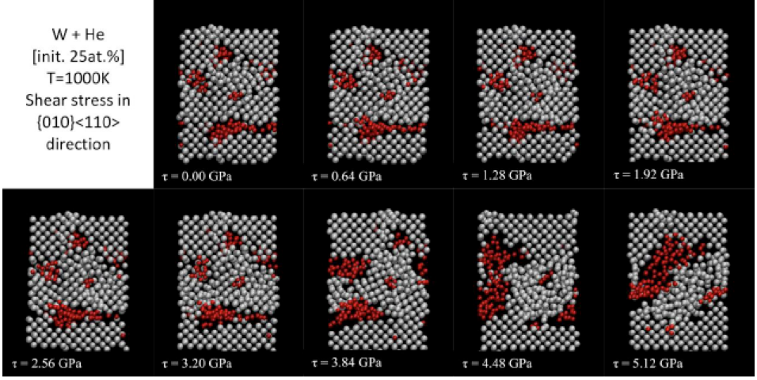
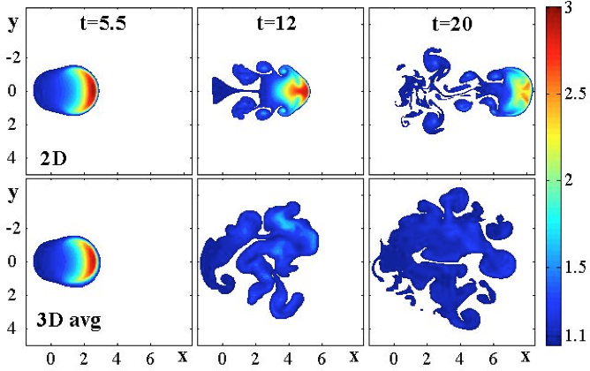
On Edge Plasma, First Wall, and Dust Issues in Fusion Devices
S. I. Krasheninnikov¹, J. R. Angus¹, J. Guterl¹, A. Yu. Pigarov¹, R. D. Smirnov¹, R. P. Doerner¹, M. Umansky²,
T. D. Rognlien², D. K. Mansfield³, A. L. Roquemore³, C. H. Skinner³, E. D. Marenkov⁴, and A. A. Pisarev⁴
¹University of California at San Diego, La Jolla, CA 92093, USA; ²Lawrence Livermore National Laboratory, Livermore, CA 94551, USA; ³Princeton Plasma Physics Laboratory, Princeton, NJ 08543, USA; ⁴Nuclear Research National University MEPhI, Moscow, 115409, Russia
TH-3/2
3D BOUT++ modeling of blobs and ELM filaments shows that in large scale tokamaks like ITER, the onset of drift wave turbulence can disperse blobs/ELMs before they reach the wall chamber
Molecular Dynamic simulations shows enhanced plasticity of W with large amount of entrained He
Plastic deformation strongly facilitates growth of He bubbles
Time slices of blob density contours from
2D (top) and 3D (bottom) simulations
Time slices of plastic deformation of W under increasing shear stress, show coagulation of He clusters,
which are immobile otherwise, into bubble

Slide 30
Outline
TS Hahm S/1-3
Validations of Gyrokinetic Simulations
Nonlocal Transport from Flux-driven Gyrokinetic Simulations
Intrinsic Rotation / Momentum Transport / L-H Transition
Pedestal Stability / ELM Simulations
Suppression / Mitigation of ELMs
Boundary Physics
Self-Organization in Boundary Physics, MHD, and W-P Physics.

Slide 31
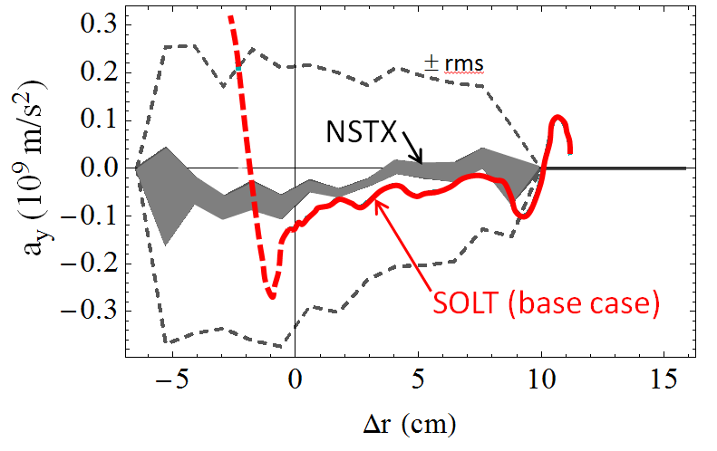
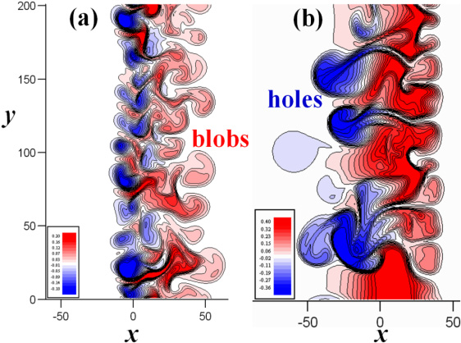
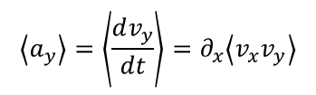
Blobs play significant roles in boundary turbulent transport
Compare experiment and simulation
Edge Sheared Flows and Blob Dynamics
[J. R. Myra et al., 251-TH/P4-23]
Blob trajectories tracked using gas puff imaging (GPI) allow determination of Reynolds stress:
$$\left\langle a_{y}\right\rangle =\left\langle \frac{dv_{y}}{dt}\right\rangle =∂_{x}\left\langle v_{x}v_{y}\right\rangle$$
Lodestar
Effects of Collisionality on the Nonlinear Characteristics of Boundary Turbulence and Blob/hole Transport in Tokamak Plasmas
[Jiquan Li, et al., 325-TH/P4-24]
Blobs going outward down the gradient,
and holes coming inward up the gradient :

Slide 32
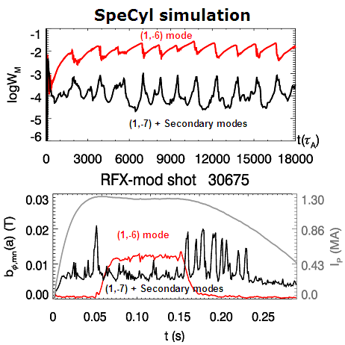
HELICAL REGIMES in
RFP NONLINEAR modelling (TH/P2-16)
S. Cappello
3D nonlinear MHD
stimulated helical regime (1,-6)
simulation from benchmarked codes:
SpeCyl and PIXIE3D
simulation
KEY RESULT:
Edge Magnetic Perturbation (MP) can drive Helical regime,
Successfully obtained in RFX-mod thanks to Feedback Control.
Cf. W.A. Cooper [TH/7-1]
Helical Core in Tokamaks
N. Mizuguchi [TH/P3-26]
Helical Structure in RFP
experiment

Slide 33
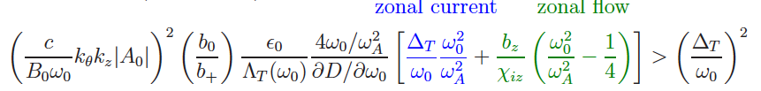
Nonlinear excitations of zonal structures by Toroidal Alfvén Eigenmodes
F. Zonca and Liu Chen
[TH/4-2]
Zonal structures have important self-regulatory roles in the dynamics of microscopic drift-wave type turbulences including drift Alfvén waves
They include zonal flows, zonal magnetic fields (observed in CHS) and radial corrugations of (energetic particle) distribution function and corresponding profiles.
Theory shows that spontaneous excitation of zonal current is more easily induced by finite amplitude TAEs including the proper trapped ion responses, than the usual zonal flow.
Branching ratio between zonal current and flow is set by TAE sideband frequency shift (geometry + nonuniformity) and zonal flow polarizability (trapped ions + geometry).
Including kinetic thermal ion treatment and proper equilibrium geometry in the nonlinear simulations of Alfvénic modes is an important ingredient for realistic comparisons with experimental measurements.

Slide 34
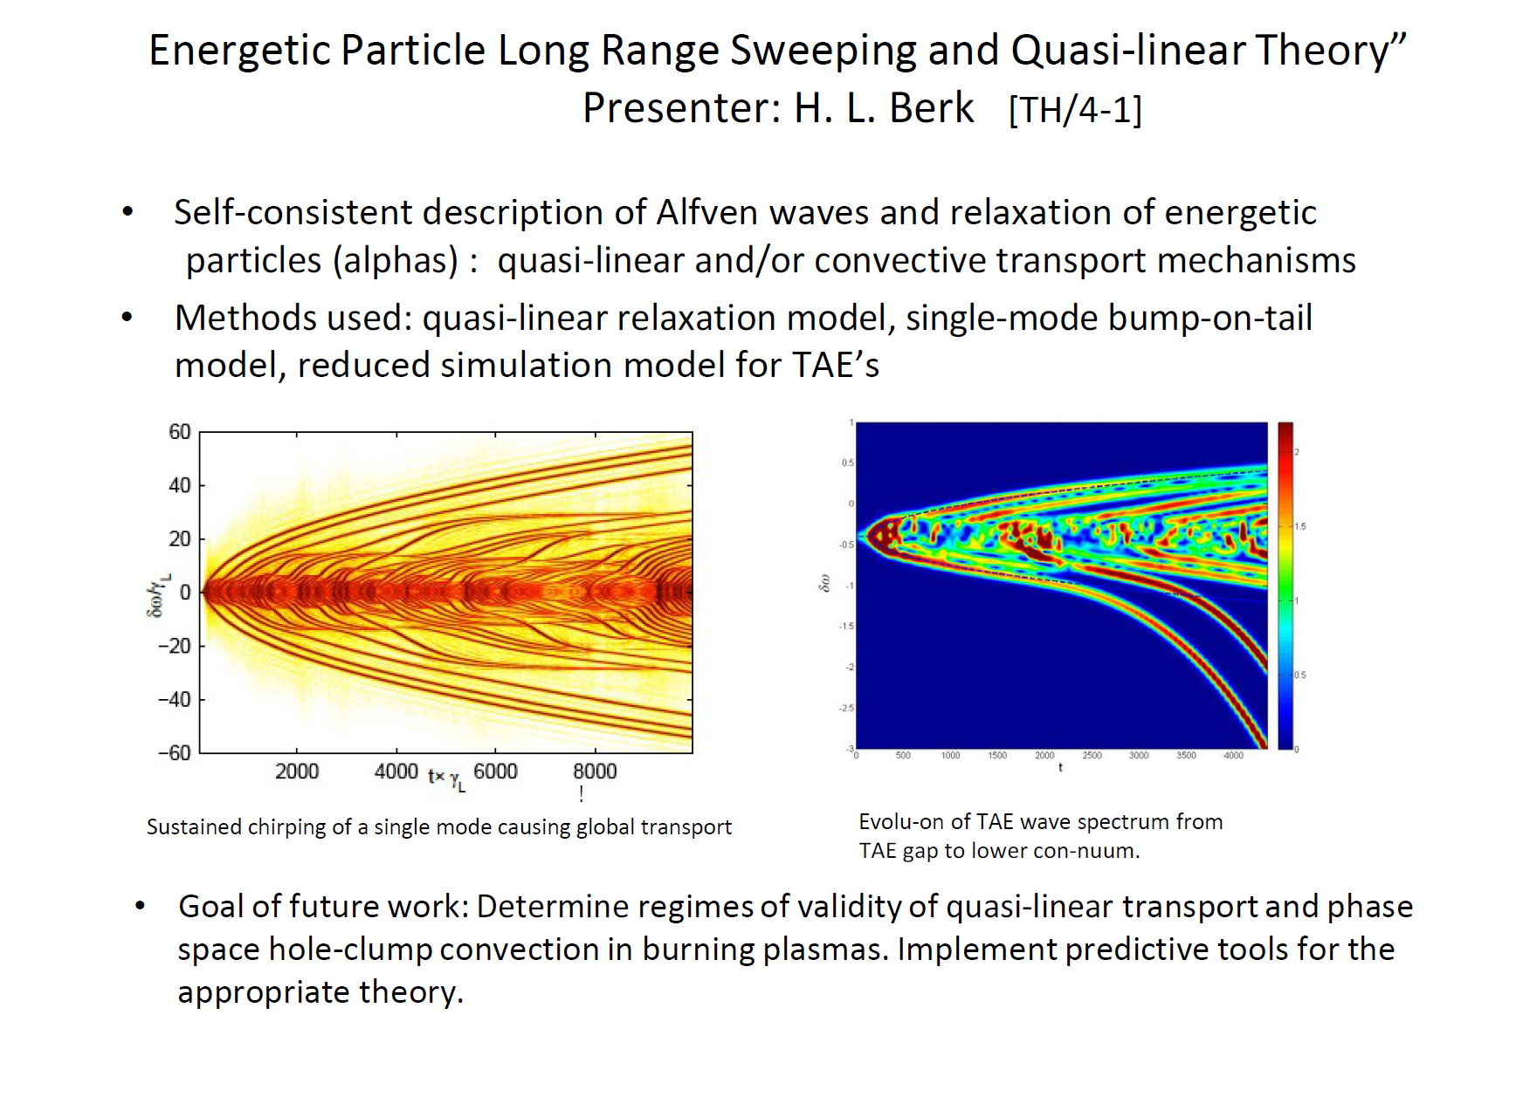

Slide 35
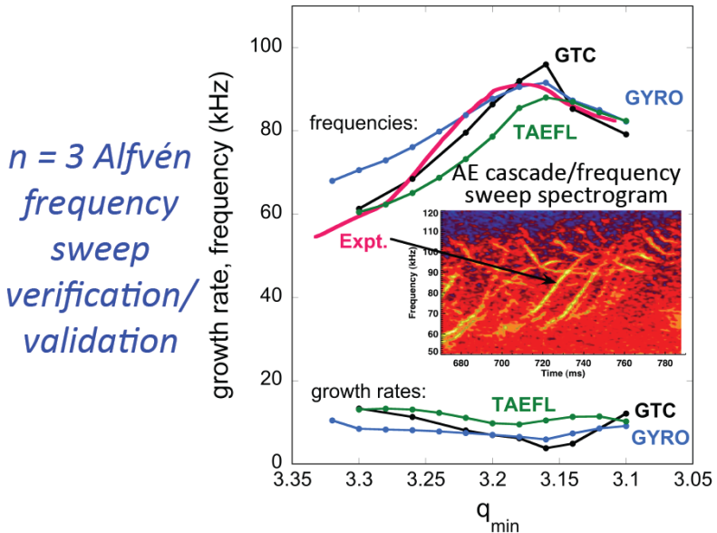
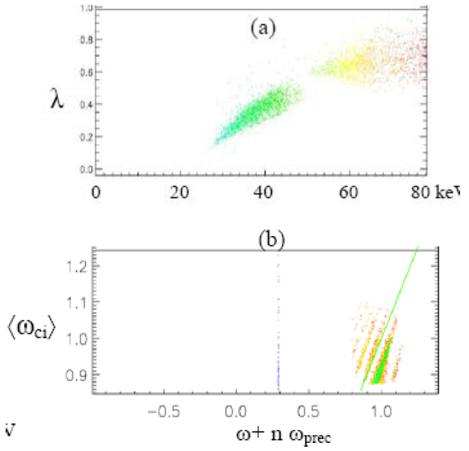
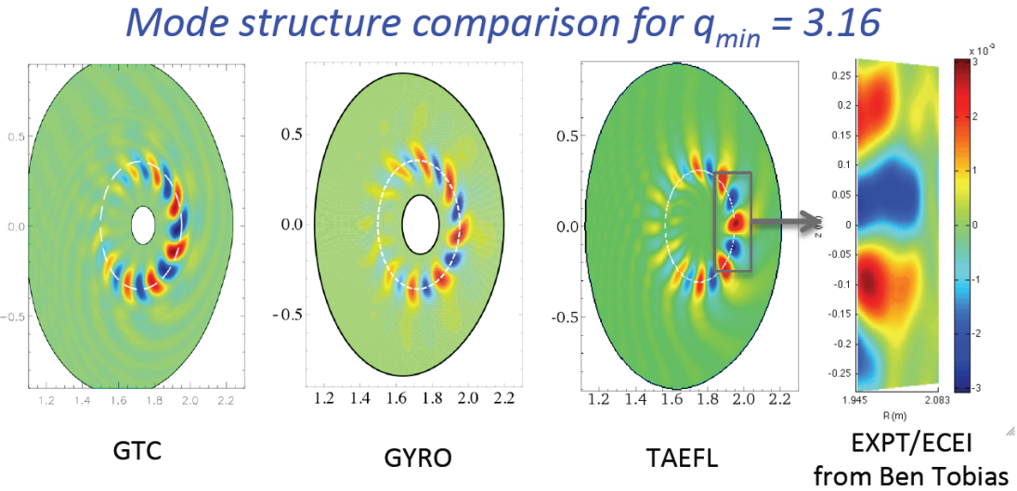
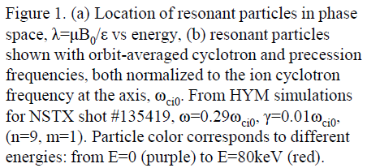
Numerical Simulations of NBI-driven GAE-modes in NSTX
Alfvén cascades/Frequency sweeping Modes in DIII-D
[E.V. Belova et al., 302-TH/P6-16]
[D.A. Spong et al., 372-TH/P6-19]
The HYM code is a nonlinear, global stability code in toroidal geometry, which includes fully kinetic ion description.
HYM simulations of GAEs show good agreement with experimental results for both NSTX L-mode and H-mode shots, in terms of the most unstable toroidal mode numbers, frequency and the mode structure.
HYM simulations for L-mode shots show good agreement in terms of amplitude, and estimated growth rate.
RSAE frequency dynamically upshifts with evolving q-­‐profile
Successfully modeled with gyrofluid (TAEFL) and gyrokinetic (GTC/GYRO) models

Slide 36
After two more years of Gyration…
TS Hahm S/1-3
2π
= 2 years
Ω_{IAEA}
2ρ_{IAEA} = r_{San Diego} - r_{Daejeon}

Slide 37
Summary of Summary
TS Hahm S/1-3
GK simulations with more realisms and enhanced computational capability have reached a higher level of primacy hierarchy in validation.
--- addressing intricated coupling between edge and core,
and between different transport channels.
MHD/fluid simulations contributed to understanding of ELM stability and RMP effects.
Reduced theoretical models have provided useful insights.
- Predator-Prey Model for L-H transition
- Heuristic Drift Model for SOL
- 4-mode Model with zonal structures,
and Bump-on-Tail model for TAE NL evolutions.

Slide 38
More research needed…
TS Hahm S/1-3
Disruptions
Isotopic Mass Dependence of Transport
Density Limit
…

