Slide 1
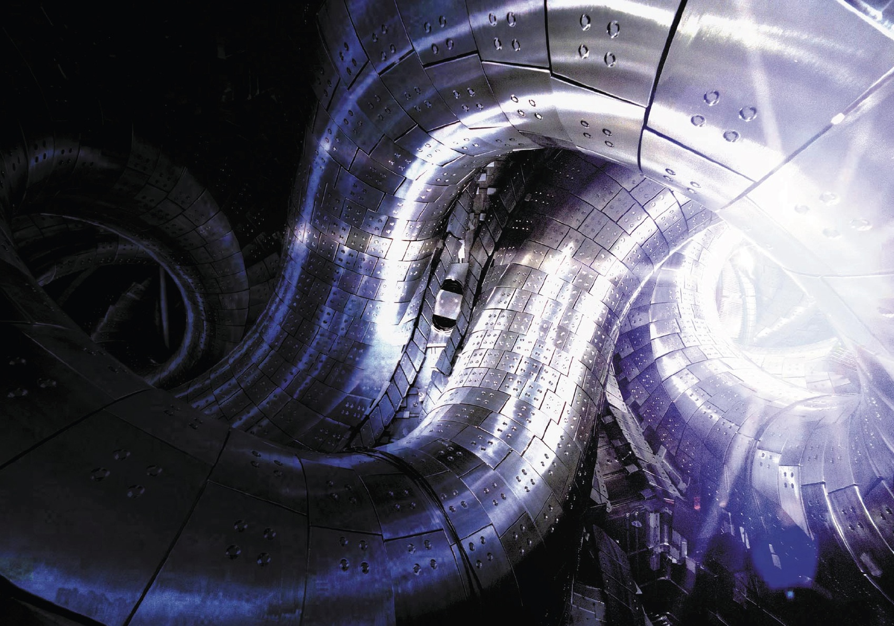
3D plasma response to magnetic field structure in the Large Helical Device
Yasuhiro Suzuki
for the LHD experiment group
National Institute for Fusion Science
The Graduate University for Advanced Studies SOKENDAI
Toki, Japan
suzuki.yasuhiro@LHD.nifs.ac.jp
Special thanks to K. Ida, K. Kamiya, S.Sakakibara, K.Y.Watanabe and H. Yamada
24th IAEA Fusion Energy Conference
San Diego 8-13 October, 2012
Notes:
1

Slide 2
Acknowledgement
K. Ida, S. Sakakibara, M. Yoshinuma, K. Y. Watanabe,
S. Ohdachi, Y. Takemura, R. Seki, K. Nagaoka, K. Ogawa,
Y. Narushima, H. Yamada and LHD experiment group
(National Institute for Fusion Science, Japan)
K. Kamiya (Japan Atomic Energy Agency, Japan)
K. Nagasaki (IAE, Kyoto University, Japan)
S. Inagaki(RIAM, Kyushu University, Japan)
Y. Liang (Forschungszentrum Juelich, Germany)
T. Evans (General Atomics, USA)
We would like to thank all colleagues to do this work!

Slide 3
Outline
Introduction
Identification of effective plasma boundary using E_{r} measurement
Comparison with 3D MHD equilibrium analysis
Summary

Slide 4
Outline
Introduction
Identification of effective plasma boundary using E_{r} measurement
Comparison with 3D MHD equilibrium analysis
Summary

Slide 5
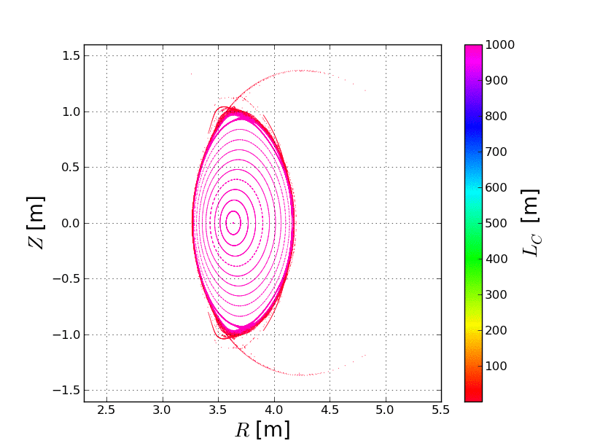
Introduction
Vacuum flux surfaces of LHD
LHD is an L/M=2/10 Heliotron configuration. The rotational transform, ι=1/q, is created by the 3D shaping.

Slide 6
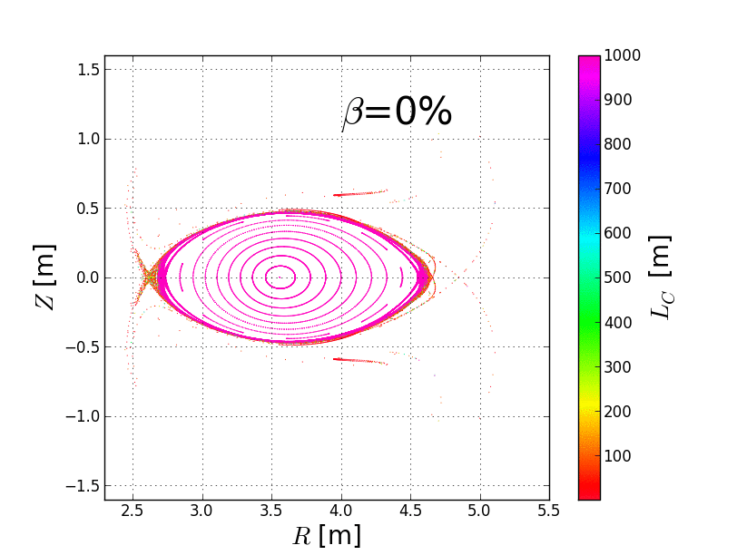
Introduction
3D MHD modeling by HINT
LHD is an L/M=2/10 Heliotron configuration. The rotational transform, ι=1/q, is created by the 3D shaping.
Analyzing 3D MHD equilibrium, “3D plasma response” was found. That is, magnetic field lines are naturally stochastized by pressure-induced perturbed field driven by currents along rippled field lines.

Slide 7
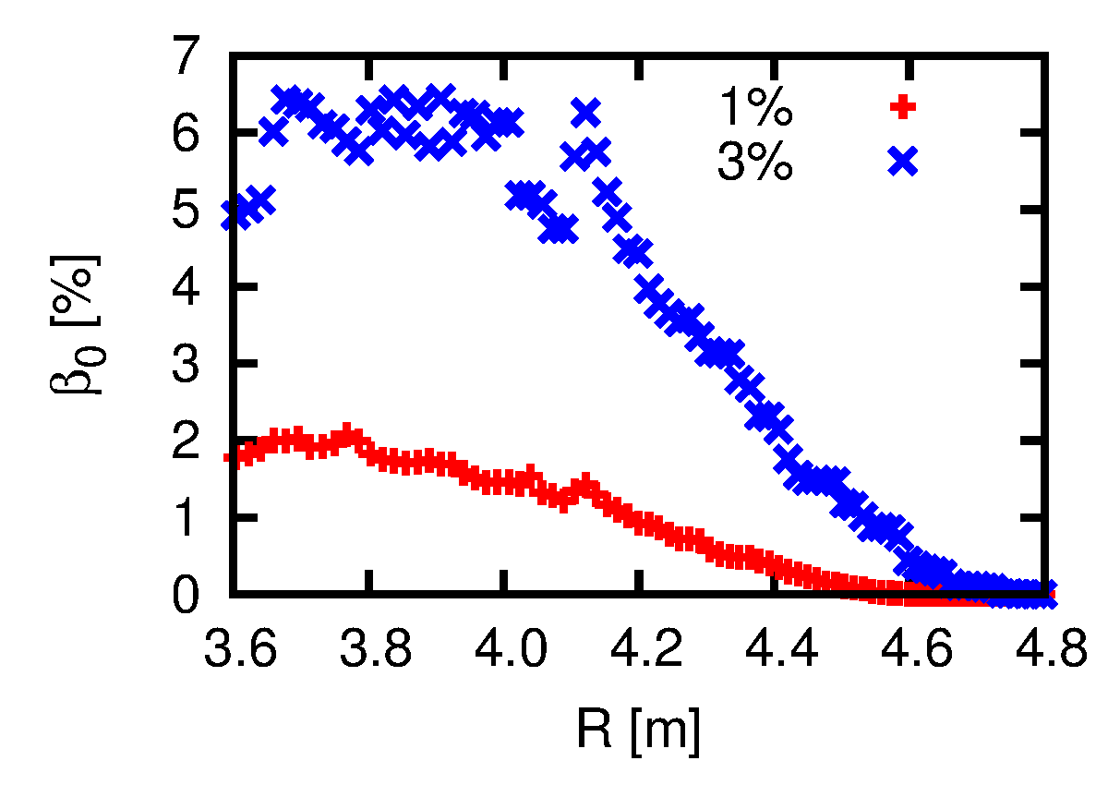
Introduction
Pressure profiles with different β
LHD is an L/M=2/10 Heliotron configuration. The rotational transform, ι=1/q, is created by the 3D shaping.
Analyzing 3D MHD equilibrium, “3D plasma response” was found. That is, magnetic field lines are naturally stochastized by pressure-induced perturbed field driven by currents along rippled field lines.
In experiments, changing the boundary of plasma pressure is observed. Increasing b, the boundary shifts to the outward of the torus.

Slide 8
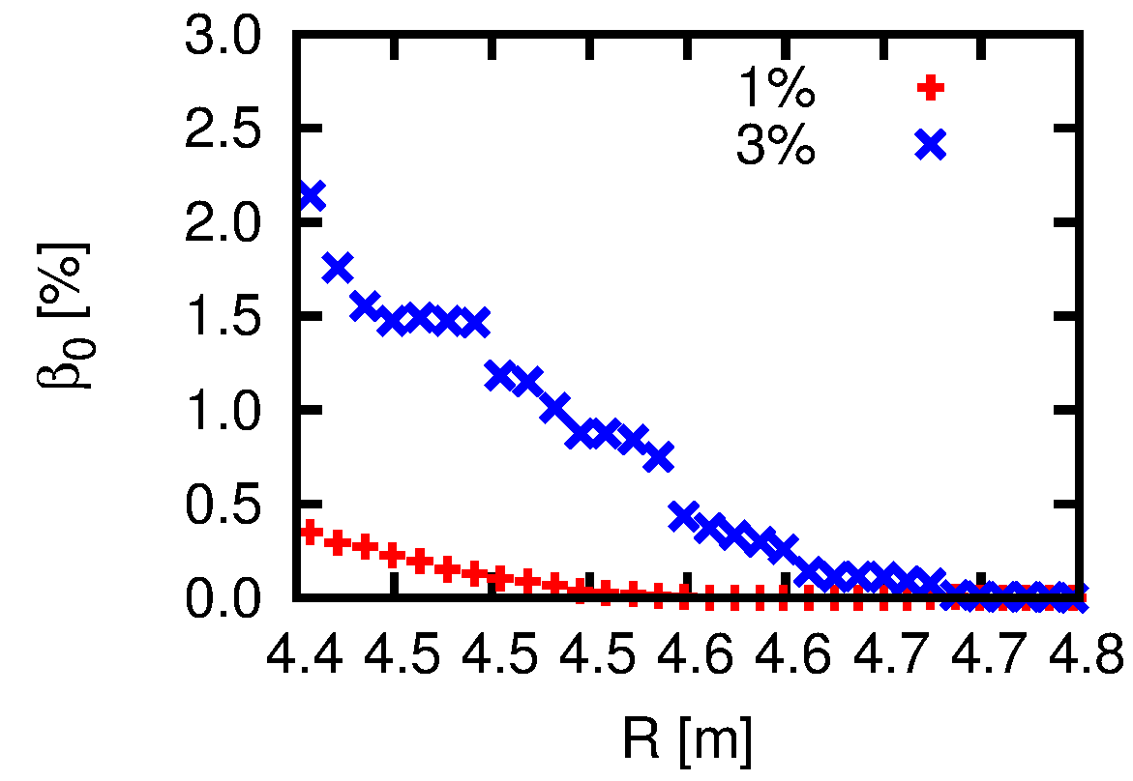
Introduction
Pressure profiles with different β
LHD is an L/M=2/10 Heliotron configuration. The rotational transform, ι=1/q, is created by the 3D shaping.
Analyzing 3D MHD equilibrium, “3D plasma response” was found. That is, magnetic field lines are naturally stochastized by pressure-induced perturbed field driven by currents along rippled field lines.
In experiments, changing the boundary of plasma pressure is observed. Increasing b, the boundary shifts to the outward of the torus.
LCFS
in vac.

Slide 9
Introduction
Pressure profiles with different β
LHD is an L/M=2/10 Heliotron configuration. The rotational transform, ι=1/q, is created by the 3D shaping.
Analyzing 3D MHD equilibrium, “3D plasma response” was found. That is, magnetic field lines are naturally stochastized by pressure-induced perturbed field driven by currents along rippled field lines.
In experiments, changing the boundary of plasma pressure is observed. Increasing b, the boundary shifts to the outward of the torus.
This is also important in tokamak RMP experiments. Strong bootstrap current on the pedestal may drive the 3D plasma response. The magnetic field structure might be changed.
The identification of 3D plasma response in the experiments is an important issue.
LCFS
in vac.

Slide 10
Introduction
Pressure profiles with different β
LHD is an L/M=2/10 Heliotron configuration. The rotational transform, ι=1/q, is created by the 3D shaping.
Analyzing 3D MHD equilibrium, “3D plasma response” was found. That is, magnetic field lines are naturally stochastized by pressure-induced perturbed field driven by currents along rippled field lines.
In experiments, changing the boundary of plasma pressure is observed. Increasing b, the boundary shifts to the outward of the torus.
This is also important in tokamak RMP experiments. Strong bootstrap current on the pedestal may drive the 3D plasma response. The magnetic field structure might be changed.
The identification of 3D plasma response in the experiments is an important issue.
LCFS
in vac.
3D plasma response is a common issue in non-axisymmetric tori.

Slide 11
Introduction
3D plasma response causes the stochastization in the peripheral region.
Where is the plasma boundary?
How does the magnetic field structure change?
Identifications of plasma boundary and topology in the experiment are important and urgent issues!
Hypothesis:
Lost of electrons along stochastic and opening field lines produces positive electric field.
=> Positive electric field in the edge is an index of changing magnetic field structure!
In this study,
Change of magnetic field structure is identified by the radial electric field.
Comparing 3D MHD equilibrium analyses, impact of 3D plasma response to magnetic field structure is studied.

Slide 12
Outline
Introduction
Identification of effective plasma boundary using E_{r} measurement
Comparison with 3D MHD equilibrium analysis
Summary

Slide 13
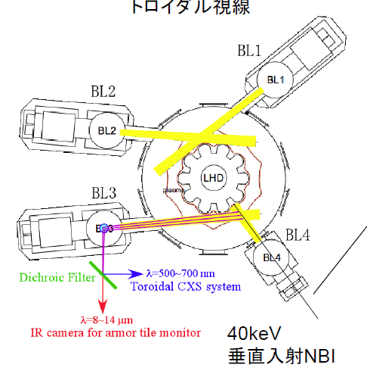
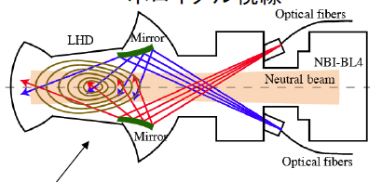
Radial Electric Field Measurement by CXRS
Charge Exchange Recombination Spectroscopy in LHD
Toroidal system
Poloidal system
The CXRS measures velocities of carbon impurity ions.
The radial electric field Er is defined by a following radial force balance equation,
40keV
Perpendicular NBI
In this study, the magnetic field in the outward of the torus is studied at horizontally elongated cross section.

Slide 14
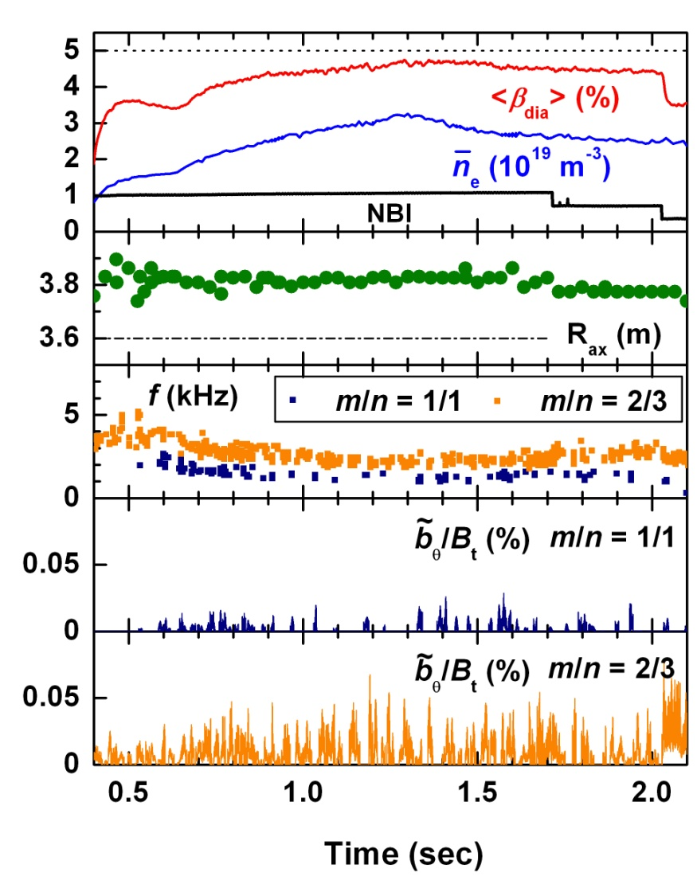
β-scan in Quasi Steady State Discharge
<β>_{max} ~is scanned for 1~ 4.5 %. Achieved β is changed by changing of magnetic field B=0.425~1.5T.
Plasma was maintained for 30~100τ_{E}
Peripheral MHD modes are dominantly observed. Those modes are not collapsed.
Net current is not free but small.
Boundary of pressure shift to outward of torus
R_{ax} = 3.6 m, B_{t} = -0.425 T

Slide 15
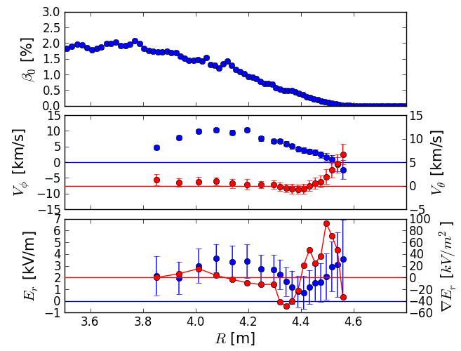
Identification of effective plasma boundary by Er measurement
An example of identification of plasma boundary by E_{r}
Hypothesis:
If field lines are opening by “3D plasma response”,
LCFS
in vac.
Positive E_{r} is appeared in the peripheral region.
“effective plasma boundary” is defined by E_{r} profile.
NOTE:
Effective plasma boundary is the outward of vacuum LCFS.
Position of strong E_{r} shear is the effective plasma boundary.

Slide 16
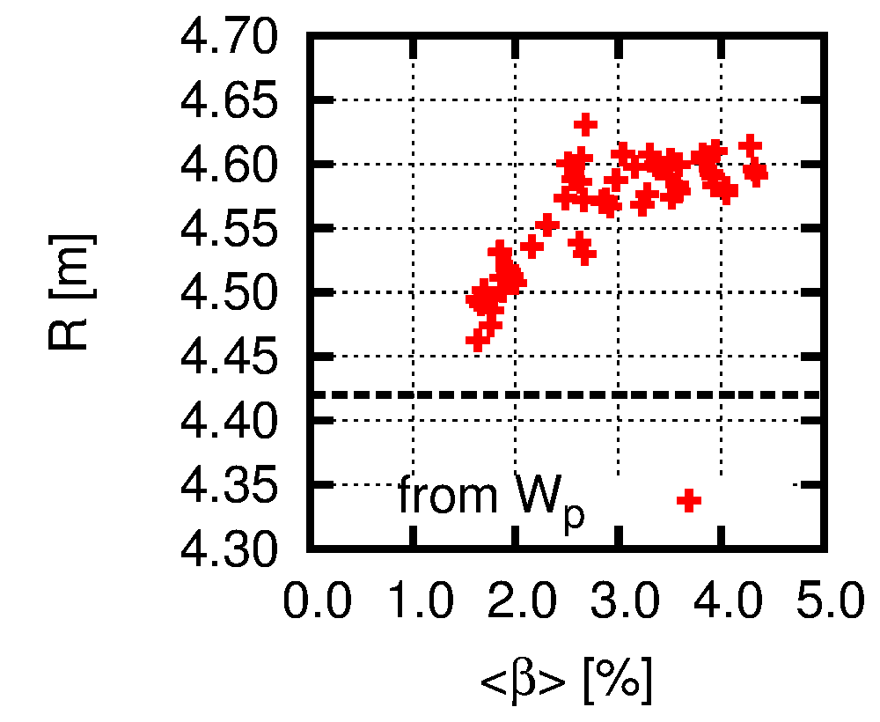
Change of effective plasma boundary with increased β
Boundary with 99% of total stored energy
To discuss the change of the effective plasma boundary due to increased β, boundaries with 99% of total stored energy W_{p} are studied.
Those boundaries move to the outward of the torus for β < 3%.
For β > 3%, shifts of those boundaries are saturated at R ~ 4.6m.

Slide 17
Change of effective plasma boundary with increased β
Boundary with 99% of total stored energy
To discuss the change of the effective plasma boundary due to increased β, boundaries with 99% of total stored energy W_{p} are studied.
Those boundaries move to the outward of the torus for β < 3%.
For β > 3%, shifts of those boundaries are saturated at R ~ 4.6m.
The boundary with 99% of W_{p} does not mean the effective plasma boundary because “99%” is an arbitrarily parameter.

Slide 18
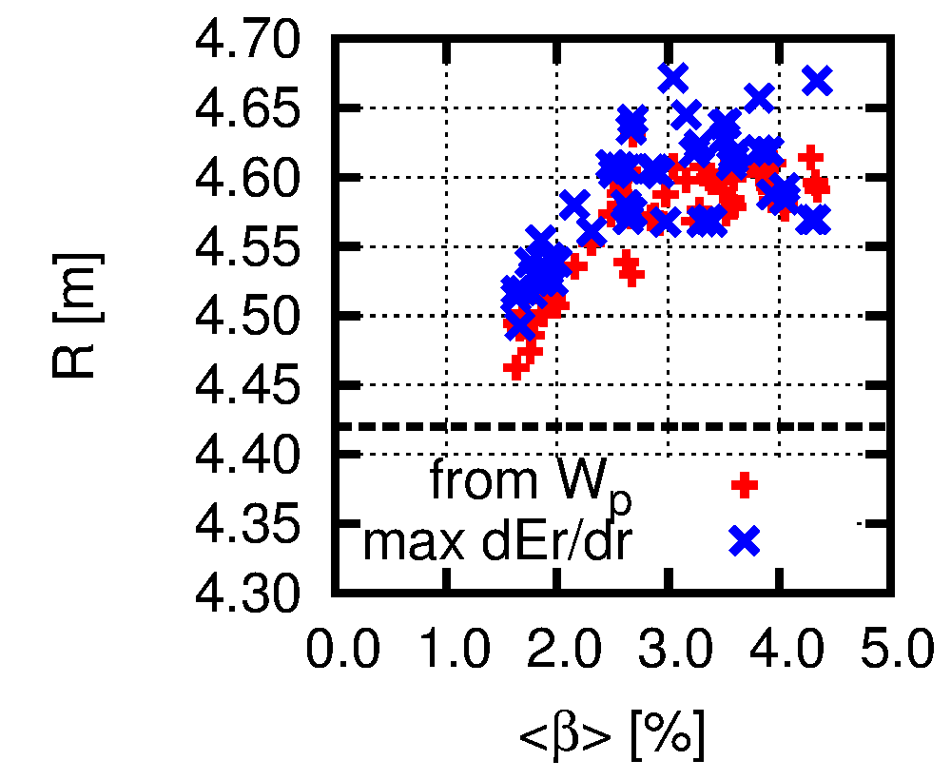
Change of effective plasma boundary with increased β
Position of max E_{r} shear
To identify the effective plasma boundary more robustly, positions of max E_{r} shear are studied.
The position of max E_{r} shear may reflect the confinement of electrons.
Boundaries defined by W_{p} and E_{r} shear are comparable for β < 3%.
For β > 3%, positions of max E_{r} shear are almost same or shift more outward than boundaries of W_{p}.
For β > 4%, it seems that positions of max E_{r} shear shift to the inward of the torus again. => further study!

Slide 19
Change of effective plasma boundary with increased β
Position of max E_{r} shear
To identify the effective plasma boundary more robustly, positions of max E_{r} shear are studied.
The position of max E_{r} shear may reflect the confinement of electrons.
Boundaries defined by W_{p} and E_{r} shear are comparable for β < 3%.
For β > 3%, positions of max E_{r} shear are almost same or shift more outward than boundaries of W_{p}.
For β > 4%, it seems that positions of max E_{r} shear shift to the inward of the torus again. => further study!
Effective plasma boundary changes due to increased β.

Slide 20
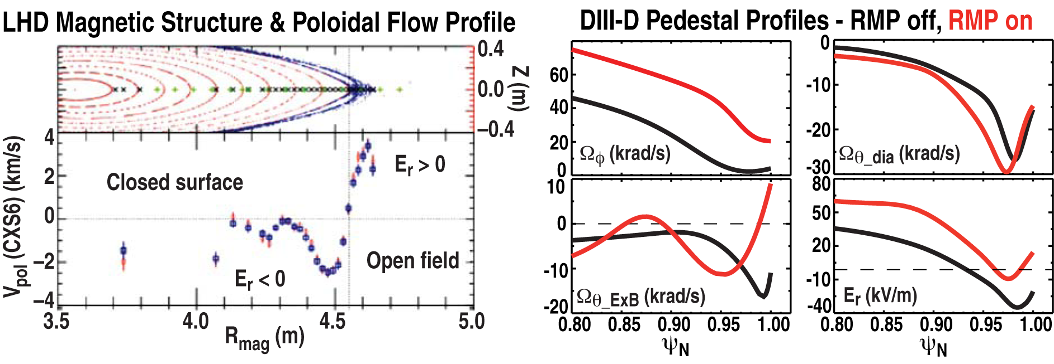
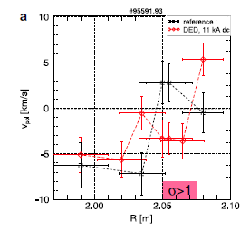
Comparisons with tokamaks
The positive E_{r} might be appeared on opening field lines in the stochastic region!
TEXTOR
TEXTOR DED off , on
B.Unterberg, J.Nucl.Mater, 363-365 (2007) 698
T. Evans, Plasma Conference2012, Kanazawa, Japan
When the RMP field is applied in TEXTOR and DIII-D:
The edge toroidal flow increases
The E x B flow becomes positive at the edge of the plasma
Courtesy to Y. Liang (FZ-Juelich) and T.Evans (GA)

Slide 21
Outline
Introduction
Identification of effective plasma boundary using E_{r} measurement
Comparison with 3D MHD equilibrium analysis
Summary

Slide 22
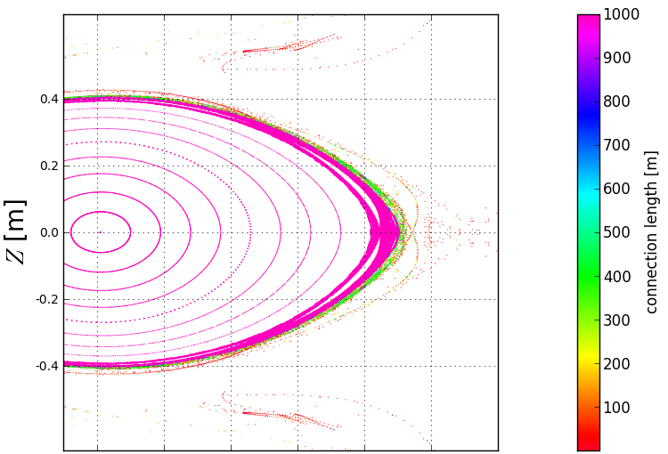
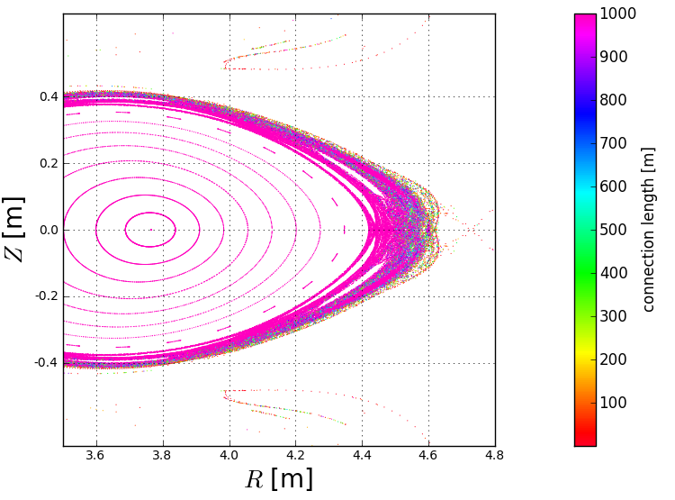
Comparisons between Er measurement and numerical modeling
Positions of max E_{r} shear and 3D MHD equilibria by HINT2 are compared.
β~1%
HINT2 :
A 3D MHD Equilibrium calculation code without an assumption of nested flux surfaces.
Magnetic islands and stochastic region can be resolved.
Y. Suzuki, et al., Nucl. Fusion 46 (2006) L19
For β~1%, the width of stochastic region is not large. Sharp boundary of the connection length L_{C} appears on the edge of stochastic region.
A point of max E_{r} shear appears on the boundary between short and long L_{C}.
For β~3%, the width of stochastic region is increased by the 3D plasma response.
In the stochastic region, field lines of short and long L_{C} are overlapped. A point of max E_{r} shear moves with increased stochastic region.
L_{C} is still long on the point of max E_{r} shear.
β~3%

Slide 23
Comparisons between Er measurement and numerical modeling
Positions of max E_{r} shear and 3D MHD equilibria by HINT2 are compared.
β~1%
HINT2 :
A 3D MHD Equilibrium calculation code without an assumption of nested flux surfaces.
Magnetic islands and stochastic region can be resolved.
Y. Suzuki, et al., Nucl. Fusion 46 (2006) L19
LCFS
in vac.
For β~1%, the width of stochastic region is not large. Sharp boundary of the connection length L_{C} appears on the edge of stochastic region.
A point of max E_{r} shear appears on the boundary between short and long L_{C}.
For β~3%, the width of stochastic region is increased by the 3D plasma response.
In the stochastic region, field lines of short and long L_{C} are overlapped. A point of max E_{r} shear moves with increased stochastic region.
L_{C} is still long on the point of max E_{r} shear.
β~3%
LCFS
in vac.

Slide 24
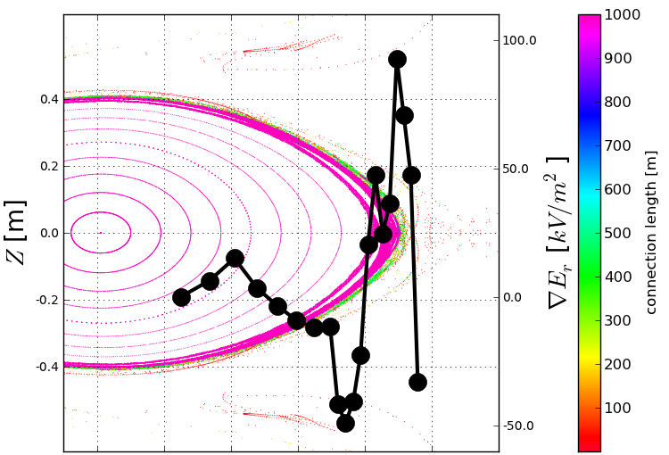
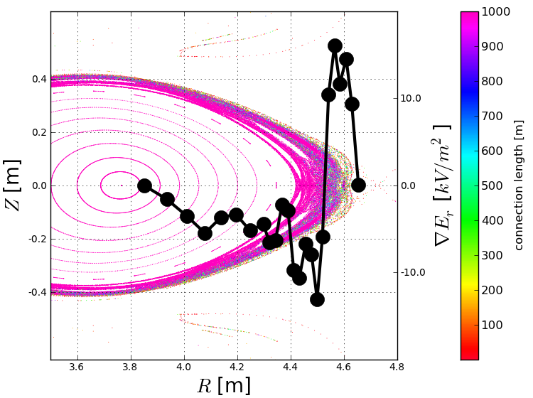
Comparisons between Er measurement and numerical modeling
Positions of max E_{r} shear and 3D MHD equilibria by HINT2 are compared.
β~1%
HINT2 :
A 3D MHD Equilibrium calculation code without an assumption of nested flux surfaces.
Magnetic islands and stochastic region can be resolved.
Y. Suzuki, et al., Nucl. Fusion 46 (2006) L19
LCFS
in vac.
For β~1%, the width of stochastic region is not large. Sharp boundary of the connection length L_{C} appears on the edge of stochastic region.
A point of max E_{r} shear appears on the boundary between short and long L_{C}.
For β~3%, the width of stochastic region is increased by the 3D plasma response.
In the stochastic region, field lines of short and long L_{C} are overlapped. A point of max E_{r} shear moves with increased stochastic region.
L_{C} is still long on the point of max E_{r} shear.
β~3%
LCFS
in vac.

Slide 25
Comparisons between Er measurement and numerical modeling
Positions of max E_{r} shear and 3D MHD equilibria by HINT2 are compared.
β~1%
HINT2 :
A 3D MHD Equilibrium calculation code without an assumption of nested flux surfaces.
Magnetic islands and stochastic region can be resolved.
Y. Suzuki, et al., Nucl. Fusion 46 (2006) L19
LCFS
in vac.
For β~1%, the width of stochastic region is not large. Sharp boundary of the connection length L_{C} appears on the edge of stochastic region.
A point of max E_{r} shear appears on the boundary between short and long L_{C}.
For β~3%, the width of stochastic region is increased by the 3D plasma response.
In the stochastic region, field lines of short and long L_{C} are overlapped. A point of max E_{r} shear moves with increased stochastic region.
L_{C} is still long on the point of max E_{r} shear.
β~3%
LCFS
in vac.

Slide 26
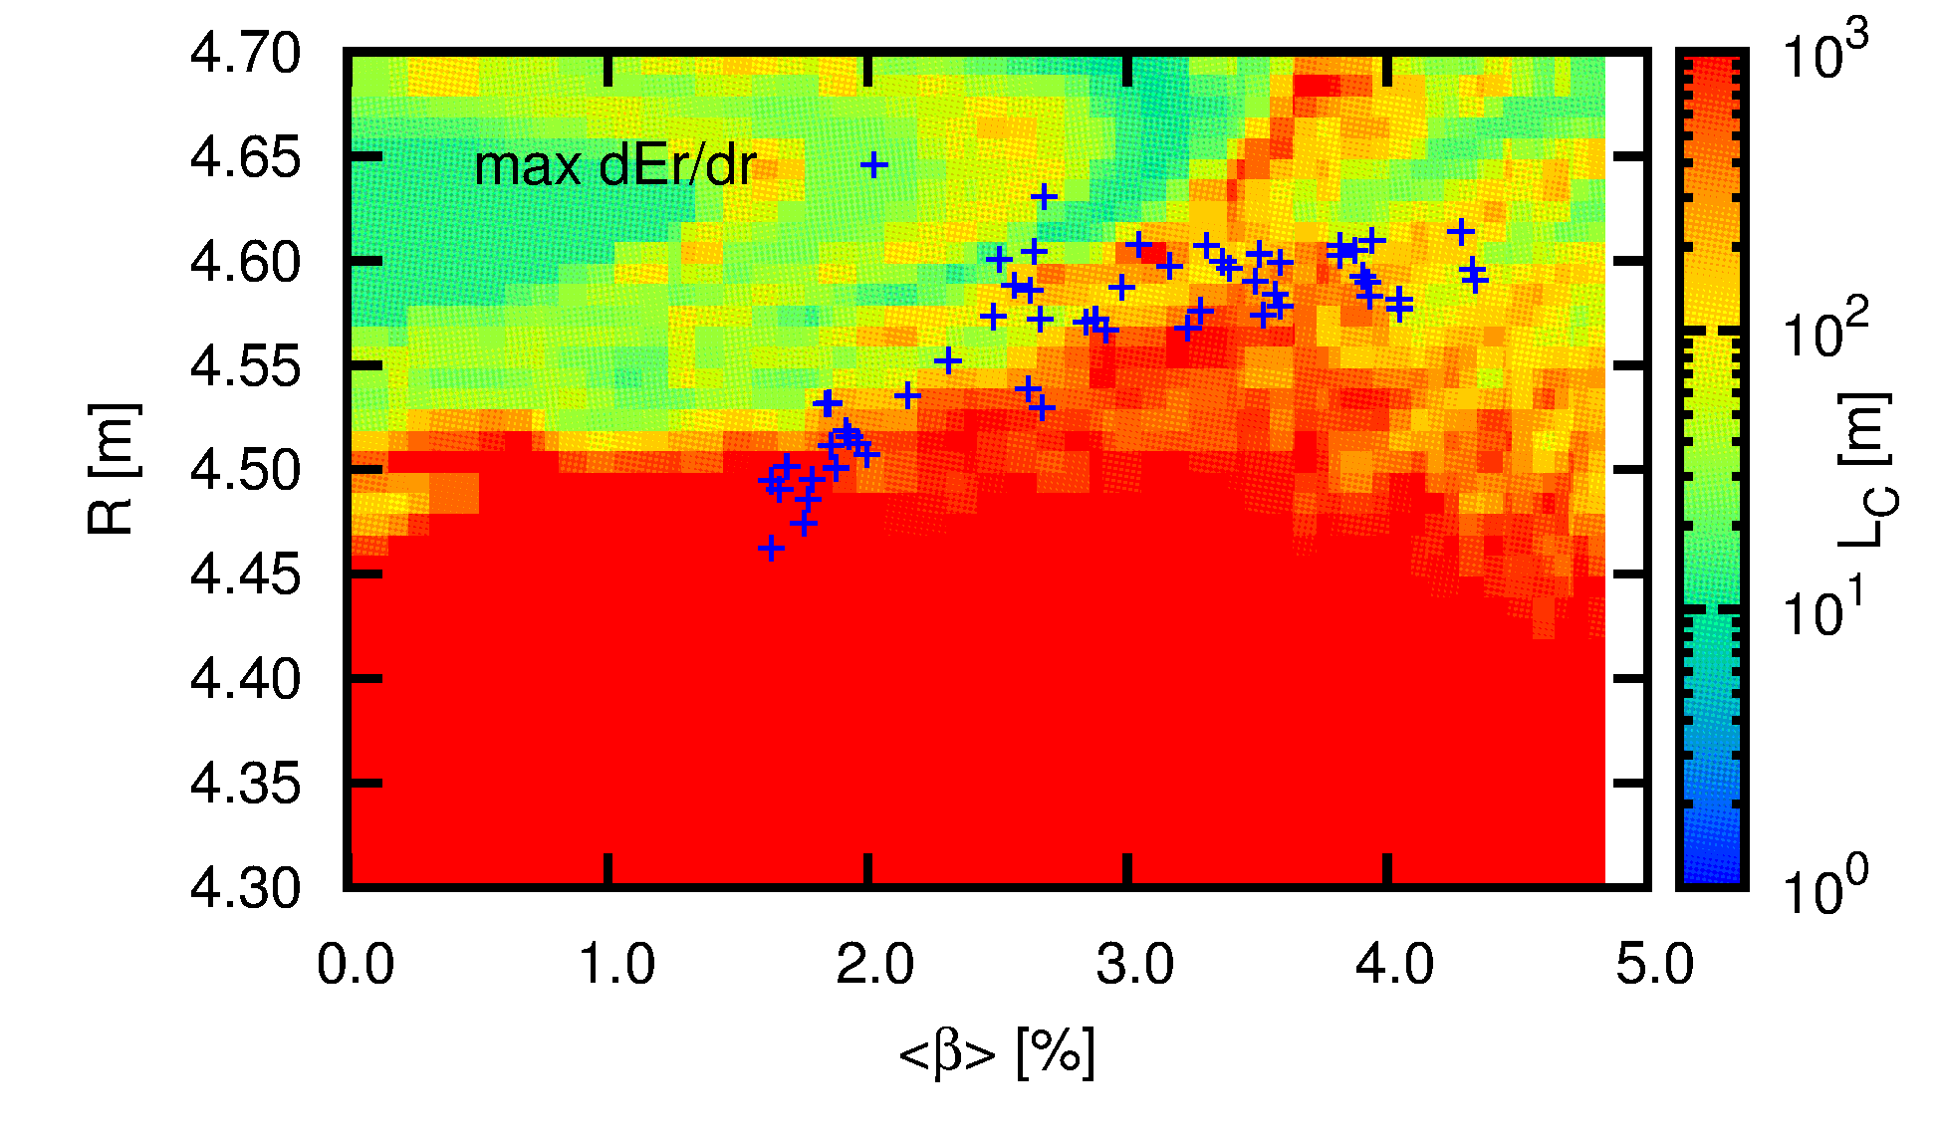
Comparisons between Er measurement and numerical modeling
3D MHD equilibrium analyses suggest :
1.Magnetic filed lines become stochastic by the “3D plasma response”.
2.But L_{C} is still long in the stochastic region.
-> Stochastic region is still the confinement region.
-> “effective plasma boundary” is not the LCFS.
Comparison with HINT2 modeling
Contours of connection length with different β
β~3%
LCFS
in vac.
L_{C} is long in the outward of the torus.
Short L_{C} appears due to increased β.
Positions of max E_{r} shear correlate contours of L_{C}.
Position of max E_{r} shear appears in short L_{C}.
max E_{r} shear appears in stochastic region
Is the position of max E_{r} shear decided by L_{C}?

Slide 27
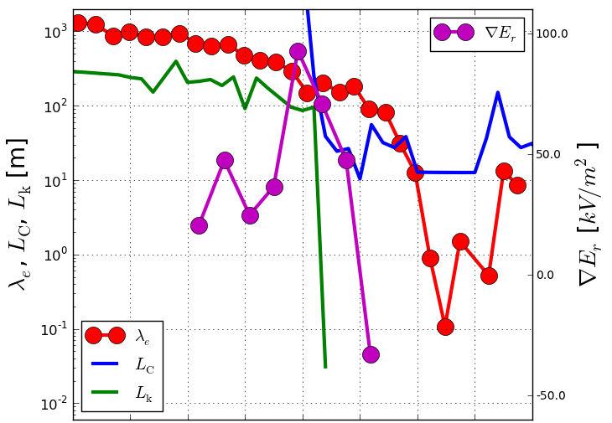
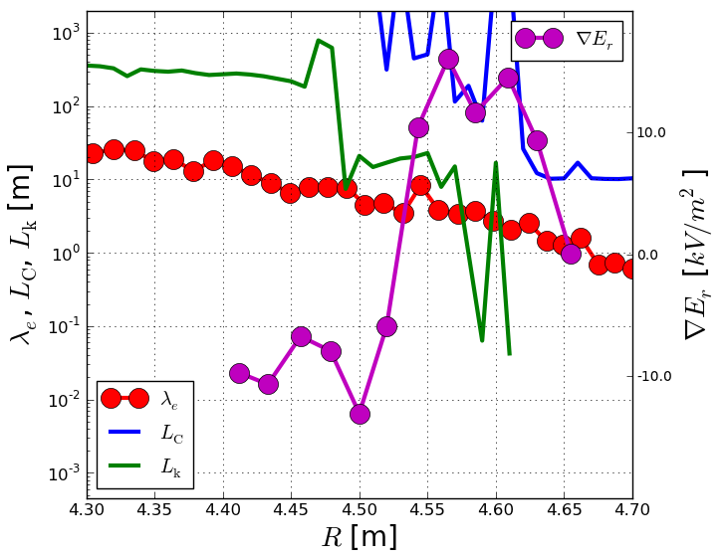
Impact of magnetic field structure to effective plasma boundary
To understand correlation between 3D magnetic field structure and effective plasma boundary, correlation lengths ( L_{C} and L_{k}) and electron mean free path λ_{e} are studied.
LCFS
in vac.
L_{C}: connection length of magnetic field lines.
L_{k}: Kolmogorov length to measure the stochasticity.
For β~1%, λ_{e} is sufficiently long because of high T_{e} and low n_{e}. The effective plasma boundary is defined clearly if λ_{e} is longer than L_{C}.
For β~3%, the stochastic region increases. L_{C} and L_{k} are longer than λ_{e} at R < 4.55m
L_{C} is still longer than λ_{e} but L_{k} becomes shorter than λ_{e} at R > 4.55m. Strong stochastization by 3D plasma response is expected in the region.
Point of max E_{r} shear appears on short L_{k}.
β~1%
LCFS
in vac.
This suggests a possibility the effective plasma boundary is decided by the stochasticity of 3D plasma response.
β~3%

Slide 28
Discussions
We studied the change of the effective plasma boundary by 3D plasma response.
However, we do not resolve followings:
We identify the effective plasma boundary but we do not identify the topology of the magnetic field.
E_{r} measurement should be improved.
or
other ideas are necessary ( -> MECH ).
In this study, only magnetostatic 3D MHD equilibrium are compared with zero net current.
collisionality

Slide 29
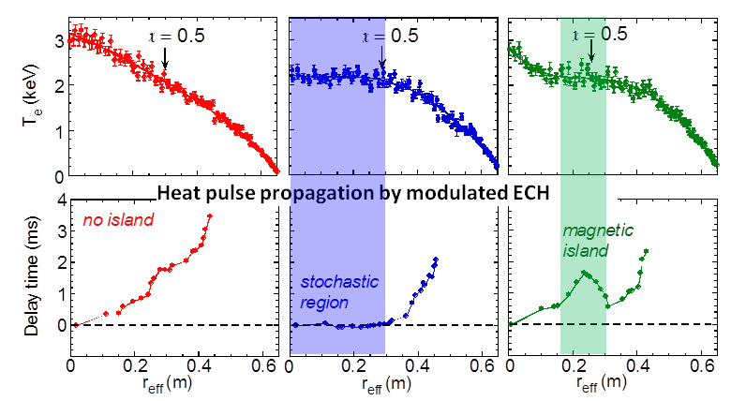
Identification of magnetic topology by MECH
Heat pulse propagation successfully demonstrates the magnetic topology in the plasma core.
Global confinement
does not change
significantly, but
topology changes
dramatically
Propagation
slow ➔ nested
fast ➔ stochastic

Slide 30
Outline
Introduction
Identification of effective plasma boundary using E_{r} measurement
Comparison with 3D MHD equilibrium analysis
Summary

Slide 31
Summary
Future works
Change of the effective plasma boundary by 3D plasma response is studied.
The effective plasma boundary is identified by the Er measurement. Increasing β, the effective plasma boundary shifts outer than the vacuum last closed flux surfaces.
Comparing 3D MHD equilibrium analyses, we discussed why the effective plasma boundary is changed by 3D plasma response. 3D MHD equilibrium analysis suggests strongly stochastic regions correlate positions of strong Er shear from negative to positive.
We could not identify the topology of the magnetic field. To identify the topology, we need improvement of Er measurement or other ideas. MECH experiments is one idea.
Further studies using improved CXRS and comparing with MECH experiments.
Further studies of collisionality.

