Slide 1
Evaluation of a Field Aligned ICRF Antenna in Alcator C-Mod
24th IAEA Fusion Energy Conference
San Diego, USA October 8-13 2012
S.J. Wukitch, D. Brunner, M.L. Garrett, B. Labombard, C. Lau, Y. Lin, B. Lipschultz, R. Ochoukov, M.L. Reinke, J.L. Terry, D. Whyte and the Alcator C-Mod Team
Goal:
Test whether a field aligned (FA) antenna can improve RF antenna operation, particularly impurity contamination and impurity sources.
Key Results:
Field aligned ICRF antenna has reduced impurity contamination and impurity sources.
Operational characteristics of this novel, high power ICRF antenna are favorable.
Measured plasma potentials for FA antenna are not remarkably different from plasma potentials associated with toroidally aligned (TA) antenna.

Slide 2
Outline
Motivation
Antenna and Diagnostic description
Impurity contamination and source characterization.
Antenna coupling and electrical performance.
Characterization of plasma potential with FA and TA antennas.
Field Aligned Antenna
Toroidally Aligned (TA) Antenna

Slide 3
For High Z PFC Devices, A New Approach to Limit Impurities is Required
Impurity contamination with ICRF antenna operation has been universally observed.
‘Jacquinot rules’* to minimize ICRF impurity contamination are:
  Operate in so-called dipole phasing.
  Align the Faraday screen with total magnetic field.
  Antenna armor should use low Z materials.
  Utilize high single pass absorption.
Despite applying ‘Jacquinot rules’, experience from JET, ASDEX-U, C-Mod has shown that this prescription is insufficient in devices with high Z PFCs.
Can a FA antenna reduce ICRF impurity contamination?
G. Matthews et al., 20th Int. Conf. on Plasma-Surface Interactions in Controlled Fusion Devices, Aachen (2012).
*Jacquinot et al., Fusion Eng. Design 12, 245 (1990).

Slide 4
Underlying Physics of Impurity Contamination is Thought to be RF-Sheaths
TA antennas were found to have less impurity contamination in dipole phasing rather than monopole.
Reduction in E|| was used to explain results.¹
  Significant reduction in integrated E|| is shown in recent FEM simulations.
Reduce E|| and impurity contamination should be reduced.
Myra et al., Fus. Eng. Design 31, 291 (1996)

Slide 5
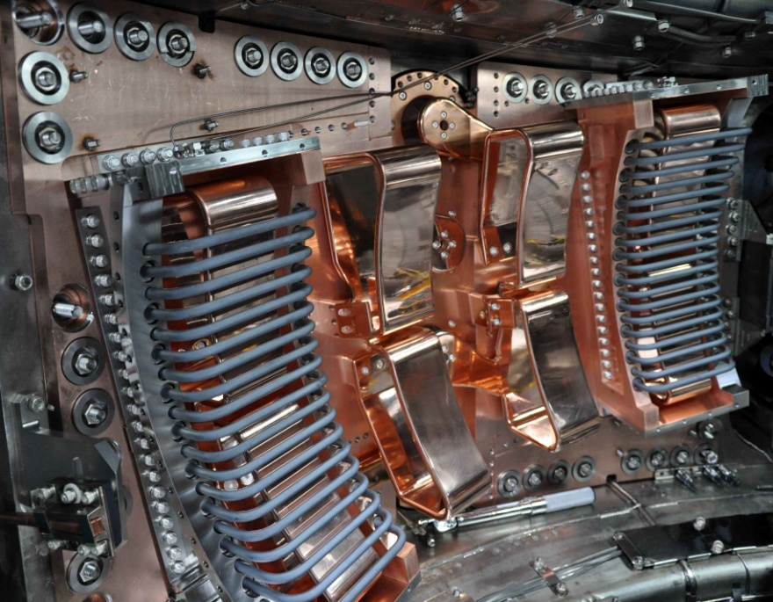
Guiding Design Principle is Field Line Symmetry
Rotate antenna straps and structure 10º to be perpendicular to total B field.
  Along a field line, integrated E|| will be minimized due to symmetry.

Slide 6
Guiding Design Principle is Field Line Symmetry
Rotate antenna straps and structure 10º to be perpendicular to total B field.
  Along a field line, integrated E|| will be minimized due to symmetry.
For a FA antenna, the integrated E|| fields are reduced for all antenna phases.
  For dipole, estimated sheath field is reduced ~2-3.
  For monopole, sheath field is negligible – a surprising prediction.

Slide 7
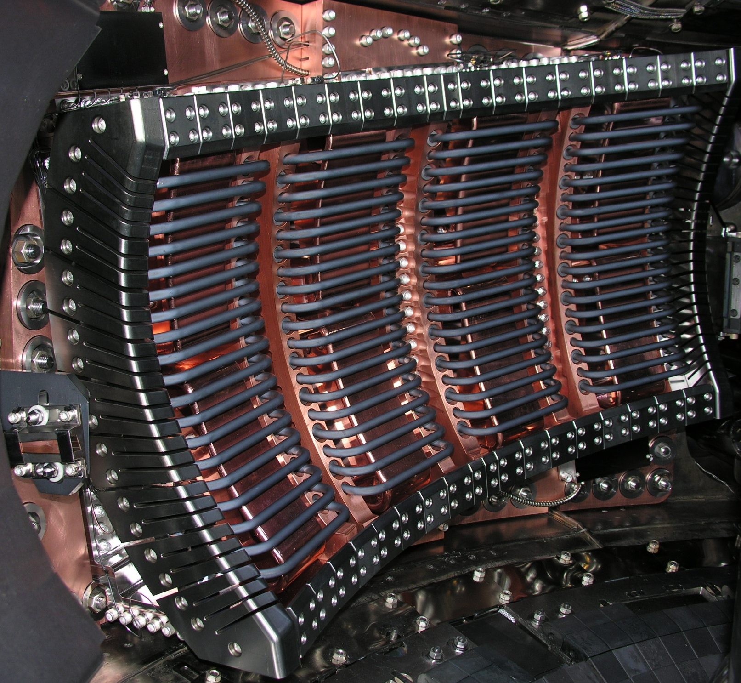
Key Experimental Diagnostics
Core impurity content is monitored using VUV spectroscopy Mo XXXI.
Local impurity (Mo I, Ti I, and B I) sources are monitored with visible spectrometer:
  Views of FA antenna (shown as white circles),
  TA antennas, and
  plasma limiter.
Plasma potential is monitored by gas puff imaging (GPI) and reciprocating emissive probe.

Slide 8
SOL Plasma Potential Profile Estimated from GPI Measurements
2D GPI measures emission fluctuations resulting from the turbulence in the local background plasma.
In the far SOL, turbulence is convected at the local ExB velocity.
Measure the radial profile of dominant poloidal phase velocities and deduce the Er profile.
Plasma potential is estimated as φ= λ⊥Er where is λ⊥ penetration depth of the rectified potential.
  Er profile (top figure) yields a plasma potential profile shown in bottom figure
See EX/P5-39 Terry

Slide 9
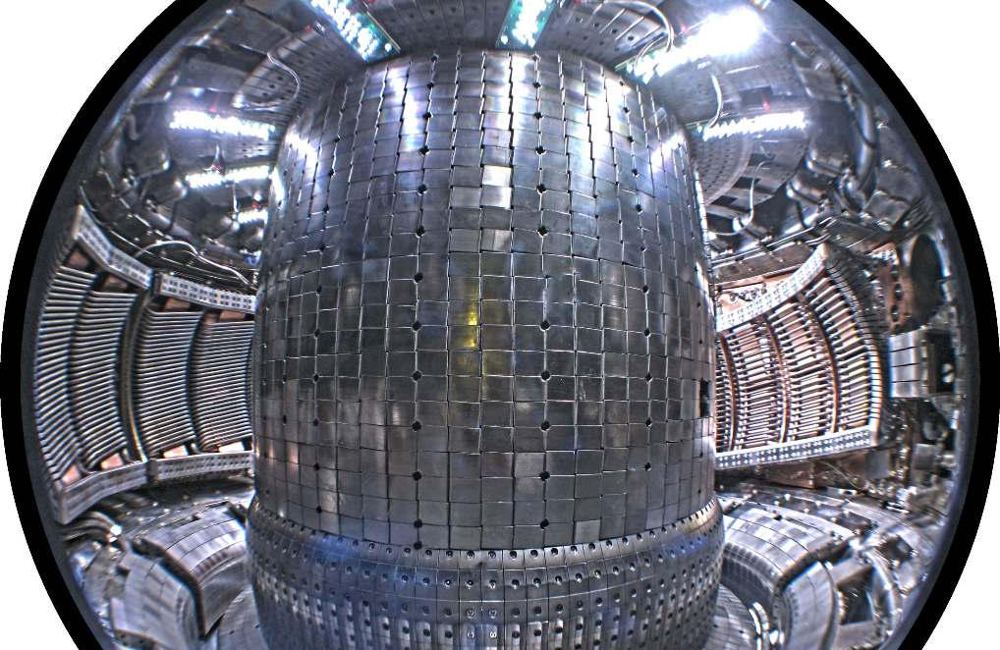
Field Aligned Antenna Evaluation: Experimental Overview
Compare antenna performance between toroidally and field aligned antenna in near axis minority H absorption scenario with RF power up to 3 MW.
  Magnetic field 5.2-5.4 T with currents 0.6-1.3 MA.
  Experiments have been done prior and post boronization.
TA-ant
FA-ant
Experimental parameters are similar to expected ITER conditions:
  Antenna power density exceeds anticipated ITER power density.
  Experiments are performed at the ITER magnetic field and plasma density.
  Strong single pass absorption.
  Metallic PFCs (Mo) that has similar sputtering characteristics as tungsten.
  Scrape off layer is opaque to neutrals.

Slide 10
In L-mode, FA Antenna has Lower Impurity Contamination
Prior to boronization in L-mode discharges, plasma response is more favorable for power from FA-antenna.
Impurity contamination is lower.
  Radiated power is 25% lower for comparable injected power.
  Core molybdenum content is significantly reduced.

Slide 11
In H-mode, FA Antenna has Lower Impurity Contamination
Core Mo is significantly lower for FA antenna compared to TA antennas.
  Rise time on the core Mo content is significantly slower for the FA antenna than the TA-antennas.
FA antenna has lower radiated power.
  Radiated power is ~20-30% lower than for the TA antennas in EDA H-mode.

Slide 12
TA Antenna Mo Source Correlates with TA Power
Compare the response of the local Mo source for each antenna view when the TA and FA antenna are powered separately.
Strong Mo source response at the TA antenna when the TA antenna is powered.
  Mo source at the TA antenna increases with each power step.

Slide 13
TA Antenna Mo Source Correlates with TA Power
Compare the response of the local Mo source for each antenna view when the TA and FA antenna are powered separately.
Strong Mo source response at the TA antenna when the TA antenna is powered.
  Mo source at the TA antenna increases with each power step.
Weak Mo source response at the TA antenna when FA antenna is powered.

Slide 14
FA Antenna Mo Source Correlates with TA Power
Measurable Mo source response at FA antenna when TA antenna is powered.

Slide 15
FA Antenna Mo Source has Weaker Response to FA Power
Measurable Mo source response at FA antenna when TA antenna is powered.
Mo source response is lower at FA antenna when FA antenna is active.
  Plasma limiter views show similar behavior to FA antenna view.

Slide 16
Engineering Performance has met or Exceeded Expectations
TA antenna Γ and phase of Γ (φ_{Γ}) varies over wide range.
  From matching perspective, would like less variation in Γ and little or no variation in φ_{Γ}.

Slide 17
Engineering Performance has met or Exceeded Expectations
FA antenna has improved load tolerance.
  Γ and φ_{Γ} variation is significantly reduced.
  From matching perspective, antenna is effectively load tolerant.

Slide 18
Engineering Performance has met or Exceeded Expectations
FA antenna has improved load tolerance.
  Γ and φ_{Γ} variation is significantly reduced.
  From matching perspective, antenna is effectively load tolerant.
Achieved 45 kV and 9 MW/m² into plasma (meets ITER requirement).
  Antenna power is limited by voltage handling – injected power effectively is dictated by antenna loading.
  In L-mode, 3 MW have been coupled (~9 MW/m²) high loading.
  In ELM free H-mode, 2 MW has been coupled (6 MW/m²) low loading.

Slide 19
Measured Plasma Potential However is NOT Reduced
Plasma potential associated with the FA antenna is very similar to potentials observed from the TA antennas.
  GPI and emissive probe measurements are in agreement.
Integrated E|| does not set the plasma potentials.
See EX/P5-39 Terry

Slide 20
Monopole Phasing does not Perform as well as Dipole
Recall FA antenna in monopole phasing was predicted to have the lowest integrated E|| fields.
Plasma response to monopole is significantly lower than dipole phasing.

Slide 21
Monopole Phasing does not Perform as well as Dipole
Recall FA antenna in monopole phasing was predicted to have the lowest integrated E|| fields.
Plasma response to monopole is significantly lower than dipole phasing.
Measured plasma potential is higher for monopole operation than that measured during dipole operation.

Slide 22
What Physics Influences the Plasma Potential?
Integrated E|| is does not set SOL plasma potentials.
Plasma potential scales as P_{RF}^{1/2}.
Low Z seeding has a strong influence on measured potentials with same injected ICRF power.
  Are there additional plasma effects that can be used to modify the plasma potential in the presence of ICRF?
Investigate role of the ICRF antenna in setting plasma potential.
  Antenna protection tiles have been shown to draw electron current (ASDEX-U and TEXTOR).
  Does the tile geometry and orientation to the magnetic field play a role.

Slide 23
Field Aligned ICRF Antenna Results are Promising
A field aligned ICRF antenna has reduced impurity contamination and impurity sources.
FA antenna operational characteristics are favorable.
  Antenna is more resilient to load variations than TA-antennas.
  Antenna has achieved voltages up to 45 kV and power density ~9 MW/m². (similar to expected ITER values).
Our physics understanding of FA antenna is incomplete.
  Plasma potentials associated with FA antenna operation are not remarkably different from TA antenna operation.
  Monopole phasing has higher impurity contamination and plasma potentials than dipole phasing.
  Clarification of the underlying physics that influences the SOL plasma potential in the presence of ICRF is required.

Slide 24
Impurity Contamination with ICRF Antenna Operation is Universally Observed
Impurity influx during ICRF operation can limit plasma performance, particularly high performance discharges.
  ICRF heated H-mode performance with high Z PFCs is insufficient.
  Seek to develop ICRF antennas compatible with high performance discharges without needing to resort to boronization.
Detailed phenomenology often differs from device to device.
  In C-Mod, an impurity source at antenna is present but is not dominant and non-antenna sources are important.
  ASDEX-U data indicates primary RF source is the RF limiters.¹
  JET has identified the FS and sources away from antenna as important impurity sources.²
1. R. Neu et al., 20th Int. Conf. on Plasma-Surface Interactions in Controlled Fusion Devices, Aachen (2012).
2. V. Bobkov et al., 20th Int. Conf. on Plasma-Surface Interactions in Controlled Fusion Devices, Aachen (2012).

