Slide 1
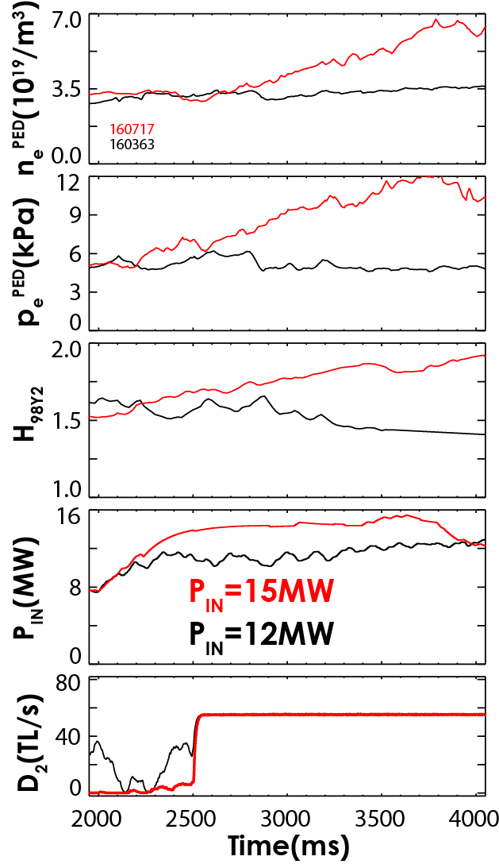
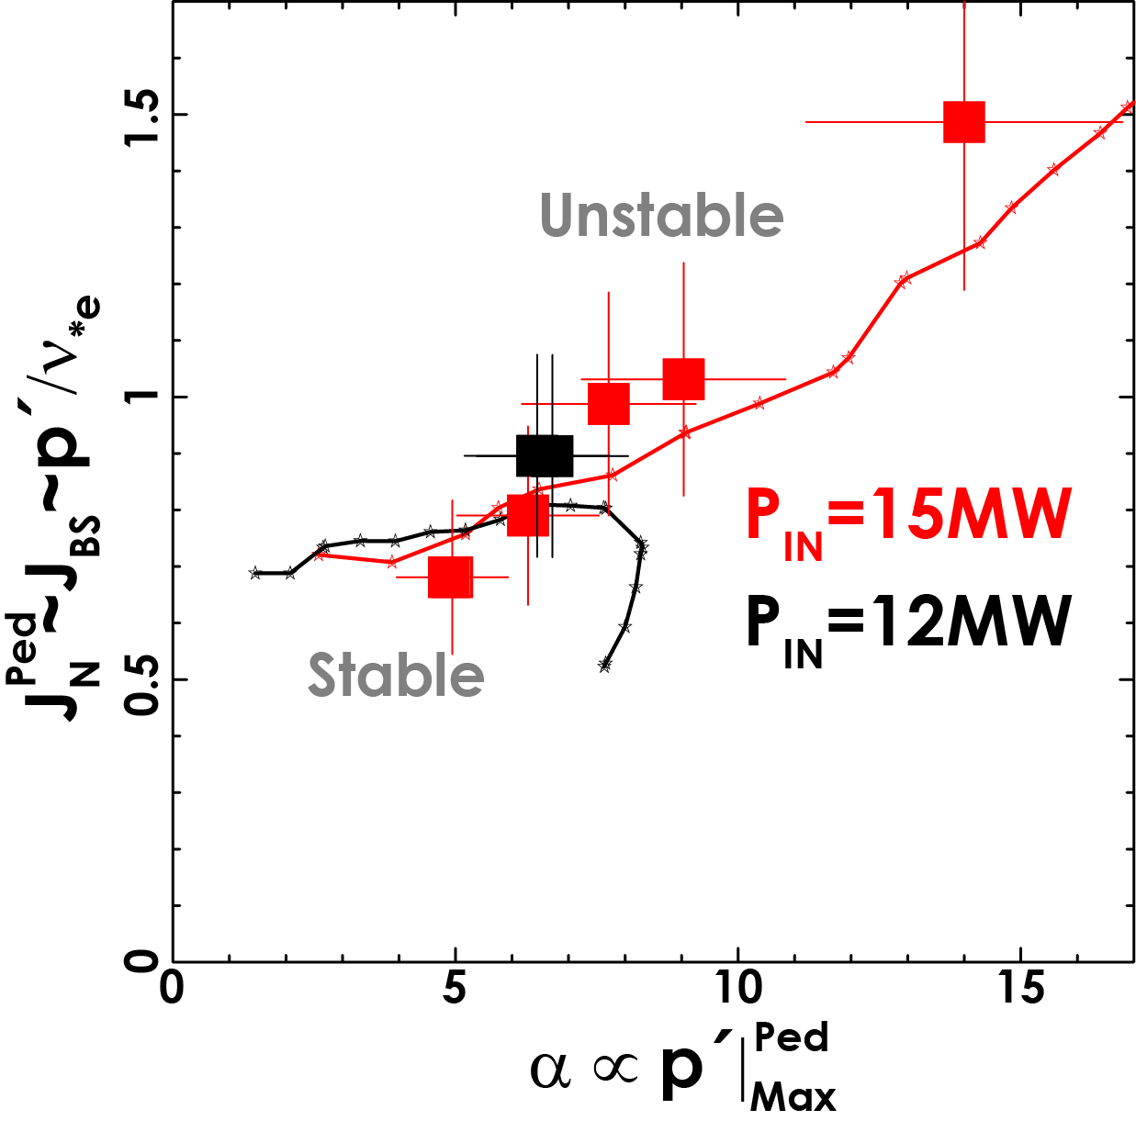
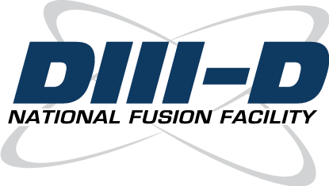
Pedestal Response to D₂ Gas Puffing at High Power Results in Improved Energy Confinement in DND Hybrid Plasmas
Increase in both density and energy confinement not observed at lower power levels
Associated with increased pedestal pressure due to improved peeling-ballooning mode stability at higher collisionality (density) and power levels
Possibility for improved fueling and energy confinement in future high power DND tokamaks
Petrie EX#/3-43
Notes:
MIGHT ADD SOME EXTRA NOTES FOR SPEAKER HERE – on WHY IMPORTANT, HOW THIS IS NEW, ETC.

