Slide 1
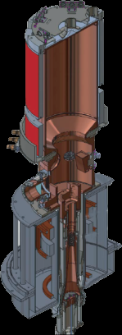
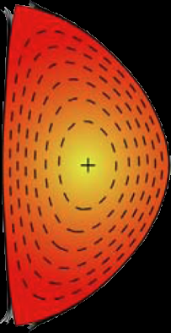
State-of-the-Art Neoclassical Tearing Mode Control in DIII-D Using Real-time Steerable Electron Cyclotron Current Drive Launchers
Egemen Kolemen¹, A.S. Welander², R.J. La Haye², N.W. Eidietis², D.A. Humphreys², J. Lohr², V. Noraky², B.G. Penaflor², R. Prater², and F. Turco³
1) Princeton Plasma Physics Laboratory, Princeton, NJ, USA
2) General Atomics, San Diego, CA, USA
3) Columbia University, 116th St and Broadway, New York, NY 10027, USA
Presented at IAEA Meeting, October, 2012
Catch &
Subdue

Slide 2
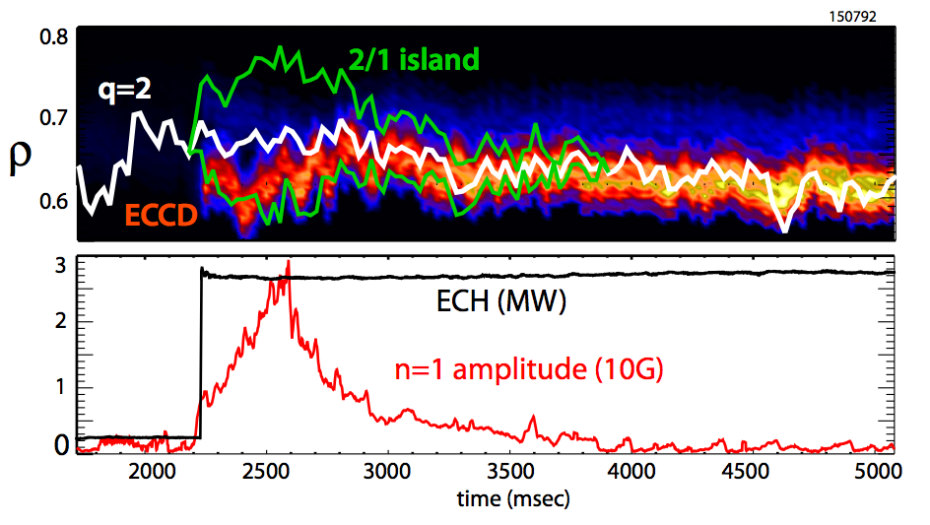
Fully Automatic NTM Control Using Real-Time Mirror Steering Can Suppress the 2/1 Mode
New fully automatic NTM control system at DIII-D integrates all the Real-Time (RT) components of mode detection, location, suppression.
New control strategy “Catch and Subdue” can reduce the EC power use; lead to higher Q and reduce disruption risk in ITER

Slide 3
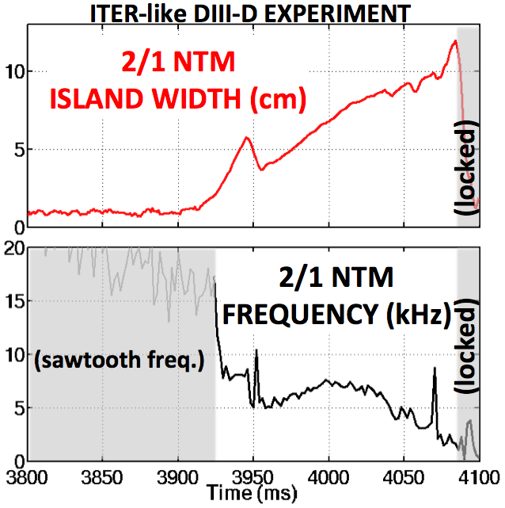
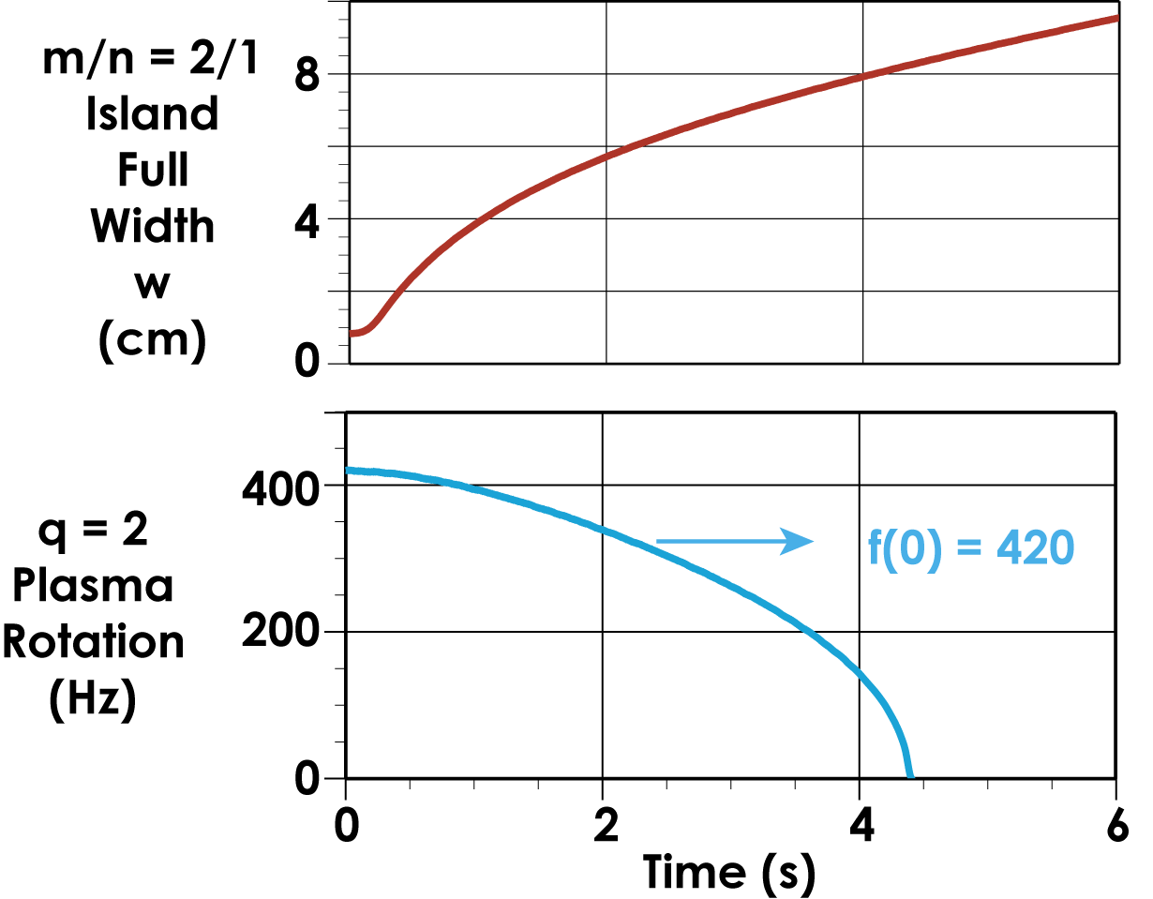
In ITER, without ECCD, 2/1 Islands Can Grow and Cause Disruptions
DIII-D experiment
ITER Simulation
La Haye
IAEA 2008
Loss of H-mode and disruption is expected after locking
Need robust and efficient NTM control strategies

Slide 4
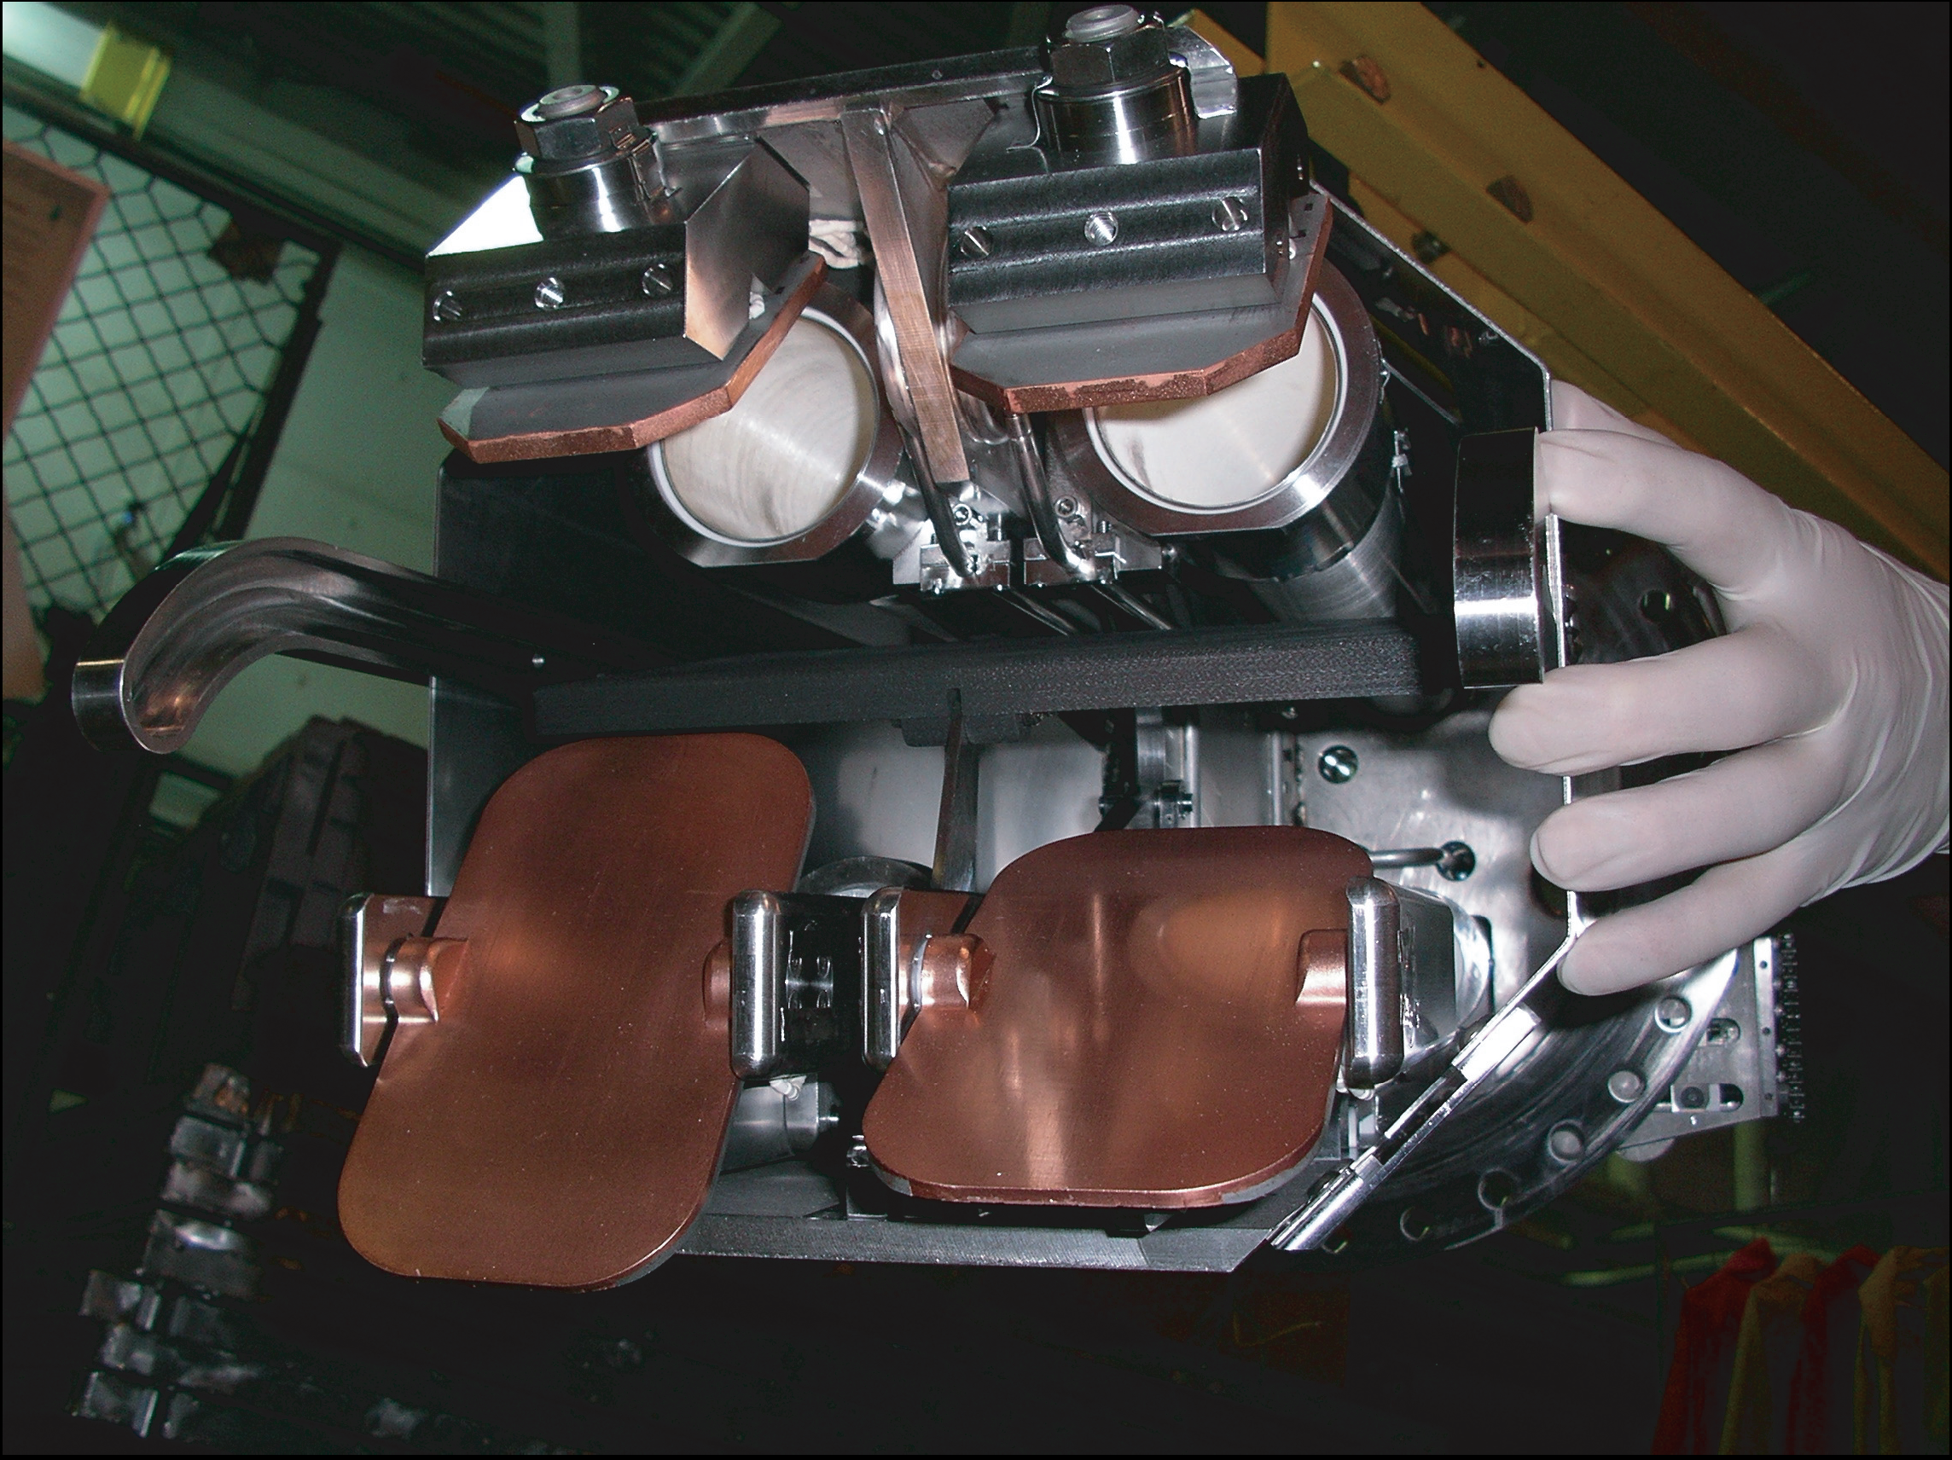
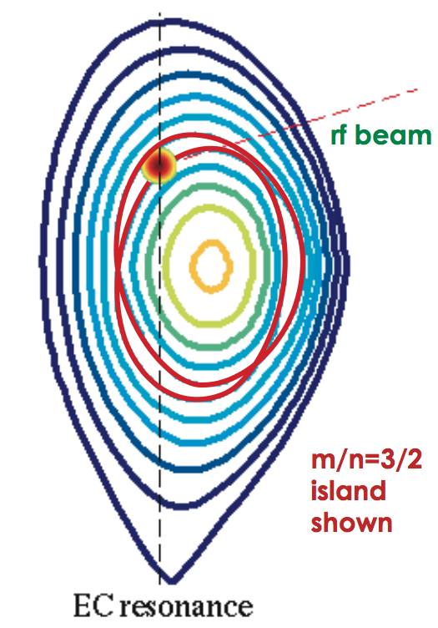
Accurate Alignment of ECCD to Resonant Surface Suppresses Neoclassical Tearing Mode
Steerable Launcher Mirror
5 Gyrotrons (~2.8 MW injected)
Align the Electron Cyclotron Current Drive deposition with the Neoclassical Tearing Mode (NTM) island for suppression
Mirrors steered to move the beam vertically along the EC resonance for best alignment

Slide 5
Accurate Alignment of ECCD to Resonant Surface Suppresses Neoclassical Tearing Mode
Steerable Launcher Mirror
5 Gyrotrons (~2.8 MW injected)
Align the Electron Cyclotron Current Drive deposition with the Neoclassical Tearing Mode (NTM) island for suppression
Mirrors steered to move the beam vertically along the EC resonance for best alignment

Slide 6
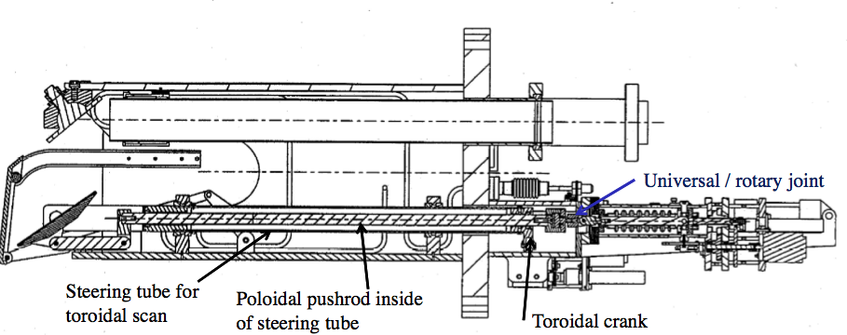
DIII-D NTM Control System Overview
rf beam
EC Launcher
Mirror Control
System
Gyrotrons
Control System
Diagnostics ➔ Detect NTM / Find Location
Plasma Control
System (PCS)

Slide 7
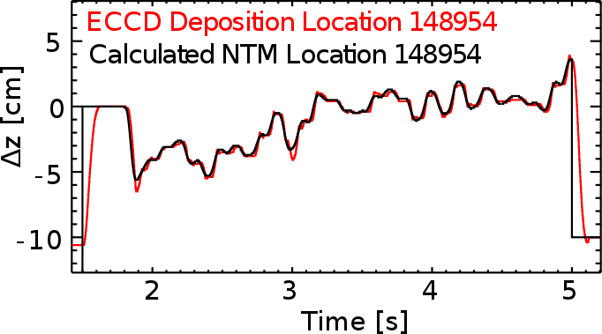
Real time MSE Equilibria Enable Precise Tracking of Resonant Surface
Δz
➔
Real time MSE tracks q=3/2 or 2
Calculate intersection point of the q surface with 2f_{ce}
Move the mirrors to align the ECCD with NTM
Tracking performance with minimal overshoot and <1 cm error.
Calibration:
ECCD deposition: with 100 Hz ECCD modulation
NTM location: with ECE based calculation & Sweeps across NTM
Mapping of angle in mirror to position in plasma: Ray tracing

Slide 8
Application to the 3/2 NTM:
Head room to develop the technique

Slide 9
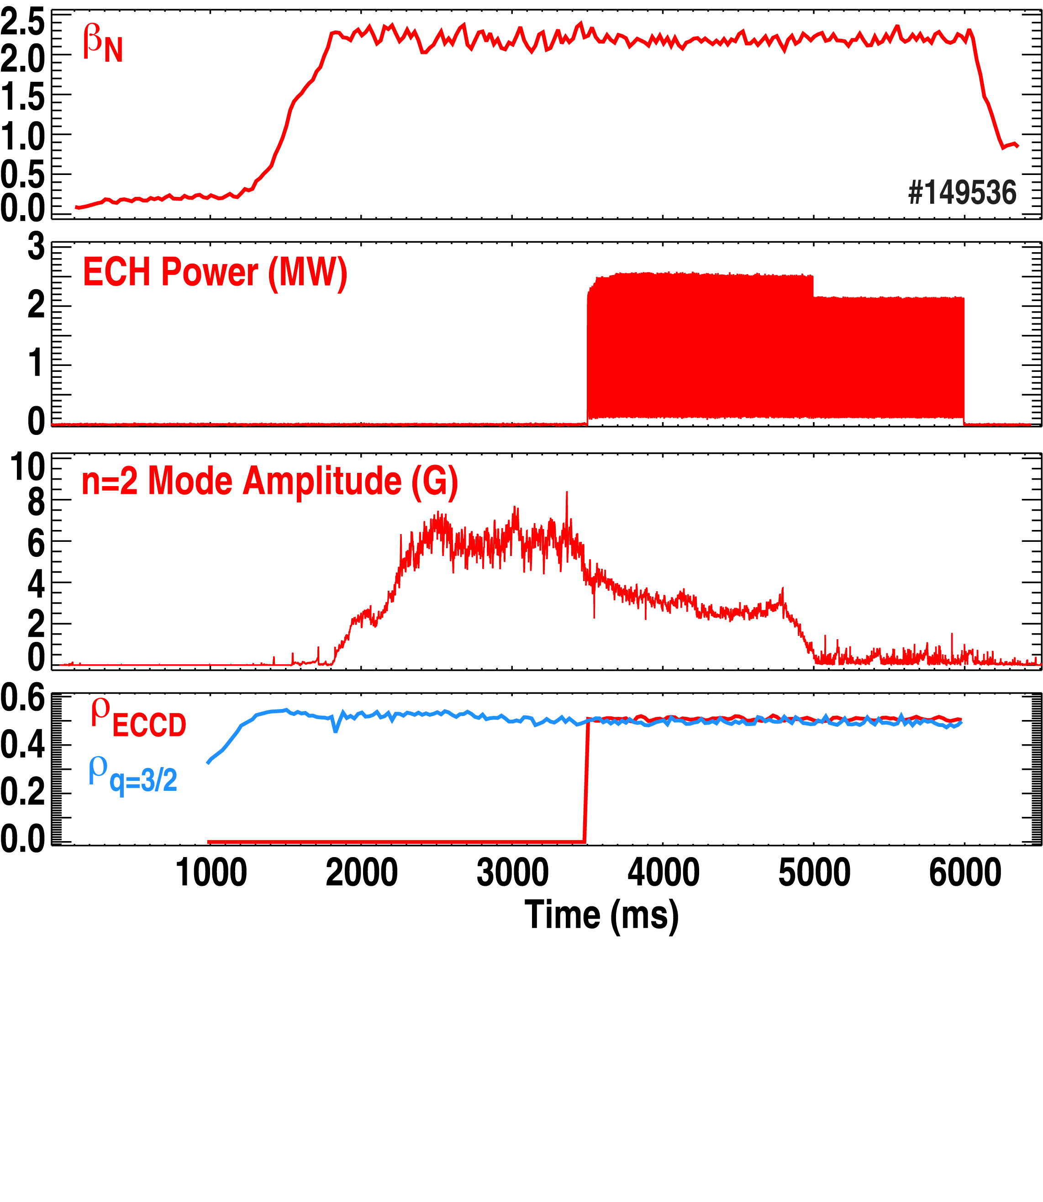
NTM Control Methods: Successful 3/2 NTM Suppression After Mode Saturation

Slide 10
NTM Control Methods: Preemptive NTM Suppression Achieved
Without ECCD, 3/2 NTM develops
NTM Preemption with ECCD

Slide 11
Minimize EC Use for Higher Q Operation
ITER strategies:
Preemptive suppression: uses continuous power, decreases Q
Suppression after saturation: requires large power and long time, risking disruptions
Preferable to intercept mode while still small
Pre-emptive suppression
12
Q=10 operating point
10
Pre-emptive stabilization with 7 or 20MW
Q
8
3/2 NTM
6
Modes drop performance
2/1 NTM
4
0
10
20
30
P_{EC} (MW)
[Zohm, IAEA 2006]

Slide 12
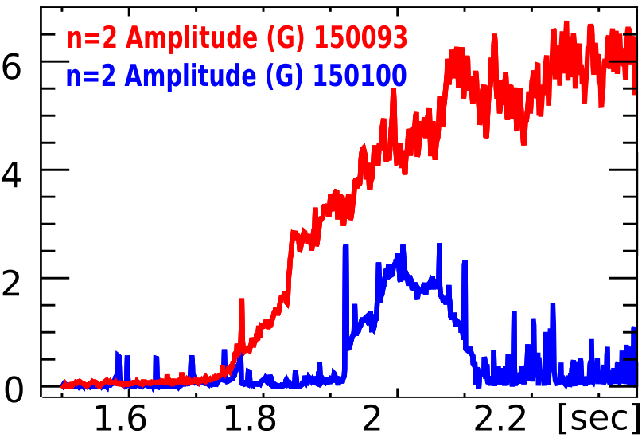
New "Catch and Subdue" Technique is More Efficient
Continuous q-surface Following
Constantly calculate q-surface
Track w/ mirrors; be ready to suppress
Detect that island is forming (2/1 or 3/2)
Real-time Fourier analysis of Mirnov diagnostics
Turn Gyrotrons ON when the mode is detected
Result: Catch the island before it saturates
Island saturation for 2/1 mode ~100-150 ms, 3/2 mode ~200ms
Detect
ms
Example of 3/2 Catch&Subdue

Slide 13
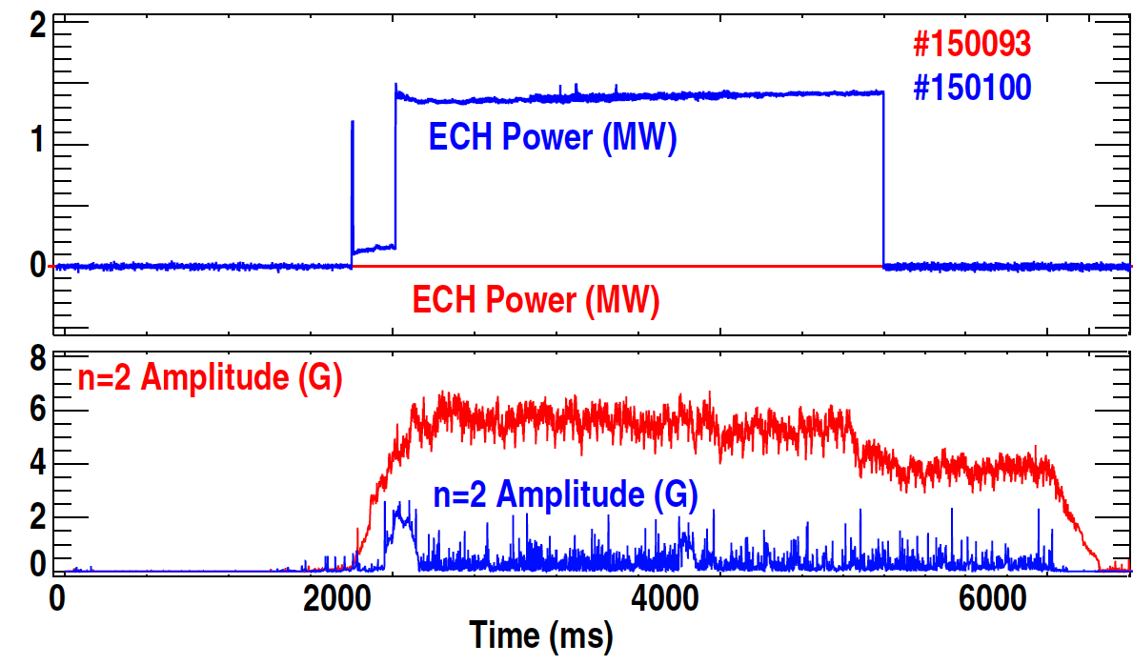
Catch and Subdue Technique Enables Much Faster Suppression and Reduced ECCD Power
Control Start
150093: No ECCD
(Beam drops after 5 sec)
150100: Catch and Subdue
(Many more examples)
Results:
Less power needed: Suppression with 3 gyrotrons instead of 5 for fully saturated modes
Faster suppression (~140 ms after the gyrotrons turn on)
Avoids continuous power deposition of the preemptive approach

Slide 14
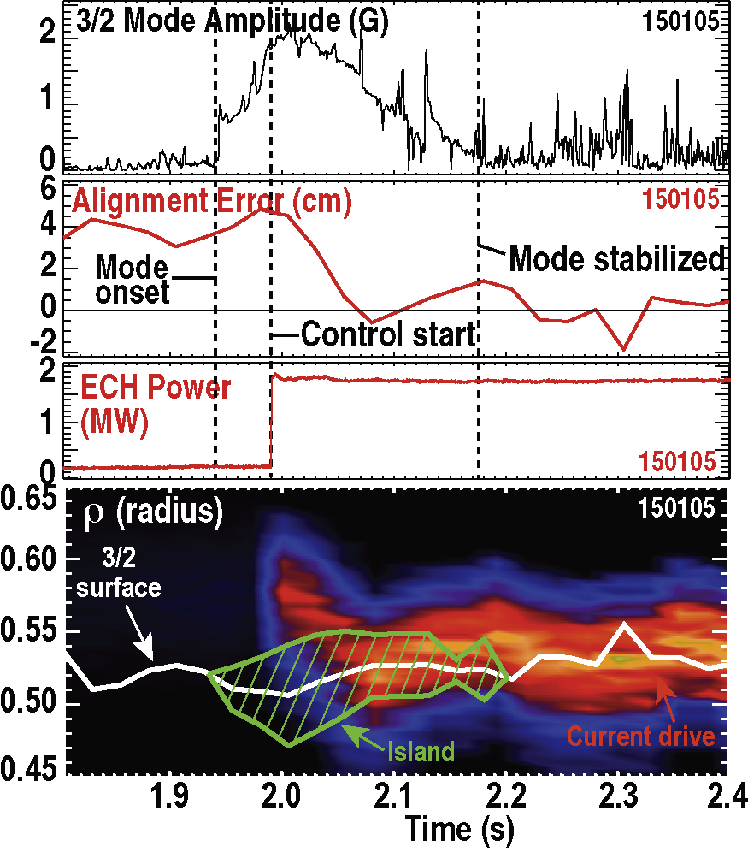
Catch and Subdue Even Works Well Starting from a Misalignment of ECCD and q Surface
Experiment:
Intentional mirror misalignment ~4 cm
Result:
System rapidly corrects deposition location
Fast suppression: complete suppression takes ~40 ms longer than aligned case

Slide 15
Saturated Mode Suppression of 3/2 NTM Requires Good Alignment & J_{eccd}>J_{boot}
Contour plot of Mode Amplitude
Color=Mode amplitude (Gauss)
Saturated
Suppression
EC Power (MW)
No mode
Power: Peak ECCD (J_{eccd}) > local bootstrap current density (J_{boot}) ➔ To replace the missing current in the island.
Alignment: ECCD aligned with the 3/2 island within the half width of the ECCD profile
J_{eccd}~J_{boot}
Alignment: (ρ_{3/2}-ρ_{eccd})/FWHM_{eccd}

Slide 16
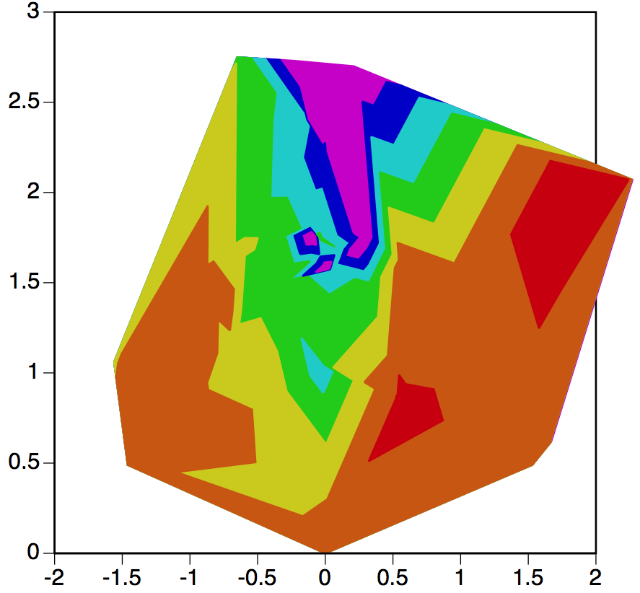
Catch and Subdue Needs Less Power
Contour plot of Mode Amplitude
Color=Mode amplitude (Gauss)
C&S+Saturated
Suppression
EC Power (MW)
No mode
Catch and Subdue needs less power compared to saturated mode suppression.
J_{eccd}~J_{boot}
Alignment: (ρ_{3/2}-ρ_{eccd})/FWHM_{eccd}

Slide 17
Preemptive ECCD Reduces Power Requirement for 3/2 Suppression by Over 50%
Contour plot of Mode Amplitude
Color=Mode amplitude (Gauss)
EC Power (MW)
No mode
Preemption reduces the power threshold.
J_{eccd}~J_{boot}
Preemptive
Alignment: (ρ_{3/2}-ρ_{eccd})/FWHM_{eccd}

Slide 18
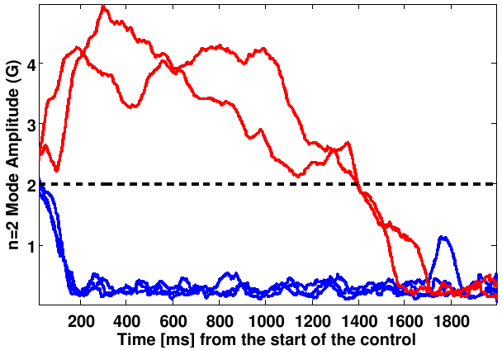
Early Mode Detection is Key for Rapid NTM Suppression
Below the critical amplitude small island effect takes over which enable fast suppression
Above the critical amplitude the mode saturates and suppression takes more than a second or becomes unachievable
2 late “catch” shots
3 early “catch” shots
Critical amplitude (knee)
*All shots with same β_{N} and ECCD is actively aligned with a power of 1.5±0.2 MW at the island location.

Slide 19
Application to the 2/1 NTM:
Most challenging and important case

Slide 20
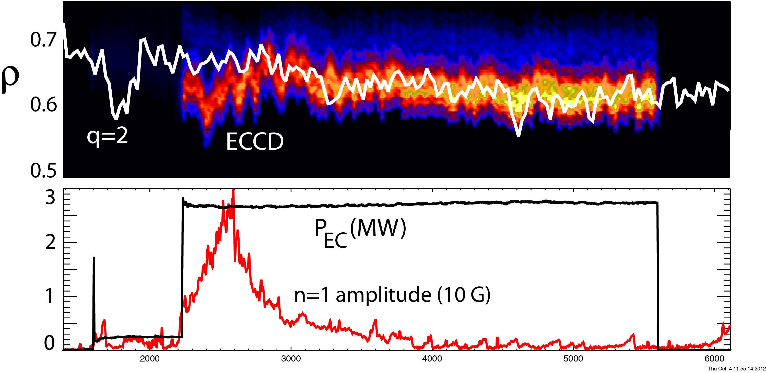
Successful 2/1 NTM Catch and Subdue Demonstrated
Time [ms]
Peak mode amplitude is reduced; without ECCD, mode reaches ~40 G and locks with loss of H-mode
The mode is brought to full suppression

Slide 21
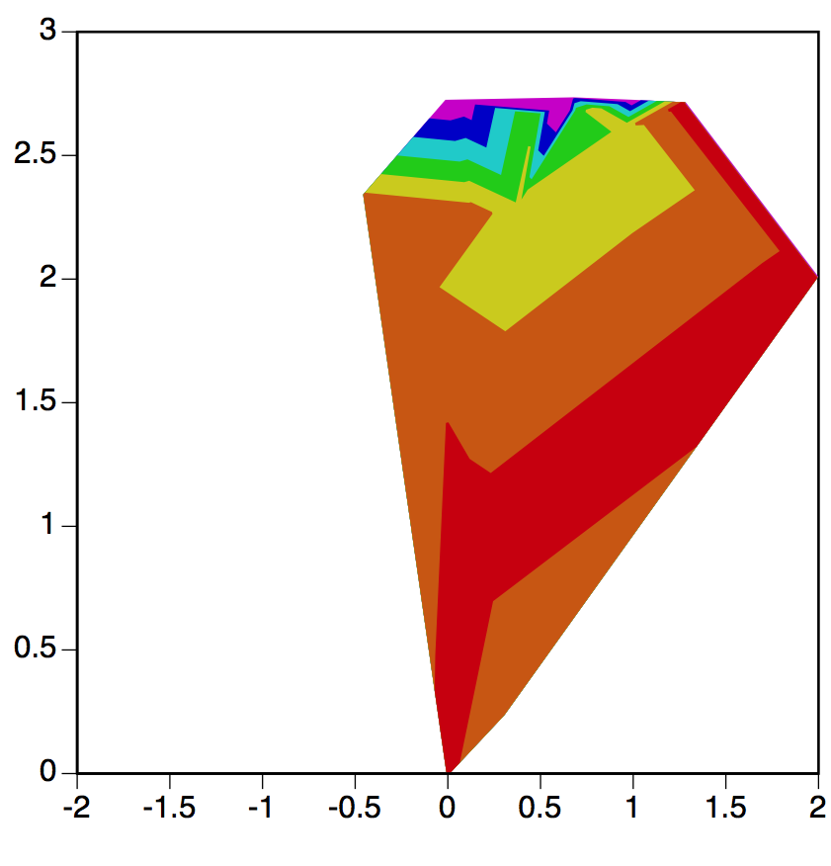
2/1 Mode Suppression Requires Good Alignment & J_{eccd}>J_{boot}
Contour plot of Mode Amplitude
Color=Mode amplitude (Gauss)
Catch and Subdue
Suppression
No mode
EC Power (MW)
J_{eccd}~J_{boot}
at q=2
Catch & Subdue suppression of 2/1 pushes the limit of the available EC power
Alignment: (ρ_{2/1}-ρ_{eccd})/FWHM_{eccd}

Slide 22
Preemptive ECCD Reduces Power Requirement for 2/1 Suppression by 40%
Contour plot of Mode Amplitude
Color=Mode amplitude (Gauss)
Catch and Subdue + Preemption
No mode
EC Power (MW)
J_{eccd}~J_{boot}
at q=2
Preemption reduces the power threshold.
Preemption
Alignment: (ρ_{2/1}-ρ_{eccd})/FWHM_{eccd}

Slide 23
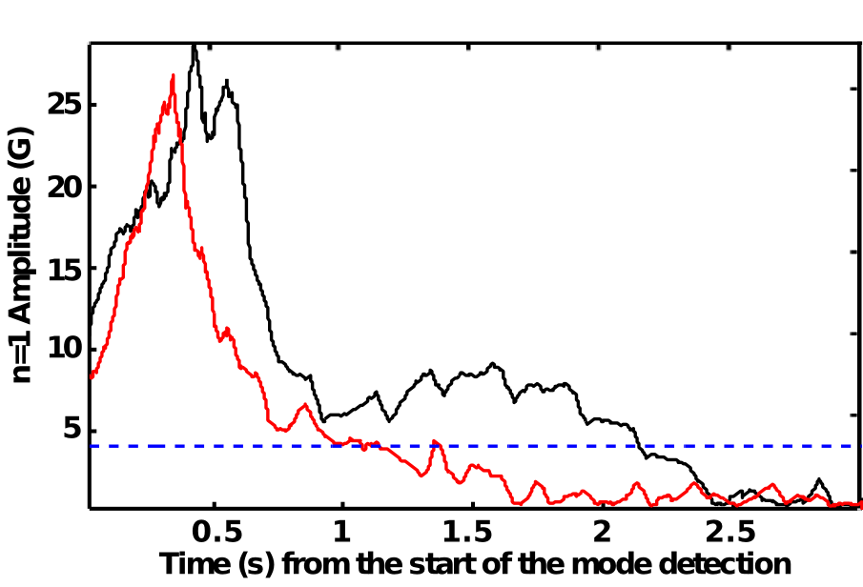
Faster Suppression Needs Early Mode Detection for “Catch and Subdue”
Islands caught bigger than the critical amplitude takes much longer to suppress
Noise from sawteeth and ELMs are hindrance for small island detection
Also important for ITER
Detection below the critical amplitude would reduce the energy even even lower
#150783, #150792
Critical Amplitude (knee)

Slide 24
Integration of NTM Control Elements Has Demonstrated the Ability to Efficiently Control NTMs in ITER
Advanced integrated control:
Mode detection with Fourier analysis of the Mirnov diagnostics
Real-time high accuracy equilibrium reconstruction with MSE
Fast EC steerable mirrors
Fully automatic control algorithm “catch and subdue” that fuses all the ingredients.
Provides an efficient approach for ITER
Reduces power requirements for NTM control
Reduces time to suppress modes
Decreases adverse effects on confinement & disruption
Enables higher Q in ITER
Catch &
Subdue

